Slide 1
Bonga University
Department of Plant Science
Course Title: Agro-climatology (Plsc206)
Instr. Zinaw Asaye (M.Sc)
2020
Bonga, Ethiopia

Slide 2
Chapter 1
Climate and weather
Activity
What are the major differences b/n weather and climate?
Weather variability/ climate variability
Weather is the day-to-day state of the atmosphere, and its short-term variation or variability
We talk about the weather in terms of "What will be the likely conditions of today?"
"How hot/cold is it right now?"
Weather is not the same everywhere
Perhaps it may be hot, dry or sunny where you live today, but in other parts of Ethiopia it might be cloudy and rainy.

Slide 3
The term weather refers to the state of the atmosphere at a given time and place.
The variables that are commonly used by meteorologists to measure daily weather phenomena are air temperature, precipitation (e.g., rain, sleet, snow and hail), atmospheric pressure and humidity, wind, and sunshine and cloud cover.
For agriculture such phenomena as rain, cloud, frost, windstorm, and hailstorm are of significant factors for crop production

Slide 4
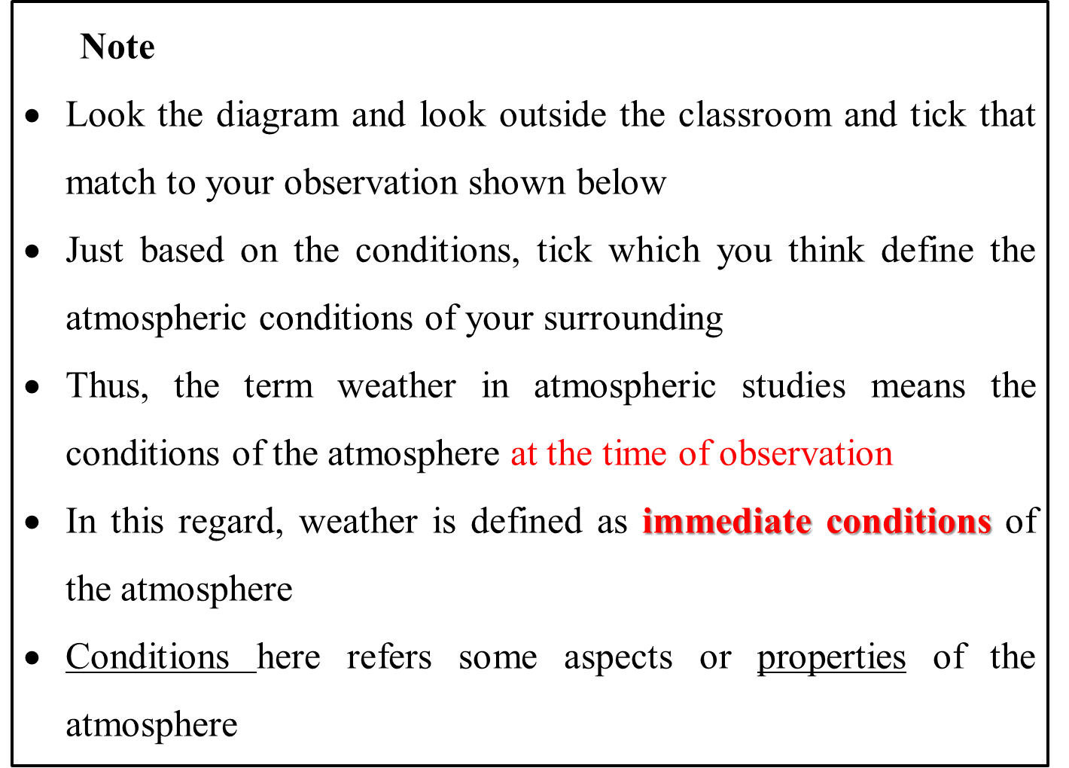

Slide 5
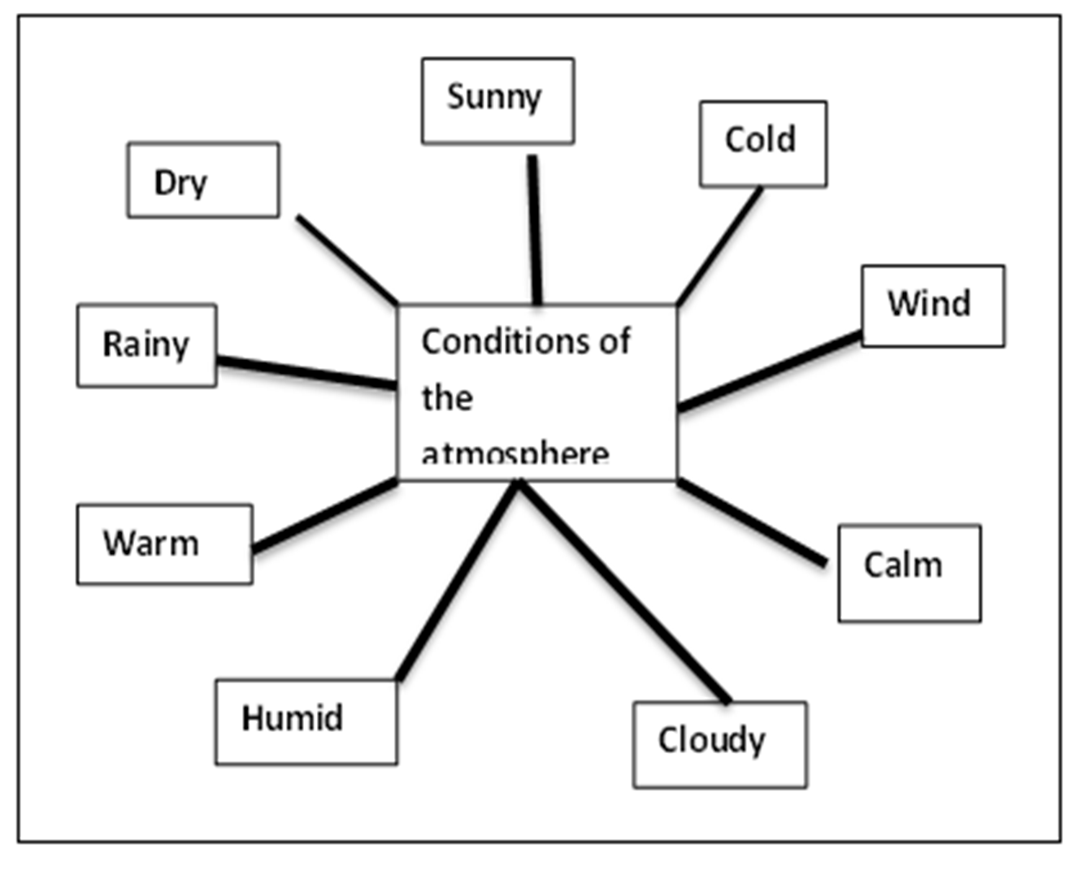

Slide 6
Climate change
In popular usage, it is the average weather conditions for longer periods or the average weather pattern over many years.
According to Winstanley (2007) climate change is defined as;
From one 30-year period to another 30 years
– From one century to another
– From one millennium to another
• You can’t have climate change less than 30-years period of time
The World Meteorological Organization (WMO) requires the calculation of averages for consecutive periods of 30 years, with the latest being from 1961 to 1990.
Climate is changing because of many factors such as global warming, or greenhouse effect

Slide 7
Climate can be described at different scales.
1. Global climate is the average temperature of the earth’s surface and is measured by analyzing temperatures recorded from thousands of stations all over the world, both on land and at sea
Though most current projections of climate change refer to global climate, there is also zonal climates which include
2. Latitudinal climates are temperature regimes determined by the location north or south of the equator.
They include polar climate, temperate climate, sub-tropical climate and tropical climate.

Slide 8
2. Regional climates are patterns of weather that affect a significant geographical area.
The main factors determining regional climate are:
(i) differences in temperature caused by distance from the equator and seasonal changes in the angle of the sun’s rays as the earth rotates;
(ii) Global distribution of land and sea masses; and
(iii) the worldwide system of winds, called the general circulation, which arises as a result of temperature difference between the equator and the poles.
Examples of regional climates are maritime climate, continental climate, monsoon climate, Mediterranean climate, Sahelian climate and desert climate.

Slide 9
3. Local climates have influence over very small geographical areas, of only a few kilometers or tens of kilometers across.
They include land and sea breezes, the orographic lifting of air masses and formation of clouds on the windward side of mountains, and the heat island effects of cities.
If the area involved is very small it may be referred to as a microclimate.

Slide 10
Climate system
The climate system is highly complex. Under the influence of the sun’s radiation, it determines the earth’s climate (WMO, 1992) and consists of:
_ the atmosphere: gaseous matter above the earth’s surface;
_ the hydrosphere: liquid water on or below the earth’s surface;
_ the cryosphere: snow and ice on the earth’s surface;
_ the lithosphere: earth’s land surface (e.g., rock, soil and sediment);
_ the biosphere: earth’s plants and animal life, including humans.

Slide 11
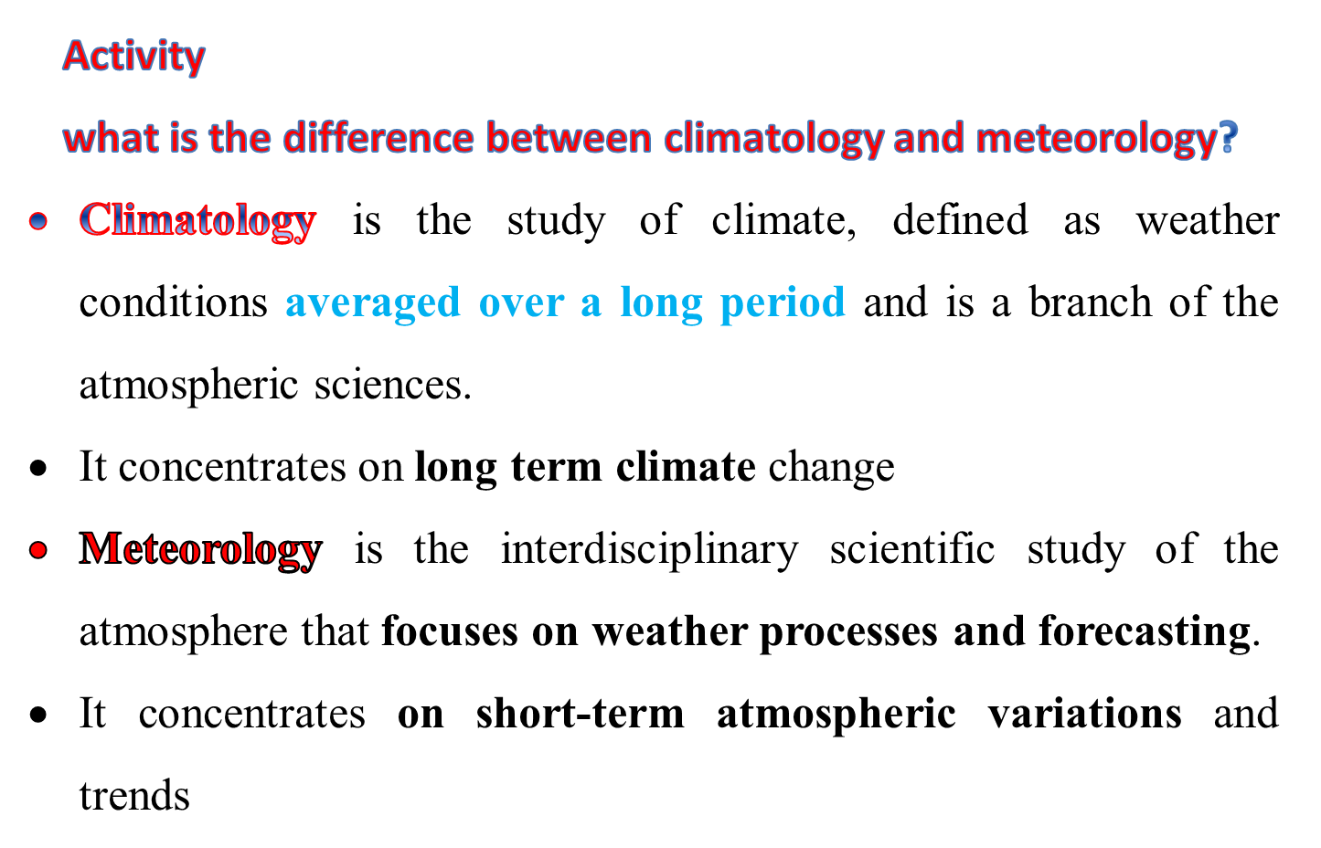

Slide 12
Time factor in climate and weather (major difference)
The difference between weather and climate is a measure of time span.
Weather refers to the atmospheric conditions of a specific place over a short period of time
Climate refers to the average atmospheric conditions over relatively long periods, usually 30 years.
In other words, when one talks about the climate, then we are talking about the pattern over a long term, while weather is referred to short term.

Slide 13
Activity
What are the elements of climate and weather?
Components/Elements of Weather and Climate
Weather is the mix of events that happen each day in our atmosphere including temperature, rainfall and humidity.
Elements of weather include cloud cover, cloud type, visibility, atmospheric pressure, wind speed, wind direction, rainfall and temperature, sunshine, snow, sleet, freezing rain, flooding, ice storms, steady rains from a cold front or warm front, excessive heat, heat waves over short period of time.
Elements of climate include precipitation, temperature, humidity, sunshine, wind velocity, fog, frost and hailstorms over long period of time.

Slide 14
Forecast and Measurement
Weather forecasts are made by collecting data that describe the current state of the atmosphere (particularly the temperature, humidity and wind) and using physically-based mathematical models ( global circulation models) to determine how the atmosphere is expected to change in the future.
However, due to the chaotic nature of the atmosphere perfect forecasts are impossible, and less accurate as the range of the forecast increases.
A general period of 30 years is taken to forecast climate of an area
The time frame point of view weather forecasts is usually easier and more accurate than forecasts about climate change.

Slide 15
Activity
How can we record metrological data?
Observation of elements of weather
Surface based observation: carried out at the specific sites on land or sea surfaces (meteorological station)
Upper air observation: carried out above ground level at a height of 15 to 25 km. It uses instruments like rockets and air crafts
Satellite observation: as you know the moon is the only satellite on earth.
But there are hundreds of artificial or man-made satellites that consistently move around the earth.
Among the satellites that are sent to space, weather satellites are important one to get meteorological data.
Remote sensing instruments on weather satellite are now used to measure elements of weather plus O₃ layer.

Slide 16
Other measures of elements of weather
Hygrometers are special thermometers that measure humidity by calculating the amount of water vapor in the air.
Rain gauges are containers that collect and measure rainfall or any other form of precipitation. Levels of rainfall are measured in millimeters (mm).
Barometers are used to measure atmospheric pressure. They may be either mercury or aneroid (vacuum) barometers. Often they are attached to a pen that charts movements in pressure on a piece of paper. Unit of measurement is in mbs.

Slide 17
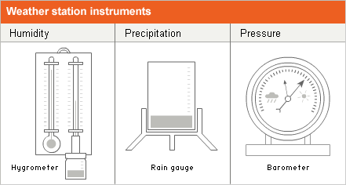

Slide 18
Sunshine recorders are used to measure sunshine. The sun's rays are focused through a magnifying glass into a chart. The chart helps to show for how many hours the sun shines.
• Maximum and minimum thermometers measure the highest and lowest temperature in degrees Celsius.
Wind vanes are used to show the direction of the wind.
Anemometers are used to record the wind speed in km/h. An anemometer catches the wind in cups and calculates the wind speed based on how fast it rotates.

Slide 19
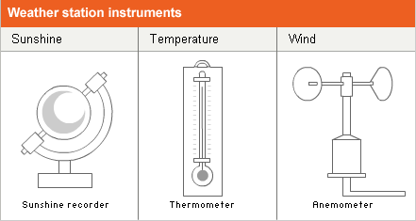

Slide 20
What are the driving forces of climate change?
The main driving forces for climate change are categorized into human (anthropogenic) and natural.
The main anthropogenic forces for future climate change include demography, socio-economic development, the rate of technological change, burning of fossil fuels and land use land cover change (Walochnik et al., 2010).
Among the anthropogenic factors, demographic change, socio-economic development and land use land cover change are vital in global climate change (Young et al., 2009).
Anthropogenic drivers simply mean the range of human actions that cause climate change and the factors that shape those actions (Rosa and Dietz, 2012).

Slide 21
The natural driving forces on the other hand include chemical composition of the sea and the atmosphere, plate tectonics, volcanic activities and burning of meteorites (Walochnik et al., 2010).
Increasing the maximum and minimum temperatures, increasing the number of hot days, decreasing rainy days and increasing the variability of rainfall are all indicators of climate variability.
Climate variability is manifested by frequent drought, hunger, famine, chronic and transitory food insecurity, spreading diseases and decreasing crop production.

Slide 22
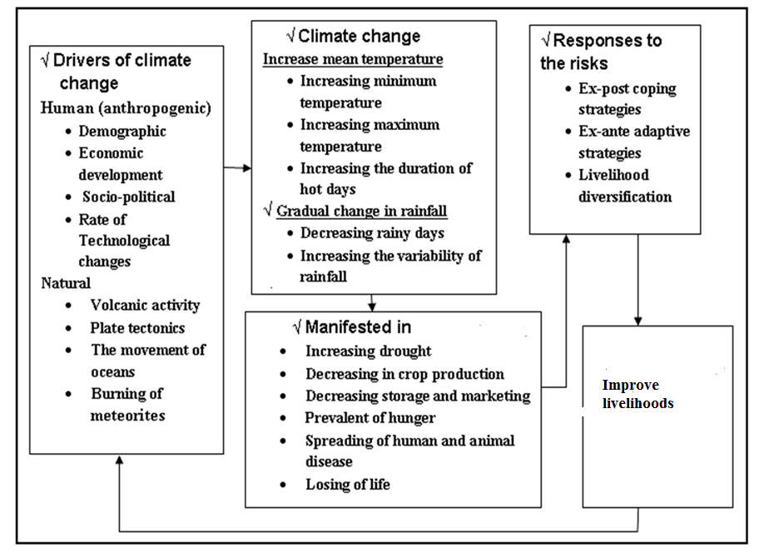
By looking the figure explain the basic concept

Slide 23
Layers of the Atmosphere
Definition of the atmosphere
Atmosphere is a material that surrounds our planet earth.
The thin envelope of gases surrounding the earth.
Density decreases rapidly with height
Air (atmosphere) is a mechanical mixture of gases and aerosols. That is, mixture of gases plus suspended solid and liquid particles (aerosols)
It affects all things found on earth in one way or another.

Slide 24
Activity
What happens the earth if there is no atmosphere?
Important Notice:
If the earth has no atmosphere, there would not be clouds, no rain, no rivers, no lakes, no oceans, etc. There would not be sounds, no blue sky, and no red sunset. If there is no atmosphere, day time temperature will be very high and night temperature will be extremely low. For example, the moon does not have atmosphere. As a result, daytime temperature reached to 100⁰Cand night temperature approaches to -150⁰C. This showed that if there is no atmosphere the earth would be freeze during night and extremely hot during the day. It is thus, the atmosphere, which insulates the earth from such kind of temperatures extreme.

Slide 25
Thermal Layers of the Atmosphere
As one moves upwards, the atmosphere becomes thinner and thinner and you can find molecules of gasses up to 60, 000 km above the earth’s surface.
However, almost 99.99% of the air masses are found below 50 km and > 50 % found below 6 km.
Using observational balloons, instrumental air crafts and weather satellites the atmosphere is not physically uniform throughout.
These variations resulted in distinct series of layers separated by clear boundaries.

Slide 26
The Troposphere (surface to 8-20 km and some say 10-15 km)
temperature decreases with altitude. That is , 6.5⁰C per 1000m.
In this layer you can find all weathers you are familiar with (snow, rainfall, fog, lightening, thunder, hail, hurricanes, aerosols and so on)
This is the lowest atmospheric layer and is about 11 km thick.
The troposphere is disturbed by rising and descending air currents (turbulence)
There is a thin buffer zone between the troposphere and the next layer called the tropopause.
In this zone, no significant change in temperature observed (constant) that ranges between 11 and 20 km
The troposphere is thinner at the poles (averaging about 8km thick) and thicker at the equator (averaging about 16km thick).

Slide 27
The Tropopause
At the very top of the troposphere is the tropopause where the temperature reaches a (stable) minimum.
Some scientists call the tropopause a "thermal layer" or "cold trap" because this is a point where rising water vapour cannot go higher because it changes into ice and is trapped.
If there is no cold trap, Earth would loose all its water!
Warm air from Earth's surface rises and cold air above it rushes in to replace it.
When warm air reaches the tropopause, it cannot go higher as the air above it (in the stratosphere) preventing much air convection beyond the tropopause.
The tropopause acts like an invisible barrier and is the reason why most clouds form and weather phenomena occur within the troposphere.
We find the jet stream here. These are very strong winds that blow eastward.

Slide 28
The Stratosphere and Ozone Layer (18- 50 km)
The temperature increases slightly with altitude in the stratosphere
The stratosphere is warmer at the top than the bottom
The highest temperature in this region is about 32 degrees Fahrenheit or 0 degrees Celsius.
Though, temperature increases still it is below 0 degree centigrade
This is due to in this region of the atmosphere there is ozone layer, which absorbs most of the harmful ultraviolet radiation from the Sun.
.The lower portion has a nearly constant temperature with height but in the upper portion the temperature increases with altitude because of absorption of sunlight by ozone.
This temperature increase with altitude is the opposite of the situation in the troposphere.

Slide 29

O₂+ UV radiation O+O
Mono atomic oxygen quickly combines with O₂ to form ozone
O₂ + O O₃
O₃ + UV radiation O₂ + O₂
From these it can be learned that ozone is continuously formed and destroyed in the atmosphere

Slide 30
The more O₃ is produced the more we are protected from the dangerous UV radiation that harm life
There is considerable recent concern that manmade fluorine chlorine carbon (fluorocarbon) compounds are depleting the ozone layer, with a horrific future consequences for life on the Earth.
Cl + O₃ ClO + O₂
As a result, un expectedly temperature increases after 20 km
An increase of temperature with height is called temperature inversion b/c O₃ absorbs UV

Slide 31
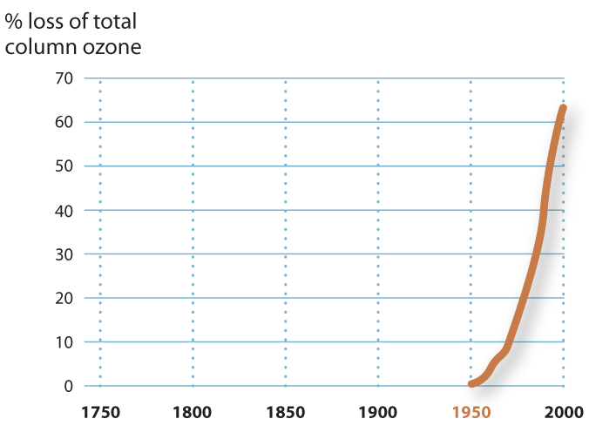

Slide 32
Summary
The stratosphere contains a thin layer of ozone molecules (with three oxygen atoms) which forms a protective layer shielding life on Earth from the Sun’s harmful ultraviolet radiation.
But this ozone layer is being depleted, and is getting thinner over Europe, Asia, North American and Antarctica.
"Holes" are appearing in the ozone layer.

Slide 33
The Mesosphere (50-90 km) – Middle layer
Here the atmosphere is very rarefied, that is, thin, and molecules are great distances apart
the temperature is decreasing with altitude, about -120 Celsius at the top.
It is a cold layer where the temperature generally decreases with increasing altitude.
Here in the mesosphere, the atmosphere is very rarefied nevertheless strong enough to slow down meteors crashing into the atmosphere, where they burn up, leaving fiery trails in the night sky.

Slide 34
Ionosphere
This is the lower part of the thermosphere or upper part of the mesosphere
Gas particles absorb ultraviolet and X-ray radiation from the sun
The particles of gas become electrically charged (ions).
Radio waves are reacted off the ions and reflect waves back to earth.
This generally helps radio communication.
However, solar flames can increase the number of ions and can interfere with the transmission of some radio waves

Slide 35
Many radio waves are reflected at night by the ionosphere making it possible to hear AM radio and shortwave radio stations that are very far away.
Gamma rays and x-rays are absorbed by the upper atmosphere; visible light can reach to the ground.
Many infrared wavelengths can also pass through the atmosphere.

Slide 36
Thermosphere
Temperatures in this region may be as high as thousands of degrees.
That is, temperature increases with height and can rise to as high as 3,600°F (2000°C).
The thermosphere rises several hundred miles above the earth's surface, from 50 miles up to about 400 miles.
Nonetheless, the air would feel cold because the hot molecules are so far apart.
This layer is known as the upper atmosphere.

Slide 37
Exosphere
Extending from the top of the thermosphere to 6200 miles (10,000 km) above the earth is the exosphere.
This layer has very few atmospheric molecules, which can escape into space.
Air is very thin here.
This is the area where satellites revolve the earth.

Slide 38
Magnetosphere
The area around the earth that extends beyond the atmosphere
The earth's magnetic field operates here.
It begins at about 1000 km. It is made up of positively charged protons and negatively charged electrons.
This traps the particles that are given off by the sun.
They are concentrated into belts or layers called the Van Allen radiation belts.
The Van Allen belts trap deadly radiation.
When large amounts are given off during a solar flare, the particles collide with each other causing the aurora borealis or the northern lights.

Slide 39
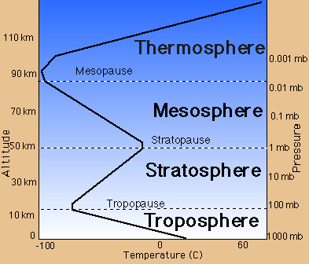

Slide 40
Summary
Scientists divided the atmosphere into four layers according to temperature: troposphere, stratosphere, mesosphere, and thermosphere.
The temperature drops as we go up through the troposphere, but it rises as we move through the next layer, the stratosphere.
The farther away from earth, the thinner the atmosphere gets

Slide 41
Chapter 3. AGRO-ECOLOGY AND AGRO-CLIMATE CLASSIFICATION OF ETHIOPIA
What are the basic differences between agro-ecology and agro-climatology?
Agro-climatology
Agro-ecology is composed of two terms.
Agro means the ecology of crop production while, ecology is the study of relationship among organisms in their physical environment (Bateman et al., 2006).
In short ecology’ is the science of the relationships between living organisms and their abiotic environment. Agro-ecology’ particularly relates to agronomic requirements. Hence agronomy?

Slide 42
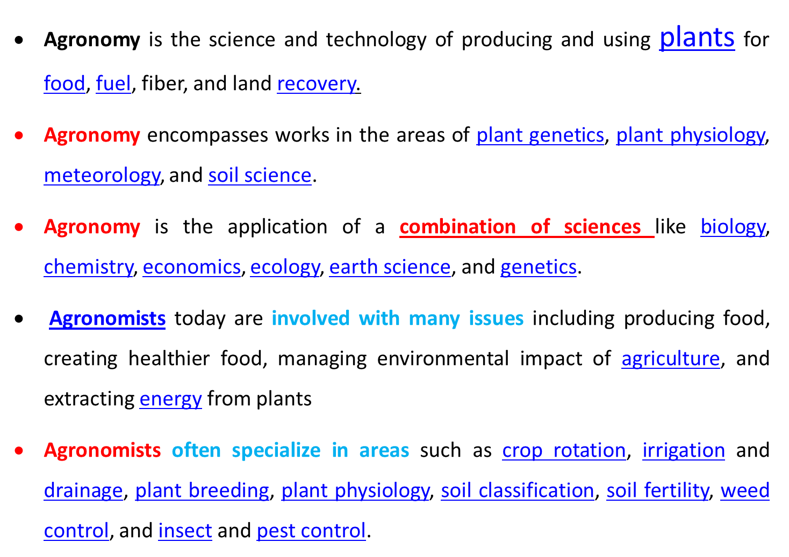

Slide 43
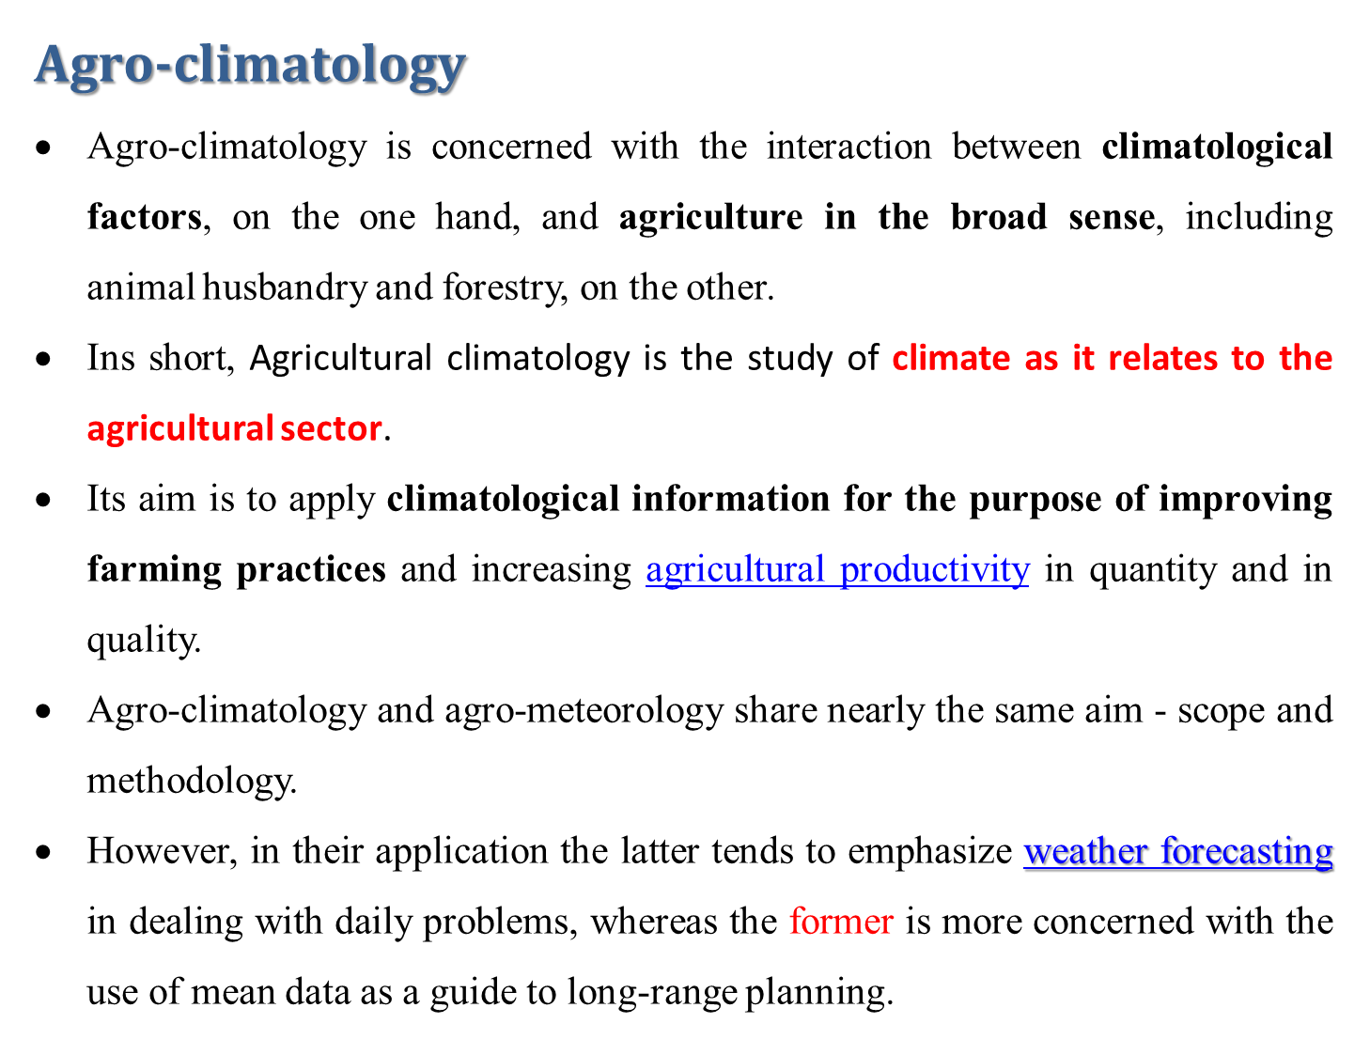

Slide 44
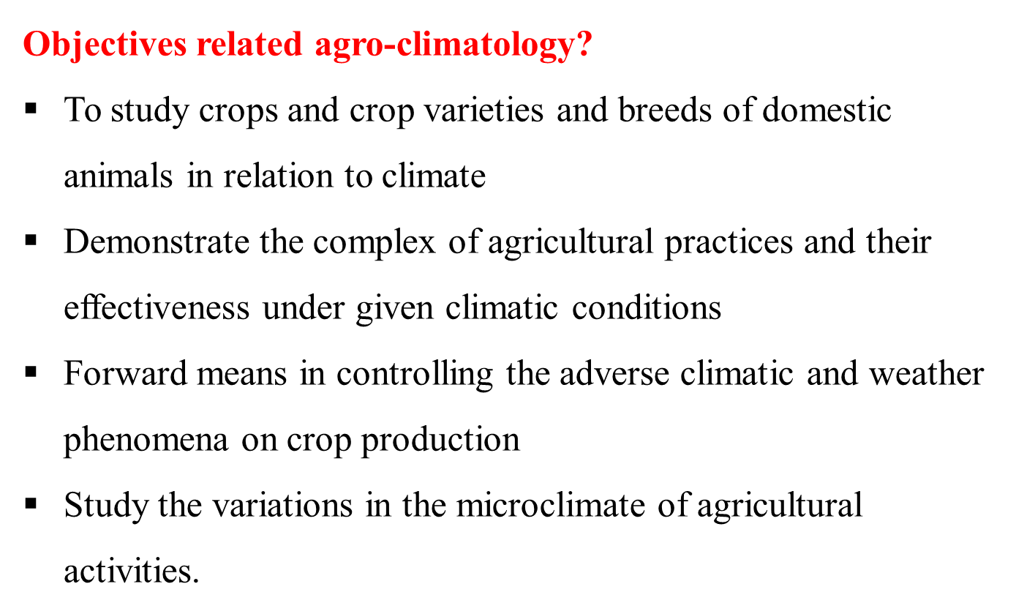

Slide 45
Traditional altitudinal belts of Ethiopia
Because of the importance of altitude in mountainous country like Ethiopia, land users have traditionally classified their environment in relation to topography.
This traditional classification is a relative one, although it has some absolute characteristics.
Early travellers, such as James Bruce in 1768-1773, used the term 'Kolla' for the 'hottest part of Abyssinia' (Bruce, 1790).

Slide 46
He also referred to 'Dega' as signifying 'the hill, or high ground' (Bruce, 1790).
On one of his maps, he named a small village west of Lake Tana near 'Abay River' as 'Weynadega' (Bruce, 1790).
Before James Bruce, no indication of altitudinal belts could be screened from secondary literature,
Later travellers like Rohlfs (1883) quotes that 'the Abyssinians divide their country into: (a) Kolla, the lowlands, (b) Deka Woina (1,500-3,000 m a.s.l.), and Deka (above 3,000 m a.s.l.)'.
Likewise, Dove (1890) described major agricultural zones in northern Ethiopia more precisely as being ‘Kolla’ at altitudes below 1800 m a.s.l., ‘Weyna Dega’ for altitudes between 1800 – 2400 m, and ‘Dega’ for areas above 2400 m.

Slide 47
Later on, scientists like Huffnagel (1961) confirmed this traditional Ethiopian zonation and added a further zone at high altitudes, called ‘Wurch’, for areas higher than 3800 m a.s.l.
Currently, major agro-ecological zones of Ethiopia include (Ejiga, 2006)
Kolla, lowland (500-1500 m asl) Woina-Dega, mid-highland and 1500-2300 m asl
Dega, highland, with respective elevations above 2300 masl
Wurch very cold above 3700 m asl

Slide 48
Characteristics of each agro-ecology
Despite the above flexibility in the traditional altitudinal classification, there are certain characteristics, which most Ethiopian land users would agree to.
In the Wurch zone, usually no rain-fed crops would be expected to grow.
In this zone, frost is a frequent phenomenon, and afro-alpine grasslands are the dominant land use type.

Slide 49
Dega agro-ecological zone
The Dega zone usually is a zone where crops such as barley would be expected to grow in this belt
Within the Dega, a differentiation can be made between the High Dega belt, where only barley and sometimes potatoes are grown, but no wheat and pulses, and a Lower Dega or "Dega proper" belt, which would additionally allow for wheat and pulses, but still be an area with relatively cold climatic conditions and no teff or maize grown.
The most dominant Ethiopian agricultural belt is called Weyna Dega.
All major rain-fed crops can be grown in most parts of this belt, particularly teff and maize.
This is a belt where both agro-climatic as well as ecological conditions are highly suitable for rain-fed farming.

Slide 50
The lower part of the Weyna Dega is also suitable for cash crops such as coffee and tea, or for Inset another major staple crop of southern Ethiopia.
Below the Weyna Dega belt there is the Kolla belt, where there are moisture limitations for crops such as potatoes, wheat and pulses.
However, sorghum is a dominant crop in the Kolla belt, and teff and maize will also be grown if rainfall permits.
It is a belt where temperature conditions are much warmer than in the highlands, and where there is also higher rainfall variability and recurring drought conditions.

Slide 51
Below the Kolla is the Berha Belt, where no rain fed cultivation is normally possible.
Hot temperatures and persistent drought render the area unsuitable for rain fed agriculture,
Currently large-scale irrigation systems along major rivers have been developed in some parts of Ethiopia, particularly along the Awash River.

Slide 52
In most studies in the field of agro-ecology, a major attempt is agro-ecological zonation through the application of agro-climatic models and tools.
‘Zones’ are horizontal spatial units having similar properties (such as agro-ecology).
‘Belts’, on the other hand, are spatial units which lie between two defined altitudinal boundaries and also have specific properties, similar to the zones.
A number of scientific approaches have been applied in Ethiopia to determine agro-ecological zones (AZs).

Slide 53
In agro-ecological zonation mostly temperature and rainfall can be taken as a criteria in relation to the growing length of crops
Based on rainfall availability and variability, as well as soil conditions seven moisture regimes are identified that is, arid, semi-arid, sub-moist, moist, sub-humid, humid, to per-humid conditions.
Based on temperature or thermal conditions six agro-ecological zones are identified that is, hot, warm, tepid, cool, cold and very cold

Slide 54
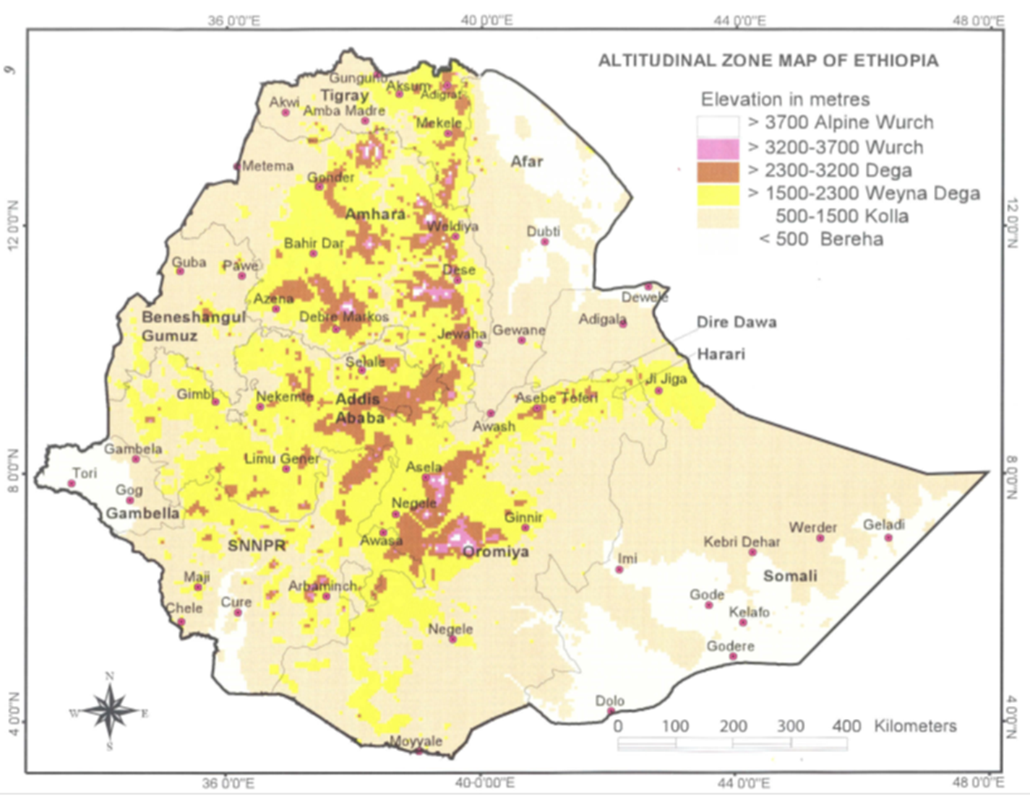

Slide 55
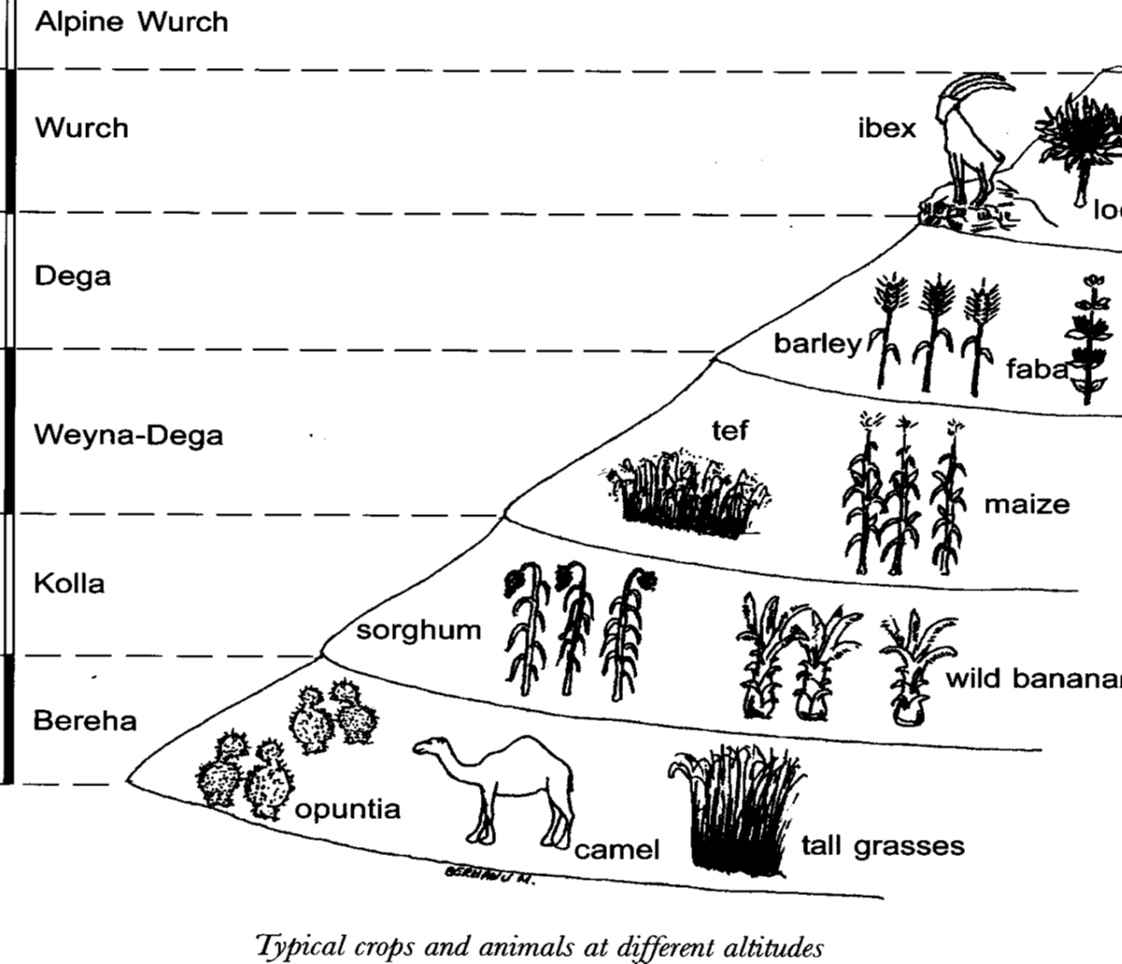

Slide 56
Based on altitude Hurni (1986) classified 7 agro-ecological zones
1. High wurch (source: Altitude: > 3700
Traditional conservation methods: none Dominant soils: Black soils
Vegetation types: natural trees mountain grasslands
2. Moist wurch
Dominant crops: barely and cropping season once per year
Altitude: 3200-3700
Traditional conservation methods: none
Dominant soils: Black soils, degraded
Vegetation types: Erica, Hypercium

Slide 57
3. Wet wurch
Dominant crops: barely and cropping season once per year
Altitude: 3200-3700
Traditional conservation methods: none
Dominant soils: Black soils, degraded
Vegetation types: Erica, Hypercium
4. Moist Dega
Dominant crops: barely, wheat, pulses and 1 cropping per year
Altitude: 2300-3200
Traditional conservation methods: some traditional terracing
Dominant soils: brown clay soils
Vegetation types: Juniperus, Hagenia, pod carpus

Slide 58
5. Wet Dega
Dominant crops: barely, wheat, nug, pulses and one cropping per year
Altitude: 2300-3200
Traditional conservation methods: some traditional terracing
Dominant soils: dark brown clay soils
Vegetation types: Juniperus, Hagenia, pod carpus , bamboo
6. Dry weyna- Dega
Dominant crops: barely, wheat, teff, barely, maize and one cropping per year
Altitude: 1500-2300
Traditional conservation methods: terracing wide spread
Dominant soils: light brown to yellow soils
Vegetation types: acacia trees

Slide 59
7. Moist woina- Dega
Dominant crops: barely, wheat, teff, maize, sorghum, nug, dagussa, barely and one cropping per year
Altitude: 1500-2300
Traditional conservation methods: terracing wide spread
Dominant soils: red brown soils
Vegetation types: acacia trees, cordie, Ficus
8. Wet woina- Dega
Dominant crops: barely, wheat, teff, maize, sorghum, nug, dagussa, barely, inset in some areas and one cropping per year
Altitude: 1500-2300
Traditional conservation methods: drainage wide spread
Dominant soils: red soils, deep weathered, gullies are frequent
Vegetation types: acacia trees, cordie, Ficus

Slide 60
9. Dry Kolla
Dominant crops: sorghum, teff
Altitude: 500-1500
Traditional conservation methods: water retention terraces
Dominant soils: yellow sandy soils
Vegetation types: acacia bushes
10. Moist Kolla
Dominant crops: sorghum, rarely teff, nug, dagussa, ground nuts,
Altitude: 500-1500
Traditional conservation methods: terracing widespread
Dominant soils: yellow silt soils
Vegetation types: acacia bushes, Erythrina, Cordia, Ficus

Slide 61
11. Bereha
Dominant crops: none except irrigation
Altitude: < 500
Traditional conservation methods: no land management practices
Dominant soils: yellow sandy soils
Vegetation types: acacia bushes

Slide 62
Climate classification systems
The Ethiopian traditional system uses altitude and mean daily temperature to divide the country into 5 climate zones (Gemechu, 1977).
Both the Köppen and the Thornthwaite classification systems have also been applied (Gonfa, 1996).
Another broad classification can be made using the rainfall distribution taking into consideration the distinction between the monomodal, the bi-modal and diffuse rainfall region (Haile & Yarotskaya, 1987).

Slide 63
However, the most useful for agricultural purposes is the agro-climatic zones, which used the water balance concept, the length of the growing season (including onset dates) at certain probability levels (NMSA, 1996).
In this way three distinct zones can be identified namely the area without a significant growing period (N), areas with a single growing period (S) and area with a double growing period (D) (look the Figure below and name the single, double and no growing periods).

Slide 64
Fig. Agro-climatic classification of Ethiopia (NMSA, 1996)

Slide 65
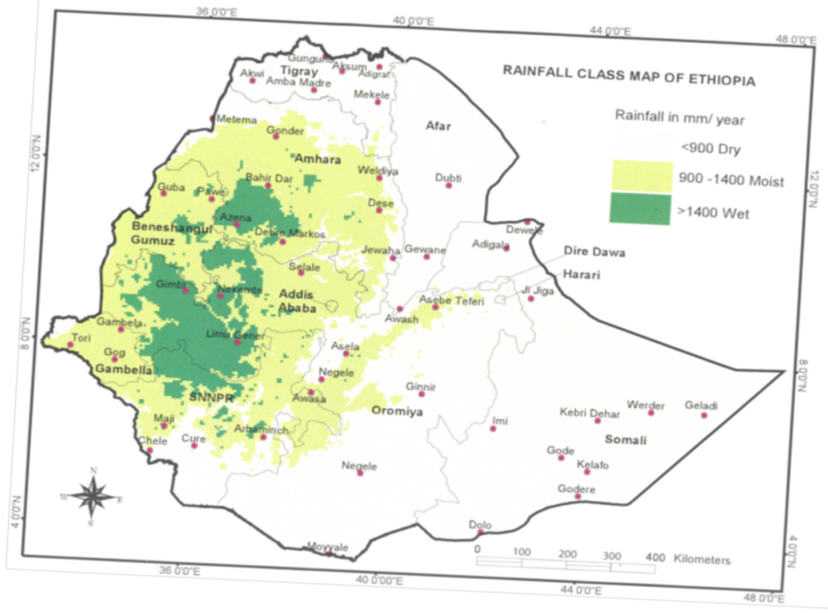

Slide 66
UNIT 4
RELATIONSHIPS BETWEEN CLIMATE AND CROPS
Rainfall, snowfall, surface temperatures—all these directly affect the ability of small and large-scale farmers around the world to grow crops and rare livestock.
While food security depends on a great complexity of factors, perhaps none is more consistently influential than the impact of weather and climate
In this regard, Climate plays a crucial role in the distribution and growing of crops and animal species,
It also determines the timing and/or length of the crop-growing season.

Slide 67
Crop Response to Weather Variables
The response of crops to the different weather variables is quite complex and difficult to describe. If one of the variables is limiting (for example, temperatures that are too hot or too cold), then the effects of solar radiation or precipitation do not greatly affect the crop.
When none of the variables is limiting, the crop will respond to the variable that is farthest from the optimum for that variable

Slide 68
Temperature
Other than planting, temperature is the main variable that determines when a crop will grow.
It also determines, along with precipitation and solar radiation, how well a crop will grow and how fast it will develop.
There are four temperature thresholds, called the cardinal temperatures, that define the growth of a crop: the absolute minimum, the optimum minimum, the optimum maximum, and the absolute maximum.
The absolute minimum and maximum temperatures define the coldest and hottest temperatures at which a crop will grow.
Temperatures between the optimum minimum and maximum define the range of temperature where the crop performs the best.
Corn, for example, has an absolute minimum temperature of 10°C, an optimum minimum of 18°C, an optimum maximum of 33 °C, and an absolute maximum of 47°C.

Slide 69
sorghum (Sorghum bicolor), have absolute minimum temperatures ranging from 7 to 10 °C, optimum minimums from 15 to 27 °C, optimum maximums from 33 to 40 °C, and absolute maximums from 40 to 47 °C.
wheat (Triticum aestivum), soybean (Glycine max, Merrill), and alfalfa (Medicago sativa), have absolute minimum temperatures ranging from 2 to 5 °C, optimum minimums from 15 to 20 °C, optimum maximums from 23 to 33 °C, and absolute maximums from (27 to 38 °C. (Hollinger and Angel, No date)

Slide 70
Temperature stress
Crops experience stress from both heat and cold.
Heat stress mostly occurs in the summer, while cold stress occurs in the spring and fall, usually when crops are being established or maturing.
When temperature exceeds a crop’s optimum maximum, the crop experiences heat stress.
A heat stress unit (HSU) is defined as the number of degrees the maximum daily air temperature is above the heat stress threshold times the number of days.
For example, if the heat stress threshold is 32 °C, and the maximum temperature is 34 °C, then the number of heat stress units equals 4 F (2 C) HSU.
Each day the maximum temperature reaches 34 °C, an additional 2 C HSUs are accumulated.

Slide 71
Precipitation
The type, timing, and amount of precipitation received during the year play critical roles in crop productivity.
Precipitation types include unfrozen (rain) and frozen (snow, sleet, and hail).
Snow and sleet occur in the winter and hail in the warmer seasons. In the winter, frozen precipitation is less efficient than unfrozen in recharging the soil profile due to its accumulating on the soil surface, which is quite often frozen.
As the snow melts on a frozen soil surface, the water tends to run off rather than move down into the soil.
Also, snow on the surface will sublimate (i.e.,be transformed directly from snow to water vapor) and be carried away from the soil surface.

Slide 72
Rain is generally more efficient in recharging the soil profile and thus is more available for crops.
The efficiency of rain in recharging the soil depends on the rate or intensity with which the rain falls.
Rain showers or storms that fall at rates greater than 0.5 inches an hour (12.7 cm/hr) are less efficient than lighter showers because the water forms ponds on the surface and runs off the fields into ditches and rivers, carrying along precious topsoil.

Slide 73
Potential Evapotranspiration
Evapotranspiration is the removal of water from soil by a combination of evaporation from the soil surface and transpiration (loss of water vapor) from plant leaves.
Surface evaporation is limited to the top 2 to 4 inches of soil, while transpiration results in removal of water from the soil to a depth equal to the deepest roots

Slide 74
Potential evapotranspiration is the amount of water that would evaporate from the soil surface and from plants when the soil is at field capacity.
Field capacity defines the amount of water the soil holds after it has been saturated and then drained, until drainage virtually ceases.
Soil that is drier than field capacity will experience actual evapotranspiration less than potential evapotranspiration.
Actual evapotranspiration will also be less than potential evapotranspiration when plant canopies do not totally cover the soil.
Potential evapotranspiration is greatest in dry years with low humidity and predominantly clear skies and least in wet years with high humidity and cloudier-than-normal skies.

Slide 75
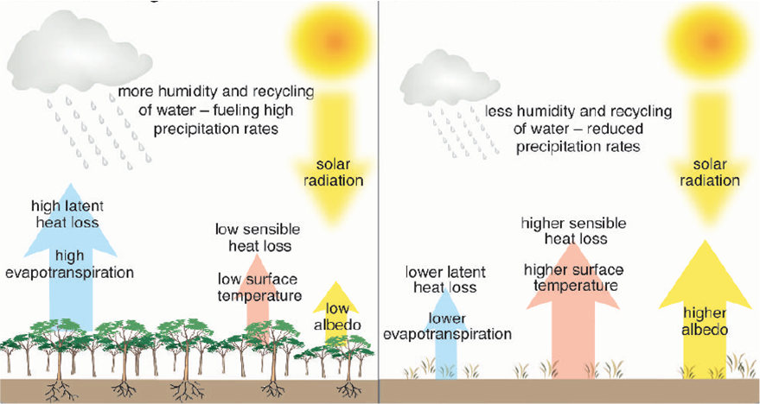
Look the diagram and write a short not about crop/climate relationships,

Slide 76
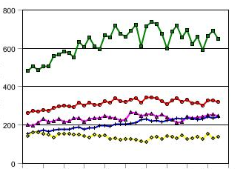
Crop / climate interactions in the TROPICS
Tropical regions (Africa): vulnerable to climate change
  dependence on climate
  poverty
  demographic pressure
Present
Cereals per capita
Future
Estimates ~ by 2050, food production demand
x 2 in Asia and Latin America
x 5 in Africa
Kg/capita
1980
Importance of climate change impacts on crop yields in the TROPICS (AFRICA)
1960
2000
Developed countries
Africa
World
Latin / Caribbean
Asia developing
Population increase > food supply increase

Slide 77
All crops differ in their biological characteristics and their environmental requirements,
While the physical character of the earth’s surface varies greatly from place to place.
A great many variables influence crop growth and development, including day-length, the amount of solar energy received, the amount of precipitation available for transpiration, temperature during the growing season and the level of mineral plant nutrients in the soil.
Many of these variables all critical for successful plant growth, however, can be modified by the farmer
For example, in dry regions irrigation can supplement precipitation, fertilizers can add plant nutrients and temperature and day-length can be modified by growing crops indoors with heating and controlled lighting.

Slide 78
Optimum Growth
Plant requirements in terms of temperature, moisture and plant nutrients are rarely linear.
For any plant there are (i) minimum requirements of temperature or moisture without which no growth will take place; (ii) maximum limits, beyond which growth ceases.
Between these limits are (iii) environmental characteristics which give optimum growth and development; here are found the highest yields.
For example, when little fertilizer is used and with small amounts of rainfall , crops like wheat did not give better yield

Slide 79
Then, as annual rainfall increased so did yields however, further increases in rainfall led, however, to a decline in yields.
It follows that one might expect there to be for any one crop areas of the earth’s surface where yields are highest and variability is lowest This is the ecological optimum.
Away from the optimum area, environmental conditions deteriorate so that yields fall and variability increases, until the point of minimum requirements is reached This is the absolute limit to growth.

Slide 80
In an imaginary continent, the optimum conditions for a given crop are in the center (Figure).
Yields are 5 tones per hectare, but they decline away from this zone, and eventually climate conditions are so adverse that no growth occurs and the yield is zero.
This is the absolute limit of cultivation.
However, farmers are not likely to cultivate the crop near the absolute limit, for economic as well as ecological factors determine where a crop is grown.

Slide 82
Suppose the price received for the crop is £100 per tonne, and the cost of production (the same everywhere) is £150 per hectare.
Under these conditions production cost per tonne will increase with increasingly adverse climatic conditions (Figure), and profit per hectare will also decline away from the optimum zone.
Farmers will clearly cultivate the crop only within this economic limit.

Slide 83
Optimum Areas and Competing Crops
So far it has been assumed that only one crop is grown by farmers, but obviously this is not always so.
Now, not only does the earth’s surface vary greatly in the opportunities it affords for plant growth,
However, the environmental requirements of crops differ a great deal, so that the optimum areas and the absolute limits will vary as well.
In some cases the optimum areas of two crops—or two groups of crops—are mutually exclusive.

Slide 84
For example, tea and rubber are confined to the tropics because they require high temperatures and large amounts of rainfall throughout the year; Thus, they cannot be grown in the temperate regions.
Conversely, some cereal crops such as wheat and temperate potatoes can be grown at the pole ward limits, but their successful development needs a period of low temperature that never occurs in the tropics.
Sugar-cane and sugar-beet well illustrate this mutual exclusiveness.
Both require periods of high temperatures for sucrose to form in the plant, and both ideally require rainfall during the growing season, but a dry period at harvest.

Slide 85
However, the risk of frost limits the northward expansion of sugar cane, and the absence of a cold period prevents the growth of sugar beet in the tropics.
Exception is southern Spain where sugar-cane and sugar-beet are grown together.
A more common situation occurs where two or more crops have a similar optimum area and compete for the zone where both crops give their highest yields, which diminish with increasing distance from the optimum area (Figure).

Slide 86
As it is shown in Figure, both maize and wheat give their highest yields in an area to the west of Buenos Aires, but maize is the predominant crop in this zone, because, with equal inputs, it gives higher yields than wheat. Why?
Southwards rainfall declines, and so does the proportion of the cropland in maize, until wheat becomes the dominant crop.
This is because maize yields fall off more rapidly than wheat yields as rainfall diminishes, for wheat is more drought-resistant than maize.

Slide 87
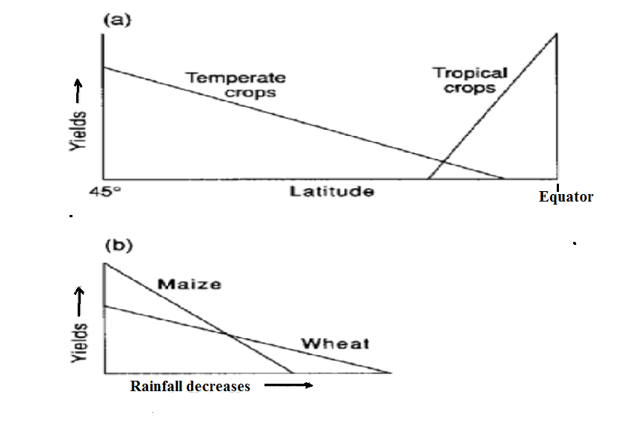

Slide 88
The Influence of Temperature and Moisture for the Growth Crops
Most temperate crops will not grow until temperatures are above 6°C
For tropical crops this threshold is higher.
in spring they can retard germination, and severe frosts may destroy a planting crop, whilst early frosts in late summer may damage the mature crop in temperate areas.
This is also true to Ethiopian highlands
A number of crops such as the palm oil and cacao need high temperatures and high rainfall throughout the year, and this limits their cultivation to the tropics.

Slide 89
On the other hand, barley, potatoes and some grasses can be grown in cool short summers as far north as the subarctic.
Some crops have a remarkable latitudinal range;
Of the cereals rice and maize can be grown in lowland areas near the equator, but also north of 50° in the northern hemisphere.
Rye, oats, sugar-beet and potatoes are grown north of 50° latitude- in the northern hemisphere,
However, these and other temperate crops can be grown in equatorial regions at high altitudes, where temperatures are lower (Ethiopia is an example)

Slide 90
The relationship between the seasonal evolution of temperature and precipitation determines crop cultivation (Bunting, 1974).
In the humid tropics, warm temperatures and consistent rainfall allow multiple harvests of a crop in a year.
However, high rainfall may be harmful to crop growth as it may lead to leaching of essential nutrients from the soil.
Away from the equator, the temporal distribution of rainfall becomes more seasonal and variable.
The timing of crop cultivation is highly dependent on the arrival (late or early) and duration of the rains (lengthy of rainy)

Slide 91
At greater latitudes, the seasonal cycle of temperature increases in amplitude while the distribution of rainfall can vary between regions.
At temperate latitudes crop growing seasons are controlled more by temperature than rainfall.
The large variation in climate across the globe has resulted in the evolution and breeding of many crop species varying in morphology and physiology

Slide 92
As far as moisture requirement is concerned, crop growth can be grouped into categories.
First, crops differ greatly in the amount of water needed to give optimum yields.
Wheat and rye for example, can be grown in areas where annual rainfall is between 25 cm and 100 cm,
But rubber needs over 178 cm and tea over 254 cm.
As over half the earth’s surface receives between 250 and 1000 mm of rain in a year, wheat can be widely grown.
Second, as noted earlier there is a relationship between water supply and crop yield, but it is not linear.

Slide 93
The yield of wheat, oats, sugar-beet, maize and potatoes increases as water supply increases,
but declines after an optimum yield has been reached
The distribution of mean annual rainfall is not a reliable guide to the possible location of crops, because not all the water is available to the plant (some is evaporated, some come out).
Evaporation rates in the tropics are some four times those in Europe because of temperature differences, and so mean annual rainfalls in West Africa have to be above those in northern Europe to give equivalent soil moisture availability.

Slide 94
Rainfall variability and the margin
Away from the area of optimum rainfall not only do crop yields decline, but variability from year to year increases.
This is particularly true in the sub humid and semi-arid zones,
Where much of the world’s commercial wheat is grown variability is high (Prairie provinces in Canada, the Great Plains in the USA, and southern Russia).

Slide 95
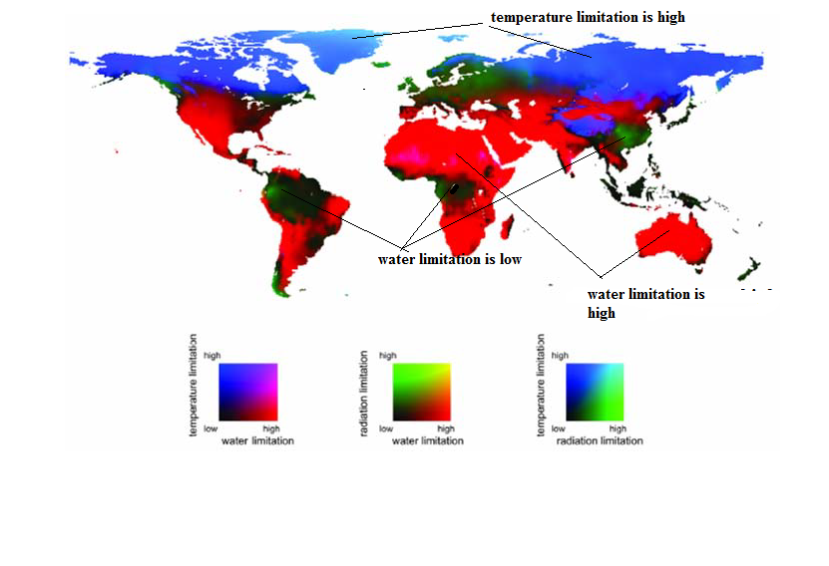

Slide 96
Unit 5
Impact of Climate change on Crop Production
Climate change is not a new phenomenon in the world.
The rise in temperature of the earth surface and in atmosphere, fluctuation in rainfall, declining ground water, flooding due to high rainfall, drought, heavy wind, rising sea level due to melting of glacier, cyclone, wind speed, hail storm and landslide are all the clear evidence of climate change.
Though, it is a natural process but in some cases human activities are also responsible for this change.

Slide 97
Human factors responsible for climate change include growing population, rapid urbanization, higher industrialization, use of modern technology, innovation, transport, building construction and reduction in forest area (Ahmad et al., 2011).
Developing countries are most vulnerable compared to developed countries.
There are many reasons which increase the vulnerabilities for developing countries like low level of technological progress, lack of resources to mitigate the adverse effect of climate change on agriculture; and due to their greater dependence on agriculture for livelihood of large populations

Slide 98
We can agree that climate and its variability impact all sectors of economy in several ways
For example, an increment in maximum temperature may increase mean sea levels and it would affect large populations in peninsular and coastal areas.
It may increase 15 to 40% rainfall and raise the annual mean temperature by 3 to 6 degree.
Climate change adversely affects the food security in all countries through agriculture production.

Slide 99
It affects food security in four dimensions, food availability, food accessibility, food utilization and food system stability.
It will also have an impact on human health, livelihood assets and food production and distribution channels (FAO, 2008).
Due to rising global population size, climate change will challenge agricultural production and food security (location of production, supply, volume, quality)
By 2080, agriculture output in Least Developed Countries (LDCs) may decline by 20% due to climate change while output in industrial countries is expected to decrease by 6%

Slide 100
Crops and atmospheric composition
Crop prediction models suggest that
Food crop production will increase slightly at high latitudes under moderate climate change, but then decrease towards the end of this century (Fischer et al., 2005).
In contrast, crop production is predicted to decline across the tropics even under moderate climate change.

Slide 101
The agricultural activities will also influence atmospheric composition through emissions of methane from rice paddies, and nitrous oxide from the use of synthetic fertilizers.
Since these are important greenhouse gases, and projected to increase up to 60% by 2030 (Gregory et al. 2005).
As well as being a potent greenhouse gas, nitrous oxide is also involved in stratospheric ozone depletion.

Slide 102
Crops and water resources
It is generally, accepted that the availability of water for agriculture will be a key issue for crop production in the coming decades.
Hence, there is a focus worldwide on how to improve the efficiency of water use for crop production.
However, water availability assessment requires the integration of information from crop, climate and hydrological models.
For example, for irrigated crop production, changes in rainfall will influence available of water from stream or groundwater.

Slide 103
Effects of extreme events on crops
More detailed information, however, is often critical for determining the impacts of extreme events.
For example, heavy rainfall will cause a flood; clustering of intense weather systems magnifies potential damage;
The spatial and temporal evolution of droughts is crucial for water-resource management; and the timing of heat- and water-stress during the life cycle of crops is a key determinant of yield.
Important climate thresholds for food crops include episodes of high temperatures that coincide with critical phases of the crop cycle.
These high-temperature episodes can lead to dramatic reductions in yield, in some cases up to 50% (Porter & Semenov 2005).

Slide 104
Climate change scenarios suggest that critical temperature thresholds for food crops will be exceeded with increasing frequency in the future.
For some crops, these critical temperatures, particularly at anthesis (flowering), are reasonably well known (e.g. temperatures greater than 35⁰C for more than 1 h leads to pollen sterility in rice), but for others they are not well characterized.
In general, the reproductive limits for most crops are narrow, with temperatures in the mid-30⁰C representing the threshold for successful grain set (Porter & Semenov 2005).

Slide 105
Understanding socio-economic responses
It is important to consider the complete food chain from production to distribution, access and utilization (Gregory et al. 2005).
This requires an appreciation of the intimate relationship between climate, socioeconomic and environmental factors and an understanding of major economic sectors.
There have been rapid changes worldwide in food systems associated with urbanization and the dominance of supermarket chains.

Slide 106
These may radically alter the relationship between food production and food security, with lifestyles and preferences driving consumption and demand; countries such as India and China are already showing trends towards a western-style diet with increased consumption of meat.
Adapting to climate change may be as much to do with improving infrastructures for food distribution as with changing agricultural practices.
The relentless pressures of increasing populations on land and water use are major factors in determining future scenarios for food security and are likely to be key factors in risks of famine.
There is a gradual decline in ‘carry over’ food stocks with implications for food security (Haile 2005).

Slide 107
Understanding and assessing the vulnerability of populations requires engagement across a wide range of disciplines with the recognition that risk is multi-dimensional.
Rapidly changing socioeconomic factors can lead to increased sensitivity to
climate shocks; for example, the high incidence of HIV and increasing levels of poverty in Africa increase the exposure of the population and its inability to cope with climatic stress.
Simulation methods that integrate climate and human behaviour provide a novel approach to understanding adaptation options for climate variability and change (Bharwani et al. 2005).

Slide 108
The effect of climate change in Africa
The region with the most severe expected climate impacts.
About two-thirds of arable land in Africa is expected to be lost by 2025.
Decreased rainfall would also impact yields from rain-fed agriculture, with estimations of up to 50% in some countries.
A combination of increased temperature and rainfall changes would lengthen the growing season benefiting, for example, the production of Ethiopian coffee and some countries in the horn of Africa.

Slide 109
Asia
The most serious potential threat arising from climate change in Asia is water scarcity.
Central and South Asia would experience negative impacts, while the impacts on East and South-East Asia would be beneficial.
The two most populated countries in the world would experience different impacts –India with negative impacts, and China with positive impacts.
Europe
Climate-related increases in crop yields, of about 5 percent in wheat, are expected mainly in northern Europe;
while the largest reductions of all crops, of up to 10 percent, are expected in the Mediterranean region.

Slide 110
Latin America and the Caribbean:
Overall yield production of wheat, rice, maize, and soybean is estimated to decrease by 2.5 to 5%.
The impact of climate change in Latin America’s productive sectors is estimated to be a 1.3% reduction in the region’s GDP for an increase of 2°C in global temperature
• Northern America:
Overall, decreased precipitation will create important problems for the United States, restricting the availability of water for irrigation
This would affect in particular the western region of the United States;
However, some yield increases are expected in the Great Plains.

Slide 111
Oceania:
As a result of reduced precipitation, water security problems are very likely to intensify, and change land use away from drier areas.
This would negatively affect Australia in particular, the major food producing country in the region.

Slide 112
Adaptation to climate change
What is the difference between adaptation and mitigation strategies?
People actively manage risk/ hazard in a variety of ways among these, the adaptive measures are important
It anticipates the events of shocks in advance (Mahrijan and Chhetri, 2006; Ellis, 3003).
It is a long-term strategy of averting a threat with consistent responses (Osbahr et al., 2008).
It includes livelihood diversification, intensification of cropping, growing of drought resistant crops, diversify livestock herds, diversifying crops, growing short maturing plants and use of water harvesting technologies

Slide 113
Then what is adaptation/mitigation?
The definition of adaptation is given as the continuous process of change to livelihoods, often geared towards enhancing existing security and wealth, and reducing vulnerability and poverty (Ellis 2000)
Adaptation is different from mitigation in that adaptation strategies are implemented at local or community level, while mitigation strategies are employed at higher level (government level)

Slide 114
Both activities are likely to be important as responses to potential climate change.
The interesting aspect of these two approaches is that mitigation involves taking some action now or throughout the period,
whereas adaptation tends to be about taking action in the future or anticipation of climate change (McKibbin and Wilcoxen, 2003).

Slide 115
Mitigation and adaptive strategies
Until recently, mitigation and adaptation were seen as two mutually exclusive strategies.
Nevertheless, there are strong linkages between the two and it is increasingly recognized that integration of both strategies is a prerequisite for successfully addressing climate change scenarios.
Mitigation strategies are procedures or activities that help prevent or minimize the process of climate change.
In the African Sahel, mitigation activities are traditionally employed as natural resources conservation and serve for the purposes of reducing the emission of GHG from anthropogenic sources, and enhancing carbon ‘‘sink’’(Nyong et al., 2007).

Slide 116
Adaptation methods on the other hand, are those strategies that enable the individual or the community to adjust to the impacts of the climate in the local areas.
Such strategies will include the adoption of efficient environmental resources management practices such as planting of early maturing crops, adoption of varieties of crops and selective keeping of livestock in areas where rainfall showed a declining trend (Nyong et al., 2007).
mitigation is the act of reducing the accumulation of greenhouse gases in the atmosphere (whether by reducing the emission of these gases or by increasing the absorption through creation of sinks).

Slide 117
It is predicted that the trends in food consumption may change by 2020 to cope with the decrease in food production due to climate change.
For instance, cereal consumption for food may shift to roots and tubers (e.g. potatoes, sweet potatoes)
The consumption of alternative sources of protein may increase, in particular of legumes (e.g.: beans, lentils)

Slide 118
Crop pests
Biologists have shown how elaborate are the interrelationships between the flora and fauna of the natural world.
Most plants and animals are food for some other plant or animal.
The animals kept by humans, or the plants grown by them, may not exception.
Goats may be attacked by tigers, sheep by dogs; less dramatically they provide a host for ticks, insects and parasites.
Crops, too, provide food for birds, animals and insects.
To the farmer these creatures are pests and diseases which must be eliminated,
Despite advances in pesticides, pests and diseases still destroy a large proportion of the world’s standing crop each year.
The spread of disease has also had an important effect on the location of some crops.

Slide 119
Climate change and Plant diseases
Different models predict that expected climate change will significantly increase the occurrence of plant diseases in the coming years
Long term climate change also showed that there is predicted changes in the varieties of diseases
However, the effects of climate change on health and diseases are not well understood
Some research findings pointed that crops are expected to benefit from warmer temperature and increased levels of CO₂ in the atmosphere

Slide 120
Nevertheless, plants might be stressed by dry soils and weather extremes
Stressed plants are more susceptible to diseases
In addition, pathogens that cause crop diseases will be influenced directly by change of climate
Typically, the two most important environmental factors in the increasing of plant diseases include temp and moisture
For example, in temperate areas most plant diseases are inactive during winter while they become active during summer
Moisture in the form of free water or high humidity is a necessary condition for infection, reproduction and spread in many plant pathogens

Slide 121
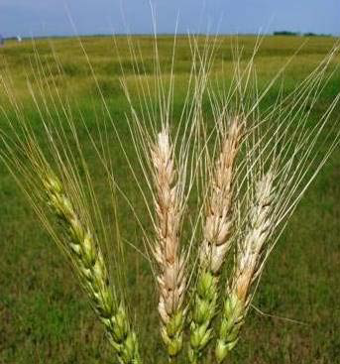
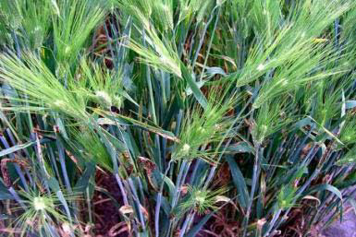
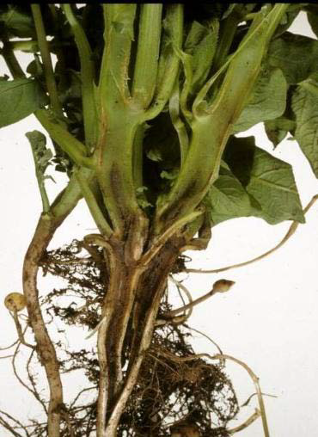
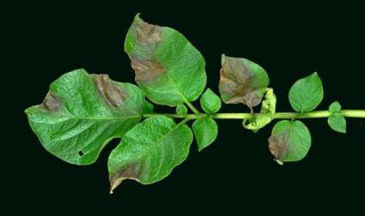

Slide 122

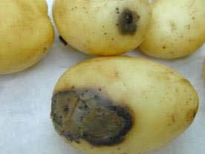

Slide 123
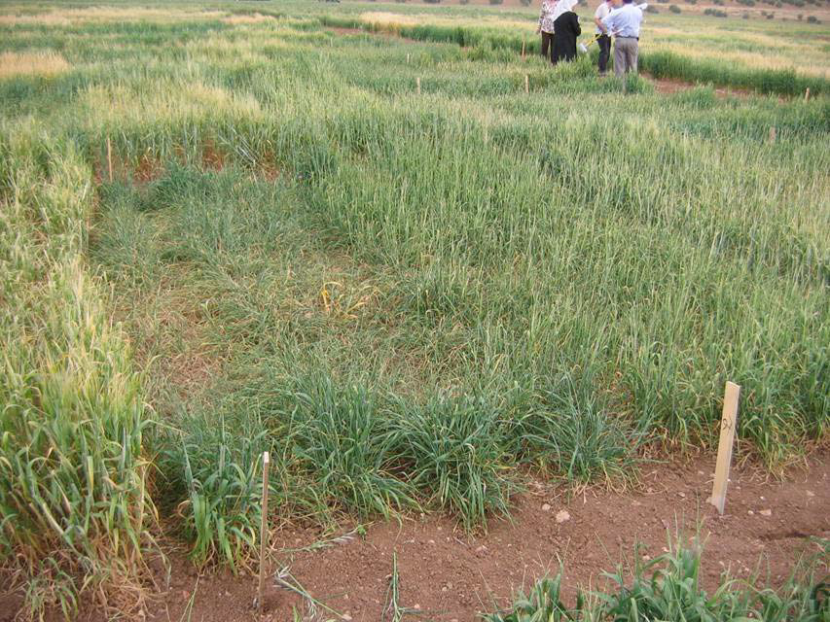
Wheat: temperature stress –sterility (fruitless)

Slide 124
Climate change is likely globally to :
reduce potential agricultural output in the longer term and increase risk of hunger.
• Adverse effects, regionally and near-term, are especially marked in tropics and subtropics (eg especially in Africa)
Most serious effects, sub-nationally, will probably be at the social and economic margins (where adaptive capacity is low).
• Stabilisation at 750 ppm does not avoid most serious
effects. Stabilisation at 550 ppm does, but cost will be great (= c.20 times Kyoto reductions).
• Therefore, successful mitigation will need to be part of a ‘Sustainable Development’ pathway.

Slide 125
A combination of adaptation and mitigation is necessary.
• Invest in adaptation, to increase resilience to climate change:
technology (eg crop breeding for new climates; rural electrification ),
b) management (eg farming systems that use water more efficiently),
c)institutions (eg market and tariff structure).
• Many adaptations can be ‘win-win’ (eg drought proofing for present weather can increase resilience to effects of a long-term drying trend).

Slide 126
Need to foster adaptation in most vulnerable egions: the poorest, small island, low-lying coats, andn semi-arid tropics/sub-tropics
• Should we concentrate more on nonoptimising objectives? eg reduce risk, minimise yield reductions in drought years,
develop resilient (rather than maximising) crop varieties and crop mixes.
• Regardless…Adaptation is needed now.

