Slide 1
CHAPTER ONE
Regression Analysis
with Qualitative Information:
Binary (or Dummy) Variables

Slide 2
Describing Qualitative Information
Qualitative factors often come in the form of binary information:
a person is female or male; a person does or does not own a personal computer; a firm offers a certain kind of employee pension plan or it does not; a state administers capital punishment or it does not.
In all of these examples, the relevant information can be captured by defining a binary variable or a zero-one variable.
In econometrics,binary variables are most commonly called dummy variables, although this name is not especially descriptive.

Slide 3
CONT…
To quantify the qualitative information we can us binary distribution i.e. success or failure.
In defining a dummy variable, we must decide which event is assigned the value one and which is assigned the value zero.
For instance, if we went to study the income distribution of the student by sex(male and female). First we have to decide one event zero and one for other. Suppose with the outcome which we will donate Y, being assigned a value of 1 if the event occur and zero other wise i.e 1=male and 0 =female. But if the event occur there is no way to be the other way(mutual).

Slide 4
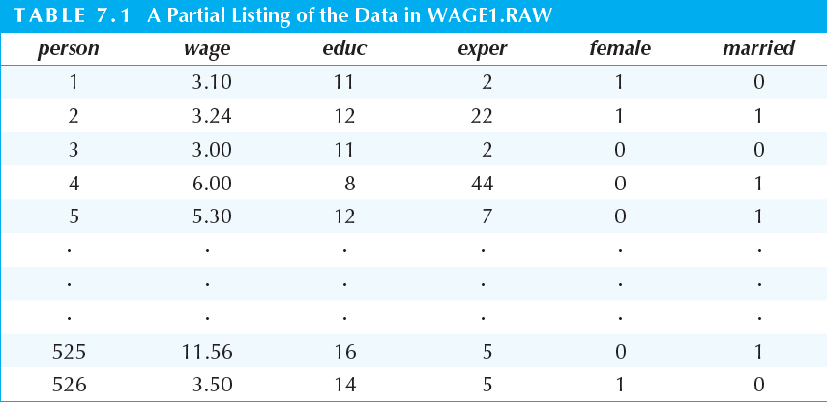
Example
Jeffrey M. Wooldridge-Introductory Econometrics_ A Modern Approach-South-Western College Pub (2012),page 228

Slide 5
Cont…
For example, in a study of individual wage determination, we might define female to be a binary variable taking on the value one for females and the value zero for males. The name in this case indicates the event with the value one. The same information is captured by defining male to be one if the person is male and zero if the person is female.
Either of these is better than using gender because this name does not make it clear when the dummy variable is one: does gender = 1 correspond to male or female?
Further, we define a binary variable married to equal one if a person is married and zero if otherwise. Table 7.1 gives a partial listing of a wage data set that might result. We see that Person 1 is female and not married, Person 2 is female and married, Person 3 is male and not married, and so on.
Why do we use the values zero and one to describe qualitative information? In a sense, these values are arbitrary: any two different values would do.

Slide 6
    THE NATURE OF DUMMY VARIABLES
In regression analysis the dependent variable, or regressand, is frequently influenced not only by ratio scale variables (e.g., income, output, prices, costs, height, and temperature) but also by variables that are essentially qualitative or nominal scale, in nature, such as sex, race, color, religion, nationality, geographical region, political upheavals, and party affiliation. For example, holding all other factors constant, female workers are found to earn less than their male counterparts or nonwhite workers are found to earn less than whites. This pattern may result from sex or racial discrimination, but whatever the reason, qualitative variables such as sex and race seem to influence the regressand and clearly should be included among the explanatory variables, or the regressors.

Slide 7
Cont..
How do we incorporate binary information into regression models?
Since such variables usually indicate the presence or absence of a“quality” or an attribute, such as male or female, black or white, Catholic or non-Catholic, Democrat or Republican, they are essentially nominal scale variables. One way we could “quantify” such attributes is by constructing artificial variables that take on values of 1 or 0, 1 indicating the presence (or possession) of that attribute and 0 indicating the absence of that attribute.For example 1 may indicate that a person is a female and 0 may designate amale; or 1 may indicate that a person is a college graduate, and 0 that theperson is not, and so on. Variables that assume such 0 and 1 values are called dummy variables. Such variables are thus essentially a device to classify data into mutually exclusive categories such as male or female.

Slide 8
Cont…
Dummy variables can be incorporated in regression models just as easily as quantitative variables. In the simplest case, with only a single dummy explanatory variable, we just add it as an independent variable in the equation.
For example, consider the following simple model of hourly wage determination:

Slide 9
Cont..
In model above, only two observed factors affect wage: gender and education. Because female = 1 when the person is female, and male = 0 when the person is male, the
Parameter has the following interpretation: is the difference in hourly wage between females and males, given the same amount of education (and the same error term u).
Thus, the coefficient determines whether there is discrimination against women: if < 0, then, for the same level of other factors, women earn less than men on average.

Slide 10
Cont…
As a matter of fact, a regression model may contain regressors that are all exclusively dummy, or qualitative, in nature. Such models are called Analysis of Variance (ANOVA) models. ANOVA models are used to assess the statistical significance of the relationship between a quantitative regressand and qualitative or dummy regressors. They are often used to compare the differences in the mean values of two or more groups or categories, and are therefore more general than the t test which can be used to compare the means of two groups or categories only.

Slide 11

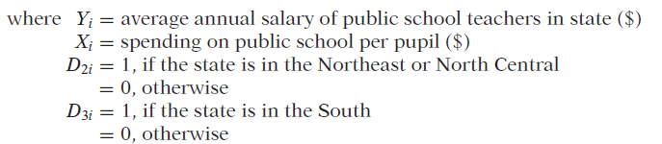
Cont…
Example: Suppose the following model is specified by the researcher to find out if the average annual salary (AAS) of public school teachers differs among the three geographical regions of the country namely Northeast and North Central, South, and West(you can refer Gujariti,2004;299):
…………………………………1.1

Slide 12

Cont…
Note that (1.1) is multiple regression models with only qualitative, or dummy, regressors, taking the value of 1 if the observation belongs to a particular category and 0 if it does not belong to that category or group. Hereafter, we shall designate all dummy variables by the letter D.
What does the model (1.1) tell us? Assuming that the error term satisfies the usual OLS assumptions, on taking expectation of (1.1) on both sides, we obtain:
Mean salary of public school teachers in the Northeast and North Central:
1. Mean salary of public school teachers in the Northeast and North Central:

Slide 13


Cont….
2. Mean salary of public school teachers in the South:
3. Mean salary of public school teachers in the West:
In other words, the mean salary of public school teachers in the West is given by the intercept,

Slide 14
Cont…
in the multiple regression (1.1), and the “slope” coefficients
and tell by how much the mean salaries of teachers in the Northeast and North Central and in the South differ from the mean salary of teachers in the West. But how do we know if these differences are statistically significant? Let us present the results based on the regression (1.1). After collecting the data and doing regression the researcher obtained the following result:
………………………………1.2
se = (1128.523) (1435.953) (1499.615)
t = (23.1759) (−1.2078) (−2.1776)
p-v=(0.0000) (0.2330)(0.0349) = 0.0901

Slide 15
Cont…
As these regression results show, the mean salary of teachers in the West is about $26,158, that of teachers in the Northeast and North Central is lower by about $1,734, and that of teachers in the South is lower by about $3,265.
The actual mean salaries in the last two regions can be easily obtained by adding these differential salaries to the mean salary of teachers in the West, as shown in equations second and third. Doing this, we will find that the mean salaries in the latter two regions are about $24,424 and $22,894.

Slide 16
Cont….
Therefore, the overall conclusion is that statistically the mean salaries of public school teachers in the West and the Northeast and North Central are about the same but the mean salary of teachers in the South is statistically significantly lower by about $3,265.
A caution is in order in interpreting these differences. The dummy variables will simply point out the differences, if they exist, but they do not suggest the reasons for the differences. Differences in educational levels, in cost of living indexes, in gender and race may all have some effect on the observed differences. Therefore, unless we take into account all the other variables that may affect a teacher’s salary, we will not be able to pin down the cause(s) of the differences.

Slide 17
Caution in the Use of Dummy Variables
Although they are easy to incorporate in the regression models, one must use the dummy variables carefully. In particular, consider the following aspects:
1.In Example above, to distinguish the three regions, we used only two dummy variables, D2 and D3.Why did we not use three dummies to distinguish the three regions? Suppose we do that and write the model as:
Where D1i takes a value of 1 for states in the West and 0 otherwise. Thus, we now have a dummy variable for each of the three geographical regions. If you were to run the regression using the data collected, the computer will “refuse” to run the regression, why? The reason is that in the setup of where you have a dummy variable for each category or group and also an intercept, you have a case of perfect collinearity, that is, exact linear relationships among the variables.

Slide 18
Cont…
If a qualitative variable has m categories, introduce only (m − 1) dummy variables. In our example, since the qualitative variable “region” has three categories, we introduced only two dummies. If you do not follow this rule, you will fall into what is called the dummy variable trap, that is, the situation of perfect collinearity or perfect multicollinearity, if there is more than one exact relationship among the variables.
This rule also applies if we have more than one qualitative variable in the model. Thus we should restate the preceding rule as: For each qualitative regressor the number of dummy variables introduced must be one less than the categories of that variable.

Slide 19
Cont…
2. The category for which no dummy variable is assigned is known as the base, benchmark, control, comparison, reference, or omitted category. And all comparisons are made in relation to the benchmark category.
3. The intercept value (β1) represents the mean value of the benchmark category. Example 1.1, the benchmark category is the Western region. Hence, in the regression (1.5) the intercept value of about 26,159 represents the mean salary of teachers in the Western states.
4. The coefficients attached to the dummy variables in (1.1) are known as the differential intercept coefficients because they tell by how much the value of the intercept that receives the value of 1 differs from the intercept coefficient of the benchmark category. For example, in above example,the value of about −1,734 tells us that the mean salary of teachers in the Northeast or North Central is smaller by about $1,734 than the mean salary of about$26,159 for the benchmark category, the West.

Slide 20
Cont…
5. If a qualitative variable has more than one category, as in our illustrative example, the choice of the benchmark category is strictly up to the researcher.
6. We warned above about the dummy variable trap. There is a way to
circumvent this trap by introducing as many dummy variables as the number of categories of that variable, provided we do not introduce the intercept in such a model. Thus, if we drop the intercept term from the above equation and consider the following model,
Yi = β1D1i + β2D2i + β3D3i + ui
we do not fall into the dummy variable trap, as there is no longer perfect collinearity.
How do we interpret regression??????
If you take the expectation of you will find that:
β1 = mean salary of teachers in the West
β2 = mean salary of teachers in the Northeast and North Central.
β3 = mean salary of teachers in the South.
In other words, with the intercept suppressed, and allowing a dummy variable
for each category, we obtain directly the mean values of the various categories.

Slide 21
Example
The results of (9.2.7) for our illustrative example are as follows(Gujirati, page 303):
ˆYi = 26,158.62D1i + 24,424.14D2i + 22,894D3i
se = (1128.523) (887.9170) (986.8645)
t = (23.1795)* (27.5072)* (23.1987)*
R2 = 0.0901
where * indicates that the p values of these t ratios are very small.
As you can see, the dummy coefficients give directly the mean (salary) values in the three regions, West, Northeast and North Central, and South.

Slide 22
Cont…
7. Which is a better method of introducing a dummy variable: (1) introduce
a dummy for each category and omit the intercept term or (2) include the intercept term and introduce only (m − 1) dummies, where m is the number of categories of the dummy variable?
As Kennedy notes: Most researchers find the equation with an intercept more convenient because it allows them to address more easily the questions in which they usually have the most interest, namely, whether or not the categorization makes a difference, and if so, by how much. If the categorization does make a difference, by how much is measured directly by the dummy variable coefficient estimates. Testing wheather or not the categorization is relevant can be done by running a t test of a dummy variable coefficient against zero (or, to be more general, an F test on the appropriate set of dummy variable coefficient estimates).

Slide 23
ANOVA MODELS WITH TWO QUALITATIVE VARIABLES
In the previous section we considered an ANOVA model with one qualitative variable with three categories. In this section we consider another ANOVA model, but with two qualitative variables, and bring out some additional points about dummy variables.
EXAMPLE 2
HOURLY WAGES IN RELATION TO MARITAL STATUS AND REGION OF RESIDENCE From a sample of 528 persons in May 1985, the following regression results were obtained:

Slide 24
Cont…
Yi = 8.8148 + 1.0997D2i − 1.6729D3i
se = (0.4015) (0.4642) (0.4854)
t = (21.9528) (2.3688) (−3.4462)
(0.0000)* (0.0182)* (0.0006)*
R2 = 0.0322
where Y = hourly wage ($)
D2 = married status, 1 = married, 0 = otherwise
D3 = region of residence; 1 = South, 0 = otherwise and * denotes the p values.
In this example we have two qualitative regressors, each with two categories. Hence we have assigned a single dummy variable for each category.

Slide 25
Cont…
Which is the benchmark category here? Obviously, it is unmarried, non-South residence. In other words, unmarried persons who do not live in the South are the omitted category. Therefore, all comparisons are made in relation to this group. The mean hourly wage in this benchmark is about $8.81. Compared with this, the average hourly wage of those who are married is higher by about $1.10, for an actual average wage of $9.91 (= 8.81 + 1.10). By contrast, for those who live in the South, the average hourly wage is lower by about $1.67,for an actual average hourly wage of $7.14.

Slide 26
Are the preceding average hourly wages statistically different compared to the base category? They are, for all the differential intercepts are statistically significant, as their p values are quite low.
The point to note about this example is this: Once you go beyond one qualitative variable, you have to pay close attention to the category that is treated as the base category, since all comparisons are made in relation to that category. This is especially important when you have several qualitative regressors, each with several categories. But the mechanics of introducing several qualitative variables should be clear by now.

Slide 27
REGRESSION WITH A MIXTURE OF QUANTITATIVE AND QUALITATIVE REGRESSORS: THE ANCOVA MODELS
ANOVA models of the type discussed in the preceding two sections, although common in fields of sociology, psychology, education, and market research, are not that common in economics. Typically, in most economic research a regression model contains some explanatory variables that are quantitative and some that are qualitative. Regression models containing an admixture of quantitative and qualitative variables are called analysis of covariance (ANCOVA) models.
ANCOVA models are an extension of the ANOVA models in that they provide a method of statistically controlling the effects of quantitative regressors, called covariates or control variables, in a model that includes both quantitative and qualitative, or dummy, regressors. We now illustrate the ANCOVA models.

Slide 28
Cont…
To motivate the analysis, let us reconsider Example 1.1 by maintaining that the average salary of public school teachers may not be different in the three regions if we take into account any variables that cannot be standardized across the regions. Consider, for example, the variable expenditure on public schools by local authorities, as public education is primarily a local and state question. To see if this is the case, we develop the following model:
Where, yi = average annual salary of public school teachers in state ($)
Xi = spending on public school per pupil ($)
D2i = 1, if the state is in the Northeast or North Central = 0, otherwise
D3i = 1, if the state is in the South = 0, otherwise
Keep in mind that we are treating the West as the benchmark category. Also, note that besides the two qualitative regressors, we have a quantitative variable, X, which in the context of the ANCOVA models is known as a covariate, as noted earlier.

Slide 29
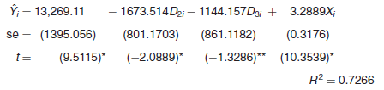
Example
TEACHER’S SALARY IN RELATION TO REGION AND SPENDING ON PUBLIC SCHOOL PER PUPIL
Suppose the regression result is found as follows:
Where * indicates p values less than 5 percent, and ** indicates p values greater than 5 percent.

Slide 30
Cont…
As these results suggest, ceteris paribus, as public expenditure goes up by a dollar, on average, a public school teacher’s salary goes up by about $3.29. Controlling for spending on education, we now see that the differential intercept coefficient is significant for the Northeast and North-Central region, but not for the South. These results are different from the the previous example. But this should not be surprising, for in previous, we did not account for the covariate, differences in per pupil public spending on education. Diagrammatically, we have the situation shown in Fig.1 below.

Slide 31
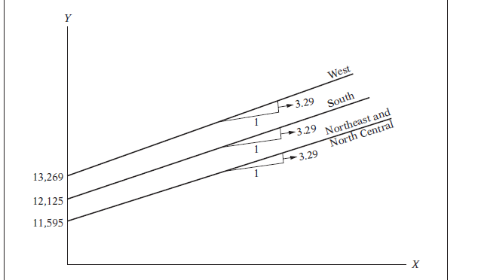
Cont…
Fig.1: Public school teacher’s salary (Y) in relation to per pupil expenditure on education (X)

Slide 32
INTERACTION EFFECTS USING DUMMY VARIABLES
Interactions among Dummy Variables
Dummy variables are a flexible tool that can handle a variety of interesting problems. Just as variables with quantitative meaning can be interacted in regression models, so can dummy variables. We have four categories based on skin color(white/non white) and gender. In fact, we can recast that model by adding an interaction term between female and married to the model where female and rice appear separately. This allows the rice premium to depend on gender. For purposes of comparison, the estimated model with the female-non white interaction term from Gujariti page 311:
D2= 1 =Female D3= 1=non-white

Slide 33
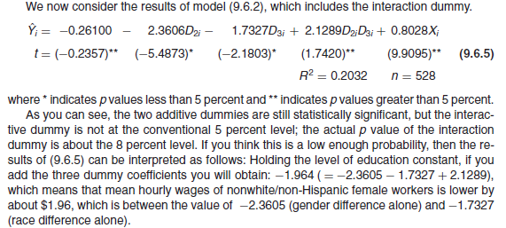
Cont…

Slide 34
1.3 Dummy as Dependent Variable (QUALITATIVE RESPONSE MODELS)
In model we have seen until now, the dependent variable y has had quantitative meaning (for example, y is a dollar amount). What happens if we want to use multiple regression to explain a qualitative event?
In the simplest case, and one that often arises in practice, the event we would like to explain is a binary outcome. In other words, our dependent variable, y, takes on only two values: zero and one. For example, y can be defined to indicate whether an adult has a high school education; y can indicate whether a college student used illegal drugs during a given school year; or y can indicate whether a firm was taken over by another firm during a given year. In each of these examples, we can let y=1 denote one of the outcomes and y=0 the other outcome.

Slide 35
Cont…
The response variable, or regressand, can take only two values, say, 1 if the person is in the labor force and 0 if he or she is not. In other words, the regressand is a binary, or dichotomous, variable.
One can think of several other examples where the regressand is qualitative in nature. Thus, a family either owns a house or it does not, it has disability insurance or it does not, both husband and wife are in the labor force or only one spouse is. Similarly, a certain drug is effective in curing an illness or it is not.
We do not have to restrict our response variable to yes/no or dichotomous categories only. In general, we can have a polychotomous (or multiple-category) response variable.
In a model where Y is quantitative, our objective is to estimate its expected, or mean, value given the values of the regressors. In models where Y is qualitative, our objective is to find the probability of something happening, such as voting for a Democratic candidate, or owning a house, or belonging to a union, or participating in a sport etc. Hence, qualitative response regression models are often known as probability models.

Slide 36
Cont…
We start our study of qualitative response models by considering the binary response regression model. There are three approaches to develop a probability model for a binary response variable:
The linear probability model (LPM)
The logit model
The probit model
Because of its comparative simplicity, and because it can be estimated by OLS, we will first consider the LPM, leaving the other two models for subsequent sections.

Slide 37
THE LINEAR PROBABILITY MODEL
P(y = 1) = E(y), when y is a binary variable, so we can write our model as
P(y = 1) = β₁ + β₂x₂ + … + β_{k}x_{k}
So, the interpretation of β_{j} is the change in the probability of success when x_{j} changes
The predicted y is the predicted probability of success
Assuming E() = 0, as usual (to obtain unbiased estimators), we obtain:

Slide 38
Cont…
Now, if = probability that = 1 (that is, the event occurs), and (1 −) = probability that = 0 (that is, the event does not occur), the variable has the following (probability) distribution:
That is, Yi follows the Bernoulli probability distribution.
Now, by the definition of mathematical expectation, we obtain:
Yi | Probability
0 | 1 −Pi
1 | Pi

Slide 39
Cont…
y, p
1
Fig:1.2
β₁ +β₂X_{i}
β₁
0
X_{i}
X
The simplest binary choice model is the linear probability model where, as the name implies, the probability of the event occurring, p, is assumed to be a linear function of a set of explanatory variables.

Slide 40
Cont…
Now, by the definition of mathematical expectation, we obtain:
E(Yi)=0(1−pi)+1(pi)= E(Yi/Xi)=
Which means, the expectation of a Bernoulli random variable is the probability that the random variable equals 1. In passing note that if there are n independent trials, each with a probability p of success and probability (1 − p) of failure, and X of these trials represent the number of successes, then X is said to follow the binomial distribution. The mean of the binomial distribution is np and its variance is np(1 − p). The term success is defined in the context of the problem.
Since the probability must lie between 0 and 1, we have the restriction
0 ≤E (Yi|Xi ) ≤ 1,
That is, the conditional expectation (or conditional probability) must lie between 0 and 1. From the preceding discussion it would seem that OLS can be easily extended to binary dependent variable regression models. So, perhaps there is nothing new here. Unfortunately, this is not the case, for the LPM poses several problems, which are as follows:

Slide 41
Shortcomings of the LPM
There are a number of problems with the LPM. The main problem is the Non-fulfilment of 0 ≤ E(Y_{i}) ≤ 1
This means there is no guarantee that the predicted values of Y will all lie between 0 and 1.
Other issues:
Limited usefulness of R²
Marginal effects are constant

Slide 42
Cont..
Unfortunately, the linear probability model has some serious shortcomings. First, there are problems with the disturbance term.
As usual, the value of the dependent variable Y_{i} in observation i has a nonstochastic component and a random component. The nonstochastic component depends on X_{i} and the parameters. The random component is the disturbance term.

Slide 43
Cont…
Cont..
Therefore the error term is non-normally distributed

Slide 44
Cont..
In addition the error term is hetroskedastic
Which clearly varies with the values of X
However neither of these problems are insurmountable:
Problem of non-normality can be circumvented provided we have a large sample size (invoke the central limit theorem)
Problem of heteroskedasticity can be removed by either using WLS or White’s adjustment

Slide 45
Cont…

Slide 46
A NUMERICAL EXAMPLE
From data the LPM estimated by OLS is asfollows (refer Gujarati, 2004, p587):
= −0.9457 + 0.1021
(0.1228) (0.0082)
t = (−7.6984) (12.515) R2 = 0.8048
First, let us interpret this regression. The intercept of −0.9457 gives the “probability’’ that a family with zero income will own a house. Since this value is negative, and since probability cannot be negative, we treat this value as zero, which is sensible in the present instance. The slope value of 0.1021 means that for a unit change in income, on the average the probability of owning a house increases by 0.1021 or about 10 percent. Of course, given a particular level of income, we can estimate the actual probability of owning a house from. Thus, for X = 12 ($12,000), the estimated probability of owning a house is E( ) = −0.9457 + 12(0.1021) = 0.2795 That is, the probability that a family with an income of $12,000 will own a house is about 28 percent.

Slide 47
1.4. Logit and Probit Models for Binary Response
Logit and probit models overcome the shortcomings of the LPM; the disadvantage is that they are more difficult to interpret. The linear probability model is simple to estimate and use, but it has some drawbacks as previously seen. These limitations of the LPM can be overcome by using more sophisticated binary response models(e.i. Logit and Probit Models).

Slide 48
THE LOGIT MODEL

