Slide 1
Chapter - 2: Financial Analysis and Appraisal of Projects
The main content of the chapter are:
Scope and Rationale
Identification of Costs and Benefits
Classification of Costs and Benefits
The valuation of financial costs and benefits
Investment Profitability Analysis
Sensitivity analysis

Slide 2
Scope and Rationale
What is financial analysis?
Every project has to be first analyzed in terms of its timely implementation and financing.
It aims at confirming that under prevailing market conditions the project will become and remain viable.
It is concerned with assessing the feasibility of a new project from the point of view of its financial results.

Slide 3
Cont…,
The project’s direct benefits and costs are, therefore, calculated in monetary terms at the prevailing market prices.
This analysis is applied to appraise the soundness and acceptability of a single project.
A comprehensive financial analysis provides the basic data needed for the economic evaluation of the project and is the starting point for such evaluation.

Slide 4
Cont…,
It has to be noted that the financial analyst should be able to communicate and know what to ask from the d/t team members to collect relevant information on:
1. Revenue, both forecasted sales and selling price; (from Demand and Market Study)

Slide 5
Cont…,
2. Initial investment costs distributed over the implementation of the project; (Engineering, Site Development as well as Materials and Inputs);
3. Operating costs / over its operating life.

Slide 6
Identification of Costs & Benefits
In project analysis, the identification of costs and benefits is the first step. This involves:
The specification of the costs and benefit of variables for which data should be collected,
Identification of the sources of information, and
Assessment of the quality and reliability of the collected information.

Slide 7
Cont…,
The costs and benefits of a project depend on the objectives the project wants to achieve.
A cost is anything that reduces an objective, and a benefit is anything that contributes to an objective.
The objective of the project may be:
To maximize family net income /profit.
Increase national income

Slide 8
Cont…,
Income distribution.
Increase job opportunities
Raising the level of education,
Improve rural health, & etc.
The dominant objective of the firm’s project is maximization of income/profit and increased national income is the most important objective of national economic policy.

Slide 9
Cont…,
Thus, anything that directly reduces the total final goods and services is obviously a cost, and anything that directly increases them is a benefit.
Again, anything that reduces national income is a cost and anything that increases national income is a benefit.

Slide 10
Classifications of Cost and Benefits
There are alternative ways of classifying costs and benefits of a project.
One is to categorize both costs and benefits into:
Tangible and intangible: The prices that the project actually pays for inputs are the appropriate prices to use to estimate the project’s financial costs.
These prices may include taxes, tariffs, rents, or be net of subsidies.

Slide 11
Cont…,
Some of the project costs are tangible and quantifiable while many more are intangible and non quantifiable.
The costs of a project depend on the exact project formulation, location, resource availability, or objective of the project.
Tangible benefits can arise either from increased production or from reduced costs.

Slide 12
Cont…,
In general the following benefits can be expected:
Increased production
Quality improvement
Changes in time of sale
changes in location of sale
Changes in product form (grading)
Cost reduction through technological advancement & etc.

Slide 13
Another classification:
1. Total investment costs; including:
Initial investment costs;
Fixed investment costs;
The cost of land and site development
The cost of buildings and civil works
Plant and machinery
Miscellaneous fixed assets (furniture)

Slide 14
Cont…,
Pre-Production expenditures; This includes the following investment cost items.
Intangible assets; These include:
Patents, licenses, engineering fees, and goodwill.
Preparatory studies, like feasibility studies, consultant fees for preparing studies, supervision costs, & etc.

Slide 15
Cont…,
Other Pre-operation expenses. These include:
Rents, taxes, Salaries, and others
Pre-production marketing costs, promotional expenses, creation of sales network, etc.;
Training costs, including all fees, travel, living expenses etc.;
Insurance charges;

Slide 16
Cont…,
Interest on loan,
Miscellaneous expenses

Slide 17
b. Plant and Equipment Replacement Costs
Every machinery and equipment does not have equal economic life.
Even though there are machineries and equipment that productively be operated for many years, there are also equipment, machinery components and parts which need to be regularly replaced for smooth operation of the same technology.

Slide 18
Cont…,
So sound project planning work should adequately provide for replacement of components and parts.
In fact the first thing to do would be to identify such items and then estimate the costs for replacement .

Slide 19
2. Operating costs
This may includes
Material cost
Utilities: consisting of power, water, and fuel are also important cost components.
Labor: this is the cost of all manpower employed in the enterprise.
Factory Overhead: the expense on repairs and maintenance, rent, taxes, insurance on factory assets, etc.

Slide 20
Cont…,
Contingency allowances are usually included as a regular part of the project cost.
It would be unrealistic to base project cost estimates only on these assumptions of perfect knowledge and complete price stability.

Slide 21
Cont…,
Sound project planning requires that provision be made in advance for possible adverse changes in physical conditions or prices that would add to the baseline cost.
Contingency allowances may be divided into those that provide for physical contingencies and those for price contingencies.
In turn price contingencies comprises two categories, those for relative changes in price and those for general inflation.

Slide 22
Cont…,
To avoid the problem of inflation on the other hand it is advisable to work with constant prices instead of current prices.

Slide 23
The Valuation of Financial Cost and Benefits
This is an issue of pricing/valuing/ of the project’s inputs and outputs.
The inputs and outputs of a project appear in physical form and prices are used to express them in value terms.
The financial benefits of a project are just the revenues received and the financial costs are the expenditures that are actually incurred by the implementing agency as a result of the project.

Slide 24
Cont…,
If the project is producing some goods and services for sale, the revenue that the project implementer expects to receive every year from these sales will be the benefits of the project.
The costs incurred are the expenditures made to establish and operate the project.
In financial analysis all receipts and expenditures are valued as they appear in the financial balance sheet of the project, and are therefore, measured in market prices.

Slide 25
Cont…,
Since the project implementers will have to pay market prices for the inputs and will receive market prices for the outputs they produce, the financial costs and benefits of the project are measured in these market prices.

Slide 26
Investment Profitability Analysis
A. Non-discounting (traditional) measures of project worth
1. Payback Period (PBP)
2. Accounting Rate of Return (ARR)
1. Payback Period (PBP)
Payback period refers to the length of time it takes to recover initial investment of the project.
Depending on the nature of net cash flows, payback period may be computed in two ways.

Slide 27
Cont…,
When cash flow is in annuity form (even cash flows)
Annuity refers to equal amount of cash flows that occur every period over the life of the project.

Slide 28
Cont…,
To illustrate the computation of payback period, assume that a project requires an initial investment of Br. 24,000 and annual after tax cash flows of Br. 6000 for five years.
How long it takes the company to recover its initial investment?

Slide 29
Cont…,
It is expected to take the company four years to recover the project’s initial investment of Br. 24,000
b) When cash flows are not in annuity form (Uneven cash flows)
When net cash flows are not annuity, payback period is obtained by adding net cash flows for successful years until the total is equal to initial investment.

Slide 30
Cont…,
PBP= Years before full recovery + Un recovered cost
Cash flow during the next year
To exemplify, assume that a project requires an initial investment of Br. 60,000.
The after taxes cash flows (or net cash flows) are as follows:
Year 1 = 8000 Year 3 = 22,000 Year 5 = 20,000
Year 2 = 15,000 Year 4 = 20,000

Slide 31
Cont…,
The payback period is computed as follows;
In the above example, if the 1st three years’ net cash flows are added, the sum is equal to Br. 45,000.
But the initial investment is Br. 60,000.

Slide 32
Cont…,
If the fourth year net cash flows (Br. 20,000) is added to Br. 45,000, the sum is Br. 65,000 which is greater than the initial investment.
Thus, the payback period is between year 3 and year 4.
To find the exact payback period, we take the three years and divide the remaining cash flows by the fourth year net cash flows.

Slide 33
Cont…,
If the exact payback period is needed in months the fraction can be computed as follows:
= 3 years and 9 months
The shorter the payback period, the more desirable the project.

Slide 34
Cont…,
Advantages of Payback Period
It is simple both in concept and application
It is a rough and ready made method for dealing with risk & etc.
Disadvantages of Payback Period
It fails to consider time value of money
It ignores cash flows beyond the payback period
It is a measure of the project’s capital recovery, not profitability & etc.

Slide 35
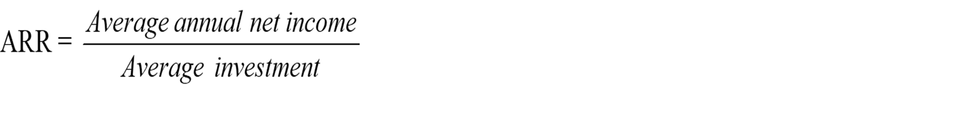
2. Accounting/Average Rate of Return (ARR)
The accounting rate of return is a measure of profitability which relates/compare net income to investment. Compare
The most common method of computing ARR, is shown below;

Slide 36
Cont…,
To illustrate, assume that a project has original investment of Br. 70,000, life of 4 years, and salvage value of Br. 6000.
Income before depreciation and taxes for each of the four years are as follows: year1, Br. 40,000; year 2, Br. 42,000; year 3, Br. 36,000; and year 4, Br. 50,000.
Income tax rate is 40%.

Slide 37
Cont…,
Depreciation = 70,000 – 6000 = 16,000
4
Before ARR is determined, it is necessary to compute net income for each of the four years as follows:

Slide 38
Cont…,
Year 1 Year 2 Year 3 Year 4
Income before depreciation & tax 40,000 42,000 36,000 50,000
Less: Depreciation 16,000 16,000 16,000 16,000
Income before taxes 24,000 26,000 20,000 34,000
Less: Taxes (40%) 9,600 10,400 8,000 13,600
Net income 14,400 15,600 12,000 20,400

Slide 39

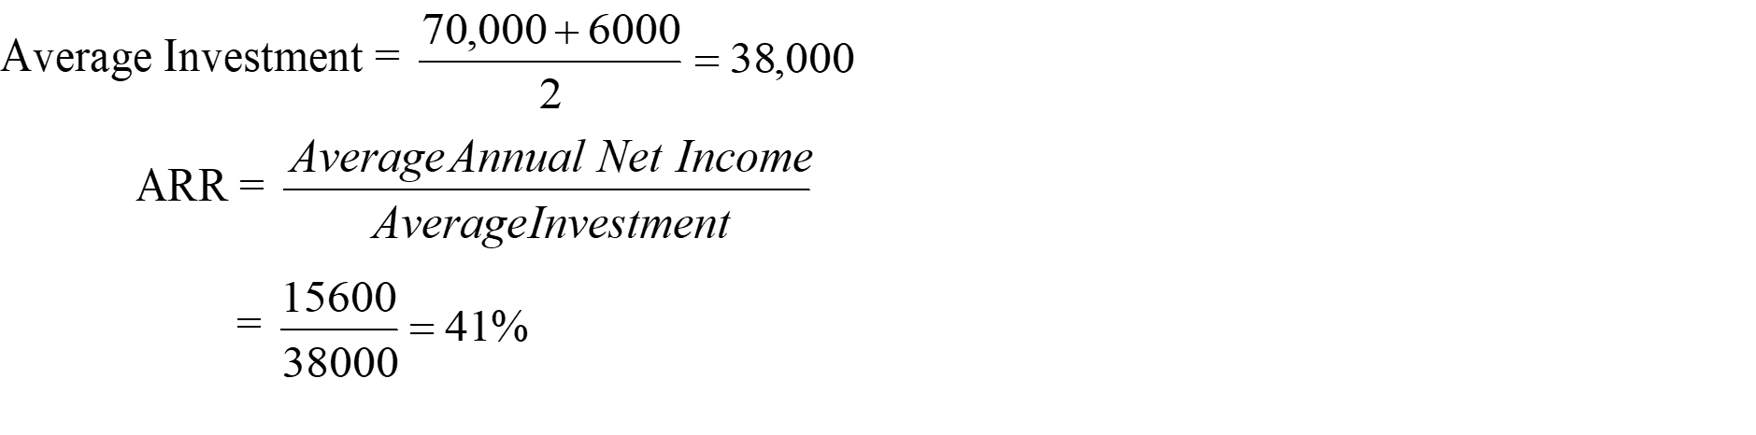
Cont…,

Slide 40
Cont…,
The ARR for a project proposal shall be compared with a required rate of return (normal saving interest rate).
Therefore, if we compare the ARR of the project proposals in our example, say with an interest rate of 36%, the proposal is good for implementation.
Decision Rule for Accounting Rate of Return
Accept the project if ARR exceeds the required rate of return.
Reject the project if ARR is less than the required rate of return.

Slide 41
Advantages of ARR
It is simple to calculate
It is based on accounting information, which is readily available and familiar to businessmen.
It considers benefits over the entire life of the project & etc.
Limitations of ARR
It is based upon accounting profit.
It does not take into account the time value of money & etc.

Slide 42
Discounted Cash Flows (DCF) measures of project worth
1. Net Present Value Method
The net present value of project is the d/ce b/n the present value of net cash inflows and present value of initial investment. Or;
NPV = PV of NCF – I₀
Where: PV = Present value and NCF = Net cash flows

Slide 43
Cont…,
To illustrate, assume that a project is expected to have initial investment and life of Br. 40,000 and five years respectively.
The annual after tax net cash flow is estimated at Br. 12,000 for each of the five years & the required rate of return is 10%.

Slide 44
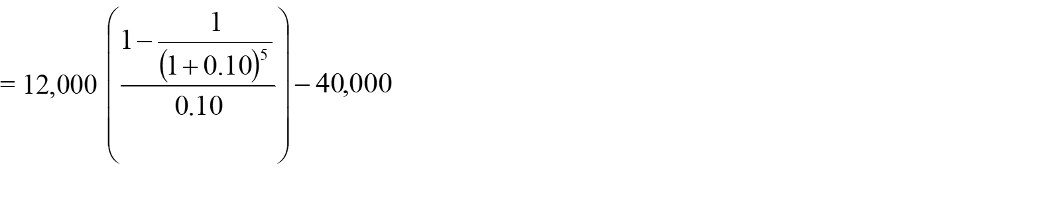
Cont…,
Net present value is determined as follows:
NPV = PV of NCF – I₀
= 12,000 (3.791) – 40,000
= 45,492 – 40,000 = 5492

Slide 45
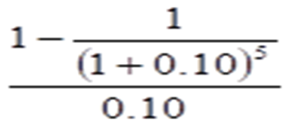
Cont…,
In the above formula, represents the discount factor and its value is equal to 3.791.
This discount factor can be taken from the present value of annuity table from the intersection of i = 10% and n = 5.
It can also be determined using your calculator.

Slide 46
Cont…,
In the above example, net cash flows are annuity.
The same procedure can be followed if net cash flows are not in annuity form.
To illustrate the computation of NPV when net cash flows are not annuity, suppose the project has initial investment and useful life of Br. 30,000 and four years respectively.
Its annual cash flows are as follows: Year 1, Br. 10000; Year 2, Br. 8000; year 3, Br. 15000; and year 4, Br. 12,000.

Slide 47
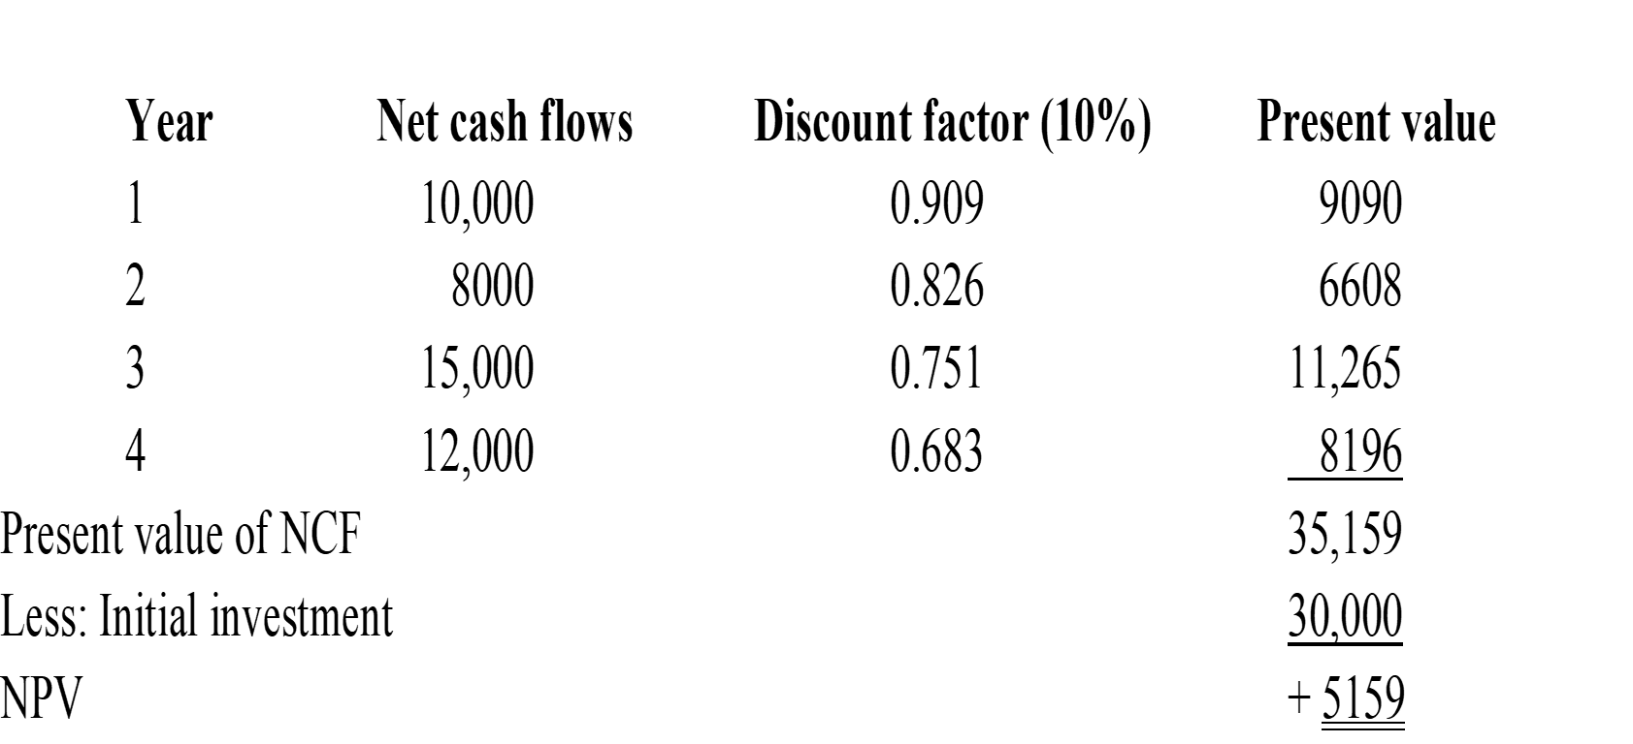
Cont…,
If the required rate of return is 10%, NPV is determined as follows:

Slide 48
Cont…,
NPV represents the amount by which the value of (wealth of) the firm will increase if the project is accepted.
Decision Rule for NPV
If NPV is greater than zero (NPV > 0), the project is considered desirable.
If NPV is less than 0, the project is considered undesirable.

Slide 49
2. Internal Rate of Return (IRR)
Internal Rate of Return is the discount rate which equates the project NPV equal to zero.
It is the discount rate at which the present value of Net cash flows is equal to the present value of initial investment.
In other words, IRR is the rate of return on investments in the project.
The determination of IRR is purely based on project cash flows.

Slide 50
Cont…,
IRR is determined using trial and error: the complexity of determining IRR is greater if net cash flows are not in annuity form.
This section illustrates the determination of net cash flows when cash flows are annuity as well as non-annuity.

Slide 51
Cont…,
a) Determination IRR when NCFs are annuity.
Assume that the project has initial investment of Br. 40,000, and useful life of five years.
The annual net cash flows is estimated at Br. 12000 for five years.
The required rate of return is 10%.
The following steps can be followed to determine IRR.

Slide 52
Cont…,
Step1: Compute the leading discount factor (payback period)
Step 2. From the present value of annuity table, find two discount factors and their corresponding interest rates closest to the computed leading discount factor.

Slide 53
Cont…,
If we look in the PV of annuity table on n = 5 years row (horizontally), (3.333) is found between 15% and 16%.
Interest rate 15% 16%
Discount factor 3.352 3.274

Slide 54
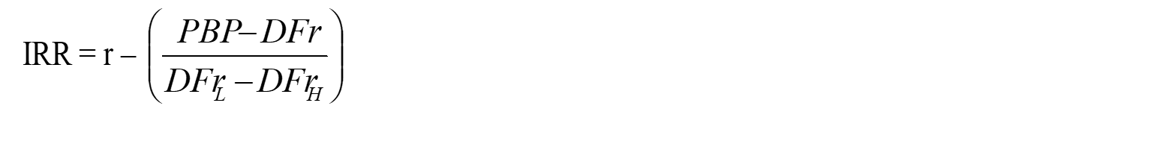
Cont…,
Step 3: Compute the actual IRR using the following formula:
Where:
r = either of the two interest rates (15% or 16%)
DFr = Discount factor for the taken interest rate
DFr_{L} = Discount factor for the lower interest rate
DFr_{H} = Discount factor for the higher interest rate

Slide 55
Cont…,
Let's take r = 15%, IRR is determined as follows:
= 15% - (-0.24)
= 15.24%
If we take r = 16%, the computation of IRR looks like the following:
= 15.24%

Slide 56
Cont…,
b) Determination of IRR when net cash flows are non- annuity
The steps followed in the preceding section are equally applicable for non-annuity cash flows.
However, one step is added at the beginning to determine the weighted average net cash flow, which will be used to determine the leading discount factor.

Slide 57
Cont…,
To illustrate, assume that a project has initial investment of Br. 40,000 and the following net cash flows: year 1, Br. 15,000; year 2, Br. 10,000; year 3, Br. 10,000; year 4, Br. 15000; and year 5, Br. 15,000.
The discount rate is 15%.
The following steps can be used to compute IRR:

Slide 58
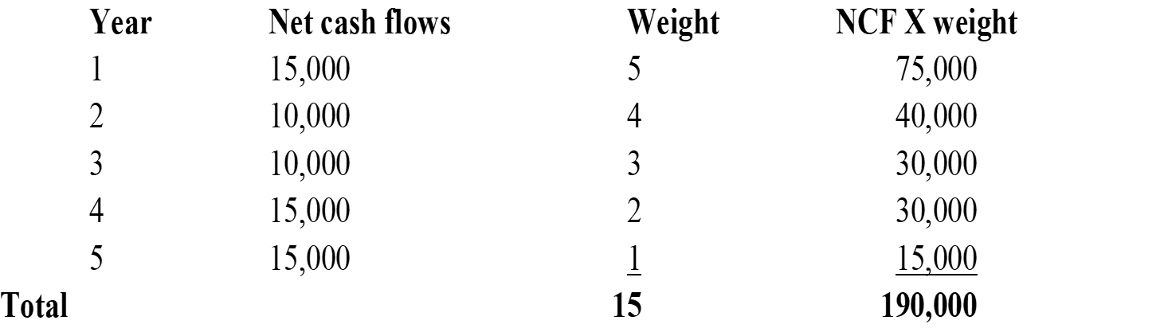
Cont…,
Step 1. Compute the weighted average net cash flows.
Note that the weight is assigned in the reverse order of the project's useful life.

Slide 59
Cont…,
Step 2: Compute the leading discount factor (PBP)
Step 3: From the present value of annuity table, find the starting rate (a good 1st guess) by looking for the closest interest rate and discount factor.
In this case, the nearest rate is 18%.

Slide 60
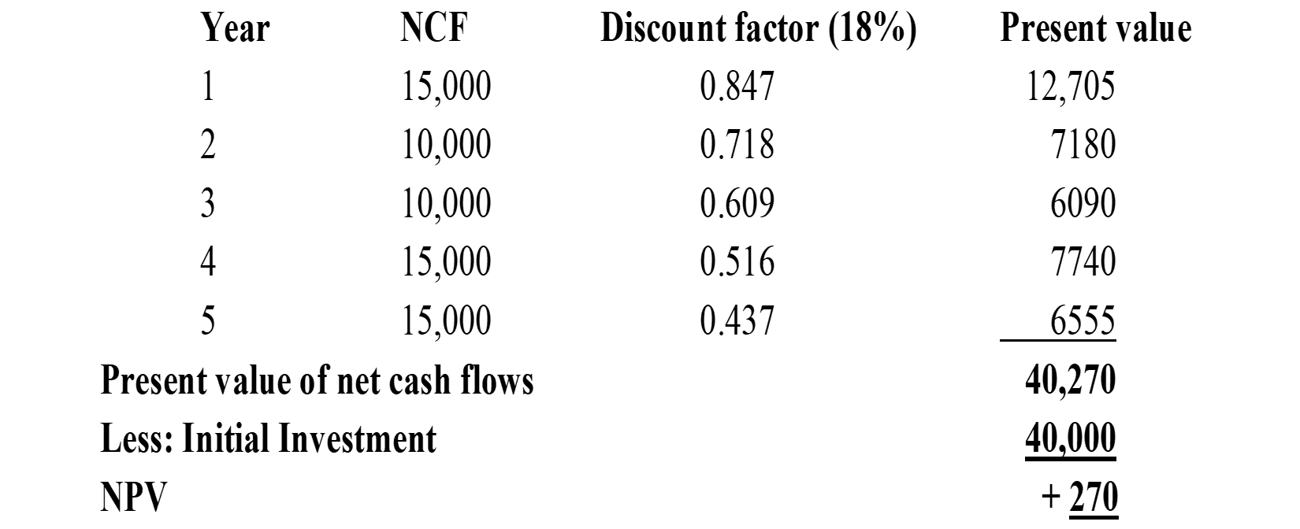
Cont…,
Step 4: Compute NPV at the 1st guess (18%) NPV (18%)

Slide 61
Cont…,
Since, at IRR, NPV is equal to zero, 18% is not the exact IRR. Thus, another rate should be tried.
Which rate should be tried next? Generally as we go down (in rate decreasing direction), discount factor increases.
Now we need to find a rate at which NPV = 0.
Thus, we should try a higher rate.
The next (2nd) guess could be 19%.

Slide 62
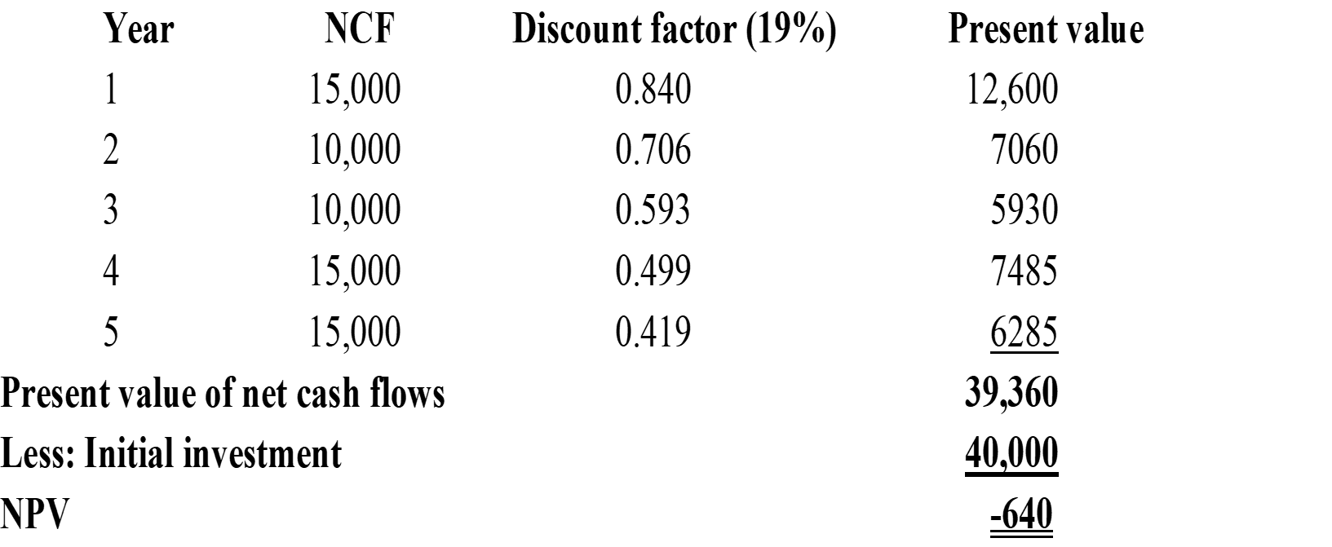
Cont…,
Then NPV should be computed at 19% using the above procedure.

Slide 63
Cont…,
At 19% NPV is negative, this implies that IRR lies between 18% & 19%.
Thus, such iteration process ends when two neighboring rates, at lower rate NPV is positive and at higher rate is negative.
To find the exact IRR, steps 4 and 5 will be followed:
Step 4: Obtain the absolute sum of the two present values
Sum = |+270| + |-640|
= 270 + 640
= 910

Slide 64
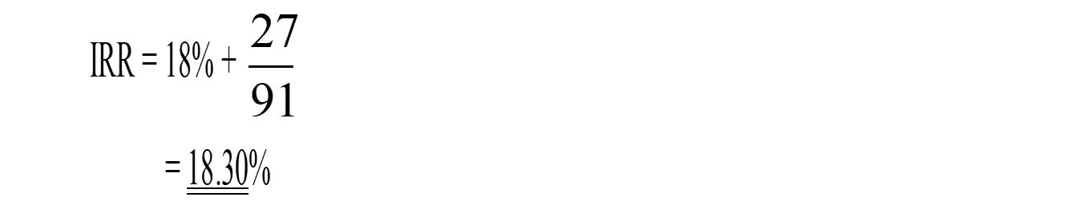
Cont…,
Step 5: Divided the NPV of the smaller rate by the absolute sum and add to the smaller rate
Decision Rule for IRR
Accept: If the IRR is greater than the discount rate
Reject: If the IRR is less than the discount rate

Slide 65
Cont…,
3. Profitability Index (PI)
The profitability index, also called benefit - cost ratio, is the ratio of the present value of net cash flows and initial investment.
To illustrate, assume that a project is expected to have initial investment and useful life of Br. 90,000 and four years respectively.

Slide 66

Cont…,
Annual net cash flows amounted to Br. 40,000 and the discount rate is 10%.
Profitability index can be computed as follow:

Slide 67
Cont…,
Decision rule for profitability Index
Accept if the project's profitability index is greater than 1
Reject if the project's profitability index is less than 1

Slide 68
Sensitivity Analysis
Sensitivity analysis is a techniques applied to uncertainties.
These uncertainties are factors affecting project outcomes, which cannot be quantified.
The purpose of sensitivity analysis is to tell us the factors, which are liable to have the greatest influence over project success and failure.

Slide 69
Cont…,
Once these factors have been identified it is then possible to deign appropriate mitigation measures.
Sensitivity analysis (sometimes called ‘what if’ analysis) shows how the NPV or other criterion of merit changes with variations in the value of any variable (sales volume, selling price per unit, cost per unit etc.).

Slide 70
Cont…,
It consists of testing the sensitivity of the NPV or IRR to changes of basic variables and parameters that enter the project’s input and output streams.
It generally involves considering the effect on the NPV of plausible variations in some of the inputs.
The purpose of the sensitivity analysis is:
To enhance our understanding of the structure and working of the project;

Slide 71
Cont…,
To guide us in the design of the project so that high NPV or IRR are obtained;
To suggest areas and means by which risk can be reduced.
The key variables whose variations should be studied will be different from project to project.
The variable that is most commonly varied in sensitivity analysis are:
Discount rate/ interest rate;

Slide 72
Cont…,
Total investment costs;
Implementation times;
Output levels and prices;
The volume of demand;
The level of capacity; and
Operating cost & etc.

Slide 73
Cont…,
This is done to determine the sensitivity of the estimated NPV to changes in these variables.
This should provide those planning and managing projects with ideas about the areas that need to be studied in more depth or where actions may be required to protect the project.

