Slide 1
Chapter- 4:Project Implementation, Monitoring and Evaluation
Monitoring and Evaluation
Monitoring and evaluation are essential management tools which help to ensure that project activities are implemented as planned and to assess whether desired results are being achieved.

Slide 2
Cont…
Monitoring is a process of measuring, recording, collecting and analyzing data on actual implementation of the project and communicating it to the project managers.
So that any deviation from the planned operations are detected, analysis for causes of deviation is carried out and suitable corrective actions are taken.

Slide 3
Cont…
Monitoring is a long-term / on going process in order to ensure whether activities are taking place according to standards and to find out weaknesses within the project.
Monitoring is activity based.
Monitoring is the continuous, systematic and critical review of operations in order to measure their evolution and adjust them according to circumstances and project’s objectives.

Slide 4
Cont…
The purpose of monitoring are to;
  provide concurrent feedback on the progress of activities
  Identify the problems in their implementation
  To promote accountability* to all stakeholders of a project (project agents , donors, etc) and to take corrective action

Slide 5
Cont…
Thus in the process of Monitoring;
  Any deviations from plans would be detected
  The causes for deviations would be Identified
  Corrective action would be taken

Slide 6
Different steps of project’s monitoring
..
3
1
2
4
The project
Collecting data
Processing/Arranging data
Taking decisions
Analysis
Taking corrective action
5

Slide 7
Cont…
Evaluation: is after the end or at mid-term of the Project to find out the weakness and the results of the project.
It is a systematic way of learning from experience and using the lessons learnt to improve current activities and promote better planning by careful selection of alternatives for future action.

Slide 8
Cont….
Evaluation can be used as a point of reference for future projects.
Evaluation involves external people.
Evaluation is a one or two time event (always happens at the end of the project).
Evaluation is result based ; measures the results through indicators.

Slide 9
Cont…
Evaluation involves the same skills as assessment and analysis.
Evaluation should be done neutrally and preferably by external staff.
One of the most important sources of information for evaluations may be data used for monitoring.

Slide 10
Reasons for carrying out an Evaluation
To review the implementation of and services provided by project so as to identify problems.
To document results achieved by a project funded by donor agencies.
To know whether desired outcomes are being achieved and identify remedial measures.
To assess whether the desired results of a project have been achieved

Slide 11
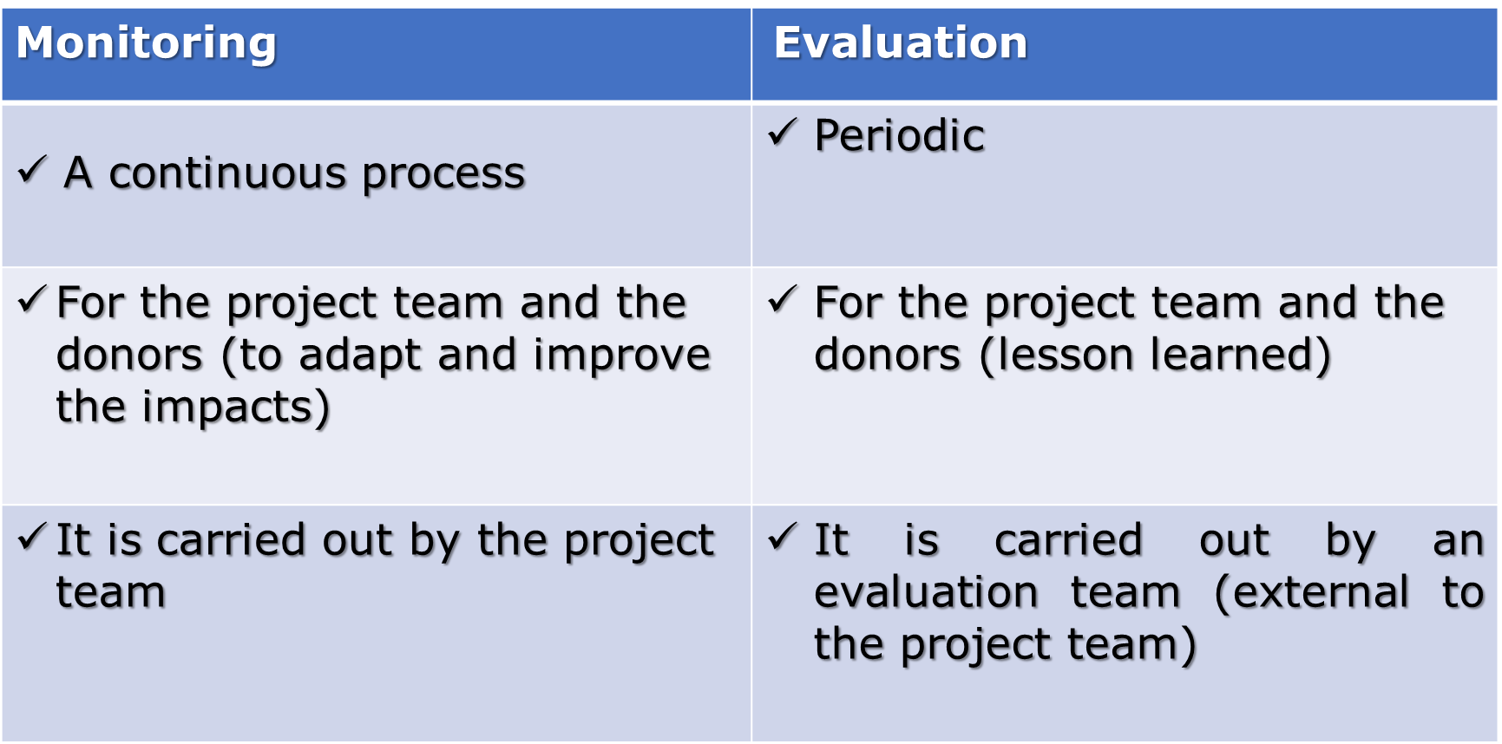
Cont…

Slide 12
Types of Evaluation
Formative
  “Improve”
  Periodic and timely
  Focus on project activities and outputs
  Leads to early recommendations for project improvement
Summative
  “Prove”
  Focus on outcomes and impact

Slide 13
Process of Evaluation
The process of evaluation consists of the following components:
Specify the particular subjects
Information support
Verify relevance
Assess adequacy
Review progress
Assess efficiency (cost - effectiveness)
Assess effectiveness

Slide 14
Chapter 5: Evaluation; Basics of impact evaluation
What is impact evaluation?
By ‘impact’ we mean the broad or longer-term effects of a project.
This can include effects on people who are direct users of a project, effects on those who are not direct users, or effects on a wider field such as government policy.

Slide 15
Cont…
Impact evaluation is an effort to understand whether the changes in well-being are indeed due to project intervention.
Specifically, impact evaluation tries to determine whether it is possible to identify the project effect and to what extent the measured effect can be attributed to the project and not to some other causes.

Slide 16
Cont…
The basic organizing principle for any good evaluation of an intervention is to ask the question: what would have happened in the absence of the intervention? or
What would have been the welfare levels of particular communities, groups, households and individuals without the intervention?

Slide 17
Quantitative versus Qualitative Impact Assessments
Governments, donors, and other practitioners in the development community are intense to determine the effectiveness of project with far-reaching goals such as lowering poverty or increasing employment.
These policy missions are often possible only through impact evaluations based on hard evidence from survey data or through related quantitative approaches.

Slide 18
Cont…
Qualitative: Qualitative information such as understanding the local sociocultural context, and participant details.
Qualitative information can help to identify mechanisms through which project might be having an impact.

Slide 19
Cont…
Quantitative: quantitative information that is important in addressing potential statistical bias in project impacts.
Therefore , a mixture of qualitative and quantitative methods (a mixed-methods approach) are useful in gaining a comprehensive view of the project’s effectiveness.

Slide 20
Quantitative Impact Assessment: Ex post versus Ex- ante Impact Evaluation
There are two types of quantitative impact evaluations: ex post and ex ante.
An ex ante impact evaluation attempts to measure the intended impacts of future project, given a potentially targeted area’s current situation.

Slide 21
Cont…
Many times, ex ante evaluations are based on structural models of the economic environment facing potential participants.
The underlying assumptions of structural models, for example, involve identifying the main economic agents in the development of the project (individuals, communities, local or national governments).

Slide 22
Cont…
These models predict project impacts.
Ex post evaluations, in contrast, measure actual impacts accrued by the beneficiaries that are attributable to project intervention.

Slide 23
Methodologies in impact evaluation
Randomizations
Reading assignment
2. Matching methods

