Slide 1
Debre Tabor University Faculty of Business and Economics Department of Management MBA Program- Extension 2012
Module Name: Research in Management
Course Title: Business Research Methodology
Credit Hour: 2 = 32 hours
Number of Chapters = 8 chapters
Assessment Method = Ass #1= Research critics = 10%
Ass #2= Term paper / mini research = 20%
Ass #3= Test = 20%
Ass #4= Final Exam = 50%
Total= 100%
Expected Attendance: 80%

Slide 2
Contents of the first Chapter
Meanings of Research
General Purpose of the research
Motivation of doing Research
Research philosophy
Criteria of Good Research
Types of Research
Ethics in research
Research Process

Slide 3
1.1. What is Research?
Literally, research is a word with two component parts i.e “re” and “search”. In which “re” means again and “search” means to examine carefully, to find, to test, to try.
Research is a noun that stands for careful and systematic investigation of situations to establish facts and principles.

Slide 4
Cont…
Research is an organized inquiry carried out to provide information for the solution of a problem.
Research is an organized and systematic way of finding answers to questions about reality.
Research is the process of identifying problems, collecting data, organizing data, analyzing and interpreting data, and finding solutions to a problem.
Research is identifying the relationship between variables, develop scientific facts, theories and principles that may predict future occurrences based on existing evidence.

Slide 5
What is Business Research?
Business research is an organized, systematic, critical, objective, scientific enquiry or investigation into a specific problem undertaken with the purpose of finding answers or solutions.
In essence , research provides the needed information that guides managers to make informed decisions to successfully deal with problems.

Slide 6
Cont’d...
Business research can be described as a systematic and organized effort to investigate specific problem encountered in the work setting, which needs a solution.
It comprises a series of steps that are designed and executed with the goal of finding answers to the issues that are of concern to the manager in the work environment.

Slide 7
1.2. General Purpose of the research
Since research is goal oriented, any research activity could aim at one or more of the following purposes.
To solve practical problems
To bridge the gap between theory and practice
To improve policy making
To develop theory

Slide 8
1.3 Motivation of Doing Research
What makes people to undertake research? This is a question of fundamental importance. The possible motives for doing research may be either one or more of the following:
Desire to get a research degree along with its consequential benefits;
Desire to face the challenge in solving the unsolved problems, i.e., concern over practical problems initiates research;
Desire to get intellectual joy of doing some creative work;
Desire to provide service to society;
Desire to get respectability.

Slide 9
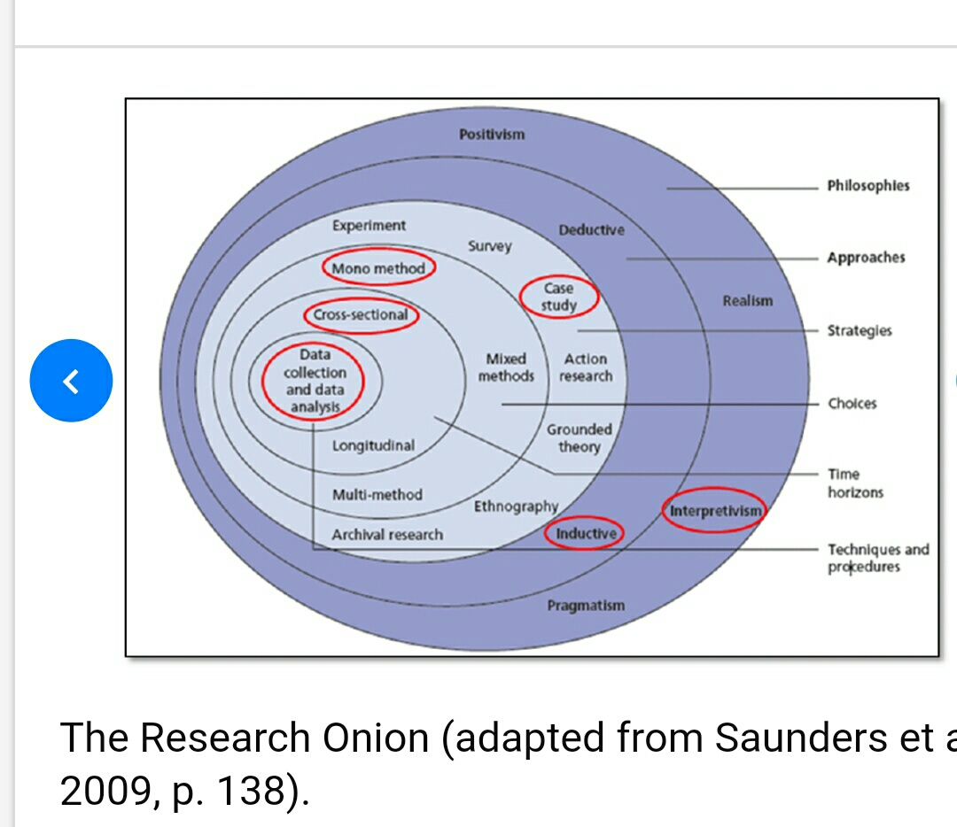
Saunders Research Onion-2009

Slide 10
1.4. Research Philosophy
Philosophy determines the place where we stand when observing the world phenomenon.
In order to decide the philosophy of the research overview of the philosophical theory of knowledge (epistemology) are vital.

Slide 11
Cont’d...
The philosophical theory of knowledge was started in Greece at the time of Plato.
In the earlies period, religion was considered as the source of knowledge appealing God as the source of knowledge and the Scriptures as its proof.
Meanwhile, the proponents of rationalism and empiricism become uncomfortable with religion as a source of knowledge.

Slide 12
Cont’d...
Rationalism; The proponents of rationalism relies on reason as the only source of true knowledge derived from certain fundamental truth by means of a priori argument. E.g. Law philosophy
Empiricism; The proponents of empiricism relies on experience as the only source of true knowledge derived from certain fundamental truth by means of a posteriori argument. E.g. Newton’s discovery

Slide 13
Cont’d...
There is no universally accepted procedure of knowledge inquiry has been developed yet.
In the contemporary approach, positivism and interpretivism were introduced as the two major paradigms of scientific realism.

Slide 14
Positivism
Positivism thinkers holds that the goal of knowledge is simply to describe the phenomenon based on experience through observation and measurement.
It is strongly related to empiricism in the idea that observation and measurement are fundamental for discovery.

Slide 15
Interpretivism
It is also called post positivism.
It is recent and emphasize perception of reality from different angles.
It assumes that objectivity is not perfect but it is approximate.

Slide 16
Paradigms in the Epistemological Development
Positivism
Quantitative
Focuses on precisely measurable aspect of reality
Interpretivism
Qualitative
Focuses on attributes

Slide 17
1.5 Types of Research
Descriptive vs. Analytical:
Descriptive research includes surveys and fact-finding enquiries of different kinds.
The major purpose of descriptive research is description of the state of affairs as it exists at present.
In social science and business research we quite often use the term Ex post facto research for descriptive research studies.
The main characteristic of this method is that the researcher has NO control over the variables; he can only report what has happened or what is happening.

Slide 18
Cont’d...
Most ex post facto research projects are used for descriptive studies in which the researcher seeks to measure such items as, for example, frequency of shopping, preferences of people, or similar data.
Ex post facto studies also include attempts by researchers to discover causes even when they cannot control the variables.
The methods of research utilized in descriptive research are survey methods of all kinds, including comparative and correlational methods.
In analytical research, on the other hand, the researcher has to use facts or information already available, and analyze these to make a critical evaluation of the material.

Slide 19
Applied vs. Fundamental:
Research can either be applied (or action) research or fundamental (to basic or pure) research.
Applied research aims at finding a solution for an immediate problem facing a society or an industrial/business organisation, whereas
Fundamental research is mainly concerned with generalisations and with the formulation of a theory. “Gathering knowledge for knowledge’s sake is termed ‘pure’ or ‘basic’ research.”
Research concerning some natural phenomenon or relating to pure mathematics are examples of fundamental research.

Slide 20
Cont’d...
Similarly, research studies, concerning human behaviour carried on with a view to make generalisations about human behaviour by academicians, are also examples of fundamental research, but research aimed at certain conclusions (say, a solution) facing a concrete social or business problem is an example of applied research.

Slide 21
Quantitative vs. Qualitative:
Quantitative research is based on the measurement of quantity or amount. It is applicable to phenomena that can be expressed in terms of quantity.
Qualitative research, on the other hand, is concerned with qualitative phenomenon, i.e., phenomena relating to or involving quality or kind.
For instance, when we are interested in investigating the reasons for human behaviour (i.e., why people think or do certain things), we quite often talk of ‘Motivation Research’, an important type of qualitative research.

Slide 22
Conceptual vs. Empirical:
Conceptual research is that related to some abstract idea(s) or theory. It is generally used by philosophers and thinkers to develop new concepts or to reinterpret existing ones.
Empirical research relies on experience or observation alone, often without due regard for system and theory. It is data-based research, coming up with conclusions which are capable of being verified by observation or experiment.
It is also called experimental research. In such a research it is necessary to get at facts first hand, at their source, and actively to go about doing certain things to stimulate the production of desired information.

Slide 23
Some Other Types of Research:
Form the point of view of time, we can think of research either as;
One-time research or longitudinal research
Field-setting research or laboratory research
Exploratory research or explanatory research
Conclusion-oriented or decision-oriented
Historical research or Predictive research

Slide 24
1.6 The hallmarks of scientific research
The following are the distinguishing characteristics of scientific research
Purposiveness
Rigor
Testability
Replicability
Precision and confidence
Objectivity
Generalizability
Parsimony

Slide 25
Cont’d ….
1. Purposiveness : research started with definite purpose. E.g to increase employee commitment
2. Rigor: good theoretical base and methodological design add Rigor to the purpose of the study. Rigor connotes carefulness. If we used inappropriate sample for example our conclusions will be misleading
3. Testability : scientific research tends itself to testing logically developed hypothesis to see whether or not the data support our hypothesis

Slide 26
Cont’d….
4. Replicability: we can find the same result if we conduct the same method (data collection) in some other organization.
E.g if we get a result that participation in decision making has positive impact of the commitment of the employees. We could find the same result in other organization.
5. Precision and confidence:
precision means closeness of findings to reality based on sample. It is the confidence interval. (E.g. estimation of defects : between 30 & 40 and 20 &50 which one is more precise).

Slide 27
Cont’d….
6. Confidence refers to the probability of our estimate are correct. It is not merely enough to be precise, but it is also important that we can confidently claim that 95% of the time our results will be true and there is only 5% chance of wrong.
The narrower the limits in which we estimate (more precise our findings) and the greater confidence we have in our study.
In social science researches 95% cl is good. The greater precision and confidence, the more scientific our study.

Slide 28
Cont’d…
7. Objectivity : the conclusions drawn through interpretation of the results of data analysis should be based on facts of findings from actual data not on our subjective /emotional values.
8. Generalizability: it is the scope of the applicability of the findings of the study in other organization. If we used appropriate methodology and design (sampling design and data collection methods) the result well be more generalizable.

Slide 29
Cont’d….
9. Parsimony: it is incorporating lesser number of variables that explain the variance far more efficiently than a complex set of variable that only marginally add to the variance explained.

Slide 30
Ethics in Research
In the early period conducting study on animals for human problem was common, but now it is becoming un ethical on the side of animal right protections group.
Conducting a study on humans have also an ethical issue.

Slide 31
Ethical Issues in Conducting Study
Informed consent: the potential participants of the research should always be informed in advance about the procedures, risk, potential benefit, inconvenience and obligations associated with the research.
Voluntary Participation: the participants of the research should be willing to be incorporated in the study and they have the right to withdraw at an time, at any data.

Slide 32
Cont’d….
3. Professional Integrity: the researcher has to respect the professional code of conducts and respect guidelines of a project. He/ she must be honest about the purpose and content of the research.
E.g health related studies and business secrets.
4. Duty to avoid harm: researchers must protect participants from risks of any harm either physically or psychologically from any personal or organizational attacks that raised because of the research.

Slide 33
Cont’d….
5. Confidentiality: except written consent is given, researchers should respect and preserve the confidentiality of participants identities and data at all times.
Researchers shall not allow third party who is not directly concerned with the result of the study to access information from participants.
6. Right to service: researchers has to organize a process of remedy when service is to be cut from control group from experimentation. Because respondents has a right for equal access to service.
.

Slide 34
1.8. The Research Process
Before embarking on the details of research methodology and techniques, it seems appropriate to present a brief overview of the research process.
Research process consists of series of actions or steps necessary to effectively carry out research and the desired sequencing of these steps.
The chart shown in the next Figure well illustrates a research process.

Slide 35
Fig 1: The Research Process
Research process consists of series of actions or steps necessary to effectively carry out research.
It is also classified in to initial phase, Middle Phase and Final Phase.
Review concepts and theories
Define research problem
Formulate hypotheses
Or
research Question
Design research (proposal)
Collect data
Analyse data
Interpret and report
Review previous Literatures

Slide 36
Cont…d

Slide 37
Cont’d….
1) Formulating the research problem;
(2) Extensive literature survey;
(3) Developing the hypothesis;
(4) Preparing the research design;
(5) Determining sample design;
(6) Collecting the data;
(7) Execution of the project;
(8) Analysis of data;
(9) Hypothesis testing;
(10) Generalizations and interpretation, and
(11) Preparation of the report or presentation of the results,

Slide 38
Thank You for Your Attention

