Slide 1

Advanced Strategic Management
Chapter TWO
Strategy In action
BY: Yissa Hassen (Ph.D. Scholar)
March, 2020
Debre Tabor University, Ethiopia

Slide 2
contents
2.1 Types of strategies
2.2 Guidelines for pursuing strategies
2.3 Michael Porter’s generic strategies

Slide 3
Quote:
"Planning. Doing things today to make us better tomorrow. Because the future belongs to those who make the hard decisions today."
Eaton Corporation

Slide 4
2.1. Nature of Strategy
In its simplest conception strategy is regarded as a unifying idea which links purpose and action.
For de Wit and Meyer (1998), strategy is any course of action for achieving an organization’s purpose(s).
Chandler, (1962: 13), defined strategy as ‘a coordinated series of actions which involve the deployment of resources to which one has access for the achievement of a given purpose.’

Slide 5
Nature of Long-term Objectives
Long-term objectives represent the results expected from pursuing certain strategies. Strategies represent the actions to be taken to accomplish long-term objectives.
Objectives should be quantitative, measurable, realistic, understandable, challenging, hierarchical (needed at corporate, business and functional level), obtainable, and congruent among organizational units.
Objectives are commonly stated in terms such as growth in assets, growth in sales, profitability, market share, degree and nature of diversification, degree and nature of vertical integration, earnings per share, and social responsibility.

Slide 6
Benefits of Objectives
Clearly established objectives offer many benefits:
They provide direction, allow synergy, aid in evaluation, establish priorities, reduce uncertainty, minimize conflicts, stimulate exertion, and aid in both the allocation of resources and the design of jobs.
Objectives provide a basis for consistent decision making by managers whose values and attitudes differ.
Objectives serve as standards by which individuals, groups, departments, divisions, and entire organizations can be evaluated.

Slide 7
Financial Vs Strategic Objective
Financial objectives include those associated with growth in revenues, growth in earnings, higher dividends, larger profit margins, greater ROI higher earnings per share, a rising stock price, improved cash flow, and so on;
Strategic objectives include things such as a larger market share, quicker on-time delivery than rivals, shorter design-to-market times than rivals, lower costs than rivals, higher product quality than rivals, wider geographic coverage than rivals, achieving technological leadership, consistently getting new or improved products to market ahead of rivals, and so on.
These two types of objectives needs trade off, as focusing on one will harm an other one. ( E.g: Higher price to increase profits jeopardize the long-term market share.

Slide 8
Cont’d……
Many, if not most, organizations simultaneously pursue a combination of two or more strategies, but a combination strategy can be exceptionally risky if carried too far.
No organization can afford to pursue all the strategies that might benefit the firm.
Priority must be established.
Hansen and Smith explain that strategic planning involves “choices that risk resources” and “trade-offs that sacrifice opportunity.”

Slide 9
Cont’d……
In large diversified companies, a combination strategy is commonly employed when different divisions pursue different strategies.
Also, organizations struggling to survive may simultaneously employ a combination of several defensive strategies, such as divestiture, liquidation, and retrenchment.

Slide 10
Levels of Strategies
In large firms, the persons primarily responsible for having effective strategies at the various levels include:
The CEO at the corporate level;
The president or executive vice president at the divisional level;
The respective chief finance officer (CFO), chief information officer (CIO), human resource manager (HRM), chief marketing officer (CMO), and so on, the functional level; and
The plant manager, regional sales manager, and so on, at the operational level.
In small firms, the persons primarily responsible for having effective strategies at the various levels include the business owner or president at the company level and then the same range of persons at the lower two levels, as with a large firm.

Slide 11
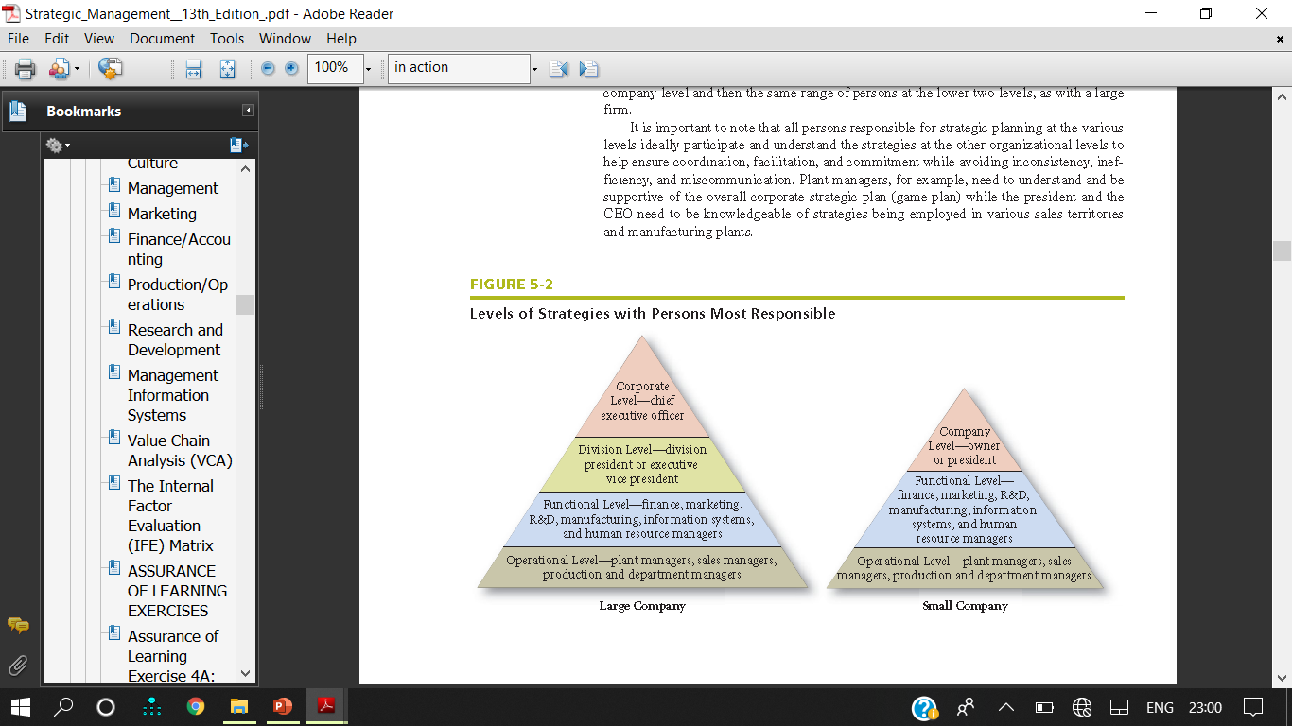
Cont’d……

Slide 12
Balanced Score Card (BSC)
What is BSC? Our university uses BSC in its planning, what are the perspectives?

Slide 13
Balanced Score Card (BSC)
Developed in 1993 by Harvard Business School professors Robert Kaplan and David Norton.
It is a strategy evaluation and control technique.
Balanced Scorecard derives its name from the perceived need of firms to “balance” financial measures that are oftentimes used exclusively in strategy evaluation and control with nonfinancial measures such as product quality and customer service.

Slide 14
Cont’d….
An effective Balanced Scorecard contains a carefully chosen combination of strategic and financial objectives tailored to the company’s business.
It serve as a tool to manage and evaluate strategy.
The overall aim of the Balanced Scorecard is to “balance” shareholder objectives with customer and operational objectives.
Obviously, these sets of objectives interrelate and many even conflict.
For example, customers want low price and high service, which may conflict with shareholders’ desire for a high return on their investment.
The Balanced Scorecard concept is consistent with the notions of continuous improvement in management (CIM) and total quality management (TQM).

Slide 15
Cont’d….
Financial measures and ratios are vitally important. However, of equal importance are factors such as customer service, employee morale, product quality, pollution abatement, business ethics, social responsibility, community involvement, and other such items.

Slide 16
Types of Strategies
Alternative strategies that an enterprise could pursue can be categorized into 11 actions:
Forward integration
Backward integration,
Horizontal integration,
Market penetration,
Market development,
Product development,
Related diversification,
Unrelated diversification,
Retrenchment
Divestiture and
Liquidation.

Slide 17
Integration Strategies
Forward Integration | Gaining ownership or increased control over distributors or retailers E.g. Microsoft opened 200 retail stores to compete with Apple Inc Ford has 4000 dealers Franchising is an option to implement easily
Backward Integration | Seeking ownership or increased control of a firm’s suppliers
Horizontal Integration | Seeking ownership or increased control over competitors

Slide 18
Intensive Strategies
Market Penetration | Seeking increased market share for present products or services in present markets through greater marketing efforts. Market penetration includes increasing the number of salespersons, increasing advertising expenditures, offering extensive sales promotion items, or increasing publicity efforts.
Market Development | Introducing present products or services into new geographic areas
Product Development | Seeking increased sales by improving present products or services or developing new ones

Slide 19
Diversification Strategies
Related Diversification | Adding new but related products or services
Unrelated Diversification | Adding new, unrelated products or services

Slide 20
Cont’d….
Most companies favor related diversification strategies in order to capitalize on synergies as follows:
Transferring competitively valuable expertise, technological know-how, or other capabilities from one business to another.
Combining the related activities of separate businesses into a single operation to achieve lower costs.
Exploiting common use of a well-known brand name.
Cross-business collaboration to create competitively valuable resource strengths and capabilities.
Diversification strategies are becoming less popular as organizations are finding it more difficult to manage diverse business activities.

Slide 21
Defensive Strategies
Retrenchment | Regrouping through cost and asset reduction to reverse declining sales and profit. Sometimes called a turnaround or reorganizational strategy. Retrenchment can entail selling off land and buildings to raise needed cash, pruning product lines, closing marginal businesses, closing obsolete factories, automating processes, reducing the number of employees, and instituting expense control systems.
Divestiture | Selling a division or part of an organization. It is often is used to raise capital for further strategic acquisitions or investments./ unprofitable, that require too much capital, or that do not fit well with the firm’s other activities. Divestiture has also become a popular strategy for firms to focus on their core businesses and become less diversified.
Liquidation | Selling all of a company’s assets, in parts, for their tangible worth. It is recognition of defeat

Slide 22
Reading Assignments
Discuss the guidelines to use the above 11 strategies.
(Source: Chapter Five Strategies in Action, Fred. R. David)

Slide 23
Porter’s Five Generic Strategies
Type 1 Cost Leadership – Low cost
Type 2 Cost Leadership – Best value
Type 3 Differentiation
Type 4 Focus – Low cost
Type 5 Focus – Best value

Slide 24
Cont’d……

Slide 25
Cont’d……
According to Porter, strategies allow organizations to gain competitive advantage from three different bases:
Cost Leadership,
Differentiation, And
Focus.

Slide 26
Cost Leadership
Cost leadership emphasizes producing standardized products at a very low per-unit cost for consumers who are price-sensitive. Two alternative types of cost leadership strategies can be defined.
Type 1 is a low-cost strategy that offers products or services to a wide range of customers at the lowest price available on the market.
Type 2 is a best-value strategy that offers products or services to a wide range of customers at the best price-value available on the market; the best-value strategy aims to offer customers a range of products or services at the lowest price available compared to a rival’s products with similar attributes.
Both Type 1 and Type 2 strategies target a large market.

Slide 27
Cont’d……
A primary reason for pursuing forward, backward, and horizontal integration strategies is to gain low-cost or best-value cost leadership benefits. But cost leadership generally must be pursued in conjunction with differentiation.
A number of cost elements affect the relative attractiveness of generic strategies, including economies or diseconomies of scale achieved, learning and experience curve effects, the percentage of capacity utilization achieved, and linkages with suppliers and distributors.

Slide 28
Cont’d…..
Low-cost producer in an industry can be especially effective when the market is composed of many price-sensitive buyers, when there are few ways to achieve product differentiation, when buyers do not care much about differences from brand to brand, or when there are a large number of buyers with significant bargaining power.
The basic idea is to under-price competitors and thereby gain market share and sales, entirely driving some competitors out of the market.

Slide 29
Cont’d……
When employing a cost leadership strategy, a firm must be careful not to use such aggressive price cuts that their own profits are low or non-existent.
Constantly be mindful of cost-saving technological breakthroughs or any other value chain advancements that could erode or destroy the firm’s competitive advantage.

Slide 30
Cont’d……
To employ cost leadership strategy successfully, a firm must ensure that its total costs across its overall value chain are lower than competitors’ total costs. There are two ways to accomplish this
Perform value chain activities more efficiently than rivals and control the factors that drive the costs of value chain activities. Such activities could include altering the plant layout, mastering newly introduced technologies, using common parts or components in different products, simplifying product design, finding ways to operate close to full capacity year-round, and so on.
Revamp the firm’s overall value chain to eliminate or bypass some cost-producing activities. Such activities could include securing new suppliers or distributors, selling products online, relocating manufacturing facilities, avoiding the use of union labor, and so on.

Slide 31
Differentiation
Differentiation does not guarantee competitive advantage, especially if standard products sufficiently meet customer needs or if rapid imitation by competitors is possible.
Durable products protected by barriers to quick copying by competitors are best.
Successful differentiation can mean greater product flexibility, greater compatibility, lower costs, improved service, less maintenance, greater convenience, or more features.

Slide 32
Cont’d……
A differentiation strategy should be pursued only after a careful study of buyers’ needs and preferences to determine the feasibility of incorporating one or more differentiating features into a unique product that features the desired attributes.
A successful differentiation strategy allows a firm to charge a higher price for its product and to gain customer loyalty because consumers may become strongly attached to the differentiation features.

Slide 33
Cont’d……
Special features that differentiate one’s product can include superior service, spare parts availability, engineering design, product performance, useful life, gas mileage, or ease of use.
The risk associated with differentiation is the unique product may not be valued highly enough by customers to justify the higher price and the competitors easily copied the unique feature.

Slide 34
Focus….
Focus strategies are most effective when consumers have distinctive preferences or requirements and when rival firms are not attempting to specialize in the same target segment.
However the risks of pursuing a focus strategy include the possibility that numerous competitors will recognize the successful focus strategy and copy it or that consumer preferences will drift toward the product attributes desired by the market as a whole.

Slide 35
Reading Assignment II
Discuss the especially attractive conditions in which each porter’s five generic strategies will be effective.

Slide 36
Means For Achieving Strategies
Cooperation Among Competitors
Joint Venture
Merger/Acquisitions
First Mover Advantages
Outsourcing

Slide 37
Cooperation Among Competitors
Strategies that stress cooperation among competitors are being used more.
For collaboration between competitors to succeed, both firms must contribute something distinctive, such as technology, distribution, basic research, or manufacturing capacity.
Learning from the partner is a major reason for cooperation why Asian and European firms enter into cooperative agreements.

Slide 38
Cooperation Among Competitors
E.g. Star alliance has 25 airlines, OneWorld Alliance has 10 SkyTeam Alliance has 15 airlines. Firms are moving to compete as groups within alliances more and more as it becomes increasingly difficult to survive alone in some industries.
Google’s YouTube and Vivendi SA’s Universal Music Group have formed a partnership called Vevo to provide a new music-video service. Google provides the technology and Universal Music provides the content, and both firms share the revenues. The two firms now operate the stand-alone site Vevo.com.
However, it may lead to lose core competencies and become a rival later.
As the manufacturing excellence of Asian firms can not be easily compared to US companies, US firms should need to be careful not to give away more intelligence than they receive in cooperative agreements with rival Asian firms.

Slide 39
Joint Venture/Partnering
Joint venture is a popular strategy that occurs when two or more companies form a temporary partnership or consortium for the purpose of capitalizing on some opportunity. Often, the two or more sponsoring firms form a separate organization and have shared equity ownership in the new entity.
Other types of cooperative arrangements include research and development partnerships, cross-distribution agreements, cross-licensing agreements, cross-manufacturing agreements, and joint-bidding consortia.

Slide 40
Cont’d….
Joint ventures and cooperative arrangements are being used increasingly because they allow companies to improve communications and networking, to globalize operations, and to minimize risk.
Joint ventures and partnerships are often used to pursue an opportunity that is too complex, uneconomical, or risky for a single firm to pursue alone.

Slide 41
Cont’d….
In a global market tied together by the Internet, joint ventures, and partnerships, alliances are proving to be a more effective way to enhance corporate growth than mergers and acquisitions.
Strategic partnering takes many forms, including outsourcing, information sharing, joint marketing, and joint research and development. Many companies, such as Eli Lilly, now host partnership training classes for their managers and partners.
There are today more than 10,000 joint ventures formed annually, more than all mergers and acquisitions.
A major reason why firms are using partnering as a means to achieve strategies is globalization.

Slide 42
Merger/Acquisition
Merger and acquisition are two commonly used ways to pursue strategies. A merger occurs when two organizations of about equal size unite to form one enterprise. An acquisition occurs when a large organization purchases (acquires) a smaller firm, or vice versa.
When a merger or acquisition is not desired by both parties, it can be called a takeover or hostile takeover.
In contrast, if the acquisition is desired by both firms, it is termed a friendly merger. Most mergers are friendly.
However, many mergers and acquisitions fail because of several reasons. ?????

Slide 43
Key Reasons Why Many Mergers
And Acquisitions Fail
• Integration difficulties
• Inadequate evaluation of target
• Large or extraordinary debt
• Inability to achieve synergy
• Too much diversification
• Managers overly focused on acquisitions
• Too large an acquisition
• Difficult to integrate different organizational cultures
•Reduced employee morale due to layoffs and relocations

Slide 44
First Mover Advantages
First mover advantages refer to the benefits a firm may achieve by entering a new market or developing a new product or service prior to rival firms.
Some advantages of being a first mover include securing access to rare resources, gaining new knowledge of key factors and issues, and carving out market share and a position that is easy to defend and costly for rival firms to overtake.
To sustain the competitive advantage gained by being the first mover, such a firm also needs to be a fast learner. There would, however, be risks associated with being the first mover, such as unexpected and unanticipated problems and costs that occur from being the first firm doing business in the new market. Therefore, being a slow mover (also called fast follower or late mover) can be effective when a firm can easily copy or imitate the lead firm’s products or services.
Apple Inc. has always been a good example of a first mover firm.

Slide 45
Outsourcing
Business-process outsourcing (BPO) is a rapidly growing new business that involves companies taking over the functional operations, such as human resources, information systems, payroll, accounting, customer service, and even marketing of other firms.
Companies are choosing to outsource their functional operations more and more for
several reasons:
It is less expensive,
It allows the firm to focus on its core businesses,
It enables the firm to provide better services.
Other advantages of outsourcing are that the strategy
Allows the firm to align itself with “best-in-world” suppliers who focus on performing the special task,
Provides the firm flexibility should customer needs shift unexpectedly, and
Allows the firm to concentrate on other internal value chain activities critical to sustaining competitive advantage. BPO is a means for achieving strategies that are similar to partnering and joint venturing.

Slide 46
Reading Assignment III
Discuss the advantages of merger/acquisition, first mover
Discuss strategic Management in Non-profit and Governmental Organizations and small organization

Slide 47
Thank You!
Any Questions
Welcome!!!

