Slide 1
ADVANCED STRATEGIC MANAGEMENT
Chapter One
OVERVIEW OF STRATEGIC MANAGEMENT
By: Yissa (Ph.D. Scholar)
March, 2020
Debre Tabor, Ethiopia

Slide 2
Contents
Meaning of Strategic Management
Stages of Strategic Management
Key terms in strategic management
The strategic management model
Benefits of strategic management
Business ethics and strategic management

Slide 3
1.1. What is Strategic Management (SM)
SM can be defined as the art and science of formulating, implementing, and evaluating cross-functional (HR, R&D, Production, marketing, finance…) decisions that enable an organization to achieve its objectives.
According to Pearce and Robinson- “Strategic Management is defined as the set of decisions and action in formulation and implementation of strategies designed to achieve the objectives of an organization”.
According to Stoner and Freeman- “Strategic Management is distinct management process that involves an organization engaging in strategic planning and then acting on those plans”.

Slide 4
Cont’d…..
According to Jauch and Glueck- “Strategic Management is a stream of decisions and action which lead to the development of an effective strategy or strategies to help achieve corporate objectives.
The strategic management process is the way in which strategists determine objectives and make strategic decisions”.
The purpose of strategic management is to exploit and create new and different opportunities for tomorrow;

Slide 5
1.2. Stages of Strategic Management
The strategic-management process consists of three stages:
Strategy formulation,
Strategy implementation, and
Strategy evaluation.

Slide 6
Strategy formulation
Strategy formulation includes:
Developing a vision and mission,
Identifying an organization’s external opportunities and threats,
Determining internal strengths and weaknesses,
Establishing long-term objectives, generating alternative strategies, and choosing particular strategies to pursue.
Strategy-formulation issues include deciding what new businesses to enter, what businesses to abandon, how to allocate resources, whether to expand operations or diversify, whether to enter international markets, whether to merge or form a joint venture, and how to avoid a hostile takeover.

Slide 7
Cont’d…..
Because no organization has unlimited resources, strategists must decide which alternative strategies will benefit the firm most.
Strategy-formulation decisions commit an organization to specific products, markets, resources, and technologies over an extended period of time.
Strategies determine long-term competitive advantages.

Slide 8
Strategy Implementation
Strategy implementation requires a firm to establish annual objectives, devise policies, motivate employees, and allocate resources so that formulated strategies can be executed.
Strategy implementation includes developing a strategy-supportive culture, creating an effective organizational structure, redirecting marketing efforts, preparing budgets, developing and utilizing information systems, and linking employee compensation to organizational performance.

Slide 9
Cont’d…..
It is the “action stage” and often considered to be the most difficult stage of strategic management which needs mobilizing employees and managers to put formulated strategies into action.
It personal discipline, commitment, and sacrifice (i.e., Interpersonal skills are especially critical for successful SI).
Successful strategy implementation depends upon managers’ ability to motivate employees, which is more an art than a science.

Slide 10
Cont’d…..
Every division and department must decide on answers to questions, such as
“What must we do to implement our part of the organization’s strategy?” and
“How best can we get the job done?”
The challenge of implementation is to stimulate managers and employees throughout an organization to work with pride and enthusiasm toward achieving stated objectives.

Slide 11
Strategy evaluation
Strategy evaluation is the final stage in strategic management.
It is a means for obtaining information on particular strategies are not working well; .
Three fundamental strategy-evaluation activities are
Reviewing external and internal factors that are the bases for current strategies,
Measuring performance, and
Taking corrective actions

Slide 12
Why strategic evaluation is needed?
All strategies are subject to future modification because external and internal factors are constantly changing.
Strategy evaluation is needed because success today is no guarantee of success tomorrow! Success always creates new and different problems; complacent organizations experience demise.
Generally, Strategy formulation, implementation, and evaluation activities occur at three hierarchical levels in a large organization: corporate, divisional or strategic business unit, and functional.

Slide 13
1.3. Key Terms in Strategic Management
Before we further discuss strategic management, we should define key terms:
Competitive advantage,
Strategists,
Vision and mission statements,
External opportunities and threats,
internal strengths and weaknesses,
Long-term objectives,
strategies,
Annual objectives, and
policies.

Slide 14
Competitive Advantage (CA)
Strategic management is all about gaining and maintaining competitive advantage.
CA is defined as “anything that a firm does especially well compared to rival firms.”
When a firm can do something that rival firms cannot do, or owns something that rival firms desire, that can represent a competitive advantage.
E.g. having less fixed asset is CA during recession (Apple) b/ce it uses outsourcing as an option no longer debt where as Sony has many fixed asset with debts in its.

Slide 15
Cont’d…..
Normally, a firm can sustain a competitive advantage for only a certain period due to rival firms imitating and undermining that advantage. Thus it is not adequate to simply obtain competitive advantage.
A firm must strive to achieve sustained competitive advantage by:
Continually adapting to changes in external trends and events and internal capabilities, competencies, and resources; and
Effectively formulating, implementing, and evaluating strategies that capitalize upon those factors.

Slide 16
Cont’d…..
For instance internet to day allows firms to use E-commerce allows firms to sell products, advertise, purchase supplies, bypass intermediaries, track inventory, eliminate paperwork, and share information.
In total, e-commerce is minimizing the expense and cumbersomeness of time, distance, and space in doing business, thus yielding better customer service, greater efficiency, improved products, and higher profitability.

Slide 17
Strategists
Strategists are the individuals who are most responsible for the success or failure of an organization. (BOD, CEO, President, chancellor…). They have more authority in the organization.
Strategists help an organization gather, analyze, and organize information on industry and competitive trends, develop forecasting models and scenario analyses, evaluate corporate and divisional performance, spot emerging market opportunities, identify business threats, and develop creative action plans.

Slide 18
Vision and Mission Statements
Vision is a statement that answers the question “What do we want to become?”
Many vision statements are a single sentence. For example, the vision statement of Stokes Eye Clinic in Florence, South Carolina, is “Our vision is to take care of your vision.”
The vision statement should be established first and foremost.
Mission statements are “enduring statements of purpose that distinguish one business from other similar firms. A mission statement identifies the scope of a firm’s operations in product and market terms.”
Mission statement addresses the basic question that faces all strategists: “What is our business?” A clear mission statement describes the values and priorities of an organization.

Slide 19
External Opportunities and Threats
External opportunities and external threats refer to economic, social, cultural, demographic, environmental, political, legal, governmental, technological, and competitive trends and events that could significantly benefit or harm an organization in the future.
Any changes on the above are creating a different type of consumer and consequently a need for different types of products, services, and strategies
Opportunities and threats are largely beyond the control of a single organization—thus the word external.
SM and OT are highly linked

Slide 20
Internal Strengths and Weaknesses
Internal strengths and internal weaknesses are an organization’s controllable activities that are performed especially well or poorly.
They arise in the management, marketing, finance/accounting, production/operations, research and development, and management information systems activities of a business.
Organizations strive to pursue strategies that capitalize on internal strengths and eliminate internal weaknesses.

Slide 21
Long-Term Objectives
Objectives can be defined as specific results that an organization seeks to achieve in pursuing its basic mission.
Long-term means more than one year.
Objectives are essential for organizational success because they state direction; aid in evaluation; create synergy; reveal priorities; focus coordination; and provide a basis for effective planning, organizing, motivating, and controlling activities.

Slide 22
Annual Objectives
Annual objectives are short-term milestones that organizations must achieve to reach long-term objectives.
Annual objectives are especially important in strategy implementation, whereas long-term objectives are particularly important in strategy formulation.
Annual objectives stated in terms of functional (MKTING, R&D….) accomplishments and the basis for allocating resources.

Slide 23
Quote on strategy
"Without a strategy, an organization is like a ship without a rudder, going around in circles. It’s like a tramp; it has no place to go."
—Joel Ross and Michael Kami

Slide 24
Strategies
Strategies are the means by which long-term objectives will be achieved.
Business strategies may include geographic expansion, diversification, acquisition, product development, market penetration, retrenchment, divestiture, liquidation, and joint ventures.
Strategies are potential actions that require top management decisions and large amounts of the firm’s resources.

Slide 25
Reading Assignment
Discuss the features of successful strategy.
Discuss the origin of strategy.

Slide 26
Activity 1
Can you discuss how strategy is related to war and business?

Slide 27
Policies
Policies are guidelines to decision making and address repetitive or recurring situations.
Policies are the means by which annual objectives will be achieved. Policies include guidelines, rules, and procedures established to support efforts to achieve stated objectives.

Slide 28
1.4. The Strategic-Management Model
The strategic-management process can best be studied and applied using a model.
Every model represents some kind of process.
The framework illustrated in next figure is a widely accepted, comprehensive model of the strategic-management process.
This model does not guarantee success, but it does represent a clear and practical approach for formulating, implementing, and evaluating strategies.

Slide 29
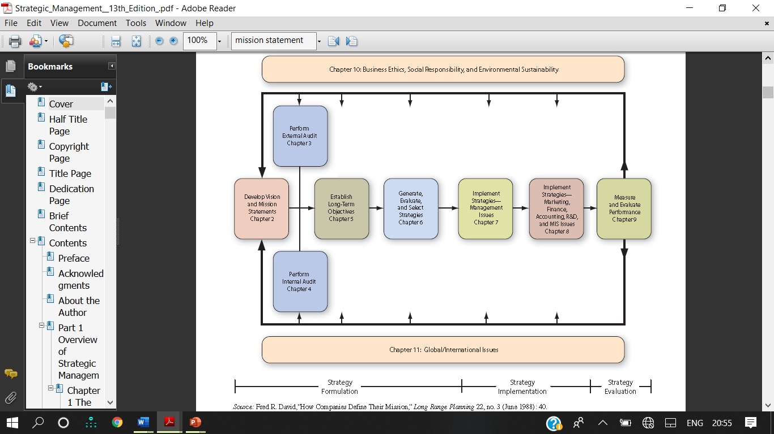
Cont’d…..

Slide 30
Cont’d…..
The strategic-management process is dynamic and continuous.
A change in any one of the major components in the model can necessitate a change in any or all of the other components.

Slide 31
1.5. Benefits of Strategic Management
Strategic management allows an organization to be more proactive than reactive in shaping its own future;
Organizations using strategic management will benefit both financial benefits (such as increased in sales, profitability, and productivity) and non-financial (such as an enhanced awareness of external threats, an improved understanding of competitors’ strategies, increased employee productivity, reduced resistance to change, and a clearer understanding of performance–reward relationships).

Slide 32
Cont’d…..
Greenly stated that strategic management offers the following benefits:
It allows for identification, prioritization, and exploitation of opportunities.
It provides an objective view of management problems.
It represents a framework for improved coordination and control of activities.
It minimizes the effects of adverse conditions and changes.
It allows major decisions to better support established objectives.
It allows more effective allocation of time and resources to identified opportunities.
It allows fewer resources and less time to be devoted to correcting erroneous or ad hoc decisions.

Slide 33
Cont’d…..
It creates a framework for internal communication among personnel.
It helps integrate the behavior of individuals into a total effort.
It provides a basis for clarifying individual responsibilities.
It encourages forward thinking.
It provides a cooperative, integrated, and enthusiastic approach to tackling problems and opportunities.
It encourages a favourable attitude toward change.
It gives a degree of discipline and formality to the management of a business.

Slide 34
Why some firms do no Strategic Planning?
Lack of knowledge or experience in strategic planning
Poor reward structures: ( Mrgs assume reward for success & punishment for Failures)
Firefighting: ( for crises and no time for planning)
Waste of time:
Too expensive (Time and Money)
Laziness ( not interested to engaged in planning)
Content with success (firms successful without plan, considers wastage)
Fear of failure ( lack of eagerness to invest time for planning

Slide 35
Why some firms do no Strategic Planning?
Overconfident:
Prior bad experience—long, cumbersome, impractical, or inflexible.
Self-interest: When someone has achieved status, privilege, or self-esteem through effectively using an old system, he or she often sees a new plan as a threat.
Fear of the unknown—People may be uncertain of their abilities to learn new skills, new systems, or new roles.
Honest difference of opinion
Suspicion—Employees may not trust Mgmt.

Slide 36
1.5. Business Ethics And Strategic Management.
Business ethics can be defined as principles of conduct within organizations that guide decision making and behavior.
Good business ethics is a prerequisite for good strategic management; good ethics is just good business.
Strategists such as CEOs and business owners are the individuals primarily responsible for ensuring that high ethical principles are espoused and practiced in an organization.
All strategy formulation, implementation, and evaluation decisions have ethical ramifications.

Slide 37
Cont’d……
Newspapers and business magazines daily report legal and moral breaches of ethical conduct by both public and private organizations.
Being unethical can be very expensive.
Business actions considered to be unethical include:
Misleading advertising or labeling, causing environmental harm, poor product or service safety, padding expense accounts, insider trading, dumping banned or flawed products in foreign markets, not providing equal opportunities for women and minorities, overpricing, moving jobs overseas, and sexual harassment.

Slide 38
Code of Business Ethics
It is a document that provides behavioral guidelines that cover daily activities and decisions within an organization.
A new wave of ethics issues related to product safety, employee health, sexual harassment, AIDS in the workplace, smoking, acid rain, affirmative action, waste disposal, foreign business practices, cover-ups, takeover tactics, conflicts of interest, employee privacy, inappropriate gifts, and security of company records has accentuated the need for strategists to develop a clear code of business ethics.
Internet fraud, hacking into company computers, spreading viruses, and identity theft are other unethical activities that plague every sector of online commerce.

Slide 39
Social Responsibility
Some strategists agree with Ralph Nader, who proclaims that organizations have tremendous social obligations.
Firms develop social policy concerns what responsibilities the firm has to employees, consumers, environmentalists, minorities, communities, shareholders, and other groups.
The impact of society on business and vice versa is becoming more pronounced each year.
Thus, Corporate social policy should be designed and articulated during strategy formulation, set and administered during strategy implementation, and reaffirmed or changed during strategy evaluation

Slide 40
Thank you Any Questions Welcome

