Slide 1
Chapter 7 – International Marketing
  Meaning of International Marketing.
  Benefits of International Marketing.
  Techniques of Entering in International Marketing.
  Firm’s Strategies to International Marketing.

Slide 2
1. Meaning of International Marketing.
International Marketing: is the performance of business activities designed to plan, price, promote, and direct the flow of a company’s goods and services to consumers or users in more than one nation for a profit.
International marketing: consists of finding and satisfying global customer needs better than the competition in both domestic and international, and of coordinating marketing activities within the constraints of the global environment. (Terpstra and Sarathy, 2000).

Slide 3
Cont…
The American Marketing Association (AMA):- defines the term international marketing as follows:
“International Marketing is the multinational process of planning and executing the conception, pricing, promotion and distribution of ideas, goods, and services to create an exchange tha1t satisfy individual and organizational objectives.“
Marketing concepts, processes, and principles are universally applicable, and the marketer’s task is the same, whether doing business in Jimma, Texas, or Dar- es- salaam, Nirobi. Business’s goal is to make a profit by promoting, pricing, and distributing products for which there is a market.

Slide 4
International Vs Domestic Market
International Marketing | Domestic Marketing
Many languages, many nations, many cultures | One language, one nation, one culture
Markets are diverse and fragmented | Market is much more homogeneous / Similar
Multiple Currencies | Single Currency
Exchange controls and tariffs normal obstacles | No problems of exchange controls and tariffs
Multiple and unstable business environments | Relatively stable business environments
Due to national economic plans government influence usual in business decisions | Minimum government interference in business decision
Marketing research very difficult, costly and cannot give desired accuracy, etc. | Data in marketing research available, easily collected, and accurate
Marketing is more difficult | Marketing is less difficult

Slide 5
Terminologies
What Is The Difference Between
International Trade
International Market
Global Market
Multinational Corporation

Slide 6
Benefits of International Marketing
Survival And Growth
For companies to survive, they need to grow. because most countries are not as fortunate as the USA and China in terms of market size, resources, and opportunities, they must trade with others to survive. Most European nations are relatively small in size, they need foreign markets to achieve economies of scale so as to be competitive with American and Chinese firms.
Sales And Profits
Foreign markets constitute a large share of the total business of many firms that have wisely cultivated markets abroad. the case of Coca-Cola clearly emphasizes the importance of overseas markets. international sales account for more than 80 percent of the firm’s operating profits.

Slide 7
Cont---
Diversification
Demand for most products is affected by such cyclical factors as recession and such seasonal factors as climate. the unfortunate consequence of these variables is sales fluctuations, which can frequently be substantial enough to cause layoffs of personnel. One way to diversify a company’s risk is to consider foreign markets as a solution to variable demand.
Inflation and Price Moderation
Imports can also be highly beneficial to a country because they constitute reserve capacity for the local economy. the lack of imported product alternatives forces consumers to pay more, resulting in inflation and excessive profits for local firms.
Standards of Living
Trade affords countries and their citizens higher standards of living than otherwise possible. without trade, product shortages force people to pay more for less.

Slide 9
Stages of International Marketing Involvement
Once a company has decided to go international, it has to decide the degree of marketing involvement and commitment. These decisions should reflect considerable study and analysis of market potential and company capabilities. In general, one of five (sometimes overlapping) stages can describe the international marketing involvement of a company.
Infrequent Foreign Marketing
No Direct Foreign Marketing
Regular Foreign Marketing
Global Marketing
International Marketing

Slide 10
No Direct Foreign Marketing
a company in this stage does not actively cultivate customers outside national boundaries; however, this company’s products may reach foreign markets. sales may be made to trading companies as well as foreign customers who directly contact the firm. web sites on the internet, many receive orders from international internet users.
Infrequent Foreign Marketing
temporary surpluses caused by variations in production levels or demand may result in infrequent marketing overseas. therefore, sales to foreign markets are made as goods become available, as domestic demand increases and absorbs surpluses, foreign sales activity is reduced or even withdrawn.

Slide 11
Regular Foreign Marketing
at this level, the firm has permanent productive capacity devoted to the production of goods and services to be marketed in foreign markets. a firm may employ foreign or domestic overseas intermediaries, or it may have its own sales force or sales subsidiaries in important foreign markets. the primary focus of operations and production is to service domestic market needs.

Slide 12
Cont…
Global Marketing
At the global marketing level, the most profound change is the orientation of the company toward markets and associated planning activities. at this stage, companies treat the world, including their home market, as one market. market segmentation decisions are no longer focused on national borders. instead, market segments are defined by income levels, usage patterns, or other factors that frequently span countries and regions.
International Marketing
Companies in this stage are fully committed to and involved in international marketing activities. such companies seek markets all over the world and sell products that are a result of planned production for markets in various countries. this planning generally entails not only the marketing but also the production of goods outside the home market.

Slide 13
Alternative Forms of Entering in International Market
Read About Forms of Entering in International Market
Licensing
Contractual Agreements
International Alliances
Foreign Direct Investment

Slide 14
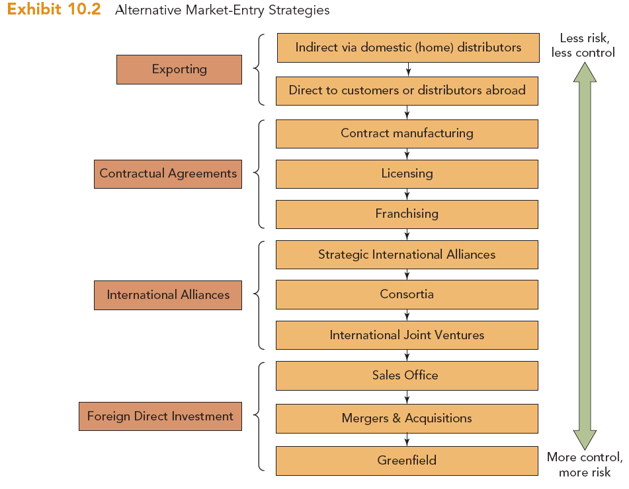

Slide 15
Marketing Strategies in international marketing
Global Product Strategies
Developing global product strategies requires knowing what types of products or services are product standardized and appropriate adaptation strategies.
PRODUCT STANDARDIZATION:
High-end products also benefit from standardization, because quality and prestige often can be marketed similarly across countries. food and beverage marketers find it more challenging to standardize given widely varying tastes and cultural habits.

Slide 16
Product Adaptation Strategies
Product Adaptation Strategies | Product
Communication |  | Do not Change product | Adapt product | Develop new product
 | Do not Change Communications | Straight extension | Product adaptation | Product invention Backward invention Forward invention
 | Adapt communications | Communication adaptation | Dual adaptation

Slide 17
Global Pricing Strategies
Companies Have Three Choices For Setting Prices In Different Countries:
Set A Uniform Price Everywhere
Set A Market-based Price In Each Country
Set A Cost-based Price In Each Country

Slide 18
Distribution Strategy for International Marketing
Seller
Seller's International Marketing Headquarters
Final
Buyers
Channels within Foreign Nations
Channels between Nations

Slide 19
Paradigm Shift
In Marketing Practice
Around The Globe
By Philip Kotler

Slide 20
Paradigm Shift in Marketing
From make-and-sell marketing to sense-and-respond marketing
From owning assets to owning brands
From vertical integration to virtual integration (outsourcing)
From mass marketing to customised marketing
From operating only in marketplace to operating in cyberspace
From pursuing market-share to pursuing customer share
From transaction marketing to relationship marketing

Slide 21
Paradigm Shift in Marketing cont…
From customer acquisition to customer retention and customer satisfaction
From mediated marketing to direct marketing
From marketer monologue to customer dialogue
From single channel marketing to multi-channel marketing
From product-centric marketing to customer-centric marketing
From marketing department doing marketing to everyone in the company doing marketing
From exploiting suppliers and distributors to partnering with them

Slide 22

I
thank
you !
G:\kindye\Islamic\nn\03 Track 02.mp3

Slide 23
20180122_074038.mp4

