Slide 1
Chapter 7
Supply Chain, Procurement and Logistics Management

Slide 2
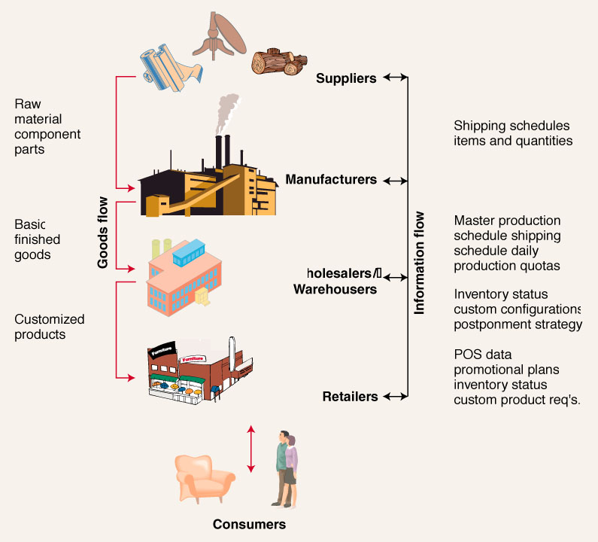
A Basic Supply Chain

Slide 3
Supply Chain Management
Supply Chain Management entails:
Making decisions regarding the structure of the supply chain
Coordinating the movement of goods and delivery of services
Sharing information between members of the supply chain.

Slide 4
SCM Factors
SCM must consider the following trends, improved capabilities, & realities:
Consumer Expectations and Competition – power has shifted to the consumer
Globalization – capitalize on emerging markets
Information Technology – e-commerce, Internet, EDI, scanning data, intranets
Government Regulations - like trade barriers
Environment Issues – e.g. waste minimization

Slide 5
Components of a Typical Supply Chain
External
Suppliers
Internal
Functions
External
Distributors
INFORMATION

Slide 6
External Suppliers
External suppliers provide the necessary raw materials, services, and component parts.
Purchased materials & services frequently represent 50% (or more) of the costs of goods sold.
Suppliers are frequently members of several supply chains – often in different roles.

Slide 7
External Suppliers
Tier one suppliers:
Directly supplies materials or services to the firm that does business with the final customer
Tier two suppliers:
Provides materials or services to tier one suppliers
Tier three suppliers:
Providers materials or services to tier two suppliers

Slide 8
Internal Functions
Vary by industry & firm, but might include:
Processing
Purchasing
Production Planning & Control
Quality Assurance
Shipping

Slide 9
Logistics & Distribution
Logistics: getting the right material to the right place at the right time in the right quantity:
Traffic Management:
The selection, scheduling & control of carriers (e.g.: trucks & rail) for both incoming & outgoing materials & products
Distribution Management:
The packaging, storing & handling of products in transit to the end-user.

Slide 10
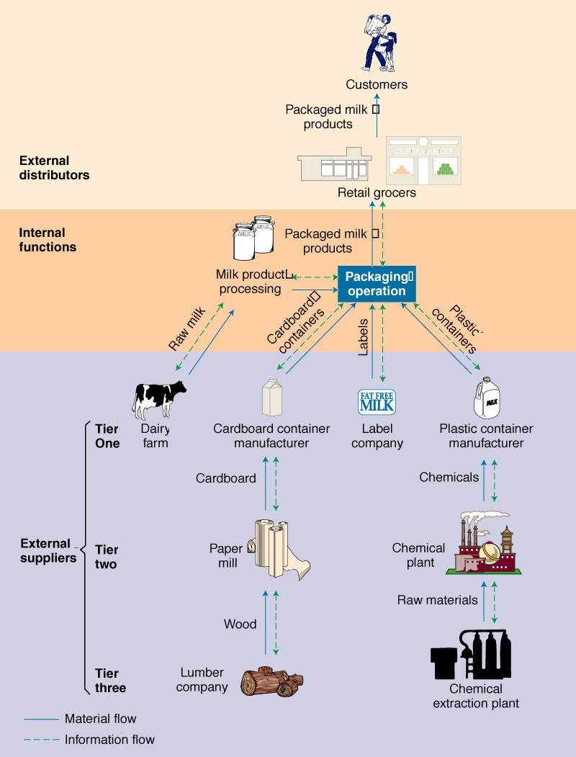
Dairy Products Supply Chain

Slide 11
Vertical Integration
A measure of how much of the supply chain is controlled by the manufacturer.
Backward integration:
Acquiring control of raw material suppliers.
Forward integration:
Acquiring control of distribution channels.

Slide 12
Outsourcing
Entails paying third-party suppliers to provide raw materials and services, rather than making them in-house.
Outsourcing is increasing as many firms try to focus their internal operations on what they do best.

Slide 13
Insourcing vs. Outsourcing
What questions need to be asked before sourcing decisions are made?
Is product/service technology critical to firm’s success?
Is operation a core competency?
Do you have the capital to provide capacity & keep the process current?
Will outsourcing extend lead times and limit flexibility?
Can others do it for less cost and better quality?

Slide 14
Purchasing’s Role in SCM
Purchasing role has attained increased importance since material costs represent 50-60% of cost of goods sold
Ethics considerations
Developing supplier relationships
Determining how many suppliers
Developing partnerships
Industry trend is to a much smaller supplier base. Why?

Slide 15
Partnering with Suppliers
Involves developing a long-term, mutually-beneficial relationship:
Requires trust to share information, risk, opportunities, & investing in compatible technology
Work together to reduce waste and inefficiency & develop new products
Agree to share the gains

Slide 16
Supplier Relationships and JIT
Use single-source suppliers when possible
Build long-term relationships
Work together to certify processes
Co-locate facilities to reduce transport if possible
Stabilize delivery schedules
Share cost & other information
Early involvement during new product designs

Slide 17
The Role of Warehouses
General Warehouses:
Used for long-term storage of goods
Distribution Warehouses:
Transportation consolidation:
Consolidate LTL into TL deliveries
Product mixing & blending:
Group multiple items from various suppliers
Improve service:
Reduced response time
Allow for last-minute customization

Slide 18
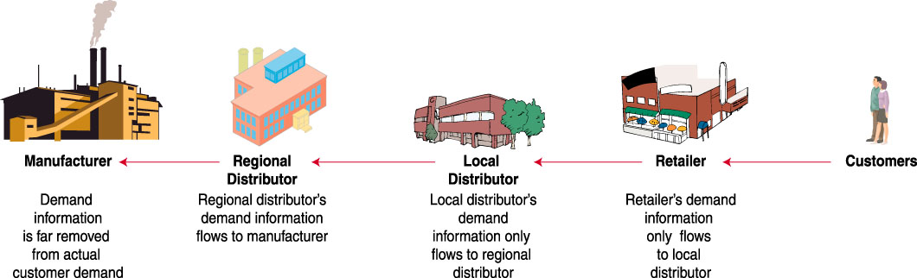
Information Flow in Supply Chains

Slide 19
Information Sharing
Supply chain partners can benefit by sharing information on sales, demand forecasts, inventory levels & marketing campaigns
Inaccurate or distorted information leads to the Bullwhip Effect

Slide 20
The Bullwhip Effect
If information isn’t shared, everyone has to guess what is going on downstream.
Guessing wrong leads to too much or too little inventory:
If too much, firms hold off buying more until inventories fall (leading suppliers to think demand has fallen).
If too little, firms demand a rush order & order more than usual to avoid being caught short in the future (leading suppliers to think demand has risen).

Slide 21
Short-Circuit the Bullwhip
Make information transparent:
Use Electronic Data Interchange (EDI) to support Just-In-Time supplier replenishment
Use bar codes & electronic scanning to capture & share point-of-sale data
Eliminate wholesale price promotions & quantity discounts

Slide 22
Electronic Data Interchange
The most common method of using computer-to-computer links to exchange data between supply chain partners in a standardized format.
Benefits include:
Quick transfer of information
Reduced paperwork & administration
Improved data accuracy & tracking capability

Slide 23
Integrated SCM
Implementing integrated SCM requires:
Analyzing the whole supply chain
Starting by integrating internal functions first
Integrating external suppliers through partnerships
Possible Supply Chain Objectives
Reduce costs, improve quality
Reduce lead time and inventory
Reduce time to market
Increase sales
Improve demand data/forecasting
© 2005 Wiley
23

Slide 24
Logistics management
Logistics Defined

Slide 25
Logistics management …
Activity fragmentation to 1960
Activity Integration 1960 to 2000
Evolution of Supply Chain Management
2000+
Demand forecasting
Demand forecasting
Purchasing
Purchasing
Requirements planning
Requirements planning
Purchasing/
Production planning
Purchasing/
Production planning
Materials
Materials
Management
Manufacturing inventory
Management
Manufacturing inventory
Warehousing
Warehousing
Logistics
Material handling
Logistics
Material handling
Packaging
Packaging
Supply Chain
Finished goods inventory
Supply Chain
Finished goods inventory
Supply Chain
Physical
Supply Chain
Physical
Management
Management
Management
Distribution
Management
Distribution planning
Distribution
Distribution planning
Order processing
Order processing
Transportation
Transportation
Customer service
Customer service
Strategic planning
Strategic planning
Information services
Information services
Marketing/sales
Marketing/sales
Finance
Finance

Slide 26
Logistics management …
Critical Customer Service Loop
Critical Customer Service Loop

Slide 27
Logistics management …
Significance of Logistics

Slide 28
Logistics management …
Wal-Mart
Wins with Logistics!
Costs are lower than K-Mart or Target Stores
CEO is a former logistician
Wal-Mart is the largest retailer in the world!

Slide 29
Relationship of Logistics to Marketing and Production
LOGISTICS
Sample
PRODUCTION/
activities:
MARKETING
OPERATIONS
•
Transport
Interface
Sample
Sample activities:
Interface
•
Inventory
activities:
activities:
•
Quality control
activities:
•
Order
•
Customer
•
Promotion
•
Detailed production
•
Product
processing
service
•
Market
scheduling
scheduling
•
Materials
standards
research
•
Equipment
maint
.
•
Plant
handling
•
Pricing
•
Product
•
Capacity planning
location
•
Packaging
mix
•
Work measurement
•
Purchasing
•
Retail
•
Sales force
&
standards
location
management
Production-
Marketing-
logistics
logistics
interface
interface
Internal Supply Chain

Slide 30
Logistics management …
Historical perspective of distribution:
“The last frontier of cost economies”
The contemporary view:
Distribution is a new frontier for demand generation—a competitive weapon.
Peter Drucker, 1962
Both views are now important!

Slide 31
Thank you!
Questions?

