Slide 1
Chapter 2
Operations Strategy and Competitiveness

Slide 2
The Role of Operations Strategy
Provide a plan that makes best use of resources which;
  Specifies the policies and plans for using organizational resources
  Supports Business Strategy as shown on next slide

Slide 3
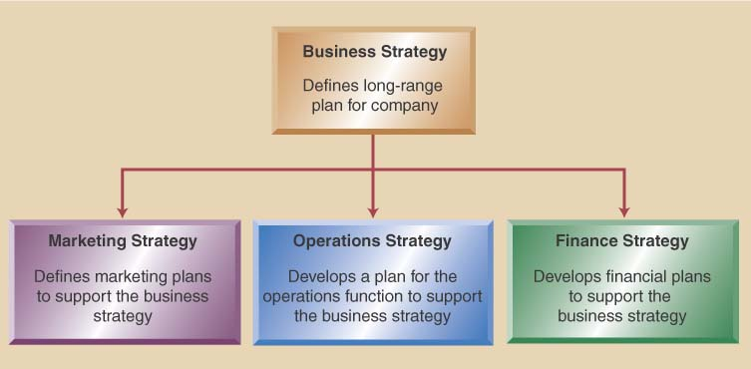
Business/Functional Strategy

Slide 4
Importance of Operations Strategy
Operations strategy ensures all tasks performed are the right tasks
Essential differences between operational efficiency and strategy:
  Operational efficiency is performing tasks well, even better than competitors
  Strategy is a plan for competing in the marketplace

Slide 5
To Develop a Business Strategy
Consider these factors in strategic decisions:
  What business is the company in (mission)
  Analyze and understand the market (environmental scanning)
  Identify the company strengths (core competencies)

Slide 6
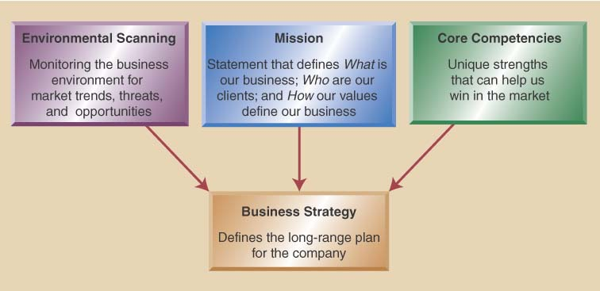
Three Inputs to a Business Strategy

Slide 7
Key Examples
Mission: Dell Computer- “to be the most successful computer company in the world”
Environmental Scanning: political trends, social trends, economic trends, market place trends, global trends
Core Competencies: strength of workers, modern facilities, market understanding, best technologies, financial know-how, logistics

Slide 8
Developing an Operations Strategy
Operations Strategy: a plan for the design and management of operations functions
  is developed after the business strategy
  focuses on specific capabilities which give it a competitive edge – competitive priorities

Slide 9
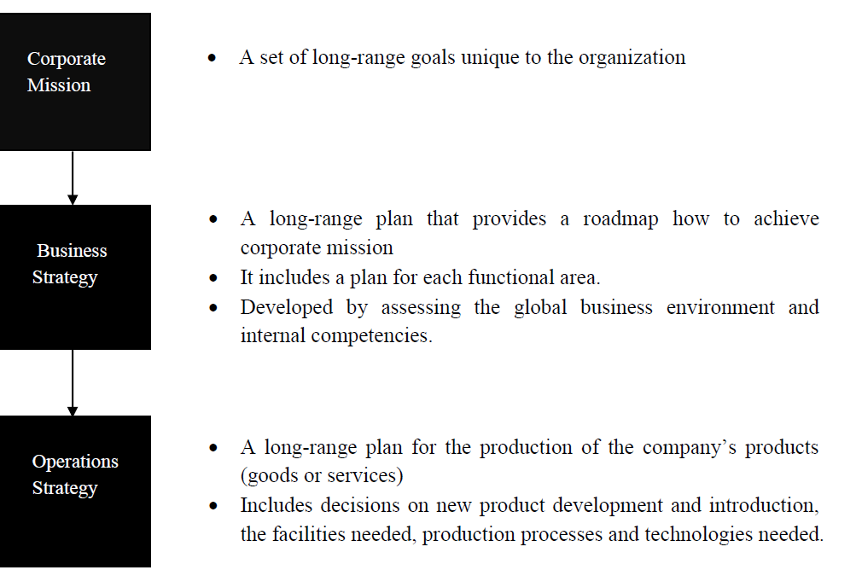
Developing operation strategies and competitive dimensions
Operational Strategies

Slide 10
Competitive dimensions of operations
Cost: “make it cheap”
Quality: “make it good”
Speed of delivery: “make it fast”
Reliability: “provide it when promised”
Coping with change in demand: “change its volume”
Flexibility and new product development: “change it”
Other product-specific criteria: “support it”
By Yabibal A.

Slide 11
Competitive Priorities- The Edge
Four Key Operations Questions:
Will you compete on –
Cost?
Quality?
Time?
Flexibility?
All of the above? Some? Tradeoffs?

Slide 12
Competing on Cost
Offering product at a low price relative to competition
  Typically high volume products
  Often limit product range & offer little customization
  May invest in automation to reduce unit costs
  Can use lower skill labor
  Probably uses product focused layouts
  Low cost does not mean always low quality

Slide 13
Competing on Quality
Quality is often subjective
Quality is defined differently depending on who is defining it
Two major quality dimensions include
  High performance design:
    Superior features, high durability, & excellent customer service
  Product & service consistency:
    Meets design specifications
    Close tolerances
    Error free delivery
Quality needs to address
  Product design quality – product/service meets requirements
  Process quality – error free products

Slide 14
Competing on Time
Time/speed one of most important competition priorities
First that can deliver often wins the race
Time related issues involve
  Rapid delivery:
    Focused on shorter time between order placement and delivery
  On-time delivery:
    Deliver product exactly when needed every time

Slide 15
Competing on Flexibility
Company environment changes rapidly
Company must accommodate change by being flexible
  Product flexibility:
    Easily switch production from one item to another
    Easily customize product/service to meet specific requirements of a customer
  Volume flexibility:
    Ability to ramp production up and down to match market demands

Slide 16
The Need for Trade-offs
Decisions must emphasize priorities that support business strategy
Decisions often required trade offs
Decisions must focus on order qualifiers and order winners
  Which priorities are “Order Qualifiers”?
  Must have excellent quality since everyone expects it
  Which priorities are “Order Winners”?
  Dell competes on all four priorities
  Southwest Airlines competes on cost
  McDonald’s competes on consistency
  FedEx competes on speed

Slide 17
Strategic Role of Technology
Technology should support competitive priorities
Three Applications: product technology, process technology, and information technology
  Products - Teflon, CD’s, fiber optic cable
  Processes – flexible automation, CAM, Robots
  Information Technology – POS, EDI, ERP, B2B

Slide 18
Technology for Competitive Advantage
Technology has positive and negative potentials
  Positive
    Improve processes
    Maintain up-to-date standards
    Obtain competitive advantage
  Negative
    Costly
    Risks such as overstating benefits

Slide 19
Technology for Competitive Advantage
Technology should:
  Support competitive priorities
  Can require change to strategic plans
  Can require change to operations strategy
Technology is an important strategic decision

Slide 20
Thank you!
Questions?

