Slide 1
Chapter 5
Total Quality Management and Control

Slide 2
Competing on Quality?
High performance design:
  Superior features, high durability, & excellent customer service
Product & service consistency:
  Meets design specifications
  Close tolerances
  Error free delivery

Slide 3
Defining Quality – 5 Ways
Conformance to specifications
  Does product/service meet targets and tolerances defined by designers?
Fitness for use
  Evaluates performance for intended use
Value for price paid
  Evaluation of usefulness vs. price paid
Support services
  Quality of support after sale
Psychological
  e.g. Ambiance, prestige, friendly staff
Notes:
Aesthetic

Slide 4
Manufacturing Quality vs. Service Quality
Manufacturing quality focuses on tangible product features
  Conformance, performance, reliability, features, durability, serviceability
Service organizations produce intangible products that must be experienced
  Quality often defined by perceptional factors like responsiveness, courtesy, friendliness, promptness, waiting time, consistency

Slide 5
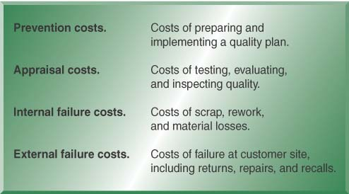
Cost of Quality
Early detection/prevention is less costly
  May be less by a factor of 10

Slide 6
What is TQM?
Meeting quality expectations as defined by the customer
Integrated organizational effort designed to improve quality of processes at every business level

Slide 7
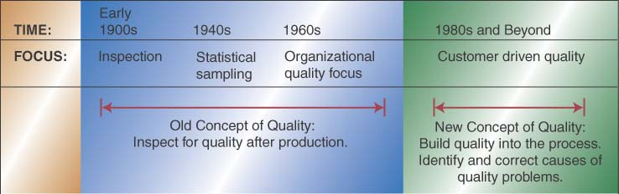
Evolution of TQM – New Focus

Slide 8
TQM Philosophy – What’s Different?
Focus on Customer
  Identify and meet customer needs
  Stay tuned to changing needs, e.g. fashion styles
Continuous Improvement
  Continuous learning and problem solving, e.g. Kaizen, 6 sigma
Quality at the Source
  Prevention & problem solving vs. inspection
Employee Empowerment
  Empower all employees; external and internal customers

Slide 9
TQM Philosophy– What’s Different? (continued)
Understanding Quality Tools
  Ongoing training on analysis, assessment, and correction, & implementation tools
Team Approach
  Teams formed around processes – 8 to 10 people
  Meet weekly to analyze and solve problems
Benchmarking
  Studying practices at “best in class” companies
Managing Supplier Quality
  Certifying suppliers vs. receiving inspection

Slide 10
Ways of Improving Quality
Plan-Do-Study-Act Cycle (PDSA)
  Also called the Deming Wheel after originator
  Circular, never ending problem solving process
Seven Tools of Quality Control
  Tools typically taught to problem solving teams

Slide 11
PDSA Details
Plan
  Evaluate current process
  Collect data, identify problems
  Develop an improvement plan, performance objectives
Do
  Implement the plan – trial basis
Study
  Collect data and evaluate against objectives
Act
  Communicate the results from trial
  If successful, implement new process

Slide 12
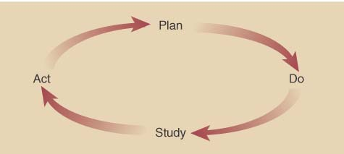
PDSA (continued)
Cycle is repeated
  After act phase, start planning and repeat process

Slide 13
Seven Problem Solving Tools
Cause-and-Effect Diagrams
Flowcharts
Checklists
Control Charts
Scatter Diagrams
Pareto Analysis
Histograms

Slide 14
Cause-and-Effect Diagrams
Called Fishbone Diagram
Focused on identifying the causes of quality problem

Slide 15
Example: Delayed Flight Departures
Equipment
Personnel
  Gate agents cannot process passengers quickly enough
Aircraft late to gate
Too few agents
Late arrival
Agents undertrained
Gate occupied
Agents undermotivated
Other
Agents arrive at gate late
Mechanical failures
Late cabin cleaners
Weather
late pushback tug
Late or unavailable cabin crews
Air traffic
late or unavailable cockpit crews
Delayed
Flight
Departures
poor announcement of departures
weight an balance sheet late
Delayed checkin procedure
Late baggage to aircraft
Confused seat selection
Late fuel
Passengers bypass checkin counter
Late food service
Checking oversize baggage
Issuance of boarding pass
Acceptance of late passengers
cutoff too close to departure time
Material
Desire to protect late passengers
Desire to help company’s income
Poor gate locations
Procedure

Slide 16
Flowcharts
Used to document the detailed steps in a process
Often the first step in Process Re-Engineering

Slide 17
Example: Process at Departure Gate

Slide 18
Checklist
Simple data check-off sheet designed to identify type of quality problems at each work station; per shift, per machine, per operator

Slide 19
Control Charts
Important tool used in Statistical Process Control
The UCL and LCL are calculated limits used to show when process is in or out of control

Slide 20
Scatter Diagrams
A graph that shows how two variables are related to one another
Data can be used in a regression analysis to establish equation for the relationship

Slide 21
Pareto Analysis
Technique that displays the degree of importance for each element
Named after the 19th century Italian economist
Often called the 80-20 Rule
Principle is that quality problems are the result of only a few problems e.g. 80% of the problems caused by 20% of causes

Slide 22
Histograms
A chart that shows the frequency distribution of observed values of a variable like service time
at a bank drive-up window
Displays whether the distribution is symmetrical (normal) or skewed

Slide 23
Quality Awards and Standards
Malcolm Baldrige National Quality Award
The Deming Prize
ISO 9000 Certification
ISO 14000 Standards

Slide 24
MBNQA- What Is It?
Award named after the former Secretary of Commerce – Regan Administration
Intended to reward and stimulate quality initiatives
Given to no more that two companies in each of three categories; manufacturing, service, and small business
Past winners; FedEx, 3M, IBM, Ritz-Carlton
Typical winners have scored around 700 points

Slide 25
The Deming Prize
Given by the Union of Japanese Scientists and Engineers since 1951
Named after W. Edwards Deming who worked to improve Japanese quality after WWII
Not open to foreign companies until 1984
Florida P & L was first US company winner

Slide 26
ISO Standards
ISO 9000 Standards:
  Certification developed by International Organization for Standardization
  Set of internationally recognized quality standards
  Companies are periodically audited & certified
  ISO 9000:2000 QMS – Fundamentals and
  Standards
  ISO 9001:2000 QMS – Requirements
  ISO 9004:2000 QMS - Guidelines for Performance
  More than 40,000 companies have been certified
ISO 14000:
    Focuses on a company’s environmental responsibility

Slide 27
Why TQM Efforts Fail
Lack of a genuine quality culture
Lack of top management support and commitment
Over- and under-reliance on SPC methods

Slide 28
Statistical Quality Control Techniques

Slide 29
Sources of Variation in Production and Service Processes
Common causes of variation
  Random causes that we cannot identify
  Unavoidable
  Cause slight differences in process variables like diameter, weight, service time, temperature, etc.
Assignable causes of variation
  Causes can be identified and eliminated
  Typical causes are poor employee training, worn tool, machine needing repair, etc.

Slide 30
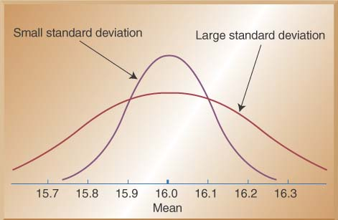
Measuring Variation: The Standard Deviation
Small vs. Large Variation

Slide 31
Process Capability
A measure of the ability of a process to meet preset design specifications:
  Determines whether the process can do what we are asking it to do
Design specifications (tolerances):
  Determined by design engineers to define the acceptable range of individual product characteristics (e.g.: physical dimensions, elapsed time, etc.)
  Based upon customer expectations & how the product works (not statistics!)

Slide 32
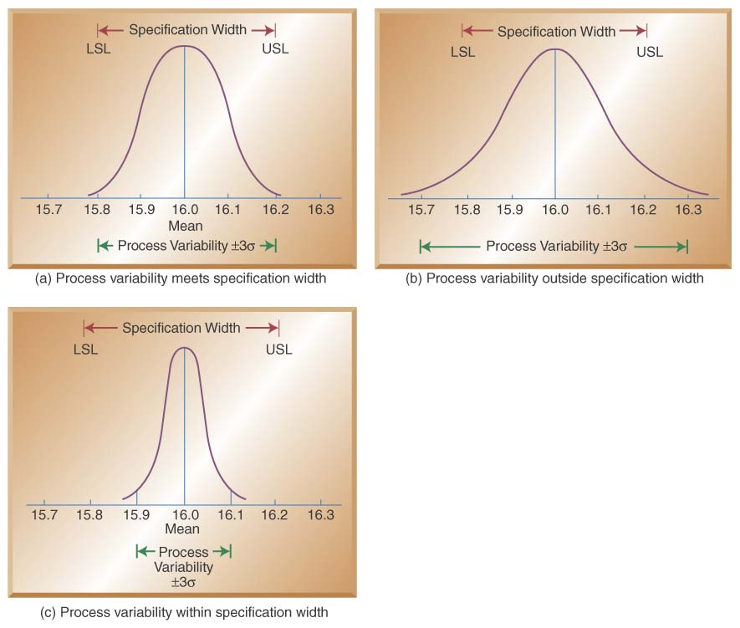
Relationship between Process Variability and Specification Width

Slide 33
Three Sigma Capability
Mean output +/- 3 standard deviations falls within the design specification
It means that 0.26% of output falls outside the design specification and is unacceptable.
The result: a 3-sigma capable process produces 2600 defects for every million units produced

Slide 34
Six Sigma Capability
Six sigma capability assumes the process is capable of producing output where the mean +/- 6 standard deviations fall within the design specifications
The result: only 3.4 defects for every million produced
Six sigma capability means smaller variation and therefore higher quality

Slide 35
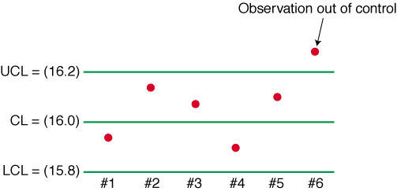
Process Control Charts
Control Charts show sample data plotted on a graph with Center Line (CL), Upper Control Limit (UCL), and Lower Control Limit (LCL).

Slide 36
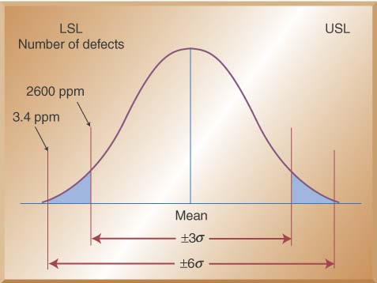
Setting Control Limits

Slide 37
Types of Control Charts
Control chart for variables are used to monitor characteristics that can be measured, e.g. length, weight, diameter, time, etc.
Control charts for attributes are used to monitor characteristics that have discrete values and can be counted, e.g. % defective, number of flaws in a shirt, number of broken eggs in a box, etc.

Slide 38
Control Charts for Variables
Mean (x-bar) charts
  Tracks the central tendency (the average value observed) over time
Range (R) charts:
  Tracks the spread of the distribution over time (estimates the observed variation)

Slide 39
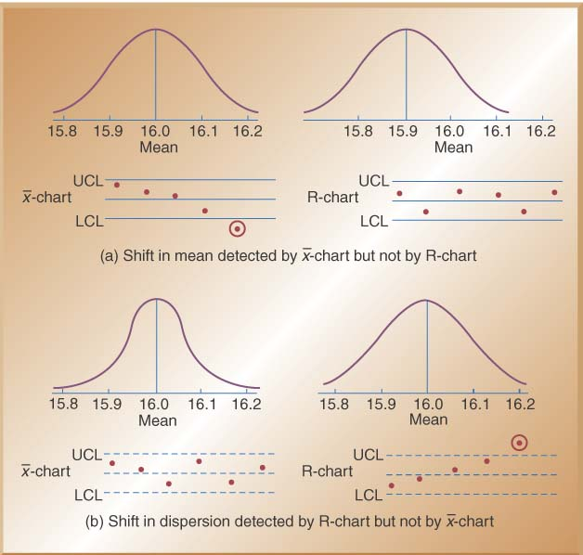
x-bar and R charts monitor different parameters!

Slide 40
Constructing a X-bar Chart:
A quality control inspector at the Cocoa Fizz soft drink company has taken three samples with four observations each of the volume of bottles filled. If the standard deviation of the bottling operation is .2 ounces, use the data below to develop control charts with limits of 3 standard deviations for the 16 oz. bottling operation.
 | Time 1 | Time 2 | Time 3
Observation 1 | 15.8 | 16.1 | 16.0
Observation 2 | 16.0 | 16.0 | 15.9
Observation 3 | 15.8 | 15.8 | 15.9
Observation 4 | 15.9 | 15.9 | 15.8

Slide 41
Step 1:
Calculate the Mean of Each Sample
 | Time 1 | Time 2 | Time 3
Observation 1 | 15.8 | 16.1 | 16.0
Observation 2 | 16.0 | 16.0 | 15.9
Observation 3 | 15.8 | 15.8 | 15.9
Observation 4 | 15.9 | 15.9 | 15.8
Sample means (X-bar) | 15.875 | 15.975 | 15.9

Slide 42
Step 2: Calculate the Standard Deviation of the Sample Mean

Slide 43
Step 3: Calculate CL, UCL, LCL
Center line (x-double bar):
Control limits for ±3σ limits (z = 3):

Slide 44
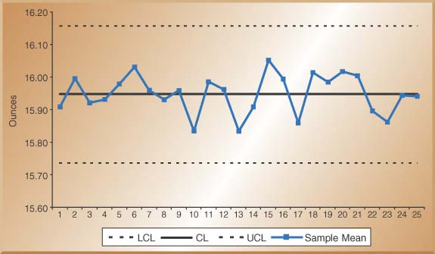
Step 4: Draw the Chart

Slide 45
An Alternative Method for the X-bar Chart Using R-bar and the A2 Factor
Sample Size
(n)
Factor for x-Chart
Factors for R-Chart
Use this method when sigma for the process distribution is not known. Use factor A2 from Table 6.1
A2
D3
D4
2
1.88
0.00
3.27
3
1.02
0.00
2.57
4
0.73
0.00
2.28
5
0.58
0.00
2.11
6
0.48
0.00
2.00
7
0.42
0.08
1.92
8
0.37
0.14
1.86
9
0.34
0.18
1.82
10
0.31
0.22
1.78
11
0.29
0.26
1.74
12
0.27
0.28
1.72
13
0.25
0.31
1.69
14
0.24
0.33
1.67
15
0.22
0.35
1.65

Slide 46
Step 1: Calculate the Range of Each Sample and Average Range
 | Time 1 | Time 2 | Time 3
Observation 1 | 15.8 | 16.1 | 16.0
Observation 2 | 16.0 | 16.0 | 15.9
Observation 3 | 15.8 | 15.8 | 15.9
Observation 4 | 15.9 | 15.9 | 15.8
Sample ranges (R) | 0.2 | 0.3 | 0.2

Slide 47
Step 2: Calculate CL, UCL, LCL
Center line:
Control limits for ±3σ limits:

Slide 48
Control Chart for Range (R-Chart)
Center Line and Control Limit calculations:
Factor for x-Chart
Factors for R-Chart
Sample Size
(n)
A2
D3
D4
2
1.88
0.00
3.27
3
1.02
0.00
2.57
4
0.73
0.00
2.28
5
0.58
0.00
2.11
6
0.48
0.00
2.00
7
0.42
0.08
1.92
8
0.37
0.14
1.86
9
0.34
0.18
1.82
10
0.31
0.22
1.78
11
0.29
0.26
1.74
12
0.27
0.28
1.72
13
0.25
0.31
1.69
14
0.24
0.33
1.67
15
0.22
0.35
1.65

Slide 49
R-Bar Control Chart

Slide 50
Control Charts for Attributes –P-Charts & C-Charts
Use P-Charts for quality characteristics that are discrete and involve yes/no or good/bad decisions
  Percent of leaking caulking tubes in a box of 48
  Percent of broken eggs in a carton
Use C-Charts for discrete defects when there can be more than one defect per unit
  Number of flaws or stains in a carpet sample cut from a production run
  Number of complaints per customer at a hotel

Slide 51
Constructing a P-Chart:
A Production manager for a tire company has inspected the number of defective tires in five random samples with 20 tires in each sample. The table below shows the number of defective tires in each sample of 20 tires.
Sample | Sample Size (n) | Number Defective
1 | 20 | 3
2 | 20 | 2
3 | 20 | 1
4 | 20 | 2
5 | 20 | 1

Slide 52
Step 1:
Calculate the Percent defective of Each Sample and the Overall Percent Defective (P-Bar)
Sample | Number Defective | Sample Size | Percent Defective
1 | 3 | 20 | .15
2 | 2 | 20 | .10
3 | 1 | 20 | .05
4 | 2 | 20 | .10
5 | 1 | 20 | .05
Total | 9 | 100 | .09

Slide 53
Step 2: Calculate the Standard Deviation of P.

Slide 54
Step 3: Calculate CL, UCL, LCL
Center line (p bar):
Control limits for ±3σ limits:

Slide 55
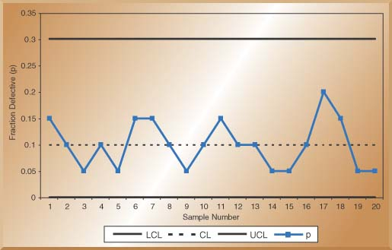
Step 4: Draw the Chart

Slide 56
Constructing a C-Chart:
Week | Number of Complaints
1 | 3
2 | 2
3 | 3
4 | 1
5 | 3
6 | 3
7 | 2
8 | 1
9 | 3
10 | 1
Total | 22
The number of weekly customer complaints are monitored in a large hotel. Develop a three sigma control limits For a C-Chart using the data table On the right.

Slide 57
Calculate CL, UCL, LCL
Center line (c bar):
Control limits for ±3σ limits:

Slide 58
SQC in Services
Service Organizations have lagged behind manufacturers in the use of statistical quality control
Statistical measurements are required and it is more difficult to measure the quality of a service
  Services produce more intangible products
  Perceptions of quality are highly subjective
A way to deal with service quality is to devise quantifiable measurements of the service element
  Check-in time at a hotel
  Number of complaints received per month at a restaurant
  Number of telephone rings before a call is answered
  Acceptable control limits can be developed and charted

Slide 59
Thank you!
Questions?

