Slide 1
Welcome to all
2nd Year MBA. Students
Dr. Krishna Gadasandula
M.B.A., M.Com. M.Phil. and Ph.D.
With more than ten years of experience in Accounting and Finance Teaching, Research, Training & Education Management.
Mail: krishnagadasandula@gmail.com, # +91 9866349726-, 0904565415(Local Phone No.)
Hyderabad.India.

Slide 2
Financial Markets & Institutions
Chapter - 4
SECURITIES MARKET AND TRADING
    Primary, Secondary and Third Markets.
    Foreign markets
    3. Stock Market Indicators
    Institutional Vs Private Investments

Slide 3
Assessment Methods
Assessment method | Weight
Assessment -I - (Individual Assignment )- | 10%
Assessment -II (Group Assignment) | 20%
Assessment –III (Test ) | 20%
Final Exam | 50 %
Total | 100%

Slide 4
Primary, Secondary and Third Markets?

Slide 5
  Primary and Secondary Market Comparison
BASIS FOR COMPARISON | PRIMARY MARKET | SECONDARY MARKET
Meaning | The market place for new shares is called primary market. | The place where formerly issued securities are traded is known as Secondary Market.
Another name | New Issue Market (NIM) | After Market
Type of Purchasing | Direct | Indirect
Financing | It supplies funds to budding enterprises and also to existing companies for expansion and diversification. | It does not provide funding to companies.
How many times a security can be sold? | Only once | Multiple times
Buying and Selling between | Company and Investors | Investors
Who will gain the amount on the sale of shares? | Company | Investors
Intermediary | Underwriters | Brokers
Price | Fixed price | Fluctuates, depends on the demand and supply force
Organizational difference | Not rooted to any specific spot or geographical location. | It has physical existence.

Slide 6
  Third Market
What is Third Market?
The third market is an over-the-counter (OTC) market in which brokers and large institutional investors trade exchange-listed securities between one another.
A third market consists of trading by non-exchange member brokers/dealers and institutional investors of exchange-listed stocks.
In other words, the third market involves exchange-listed securities that are being traded over-the-counter between brokers/dealers and large institutional investors
The third market supports the primary and secondary markets. The primary market describes the issuance of new securities. The secondary market is traditionally where seasoned securities are exchanged among market participants. And now, the third market is ancillary to the secondary market, with an emphasis on OTC markets and institutional investors.
Third market trading began in the 1960s with firms such as Jefferies & Company, although, today, there are a number of brokerage firms focused on third market trading.

Slide 7
  Third Market
HOW IT WORKS (EXAMPLE):
The third market is an OTC venue in which brokers and institutional investors (e.g., insurance companies and mutual funds) trade securities listed and publicly traded on a registered exchange (e.g., NYSE or AMEX). Unlike most exchange trading, buyers and sellers in the third market trade with each other for the benefit of their own portfolios rather than in an agency capacity on clients' behalf.
WHY IT MATTERS:
The third market brings together large investors willing and able to purchase and sell their own securities holdings for cash and immediate delivery. Securities can be purchased at lower prices in the third market because of the absence of broker's commissions.

Slide 8
    Foreign markets?

Slide 9
  Foreign markets?
The market in one country for the trading of securities registered and based in another country. Trading in a foreign market may involve trading on a foreign exchange electronically, or it may involve trading those foreign securities on domestic exchange. Foreign markets often, but do not always, expose the investor to foreign exchange risk.
How to enter a foreign market?
By selling your product or service in another country, you can introduce your company to huge markets, increase your sales and profits, gain brand recognition, reduce the risk of only operating in one market (eg, due to economic or seasonal downturns) and extend your product’s life cycle.
When to enter?
If you know that your competitors are considering entering the same market as you, there are two options: aim to be ‘first to market’ or wait and see how successful your competitors are and follow them into the market.
Scale of entry
The obvious issue here is cost. Entering a market on a large scale will require significant resources. Although this is more likely to make an impression on a new market as it will attract the attention of customers and local businesses alike, it may be risky financially if your company does not take off.

Slide 10
  Foreign market entry methods
Market entry methods
When you know the scale of entry, you will need to work out how to take your business abroad. This will require careful consideration as your decision could significantly impact your results. There are several market entry methods that can be used.
Exporting
Exporting is the direct sale of goods and / or services in another country. It is possibly the best-known method of entering a foreign market, as well as the lowest risk. It may also be cost-effective as you will not need to invest in production facilities in your chosen country – all goods are still produced in your home country then sent to foreign countries for sale. However, rising transportation costs are likely to increase the cost of exporting in the near future.
Licensing
Licensing allows another company in your target country to use your property. The property in question is normally intangible – for example, trademarks, production techniques or patents. The licensee will pay a fee in order to be allowed the right to use the property.

Slide 11
  Foreign market entry methods
Franchising
Franchising is somewhat similar to licensing in that intellectual property rights are sold to a franchisee. However, the rules for how the franchisee carries out business are usually very strict – for example, any processes must be followed, or specific components must be used in manufacturing.
Joint-venture
A joint venture consists of two companies establishing a jointly-owned business. One of the owners will be a local business (local to the foreign market). The two companies would then provide the new business with a management team and share control of the joint venture.
Foreign direct investment
Foreign direct investment (FDI) is when you directly invest in facilities in a foreign market. It requires a lot of capital to cover costs such as premises, technology and staff. FDI can be done either by establishing a new venture or acquiring an existing company.

Slide 12
  Stock Market Indicators

Slide 13
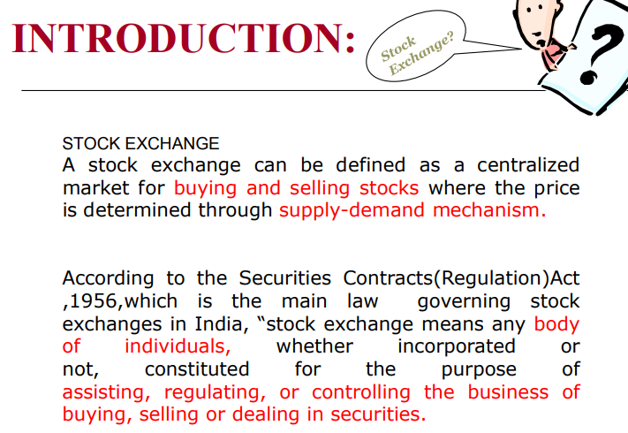
  Stock Market Indicators

Slide 14
  Stock Market Indicators
Market indicators are quantitative factors that predict the future behavior of market indices.
A stock market index is a method of measuring a section of the stock market.
The Index may be weighted to reflect the market capitalization
Stock market indices are useful in understanding the level of prices
and the trend of price movements of the market

Slide 15
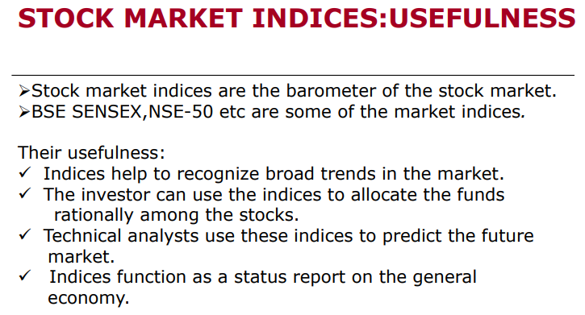

Slide 16
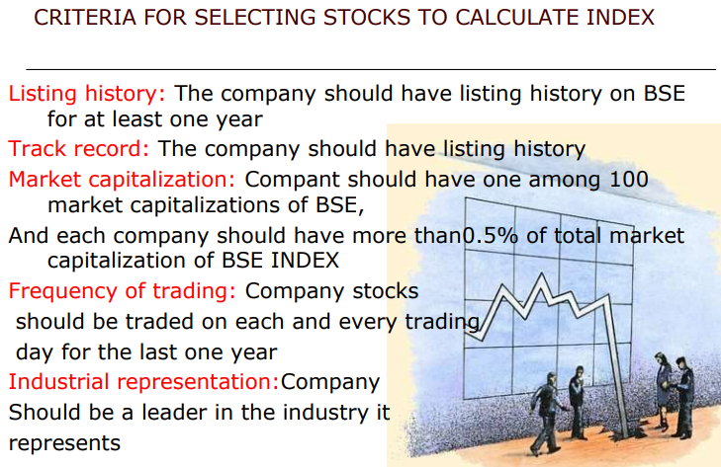

Slide 17
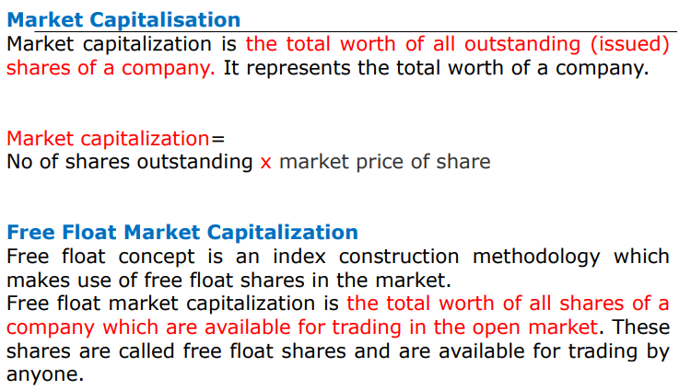

Slide 18
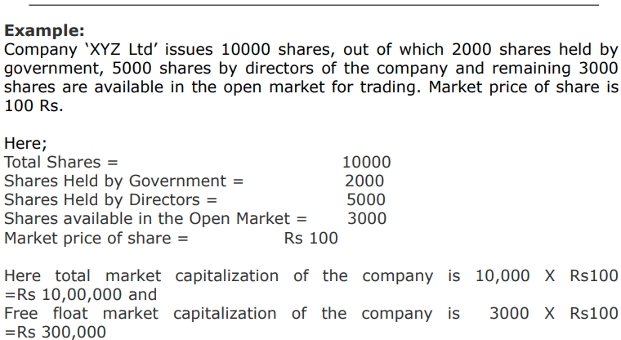

Slide 19
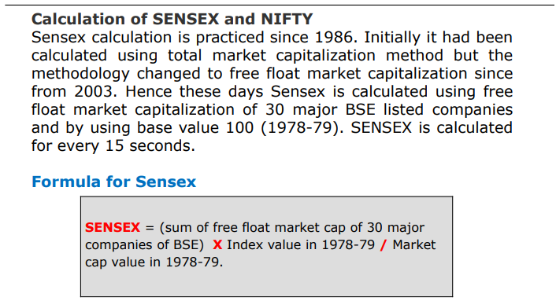

Slide 20
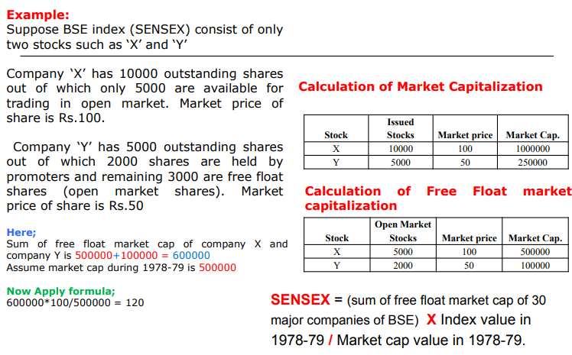
Notes:
A stock index or stock market index is a measurement of a section of the stock market. It is computed from the prices of selected stocks (typically a weighted average). It is a tool used by investors and financial managers to describe the market, and to compare the return on specific investments

Slide 21
Common Indicators for the U.S. Stock Market
The DJIA, also referred to as the Dow, is an average derived from 30 of the top stocks traded on the New York Stock Exchange (NYSE). It is the most highly used and frequently quoted of all the leading stock market indicators.
The S&P 500 Index is made up of 500 stocks that are chosen based on market capitalization, liquidity and their industry sectors. The S&P 500 is a broad market indicator of U.S. equities. The index is a value-weighted index with each stock's weight proportionate to its market value.
The Nasdaq Composite Index is weighted by the capitalization of the market. It includes more than 3,000 stocks on the Nasdaq Stock Exchange. Included in the index are American depositary receipts, real estate investment trusts and many small-cap stocks.

Slide 22
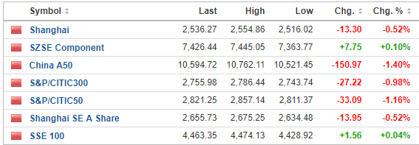
Common Indicators for the China Stock Market
The SSE Composite (also known as Shanghai Composite) Index is the most commonly used indicator to reflect SSE's market performance. Constituents for the SSE Composite Index are all listed stocks (A shares and B shares) at the Shanghai Stock Exchange. The Base Day for the SSE Composite Index is December 19, 1990

Slide 23
  Institutional Vs Private Investments?

Slide 24
  Institutional Vs Private Investments
Institutional investors are typically banks, pension funds, insurance companies, and hedge and mutual funds.
Private investors include individuals, venture capital companies, and, sometimes family and friends. If you have a start-up company, you'll probably have to depend on private investors for money.
  Whether you are learning about personal investing or seeking investment dollars for your company, you should know the difference between private and institutional investors.

Slide 25
  Institutional Vs Private Investments
Investment Targets
Institutional Investors: When investors, particularly financial institutions, pension funds, universities and insurance companies, pool funds to invest millions on a variety of assets, they become institutional investors. Because of their large dollars, institutional investors typically invest in large projects and companies.
Private investors : In most cases, they seek secure investments that return modest or guaranteed earnings, with a maximum of safety. Private investors exercise more freedom in selecting investment options, willing to invest in smaller companies and start-ups.
Risk
From the individual that buys stocks, mutual funds or real estate to generate investment returns to venture capitalists making risky investments in young companies, private investors design their own investment plans. They are willing to take on higher risk than institutional investors.
Private investors are prime sources of small business capital. Institutional investors typically have little interest in small business because of the higher risk, regardless of the potential high rewards.

Slide 26
  Institutional Vs Private Investments
Investment Size
Institutional investors usually are attracted to large companies and investments. Since they often have pooled funds from a variety of companies, they tend to have large dollars.
Private investors, including so-called angel investors, are the most important source of capital for new or smaller businesses.
Lending Vs Investment
Some institutional investors, particularly banks, often prefer to lend money instead of making pure investments. Whether offering loans or lines of credit, these institutional investors seek out established, low risk organizations.
Private investors, particularly venture capitalists, hardly ever offer loans, preferring to use their dollars to receive an ownership share in companies. Unlike some angel investors, who may have selfless goals, most private investors, like venture capital firms, simply want to make money.

Slide 27
  Institutional Vs Private Investments
Significance of private and institutional investors
Both private and institutional investors strongly influence the financial strength of an economy. As institutional investors minimize risk, they are active buyers of secure, but modest return, blue chip proven investments.
Private investors welcome higher risk, with hopes of higher rewards, earnings, than institutional investors.
Private investors may select non-public or public companies as investment targets,
while institutional investors prefer publicly-traded companies and municipalities for their money decisions.

Slide 28
Thank you .

