Slide 1
Chapter –II
Financial Markets & Institutions
BANKING SYSTEM

Slide 2
Course Title: Financial Markets & Institutions
Course Code: MBA 5052
Instructor: Dr.Krishna Gadasandula

Slide 3
Syllabus -Chapter and Content Objectives
Chapter 2 ------BANKING SYSTEM
1 .Evolution of Central Banking,2 .Definition of a Central Bank 3.Central Banking Functions 4.Credit Control Methods 4. Monetary Policy & its Objectives 5. Regulation of the financial system 6. Central banking system in Ethiopia Commercial Banking system 1. Definition of commercial banking 2.Commercial banking services 3. Domestic and international banking operation

Slide 4
  BANKING SYSTEM
A banking system is a group or network of institutions that provide financial services for us. These institutions are responsible for operating a payment system, providing loans, taking deposits, and helping with investments.
Functions of Banking :
  To deposit funds and use our checking accounts
  Debit cards to pay our bills or make purchases
  Finance our cars and homes
  Distribute currency and establish money related policies
  Conduct trades or deal with capital markets
  Obtain profit by charging more interests And paying less interest on deposits

Slide 5
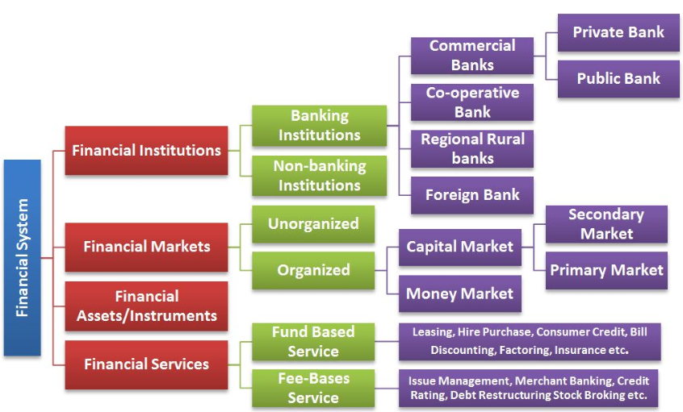
  Types Of Banking or Financial Institutions

Slide 6
  Evaluation of Central Banking with reference to Ethiopia

Slide 7
  Ethiopia - Banking Systems
  The GOE allowed the establishment of private banks and insurance companies in 1994, but continues to prohibit foreign ownership in this sector.
    The Ethiopian banking sector is currently comprised of a central bank (The National Bank of Ethiopia or NBE), two government owned banks and sixteen private banks.
    In September 2011, NBE issued a regulation that increased the minimum paid up capital required to establish a new bank from 75 million Birr ($3.4 million) to 500 million Birr ($22 million), which effectively stopped the entry of most new banks to the market.
  Under the Growth and Transformation Plan II (GTP II) period, NBE further increased the minimum paid up capital for banks to 2 Billion Birr ($90 million) and advised all the sixteen currently operating private banks to increase their paid up capital to that amount by 2020.

Slide 8
  Ethiopia - Banking Systems
  Foreign banks are not permitted to provide financial services in Ethiopia and the market is closed to foreign retail banks. Currently, Ethiopia has allowed some foreign banks to open liaison offices in Addis, to facilitate credit to companies from their countries of origins.
    Chinese, German, Kenyan, Turkish, and South African banks have opened liaison offices in Ethiopia.
    Based on the most recently data, Commercial Bank of Ethiopia (CBE) mobilizes more than 60 percent of total bank deposits, bank loans and foreign exchange.
    NBE controls the bank’s minimum deposit rate, which now stands at 5 percent, while loan interest rates are allowed to float. Real deposit interest rates have been negative in recent years mainly due to inflation.

Slide 9
  Ethiopia - Banking Systems
  The state-owned Commercial Bank of Ethiopia (CBE) dominates the market in terms of assets, deposits, bank branches, and total banking workforce.
    In 2016, CBE merged with another state owned bank, the Construction and Business Bank.
    The other government-owned specialized bank is the Development Bank of Ethiopia (DBE). The state-owned DBE provides loans to investors in priority sectors.
  DBE extends short, medium, and long-term loans for viable development projects, including industrial and agricultural projects. DBE also provides other banking services such as checking and saving accounts to its clients.

Slide 10
  Ethiopia - Banking Systems
  NBE may engage with banks and other financial institutions in the discount, purchase, or sale of duly signed and endorsed bills of exchange, promissory notes, acceptances, and other credit instruments with maturity periods not exceeding 180 days from the date of their discount, rediscount, or acquisition by the bank.
  The bank may buy, sell, and hold foreign currency notes and coins and such documents and instruments, including telegraphic transfers, as they are customarily employed in international payments or transfers of funds.

Slide 11
  Ethiopia - Banking Systems
  This action constrains banks' liquidity and capacity to supply businesses with needed finance.
  There is a growing liquidity problem in Ethiopia that is impeding the private sector.
    To address these problems, NBE reduced reserve and liquidity requirements of banks from 25% to 10%, respectively in January 2012 and further reduced the reserve requirement to 5% in March 2013.
  In 2015, NBE allowed commercial banks to provide mobile banking service and agent banking. Pursuant to NBE’s permit, many of the commercial banks added mobile and agent banking in their line of services..

Slide 12
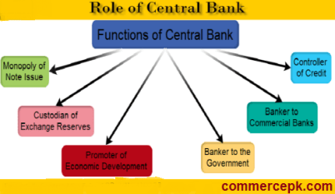
  Functions of central bank

Slide 13
  Methods of Credit Control used by Central Bank

Slide 14
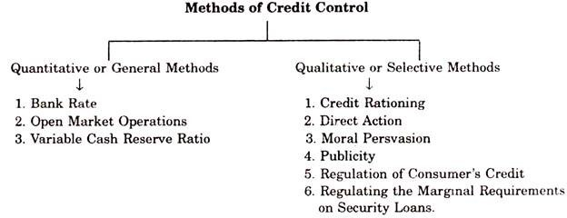
  Methods of Credit Control used by Central Bank
The following points highlight the two categories of methods of credit control by central bank.
The two categories are: I. Quantitative or General Methods II. Qualitative or Selective Methods.

Slide 15
  Methods of Credit Control used by Central Bank
Category # I. Quantitative or General Methods:
1. Bank Rate Policy:
Bank rate, also referred to as the discount rate in American English, is the rate of interest which a central bank charges on its loans and advances to a commercialbank. ... Whenever a bank has a shortage of funds, they can typically borrow from the central bank based on the monetary policy of the country.
If the Central Bank wants to control credit, it will raise the bank rate. As a result, the market rate and other lending rates in the money-market will go up. Borrowing will be discouraged. The raising of bank rate will lead to contraction of credit.
Similarly, a fall in bank rate mil lowers the lending rates in the money market which in turn will stimulate commercial and industrial activity, for which more credit will be required from the banks. Thus, there will be expansion of the volume of bank Credit.

Slide 16
  Methods of Credit Control used by Central Bank
Repo Rate: The term ‘Repo’ stands for ‘Repurchase agreement’. Repo is form of short-term, interest-bearing and collateral-backed borrowing.
Interest rate for such borrowings is termed as repo rate.
  In Indian Banking terms, repo rate is the rate at which Reserve Bank of India lends money to all the commercial banks in the country in the event of scarcity of funds.
Current repo rate is 6.25%
Reverse Repo Rate: is the rate at which – central banks barrow money from commercial banks. Reverse repo is an opposite contract to the Repo Rate.
Reverse Repo rate is the rate at which Reserve Bank of India borrows funds from all the other commercial banks in the country. In other words, it is the rate at which commercial banks in India park their excess money with Reserve Bank of India for a short-term period. Current reverse repo rate is calculated at 6%.
  Liquidity Regulator
  Price Stability:

Slide 17
  Methods of Credit Control used by Central Bank
2) Open Market Operations:(OMO)
OMO's Infusing the liquidity in to the market
Buying and selling of Govt. securities in the open market to expand/contract the amount of money in the banking system.
Recently RBI annouced that it will inject INR 12000 crores(120 Billion)liquidity into the system through purchase of government securities (OMO's), Purchasing bonds with maturity ranging between 2020-2030.
Central bank involve in OMO to buy or sell of securities in the amrket with expansionary or contractionary

Slide 18
  Methods of Credit Control used by Central Bank
Expansionary:
Money supply increases
Purchase of govt. sec by central bank
Liquidity increses
Contractionary:
Money supply decreases
Selling of securities by central bank
Liquidity decreases

Slide 19
  Methods of Credit Control used by Central Bank
3. Cash Reserve Ratio:
Cash Reserve Ratio (CRR) is the amount of funds that banks have to maintain with the central bank.
Under this system the Central Bank controls credit by changing the Cash Reserves Ratio. For example—If the Commercial Banks have excessive cash reserves on the basis of which they are creating too much of credit which is harmful for the larger interest of the economy.
So it will raise the cash reserve ratio which the Commercial Banks are required to maintain with the Central Bank.

Slide 20
  Methods of Credit Control used by Central Bank
Category # II. Qualitative/Direct or Selective Method of Credit Control:
The qualitative or the selective methods are directed towards the diversion of credit into particular uses or channels in the economy. Their objective is mainly to control and regulate the flow of credit into particular industries or businesses.
he following are the important methods of credit control under selective method:
1. Rationing of Credit.
2. Direct Action.
3. Moral Persuasion.
4. Method of Publicity.
5. Regulation of Consumer’s Credit.
6. Regulating the Marginal Requirements on Security Loans.

Slide 21
  Methods of Credit Control used by Central Bank
1. Rationing of Credit:
Under this method the credit is rationed by limiting the amount available to each applicant. The Central Bank puts restrictions on demands for accommodations made upon it during times of monetary stringency.
This is an important method of credit control and this policy has been adopted by a number of countries like Russia and Germany.
2. Direct Action:
Under this method if the Commercial Banks do not follow the policy of the Central Bank, then the Central Bank has the only recourse to direct action. This method can be used to enforce both quantitatively and qualitatively credit controls by the Central Banks.

Slide 22
  Methods of Credit Control used by Central Bank
3. Moral Persuasion:
This method is frequently adopted by the Central Bank to exercise control over the Commercial Banks. Under this method Central Bank gives advice, then request and persuasion to the Commercial Banks to co-operate with the Central Bank is implementing its credit policies.
If the Commercial Banks do not follow or do not abide by the advice or request of the Central Bank no gross action is taken against them.
4. Method of Publicity:
In modern times, Central Bank in order to make their policies successful, take the course of the medium of publicity. A policy can be effectively successful only when an effective public opinion is created in its favor.
Its officials through news-papers, journals, conferences and seminar’s present a correct picture of the economic conditions of the country before the public and give a prospective economic policies.
In developed countries Commercial Banks automatically change their credit creation policy. But in developing countries Commercial Banks being lured by regional gains. Even the Reserve Bank of India follows this policy.

Slide 23
  Methods of Credit Control used by Central Bank
5. Regulation of Consumer’s Credit:
Under this method consumers are given credit in a little quantity and this period is fixed for 18 months; consequently credit creation expanded within the limit.
This method was originally adopted by the U.S.A. as a protective and defensive measure, there after it has been used and adopted by various other countries.

Slide 24
  Monetary Policy & its Objectives

Slide 25
  Monetary Policy & its Objectives
Monetary policy is how central banks manage liquidity to create economic growth. Liquidity is how much there is in the money supply. That includes credit, cash, checks, and money market mutual funds.
Dr.D.C. Rowan remarked, “The monetary policy is defined as discretionary action undertaken by the authorities designed to influence:
(a) The supply of money,
(b) Cost of Money or rate of interest and
(c) The availability of money.”
Objectives of Monetary Policy
The primary objective of central banks is to manage inflation. The second is to reduce unemployment, but only after they have controlled inflation.
The U.S. Federal Reserve, like many other central banks, has specific targets for these objectives. It seeks an unemployment rate below 6.5 percent. The Fed says the natural rate of unemployment is between 4.7 percent and 5.8 percent. It wants the core inflation rate to be between 2 percent and 2.5 percent. It seeks healthy economic growth. That's a 2 to 3 percent annual increase in the nation's gross domestic product.

Slide 26
  Unemployment rate in different countries
Kenya 11.50 Dec/17.
Congo46.10Dec/13
South Africa27.10Dec/18
Nigeria23.10Sep/18
Ethiopia16.80Dec/15
Zimbabwe5.16Dec/17
China3.80Dec/18
India3.53Dec/18
United States3.80Mar/19

Slide 27
  Monetary Policy & its Objectives
Top 6 Objectives of Monetary Policy
As the objective of monetary policy varies from country to country and from time to time, a brief description of the same has been as following:
(i) Neutrality of money
(ii) Stability of exchange rates
(iii) Price stability
(iv) Full Employment
(v) Economic Growth
(vi) Equilibrium in the Balance of Payments.

Slide 28
Thank you .

