Slide 1
Education Quotes
Education is the most powerful weapon which you can use to change the world. ...
Education is the passport to the future, for tomorrow belongs to those who prepare for it today. ...
Education is An investment in knowledge pays the best interest.
Dr.Krishna Gadasandula

Slide 2
Welcome to all 2nd Year MBA. Students
Dr. Krishna Gadasandula M.B.A., M.Com. M.Phil. and Ph.D. With more than ten years of experience in Accounting and Finance Teaching, Research, Training & Education Management. Mail: krishnagadasandula@gmail.com, # +91 9866349726-, 0904565415(Local Phone No.)
Hyderabad.India.

Slide 3
What is the Difference between
Businessman and Entrepreneur?

Slide 4
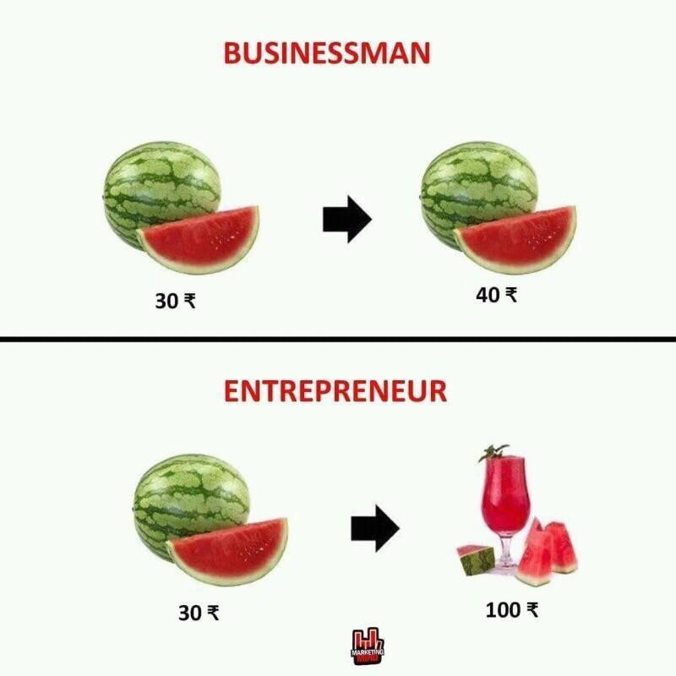
Activity-Based Costing System
Dr.G.Krishna

Slide 5
Course Title: Financial Markets & Institutions Course Code: MBA 5052 Instructor: Dr.Krishna Gadasandula current batch cr ph no. +251 91870 7232 +251 911998132 ok

Slide 6
Financial Markets and Institutions: Syllabus
Advanced Management Accounting:

Slide 7
Syllabus -Chapter and Content Objectives
Chapter 1: INTRODUCTION TO FINANCIAL INSTITUTIONS
Meaning and nature of financial institutions Types of financial institutions Functions of financial institutions Role of financial institutions Money & Characteristics of a developed Money Market
Chapter 2 ------BANKING SYSTEM
1 .Evolution of Central Banking,2 .Definition of a Central Bank 3.Central Banking Functions 4.Credit Control Methods 4. Monetary Policy & its Objectives 5. Regulation of the financial system 6. Central banking system in Ethiopia Commercial Banking system 1. Definition of commercial banking 2.Commercial banking services 3. Domestic and international banking operation

Slide 8
Syllabus -Chapter and Content Objectives
Chapter 3 ----OVERVIEW OF INVESTMENT
Investment in general Investment Decision Process: Important Considerations Investment Alternatives: Money market, fixed income, equity, and derivative Indirect investment through different types of investment companies 5. Return and risks from investment 6. Asset Pricing Models Analysis
Chapter 4--- ---SECURITIES MARKET AND TRADING
Primary, Secondary and Third Markets. 2. Foreign markets 3. Stock Market Indicators 4. Institutional Vs Private Investments
Chapter 5--- ---SECURITY ANALYSIS
1 Market analysis 2 Industry Analysis 3 Company Analysis 4 Technical Analysis
Chapter 6--INTRODUCTION TO DERIVATIVE MARKET
1 Futures and Forwards, 2 Options, 3 Swaps 4 Floors and Caps

Slide 9
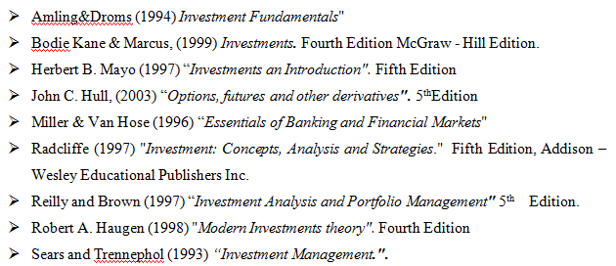
Syllabus -Chapter and Content Objectives
Chapter 7 ----PORTFOLIO SELECTION, MANAGEMENT AND EVALUATION
1. portfolio Selection, 2. Portfolio Management, 3. Portfolio Evaluation
References:

Slide 10
Assessment Methods
Assessment method | Weight
Assessment -I - (Individual Assignment )- | 10%
Assessment -II (Group Assignment) | 20%
Assessment –III (Test ) | 20%
Final Exam | 50 %
Total | 100%

Slide 11
?
Chapter 1: INTRODUCTION TO FINANCIAL INSTITUTIONS
Meaning and nature of financial institutions Types of financial institutions Functions of financial institutions Role of financial institutions Money & Characteristics of a developed Money Market

Slide 12
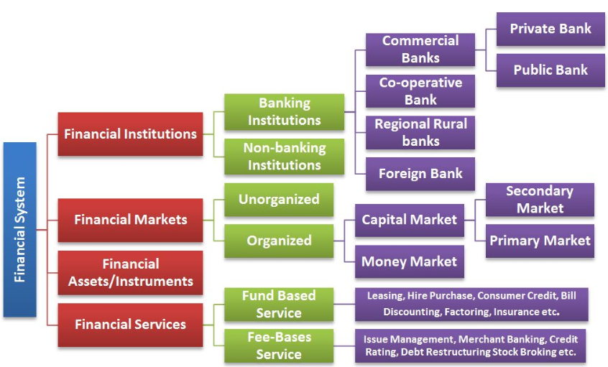
?
Financial System :
Meaning and nature of financial institutions Types of financial institutions Functions of financial institutions Role of financial institutions Money & Characteristics of a developed Money Market

Slide 13
Meaning and nature of financial institutions

Slide 14
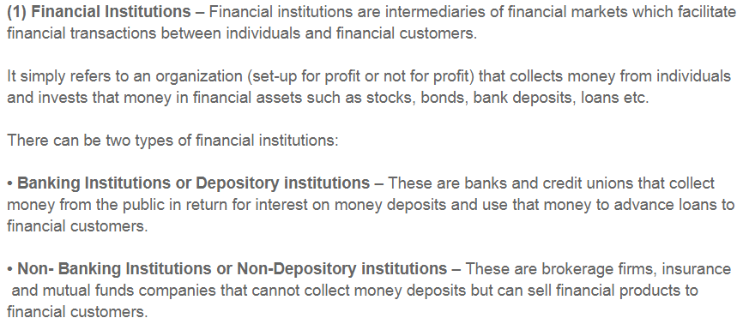
Meaning and nature of financial institutions

Slide 15
Types Of Financial Institutions, functions And Their Roles

Slide 16
How many banks are there in Ethiopia?

Slide 17
List of banks in Ethiopia
]
 | Bank Name | Year Est. | No of Branches
1 | Abay Bank S.C. | 2010 | 159^{[2]}
2 | Addis International Bank | 2011 | 54^{[4]}
3 | Awash International Bank | 1994 | 191
4 | Bank of Abyssinia | 1996 | 233^{[6]}
5 | Berhan International Bank | 2010 | 46
6 | Bunna International Bank | 2009 | 72
7 | Commercial Bank of Ethiopia | 1963 | 1192^{[8]}
8 | Cooperative Bank of Oromia(s.c.) | 2005 | 190
9 | Dashen Bank | 2003 | 146^{[10]}
10 | Debub Global Bank | 2012 | 32
11 | Development Bank of Ethiopia | 1909 | 43
12 | Enat Bank | 2013 | 7
13 | Lion International Bank | 2006 | 67
14 | Nib International Bank | 1999 | 98
15 | Oromia International Bank | 2008 | 115
16 | United Bank | 1998 | 108^{[11]}
17 | Wegagen Bank | 1997 | 211^{[12]}
18 | Zemen Bank | 2009 | 1
 | Total |  | 2357

Slide 18
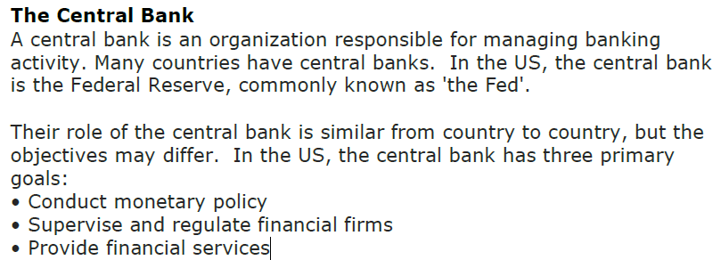
Here are some of the main categories Financial institutions know: Repo rate, Reverse Repo , CRR, SLR
.

Slide 19
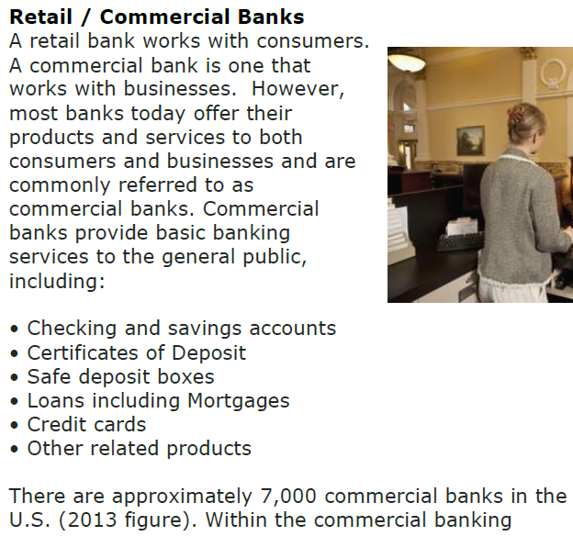
Types of financial institutions and their functions
.

Slide 20
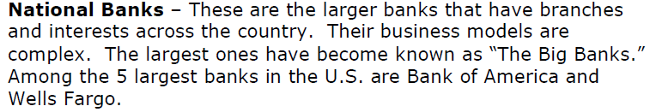
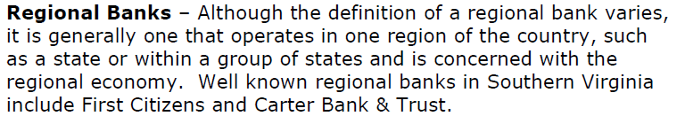
Types of financial institutions
.

Slide 21
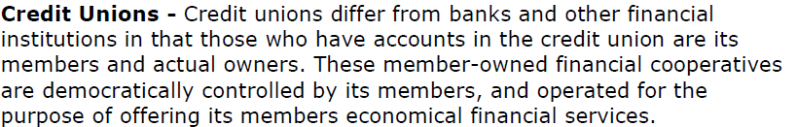
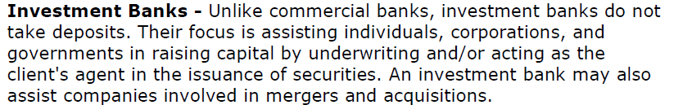
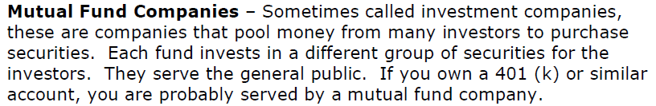
Types of financial institutions
.

Slide 22
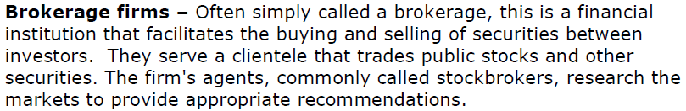
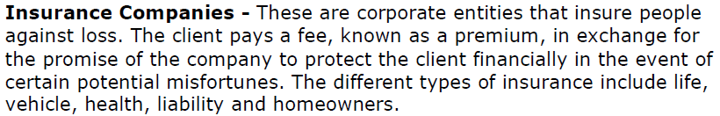
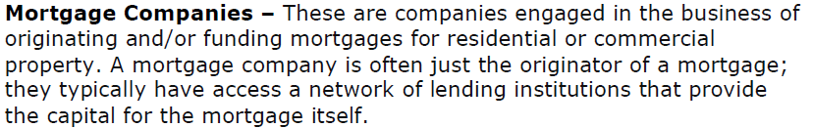
Types of financial institutions
.

Slide 23
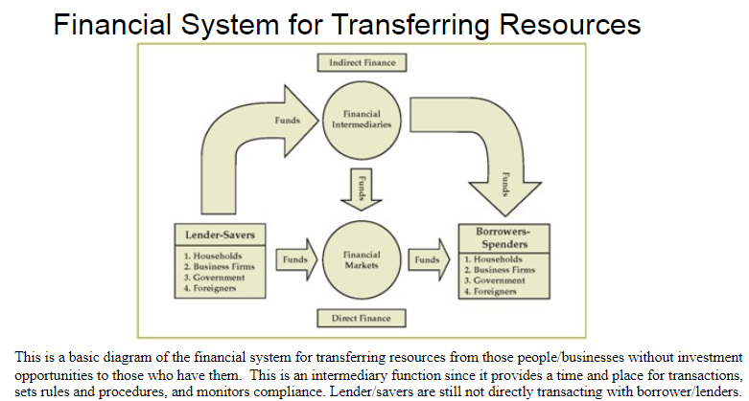
.
.

Slide 24
Role of Financial Institutions
The processes of globalization that have engulfed the world economy caused significant changes in the bank industry.
Banks more and more look like financial supermarkets which offer a complete service from the classic work through investment banking, insurance and trade securities.

Slide 25
Role of Financial Institutions
System of financial markets and institutions has a much more important role than the role of converting savings into investment.
1.One of the more recent microeconomic approaches to economic growth is the promotion of entrepreneurial activities.
2. Entrepreneurial efforts have been found to generate a wide range of economic benefits, including new businesses, new jobs, innovative products and services.
3. Financing the small scale sector: Credit is the prime input for sustained growth of small scale sector and its availability is thus a matter of great importance.

Slide 26
Role of Financial Institutions
4. Micro Finance Credit: Providing loans to unemployed or low-income individuals or groups who would otherwise have no other means of gaining financial services.
5. State level Institutions: Several financial institutions have been set up at the State level which supplement the financial assistance provided by the all India institutions.
6. Insurance and Financial services: The institutions are supporting a broad range of financial services to help expand local capital markets and develop local financial infrastructure.
And Development financial Institutions

Slide 27
Home Assignment
Write a Note on Development financial Institutions in Ethiopia.

Slide 28
Financial Market

Slide 29
It is the market for sale and purchase of stocks (shares), bonds, bills of exchange, commodities, foreign currency etc which works as liquid assets. Financial market is of two types:
Financial Market
FINANCIAL MARKETS
MONEY MARKET
CAPITAL MARKET

Slide 30

.
FINANCIAL MARKETS
MONEY MARKET
CAPITAL MARKET

Slide 31

MONEY MARKET

Slide 32

Money Market
Money market is a mechanism that deals with the lending of short term funds (less than one year)
A segment of the financial market in which financial instrument with high liquidity and very short maturities are traded.

Slide 33

Features of money market
Constituents of Money Market
Heterogeneous (diverse) Market
Dealers of Money Market
Short-term Loans
Different from Capital Market
Association with Big Cities

Slide 34
Characteristics of A Developed Money Market
Existence of Central Bank
Highly organized commercial Banking System
Availability of proper credit instruments
International attraction
Uniformity of interest rates
Stability of prices and
Highly developed Industrial system

Slide 35
Importance of Money Market
Financing Industry
Financing trade
Self sufficiency of banks
Effective implementation of monetary policy
Encourages economic growth
Help to government

Slide 36
Instruments of Money Market

Slide 37
Instrument of Money Market
Treasury bills(T’Bills)
Short-term (usually less than one year, typically three months) maturity promissory note issued by a national (federal) government as a primary instrument for regulating money supply and raising funds via open market operations
Commercial bills(CB or CP)
short-term unsecured promissory notes issued by companies.
Commercial paper is an unsecured, short-term debt instrument issued by a corporation, typically for the financing of accounts payable and inventories, and meeting short-term liabilities. Maturities on commercial paper rarely range longer than 270 days
Call Money market:
An interbank call money market is a short-term money market which allows for large financial institutions, such as banks, mutual funds and corporations, to borrow and lend money at interbank rates.

Slide 38
.
Instrument of Money Market
Promissory notes☹(PN)
A signed document containing a written promise to pay a stated sum to a specified person or the bearer at a specified date or on demand.
A promissory note is a financial instrument that contains a written promise by one party (the note's issuer or maker) to pay another party (the note's payee) a definite sum of money, either on demand or at a specified future date
Certificate of Deposits(CD or COD)
A certificate issued by a bank to a person depositing money for a specified length of time at a specified rate of interest.
A certificate of deposit (CD) is a savings certificate with a fixed maturity date, specified fixed interest rate and can be issued in any denomination aside from minimum investment requirements. A CD restricts access to the funds until the maturity date of the investment

Slide 39
Instrument of Money Market
A repurchase agreement (repo) is a form of short-term borrowing for dealers in government securities. The dealer sells the government securities to investors, usually on an overnight basis, and buys them back the following day.
A dealer or other holder of government securities (usually T-bills) sells the securities to a lender and agrees to repurchase them at an agreed future date at an agreed price.

Slide 40
Instrument of Money Market
Real interest rates are largely negative in Ethiopia.
The minimum bank deposit rate of 7.00%, bond yield of 3.67%,
Treasury bill yield of 3.67% and
Inflation rate is 16%
Return is lower than the inflation rate.

Slide 41
CAPITAL MARKET

Slide 42
CAPITAL MARKET
The market where investment instruments like bonds and equities are traded is known as the capital market.
The primal role of this market is to make investment from investors who have surplus funds to the ones who are running a deficit
The capital market offers both long term and overnight funds.
The different types of financial instruments that are traded in the capital markets are:
> Equity and Debt instruments
> Insurance instruments,
> Foreign exchange instruments, and
> Hybrid instruments

Slide 43
Nature of capital market
The nature of capital market is brought out by the following facts:
It Has Two Segments(Primary and secondary)
It Deals In Long-Term Securities
It Performs Trade-off Function
It Creates Dispersion In Business Ownership
It Helps In Capital Formation
It Helps In Creating Liquidity

Slide 44
T
Y
P
E
S
O
F
C
A
P
I
T
A
L
M
A
R
K
E
T
Primary Market
Secondary Market

Slide 45
Primary Market
It is that market in which shares, debentures and other securities are sold for the first time for collecting long-term capital.
This market is concerned with new issues. Therefore, the primary market is also called NEW ISSUE MARKET.
In this market, the flow of funds is from savers to borrowers (industries), hence, it helps directly in the capital formation of the country.
The money collected from this market is generally used by the companies to modernize the plant, machinery and buildings, for extending business, and for setting up new business unit.

Slide 46
Features of Primary Market
It Is Related With New Issues
It Has No Particular Place
It Has Various Methods Of Float Capital: Following are the methods of raising capital in the primary market:
i) Public Issue (IPO)
ii) Offer For Sale
iii) Private Placement
iv) Right Issue
v) Electronic-Initial Public Offer
It comes before Secondary Market
Learn About Methods of issue in IPO

Slide 47
Secondary Market
The secondary market is that market in which the buying and selling of the previously issued securities is done.
The transactions of the secondary market are generally done through the medium of stock exchange.
The chief purpose of the secondary market is to create liquidity in securities.
If an individual has bought some security and he now wants to sell it, he can do so through the medium of stock exchange to sell or purchase through the medium of stock exchange requires the services of the broker presently.

Slide 48
Features of Secondary Market
It Creates Liquidity
It Comes After Primary Market
It Has A Particular Place
It Encourage New Investments
There is no Secondary market in Ethiopian stock market Why?

Slide 49
Thank you .

