Slide 1
Chapter-7
PORTFOLIO SELECTION, MANAGEMENT AND EVALUATION
Portfolio Management
Dr.Krishna Gadasandula

Slide 2
Welcome to all
2nd Year MBA. Students
Dr. Krishna Gadasandula
M.B.A., M.Com. M.Phil. and Ph.D.
With more than ten years of experience in Accounting and Finance Teaching, Research, Training & Education Management.
Mail: krishnagadasandula@gmail.com, # +91 9866349726-, 0904565415(Local Phone No.)
Hyderabad.India.

Slide 3
Portfolio:
Meaning : Refers to a collection of investment tools such as stocks, mutual funds bonds, cash etc. depending on the investor's income, budget and convenient time frame.

Slide 4
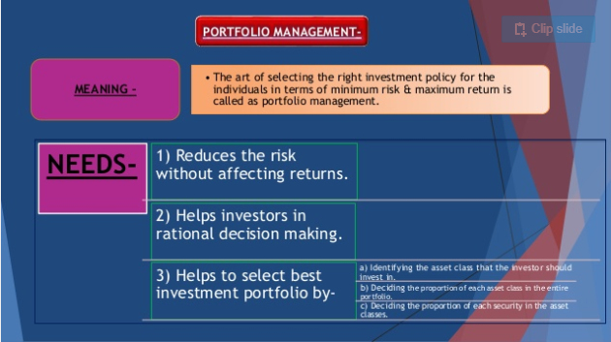

Slide 5
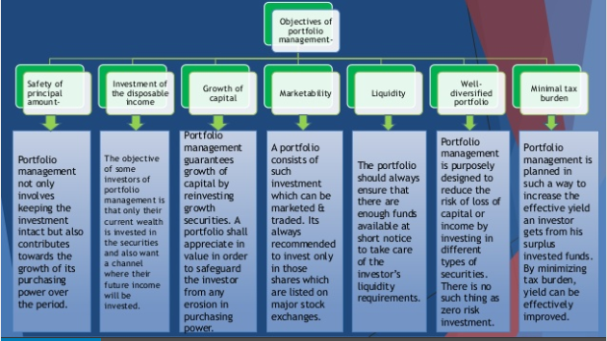

Slide 6
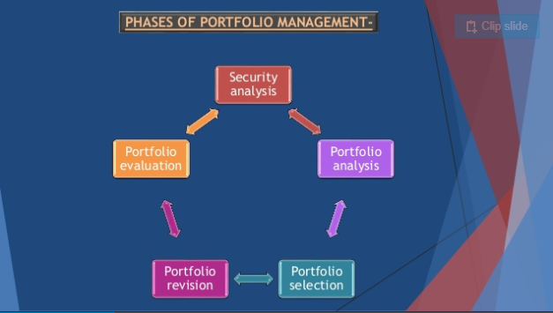

Slide 7
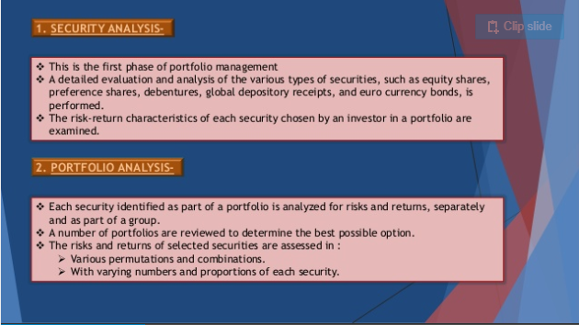

Slide 8
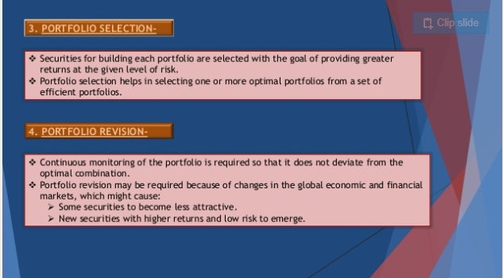

Slide 9
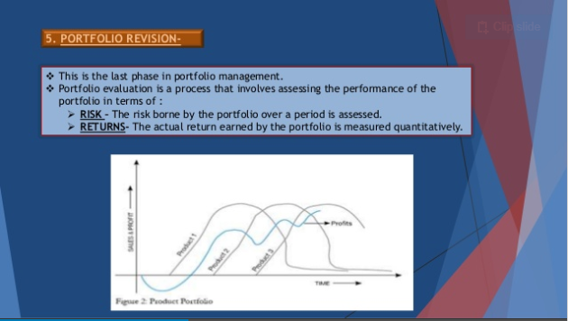

Slide 10
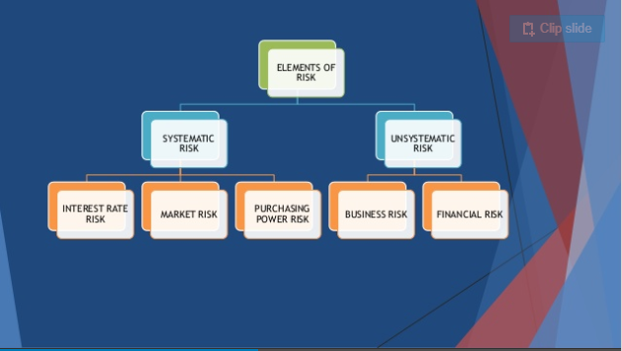

Slide 11
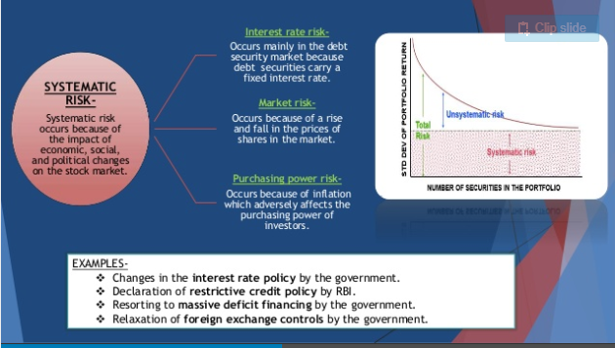

Slide 12
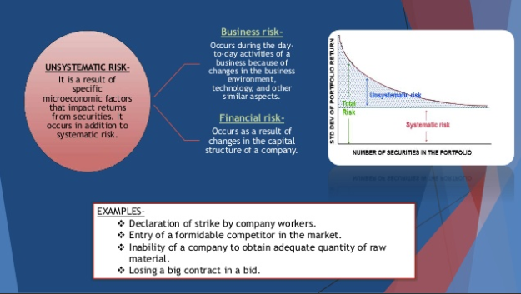

Slide 13
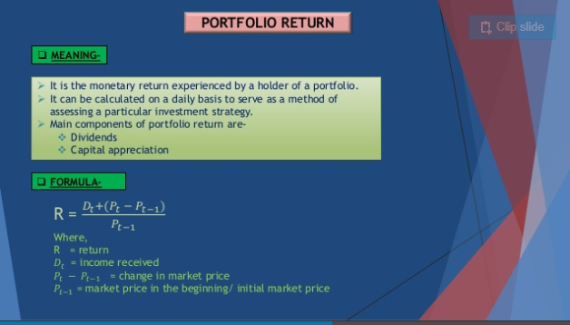

Slide 14
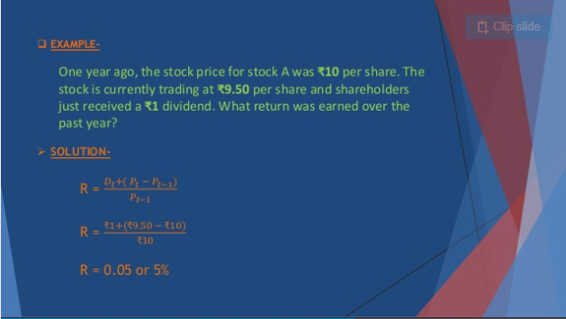

Slide 15
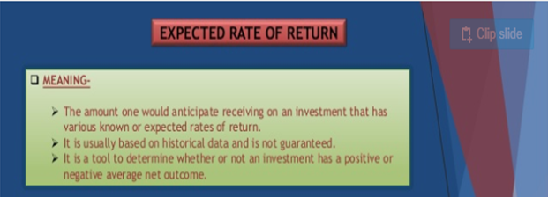

Slide 16
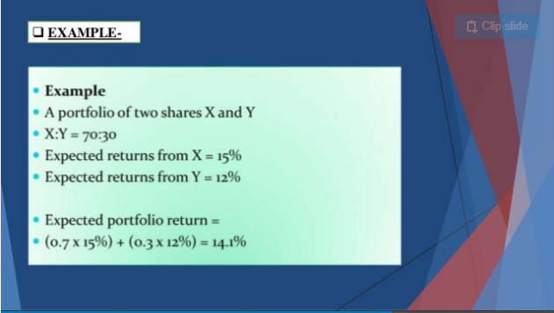

Slide 17
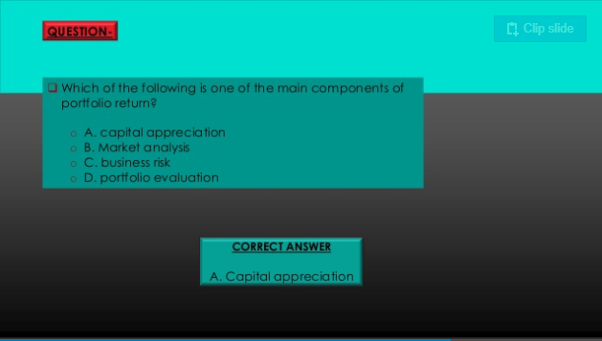

Slide 18
Thank you .

