Slide 1

Leadership and Change Management
(MBA5023)
Chapter TWO:
Leadership Theories and Styles
BY: Yissa Hassen (Ph.D Scholar)
March, 2020
Debre Tabor, Ethiopia

Slide 2
  2.1: Leadership style

Slide 3
What is Leadership style?
What are the types of Leadership Style?

Slide 4
What is Leadership style?
What are the types of Leadership Style?

Slide 5
  Cont’d……
The focus on finding leadership style (behavior patterns of leaders) is on the relationship between leaders’ action and the reaction of subordinates emotionally and behaviorally. A manager’s leadership style is composed of three parts:

Slide 6
  Cont’d……
leadership style is composed of three parts:
A. How the manager chooses to motivate subordinates
Motivation approach
Positive | Negative
Responsibility Recognition Praise Security Monetary Rewards | Threats Coercion Fines Suspensions Termination

Slide 7
  Cont’d……
B. His/her decision-making style: the degree of decision-making authority the manager grants to subordinates.
C. His/her areas of emphasis (orientation) in the work environment: Task orientation, employee orientation.

Slide 8
  Cont’d……
Based on the above points there are three types of leadership styles:
Autocratic or Authoritative
Democratic or Participative
Laissez Fair or Free rein

Slide 9
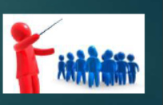
  A. Autocratic or authoritarian style
It is closely associated with the classical approach to management.
The manager who follows this style is dogmatic and leads by the ability to withhold or give rewards and punishment, i.e. motivation is through incentives and fear.

Slide 10
Cont’d….
Under the autocratic leadership style, all decision-making powers are centralized in the leader, as with dictator leaders.
They do not entertain any suggestions or initiatives from subordinates.
The autocratic leadership has been successful as it provides strong motivation to the leader.
It permits quick decision-making, as only one person decides for the whole group and keeps each decision to himself until he feels it is needed to be shared with the rest of the group.
High degree of dependency on the leader
May be valuable in some types of business where decisions need to be made quickly and decisively

Slide 11
  Cont’d……
In this approach find the manager making the decision and then “Selling” it to employees or making the decision and allowing the group the opportunity to ask questions.
The autocratic leader is task-oriented and places little value on showing consideration to subordinations as a leadership technique.
The Autocratic manager uses Theory X assumption as his philosophical base for leadership.

Slide 12
  Advantages
When there is a need to influence subordinates in favor of organizational objectives which has an effect on individuals.
When subordinates are new, they need to be directed.
When the situation calls for unilateral decision-making – perhaps there is no enough time for quality input from subordinates or the subordinates may lack information.

Slide 13
  Disadvantages
Employees’/subordinates’ ideas will not be used to solve organizational problems, which in some cases subordinates may have better ideas than the superior about a particular problem.
Subordinates would be demotivated, i.e. It may suppress individual initiative
Poor implementation of decisions

Slide 14
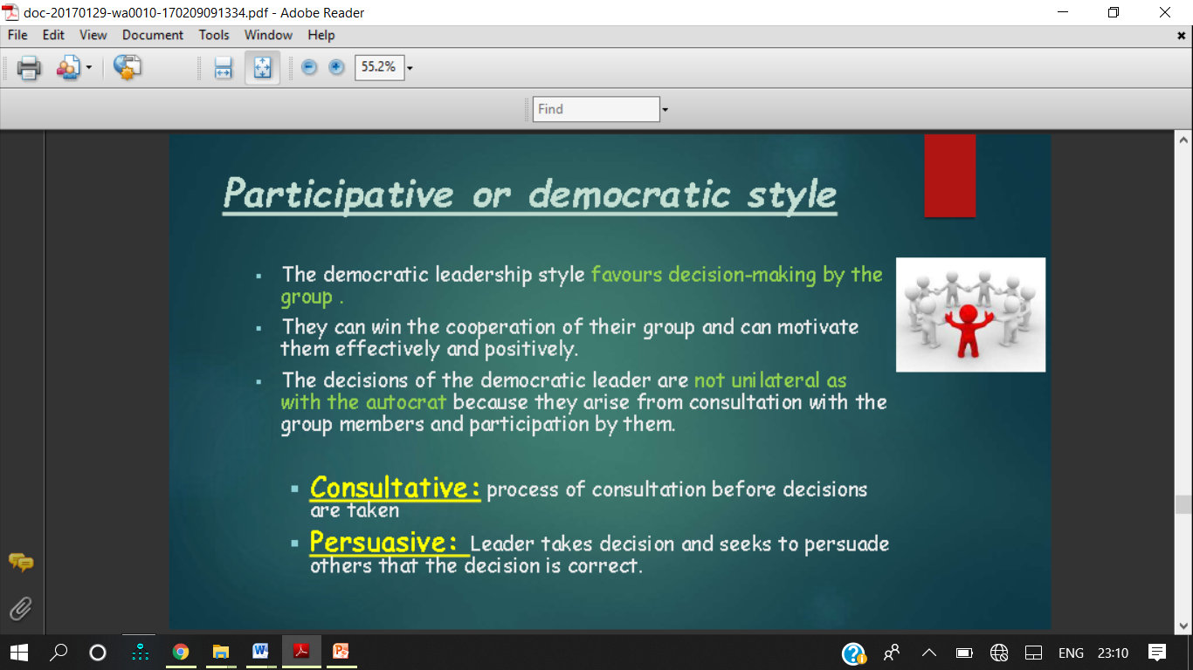
Participative or democratic style

Slide 15
Participative or democratic style
The democratic leadership style favours decision-making by the group .
They can win the cooperation of their group and can motivate them effectively and positively.
The decisions are made with the consultation of group members and participation by them.
Consultative: process of consultation before decisions are taken
Persuasive: Leader takes decision and seeks to persuade others that the decision is correct.

Slide 16
  Cont’d……
The leader delegates a great deal of authority while retaining ultimate responsibility.
Active two-way communication (upward and downward) exists.
The democrat leader uses Theory Y assumption as his/her philosophical base for leadership.

Slide 17
  Cont’d……
The advantages of democratic leadership style are the disadvantages of the autocratic leadership style after we make them opposite.
Disadvantages/Limitations
Subordinates may be too involved to influence the manager even when there is no need.
The manager may not be able to influence the subordinates to the extent needed.
However, the major advantage of this leadership style is that, it enhances personal commitment through participation.

Slide 18
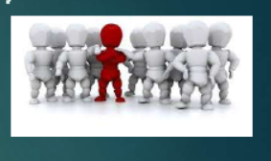
Laissez –Faire or free rein style

Slide 19
Laissez –Faire or free rein style
A free rein leader does not lead, but leaves the group entirely to itself such a leader allows maximum freedom to subordinates, i.e. they are given a free hand in deciding their own policies and methods.
Can be very useful in businesses where creative ideas are important
Can be highly motivational, as people have control over their working life
Can make coordination and decision making time-consuming and lacking in overall direction
Relies on good team work.
Relies on good interpersonal relations

Slide 20
  Cont’d……
leaders generally give the group complete freedom, provide the necessary materials, participate only to answer questions, and avoid decision-making whenever possible.
Leaders depend largely on subordinates to set their own goals and the means of achieving them, and they see their role as one of aiding the operations of followers by furnishing them information and acting primarily as a contact with the groups external environment, i.e. the leader’s role is to serve as a logistics specialist or representative of the group to outside groups.

Slide 21
  Cont’d……
The application of Laissez-Faire style can be found with individuals or groups that the manager views as being knowledgeable, independent, or motivated.
Additionally, if the work group is composed of high achievers, or is highly research oriented, this style has potential benefits.
Primarily horizontal communication among peers exists.

Slide 22
  Cont’d……
Advantages
It gives quite freedom for subordinates
It gives much responsibility and self-guidance for subordinates
It permits self-starters to do things as they see fit without leader
Disadvantages
Group may drift aimlessly in the absence of direction from leader.
It may make things out of control.

Slide 23
Situational Leadership style
The situational leadership style states that for a manager to be democrat, autocratic or laissez-faire, situations force him/her.

Slide 24



