Slide 1
Chapter -Seven
Data Processing and Data Analysis
By: K.E

Slide 2
7.1. Data Processing and Analysis
The data, after collection, has to be processed and analysed in accordance with the outline laid down for the purpose at the time of developing the research plan.
This is essential for a scientific study and for ensuring that we have all relevant data for making contemplated comparisons and analysis.
Technically speaking, processing implies editing, coding, classification and tabulation of collected data so that they are amenable to analysis.
The term analysis refers to the computation of certain measures along with searching for patterns of relationship that exist among data-groups.

Slide 3
Cont’d…
Thus, “in the process of analysis, relationships or differences supporting or conflicting with original or new hypotheses should be subjected to statistical tests of significance to determine with what validity data can be said to indicate any conclusions

Slide 4
PROCESSING OPERATIONS
The following are the explanation of all the data processing operations.
Editing: Editing of data is a process of examining the collected raw data (specially in surveys) to detect errors and omissions and to correct these when possible.
As a matter of fact, editing involves a careful scrutiny of the completed questionnaires and/or schedules. Editing is done to assure that the data are accurate, consistent with other facts gathered, uniformly entered, as completed as possible and have been well arranged to facilitate coding and tabulation.
With regard to points or stages at which editing should be done, one can talk of field editing and central editing.

Slide 5
Cont’d…
Field editing consists in the review of the reporting forms by the investigator for completing (translating or rewriting) what the latter has written in abbreviated and/or in illegible form at the time of recording the respondents’ responses. This type of editing is necessary in view of the fact that individual writing styles often can be difficult for others to decipher.
This sort of editing should be done as soon as possible after the interview, preferably on the very day or on the next day. While doing field editing, the investigator must restrain himself and must not correct errors of omission by simply guessing what the informant would have said if the question had been asked.

Slide 6
Cont’d…
Central editing should take place when all forms or schedules have been completed and returned to the office.
This type of editing implies that all forms should get a thorough editing by a single editor in a small study and by a team of editors in case of a large inquiry.
Editor(s) may correct the obvious errors such as an entry in the wrong place, entry recorded in months when it should have been recorded in weeks, and the like.
In case of inappropriate on missing replies, the editor can sometimes determine the proper answer by reviewing the other information in the schedule.
At times, the respondent can be contacted for clarification.

Slide 7
Cont’d…
Coding: Coding refers to the process of assigning numerals or other symbols to answers so that responses can be put into a limited number of categories or classes. Such classes should be appropriate to the research problem under consideration.
They must also possess the characteristic of exhaustiveness (i.e., there must be a class for every data item) and also that of mutual exclusively which means that a specific answer can be placed in one and only one cell in a given category set.
Another rule to be observed is that of unidimensionality by which is meant that every class is defined in terms of only one concept.

Slide 8
Cont’d…
Coding is necessary for efficient analysis and through it the several replies may be reduced to a small number of classes which contain the critical information required for analysis. Coding decisions should usually be taken at the designing stage of the questionnaire.
Coding may be done at the time of questionnaire design

Slide 9
Cont’d…
Classification: Most research studies result in a large volume of raw data which must be reduced into homogeneous groups if we are to get meaningful relationships.
This fact necessitates classification of data which happens to be the process of arranging data in groups or classes on the basis of common characteristics.
Data having a common characteristic are placed in one class and in this way the entire data get divided into a number of groups or classes.

Slide 10
Types of classifications
Classification can be one of the following two types, depending upon the nature of the phenomenon involved:
Classification according to attributes: As stated above, data are classified on the basis of common characteristics which can either be descriptive (such as literacy, sex, honesty, etc.) or numerical (such as weight, height, income, etc.).
Descriptive characteristics refer to qualitative phenomenon which cannot be measured quantitatively; only their presence or absence in an individual item can be noticed.
Data obtained this way on the basis of certain attributes are known as statistics of attributes and their classification is said to be classification according to attributes.

Slide 11
Cont’d…
Classification according to class-intervals: Unlike descriptive characteristics, the numerical characteristics refer to quantitative phenomenon which can be measured through some statistical units.
Data relating to income, production, age, weight, etc. come under this category.
Such data are known as statistics of variables and are classified on the basis of class intervals. For instance, persons whose incomes, say, are within Rs 201 to Rs 400 can form one group, those whose incomes are within Rs 401 to Rs 600 can form another group and so on.
In this way the entire data may be divided into a number of groups or classes or what are usually called, ‘class-intervals.’
Then items in each class will be counted

Slide 12
Cont’d…
Tabulation: When a mass of data has been assembled, it becomes necessary for the researcher to arrange the same in some kind of concise and logical order. This procedure is referred to as tabulation.
Thus, tabulation is the process of summarising raw data and displaying the same in compact form (i.e., in the form of statistical tables) for further analysis.
In a broader sense, tabulation is an orderly arrangement of data in columns and rows.

Slide 13
Reading Assignment
Generally Accepted Principles Of Tabulation:
Some Problems In Processing

Slide 14
Qualitative and Quantitative Data Analysis
Qualitative data refers to the expression and explanation of attributes of phenomena than the quantity or amount of measures.
Ethnographic
It is investigating how people adapt to new living conditions like prison, care home etc…
The researcher observes and analyses the social, ethnic, norms, and manners of communication on complex culture. The focus will be based on themes.
Constant comparative
It is taking one data (one interview, one observation, statement, document analysis) and compare it with other to develop conceptualization.
Phonological
It is the science of experience observed through observation.
It is stating the story in to themes. E.g mis treatment and loss of responsibility stating after detailed observation.

Slide 15
Coding
It is significant procedure for qualitative data analysis.
It is naming or categorizing data to reduce, integrate and conceptualize data.
It is dividing data in to individual words.
Types of coding
Open coding –initial stage, breakdown data to separate unit of meaning.
Axial coding – next stage, reduce the number of codes and collect them together.
Selective coding- final stage, categorizing in to core issues, develop theories.

Slide 16
Reliability and validity issues
Reliability
It is central concept in measurement of consistency.
It measures consistency overtime (stability) and internal consistency.
Stability- measures the extent to which, the same instrument measures the same result, under the same circumstance over time.
Internal consistency- it refers the extent to which the items are consistent to each other.
It is measured using chronbatches Alpha values > 0.7.

Slide 17
Validity
It refers to the extent in which a test measures what we actually wish to do.
Types of validity
External validity: assumes generalizability of events to other situations , persons, places or times.
Construct validity: it means that the instrument measures what we intend to measure, we measure the outcome what we want to measure.
Internal validity: this assumes that there is relation ship between study variable and tries to explain the relationship is casual.

Slide 18
Quantitative ANALYSIS
As stated earlier, by analysis we mean the computation of certain indices or measures along with searching for patterns of relationship that exist among the data groups.
Analysis, particularly in case of survey or experimental data, involves estimating the values of unknown parameters of the population and testing of hypotheses for drawing inferences.
Analysis may, therefore, be categorised as descriptive analysis and inferential analysis (Inferential analysis is often known as statistical analysis). “

Slide 19
Scale of measurements
Nominal data – it categorizing based on names
e.g. Gender - Male or Female
Religion – Muslim, Christian, Jew
Frequency, percentage and chi-square test can be computed.
Ordinal data – measures magnitude difference with no clear and specific interval.
e.g. Satisfaction – high , low, medium
agreement- strongly agree, agree, neutral, disagree, strongly disagree.
- Percentile and median can be applied

Slide 20
Cont…
Interval data – the measurement has equal unit in scale. It does not have absolute zero.
E.g. height in meters, weight in kilograms, temperature in degree centigrade
- T-test, ANOVA, and multivariate analysis techniques are used.
Ratio data – the measurement has equal unit in scale. It has absolute zero.
E.g. height in meters, weight in kilograms,
- All statistical analysis techniques are used.

Slide 21
Types of Quantitative Analysis
Univariate analysis
the examination of the distribution of cases on only one variable at a time (e.g., college graduation)
Bivariate analysis
the examination of two variables simultaneously (e.g., the relation between gender and college graduation)
Multivariate analysis
the examination of more than two variables simultaneously (e.g., the relationship between gender, race, and college graduation)

Slide 22
Purpose of each Analysis
Univariate analysis
Purpose: description
Bivariate analysis
Purpose: determining the empirical relationship between the two variables
Multivariate analysis
Purpose: determining the empirical relationship among the variables

Slide 23
Types of Statistics
Descriptive statistics: are techniques that summarize and describe characteristics of a group or make comparisons of characteristics between groups
Inferential statistics are used to make generalizations or inferences about a population based on findings from a sample.
The choice of a type of analysis is based on the evaluation questions, the type of data collected, and the audience who will receive the results.

Slide 24
Simple statistical Analysis
Measures of central tendency reflect the central tendencies of a distribution
Mode reflects the attribute with the greatest frequency
Median reflects the attribute that cuts the distribution in half
Mean reflects the average; sum of attributes divided by # of cases
Measures of dispersion reflect the spread or distribution of the distribution
Range is the difference between largest & smallest scores; high – low
Variance is the average of the squared differences between each observation and the mean
Standard deviation is the square root of variance

Slide 25
Types of univariate and Multivariate analysis
In modern times, with the availability of computer facilities, there has been a rapid development of multivariate analysis which may be defined as “all statistical methods which simultaneously analyse more than two variables on a sample of observations” Usually the following analyses are involved when we make a reference of multivariate analysis:

Slide 26
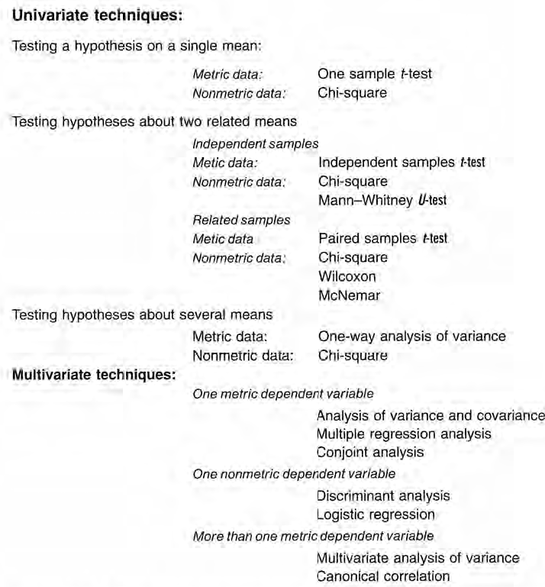
Cont’d…

Slide 27
Analysis on your study
..\..\SPSSStatistics
..\..\MBA Summer.sav
..\..\SPSS Amharic Tutorial

Slide 28
Thank you for your Attention.

