Slide 1
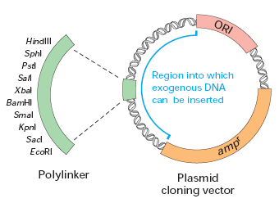
FUNDAMENTALS OF BIOTECHNOLOGY
Biol3073
Haftom G.
Department of Biology
Bonga University

Slide 2
CHAPTER ONE:
INTRODUCTION AND DEFINITION
Definition
Classical V_{S} modern Biotechnology
Scope and Application of Biotechnology

Slide 3
Introduction
The term ‘biotechnology’ was used before the 20th century for traditional activities such as making cheese, bread, wine, beer, etc.
But none of these could be considered biotechnology in the modern sense.
Genetic alteration of organisms through selective breeding, plant cloning by grafting, etc. do not fall under biotechnology.

Slide 4
The process of fermentation for the preparation and manufacturing of products such as:
Alcohol, beer, wine
Dairy products
Various types of organic acids such as vinegar, citric acid, amino acids, and vitamins can be called classical biotechnology or traditional biotechnology.
Modern biotechnology is similar to classical biotechnology in utilizing living organisms.
It is not modern in the sense of using various living organisms, but in the techniques for doing so.

Slide 5
Definition of Biotechnology
The word ‘biotechnology’ has been derived from two simple terms of science, i.e., ‘bio (Biology)’ and ‘Technology’.
Bio – life
Technology – any technique or procedure to develop new products.
The term biotechnology was used for the first time by Karl Erkey, a Hungarian Engineer, in 1919.
Later on biotechnology was defined by different scientists.

Slide 6
As per one definition biotechnology is, “Application of the principles of engineering and biological science to create new products from raw materials of biological origin, for example, vaccines or food.”
Or in other words, it can also be defined as, “the use of living organism/s or their product/s to modify or improve human health and human environment”.
Biotechnology uses either living material or biological products to create new products for their use in various pharmaceutical, medical, agricultural, and environmental applications, with the ultimate goal to benefit humanity.

Slide 7
There are several definitions for Biotechnology
United States National Science Academy
“the controlled use of biological agents like cells or cellular components for beneficial use”.
British Biotechnologists
“the application of biological organisms, systems or processes to manufacturing and service industries”
UN Convention on Biological Diversity (CBD)
“any technological application that uses biological systems, living organisms, or derivatives thereof, to make or modify products or processes for specific use.’’
Japanese Biotechnologists
“the integrated use of: biochemistry, molecular biology, microbiology and engineering sciences in order to achieve technological application of capabilities of microorganisms, cultured tissues, cells and parts”

Slide 8
Historical overview
How old is Biotechnology?
As a science, it is very new But as a technology it is very old although (has not been coined biotechnology)
Traditional biotechnology has been used for thousands of years
To produce improved food and health care products.
In one form or another, has flourished since prehistoric times.
Egyptian and Indus valley
Domesticated and breed plants and animals
Gathered and processed herbs for medicine

Slide 9
They could plant their own crops and breed their own animals, they learned to use biotechnology.
The discovery that fruit juices fermented into wine, or that milk could be converted into cheese or yogurt, or that beer could be made by fermenting solutions of malt and hops began the study of biotechnology
When the first bakers found that they could make a soft, spongy bread rather than a firm, thin cracker (biscuit), they were acting as fledgling biotechnologists.
The first animal breeders, realizing that different physical traits could be either magnified or lost by mating appropriate pairs of animals, engaged in the manipulations of biotechnology.

Slide 10
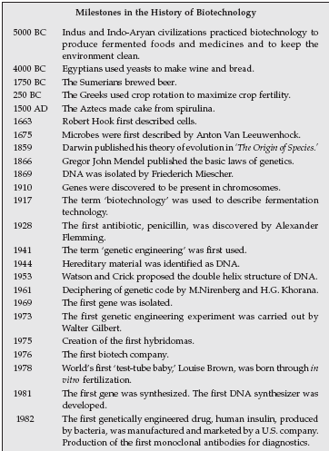

Slide 11
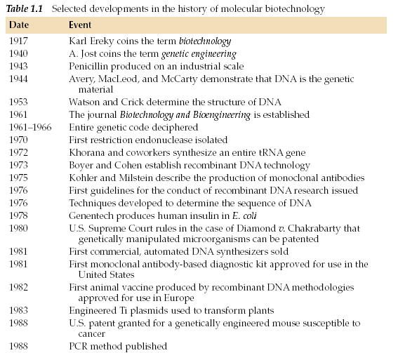

Slide 12
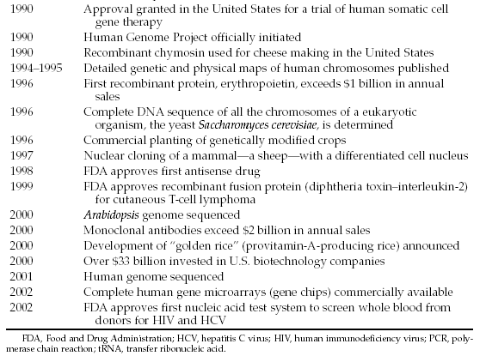

Slide 13
Classical Vs modern Biotechnology
No differences in principles but technological advancement of utilizing living cells for the benefit of man
Classical Biotechnology
Basically a microbial-based fermentation process
Is a hybrid of fermentation and biochemical engineering
Emerged during the early 20th century
Industries linked to the fermentation technology
To produce various chemicals such as ethanol, butanol, glycerine, acetone, etc.

Slide 14
Bioprocess technology
Large-scale production of proteins, antibiotics and enzymes
Includes media and buffer preparation, upstream processing and downstream processing.
Thus, fermentation technology is now part of the classical biotechnology
Modern Biotechnology
Mainly based on Genetic engineering/recombinant DNA technology and hybridoma technology in addition to bioprocess technology
rDNA technology is the main tool to produce genetically-modified organisms, including: plants, animals, and microbes

Slide 15
Scope and importance of Biotechnology
Biotechnology is controlled use of biological agents for beneficial use.
It is integrated use of biochemistry, molecular biology, microbiology to achieve technological application of the capabilities of biological agents.
Therefore, biotechnology has emerged as a science with immense potential for human welfare ranging from food processing, human health to environment protection.
The following are some of the most important applications of biotechnology.

Slide 16
Biotechnology in Medicine
Production of antibodies, DNA, RNA probes for diagnosis of various diseases;
Gene therapy: artificially replacing a disease-causing gene with a normal allele e.g. treatment of cystic fibrosis
Valuable drugs like insulin and interferon have been synthesized by bacteria for treatment of human diseases.
DNA fingerprinting is utilized for identification of parents and criminals.
Development of recombinant vaccines like human hepatitis B etc. by genetically engineered microbes
Test tube baby in humans - to resolve problem of infertility

Slide 17
B. Industrial Biotechnology
Is an area with which biotechnology was identified for large scale production of alcohol and antibiotics by microbes.
Even today, a variety of pharmaceutical drugs and chemicals like lactic acid, glycerine etc. are being produced by genetic engineering for better quality and quantity.
Biotechnology has provided us with a very efficient and economic technique for production of variety of biochemical i.e. immobilized enzymes.
Protein engineering is other important area where existing proteins and enzymes are remodeled for a specific function or for increasing efficiency of their function.

Slide 18
C. Biotechnology and Environment
Environmental problems like:
Pollution control,
Depletion of natural resources for non renewable energy
Conservation of biodiversity etc. are being dealt with using biotechnology.
For e.g. bacteria are being utilized for detoxification of industrial effluents, in combating soil spills for treatment of sewage and for biogas production.
Bio-pesticides give environmentally safer alternative to chemical pesticides for control of insect pests and diseases.

Slide 19
D. Biotechnology and agriculture
Production of
Transgenic animals for
increased milk production and growth rate and resistance to diseases etc…
Transgenic plants for
Insect and herbicide resistance and Virus protection
Increased nutritional quality and yield
In-vitro fertilization - for rapid multiplication of animals
Rapid multiplication of plants through plant tissue culture

Slide 20
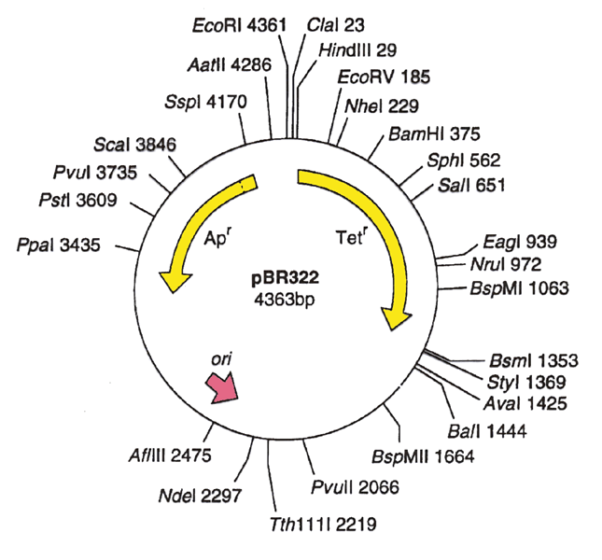
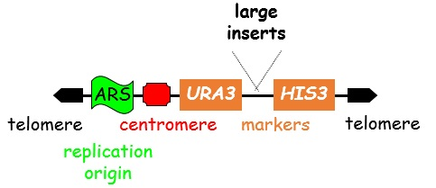
Unit two Recombinant DNA Technology
Tools of Recombinant DNA Technology
Making Recombinant DNA
DNA Library
Transgenic
Identification of Recombinants
Polymerase Chain Reaction (PCR)
DNA Probes and Hybridization Techniques

Slide 21
2. Recombinant DNA Technology (RDT)
The technology used for producing artificial DNA through the combination of different genetic materials (DNA) from different sources is referred to as Recombinant DNA Technology.
RDT is also defined as the development and application of sci­entific methods, procedures, and technolo­gies that permit direct manipulation of ge­netic material in order to alter the hereditary traits of a cell, organism, or popula­tion.
RDT includes a bunch of techniques that produce unlimi­ted amounts of otherwise unavailable or scarce biological product by introducing DNA isolated from animals or plants into bacteria and then harvesting the product from a bacterial colony, as human insulin produced in bacteria by the human insu­lin gene.

Slide 22
Recombinant DNA technology is popularly known as genetic engineering.
RDT was emerged with the discovery of restriction enzymes in the year 1968 by Swiss microbiologist Werner Arber
Inserting the desired gene into the genome of the host is not as easy as it sounds.
It involves the selection of the desired gene for administration into the host followed by a selection of the perfect vector with which the gene has to be integrated and recombinant DNA formed.
Thus the recombinant DNA has to be introduced into the host.
And at last, it has to be maintained in the host and carried forward to the offspring

Slide 23
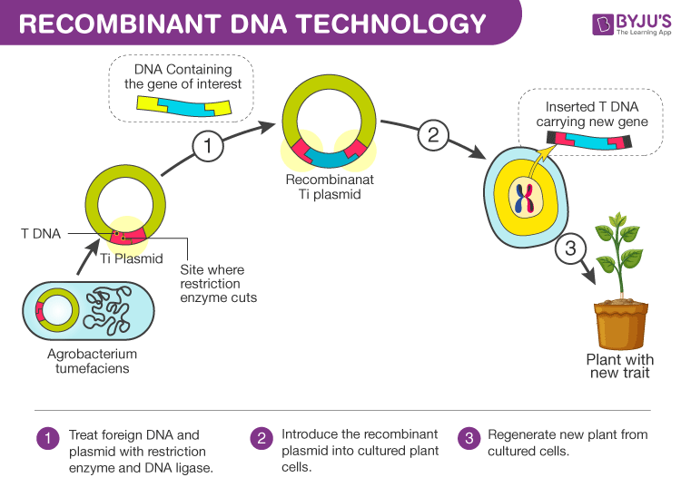

Slide 24
2.1. Tools of Recombinant DNA Technology
Restriction enzymes
Restriction enzymes belong to a larger class of enzymes called nucleases.
They are of two types:
A. Exonucleases:
They remove nucleotides from the ends of DNA.
B. Endonucleases:
They make cuts at specific positions within DNA.
Restriction enzymes that are used in RDT are endonucleases
They recognize a specific base pair sequence in DNA called a restriction site and cleave the DNA within the sequence.

Slide 25
Restriction sites differ for different restriction enzymes.
Restriction enzymes are widely found in prokaryotes and provide protection to host cell by destroying foreign DNA that makes entry into it.
Three main types of restriction endonucleases i.e., Type I, Type II and Type III are known with slightly different mode of action.
Type II restriction enzymes are used in rDNA technology because they can be used in vitro to identify and cleave within specific DNA sequences usually having 4-8 nucleotides.
More than 350 different type II endonucleases with 100 different recognition sequences are known.
The first type II enzyme isolated was HindII in 1970.

Slide 26
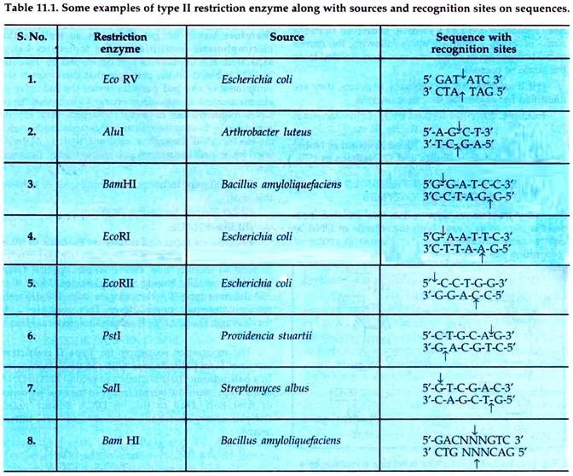

Slide 27
Nomenclature:
Nomenclature of restriction enzymes is usually done by the following technique:
The first letter of the genus is taken in which said enzyme was discovered. This letter is written in capital.
Then, first two letters of species of that organism are written.
All the above three letters should be written in italics.
This followed by strain or type identification
If an organism forms many enzymes, they are identified by sequential Roman numerals.
E.g. EcoRI i.e., EcoRI comes from Escherichia coli RY13. Here ‘R’ is derived from the name of strain. Roman numbers indicate the order in which enzymes were isolated from the strain of bacteria.

Slide 28
Cleavage Patterns of Some Common Restriction Endonucleases:
The recognition and cleavage sites and cleavage patterns of HindIII, SmaI, EcoRI, and BamHI are shown.
Cleavage by an endonuclease creates DNA sequence with either a sticky end or blunt end.
Sticky ends - fragment of DNA in which the terminal portion has a stretch of unpaired nucleotides, and the strands are not of the same length.
Blunt ends - the end of a DNA duplex that has been cut by a restriction enzyme at the same site on both strands so that there is no single-stranded overhang.
The blunt ended fragments can be joined to any other DNA fragment with blunt ends using linkers/adapters.

Slide 29
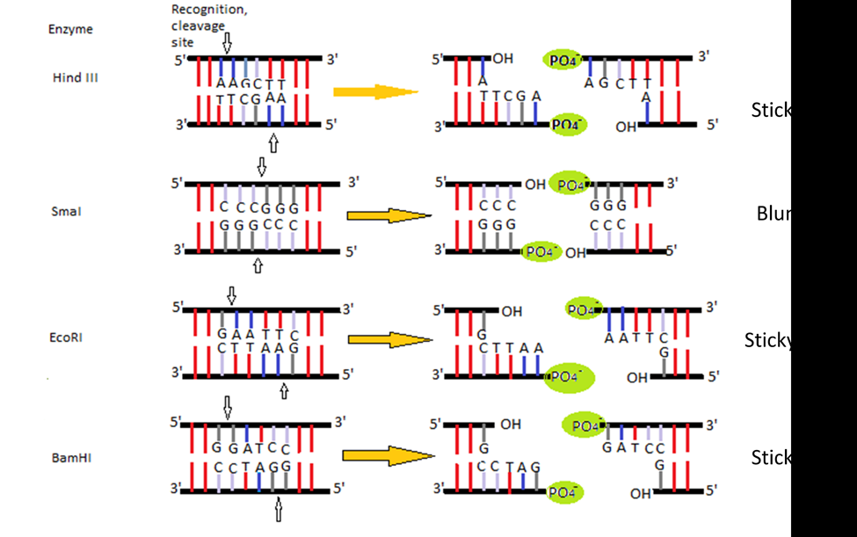
Sticky end
Blunt end
Sticky end
Sticky end

Slide 30
II. Cloning Vectors
Help in carrying and integrating the desired gene.
These form a very important part of the tools of recombinant DNA technology as they are the ultimate vehicles that carry forward the desired gene into the host organism.
Requirements for a cloning vector
Origin of replication - help for independent replication in host cell
Cloning sites – the sites recognized by the restriction enzymes where desired DNAs are inserted.
Selectable marker - genes which show resistance to certain antibiotics like ampicillin that help indicate which host cells received recombinant DNA molecule
Should be small and easy to isolate

Slide 31
General Steps of Cloning with Vectors
Prepare the vector and the DNA to be cloned by digestion with restriction enzymes to generate complementary ends.
Ligate the foreign DNA into the vector with the enzyme DNA ligase.
Introduce the DNA into bacterial or yeast cells by transformation.
Select cells containing foreign DNA by screening for selectable markers (commonly drug resistance).
Types of Cloning Vectors
Plasmid
Phage
Cosmid
Bacterial Artificial Chromosomes (BAC)
Yeast Artificial Chromosomes (YAC)

Slide 32
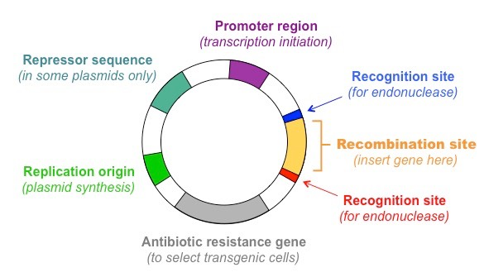
Plasmids - are the most widely used cloning vectors in the technique of gene-manipulation in bacteria.
They are circular, double-stranded DNA molecules occurring in extrachromosomal state
They replicate independently of the bacterial chromosome.
Useful for cloning DNA inserts less that 20 kb (kilobase pairs).
Inserts larger than 20 kb are lost easily in the bacterial cell.

Slide 33
Bacteriophage lambda - are derivatives of bacteriophage lambda (λ phage), a virus which infects E. coli.
They are linear DNA molecules, contains a central region of 15 kb that is not required for replication or formation of progeny phage in E. coli.
Thus, lambda can be used as a cloning vector by replacing the central 15 kb with 10-15 kb of foreign DNA.
This is done as follows: mix RE, cut donor DNA and lambda DNA in test tube ligate use in vitro packaging that will assemble progeny phage carrying the foreign DNA infect E. coli with the phage to amplify
High transformation efficiency (1000X greater than plasmid vector)

Slide 34
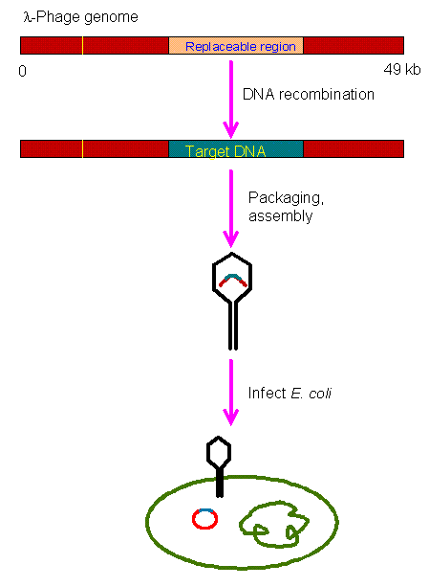

Slide 35
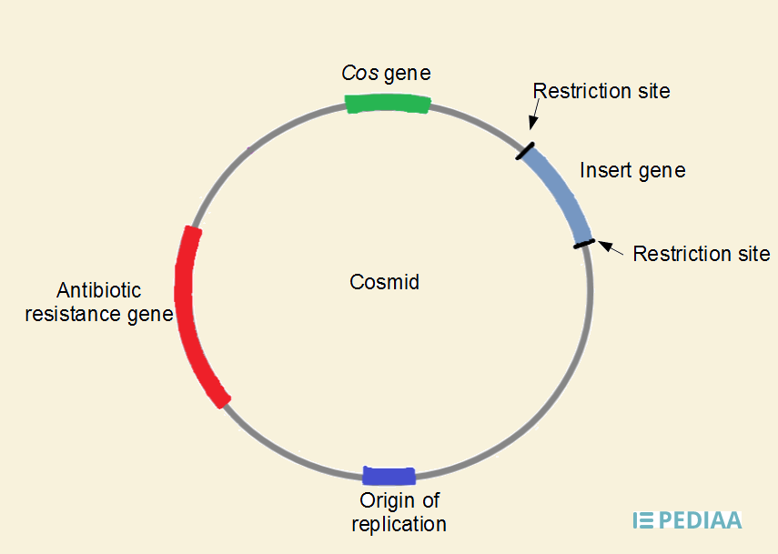
Cosmids –
are extra-chromosomal circular DNA molecules that combine features of plasmids and phages.
They also have a high transformation efficiency, and their cloning limit of 35-50 kb is larger than that of plasmids or phages.

Slide 36
Bacterial Artificial Chromosomes (BAC) - are based on bacterial mini-F plasmids, which are small pieces of episomal bacterial DNA that give the bacteria the ability to initiate conjugation with adjacent bacteria.
They have a cloning limit of 75-300 kb.
Yeast artificial chromosomes (YAC) are yeast vectors that have been engineered to contain a centromere, telomere, origin of replication, and a selectable marker.
They can carry up to 1,000 kb of DNA.
Since they are maintained in yeast (a eukaryote), they are useful for cloning eukaryotic genes that contain introns.
Also, eukaryotic genes are more easily expressed in a eukaryotic host such as yeast.

Slide 37
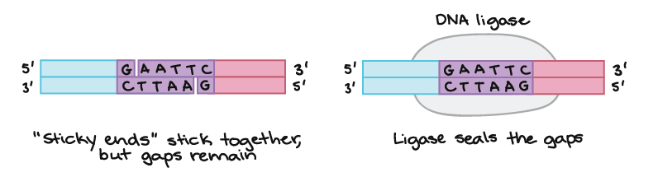
III. DNA Ligase
Once you have isolated and cut the donor and vector DNAs, they must be joined together.
The DNAs are mixed together in a tube.
If both have been cut with the same RE, the ends will match up because they are sticky.
DNA ligase is the enzyme that holds the ends of the DNAs together.
DNA ligase creates a phosphodiester bond between two DNA ends.

Slide 38
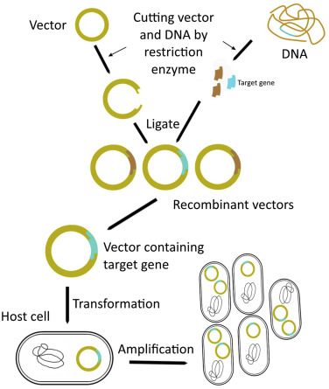

Slide 39
IV. Competent Host - into which the recombinant DNA is introduced.
The host is the ultimate tool of recombinant DNA technology which takes in the vector engineered with the desired DNA with the help of the enzymes.
Host cells like E. coli, yeast, plant and animal cells are being used.
Most popular and extensively used bacterium is E. coli due to following reasons:
E. coli a gram negative bacterium is easy to handle and grow.
It can accept a variety of vectors.
Under optimal conditions, E.coli double their numbers every 20 minutes. When bacteria reproduce recombinant DNA also reproduces.

Slide 40
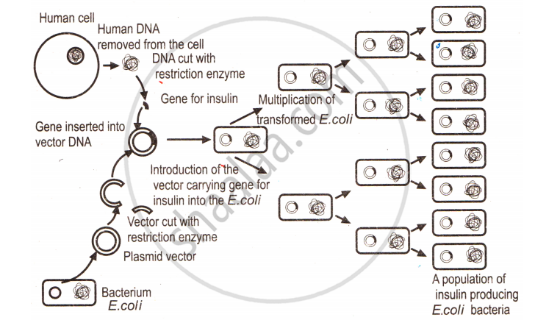

Slide 41
2.2. Making Recombinant DNA
Recombinant DNA is DNA that has been created artificially.
DNA from two or more sources is incorporated into a single recombinant molecule.
Treat DNA from both sources with the same restriction endonuclease (eg. BamHI).
BamHI cuts the same site on both molecules 5' GGATCC 3' 3' CCTAGG 5'
The ends of the cut have an overhanging piece of single-stranded DNA.
These are called "sticky ends“. They are able to base pair with any DNA molecule containing the complementary sticky end.

Slide 42
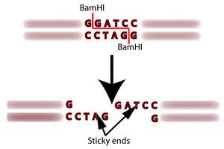
In this case, both DNA preparations have complementary sticky ends and thus can pair with each other when mixed.
Fig Bam HI
DNA ligase covalently links the two into a molecule of recombinant DNA.

Slide 43
To be useful, the recombinant molecule must be replicated many times to provide material for analysis, sequencing, etc.
The complete process of making recombinant DNA includes multiple steps, maintained in a specific sequence to generate the desired product.
Selection and isolation of DNA insert
Selection of suitable cloning vector
Introduction of DNA-insert into vector to form rec DNA molecule
rec DNA molecule is introduced into a suitable host.
Selection of transformed host cells.
Expression and multiplication of DNA-insert in the host.

Slide 44
i. Selection and isolation of DNA insert:
The first step in rec DNA technology is the selection of a DNA segment of interest which is to be cloned.
This desired DNA segment is isolated enzymatically.
This DNA segment of interest is termed as DNA insert or foreign DNA or target DNA or cloned DNA.
ii. Selection of suitable cloning vector:
The next step in rec DNA technology is selection of a suitable cloning vector
A cloning vector is a self-replicating DNA molecule, into which the DNA insert is to be integrated.
Most commonly used vectors are plasmids and bacteriophages

Slide 45
iii. Introduction of DNA-insert into vector to form recDNA
The target DNA or the DNA insert which has been extracted and cleaved enzymatically by the selective RE [in step (i)] are now ligated (joined) by the enzyme ligase to vector DNA to form a rec DNA molecule which is often called as cloning-vector-insert DNA construct.
iv. rec DNA molecule is introduced into a suitable host:
Suitable host cells are selected and the rec DNA molecule so formed [in step (iii)] is introduced into these host cells.
This process of entry of rec DNA into the host cell is called transformation.
Usually selected hosts are bacterial cells like E. coli, however yeast, fungi may also be utilized.

Slide 46
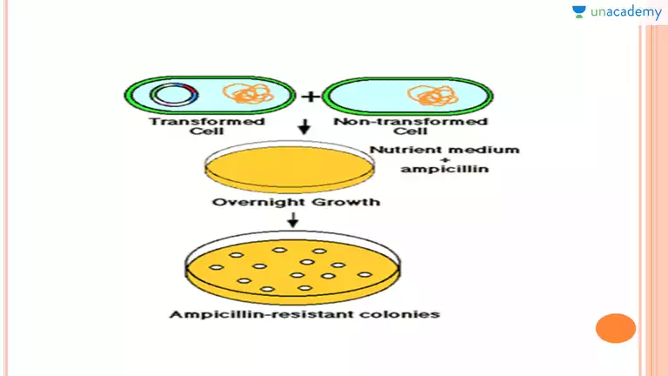
Selection of transformed host cells
Transformed cells (or recombinant cells) are those host cells which have taken up the recDNA molecule.
In this step the transformed cells are separated from the non-transformed cells by using various methods making use of marker genes.

Slide 47
vi. Expression and Multiplication of DNA insert in the host
Finally, it is to be ensured that the foreign DNA inserted into the vector DNA is expressing the desired character in the host cells.
Also, the transformed host cells are multiplied to obtain sufficient number of copies.
If needed, such genes may also be transferred and expressed into another organism.
Gene Cloning
Is a process by which large quantities of a specific, desired gene or section of DNA may be cloned or copied once the desired DNA has been isolated.

Slide 48
Method of Gene Cloning:
Selection and isolation of the desired gene and the suitable vector.
Both the desired gene and the plasmid are treated with the same restriction enzyme to produce identical sticky ends.
The DNAs from both sources are mixed together and treated with the enzyme DNA ligase to splice them together.
Recombinant plasmid or the plasmid containing the added DNA or gene is formed.
The recombinant plasmids are added to a culture of bacterial cells. Under the right conditions, some of the bacteria will take in the plasmid from the solution during a process known as transformation.

Slide 49
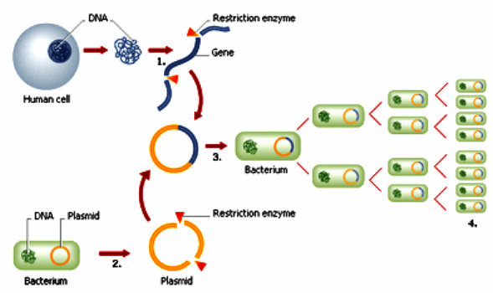
As the bacterial cells reproduces, the recombinant plasmid is copied. Soon, there will be millions of bacteria containing the recombinant plasmid with its introduced gene.
The introduced gene can begin producing its protein via transcription and translation.

Slide 50
2.3. DNA Library
A DNA library is a collection of cloned restriction fragments of the DNA of an organism.
DNA libraries can be used to isolate a specific gene of interest, as they generally include at least one fragment that contains the gene.
Two kinds of libraries will be discussed: genomic libraries and complementary DNA (cDNA) libraries.
Genomic DNA libraries
Genomic DNA libraries are a collection of DNA fragments that together represent the entire (or nearly entire) genome of the individual from which the DNA was derived.

Slide 51
The genomic DNA libraries can be prepared by the complete digestion of the total genomic DNA with a restriction enzyme
These fragments are inserted into a suitable self-replicating vectors that enable them to be maintained and propagated within the cells of microorganisms, such as Escherichia coli or Saccharomyces cerevisiae (yeast).
The amplified DNA fragments represent the entire genome of the organism and are called a genomic library.
Note: cloned cDNA lack introns and the control regions of the genes, whereas these are present in genomic libraries.
The drawback of this method is that sometimes the sequence of interest may contain multiple restriction sites, so digestion with RE results into two or more pieces

Slide 52
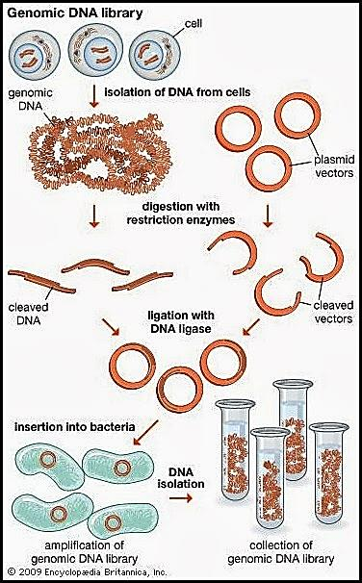

Slide 53
2. cDNA Library:
If a gene of interest is expressed at a very high level in a particular tissue, it is likely that the messenger RNA (mRNA) corresponding to that gene is also present at high concentrations in the cell.
cDNA libraries are prepared by iso­lating mRNAs from tissues which are actively synthesizing proteins, like roots and leaves in plants, ovaries or reticulocytes in mammals, etc.
The mRNAs are used for copying them into cDNAs through the use of reverse transcriptase.
The resulting cDNA is thus a double-stranded copy of mRNA.
cDNA can be amplified by cloning or by the polymerase chain reaction (PCR).

Slide 54
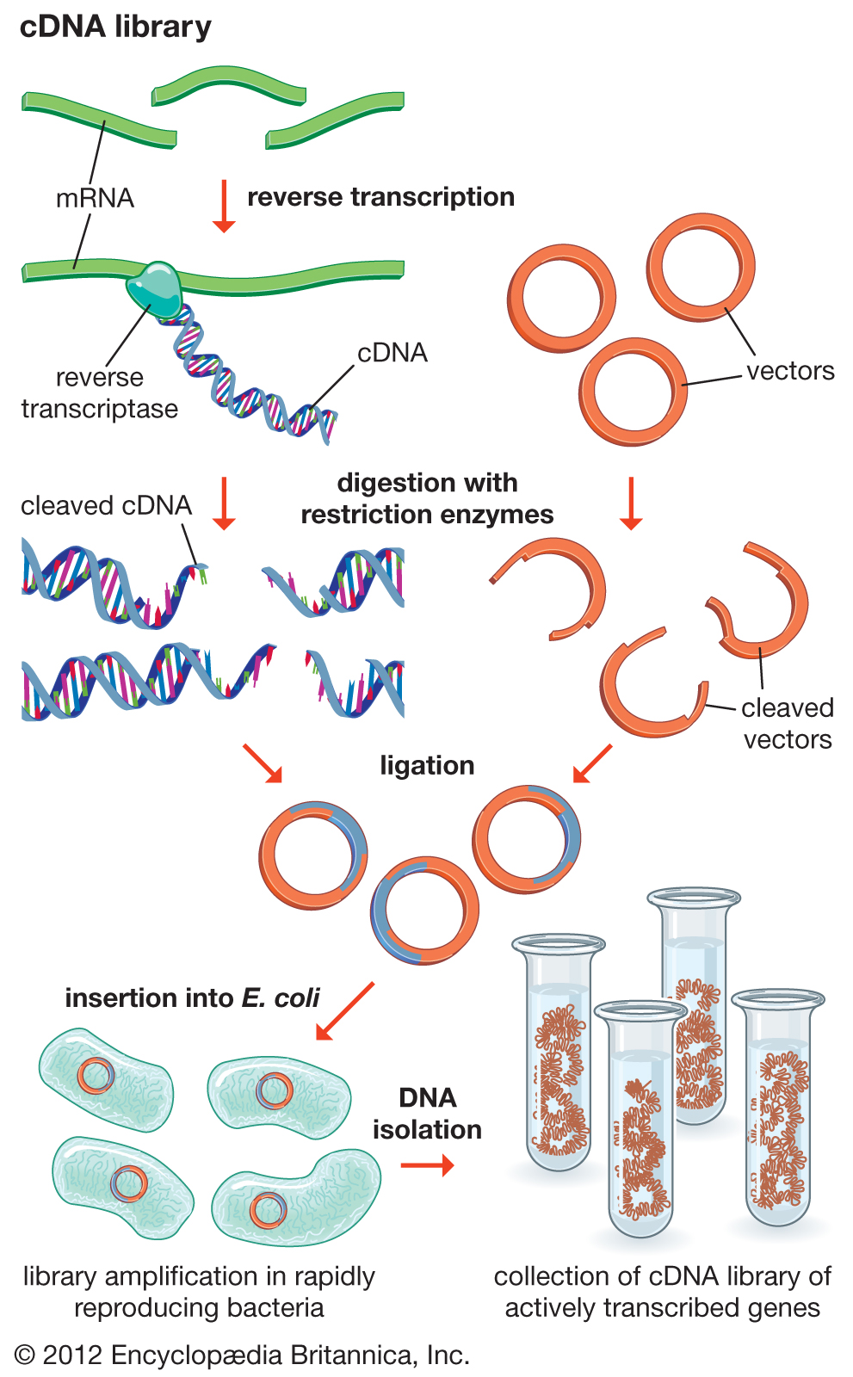

Slide 55
2.4. Transgenic: Introduction of Recombinant DNA into Host Cells
Transgenic organism is defined as living organisms containing genetic material into which DNA from different organisms has been artificially introduced. Or
Transgenic is an organism containing a transgene introduced by technological (not breeding) methods.
Transgene is the genetically engineered gene added to a species.
The phenomenon of introduction of exogenous DNA (transgene) into the genome to create and maintain a stable and heritable character is called transgenesis.
Transgenic can be plants, animals or microbes.

Slide 56
Introduction of biologically active recombinant DNA into host cells is a very important step in recombinant DNA technology or genetic engineering
The most common model organism used as a potential host for cloning is E. coli since it is very convenient to use.
The recombinant vector DNA can be introduced in E. coli using three gene transfer systems namely transformation, transduction and conjugation.
Transformation
Is the process of taking up of naked DNA from the surroundings into the host cell

Slide 57
Transformation can be brought about by the following methods:
Transformation by Natural competence
Transformation by Induced competence
Transformation by protoplast Fusion
Electroporation
Transformation by Natural competence
Bacteria belonging to Pneumococcus, Bacillus and Haemophillus are naturally competent and can take up naked DNA.
B. Transformation by induced competence
This involves addition of calcium chloride to the cell suspension which enhances the binding of plasmid DNA to lipopolysaccharide

Slide 58
Normally, DNA can’t pass bacterial cell membrane because it is very hydrophilic.
Positively charged calcium ions attract the negatively charged DNA
The plasmid DNA can then pass into the cell upon heat shock, wherein cells are cooled to a low temperature (4ºC) and then heated to a high temperature (42°C) for a short time.
This causes the bacteria to take up the DNA.
The cells are then plated on LB agar (Luria Bertani) medium containing appropriate antibiotics after incubation at 37ºC for one hour.
This enable the transferred genes to express in E. coli

Slide 59
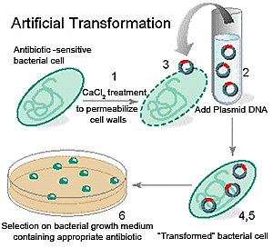

Slide 60
C. Transformation by protoplast fusion
Is used in bacteria such as Bacillus spp., Lactococcus spp. and Lactobacillus spp. etc. during their genetic manipulation.
Initially, protoplasts are generated by enzymatic removal of cell walls of bacteria which are then transformed using polyethylene glycol (PEG) along with the DNA.
PEG is then removed and protoplasts are allowed to regenerate on an osmotically stabilized medium.
The process wherein protoplasts from two different cells fuse together in PEG is called protoplast fusion.

Slide 61
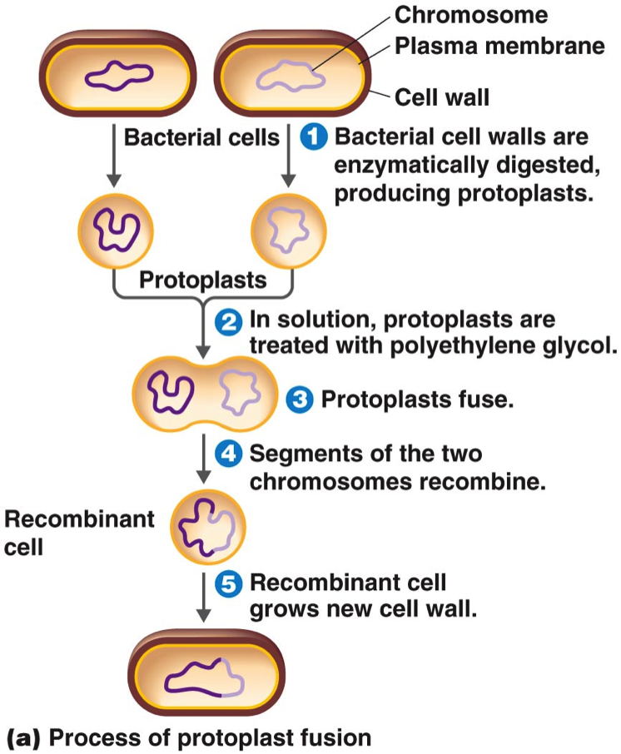

Slide 62
D. Electroporation
Electroporation is yet another versatile method of transformation of Gram negative and Gram positive bacteria, yeasts and even the mammalian cells.
Bacterial cells mixed with plasmid DNA are subjected to a brief pulse of high voltage electricity using electroporator.
The membrane of the cells exposed to high intensity electric pulse is temporarily destabilized in specific regions of cell.
Cells become permeable and DNA enters the cells.
Cells are then incubated for one hour and plated on LB agar with selection marker

Slide 63
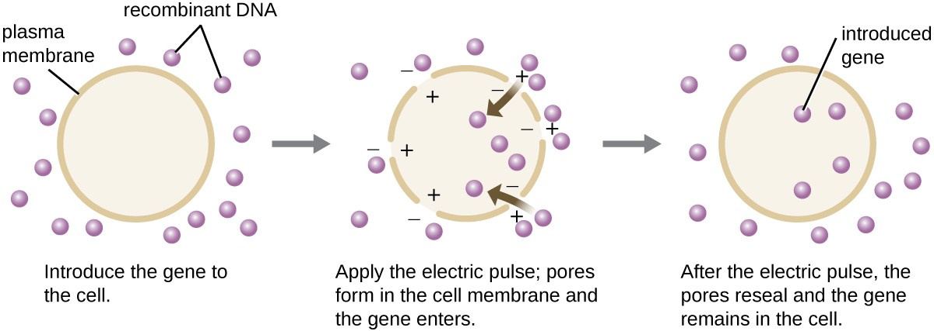

Slide 64
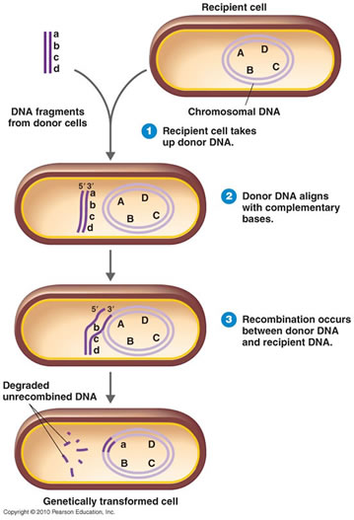

Slide 65
2. Transduction
Transduction is the process of transfer of bacterial genes into a host bacterium with the help/aid of phages.
Transduction is also known as phage mediated genetic transfer.
Transduction is of two types: a) Generalized transduction
When a phage particle attacks a bacterial cell and during its assembly, fragments of host DNA are packaged into phage particles in place of its own DNA.
When such a phage/virus particle infects a new host cell, DNA is injected into the host which can recombine with the host genome.

Slide 66
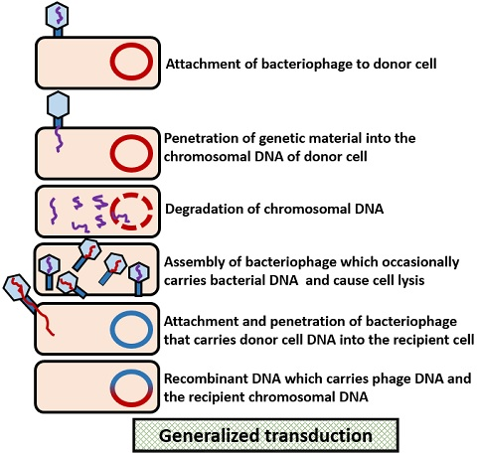

Slide 67
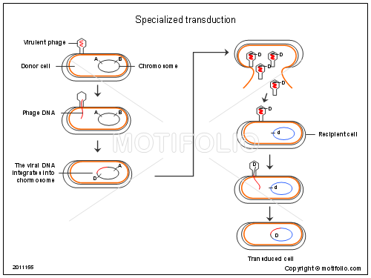

Slide 68
b) Specialized transduction
A lysogenic phage undergoes recombination with the host genome at a particular site and later when it is excised to become an independent phage genome, it carries one or more host genes with it.
These genes can be transduced into a new host cell which recombine into the genome of that cell.
3. Conjugation
Conjugation is defined as the process of transfer of genetic material from a donor cell to a recipient cell through a mating bridge
It was discovered by Lederberg and Tatum in 1946 who showed that two different strains of bacteria with different growth requirements could exchange genes.

Slide 69
They surmised that the bacterial cells must interact with each other in order to transfer the genetic material and the process is now known as sexual conjugation by direct contact.
A segment (rarely all) of the donor’s chromosome recombines with the homologous recipient chromosome.
Recipients containing donor DNA are called transconjugants.
Physical contact between cells is essential for transfer of genes
Genetic exchange in E. coli occurs in only one direction and is mediated by sex factor F.
Donor cell is F+ and the recipient cell is F-.
The transferred DNA then gets integrated into the host cell through a process called recombination

Slide 70
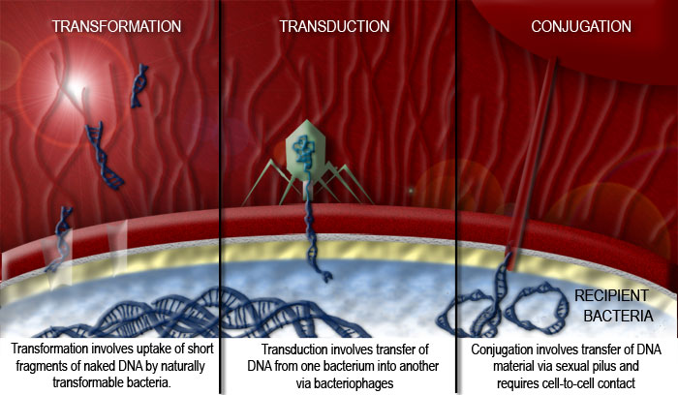

Slide 71
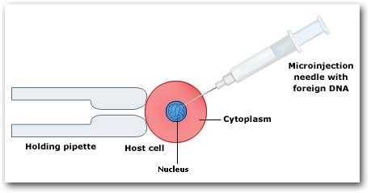
Microinjection
Specialized technique by which the DNA fragment or gene can be directly injected into the nucleus of plant and animal cells
Can be carried out without the use of any specialized vector
Involves the direct injection of the DNA into the nucleus of the host cell with the help of a glass microinjection tube or syringe

Slide 72
The biolistic method
Was developed for introducing foreign DNA into plant cells with the help of a gene or particle gun
During the biolistic method, microscopic particles of gold or tungsten coated with the DNA of interest is bombarded into the cells at a high velocity
The bombardment of the particle is carried out with the help of a mechanical device called a particle gun

Slide 73
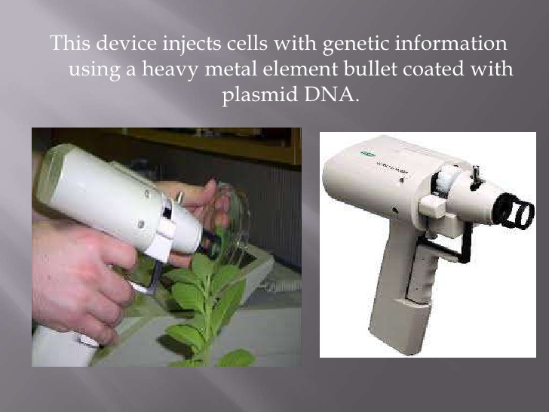
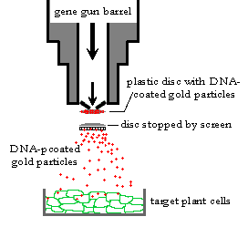

Slide 74
2.5. Selection of recombinants
The need to identify the cells that contain the desired insert at the appropriate and right orientation and isolate these from those not successfully transformed is of utmost importance to researchers.
Modern cloning vectors include selectable markers (most frequently antibiotic resistance markers) that allow only cells in which the vector, but not necessarily the insert, has been transformed to grow.
Additionally, the cloning vectors may contain color selection markers which provide blue/white screening on X-gal medium.
Nevertheless, these selection steps do not absolutely guarantee that the DNA insert is present in the cells.

Slide 75
Further investigation of the resulting colonies is required to confirm that cloning was successful.
This may be accomplished by means of PCR, restriction fragment analysis and/or DNA sequencing.
The art of cloning is to find the one particular transformed cell that contains the cloning vector with the gene of interest (referred to as a recombinant cell).
It is thus most important to be able to select recombinant cells from transformed cells (containing the vector without insert DNA) .
If this goal is achieved, the gene in question is said to have been cloned.

Slide 76
Although there are many different procedures by which the desired clone can be obtained, all are variations of two basic concepts:
Direct selection
Identification of the clone from a gene library
Direct selection
The cloning experiment is designed in such a way that the clones obtained are clones of the required gene.
Insertion of a DNA fragment into the vector destroys the integrity of one of the genes present on the molecule.
This is referred to as insertional inactivation.
Two examples will be discussed: A. direct antibiotic resistance screening, and B. blue-white color screening.

Slide 77
A. Direct antibiotic resistance screening
Most cloning vectors are designed so that the insertion of a DNA fragment into the vector destroys the integrity of one of the genes present on the molecule (usually an antibiotic resistance gene).
For instance, if the vector carries an ampicillin resistance gene (ampr), it will confer ampicillin resistance to the E. coli cells if the transformation process was successful.
This would mean that when the clones are plated out on ampicillin-containing medium, only cells containing a plasmid would be resistant to the antibiotic and, therefore, be able to grow.
However, this does not show whether the cell contains the recombinant plasmid or only the re-ligated vector.

Slide 78
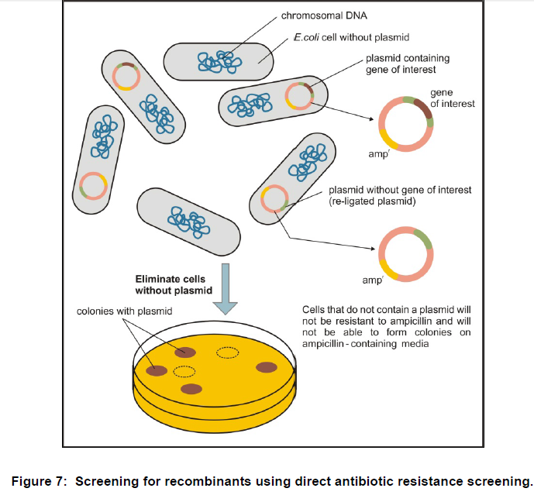

Slide 79
B. Blue-white color screening.
This method also involves the insertional inactivation of a gene and uses the production of a blue compound as an indicator .
The gene is lacZ, which encodes the enzyme ß-galactosidase, and is under the control of the lac promoter.
If the host E. coli strain is expressing the lac repressor, expression of a lacZ gene on the vector may be induced using IPTG (isopropyl- ß-D-thiogalactopyranoside), and the expressed enzyme can utilize the synthetic substrate X-gal (5-bromo-4-chlore-3-indolyl- ß-D-galactopyranoside) to yield a blue product.

Slide 80
Insertion of a DNA fragment into the lacZ gene (insertional inactivation of lacZ) in the production of a recombinant plasmid would prevent the development of the blue color.
In this method, the transformed cells are spread onto a plate containing an antibiotic (to select for transformants in the usual way), IPTG and X-gal, to yield a mixture of blue and white colonies.
The white colonies have no expressed ß-galactosidase and are hence likely to contain the inserted target fragment.
The blue colonies probably contain re-ligated vector.

Slide 81
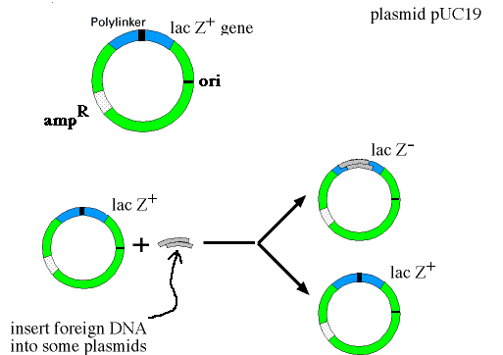

Slide 82
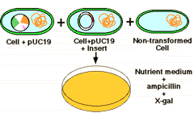
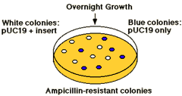

Slide 83
II. Identification of the clone from a gene library
Many different techniques are available for screening a library.
The most important approaches involve screening by nucleic acid hybridization and screening by functional analysis.
Nucleic acid hybridization requires some prior knowledge of the DNA sequence either of the gene to be cloned or of stretches of DNA in the vicinity of the gene to be cloned.
Functional screening involves the use of expression vectors that allow cells containing the vector with the desired gene to express the corresponding protein.
Under these circumstances, cells containing a vector with the desired gene can be identified by means of antibodies directed against the protein.

Slide 84
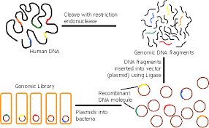

Slide 85
Functional screening
The desired gene can also be identified by the activities of the encoded gene product.
In this case, one uses a so-called expression library that has been established by cloning DNA (cDNA in the case of eukaryotes) fragments into special cloning vectors allowing the functional expression of cloned DNA fragments.
Functional gene products and hence the desired clones can then be detected either by antibodies (immunological screening) or other ligands that specifically recognize the encoded proteins or by exploiting a bioactivity of the gene product, if known.

Slide 86
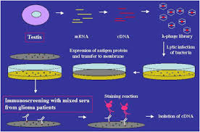

Slide 87
The procedure of immunological screening has similarities to hybridization screening, discussed before, though in this instance it is the protein encoded by the DNA (or cDNA) rather than the DNA itself that is detected on the membrane.
The membrane is treated to covalently attach the protein, and immersed in a solution containing the antibodies.
When the antibody has bound to its epitope, it is detected by other antibodies and/or chemicals that recognize it.

Slide 88
2.6. Polymerase Chain Reaction (PCR)
PCR or Polymerase Chain Reaction is a technique used in molecular biology and biotechnology to create several copies of a specific DNA segment.
This technique was developed in 1983 by Kary Mullis, an American biochemist.
PCR can generate billions of identical copies of a specific DNA sequence of interest in a few hours from minute amount of DNA.
Performed entirely biochemically (in vitro)
Used every day in forensics, diagnosing diseases, etc…

Slide 89
Principle of PCR
The principle of PCR is based on the natural processes a cell uses to replicate a new DNA strand.
PCR involves the use of primer mediated enzymes for the amplification of DNA.
DNA Polymerase synthesizes new strands of DNA complementary to the template DNA.
The DNA polymerase can add a nucleotide to the pre-existing 3’-OH group only.
Therefore, a primer is required. Thus, more nucleotides are added to the 3’ prime end of the primer by DNA polymerase.

Slide 90
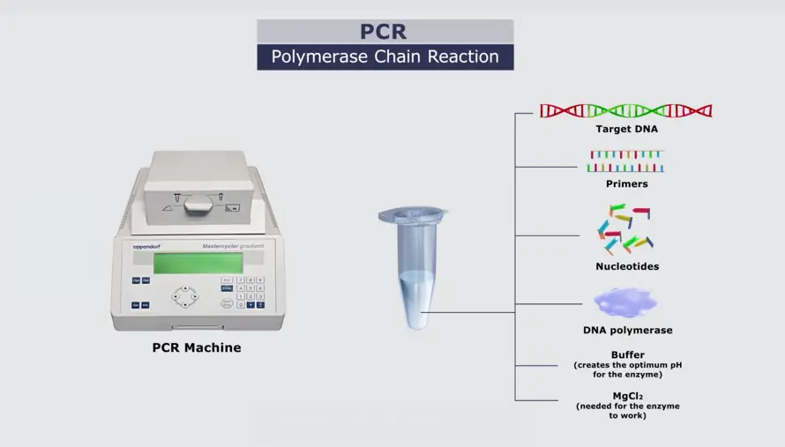
Components Of PCR
Components of PCR constitutes the following:
Water
Buffer system
dNTPs
Template DNA
Primer
DNA polymerase
Thermal cycler
Water - provide the liquid environment for the reaction to take place.
It is the matrix in which the other components interact.

Slide 91
2. Buffer system (PCR Reaction Buffer)
Reagent that provides an optimal pH and monovalent salt environment for the final reaction volume.
It contains magnesium chloride (MgCl2) which supplies the Mg++ divalent cations required as a cofactor for Type II enzymes, which include restriction endonucleases and the polymerases used in PCR.
3. Deoxyribonucleotide triphosphate (dNTPs, Nucleotides)
Single units of the bases A, T, G, and C, which are essentially "building blocks" for new DNA strands.
4. Template DNA –
The DNA that contains the region to be copied, such as a gene.

Slide 92
As little as one DNA molecule can serve as a template.
The only information needed for this fragment to be replicated is the sequence of two short regions of nucleotides at either end of the region of interest.
These two short template sequences must be known so that two primers can be synthesized.
The primers bind, or anneal, to the template at their complementary sites and serve as the starting point for copying.
5. Primers
These are the short stretches of single-stranded DNA complementary to the 3’ ends of sense and anti-sense strands
Polymerase begins synthesizing new DNA from the end of the primer.

Slide 93
6. DNA polymerase
Enzyme that synthesizes new strands of DNA complementary to the target sequence.
The first and most commonly used of these enzymes is TaqDNA polymerase (from Thermus aquaticus), whereas PfuDNA polymerase (from Pyrococcus furiosus) is used widely because of its higher fidelity when copying DNA.
Although these enzymes are subtly different, they both have two capabilities that make them suitable for PCR:
They can generate new strands of DNA using a DNA template and primers, and
They are heat resistant.

Slide 94
Taq pol lacks 3’ to 5’ exonuclease proof reading activity, commonly present in other polymerases.
Taq pol mis-incorporates 1 base in 10⁴
Thermal cycler- machine which can be programmed to carryout heating and cooling samples over a number of cycles.
Steps in PCR
There are three major steps involved in the PCR technique: denaturation, annealing, and extension.
Step 1 - denaturation
The two strands of the DNA molecule are separated by heating the starting material to temperatures of about 94 °C.

Slide 95
Step 2 – annealing
Temperature is reduced to about 54 °C so that the primers can anneal to the template.
Step 3 – extension
Temperature is raised to about 72 °C (162 °F), and the DNA polymerase begins adding nucleotides onto the ends of the annealed primers.
At the end of the cycle, which lasts about five minutes, the temperature is raised and the process begins again.
The number of copies doubles after each cycle.
Usually 25 to 30 cycles produce a sufficient amount of DNA.

Slide 96
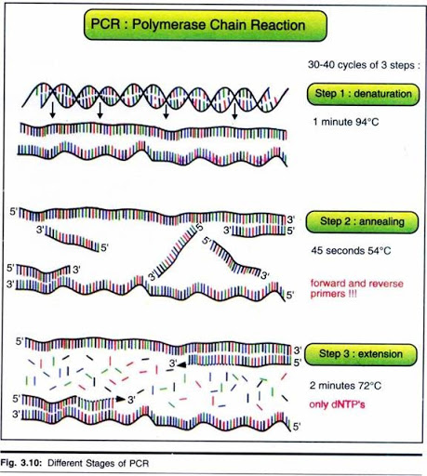

Slide 97
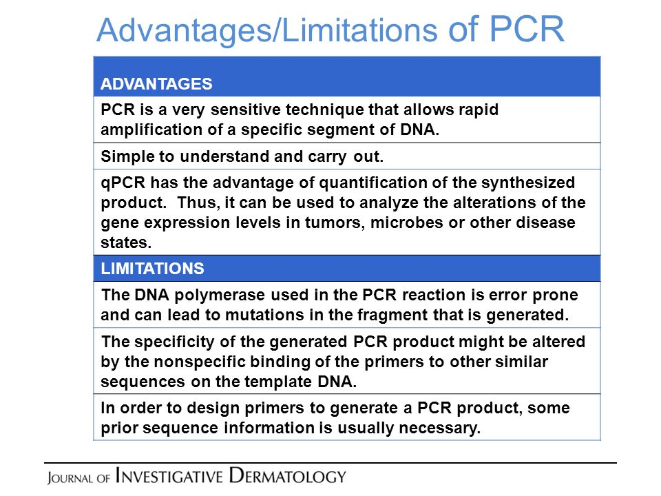
Advantages and disadvantages of PCR

Slide 98
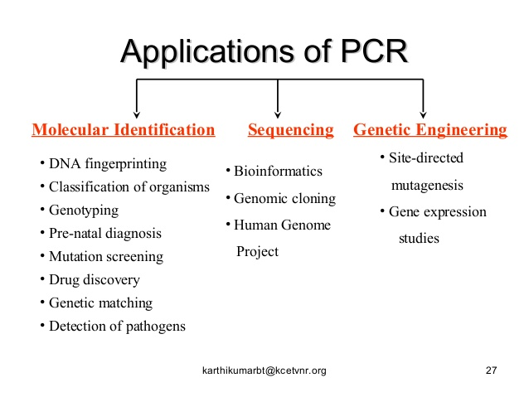

Slide 99
2.7. DNA probes
A DNA probe is a small, fluorescently or radioactively labeled DNA molecule that is used to locate similar or complementary sequences among a long stretch of DNA molecule or bacterial colonies such as genomic or cDNA libraries or in a genome.
Such DNA probes are used in hybridization experiments such as Southern hybridization to detect certain specific sequences, which are complementary to the probes.
Since the probe is labeled with a fluorescent dye or radioactive isotopes of phosphorous, its binding to specific sequences can be detected.

Slide 100
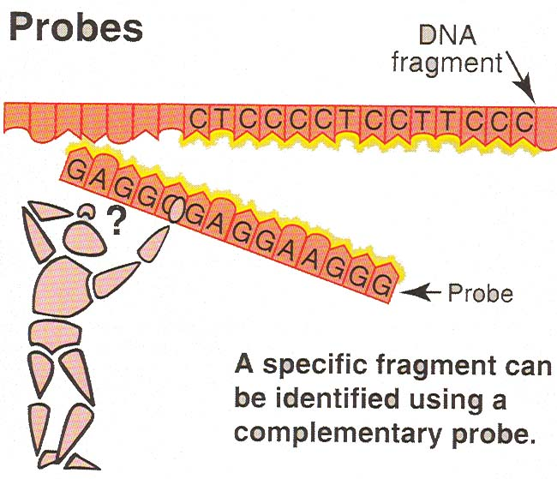
DNA probes labeled with radioactive isotopes or fluorescent dyes can be used for the screening of transformed colonies having the correct recombinant plasmid by Southern hybridization.
The probes used in hybridization of nucleic acids include oligonucleotide (15-50 nucleotides), genomic DNA fragment, cDNA fragment and RNA.

Slide 101
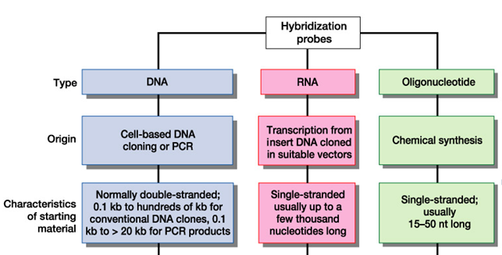
Types of Probes

Slide 102
2.8. Nucleic acid hybridization
A technique in which single-stranded nucleic acids (DNA or RNA) are allowed to interact so that complexes called hybrids are formed by molecules with similar, complementary sequences.
Strands can be separated (denatured) by heating
Remarkably, DNA can reassemble with perfect fidelity from separated strands.
The hybridization can be carried out in solution or with one component immobilized on a gel or, most commonly, on nitrocellulose paper.
Hybridizations are done in all combinations: DNA-DNA, DNA-RNA or RNA-RNA.

Slide 103
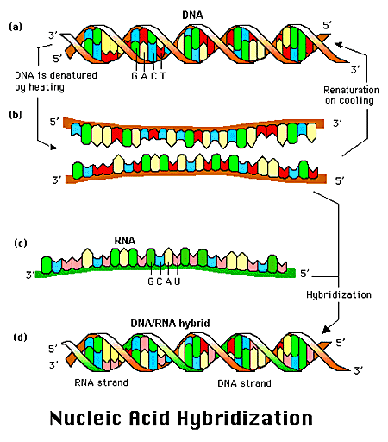

Slide 104
Hybridization Techniques
Any two single-stranded nucleic acid molecules will attempt to base pair with one another under appropriate conditions
This phenomenon of nucleic acid hybridization can be used to identify a particular recombinant if a suitable probe, complementary to the sequence sought, is available
Types of hybridizations:
1. Southern Hybridization
2. Northern Hybridization
3. Western Hybridization

Slide 105
Southern Hybridization/blotting
This technique was originally devised by Edward Southern in 1975 to identify specific DNA fragments on an agarose gel after the separation by electrophoresis.
The technique involves:
1. Isolation of the genomic DNA with a suitable procedure.
2. The genomic DNA is digested with a suitable restriction enzyme or with a mixture of different restriction enzymes to cut the long DNA molecule into fragments.
3. Restriction-digested genomic DNA is separated by electrophoresis and the DNA separated on the gel is then transferred to a membrane-a nitrocellulose or nylon membrane-with a process called blotting, which is driven by capillary action.

Slide 106
Hybridization of DNA with another DNA molecule is called Southern hybridization or blotting
Hybridization between RNA and DNA is called Northern hybridization and
Protein-protein hybridization such as antigen-antibody binding or protein-ligand binding is called Western hybridization.
Uses of Southern blots
Genetic “fingerprinting”
Diagnosis of infectious disease
Demonstrate incidence and prevalence of organisms that cannot be cultured

Slide 107
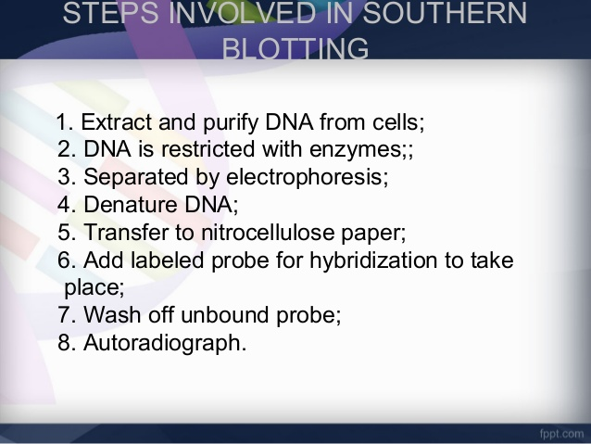
Steps involved in southern blotting/hybridization

Slide 108
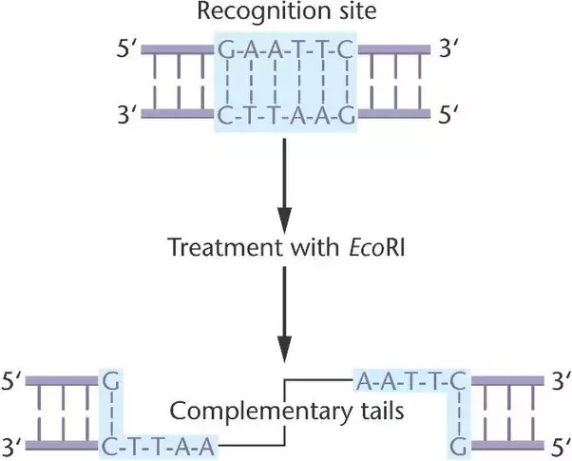
Step 1: extract and purify DNA from cells
To extract the DNA present inside the nucleus of a cell, we must first lyse the entire cell to enable the expulsion of the DNA.
Incubating the cell culture with detergent lyses the entire cell.
Now the lysed sample contains DNA and protein.
Protein is lysed by adding the proteinase enzyme and incubated.
DNA is purified and separated by alcohol precipitation.
Step 2: restricted with enzymes

Slide 109
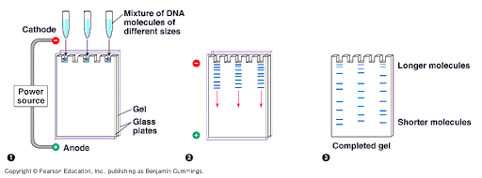
Step 3: separated by electrophoresis
Nucleic acids are negatively charged molecules.
So they move towards the anode in an electrophoresis chamber.
The movement of the DNA fragments differentiates the rate of the transport thus enabling the separation by size.

Slide 110
Step 4: Denaturation
DNA thus attained are double stranded in nature.
For our purpose of probe hybridization, we need a single stranded DNA.
DNA is therefore denatured in an alkaline solution.
This results in the formation of denatured DNA.
Step 5: transfer to nitrocellulose paper
Transfer the DNA from the gel to a solid support, i.e. blotting
The DNA molecule is saturated using a NaCl solution and permanently fixed using either UV radiation or drying 80 ºC
Step 5: add labeled probe for hybridization to take place
The filter is incubated under hybridization conditions with a specific radiolabeled probe.

Slide 111
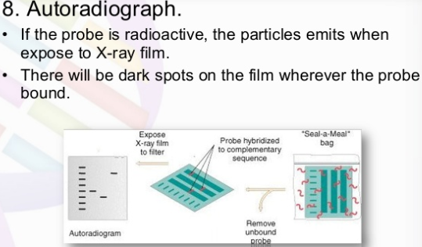
The probe hybridizes to the complementary DNA restriction fragment.
Step 7: wash off unbound probe
Blot is incubated with wash buffers containing NaCl and detergent to wash away excess probe
Step 8: Autoradiograph

Slide 112
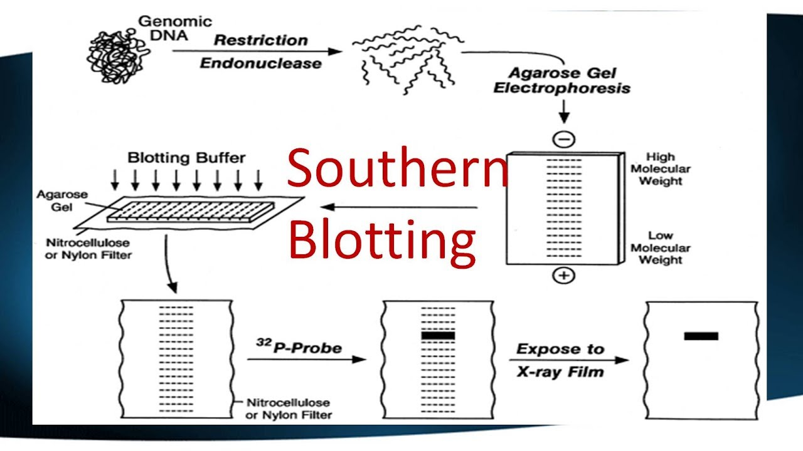

Slide 113
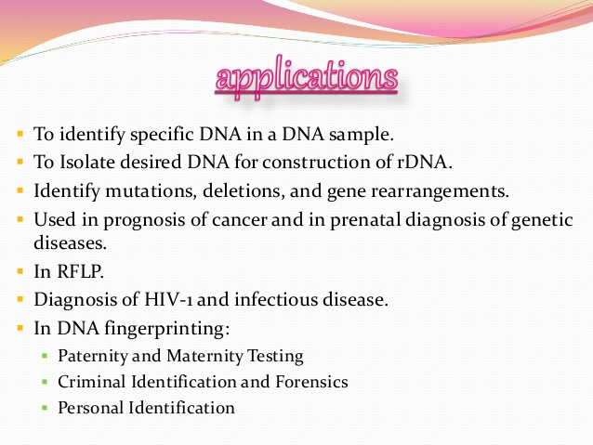

Slide 114
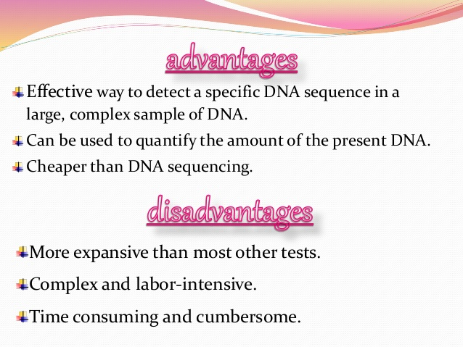

Slide 115
Northern blotting
Is a classical method for analysis of the size and steady-state level of a specific RNA in a complex sample.
In short, the RNA is size-fractionated by gel electrophoresis and transferred by blotting onto a membrane to which the RNA is covalently bound.
Then, the membrane is analyzed by hybridization to one or more specific probes that are labeled for subsequent detection.
It was developed by Alwine and his colleagues in 1979.
The term “northern” has no scientific significance just a misnomer.

Slide 116
Basic Steps of NB
Isolation of intact mRNA
Separation of RNA according to size (through a denaturing agarose gel e.g. with Glyoxal/formamide)
Transfer of the RNA to a solid support
Fixation of the RNA to the solid matrix
Hybridization of the immobilized RNA to probes complementary to the sequences of interest
Removal of probe molecules that are nonspecifically bound to the solid matrix
Detection, capture, & analysis of an image of the specifically bound probe molecules.

Slide 117


Slide 118
Advantages/applications of NB
A standard for direct study of the gene expression at the level of mRNA
Detection of mRNA transcript
Disadvantages
Time consuming procedure
Use of ethidium bromide and UV-light needs special training
Western Blotting
Is a technique in which proteins are detected immunologically in a gel following electrophoresis.
Antibodies directed against a particular protein or set of proteins are used to selectively detect those, and only those, proteins.

Slide 119
Applications:
To determine the molecular weight of a protein (identification)
To measure relative amounts (quantitation) of the protein present in complex mixtures of proteins that are not radiolabeled
Advantages
Sensitivity - as little as 0.1 ng of an average-sized protein can be detected by WB
Specificity - only the protein(s) of interest will be detected.

Slide 120
Western blotting steps
The main steps of blotting technique in a chronological order are as follows:
Sample preparation - by digesting a cell
Gel electrophoresis – to separate proteins according their size
Blotting (transferring ) the protein to solid support membrane
Probing with the specific antibody(ies) and blocking
Wash
Detection of the protein-antibody complex on the membrane
Imaging and analysis

Slide 121
Unit Three Biotechnology in Health
Hybridoma Technology and Monoclonal Antibodies
Application of Biotechnology in Medicine
Diagnosis
Vaccine production
Gene Therapy
Organ/tissue transplantation
Forensic medicine
Stem cell research and its potential in medicine

Slide 122
3.1. Hybridoma Technology and Monoclonal Antibodies
Hybridomas are the hybrid cells of myeloma (cancer) cells with antibody producing cells (lymphocytes) from an immunized donor (animal).
The hybrid cell resulting from this fusion has the ability to:
Multiply rapidly and indefinitely in vitro
Produce an antibody of predetermined specificity, known as monoclonal antibody (MAb).
The technique of producing monoclonal antibodies (MAbs) in spe-cialized cells is now popularly known as hybridoma technology.
This technology was discovered in 1975 by two scientists, George Kohler and Cesal Milstein.

Slide 123
Hybridoma cells are mass-cultured for the production of monoclonal antibodies (MAbs) either:
In vivo - injection in the peritoneal cavity of mice or
In vitro in large scale culture vessels (tissue culture)
Monoclonal Antibodies
Are a single type of antibody that are identical and are directed against a specific epitope (antigenic determinant).
Are produced by cell clones of a single parent or a single hybridoma cell line.
B-cell is isolated and fused to an immortal myeloma cell line so that large quantities of identical antibody can be generated.

Slide 124
Advantages
Can produce large quantities of identical antibody. Batch to batch homogeneity
High specificity to a single epitope thus reduced probability of cross reactivity.
Can provide better results in assays requiring quantification of the protein levels.
Disadvantages
Significantly more expensive to produce
Requires significantly more time to produce and develop the hybridized clone
Small changes in the epitopes structure often render the MAb unable to detect the target protein

Slide 125
Polyclonal Antibody
Collection of antibodies from different B cells that recognize multiple epitopes on the same antigen
Each of these individual antibodies recognizes a unique epitope that is located on that antigen.
Advantages
Inexpensive and quick to produce (Purified antibody is ready to use in under four months)
Higher overall antibody affinity against the antigen due to recognition of multiple epitopes.
Offers greater sensitivity for detecting proteins that are present in low quantities in a sample since multiple antibodies will bind to multiple epitopes on the protein.

Slide 126
Disadvantages
Variability between different batches produced in different animals at different times
Higher potential for cross reactivity due to recognizing multiple epitopes
Affinity purification of the serum will typically be required to minimize cross reactivity
Formation and Selection of Hybrid Cells
A hybridoma, is produced by the injection of a specific antigen into a mouse, producing the antigen-specific plasma cells (antibody producing cell) from the mouse’s spleen.

Slide 127
One’s spleen cells are isolated, the B cells are fused with immortal myolema cells.
Fusion is mediated by chemical protocols, most often using polyethylene glycol.
Fused cells are selected by using HAT medium (Hypoxanthine Aminopterin Thymidine)
Myeloma cells are unable to grow in HAT - lack the HGPRT (hypoxanthine-guanine phosphoribosyl transferase) gene.
B cells are able to survive (have functional HGPRT), but can not live for extended periods.

Slide 128
Fused cells are incubated in the HAT medium.
Myeloma cells die, as they cannot produce nucleotides.
Unfused B cells die, as they have a short life span.
Only the B cell-myeloma hybrids survive, since the HGPRT gene coming from the B cells is functional.
Hybrid cell can be cloned to produce many identical daughter clones.
These daughter clones then secrete the immune cell product.
Since these antibodies come from only one type of cell (the hybridoma cell) they are called monoclonal antibodies.
The advantage of this process is that it can combine the qualities of the two different types of cells; the ability to grow continually, and to produce large amounts of pure antibody.

Slide 129


Slide 130
3.2. Application of Biotechnology in Medicine
3.2.1. Diagnosis
Accurate diagnosis of disease is critical for effective management and cure.
The standard procedure for detecting some pathogens is to grow it in the lab from clinical specimens.
Many viruses and some bacteria are difficult or even impossible to grow in the laboratory.
Different microorganisms require different culture media and culture conditions.
Thus traditional methods of identification can be laborious.

Slide 131
In contrast, molecular approaches analyze macromolecules such as DNA, RNA, or protein rather than attempting to grow the disease causing agents.
In some cases, it is quicker and more accurate than conventional methods.
Molecular diagnosis
Is the use of DNA, RNA, and proteins to facilitate disease detection, diagnosis, sub-classification, prognosis, and monitoring response to therapy.
Every species of organism has a unique small-subunit ribosomal RNA coding sequence/gene (16S rRNA coding gene in bacteria, 18S rRNA coding gene in eukaryotes).

Slide 132
Hence bacteria and eukaryotic parasites may be identified by analysis of this sequence.
DNA based diagnostic systems include:
DNA hybridization
PCR
DNA sequencing
DNA fingerprinting etc…
DNA hybridization
Bacterial, fungal and viral pathogens have specific genes or sets of genes coding for diseases.
Genetic diseases on the other hand are due to mutations or absence of particular gene or genes.

Slide 133
These genes (DNA) can be used as a diagnostic tool
Example : Detection of malaria
Develop a probe that just hybridized with plasmodium DNA and not with human DNA
The probe is able to detect 10 pg of purified DNA or 1 ng of DNA in blood smear.
If probe binds specifically to DNA reaction occurs and signal will be produced as a result of the reaction
PCR based methods
The presence of the appropriate amplified size fragment confirms the presence of the target

Slide 134
Specific primers are available for the detection of many pathogens including bacteria (E. coli, M. tuberculosis), viruses (HIV) and fungi.
Example: Detection of HIV
Since HIV has a ssRNA genome, reverse transcriptase PCR is used
Specific primers are used to amplify a 156 bp portion of the HIV gag gene
Using standards the amount of PCR products can be used to determine the viral load.
This method can also be used to determine the effectiveness of antiviral therapy.

Slide 135
3.2.2. Vaccine production
A vaccine is any preparation of dead or attenuated pathogens, or their products, that when introduced into the body, stimulates the production of protective antibodies or T-cells without causing the disease.
Types of vaccine
Whole organism – live/attenuated vaccines
- killed/inactivated vaccines
Toxoids
Peptide vaccines
Recombinant vaccines
DNA vaccines

Slide 136
Live/attenuated vaccines
Attenuation is the process of reducing the strength, effect, or value of pathogenicity
Live/attenuated vaccines makeup the bulk of successful viral vaccines
Are prepared from attenuated strains that are almost or completely devoid of pathogenicity but are still immunogenic
They multiply in the human host and provide continuous antigenic stimulation over a period of time

Slide 137
Methods used for attenuation
Use of a related virus from another animal E.g. use of cowpox to prevent smallpox
Administration of pathogenic or partially attenuated virus by an unnatural route.
Repeated passages of the virus are made in an unnatural hosts
The virulence of the virus is often reduced when administered by an unnatural route.
The virus is then transferred into the natural host
Initial passages are made in healthy animals or in primary cell cultures
The major vaccines used in man and animals have all been derived this way

Slide 138
2. Killed/inactivated vaccines
Vaccines of this type are created by inactivating a pathogen, typically using heat or chemicals such as formaldehyde or formalin.
This destroys the pathogen’s ability to replicate, but keeps it “intact” so that the immune system can still recognize it.
The term ‘killed’ generally refers to bacterial vaccines, whereas ‘inactivated’ relates to viral vaccines
Because killed or inactivated pathogens can’t replicate at all, they can’t revert to a more virulent form capable of causing disease.
Polio vaccine and the seasonal influenza vaccine are examples of killed or inactivated vaccines

Slide 139
3. Toxoids
Some bacterial diseases are not directly caused by a bacterium itself, but by a toxin produced by the bacterium.
One example is tetanus: its symptoms are not caused by the Clostridium tetani bacterium, but by a neurotoxin it produces (tetanospasmin).
Immunizations for this type of pathogen can be made by inactivating the toxin that causes disease symptoms.
As with organisms or viruses used in killed or inactivated vaccines, this can be done via treatment with a chemical such as formalin, or by using heat or other methods.

Slide 140
Immunizations created using inactivated toxins are called toxoids.
Toxoids can actually be considered as killed or inactivated vaccines, but are sometimes given their own category to highlight the fact that they contain an inactivated toxin, and not an inactivated form of bacteria.
4. Recombinant vaccines
A recombinant vaccine contains either a protein or a gene encoding a protein of a pathogen origin that is immunogenic and is critical to the pathogen function.
The vaccine is produced using recombinant technology.
The vaccines based on recombinant proteins are also called subunit vaccines.

Slide 141
The logic of such vaccines, in simple terms, is as follows:
Proteins are generally immunogenic, and many of them are critical for the pathogenic organism.
The genes encoding such proteins can be identified and isolated from a pathogen.
The gene is integrated into a suitable expression vector and introduced into a suitable host where it expresses the protein in large quantities.
The protein is then isolated, purified and used for immunization or preparation of vaccine.

Slide 142
5. DNA vaccines
DNA vaccines use a microbe’s genetic material, in particular, the genes that code for important antigens.
The DNA in these vaccines is a circular form known as a plasmid.
When the genes for microbe’s antigens are introduced into the body, some cells will take up that DNA
The DNA then instructs those cells to make the microbe’s antigen.
The cells secrete the antigens and display them on their surfaces.
In other words, the body’s own cells become vaccine making factories to stimulate the immune system.
DNA vaccines are relatively easy and inexpensive to design and practice

Slide 143



Slide 144
3.2.3. Gene Therapy
Human beings suffer from more than 5000 different genetic diseases.
Eg. Cystic fibrosis, sickle cell anemia, hemophilia, etc.
In addition many common disorders like cancer, hypertension, mental illness etc… have genetic components.
Gene therapy is a technique for correcting defective genes that are responsible for disease development.
Or it is the introduction of a normal functional gene into cells, which contains the defective allele of concerned gene with the objective of correcting a genetic disorder.

Slide 145
There are three approaches/strategies:
Replacing abnormal gene by normal gene
Repairing abnormal gene
Turning a gene on or off
Two types of gene therapy are known:
Germline gene therapy
Somatic cell gene therapy
Germline gene therapy
Germ cells i.e. sperms and eggs are modified by introduction of functional genes, which are ordinarily integrated into their genomes.

Slide 146
A fertilized egg is provided with a copy of the correct version of the relevant gene and re-implanted into the mother.
If successful, the gene is present and expressed in all cells of the resulting individual.
Therefore the change due to therapy would be heritable and would be passed on to later generations.
Not yet applied for human beings due to lack of development of the techniques and ethical issues.
Used for curing diseases in animals (lower high blood pressure in rats)

Slide 147


Slide 148
Somatic gene therapy
Somatic gene therapy involves manipulation of somatic cells
It is ideally only the transfer of genes to the affected cells.
Expression of the introduced gene eliminates symptoms of the disorder and is not heritable.
Somatic cell therapy has potential in the treatment of:
Hemophilia
Cystic fibrosis
Pancrease failure

Slide 149


Slide 150


Slide 151

Gene delivery strategies

Slide 152


Slide 153


Slide 154
The first case/the first gene therapy
In the 1980s, scientists began to look into gene therapy.
They would insert human genes into a bacteria cell.
Then the bacteria cell would transcribe and translate the information into a protein
Then they would introduce the protein into human cells.
The first gene therapy was performed on September 14th, 1990.
Ashanti DeSilva was treated for SCID (sever combined immunodefiency)
Doctors removed her white blood cells, inserted the missing gene into the WBC, and then put them back into her blood stream
This strengthen her immune system
Only worked for a few months

Slide 155
How it works?
A vector delivers the therapeutic gene into a patients target cell
The target cells become infected with the viral vector
The vectors genetic material is inserted into the target cell
Functional proteins are created from the therapeutic gene causing the cell to return to a normal state
Viruses (Ex vivo therapy)
Replicate by inserting their DNA into a host cell
Gene therapy can use this to insert genes that encode for a desired protein to create the desired product
Four different types of viruses are mostly used for ex vivo gene therapy

Slide 156
Retroviruses
Are single stranded RNA genome
The retrovirus goes through reverse transcription to create double stranded DNA
The double stranded viral genome integrates into the human genome using integrase
Integrase inserts the genome anywhere because it has no specific site
May disrupt genes of the host and cause insertional mutagenesis
Vectors used are derived from the human immunodeficiency virus (HIV) and are being evaluated for safety.

Slide 157
Adenoviruses
Nonenveloped (naked), icosahedral viruses composed of a nucleocapsid and a double-stranded linear DNA genome.
They cause respiratory, intestinal, and eye infections in humans.
The genetic material of the adenoviruses is not incorporated (transient) into the host cell's genetic material.
The inserted DNA is not incorporated into the host’s genome, left free in the nucleus.
The instructions in this extra DNA molecule are transcribed but not replicated when the host cell undergoes division.
Therefore, descendants of that cell will not have the extra gene.
Thus, it has to be reinserted when more cells divide

Slide 158
Adeno-associated viruses
Are small viruses with a genome of single stranded DNA.
These viruses can insert genetic material at a specific site on chromosome 19.
It causes no known disease and does not trigger patients immune response
There are a few disadvantages to using AAV, including:
It can carry very small amount of DNA (low capacity)
Gene always “on” so the protein is always being expressed, possibly even in instances when it is not needed.

Slide 159
Herpes simplex viruses (HSV)
Relatively large linear DNA genome of double-stranded DNA 150 kb in length, encased within an icosahedral protein cage called the capsid
Are tropic for the central nervous system (CNS) and can establish lifelong latent infections in neurons.
They have a comparatively large insert size capacity (>20 kb) but are non integrating and so long-term expression of transferred genes is not possible
The major applications are expected to be in delivering genes into neurons for the treatment of nuerological diseases, such as Parkinson’s disease, and for treating CNS tumors.

Slide 160
Non viral methods
Naked DNA insertion
Liposomes
Chemical methods
Naked DNA insertion
Is based on plasmid, which is a closed, circular DNA strand.
Therapeutic genes can be inserted directly into the plasmid, and then this recombinant plasmid can be introduced into cells in a variety of ways.
For example, it can be injected directly into targeted tissues as naked-DNA.

Slide 161
Liposome
Is an artificially prepared vesicle made up of lipid bilayer
DNA is encapsulated within liposome
Can carry large size of DNA fragment
Liposome easily enters the cell membrane and delivers the genes to the target cell
It does not cause an immune response
Chemical methods
Involves the use of certain chemicals which increases cellular permeability
E.g. CaPO4 increases cellular permeability by creating pores.
The desired genes are inserted into the target cell through these pores.

Slide 162


Slide 163
3.2.4. Organ/tissue transplantation
Organ/tissue transplantation is an operation of moving an organ/tissue from one organism (the donor) to another (the recipient) or from one site to another location of a single organism.
Its objective is to replace the recipient’s damaged or absent tissue or organ
A major limitation to the success of transplantation is the immune response of the recipient to the donor tissue.
Transplantation immunology – sequence of events that occurs after an allograft or xenograft is removed from donor and then transplanted into a recipient.

Slide 164
Types of transplants
Autotransplant: is a self-tissue transfer from one body site to another in the same individual.
Organs or tissues that are transplanted within the same person’s body are called autografts.
Allotransplant: is transfer of tissue or organ between genetically different members of the same species.
Organs or tissues that are transplanted between two subjects of the same species are called allografts.
Most human tissue and organ transplants are allografts.

Slide 165
Isograft: A subset of allografts in which organs or tissues are transplanted from a donor to a genetically identical recipient (such as an identical twin).
Xenograft: A transplant of organs or tissue from one species to another.
Often an extremely dangerous type of transplant.
E.g. porcine heart valves (successful), a baboon-to-human heart (failed) etc…
Domino transplants: This operation is usually performed for cystic fibrosis as both lungs need to be replaced and it is a technically easier operation to replace the heart and lungs en bloc (at the same time).
As the recipient's native heart is usually healthy, this can then itself be transplanted into someone needing a heart transplant

Slide 166
Major organs and tissues transplanted
Thoracic organs
Heart (Deceased-donor only)
Lung (Deceased-donor and Living-Donor)
En bloc Heart/Lung (Deceased-donor and Domino transplant)
Other organs
Kidney (Deceased-donor and Living-Donor)
Liver (Deceased-donor and Living-Donor)
Pancreas (Deceased-donor only)

Slide 167
Tissues, cells, fluids
Hand (Deceased-donor only)
Cornea (Deceased-donor only Skin graft including Face transplant (almost always autograft)
Islets of Langerhans (Pancreas Islet Cells) (Deceased-donor and Living-Donor)
Bone marrow/Adult stem cell (Living-Donor and Autograft)
Blood transfusion/Blood Parts Transfusion (Living-Donor and Autograft)
Blood vessels (Autograft and Deceased-Donor)
Heart valve (Deceased-Donor, Living-Donor and Xenograft[Porcine/bovine])
Bone (Deceased-Donor, Living-Donor, and Autograft)
Skin(Deceased-Donor, Living-Donor, and Autograft)

Slide 168
Xenotransplantation
Xenotransplantation is the transplantation of cells, tissues or organs from one species to another, particularly transplants from animals to human.
It was formulated to overcome the shortage/failure of organs.
A lot of peoples are die due to failure of their organs.
Xenotransplantation is hoped to help fill the dire/urgent need for organs and to completely alleviate the need for human organ donors.
Pigs and primates are the most preferred candidate for organ donors because of:

Slide 169
Pigs | Primates (baboon)
Their organ closely match ours in size Their wide availability | Have considerably smaller organs Share 98% of our genetic make up, they are to be used as substitute humans
Advantages
It saves human lives
It solves organ shortage
But it needs more research
Arguments for xenotransplantation
Immune rejection – sometimes the body rejects the organ
Diseases may be transferred from pig to humans
Ethical issues
Not allowed by some regions
Animals right
Why should animals suffer for humans?
The right to life

Slide 170
Forensic medicine
Forensic medicine uses DNA testing to:
Establish paternity
Solve violent crimes
Investigate bioterror attacks
Trace family relationships
Track the spread of disease-causing pathogens, and
Identify the origins of human race and follow the early migrations of human populations

Slide 171
DNA fingerprinting
Is one of the methods employed in forensic medicine.
It is the characterization of one or more relatively rare features of an individuals genome or hereditary make up.
Is used to characterize biological samples and analyses genotypic traits.
You’re 99.9% identical but unique in a genome of three million letters (0.1%).
These differences (polymorphisms) exist in several places in the genome, often in microsatellites.

Slide 172
Microsatellites: are a tract of repetitive DNA in which certain DNA motifs are repeated, tipically 5-50 times.
The working principle of DNA fingerprinting
DNA is obtained from hair, semen, blood, sweat, saliva, bone or any other tissue (often found at a crime scene).
Can be done by southern blotting with an appropriate probe or by a PCR method using appropriate primers.
Can use single probes/primer or multiple probes/primers
DNA can be resolved on a gel or by a capillary electrophoresis system.

Slide 173
A DNA fingerprint is constructed by first extracting a DNA sample from body tissue, hair or fluids such as blood, saliva etc…
The sample the segmented using enzymes, and the segments arranged by size using a process called electrophoresis.
The segments are marked with probes and exposed on X-ray film, where they form a characteristic pattern of black bars – the DNA fingerprint.
If the DNA fingerprints produced from two different samples match, the two samples probably came from the same person

Slide 174

The working principle of DNA fingerprinting

Slide 175

Identification of criminals

Slide 176
Sequences examined in DNA fingerprinting
VNTRs – variable number tandem repeats: composed of 8-80 bp repeat units (eg. [GCGCAATG]n) which are tandemly repeated so that the overall length is 1-30 kb.
STRs – short tandem repeats: composed of 2-7 bp repeat units (eg. [AC]n) which are tandemly repeated so that the overall length is less than 1 kb.
RLFPs – restriction fragment length polymorphisms
Amplify using PCR, cut PCR products with restriction enzyme the size fractionation using Agarose gel electrophoresis
SNPs – single nucleotide polymorphism

Slide 177
Stem cell research and its potential in medicine
Stem cells are unspecialized cells of the human body.
They are able to differentiate into a specialized different cell types and have the ability of self-renewal.
Stem cells are the foundation cells for every organ and tissue in our bodies.
The highly specialized cells that make up these tissues originally came from an initial pool of stem cells formed shortly after fertilization.
Throughout our lives, we continue to rely on stem cells to replace injured tissues and cells that are lost every day, such as those in our skin, hair, blood and the lining of our gut.

Slide 178
When a stem cell divides, each new cell has the potential either to remain a stem cell or become another type of cell with a more specialized function, such as muscle cell, red blood cell or other cells.
Unique properties of all stem cells
All stem cells regardless of their source have three general properties:
They are capable of dividing and renewing themselves for long periods; unlike muscle cells, blood cells, or nerve cells, which do not replicate many times.

Slide 179
They are unspecialized; they don’t have any tissue specific structures that allow them to perform specialized functions.
They can give rise to specialized cell types.
When unspecialized stem cells give rise to specialized cells, the process is called differentiation.
While differentiating, the cell usually goes through several stages, becoming more specialized at each stage.
Differentiation: unspecialized stem cells give rise to specialized (differentiated) cells in response to external or internal signals.
Internal signals: turn on specific genes causing differential gene expression and the External signals include: chemicals secreted by other cells such as growth factors, cytokines etc.

Slide 180
All stem cells are not alike! Some stem cells have more potential than others.
POTENCY describes flexibility of cells.
Unipotent stem cells form only one type of specialized cell type.
Multipotent stem cells can form multiple types of cells and tissue types.
Pluripotent stem cells can form most or all cell types in the adult.
Totipotent stem cells can form all adult cell types as well as the specialized tissues to support development of the embryo (e.g. the placenta)

Slide 181


Slide 182
Types of stem cells: embryonic and adult
Embryonic stem cells
Are derived from embryos that develop from eggs that have been fertilized in vitro.
They are not derived from eggs fertilized in a women’s body
Can become all cell types of the body because they are either pluripotent or totipotent
Can be grown relatively easily in culture
Adult stem cells
Also called somatic stem cell, where somatic refers to cells of the body (not the germ cells, sperm or eggs)

Slide 183
They are thought to be an undifferentiated cells, found among differentiated cells in a tissue or organ.
Eg. Limited tissues (bone marrow, muscle, brain)
The primary role of adult stem cells in a living organism is to maintain and repair the tissue in which they are found.
Limited to differentiate into different cell types of their tissue of origin.
Therefore, they are either unipotent or multipotent
Unlike embryonic stem cells, which are defined by their origin (from pre-implantation-stage embryo), the origin of adult stem cells in some mature tissues is still unknown

Slide 184
Stem cell research and its potential in medicine
Because stem cells (particularly ES cells) can be manipulated in vitro to form a variety of different cell types, they hold great potential for regenerative medicine.
Regenerative Medicine is a comprehensive term used to describe the current methods and research employed to revive and/or replace dead or damaged tissue.
ES/totipotent cells are of most interest as they have the most developmental potential, including the ability to differentiate into tissues in which adult stem cells are only present with very low abundance.

Slide 185
Stem cells offer new potentials for treating diseases such as diabetes and heart disease
Human stem cells are currently being used to test new drugs.
Stem cells, directed to differentiate into specific cell types, offer the possibility of a renewable source of replacement cells and tissues to treat different diseases.
Example
Pancreatic islet cells to treat patients with diabetics,
Heart muscle to replace damaged or diseased heart tissue and
Immune cells for patients with immune deficiencies.

Slide 186
Genomics
Genomics is defined as investigation into the structure and function of every large numbers of genes undertaken in a simultaneous fashion.
Classified into:
Functional genomics
Structural genomics
Comparative genomics
Functional genomics: attempts to understand the broad sweep of genome function at different developmental stages and under different environmental conditions using different techniques.

Slide 187
Functional genomics is the study of genes, their resulting proteins, and the role played by the proteins
Also involves understanding the genetic control mechanisms
Genetic studies: approach to unravel/not complicate functional genomics.
Involve studying function of a gene using mutations: loss of function, gain of function, irregular function.
Characterization of mutant phenotype of every gene at all levels, including its genetic interaction with other mutants.
The goal of genetic approach to functional genomics: to identify the function of every gene by analyzing its mutant phenotype.

Slide 188
Structural genomics: characterization the physical nature of the whole genome.
Includes the genetic mapping, physical mapping and sequencing of entire genome.
Comparative genomics:
Information gained in one organism can have application in other organism even distantly related organisms.
Analyzing DNA sequence of different organisms side by side to identify genes and determine their functions
Looking for similar genes in different species to determine possible relationships and genomic variations.

Slide 189
Relationship between Genes & Disease
Genes do not cause disease, defective genes do.
One gene encodes one protein/enzyme (Beadle and Tatum 1940s)
If mutation occurs in a given gene, the protein encoded by that gene will not function properly
Many diseases are caused by mutations in the DNA
Example: Cystic fibrosis, diabetes, cancer etc..
In some cases the diseases are heritable

Slide 190
Genomics and the potential for new drug development
As discussed in the “Relationship between Genes & Disease” blog, there are many diseases which are the result of alteration of DNA sequence of one or more genes.
Genomics is thus important to know the genes implicated in hereditary diseases
This knowledge can lead to improvements in disease prevention, diagnosis and treatment.
Use of genomics to discover new drug targets began in 1993
Today, percent of research projects based on genomics in pharmacology: 10-25% average

Slide 191
Protein based Drugs: Role of Proteomics in drug development
Proteomics is large-scale study of proteins, particularly their structures and functions.
Proteins are vital parts of living organisms, as they are the main components of the physiological metabolic pathways of cells.
The word "proteome" is a blend of "protein" and "genome", and was coined by Marc Wilkins in 1994 while working on the concept as a PhD student.
Proteomics is a technology platform that is gaining widespread use in drug discovery and drug development programs.

Slide 192
Proteomics-provides effective means to identify biomarkers that have the potential to improve decision making surrounding drug efficacy and safety issues based on data derived from the study of key tissues and the discovery and appropriate utilization of biomarkers.
Proteomics is complementary to genomics because it focuses on the gene products, which are the active agents in cells.
For this reason, proteomics directly contributes to drug development as almost all drugs are directed against proteins

