Slide 1

Name Dereje Mamo; and
Addresses derejemamo.chem21@gmail.com
Organic Chemistry II
Chem-2042
UNIT TWO
AMINES

Slide 2
2. AMINES
2.1. Introduction
Amines are organic derivatives of ammonia in the same way that alcohols and ethers are organic derivatives of water.
Like ammonia, amines contain a nitrogen atom with a lone pair of electrons, making amines both basic and nucleophilic.
In fact, that most of the chemistry of amines depends on the presence of this lone pair of electrons.
Amines occur widely in all living organisms.
Trimethylamine, for instance, occurs in animal tissues and is partially responsible for the distinctive odor of fish, nicotine is found in tobacco, and cocaine is a stimulant found in the south American coca bush.

Slide 3
Cont…
In addition, amino acids are the building blocks from which all proteins are made, and cyclic amine bases are constituents of nucleic acids.

Slide 4
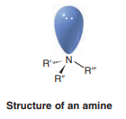
2.2. Structure and Nomenclature of amines
2.2.1. Structure of Amines
The nitrogen atom of most amines is like that of ammonia; it is approximately sp³ hybridized.
The three alkyl groups (or hydrogen atoms) occupy corners of a tetrahedron; the sp³ orbital containing the unshared electron pair is directed toward the other corner.
We describe the molecular geometry/shape of the amine by the location of the atoms as being trigonal pyramidal.
However, if we were to consider the unshared electron pair as being a group we would describe the electron-pair geometry of the amine as being tetrahedral.

Slide 5
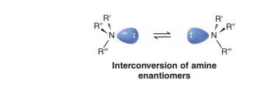
Cont…
The bond angles are what one would expect of a tetrahedral structure; they are very close to 109.5°.
The bond angles for trimethylamine, for example, are 108°.
If the alkyl groups of a tertiary amine are all different, the amine will be chiral.
There will be two enantiomer forms of the tertiary amine, and, theoretically, we ought to be able to resolve (separate) these enantiomers.

Slide 6
2.2.2. Nomenclature of Amines
Amines can be either alkyl-substituted (alkylamines) or aryl-substituted (arylamines).
Amines are classified as primary (RNH₂), secondary (R₂NH), or tertiary (R₃N), depending on the number of organic substituents attached to nitrogen.
Thus, methylamine (CH₃NH₂) is a primary amine, dimethylamine [(CH₃)₂NH] is a secondary amine, and trimethylamine [(CH₃)₃N] is a tertiary amine.

Slide 7

Cont…
Note that the usage of the terms 1$°,$ 2$°,$and 3$°$ amine are different from 1$°,$ 2$°,$and 3$°$ alcohol or alkyl halide,
because 1$°,$ 2$°,$and 3$°$ alcohol or alkyl halide refer to the degree of substitution at the alkyl carbon atom, but in 1$°,$ 2$°,$and 3$°$ amine, we refer to the degree of substitution at the nitrogen atom.

Slide 8
Cont…
Compounds containing a nitrogen atom with four attached groups also exist, but the nitrogen atom must carry a formal positive charge. Such compounds are called quaternary ammonium salts.
Primary amines are named in the IUPAC system in several ways.
For example amines, the suffix –amine is added to the name of the alkyl substituent.

Slide 9
Cont…
Amines with more than one functional group are named by considering the –NH₂ as an amino substituent on the parent molecule.
Symmetrical secondary and tertiary amines are named by adding the prefix di- or tri-to the alkyl group.

Slide 10
Cont…
Unsymmetrically substituted secondary and tertiary amines are named as N-substituted amines.
The largest alkyl group is chosen as the parent name, and the other alkyl groups are N-substituents on the parent (N because they are attached to nitrogen).

Slide 11
Cont…
The important heterocyclic amines all have common names.
In systematic replacement nomenclature the prefixes aza-, diaza-, and triaza-are used to indicate that nitrogen atoms have replaced carbon atoms in the corresponding hydrocarbon.
A nitrogen atom in the ring (or the highest atomic weight heteroatom, as in the case of thiazole) is designated position 1 and
numbering proceeds to give the lowest overall set of locants to the heteroatoms:

Slide 12
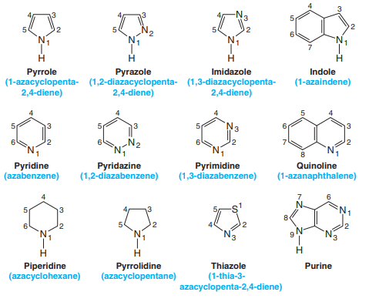
Cont…
In a fused system, numbering should prefer (in this order):
Ring with more nitrogen
Ring with other heteroatom
Larger rings
Nitrogen atom close to ring junction

Slide 13
2.3. Properties of Amines: Physical and chemical properties
2.3.1. Physical properties of amines
Amines are moderately polar substances; they have boiling points that are higher than those of alkanes, but generally lower than those of alcohols of comparable molecular weight.
Molecules of primary and secondary amines can form strong hydrogen bonds to each other and to water.
Molecules of tertiary amines cannot form hydrogen bonds to each other, but they can form hydrogen bonds to molecules of water or other hydroxylic solvents.
As a result, tertiary amines generally boil at lower temperatures than primary and secondary amines of comparable molecular weight, but all low-molecular-weight amines are very water soluble.

Slide 14
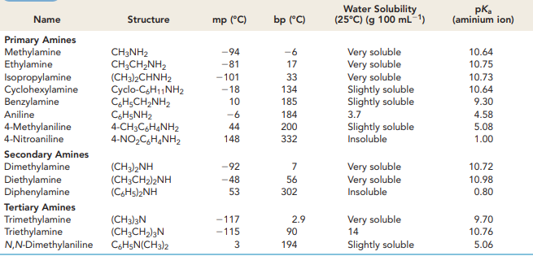
Cont…
Table 1. lists the physical properties of some common amines

Slide 15
Cont…
All amines (1º, 2º & 3°) form hydrogen bonds to water, accounting for their solubility (like dissolve like).
One other characteristic of amines is that their odors,
Low-molecular-weight amines, such as trimethylamine have a distinctive fishlike aroma/odor, while diamines such as 1,5-pentadiamine, commonly called cadaverine, have the appalling odors.

Slide 16

2.3.2. Chemical properties of amines
They are weak bases and they can react with acids (forming salt).
They react with water to produce alkylammonium ions and hydroxide anions.

Slide 17
2.4. Basicity of Nitrogen Compounds
The chemistry of amines is dominated by the lone pair of electrons on nitrogen, which makes amines both basic and nucleophilic.
They react with acids to form acid-base salts, and they react with electrophiles in many of the polar reactions.

Slide 18
Cont…
Amines are much stronger bases than alcohols and ethers, their oxygen-containing analogs.
When an amine is dissolved in water, an equilibrium is established in which water acts as an acid and transfers a proton to the amine.
Just as the acid strength of a carboxylic acid can be measured by defining an acidity constant K_{a}, the base strength of an amines can be measured by defining an analogous basicity constant K_{b}.
The larger the value of K_{b} and the smaller the value of pK_{b}, the more favourable the proton-transfer equilibrium and the stronger the base.

Slide 19
Cont…
In practice, K_{b} values are not often used. Instead, the most convenient way to measure the basicity of an amine (RNH ₂) is to look at the acidity of the corresponding ammonium ion (RNH ₃⁺).

Slide 20
Cont…
These equations say that the K_{b} of an amine multiplied by the K_{a} of the corresponding ammonium ion is equal to K_{w}, the ion-product constant for water (1.00 x 10⁻¹⁴).
Thus, if we know K_{a} for an ammonium ion, we also know K_{b} for the corresponding amine base because K_{b} = K_{w}/K_{a}.
The more acidic the ammonium ion, the less tightly the proton is held and the weaker the corresponding base.
That is, a weaker base has an ammonium ion with a smaller pK_{a}, and a stronger base has an ammonium ion with a larger pK_{a}.
Weaker base Smaller pKa for ammonium ion
Stronger base Larger pKa for ammonium ion

Slide 21
Cont…
Table 2. Lists pK_{a} values of some ammonium ions and indicates that there is a substantial range of amine basicities.
Most simple alkylamines are similar in their base strength, with pK_{a}’s for their ammonium ions in the narrow range 10 to 11.
Arylamines, however, are considerably less basic than alkylamines, as are the heterocyclic amines like pyridine and pyrrole.

Slide 22
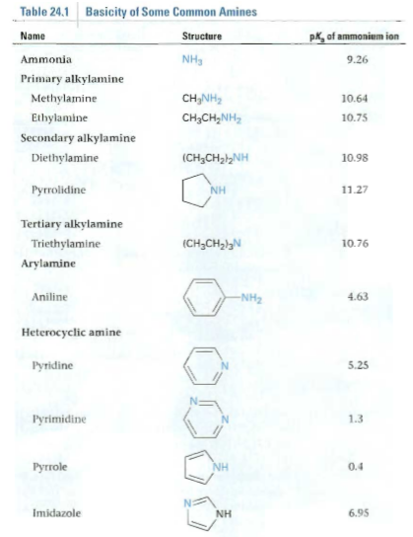
Cont…

Slide 23
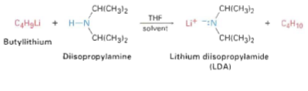
Cont…
In addition to their behaviour as bases, primary and secondary amines can also act as very weak acids because an N-H proton can be removed by a sufficiently strong base.

Slide 24
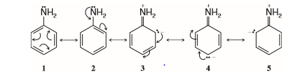
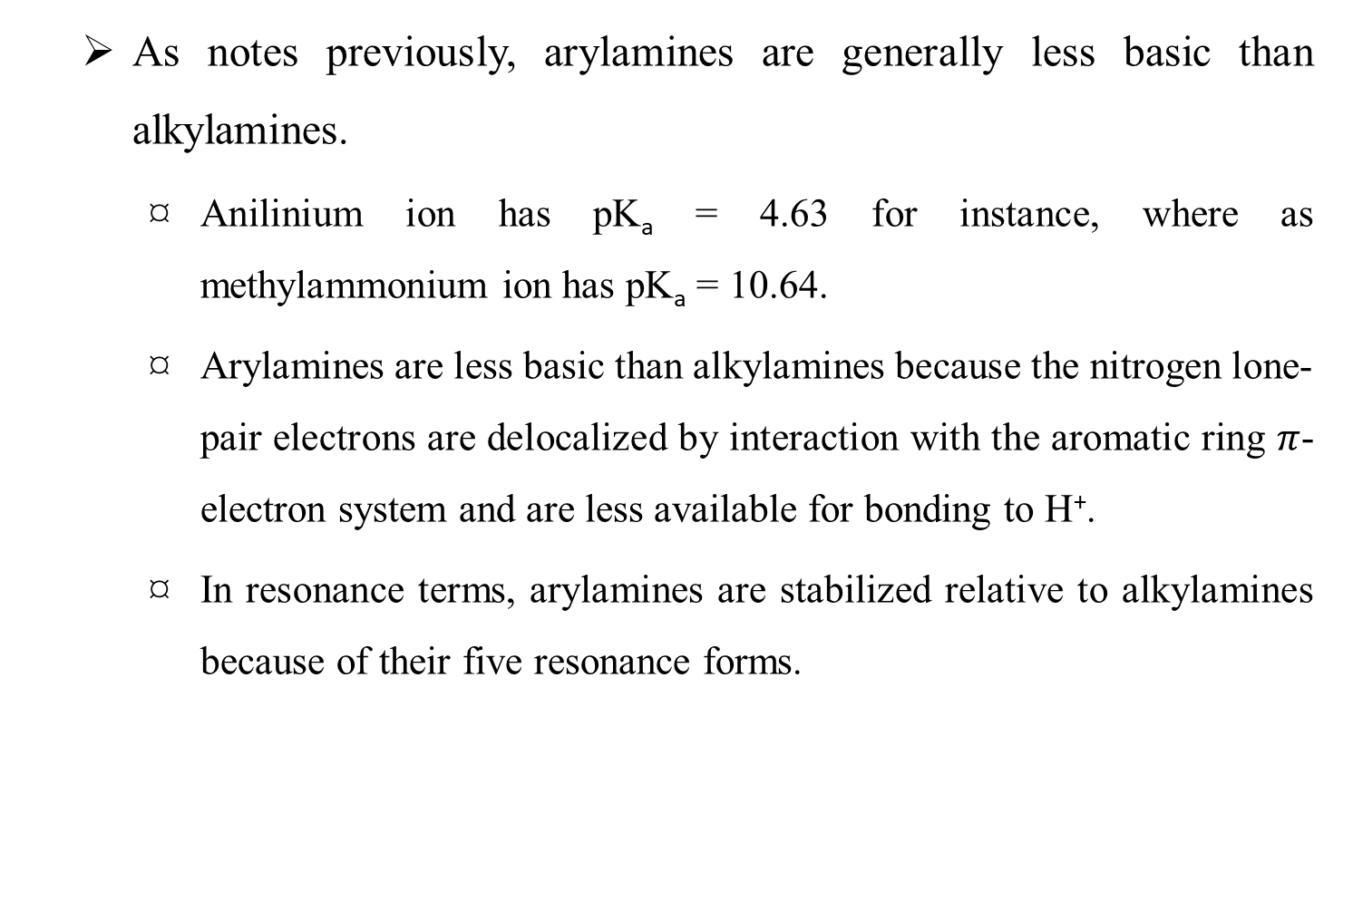
2.4.1. Basicity of Substituted Arylamines
As notes previously, arylamines are generally less basic than alkylamines.
Anilinium ion has pK_{a} = 4.63 for instance, where as methylammonium ion has pK_{a} = 10.64.
Arylamines are less basic than alkylamines because the nitrogen lone-pair electrons are delocalized by interaction with the aromatic ring $π$-electron system and are less available for bonding to H⁺.
In resonance terms, arylamines are stabilized relative to alkylamines because of their five resonance forms.

Slide 25
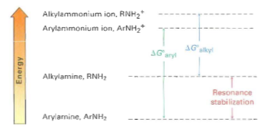
Cont…
Much of the resonance stabilization is lost on protonation, however, so the energy difference between protonated and nonprotonated forms is higher for arylamines than it is for alkylamines.
As a result, arylamines are less basic.

Slide 26
Cont…
Substituted arylamines can be either more basic or less basic than aniline, depending on the substituent.
Electron-donating substituents, such as –CH₃, -NH₂, and –OCH₃, which increase the reactivity of an aromatic ring toward electrophilic substitution, also increase the basicity of the corresponding arylamines.
Electron-withdrawing substituents, such as –Cl, -NO₂, and –CN, which decrease ring reactivity toward electrophilic substitution, also decrease arylamines basicity.

Slide 27
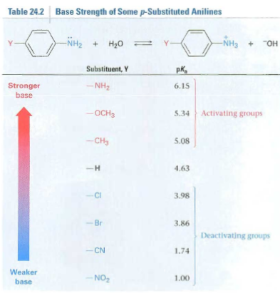
Cont…
Table 3. Considers only p-substituted anilines, but similar trends are observed for ortho and para derivatives.

Slide 28
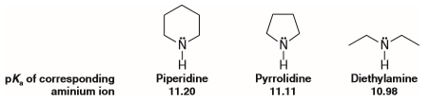
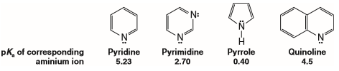
2.4.2. Basicity of Heterocyclic Amines
Nonaromatic heterocyclic amines have basicities that are approximately the same as those of acyclic amines:
In aqueous solution, aromatic heterocyclic amines such as pyridine, pyrimidine, and pyrrole are much weaker bases than nonaromatic amines or ammonia.
(In the gas phase, however, pyridine and pyrrole are more basic than ammonia, indicating that solvation has a very important effect on their relative basicities).

Slide 29
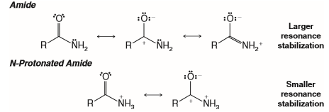
2.4.3. Amines versus Amides Basicities
Amides are far less basic than amines (even less basic than arylamines).
The pKa of the conjugate acid of a typical amide is about zero.
The lower basicity of amides when compared to amines can be understood in terms of resonance and inductive effects.
An amide is stabilized by resonance involving the nonbonding pair of electrons on the nitrogen atom.
However, an amide protonated on its nitrogen atom lacks this type of resonance stabilization. This is shown in the following resonance structures:

Slide 30
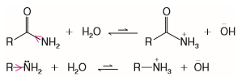
Cont…
However, a more important factor accounting for amides being weaker bases than amines is the powerful electron-withdrawing effect of the carbonyl group of the amide.
Comparing the following equilibrium, the reaction with the amide lies more to the left than the corresponding reaction with an amine. This is consistent with the amine being a stronger base than an amide.

Slide 31
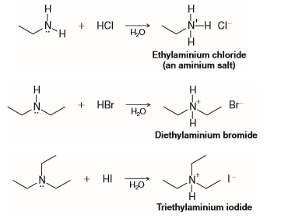
2.5. Aminium Salts and Quaternary Ammonium Salts
When primary, secondary, and tertiary amines act as bases and react with acids, they form compounds called aminium salts.
In an aminium salt the positively charged nitrogen atom is attached to at least one hydrogen atom:

Slide 32
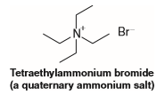
Cont…
When the central nitrogen atom of a compound is positively charged, but is not attached to a hydrogen atom, the compound is called a quaternary ammonium salt. For example,

Slide 33
Cont…
Quaternary ammonium halides—because they do not have an unshared electron pair on the nitrogen atom—cannot act as bases.
Quaternary ammonium hydroxides, however, are strong bases.
As solids, or in solution, they consist entirely of quaternary ammonium cations (R₄N⁺) and hydroxide ions (OH⁻); they are, therefore, strong bases—as strong as sodium or potassium hydroxide.
Quaternary ammonium hydroxides react with acids to form quaternary ammonium salts:

Slide 34
2.6. Reactions of Amines
2.6.1. Alkylation and Acylation
Alkylation of primary and secondary amines are difficult to control and often give mixtures of products, but tertiary amines are cleanly alkylated to give quaternary ammonium salts.
Primary and secondary (but not tertiary) amines can also be acylated by nucleophilic acyl substitution reaction with an acid chloride or an acid anhydride to yield an amide.
Not overacylation of the nitrogen does not occur because the amide product is much less nucleophilic and less reactive than the starting amine.

Slide 35

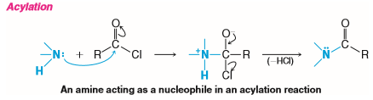
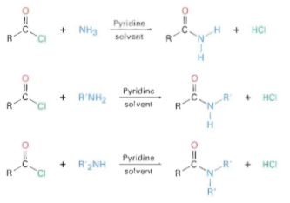
Cont…
C

Slide 36

2.6.2. Hofmann Elimination
Like alcohols, amines can be converted into alkenes by an elimination reaction.
Because an amide ion, NH₂⁻, is such a poor leaving group, however, it must first be converted into a better leaving group.
In the Hofmann elimination reaction, an amine is methylated by reaction with excess iodomethane to produce a quaternary ammonium salt, which then undergoes elimination to give an alkene on heating with a base, typically silver oxide, Ag₂O.
For example, 1-methylpentylamine is converted into 1-hexene 60% yield.

Slide 37
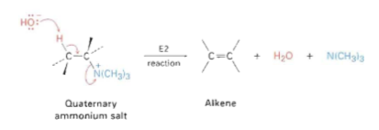
Cont…
Silver oxide acts by exchanging hydroxide ion for iodide ion in the quaternary salt, thus providing the base necessary to cause elimination.
The actual elimination step is an E₂ reaction in which hydroxide ion removes a proton at the same time that the positively charged nitrogen atom leaving.

Slide 38
Cont…
An interesting feature of the Hofmann elimination is that it gives products different from those of the most other E₂ reactions.
Whereas the more highly substituted alkene product generally predominates in the E₂ reaction of an alkyl halide (Zaitsev’s rule), the less highly substituted alkene predominates in the Hofmann elimination of a quaternary ammonium salt.
The reason for this selectivity is probably steric.
Because of the large size of the trialkylamine leaving group, the base must abstract a hydrogen from the most sterically accessible, least hindered position.

Slide 39
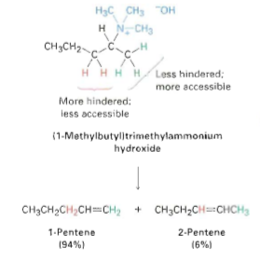
Cont…

Slide 40
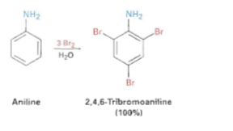
2.6.3. Electrophilic Aromatic Substitution
An amino group is strongly activating and ortho-para directing in electrophilic aromatic substitution reactions.
Thus high reactivity can be a drawback at times because its often difficult to prevent polysubstitution.
For instance, reaction of aniline with Br₂ takes rapidly and yields the 2,4,6-tribrominated product.
The amino group is so strongly activating that its not possible to stop at the monobromo stage.

Slide 41
Cont…
Another drawback to the use of amino-substituted benzenes in electrophilic aromatic substitution reactions is that Friedel-Crafts reactions are not successful.
The amino group forms an acid-base complex with the AlCl₃ catalyst, which prevents further reaction from occurring.
Both drawbacks can be overcome, however, by carrying out electrophilic aromatic substitution reactions on the corresponding amide rather than on the free amine.

Slide 42
Cont…
When we treat an amine with acetic anhydride yields the corresponding acetyl amide, or acetamide.
Although still activating and ortho-para directing, amido substituents (-NHCOR) are less strongly activating and less basic than amino groups because their nitrogen lone-pair electrons are delocalized by the neighbouring carbonyl group.
As a result, bromination of an N-arylamide occur cleanly to give a monobromo product, and hydrolysis with aqueous base then gives the free amine.

Slide 43
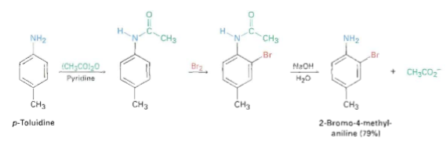
Cont…
For example, p-toluidine (4-methylaniline) can be acetylated, brominated, and hydrolysed to yield 2-bromo-4-methylaniline.
None of the 2,6-dibrominated product is obtained.

Slide 44
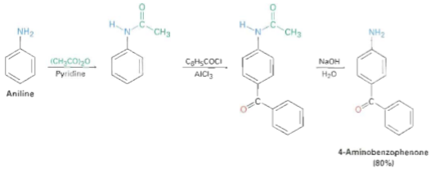
Cont…
Friedel-Crafts alkylation and acylation's of N-arylamides also proceed normally.
For example, benzoylation of acetanilide (N-acetylation) under Friedel-Crafts conditions gives 4-aminobenzophenone in 80% yield after hydrolysis.

Slide 45

2.6.4. Reactions of Amines with Nitrous Acid
Nitrous acid (HONO) is a weak, unstable acid. It is always prepared in situ, usually by treating sodium nitrite (NaNO₂) with an aqueous solution of a strong acid:
Nitrous acid reacts with all classes of amines.
The products that we obtain from these reactions depend on whether the amine is primary, secondary, or tertiary and whether the amine is aliphatic or aromatic.

Slide 46
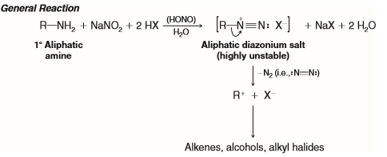
2.6.4.1. Reactions of Primary Aliphatic Amines with Nitrous Acid
Primary aliphatic amines react with nitrous acid through a reaction called diazotization to yield highly unstable aliphatic diazonium salts.
Even at low temperatures, aliphatic diazonium salts decompose spontaneously by losing nitrogen to form carbocations.
The carbocations go on to produce mixtures of alkenes, alcohols, and alkyl halides by removal of a proton, reaction with H₂O, and reaction with X⁻:

Slide 47

2.6.4.2. Reactions of Primary Arylamines with Nitrous Acid
The most important reaction of amines with nitrous acid, by far, is the reaction of primary arylamines.
Primary arylamines react with nitrous acid to give arenediazonium salts.
Even though arenediazonium salts are unstable,
they are still far more stable than aliphatic diazonium salts;
they do not decompose at an appreciable rate in solution when the temperature of the reaction mixture is kept below 5°C:

Slide 48
Cont…
Diazotization of a primary amine takes place through a series of steps.
In the presence of strong acid, nitrous acid dissociates to produce ⁺NO ions.
These ions then react with the nitrogen of the amine to form an unstable N-nitrosoaminium ion as an intermediate.
This intermediate then loses a proton to form an N-nitrosoamine, which, in turn, tautomerizes to a diazohydroxide in a reaction that is similar to keto–enol tautomerization.
Then, in the presence of acid, the diazohydroxide loses water to form the diazonium ion.

Slide 49
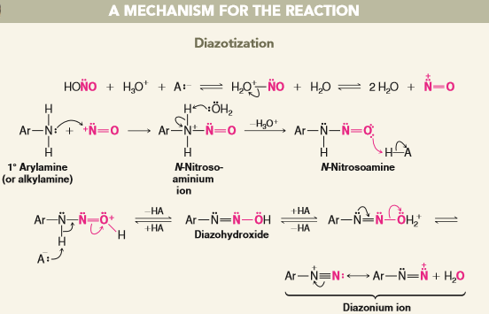
Cont…

Slide 50
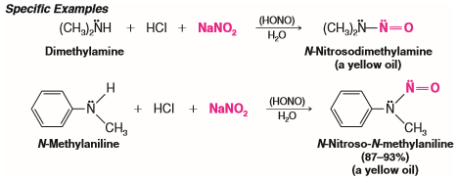
2.6.4.3. Reactions of Secondary Amines with Nitrous Acid
Secondary amines—both aryl and alkyl—react with nitrous acid to yield N-nitrosoamines.
N-Nitrosoamines usually separate from the reaction mixture as oily yellow liquids:

Slide 51

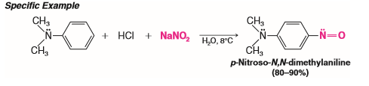
2.6.4.4. Reactions of Tertiary Amines with Nitrous Acid
When a tertiary aliphatic amine is mixed with nitrous acid, an equilibrium is established among
the tertiary amine salt, and
an N-nitrosoammonium compound

Slide 52
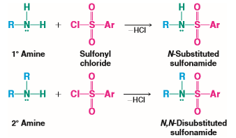

2.6.5. Reactions of Amines with Sulfonyl Chlorides
Primary and secondary amines react with sulfonyl chlorides to form sulfonamides:
When heated with aqueous acid, sulfonamides are hydrolysed to amines:

Slide 53
2.7. Preparation of Amines
In this section we discuss a variety of ways to synthesize amines. Some of these methods will be new to you, while others are methods you have studied earlier in the context of related functional groups and reactions.
2.7.1. Through Nucleophilic Substitution Reactions
2.7.1.1. Alkylation of Ammonia
Salts of primary amines can be prepared from ammonia and alkyl halides by nucleophilic substitution reactions. Subsequent treatment of the resulting aminium salts with a base gives primary amines:
This method is of very limited synthetic application because multiple alkylation's occur.

Slide 54
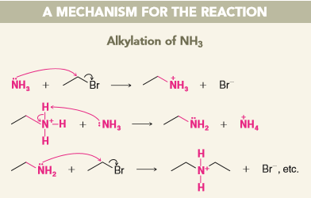
Cont…
When ethyl bromide reacts with ammonia, for example, the ethylaminium bromide that is produced initially can react with ammonia to liberate ethylamine.
Ethylamine can then compete with ammonia and react with ethyl bromide to give diethylaminium bromide.
Repetitions of alkylation and proton transfer reactions ultimately produce some tertiary amines and even some quaternary ammonium salts if the alkyl halide is present in excess.

Slide 55
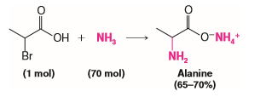
Cont…
Multiple alkylation's can be minimized by using a large excess of ammonia.
An example of this technique can be seen in the synthesis of alanine from 2-bromopropanoic acid:

Slide 56

2.7.1.2. Alkylation of Azide Ion and Reduction
A much better method for preparing a primary amine from an alkyl halide is
ﬁrst to convert the alkyl halide to an alkyl azide (R-N₃) by a nucleophilic substitution reaction, then
reduce the azide to a primary amine with sodium and alcohol or with lithium aluminium hydride.

Slide 57
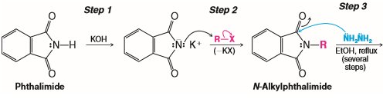
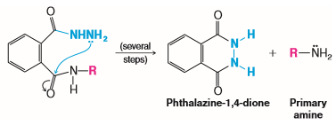
2.7.1.3. The Gabriel Synthesis
Potassium phthalimide (see the following reaction) can also be used to prepare primary amines by a method known as the Gabriel synthesis.
This synthesis also avoids the complications of multiple alkylation's that occur when alkyl halides are treated with ammonia:

Slide 58
Cont…
Phthalimide is quite acidic (pKa = 9); it can be converted to potassium phthalimide by potassium hydroxide (step 1).
The phthalimide anion is a strong nucleophile and (in step 2) it reacts with an alkyl halide by an SN² mechanism to give an N-alkylphthalimide.
At this point, the N-alkylphthalimide can be hydrolysed with aqueous acid or base, but the hydrolysis is often difﬁcult.
It is often more convenient to treat the N-alkylphthalimide with hydrazine (NH₂NH₂) in reﬂuxing ethanol (step 3) to give a primary amine and phthalazine-1,4-dione.
Syntheses of amines using the Gabriel synthesis are, as we might expect, restricted to the use of methyl, primary, and secondary alkyl halides. The use of tertiary halides leads almost exclusively to eliminations.

Slide 59

2.7.1.4. Alkylation of Tertiary Amines
Multiple alkylation's are not a problem when tertiary amines are alkylated with methyl or primary halides.
Reactions such as the following take place in good yield:

Slide 60

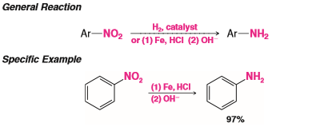
2.7.2. Preparation of Aromatic Amines through Reduction of Nitro Compounds
The most widely used method for preparing aromatic amines involves nitration of the ring and subsequent reduction of the nitro group to an amino group:
Reduction of the nitro group can also be carried out in a number of ways.
The most frequently used methods employ catalytic hydrogenation, or treatment of the nitro compound with acid and iron. Zinc, tin, or a metal salt such as SnCl₂ can also be used.

Slide 61
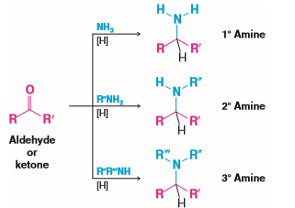
2.7.3. Preparation of Primary, Secondary, and Tertiary Amines through Reductive Amination
Aldehydes and ketones can be converted to amines through catalytic or chemical reduction in the presence of ammonia or an amine.
Primary, secondary, and tertiary amines can be prepared this way:

Slide 62
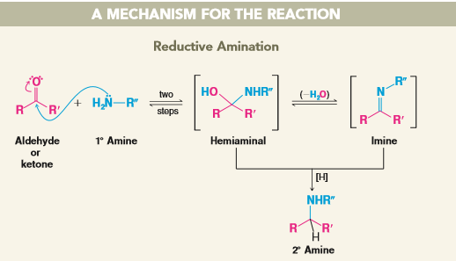
Cont…
This process, called reductive amination of the aldehyde or ketone (or reductive alkylation of the amine), appears to proceed through the following general mechanism (illustrated with a 1° amine).

Slide 63
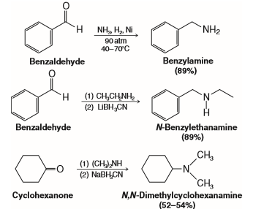
Cont…
The reducing agents employed include hydrogen and a catalyst (such as nickel) or NaBH₃CN or LiBH₃CN (sodium or lithium cyanoborohydride).
The latter two reducing agents are similar to NaBH₄ and are especially effective in reductive aminations.
Three speciﬁc examples of reductive amination follow:

Slide 64
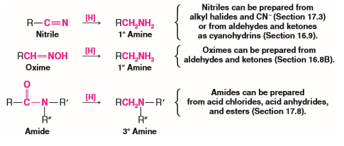
2.7.3. Preparation of Primary, Secondary, or Tertiary Amines through Reduction of Nitriles, Oximes, and Amides
Nitriles, oximes, and amides can be reduced to amines.
Reduction of a nitrile or an oxime yields a primary amine; reduction of an amide can yield a primary, secondary, or tertiary amine:
All of these reductions can be carried out with hydrogen and a catalyst or with LiAlH₄.

Slide 65
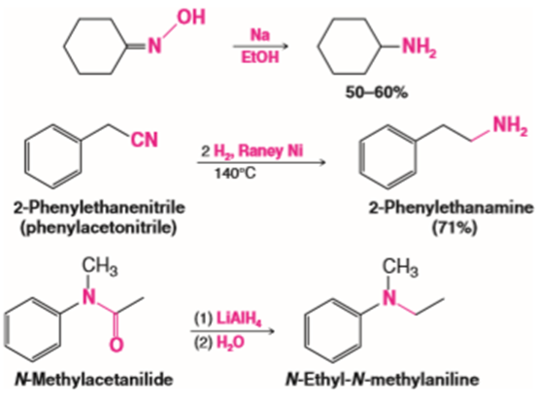
Cont…
Oximes are also conveniently reduced with sodium in ethanol. Specific examples follow:

Slide 66
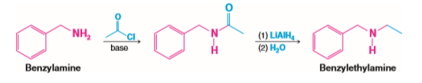
Cont…
Reduction of an amide is the last step in a useful procedure for monoalkylation of an amine.
The process begins with acylation of the amine using an acyl chloride or acid anhydride; then the amide is reduced with lithium aluminium hydride. For example,

Slide 67

2.7.4. Preparation of Primary Amines through the Hofmann and Curtius Rearrangements
2.7.4.1. Hofmann Rearrangement
Amides with no substituent on the nitrogen react with solutions of bromine or chlorine in sodium hydroxide to yield amines through a reaction known as the Hofmann rearrangement or Hofmann degradation:

Slide 68
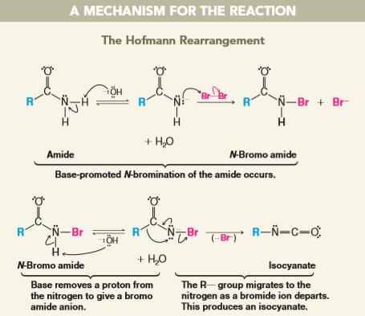
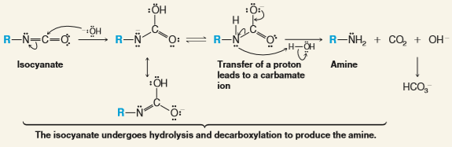
Cont…

Slide 69

2.7.1.2. Curtius Rearrangement
The Curtius rearrangement is a rearrangement that occurs with acyl azides.
It resembles the Hofmann rearrangement in that an R group migrates from the acyl carbon to the nitrogen atom as the leaving group departs.
In this instance the leaving group is N₂ (the best of all possible leaving groups since it is highly stable, is virtually nonbasic, and being a gas, removes itself from the medium).
Acyl azides are easily prepared by allowing acyl chlorides to react with sodium azide.
Heating the acyl azide brings about the rearrangement; afterward, adding water causes hydrolysis and decarboxylation of the isocyanate:

Slide 70
Cont…
END OF CHAPTER ONE
THANK YOU

