Slide 1

Collage of Natural and computational science
Department of chemistry
Statistical Thermodynamics and Surface Chemistry
Chem(3102)
Chapter 1and 2
Prepared By Tesfaye Tadesse (MSc)

Slide 2

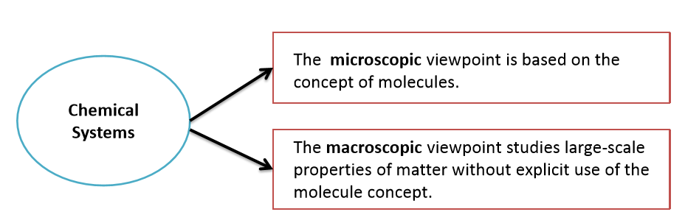
What is Physical Chemistry?
Physical chemistry is the sub parts of chemistry which study on underlying physical principles that govern the properties and behavior of Chemical Systems.
What is Chemical Systems? It can be studied from either a microscopic or a macroscopic viewpoint.

Slide 3
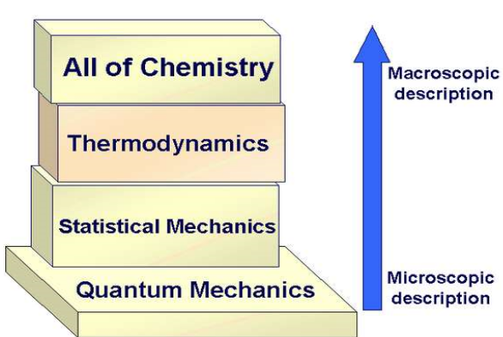
Cont…

Slide 4
What is Thermodynamic?
Thermodynamics : is combination of two where thermo refers to heat, and dynamics refers to change. There are four postulates, namely
Zeroth Law: If two bodies are in thermal equilibrium with a third body, they are also in thermal equilibrium with each other.
First Law: The internal energy of an isolated system in universe is constant. ∆E = q + w
work done by a gas (through expansion) or work done to a gas (through compression).
Second Law: “for all spontaneous processes entropy of the universe is increase “
Third Law: The entropy of a perfect crystalline substance is zero at absolute zero temperature (0.0 K)

Slide 5
Statistical thermodynamics
There are two Idea in physical chemistry.
One is the deals with the relations between bulk properties of matter related to the transfer of energy. Thermodynamics
The other is deals with molecular structure Statistical
Statistical thermodynamics is a science which study between microscopic properties of matter and its bulk properties(macroscopic properties)
Goal of Statistical Mechanics: describe macroscopic bulk thermodynamic properties in terms of microscopic atomic and molecular properties. These microscopic properties are generally measured by spectroscopy.
Macroscopic: U, H, A, G, S, μ, p, V, T, C^{V}, C^{p}
complete intensive description of a bulk system: N ≈ 10²³ particles

Slide 6
Cont…
Thermodynamic systems are ideally suited to a statistical approach, because of the Statistical arguments actually get more exact as the numbers involved get larger.
It is useful, at this stage, to make a distinction between the diﬀerent sizes of the systems that we are going to examine.
The exact deﬁnition depends on the number of particles in the system, which we shall call N. A system is macroscopic if 1/N1/2 1, which means that statistical arguments can be applied to reasonable accuracy.

Slide 7
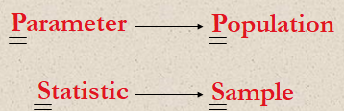
Terminology and Basic Concepts
Data consists of information coming from observations, counts, measurements, or responses.
Statistics is the science of collecting, organizing, analyzing, and interpreting data in order to make decisions.
A population is the collection of all outcomes, responses, measurement, or counts that are of interest.
A sample is a subset of a population.
A parameter is a numerical description of a population characteristic.
A statistic is a numerical description of a sample characteristic.

Slide 8
Cont…
Permutations
What do we mean by Permutations?
Permutation (P) is any arrangement of objects where order matters.
The number of different permutations of n distinct objects is n! (n factorial)
n! = n∙(n – 1)∙(n – 2)∙(n – 3)∙ ∙ ∙3∙2 ∙1
0! = 1
Examples:
6! = 6∙5∙4∙3∙2∙1 = 720
4! = 4∙3∙2∙1 = 24
The number of permutations is 9!= 9∙8∙7∙6∙5∙4∙3∙2∙1 = 362,880 ways

Slide 9
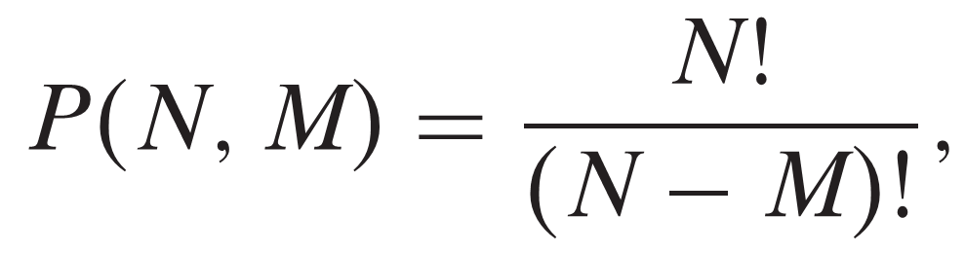
Cont…
Permutation of n objects taken r at a time
The number of different permutations of n distinct objects taken r at a time
where r ≤ n
Where,- N is total number of object in a subset under consideration
- M is number of objects to be picked at a time from subset

Slide 10
Example:
Find the number of ways of forming four-digit codes in which no digit is repeated.
Solution:
You need to select 4 digits from a group of 10 Why
n = 10, r = 4

Slide 11
Example:
Forty-three race cars started the 2007 Daytona 500. How many ways can the cars finish first, second, and third?
Solution:
You need to select 3 cars from a group of 43
n = 43, r = 3

Slide 12
Permutations are distinguishable
The number of distinguishable permutations of n objects where n₁ are of one type, n₂ are of another type, and so on.
where n₁ + n₂ + n₃ +∙∙∙+ n_{k} = n
Example
A building contractor is 12 houses planning to develop a subdivision that consists of 6 one-story houses, 4 two-story houses, and 2 split-level houses. In how many distinguishable ways can the houses be arranged?
Solution:
There are 12 houses in the subdivision
n = 12, n₁ = 6, n₂ = 4, n₃ = 2

Slide 13
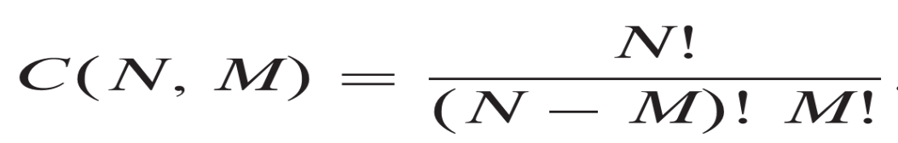
Combination
Combination is any arrangement of objects where order doesn't matter
Combination of n objects taken r at a time
A selection of r objects from a group of n objects without regard to order
Combination
Where,- N is total number of object in a subset under
consideration
- M is number of objects to be picked at a time
from subset
Combination are Indistinguishable

Slide 14
Example:
A state’s department of transportation plans to develop a new section of interstate highway and receives 16 bids for the project. The state plans to hire four of the bidding companies. How many different combinations of four companies can be selected from the 16 bidding companies?
Solution:
You need to select 4 companies from a group of 16
n = 16, r = 4
Order is not important
Solution: Combinations

Slide 15
Probability
Probability theory is concerned with predicting statistical outcomes.
An Experiment is an activity (measurement or observation) that generates to results (outcomes).
An Outcome (Sample point) is any result obtained in an experiment.
A Sample Space (S) is a set that contains all possible outcomes of an experiment.
An Event is any subset of a sample space.

Slide 16
Cont’d
Example 1 When a coin is tossed, the possible results are either head (H) or tail (T). Consider an experiment of tossing a pair coin twice.
What are the possible outcomes?
Give the sample space.
Give the event of H appearing on the second throw.
Give the event of at least one T appearing.
Solution:
HH, HT, TH, TT
S = {HH, HT, TH, TT}
A = {HH, TH}
B = {HT, TH, TT}

Slide 17



Cont’d
Probability of an event (E)
If an event E can happen in m ways out of n equally likely possibilities, the probabilityof the occurrence of an event E is given by
Example 2 A box contains 4 red and 5 black balls. If one ball is drawn at random, what is the probability of getting a
red ball?
black ball?

Slide 18
Mutually Exclusive Events
Two events, A and B, are mutually exclusive if they cannot occur at the same time.
A and B
A
B
A
B
A and B are mutually exclusive.
A and B are not mutually exclusive.

Slide 19
Addition Rule
The probability that event A or B will occur is given by
P (A or B) = P (A) + P (B) – P (A and B ).
If events A and B are mutually exclusive, then the rule can be simplified to
P (A or B) = P (A) + P (B).
Example:
You roll a die. Find the probability that you roll a number less than 3 or 4.
The events are mutually exclusive.
P (roll a number less than 3 or roll a 4)
= P (number is less than 3) + P (4)

Slide 20
Law of Multiplication of Probabilities
The probability that two independent events will occur simultaneously is equal to the product of the probability of the separate events, or
p₁₂ = p₁*p₂
Where p₁₂ is the probability that events 1 and 2 will occur simultaneously and p₁ and p₂ are the probabilities of events 1and 2.

Slide 21
Law of Addition of Probabilities
The probability of the two events are mutually exclusive events will occur is the sum of the probability of their separate occurrence, p₁ and p₂
P₁₂ = p₁ + p₂
What is the probability that a die will turn to 4 or an odd number?
Solution: The chance of getting 4 are 1/6 and the chance of getting an odd number (1, 3, and 5) is 3/6. Both these events are mutually exclusive, since it is 4, it cannot be an odd number or vice versa.
Hence, p = 1/6 + 3/6 = 4/6 = 2/3.

Slide 22
Stirling’s Approximation
In handling a distribution of N particles, we generally have to evaluate a function N! or ln N!
For small numbers these functions can be easily computed.
When N is large, simple computation is difficult and time consuming.
Therefore, a simple method is needed for the evaluation of N! or ln N!, more so when N is of the order of 10²³ in a system of interest to chemists. For large N value

Slide 23
Cont…
We can write N! as
N! = N. (N-1). (N-2) ….3.2.1 and
ln N! = ln N + ln (N-1) + ln (N-2) + …..ln 3 + ln 2 + ln 1
When N is a very large number, the summation can be approximated by an integral as,
lnN!

Slide 24
Cont…
Integrating by part and putting the limits, we get
ln N! = N ln N – N – [N ln N – N] 1
= N ln N – N + 1
Since ln 1 = 0 and N >>1, we can write
Exponentiating each side, we get the first approximation:
N! = N^{N}. e^{-N}
Therefore, ln N! = N ln N – N
N! = N^{N}. e^{-N}
It is quite unreliable when N is small
but is a very good approximation for large values of N.

Slide 25

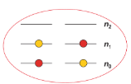
Conﬁgurations and weights
What is meant by the "weight" of a configuration?
The weight is equal to the number of particles in the system.
It is equal to the number of microstates corresponding to a given configuration.
It is equal to the total number of configurations.
A configuration is the overall set of occupation numbers {n0,n1,n2}
In our example two configuration are shown: {2, 0, 0} vs. {1, 1, 0}. Obviously the configuration {1, 1, 0} has a larger weight W = 2 (number of arrangements for occupying states in one configuration) than {2, 0, 0} with W = 1. But several aspects have been neglected for the comparison of both configuration:
Both configuration differ in the overall energy, and thus in their temperature dependence

Slide 26
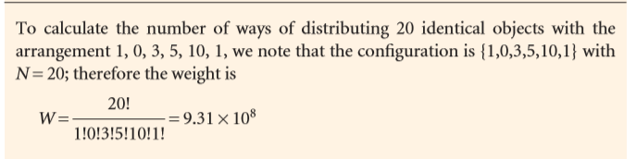

Cont…
Any individual molecule may exist in states with energies ε 0,ε 1, ε2 ε3 . . . We shall always take ε 0, the lowest state, as the zero of energy ( ε0 =0), and measure all other energies relative to that state.
A general conﬁguration {n0,n1, . . . } can be achieved in W different ways, where W is called the weight of the conﬁguration. The weight of the conﬁguration {n0,n1, . . . } is given by the expression

Slide 27
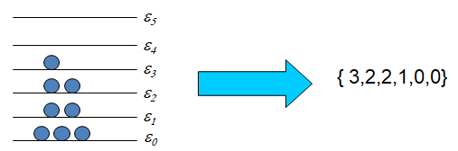
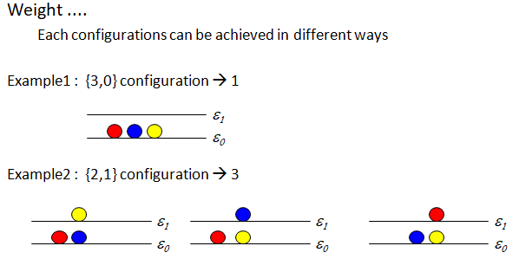
Cont…
At any instance, there may be n_{o} molecules at e₀ , n₁ molecules at e₁ , n₂ molecules at e₂ , …
→ {n₀ , n₁ , n₂ …} configuration

Slide 28
Cont…
For large number of molecules and large number of energy levels, there is a dominating configuration.
The weight of the dominating configuration is much more larger than the other configurations.
All distributions of energy are equally probable
If E = 5 and N = 5 then
5
5
5
4
4
4
3
3
3
2
2
2
1
1
1
0
0
0
All configurations have equal probability, but
possible number of way (weight) is different.

Slide 29
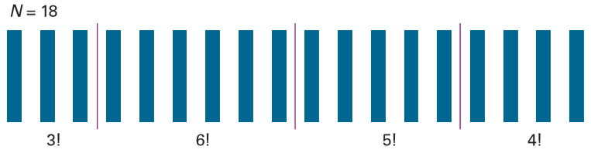
Cont’d
The 18 molecules shown here can be distributed into four receptacles (distinguished by the three vertical lines) in 18! different ways.
However, 3! of the selections that put three molecules in the ﬁrst
6! that put six molecules into the second and so on.
Hence the number of distinguishable arrangements is
18!/3!6!5!4!

Slide 30
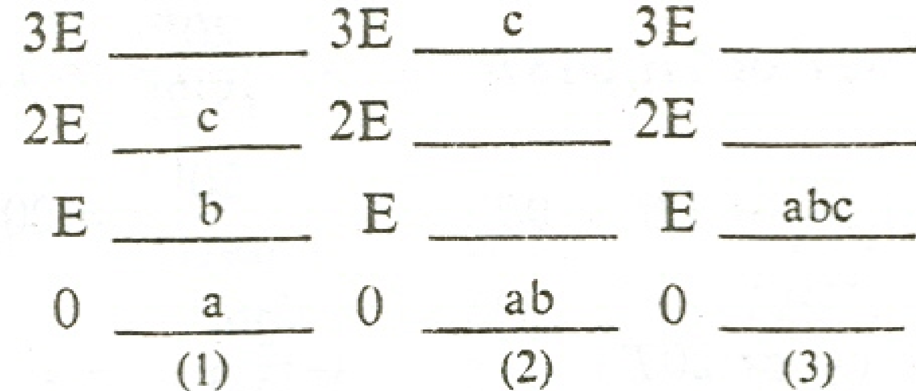
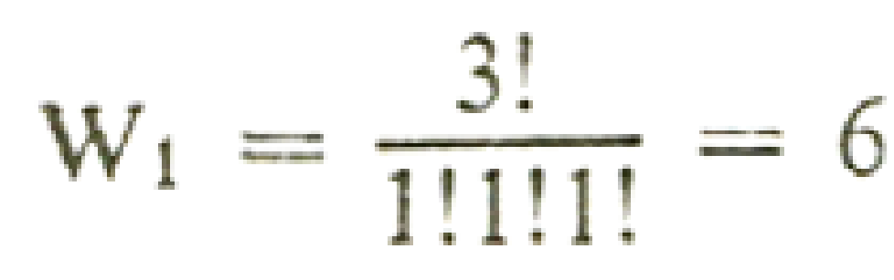
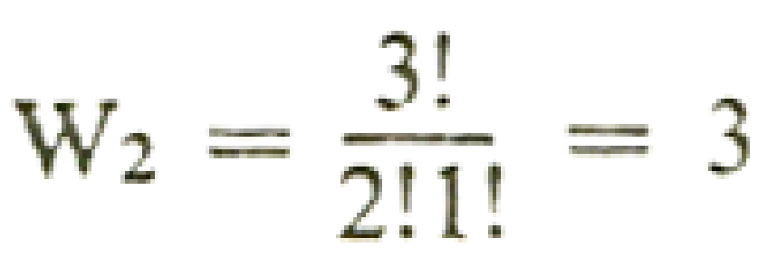
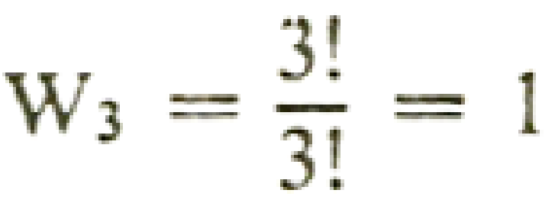
Cont’d
Similarly, in statistical mechanics, we assume that the more ways there are to arrange the particles to give a particular distribution of energies, the more probable is that distribution. (Seems reasonable)
The total number of ways of getting the distribution = 6 + 3 + 1 = 10.
Probability of occurrence of each distribution is 6/10, 3/10, and 1/10 respectively.
Thus the first distribution is the most probable distribution

Slide 31
Statistical Mechanics of Ensembles
An ensemble is a theoretical collection of a very large number particle in a systems which replicates under investigation.
Statistical ensembles are classified in three different types.
The classification of ensembles depends on the interactions of the systems with the surroundings are either through energy exchange or through energy and matter (number particles) exchange.
Micro-canonical ensemble: (N, V,U)
Canonical ensemble: (N, V, T)
Grand-canonical ensemble:(µ, V, T)

Slide 32
Cont…
I. The microcanonical ensemble
It is composed of η isolated systems (N, V,U), for which the total number of particles, N, the volume, V, and the internal energy, U, are the replicated thermodynamic properties.
In an isolated system, neither energy nor matter is exchanged and the corresponding ensemble.
II. The canonical ensemble
It is composed of η closed, isothermal systems (N, V, T)
A system exchanging only energy but not matter with its surroundings is described by canonical ensemble.

Slide 33
Cont…
II The grand canonical ensemble
It is composed of η open, isothermal systems (µ, V, T)
In this both energy and matter are exchanged between the system and the surroundings the corresponding ensemble.
For an isolated thermodynamic system, the members of the ensemble are distributed with equal probability over the possible system quantum states defined by specification of N, V, and U.
The microcanonical and canonical ensembles generally provide the most useful connections between the Maxwell–Boltzmann (M–B) method, and Gibbs methods of statistical thermodynamics.

Slide 34
Distribution Functions
What is distribution and the most probable distribution?
A distribution can be defined as a set of occupation numbers of particles in different energy states specification of an entire set alternatively.
Those a system consisting of N identical and independent particles Like electrons in various atomic orbitals, an atom consists of various energy states or orbitals like s, p, d, f orbitals
These 2, 6, 10 and 14 are the occupation numbers of s, p, d, and f orbitals respectively.

Slide 35
Cont’d
For example, consider an atom of chlorine. It consists of 17 electrons. The occupation numbers of various energy states in chlorine are,
Energy states 1s 2s 2p 3s 3p 4s Occupation No. 2 2 6 2 5
This set of 2, 2, 6, 2, 5 of 17 electrons in various energy states in a distribution of 17 electrons in Cl atom.
There could also be another way of distributing these 17 electrons (for example in excited state) 2, 2, 6, 2, 4, 1 where 1 electron from 3p orbital is transferred to 4s. This set is also a distribution of 17 electrons in Cl atom (in excited state). This is also consistent with the total number of electrons. (2, 2, 6, 2, 4, 1 )

Slide 36
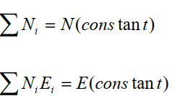
Boltzmann distribution
Boltzmann distribution is a statistical approach which the molecules in a system are distributed over the available states of that system
At a certain moment there being
n₁ particles at energy state E₁
n₂ at state E₂
n_{i} at state E_{i} and so on.
However, the distribution must satisfy the condition
Where Ni is the number of particles with energy Ei in the i th energy state.
E is the total energy of the system.
So, in a distribution, the particle can occupy any energy state but the total energy must have a constant value.

Slide 37
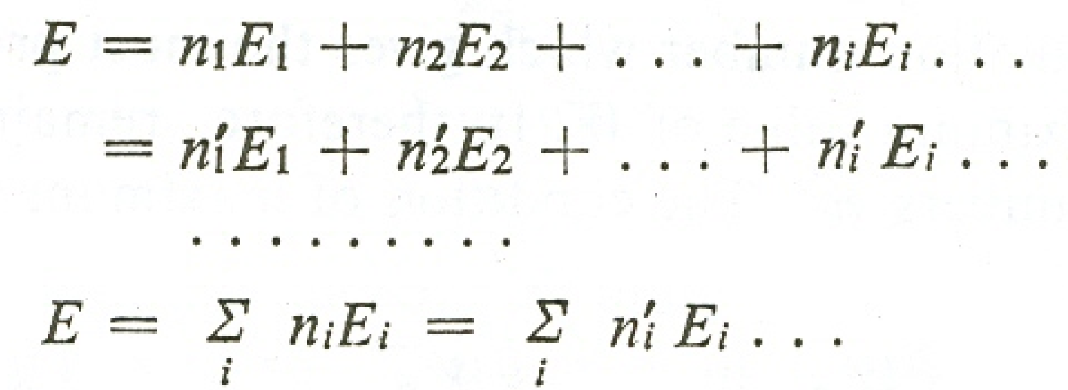
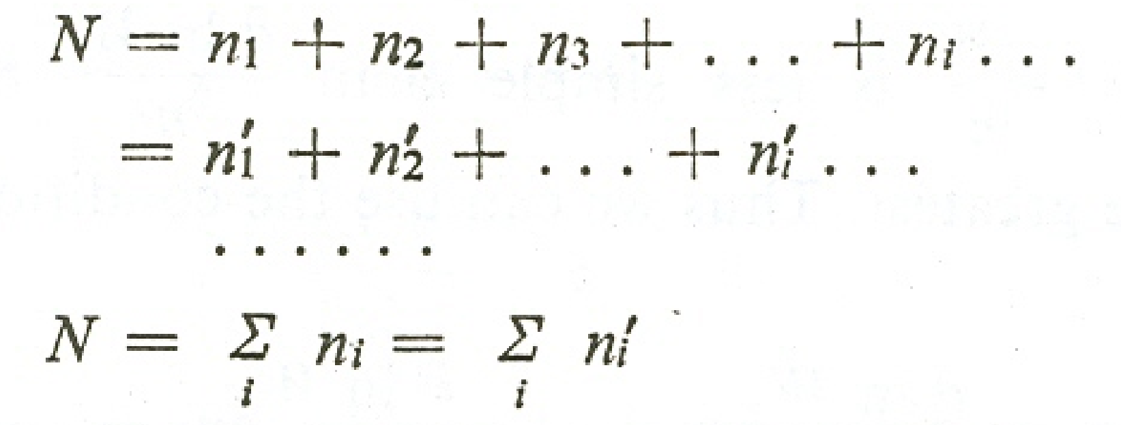
Cont’d
Assuming that the system is closed and isolated, then each set of population numbers must be governed by two conditions:
1.
…………..(eq.1)
2.
………………..(eq.2)

Slide 38

Cont…
The macroscopic properties of the system will be the result of the total configuration of the molecules in the system.
The most probable configuration of the system , largest value of W.
Boltzmann distribution, is the formula that tells us how to calculate the numbers of molecules in each state of a system at any temperature:
Ni is the number of molecules in a state with energy Ei,
N is the total number of molecules
k is Boltzmann’s constant value 1.381 × 10⁻²³ J K-1,
T is the absolute temperature.
The term in the denominator, q, is the partition function

Slide 39

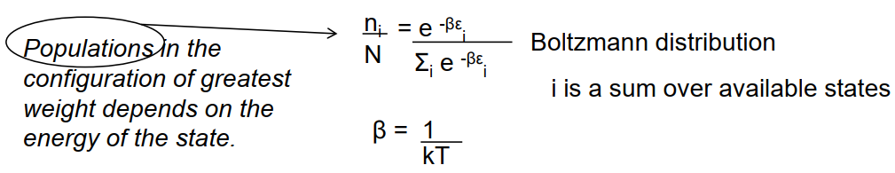
Cont...
The partition function(q) contains all the thermodynamic information about the system, such as its internal energy, entropy, heat capacity, and so on. It tell about relative population level of the state
how to calculate the partition function and how to extract the information it contains.
Hence

Slide 40




Cont’d
The most general form of the famous Boltzmann distribution law
If Ei and Ej two energy levels in a system, The ratio of energy levels would be calculated as,
Boltzmann distribution law can be stated as: ‘’The distribution of particles between any pair of energy levels depends only on their energy separation and the temperature’’

Slide 41
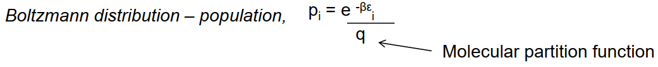

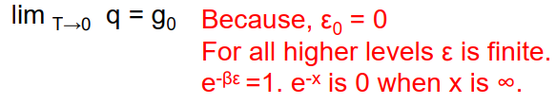


The molecular partition function
Partition function (q) depends on the temperature. When T is close to zero, the parameter β = 1/kT is close to infinity.
q

Slide 42
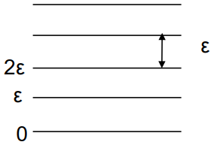
Cont’d
q = 1 + e^{-E1}/kT + e^{-E2}/kT + e^{-E3}/kT + ...
The first term is 1 because the energy of the ground state (E⁰) is 0, according to our convention, and e⁰ = 1
To see the physical significance of q, let’s suppose first that T = 0. Then, because e^{-∞} = 0, all terms other than the first are equal to 0, and q = 1.
At T = 0 only the ground state is occupied and (provided that state is non degenerate) q = 1.
At temperature so high that all the Ei/kT = 0. Then, because e⁰ = 1, the partition function is q ≈ 1 +1 + 1 + 1 + ... = N states.
The partition function is a measure of the number of thermally accessible states.
for all states with Ei> > kT the exponential term is close to 0.
For all states with Ei< < KT the exponential term is reasonably close to 1

Slide 43


Cont…
Suppose that the temperature of kT is large compared to E₁ and E₂ but small compared to E₃ and all subsequent terms .
E1/kT and E2/kT are both small compared to 1, and e^{-x} ≈ 1 when x is very small, the first three terms are all close to 1. However, because E3/kT is large compared to 1, and e^{-x} ≈ 0 when x is large, all the remaining terms are close to 0
the principal meaning of the partition function: q tells us the number of thermally accessible states at the temperature of interest.
Once we grasp the significance of q, statistical thermodynamics becomes much easier to understand.

Slide 44
Cont…
As q increases with temperature, because more states become accessible as the temperature is raised.
At low temperatures q is small, and falls to 1 as the temperature approaches absolute zero (Molecule in ground state and that state is non degenerate).
Molecules with numerous, closely spaced energy levels (like bulky molecules) can be expected to have very large partition functions.
Molecules with widely spaced energy levels can be expected to have small partition functions, because only the few lowest states will be occupied at low temperatures.

Slide 45
Electronic, Vibrational, Rotational and Translational Partition Functions
The electronic energy levels are generally very widely separated in energy compared to the thermal energy kT at room temperature.
The total energy is a sum of all these energies and is given by
The molecular partition function is written as the product of electronic, vibrational,rotational and translational Partition Functions .
Assuming the first four to be independent ,the molecular partition function (ie, a sum over the molecular energy states) is given by

Slide 46
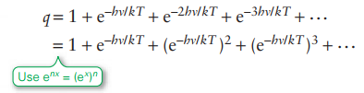


vibrational partition function
The energy levels of a harmonic oscillator, If we set the energy of the lowest state equal to zero, the energies of the states
Therefore, the vibrational partition function is

Slide 47


The Translational Partition Function, qtr.
Consider a molecule confined to a cubic box. A molecule inside a cubic box of length L has the translational energy levels given by
where nx, ny and nz are the quantum numbers in the three directions.
The translational partition function is given by

Slide 48

The Electronic Partition Function
Writing the electronic energy as E1, E2, E3,…with degeneracies g1, g2, g3,…the electronic partition function is given by

Slide 49




ThermodynamicFunction
Statistical thermodynamics very similar to that played by the wavefunction in quantum mechanics: q is a kind of thermal wavefunction.
The relation between U and q
The total energy of the system relative to the energy of the lowest state is
Because the most probable configuration is so strongly dominating, we can use the Boltzmann distribution for the populations and write

Slide 50


Cont…
we measure all energies from the lowest available level), E should be interpreted as the value of the internal energy relative to its value at T = 0, U(0). Therefore, to obtain the conventional internal energy U, we must add the internal energy at T = 0: U = U(0) + E
Secondly, because the partition function may depend on variables other than the temperature (for example, the volume), the derivative with respect to β is actually a partial derivative with these other variables held constant. The complete expression relating the molecular partition function to the thermodynamic internal energy of a system of independent molecules is therefore
An equivalent form is obtained by noting that dx/x = d ln x:

Slide 51

The statistical entropy
If it is true that the partition function contains all thermodynamic information, then it must be possible to use it to calculate the entropy as well as the internal energy.
Entropy is related to the dispersal of energy and that the partition function is a measure of the number of thermally accessible states, we can be confident that the two are indeed related.
the Boltzmann formula for the entropy: S = k ln W
W is the weight of the most probable configuration of the system.
Third Law of thermodynamics, that the entropies of all perfect crystals approach the same value as T → 0
The temperature is lowered, the value of W, and hence of S, decreases because fewer configurations are compatible with the total energy. In the limit T → 0, W = 1, so ln W = 0, because only one configuration (every molecule in the lowest level) is compatible with E = 0. It follows that S → 0 as T → 0

Slide 52

The canonical partition function
The configuration of greatest weight, subject to the constraints that the total energy of the ensemble is constant at L and that the total number of members is fixed at Ñ, is given by the canonical distribution
The quantity Q, which is a function of the temperature, is called the canonical partition function.
The thermodynamic information in the partition function
Like the molecular partition function, the canonical partition function carries all the thermodynamic information about a system.
Q is more general than q because it does not assume that the molecules are independent.
We can therefore use Q to discuss the properties of condensed phases and real gases where molecular interactions are important.

Slide 53



The internal energy
If the total energy of the ensemble is L, and there are Ñ members, the average energy of a member is E = L/Ñ. We use this quantity to calculate the internal energy of the system in the limit of Ñ (and L) approaching infinity:
The fraction, "i, of members of the ensemble in a state i with energy Ei is given by
It follows that the internal energy is given by

Slide 54
The entropy
The configuration of greatest weight, subject to the constraints that the total energy of the ensemble is constant at L and that the total number of members is fixed at Ñ, is given by the canonical distribution
The quantity Q, which is a function of the temperature, is called the canonical partition function.
The thermodynamic information in the partition function
Like the molecular partition function, the canonical partition function carries all the thermodynamic information about a system.
Q is more general than q because it does not assume that the molecules are independent.
We can therefore use Q to discuss the properties of condensed phases and real gases where molecular interactions are important.

Slide 55
CHAPTER 2
Physical Chemistry of Surfaces

Slide 56
Outlines of Lecture
Interfacial Structure
Surface Tension and Surface Free Energy
Surface tension
Surface free energy
Angle of contact
Methods of Surface Tension Measurement
The capillary Rise method
Drop Weight Method
The drop number Method

Slide 57
Outlines of Lecture
Surfaces of Solids
Adsorption at the Solid Solution Interface
Physical adsorption:
Chemical Adsorption:
Adsorption Isotherms
The Langmuir Isotherm
Freundlich adsorption isotherm
Colloids
Colloidal Systems
Lyophilic Colloids
Lyophobic Colloids

Slide 58
Interfacial Structure
Many important properties of matter are related to their surfaces.
Surfaces form the interface between two bulk phases such as solid-gas, solid-liquid, liquid-gas, and liquid-liquid
There is no interface between gases because of their complete miscibility.
Surface chemistry studies the processes that occur at the interface of two bulk phases.
The bulk phases can be solutions or pure compounds.

Slide 59
Interfacial Structure (Cont’d ….)
Surface effects have tremendous industrial and biological importance.
Many reactions occur most readily on the surface of catalysts, and heterogeneous catalysis is important in the synthesis of industrial chemicals.
The interfacial layer is a transition region between the bulk phases α and β, and is not homogeneous.

Slide 60
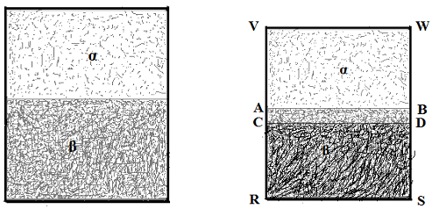

Slide 61
Surface Tension and Surface Free Energy
Surface tension
Surface tension is a property of the surface of a liquid that causes it to behave as an elastic sheet.
The physical and chemical behavior of liquids cannot be understood without taking surface tension in to account.
It governs the shape that small masses of liquid can assume and the degree of contact a liquid can make with another substance.

Slide 62
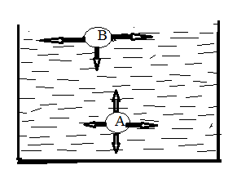
Surface Tension and Surface Free Energy (Cont’d ….)
It is caused by the attraction between the molecules of the liquid by various intermolecular forces.
This phenomenon may be explained by reference to Fig. 1.
Fig. 1 Forces on a molecule at the surface and in the interior of a liquid.

Slide 63
Surface Tension and Surface Free Energy (Cont’d ….)
In the bulk of the liquid molecule A is pulled equally in all directions by neighboring liquid molecules, resulting in a net force of zero.
At the surface of the liquid, molecules B is pulled inwards by other molecules deeper inside the liquid and are not attracted as intensely by the molecules in the neighboring medium.

Slide 64
Surface Tension and Surface Free Energy (Cont’d ….)
Therefore all of the molecules at the surface are subject to an inward force of molecular attraction.
This is balanced only by the resistance of the liquid to compression;
Hence, there is no net inward force.
However, there is a driving force to diminish the surface area, and in this respect a liquid surface resembles a stretched elastic membrane.

Slide 65
Surface Tension and Surface Free Energy (Cont’d ….)
As a result of the tendency to contract, a liquid surface behaves as if it were in a state of tension.
This effect is called the surface tension which is defined as the force in dynes (Newton) acting at right angles along the surface of a liquid one centimeter (1 meters) in length.

Slide 66
Surface Tension and Surface Free Energy (Cont’d ….)
DEFINITION OF SURFACE TENSION
The surface tension γ is the magnitude F of the force exerted parallel to the surface of a liquid divided by the length L of the line over which the force acts:
γ = F/L
SI Unit of Surface Tension: N/m
A needle has a length of 3.2 cm when placed gently on the surface of the water (γ=0.073 N/m) in a glass, this needle will float if it is not too heavy. So what is the weight of the heaviest needle that can float?

Slide 67
Surface Tension and Surface Free Energy (Cont’d ….)
Surface free energy
The splitting up of a material into smaller parts always induces stresses and deformations in each of the parts formed,
Therefore some energy is dissipated as heat and some is stored as elastic deformation.
As a consequence, the accurate experimental determination of surface energy is only possible for isotropic liquids or liquid crystals.

Slide 68
Surface Tension and Surface Free Energy (Cont’d ….)
For solids, the true value of the surface energy cannot be measured.
When applied to solids, the term "surface energy" acquires a totally different meaning and can be viewed as an "adhesive" parameter characterizing the affinity of the surface to other materials.
The higher the surface energy of a solid, the more energy is gained upon bringing this surface into contact with other materials.

Slide 69
Surface Tension and Surface Free Energy (Cont’d ….)
As a result of the inward pull, surface of the liquid always tends to contract to the smallest possible surface area.
In order to increase the surface area it is necessary to do work to bring molecules from the bulk of the liquid on to the surface against the inward attractive forces.
The work required to increase the surface area by unity is called the surface energy.

Slide 70
Surface Tension and Surface Free Energy (Cont’d ….)
Angle of contact
The rise or fall of liquid levels in a container depends on the interaction between the liquid surface and the walls of the container.
If the intermolecular forces between liquid molecules are weaker than the forces between the liquid and the solid surface, the liquid will rise and wet the solid surface.

Slide 71
Surface Tension and Surface Free Energy (Cont’d ….)
If the solid-liquid interactions are weaker than the intermolecular forces in the liquid, its level will fall and the liquid will not wet the solid surface.
The angle between the tangent to the liquid surface at the point of contact and the solid surface inside the liquid is known as the contact angle (θ) for the pair of liquid and solid surface fig.2.
The contact angle can have any value between θ and 180º.

Slide 72
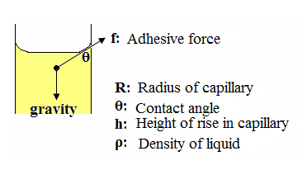
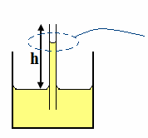
Surface Tension and Surface Free Energy (Cont’d ….)

Slide 73
Surface Tension and Surface Free Energy (Cont’d ….)
❖ Cohesive force is the force existing between like molecules in the surface of a liquid
❖ Adhesive force is the force existing between unlike molecules, such as that between a liquid and the wall of a glass capillary tube
✓ When the force of Adhesion is greater than the cohesion, the liquid is said to wet the capillary wall, spreading over it, and rising in the tube.

Slide 74
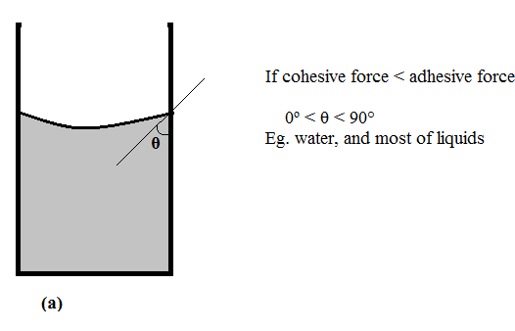
Surface Tension and Surface Free Energy (Cont’d ….)
When the adhesive forces exceed the cohesive forces, θ lies in the range 0º < θ < 90° (Fig. 2a).
When the cohesive forces exceed the adhesive forces, then 90° < θ < 180° (fig.2b).

Slide 75
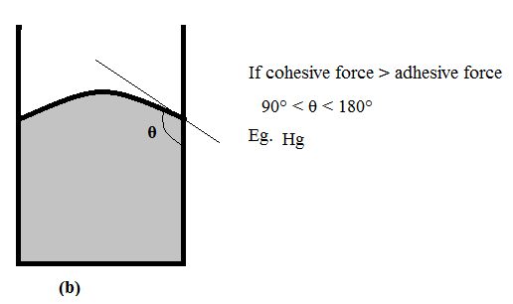
Surface Tension and Surface Free Energy (Cont’d ….)
Fig. 2. Contact angles between a liquid and a glass capillary.

Slide 76
Methods of Surface Tension Measurement
There are many methods which can be employed for the measurements of surface tension.
Here are some of the commonly used methods.
1. The capillary Rise method:
If a capillary tube is placed in a liquid, it is found that the liquid usually rises in the tube (except for mercury in which it falls).

Slide 77
Methods of Surface Tension Measurement (Cont’d …..)
Consider a Capillary tube of radius 'r' immersed in a vessel containing a liquid that wets the glass Fig. 3.
Let the liquid rise to a height 'h' above the level of the liquid
d = the density of the liquid and g is gravity
Fig.3 Surface tension measurement by capillary rise method

Slide 78


Methods of Surface Tension Measurement (Cont’d …..)
Hence, the surface tension of the liquid can be given by
If the angle of contact θ between the glass and liquid is zero then cosθ is unity and the above equation reduces to

Slide 79
Methods of Surface Tension Measurement (Cont’d …..)
The height 'h' is measured by cathetometer and the radius of the capillary tube by a traveling microscope.
2. Drop Weight Method
The weight of a drop falling from a capillary depends on the radius of the capillary and on the surface tension of the liquid.
It was first thought that the weight of a drop falling from a capillary of radius r is equal to the surface tension acting along the circumference of the capillary bore.

Slide 80
Methods of Surface Tension Measurement (Cont’d …..)
This method is generally used for the comparison of surface tension of a liquid with another of which the absolute value of surface tension is already known.
The instrument used is called a stalagmometer and consists of a bulbed capillary tube as shown in Fig. 4.
The tube is first cleaned thoroughly with chromic acid, and then with distilled water and dried.

Slide 81
Methods of Surface Tension Measurement (Cont’d …..)
The rate at which the drops fall is adjusted in such a way that each drop falls after about three seconds.
The weight of 10 drops is found. The apparatus is then washed and the experiment is repeated with the other liquid.
If m₁ & m₂ are the masses of 10 drops of the liquids and γ₁ & γ₂ are their surface tensions, then

Slide 82
Methods of Surface Tension Measurement (Cont’d …..)
If the surface tension of one liquid is known, that of the other is readily calculated
The drop number Method:
It is some times more convenient to determine the number of drops formed by a certain volume of the liquid, instead of finding the mass of a drop.

Slide 83
Methods of Surface Tension Measurement (Cont’d …..)
It is filled up to the mark 1 with the liquid whose surface tension is to be measured by sucking in the liquid.
A weighing tube is placed under the stalagmometer and a certain number of drops are allowed to fall in to it.

Slide 84

Methods of Surface Tension Measurement (Cont’d …..)
Let
n₁ = number of drops of one liquid in a certain volume V
n₂ = number of drops of second liquid (say water) in the same volume.
d₁ = density of first liquid
d₂ = density of water
Hence, the surface tension can be calculated by

Slide 85
Surfaces of Solids

Slide 86
Surfaces of Solids
The surface molecules of solids are practically fixed in position, and contrary to the behavior of liquid molecules, they cannot move to any other place.
Individual atoms and molecules are only able to vibrate around their mean position.
As a result, solid surfaces cannot spontaneously contract to minimize their surface area, and a non-equilibrium surface structure forms.

Slide 87
Surfaces of Solids (Cont’d ….)
This situation is quite distinct from that of a liquid surface.
In principle, surface tension also exists in all solids and the inward pull on the solid surface atoms is always present, owing to cohesion, exactly as in liquids.
Nevertheless, the changes of surface shape due to surface tension are very much slower in solids than in liquids;

Slide 88
Surfaces of Solids (Cont’d ….)
This is not because the cohesion forces are smaller but because the mobility of the surface molecules (or atoms) is very much less.
For this reason, measurement of the solid surface tension is a difficult and ambiguous procedure, and indirect methods are mostly applied.

Slide 89
Adsorption
The phenomenon of higher concentration of any molecular species at the surface than in the bulk
Partitioning of a chemical species between a bulk phase and the interface
Adsorbent
The substance on the surface of which adsorption takes place is called adsorbent
Adsorbate
The substance which is being adsorbed on the surface of another substance.

Slide 90
Desorption: The process of removal of an adsorbed substance from the surface on which it is adsorbed
Absorption: a species penetrates and is dissolved throughout bulk phase of solid or liquid
Sorption: When adsorption and absorption take place simultaneously, it is called sorption.

Slide 91
Adsorbent Materials
Activated Carbon
Activated Alumina
Silica Gel
Molecular Sieves (Zeolites)
Polar and Non-polar adsorbents

Slide 92
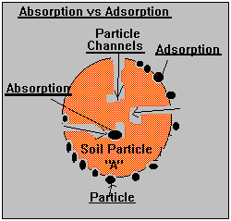
Adsorption vs. absorption

Slide 93
Types of Adsorption
Positive adsorption
Occurs when the concentration of adsorbate (material being adsorbed) is higher on the surface of adsorbent than in the bulk. Negative adsorption
Occurs when the concentration of adsorbate is less on the surface of adsorbent than in the bulk.

Slide 94
Types of Adsorption
Types of adsorption:
a. Physical adsorption or physisorption: If the adsorbate is held on a surface of adsorbent by weak van der Waals’ forces, the adsorption is called physical adsorption or physisorption.
b. Chemical adsorption or chemisorption: If the forces holding the adsorbate are as strong as in chemical bonds, the adsorption process is known as chemical adsorption of chemisorption.

Slide 95
Types of adsorption
Here is the difference!

Slide 96
Factors affecting adsorption of gases on solids:
Nature of adsorbate:
Physical adsorption is non-specific in nature and therefore every gas gets adsorbed on the surface of any solid to a lesser or greater extent.
However, easily liquefiable gases like NH₃. HCl, CO₂, etc. which have higher critical temperatures are absorbed to greater extent whereas H₂, O₂, N₂ etc. are adsorbed to lesser extent.

Slide 97
Factors affecting adsorption of gases on solids: (Cont’d……)
The chemical adsorption being highly specific, therefore, a gas gets adsorbed on specific solid only if it enters into chemical combination with it.
b. Nature of adsorbent:
Activated carbon, metal oxides like aluminum oxide, silica gel and clay are commonly used adsorbents. They have their specific adsorption properties depending upon pores.

Slide 98
Factors affecting adsorption of gases on solids: (Cont’d……)
c. Specific area of the adsorbent
The greater the specific area, more will be the extent of adsorption.
That is why porous or finely divided forms of adsorbents adsorb larger quantities of adsorbate.
The pores should be large enough to allow the gas molecules to enter.

Slide 99
Adsorption isotherm:
The variation in the amount of gas adsorbed by the adsorbent with pressure at constant temperature can be expressed by means of a curve is termed as adsorption isotherm.
The Langmuir Isotherm
Freundlich adsorption isotherm
B.E.T. multi-layer adsorption isotherm

Slide 100
The Langmuir Isotherm
developed by Irving Langmuir in 1916 from kinetic considerations
He assumed that:
1. The solid has a uniform surface,
2. Adsorbed molecules do not interact with one another.
3. The adsorbed molecules are localized at specific sizes
4. Only a mono layer can be adsorbed.

Slide 101
The Langmuir Isotherm (Cont’d ….)
Let N be the number of adsorption sites on the bare solid surface.
Let θ be the fraction of adsorption sites occupied by adsorbate at equilibrium.
The rate of desorption (r_{d}) α θN of adsorbed molecules
And hence, r_{d} = K_{d}θ N, were K_{d} is a constant at fixed T.
The adsorption rate is proportional to the rate of collision of gas phase molecules with unoccupied adsorption sites, since only a monolayer can be formed.

Slide 102
The Langmuir Isotherm (Cont’d ….)
The rate of collisions of gas molecules with the surface is proportional to the gas pressure P, and the number of unoccupied sites is (1−θ )N.
The adsorption rate is therefore
r_{a} = K_{a} P (1 −θ)N, were K_{a} is a constant at fixed T.
Equating the adsorption & desorption rates and solving for θ, we get

Slide 103



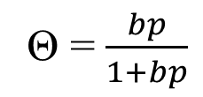
The Langmuir Isotherm (Cont’d ….)
…………………… (1)
…………………… (2)
…………………… (3)
…………………… (4)

Slide 104

The Langmuir Isotherm (Cont’d ….)
Since the rate constants k_{a} and k_{d} depend on temperature, b depends on T.
The fraction θ of sites occupied at pressure P equals
Where V is the volume adsorbed at P and V_{mon} is the volume adsorbed in the high pressure limit when a mono layer covers the entire surface
Equation (4) becomes:

Slide 105

The Langmuir Isotherm (Cont’d ….)
…………………… (5)
Note: In the low-P limit, bp in the denominator in equation (5) can be neglected and θ increases linearly with P, according to θ = bp .
In the high P-limit, θ 1.
Fig. below plots θ versus P according to the Langmuir isotherm (5) for several values of b.

Slide 106
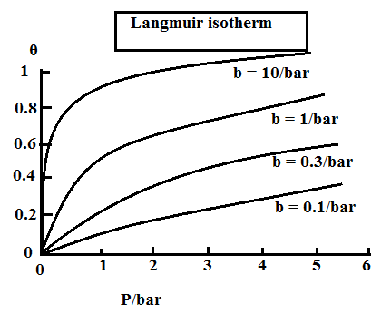
The Langmuir Isotherm (Cont’d ….)
Fig Langmuir isotherms of fractional surface coverage versus gas pressure for several values of the rate-constants ratio.

Slide 107
The Langmuir Isotherm (Cont’d ….)
Most of Langmuir's assumptions are false in that
1. The surfaces of most solids are not uniform,
2. Desorption rate depends on the location of the adsorbed molecules
There is much evidence that adsorbed molecules can move about on the surface; this mobility is much greater for physically adsorbed molecules than for chemisorbed ones and increases as temperature increases.

Slide 108

Freundlich adsorption isotherm
One of the oldest empirical adsorption isotherms
Developed by Freundlich in 1907.
It is useful for adsorption from liquid solutions and also for chemisorption isotherms.
…………………… (6)
where k and a are constants (with 0 < a < 1), was suggested on empirical grounds in the nineteenth century.

Slide 109
Freundlich adsorption isotherm (Cont’d ….)
Equation (6) gives log V = log k + a log P.
The intercept and slope of a plot of log v versus log P give log k and a respectively.
The Freundlich isotherm can be derived by modifying the Langmuir assumptions to allow for several kinds of adsorption sites on the solid, each kind having a different heat of adsorption.

Slide 110
Freundlich adsorption isotherm (Cont’d ….)
The Freundlich isotherm is not valid at very high pressures but is frequently more accurate than the Langmuir isotherm for intermediate pressures.
The Freundlich equation is often applied to adsorption of solutes from liquid solutions onto solids.
Here, the solute’s concentration c replaces P, and the mass adsorbed per unit mass of adsorbent replaces v.

Slide 111
Colloids

Slide 112
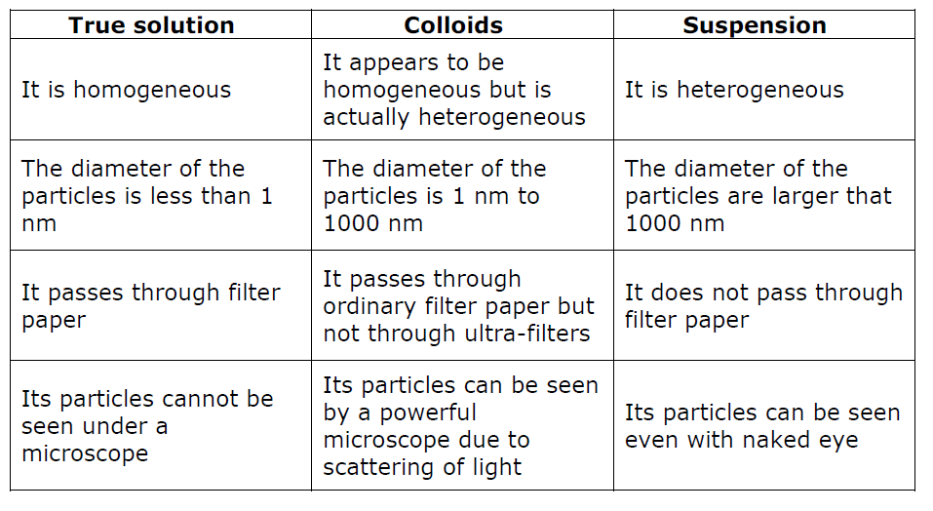
Distinction between true solution, colloids and Suspension.

Slide 113
Distinction between true solution, colloids and Suspension (Cont’d ….)
Colloids: A colloid is a heterogeneous system in which one substance is dispersed as very fine particles in another substance called dispersed medium.
Dispersed phase: The substance which is dispersed as very fine particles is called dispersed phase.
Dispersion medium: The substance present in larger quantity is called dispersion medium.

Slide 114
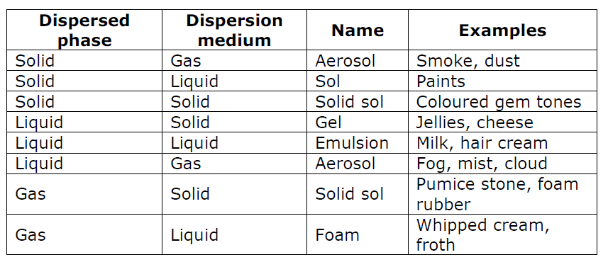
Classification of colloids on the basis of the physical state of dispersed phase and dispersion medium:

Slide 115
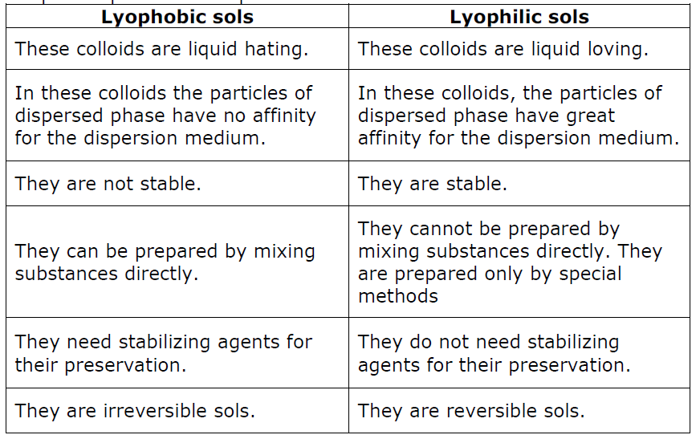
Classification of colloids on the basis of nature of interaction between dispersed phase and dispersion medium :

Slide 116
Classification of colloids on the basis of types of particles of the dispersed phase:
Multimolecular colloids:
The colloids in which the colloidal particles consist of aggregates of atoms or small molecules.
The diameter of the colloidal particle formed is less than 1 nm.
Macromolecular colloids:
These are the colloids in which the dispersed particles are themselves large molecules (usually polymers).

Slide 117
Since these molecules have dimensions comparable to those of colloids particles, their dispersions are called macromolecular colloids, e.g., proteins, starch and cellulose form macromolecular colloids.
Associated colloids (Micelles):
Those colloids which behave as normal, strong electrolytes at low concentrations, but show colloidal properties at higher concentrations due to the formation of aggregated particles of colloidal dimensions.

Slide 118

END OF C
THANK YOU
FOR YOUR
ATTENTION!!!

