Slide 1
Out lines
Motivation
Learning Outcomes(Solid state physics)
Definition of solid and its importance
Atomic Model
Crystal structure
Basis, Primitive Cells
Bravais lattices
Simple Crystal Structures Types
Index system
Reciprocal Lattice
Brillouin Zones

Slide 2
Motivation
Why study electronic devices?
They are the backbone of modern technology
1) Computers.
2) Scientific instruments.
3) Cars and airplanes (sensors and actuators).
4) Homes (radios, ovens, clocks, clothes dryers, etc.).
5) Public bathrooms (Auto-on sinks and toilets).

Slide 3
Learning Outcomes(Objectives)
Can explain crystal systems, Diffraction and Reciprocal space.
Defines Crystal, Lattice, Unit cell and Translation vectors.
Explains Crystal systems, Crystal planes and directions, Miller indices, Diffraction of waves by crystals and Bragg’s law.
Knows Reciprocal space, Reciprocal lattice, Construction of reciprocal lattice, Reciprocal lattice vectors and Diffraction condition.
Explains Reciprocal space and Laue equations and Brillouin zone.
Can explain bonding types in crystals.
Defines Bonds in crystals, Van der Waals-London interaction, Repulsive interaction and Binding energy.
Knows Ionic crystal, Madelung energy and constant.
Defines Covalent, Metallic and Hydrogen bonds.

Slide 4
Con’t
Can explain Phonons and Thermal properties of phonons.
Explains Phono-crystal interactions, Monoatomic and diatomic linear chain.
Explains Optic and Acoustic phonon modes.
Defines Thermal properties of phonons, heat capacity of phonons, Density of states and Density of states models of Debye and Einstein.
Can explain Free electron gas model and band models.
Explains Fermi free electron gas, Fermi-Dirac distribution and temperature.

Slide 5
Solid State Physics (Introduction)
Definition of a Solid
Solid State Physics deals - as the name implies - with the physical properties of solid materials.
A material is referred to as solid if it is composed of a larger number (∝10²³) of smallest constituents (atoms, molecules, …) which are in fixed positions and very tightly packed with a strong mutual attraction.
Ideal solids are incompressible just as liquids but in contrast to liquids solids show a strong resistance to shear stress which can be regarded as the main distinctive feature.
Due to these properties usually strong forces/torques are required to change the shape of a solid.

Slide 6
Con’t
2. Common Classification of Solids
The most common classification of solids regards the extend of inner order on a large scale.
Solids which exhibit a very regular, periodic structure are referred to as crystals while solids with no such positional large scale order are called amorphous(noncrystal).
Many solids have their origin in a molten substance that is cooled down.
When this cooling process is slow enough, the constituents have enough time to arrange themselves in the positions of lowest energy which usually produces a very regular pattern.
Materials that only consist of single atoms or very simple molecules therefore often form crystals.
An exception is glass which has a highly unordered (amorphous) structure (due to rather fast cooling processes).
Large molecules as for instance in organic materials or plastics usually also form amorphous solids.

Slide 7
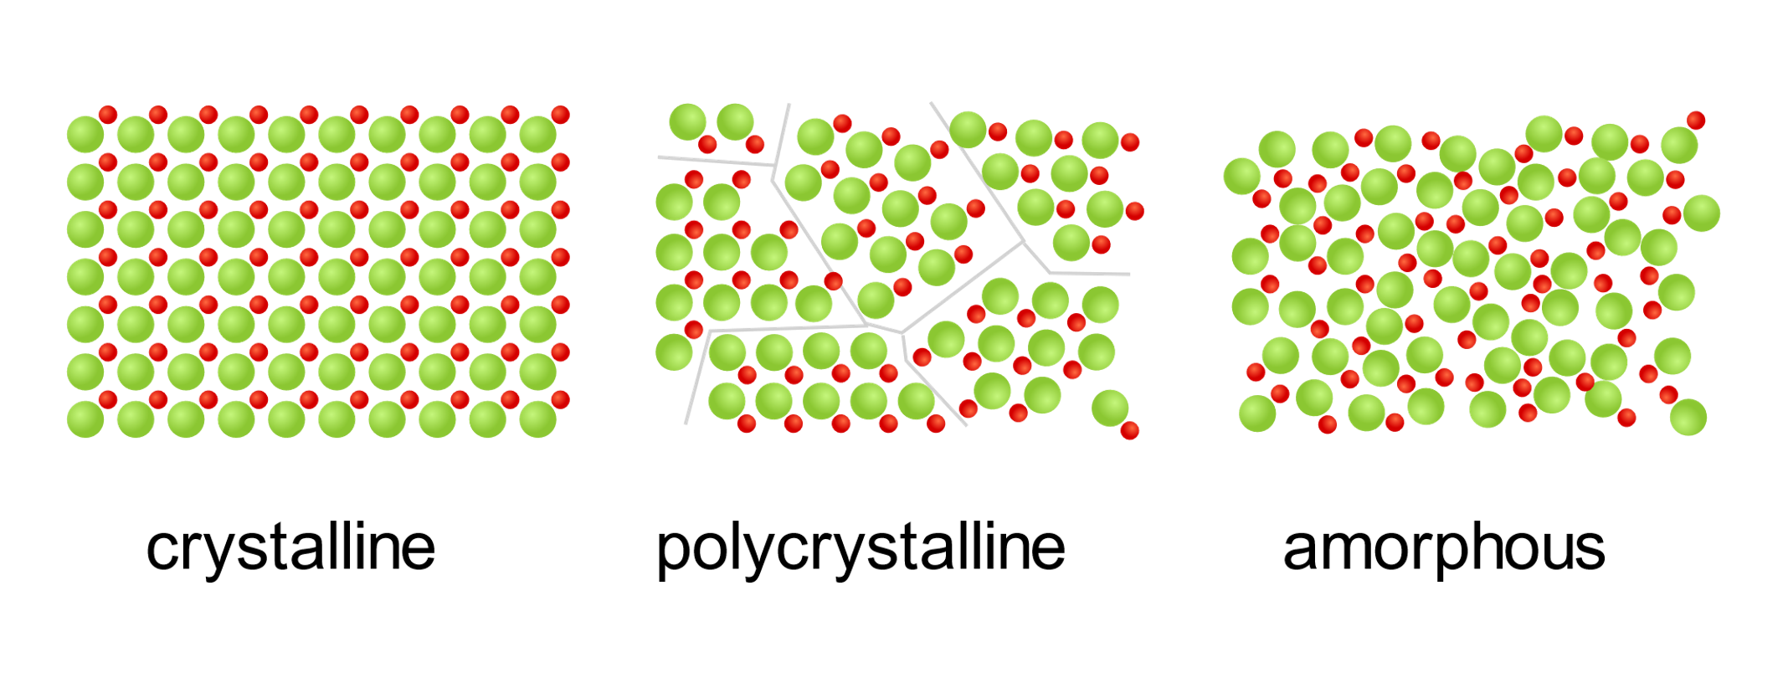
Con’t
Figure1. The ideal crystal has a high periodic order which is maintained through the whole crystal whereas an amorphous material is completely unordered. A polycrystalline material is composed of small crystalline groups (crystallites) which have however different orientations. The boundaries between these groups are therefore called grain boundaries.

Slide 8
Lattice, Basis and Crystal
A lattice is in general defined as a discrete but infinite regular arrangement of points (lattice sites) in a vector space.
1.1. Bravais Lattice: In solid state physics one usually encounters lattices which exhibit a discrete translational symmetry.
If one considers for instance the vector space R³ this means that a translation of the whole lattice by any translation vector given by
T = ma₁+ na₂+ oa₃ ₍₁₎
_{Where m,n and o are integers.}
leaves the lattice unchanged.
A lattice that can be characterized in this way is referred to as a Bravais lattice

Slide 9
Con’t
All lattice points are equivalent, i.e. all properties remain invariant under translations by any vector T.
Also, an observer sitting on one specific lattice point would see the same environment as when sitting on any other.
However, if there are lattice points with different environments they cannot form a Bravais lattice! (This is an equivalent or other definition of a Bravais lattice

Slide 10
Con’t
1.2. Primitive Translation Vectors
The linear independent generating vectors a’s of the translations (1) are called primitive translation vectors or primitive lattice vectors.
Let's illustrate this for the two-dimensional Euclidean space:
Any two linear independent vectors a1 and a2 form a basis and can be used as generators for a two-dimensional lattice:

Slide 11
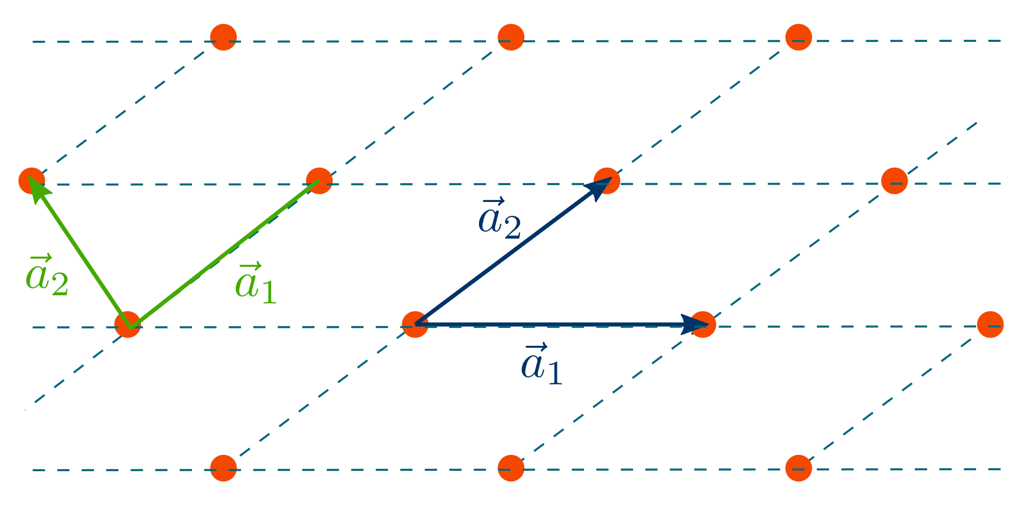
Con’t
Fig. A two-dimensional Bravais lattice can be created as the set of integer linear combinations of two (linear independent) vectors (called primitive translation vectors).
The lattice can then be described as a linear combination of these vectors with m and n being integer coefficients. T = ma₁+ na₂

Slide 12
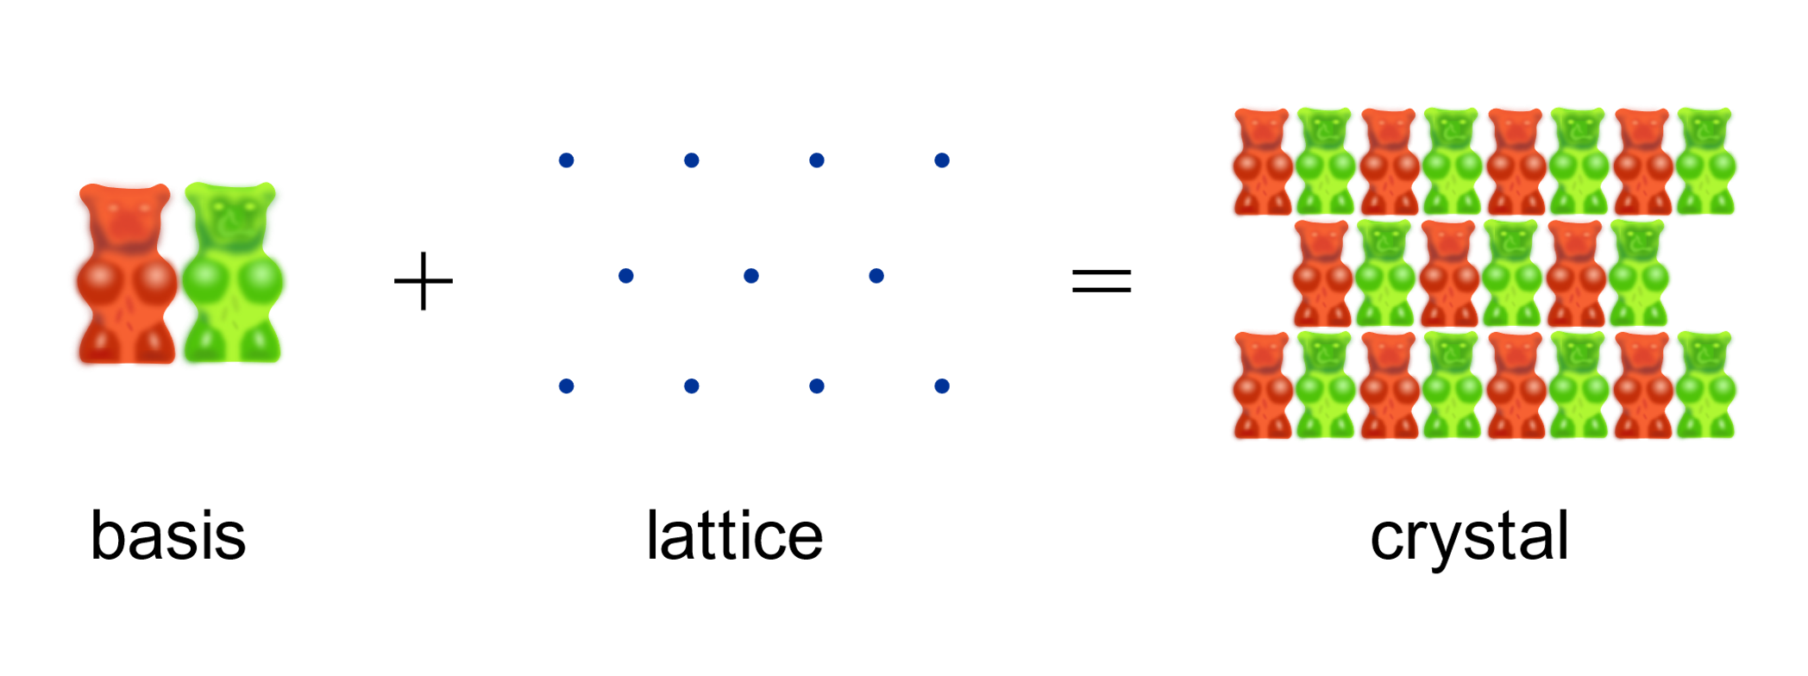
Con’t
2. Basis and Crystal
Now one could go ahead and replace the lattice points by more complex objects (called basis), e.g. a group of atoms, a molecule, ... .
This generates a structure that is referred to as a crystal.
Fig. A crystal is defined as a lattice with a basis added to each lattice site. Usually the basis consists of an atom, a group of atoms or a molecule.

Slide 13
Space lattice,Unit Cell, Primitive Cell and Wigner-Seitz Cell
Each unit cell is defined in terms of lattice points the points in space about which the particles are free to vibrate in a crystal.
Space lattice is 3-D arrangement of constituents of particles(atoms,ions or molecules).
2. Unit Cell
The simplest repeating unit in a crystal is called a unit cell.
Or unit cell is smallest but complete portion of which repeated over and again to make lattice point.
Each unit cell is defined in terms of lattice points.
Lattice point is positions which are occupied by constituent particles.

Slide 14
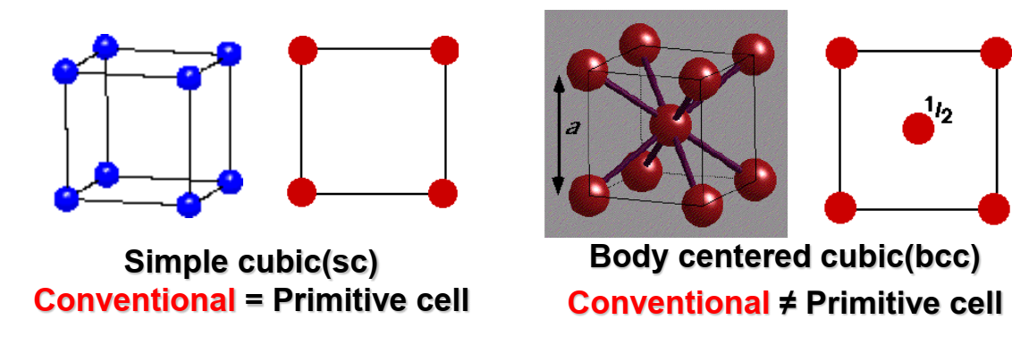
Con’t
3. Primitive cell
A primitive cell is a unit cell that contains exactly one lattice point.
It is the smallest possible cell.
If there is a lattice point at the edge of a cell and thus shared with another cell, it is only counted half.
Accordingly, a point located on the corner of a cube is shared by 8 cubes and would count with 1/8.

Slide 15
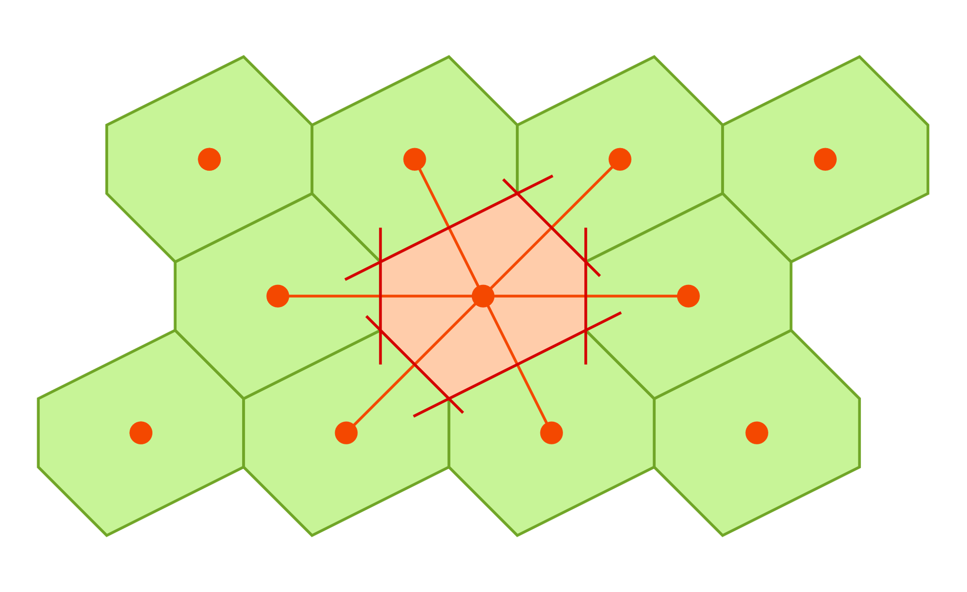
Con’t
4. Wigner-Seitz cell
There is a special type of primitive-cells known as Wigner-Seitz cell.
The Wigner-Seitz cell of a lattice point is defined as the volume that encloses all points in space which are closer to this particular lattice point than to any other. It can be constructed as depicted below.
1-Choose a lattice point.
2-Draw lines to connect these lattice point to its neighbours.
3-At the mid-point and normal to these lines draw new lines.
The volume enclosed is called as a Wigner-Seitz cell.

Slide 16
The Bravais Lattice
The Bravais lattice are the distinct lattice types which when repeated can fill the whole space.
The lattice can therefore be generated by three unit vectors, a₁, a₂ and a₃ and a set of integers k, l and m so that each lattice point, identified by a vector r, can be obtained from
r = k a₁ + l a₂ + m a₃
The vectors used to define a Bravais lattice, a1, a2, a3 , are called the primitive vectors.
There are five types of two dimensional lattice .Which are 1. Oblique 2. Rectangular 3.Centered Rectangular 4. Hexagonal 5.Square.

Slide 17
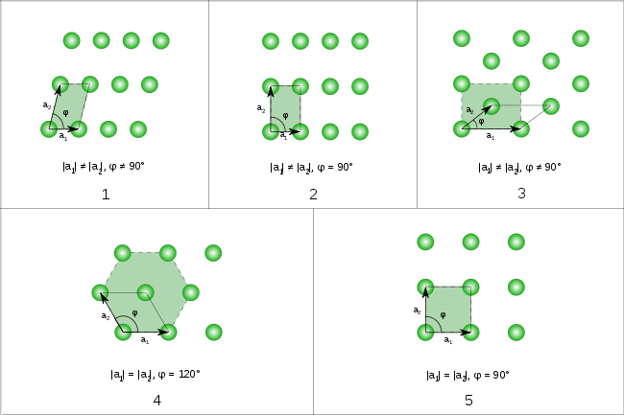
Con’t

Slide 18
Con’t
In three dimensions the 14 Bravais lattices are grouped into 7 crystal systems according to the seven types of conventional cells. They are :
Triclinic - 1 Bravais Lattice, least symmetric
Monoclinic – 2 Bravais Lattices
Orthorhombic – 4 Bravais Lattices
Rhombohedral/Trigonal -1 Bravais Lattice
Tetragonal – 2 Bravais Lattices
Hexagonal – 1 Bravais Lattices
Cubic - 3 Bravais Lattices, most symmetric

Slide 19







Con’t
Triclinic
Monoclinic
Orthorhombic
Base-Centered

Slide 20






Con’t
Rhombohedra
Tetragonal
Hexagohhhhmml
Simple
bcc
Body-Centered
simple
fcc
Simple
ntered
Cubic
Hexagonal

Slide 21
The 14 Bravais Lattice
Triclinic

Slide 22
The 14 Bravais Lattice
a ≠ b ≠ c
a ≠ b ≠ c
Triclinic

Slide 23
Monoclinic
a ≠ b ≠ c
Base centered
Simple

Slide 24
ORTHORHOMBIC
α= β=γ = 90
Base centered
Body centered
simple
Face centered

Slide 25
RHOMBOHEDRAL or TRIGONAL

Slide 26

TETRAGONAL
α= β=γ = 90
Simple
Body centered

Slide 27
Hexagonal
α= β=90, γ = 120

Slide 28
Cubic
3 cubic crystal
Simple
Body-Centered
Face-Centered

