Slide 1
Chapter - 2
FORECASTING

Slide 2
What is Forecasting?
Process of predicting a future event➔ Is it possible?
Underlying basis of
all business decisions
  Production
  Inventory
  Personnel
  Facilities
??

Slide 3
Forecasting Time Horizons
Short-range forecast
  Up to 1 year, generally less than 3 months
  Purchasing, job scheduling, workforce levels, job assignments, production levels
Medium-range forecast
  3 months to 3 years
  Sales and production planning, budgeting
Long-range forecast
  3⁺ years
  New product planning, facility location, research and development

Slide 4
Distinguishing Differences
Medium/long range forecasts deal with more comprehensive issues and support management decisions regarding planning and products, plants and processes
Short-term forecasting usually employs different methodologies than longer-term forecasting
Short-term forecasts tend to be more accurate than longer-term forecasts

Slide 5
Influence of Product Life Cycle
Introduction – Growth – Maturity – Decline
Introduction and growth require longer forecasts than maturity and decline
As product passes through life cycle, forecasts are useful in projecting Staffing levels
Inventory levels
Factory capacity

Slide 6
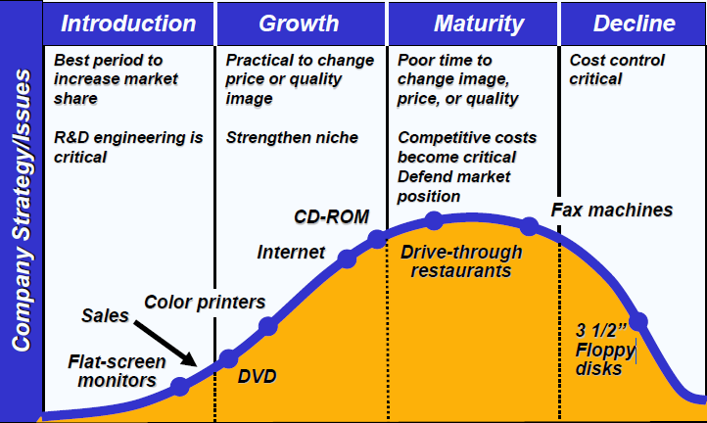
Product Life Cycle

Slide 7
Types of Forecasts
Economic forecasts
  Address business cycle – inflation rate, money supply, housing starts, etc.
Technological forecasts
  Predict rate of technological progress
  Impacts development of new products
Demand forecasts
  Predict sales of existing product
  Weather forecast is almost always wrong…remember hurricane season

Slide 8
Strategic Importance of Forecasting
Human Resources – Hiring, training, laying off workers
Capacity – Capacity shortages can result in undependable delivery, loss of customers, loss of market share
Supply-Chain Management – Good supplier relations and price advance

Slide 9
Seven Steps in Forecasting
Determine the use of the forecast
Select the items to be forecasted
Determine the time horizon of the forecast
Select the forecasting model(s)
Gather the data
Make the forecast
Validate and implement results

Slide 10
The Realities!
Forecasts are seldom perfect
Most techniques assume an underlying stability in the system
Product family and aggregated forecasts are more accurate than individual product forecasts

Slide 11
Forecasting Approaches
Qualitative Methods
Used when situation is vague and little data exist
  New products
  New technology
Involves intuition, experience
  e.g., forecasting sales on Internet
  Debate if price, e.g. “housing prices” would go up or down.

Slide 12
Techniques of Qualitative Methods
Jury of executive opinion
  Pool opinions of high-level executives, sometimes augment by statistical models
Delphi method
  Panel of experts, queried iteratively

Slide 13
Jury of Executive Opinion
Involves small group of high-level managers
Group estimates demand by working together
Combines managerial experience with statistical models
Relatively quick
‘Group-think’ disadvantage

Slide 14
Delphi Method
Iterative group process, continues until consensus is reached
3 types of participants
Decision makers
Staff
Respondents

Slide 15
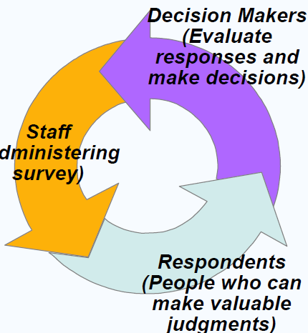
Cont…

Slide 16
Cont…
Sales force composite
  Estimates from individual salespersons are reviewed for reasonableness, then aggregated
Consumer Market Survey
  Ask the customer

Slide 17
Sales Force Composite
Each salesperson projects his or her sales
Combined at district and national levels
Sales reps know customers’ wants
Tends to be overly optimistic

Slide 18
Consumer Market Survey
Ask customers about purchasing plans
What consumers say, and what they actually do are often different
Sometimes difficult to answer

Slide 19
Forecasting Approaches
Quantitative Methods
Used when situation is ‘stable’ and historical data exist
  Existing products
  Current technology
Involves mathematical techniques
  e.g., forecasting sales of color televisions

Slide 20
Techniques of Quantitative Methods
Naive approach
Moving averages
Exponential smoothing
Trend projection
Linear regression
Time-Series Models
Associative Model

Slide 21
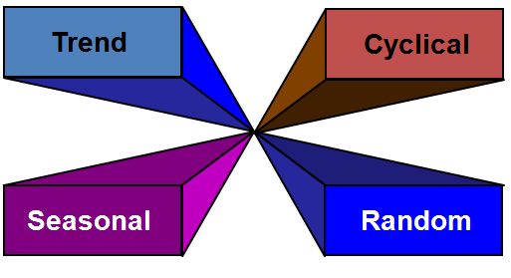
Time Series Components

Slide 22
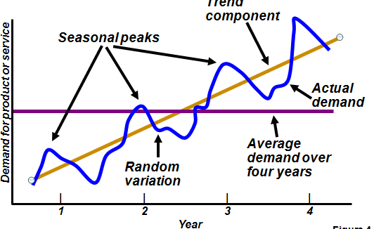
Components of Demand

Slide 23
Trend Component
Persistent, overall upward or downward pattern
Changes due to population, technology, age, culture, etc.
Typically several years duration

Slide 24
Seasonal Component
Regular pattern of up and down fluctuations
Due to weather, customs, etc.
Occurs within a single year
Seasonality in box-office revenues
Number of
Period Length Seasons
Week Day 7
Month Week 4-4.5
Month Day 28-31
Year Quarter 4
Year Month 12
Year Week 52

Slide 25
Cyclical Component
Repeating up and down movements
Affected by business cycle, political, and economic factors
Multiple years duration
Often causal or
associative
relationships
0 5 10 15 20

Slide 26
Random Component
Erratic, unsystematic, ‘residual’ fluctuations
Due to random variation or unforeseen events
Short duration and
nonrepeating
M T W T F

Slide 27
Naive Approach
Assumes demand in next period is the same as demand in most recent period
  e.g., If May sales were 48, then June sales will be 48

Slide 28
Moving Average Method
MA is a series of arithmetic means
Used if little or no trend
∑ demand in previous n periods
n
Moving average =

Slide 29
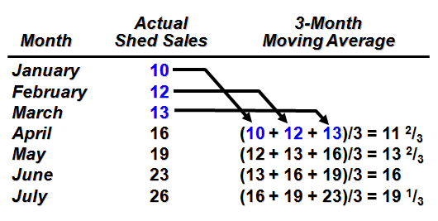
Moving Average Example

Slide 30
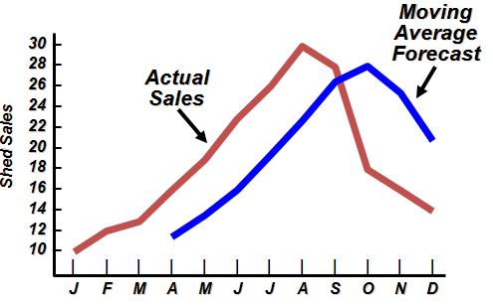
Graph of Moving Average

Slide 31
Weighted Moving Average
Used when trend is present
  Older data usually less important
Weights based on experience and intuition
∑ (weight for period n)
x (demand in period n)
∑ weights
Weighted
moving average
=

Slide 32
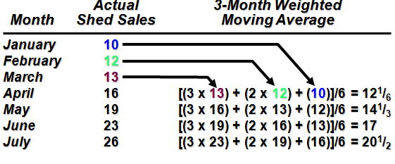
Cont…
Weights Applied Period
3 Last month
2 Two months ago
1 Three months ago
6 Sum of weights

Slide 33
Potential Problems With
Moving Average
Increasing n smooths the forecast but makes it less sensitive to changes
Do not forecast trends well ➔ why?
Require extensive historical data

Slide 34
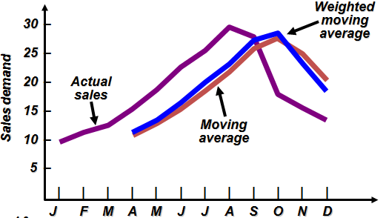
Moving Average And
Weighted Moving Average

Slide 35
Exponential Smoothing
Form of weighted moving average
  Weights decline exponentially
  Most recent data weighted most
Requires smoothing constant (α)
  Ranges from 0 to 1
  Subjectively chosen
Involves little record keeping of past data

Slide 36
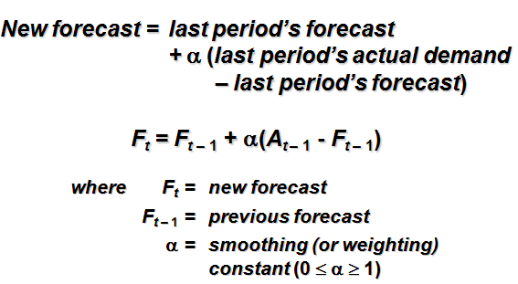
Exponential Smoothing

Slide 37
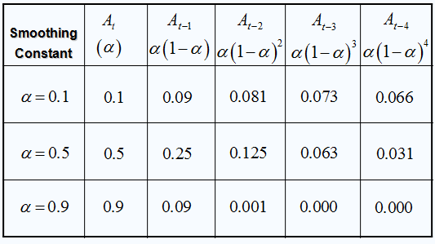
Cont…

Slide 38
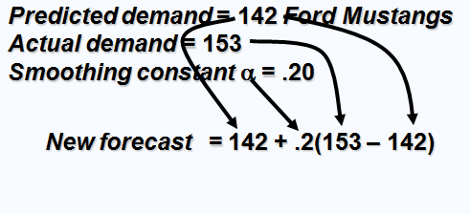
Exponential Smoothing Example
Predicted demand = 142 Ford Mustangs
Actual demand = 153
Smoothing constant α = .20

Slide 39
Cont…
Predicted demand = 142 Ford Mustangs
Actual demand = 153
Smoothing constant α = .20
New forecast = 142 + .2(153 – 142)
= 142 + 2.2
= 144.2 ≈ 144 cars

Slide 40
Choosing α
The objective is to obtain the most accurate forecast no matter the technique
We generally do this by selecting the model that gives us the lowest forecast error
Forecast error = Actual demand - Forecast value
= A_{t} - F_{t}

Slide 41
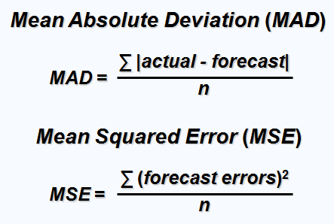
Common Measures of Error

Slide 42
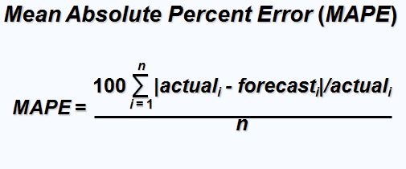
Cont…

Slide 43
Comparison of Forecast Error
Rounded Absolute Rounded Absolute
Actual Forecast Deviation Forecast Deviation
Tonnage with for with for
Quarter Unloaded α = .10 α = .10 α = .50 α = .50
1 180 175 5 175 5
2 168 176 8 178 10
3 159 175 16 173 14
4 175 173 2 166 9
5 190 173 17 170 20
6 205 175 30 180 25
7 180 178 2 193 13
8 182 178 4 186 4
84 100

Slide 44
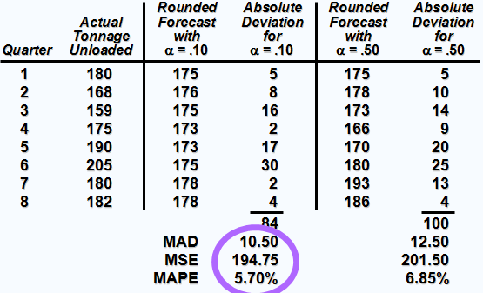
Cont…

