Slide 1
Chapter- 3
Plant Layout Design

Slide 2
Plant layout
Plant layout has been defined as a plan of, or the act of planning an optimum arrangement of industrial facilities, including
  personnel,
  operating equipment,
  storage space,
  materials handling equipment and
  all other supporting services along with the design of the best structure to contain these facilities

Slide 3
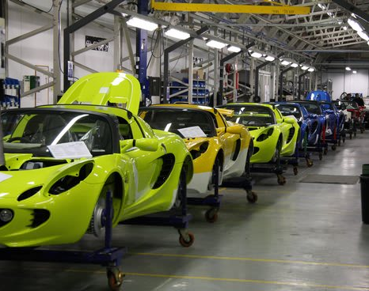

Slide 4
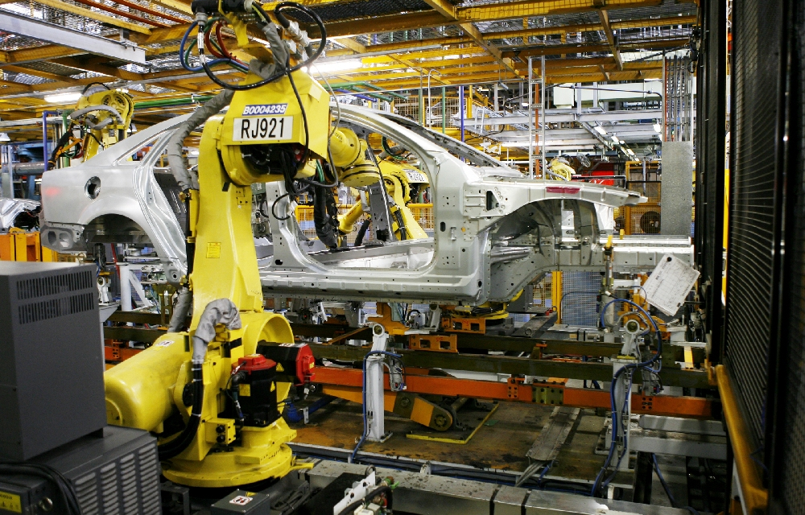

Slide 5
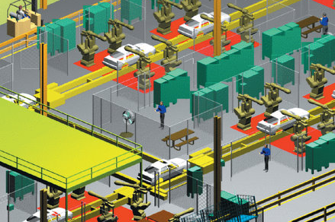

Slide 6
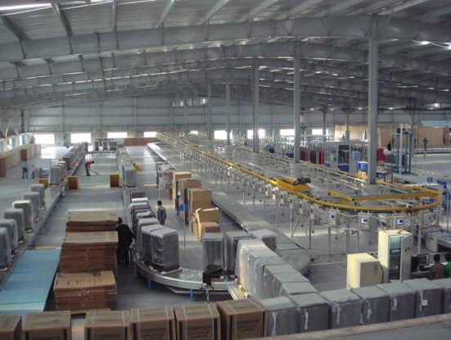

Slide 7
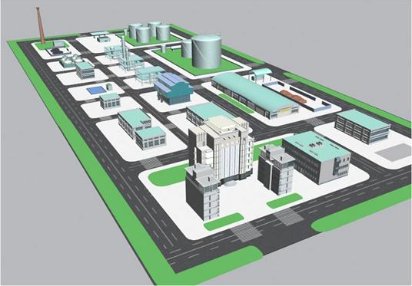

Slide 8
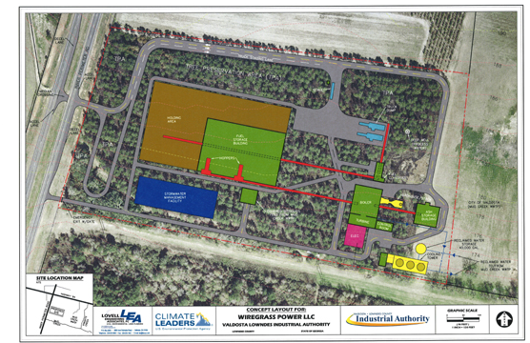

Slide 9
Locate All Areas In and Around Buildings
  Equipment
  Work stations
  Material storage
  Rest/break areas
  Utilities
  Eating areas
  Aisles
  Offices

Slide 10
Problems of layout develop when needed:
to start a new product,
to change the product design,
to reduce the cost;
And when
the market demand changes,
the plant, the product, the building become obsolete,
accidents occur frequently,
the working environment is poor.

Slide 11
The resulting problems involve
planning a completely new plant,
re-arranging a presently installed layout,
making adjustments to existing layout.

Slide 12
The objectives of a good study of plant layout are:
ensure effective space utilization,
minimize the cost of material handling (internal transports),
foresee future developments of the plant according to a rational master plan,
improve workers convenience as well as safety and create job satisfaction, and
avoid unnecessary capital investment.

Slide 13
Types of Layout
Product Layout: In this type of layout, only one product or one type of product is produced in a given area.
The product must be standardized and manufactured in large quantities in order to justify the product layout.

Slide 14
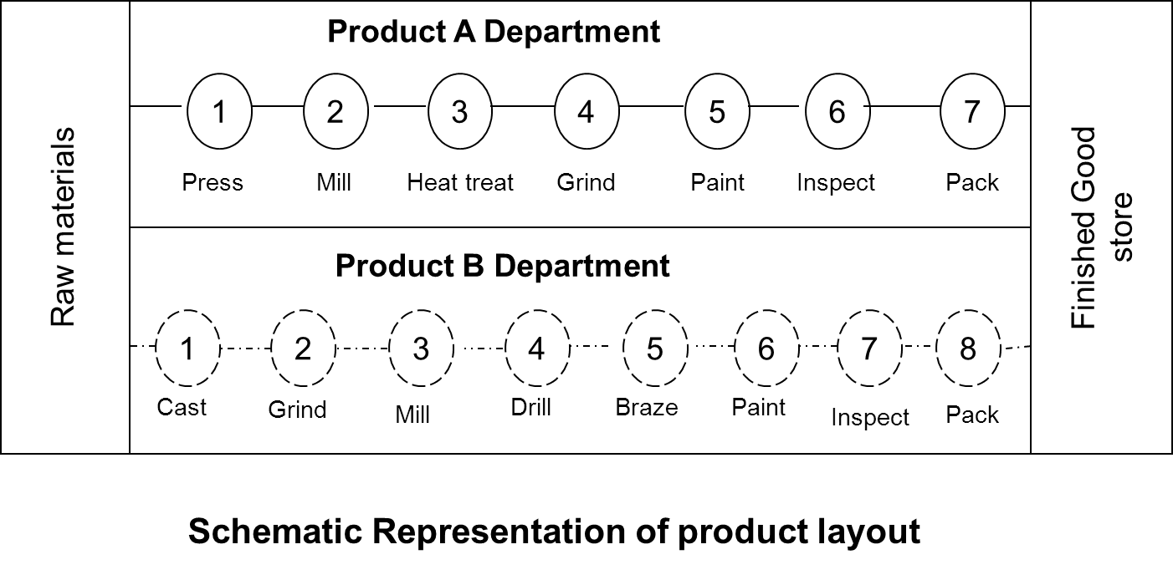

Slide 15
Some of the Advantages of Product Layout are:
lower total material handling cost,
lower total production time,
less work in process,
greater incentive for groups of workers to raise level of performance,
less floor area required per unit of production and
greater simplicity of production control, fewer control records needed and lower accounting cost.

Slide 16
Product Layout is Used When:
one or few standard products are to be produced,
large volume of production of each item over a considerable time is needed,
minimum of inspection is required during sequence of operations,
minimum of very heavy equipment or equipment requiring special facilities are needed,
materials and products permit bulk or continuous handling of mechanical means and
one machine is always used for one purpose.

Slide 17
Process Layout
Process Layout: Similar equipment and similar operations are grouped together in the process or functional layout. It is particularly useful where low volume is required.

Slide 18
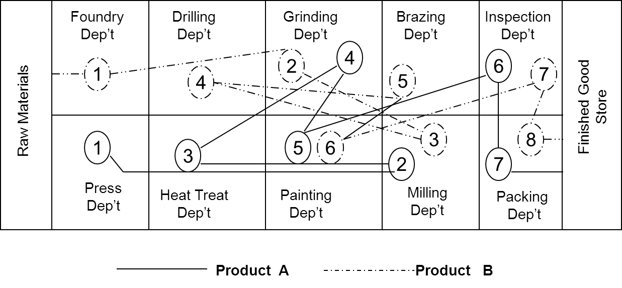

Slide 19
Some of the Advantages of Process Layout are:
less duplication of equipment, hence lower investment cost,
greater flexibility of production,
better and more efficient supervision,
greater incentive for individual workers to raise level of performance,
better control of complicated or precision processes,
easier to handle breakdowns of equipment by transferring work to another machine or station.

Slide 20
Process Layout is Used when
many types or styles of products are on special order ,
relatively low volume of production on individual items is needed,
many inspections are required during a sequence of operations,
high proportion of very heavy equipment or equipment requiring special treatment exist,
materials or products become too large or too heavy to permit bulk or continuous flow and
one machine is used for different operations.

Slide 21
Fixed-Position Layout
Fixed-Position Layout: In this type of layout, the material or major component remains in a fixed location, and tools, machinery, men as well as other pieces of material are brought to this location.
Typical examples are ship building, construction industries, aircraft building and bench work exercises. This type of layout is not frequently used in industrial enterprises. For this reason we are not going to look into its advantage and disadvantages.

Slide 22
Developing Simulating Layout Problems
Product
Design
Change
New
product
Market
Demand
Change
Obsolete
Facility
Poor
Worker
Environment
Market
Relocation
Cost
Reduction
Build New
Plant
Move to
existing
Plant
Rearrange
Existing
Plant
Minor
changes
Class of layout problems
Relation between causes and classes of layout problems
Cause and result occur very frequently
Cause and result occur less frequently
Cause and result occur occasionally
No line Cause and result occur very seldom

Slide 23
Type of Layout: It is necessary to determine which type of layout to select, product (line) or process (functional) layout.
In addition to the selection of type of layout it is also important to fix the arrangement of machines

Slide 24
Q
Q
A
Product α
P= Product
Product
β
Q=Quantity
B
Product y
C
P
P
P-Q Diagram

Slide 25
In region A there are few types of products but in a great quantity. For these products it is advisable to have product layout.
In region C there are very many products in small quantity. Hence, preferred to have process layout.
For products in region B (medium types of products and medium quantity) the case has to be studied closely so as to be able which layout to select.

Slide 26
There are different types of machine arrangements. The form of an industrial building is mainly dependent on machine arrangements and the advancement of a workpiece. The usual forms are shown

Slide 27
a) IN PARALLEL
a) IN SERIES
a) COMBINED
Examples of Machine Arrangements

Slide 28
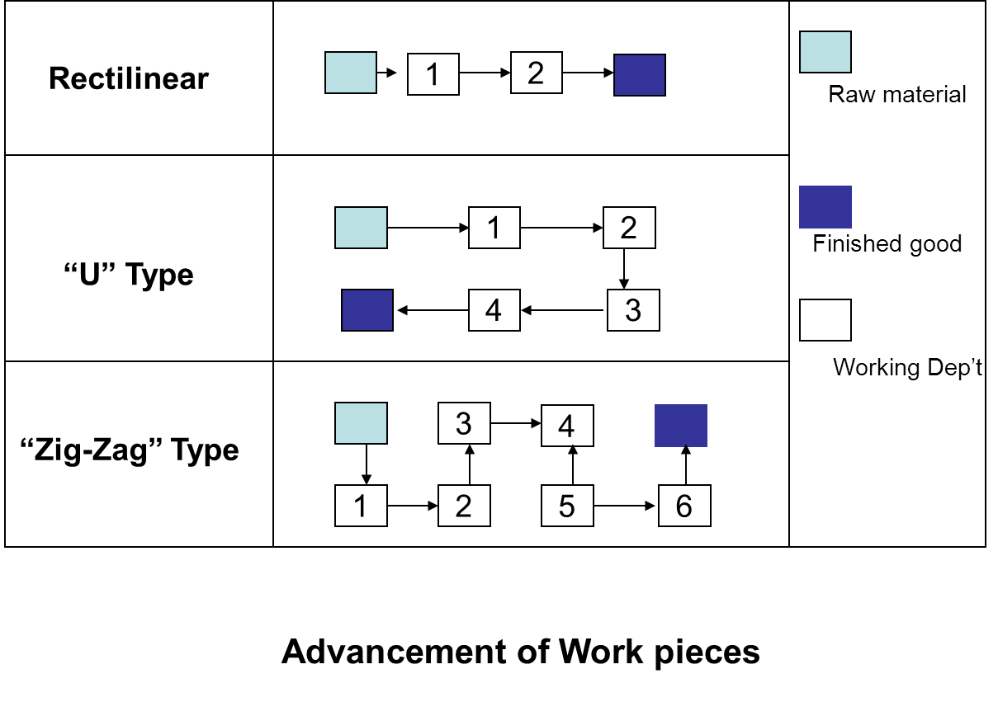

Slide 29
The Possible Internal Transport System:
After considering the type of workpiece advancement, the production capacity and the machineries required, it is necessary to examine the volume and weight of materials that has to be transported from one machine to the other, or from one department to the other

Slide 30
Cont’d…
The type of material handling equipment influences directly the plant layout and also the building.
The working position, the form of the layout, the height, width and length of the building, the loading and unloading of materials, the positions and dimensions of accessibility depends in general, on the type of internal transport system adopted.

Slide 31
A good study of internal transport system may boil down to the following major benefits:
Reduce costs by
- utilizing space to better advantage,
- increasing productivity and
- making few number of effective movements.
Reduce waste by
- eliminating damage to material during the handling process and
- maintaining proper control over in-and-out of stock handling process.

Slide 32
Improve working conditions by
providing safer working conditions and
reducing worker fatigue.
Improve the efficiency of the plant by
improving location of storage facilities,
improving routing and
increasing productivity.

Slide 33
Raw Material
Finished Good
Store
Working Dep’t
Future Expansion
Typical One Floor Industrial Building

Slide 34
In some plants, the cost of repeated handling constitutes a very high proportion of the total cost of the end product, and in some others,
the distance, materials have to move is not the sole criterion, and often is not even the primary concern for locating an area or an operation.
Hence, more realistic value assessment of the factors that truly affect total cost in different kinds of layout planning situations is needed.
The available computer aided layout algorithms fall into, either improvement, or construction routine categories.

Slide 35
Working Condition
Proper working conditions are considered important by management because they increase production effectiveness.
Employee working conditions are influenced by many factors, over which the employee has very little or no control.
A good layout considers the factors influencing working conditions.

Slide 36
LIGHTING
Good lighting facilitates accuracy and ease of seeing. A lighting system that aids these two demands means that the worker is able to see the critical details required in his job without excessive visual strain.
The lighting fixtures are described according to the way they distribute light.
Direct lighting 0-10% of flux directed to the roof
Semi direct 10-40% " " "
General diffuse 40-60% " " “
Semi indirect 60-90% " " “
Indirect 90-110% " " "

Slide 37
Cont…

Slide 38
In most European countries, the law requires for a minimum level of illumination. The following ranges are accepted internationally

Slide 39
TYPE OF WORK ILLUMINATION VALUE IN FLUX
Store and rarely accessible
working places 100 - 200
Rough work (Brewery) 200 - 500
Medium work (automobile assembly) 500 - 1000
Precise work (wool work) 500 – 1000
Fine work (Radio and TV assembly) 1000 - 2000
Very fine work (controlling wool work) 1000 - 2000
Working on a very small pieces
(watch assembly) 2000 - 7500

Slide 40
AIR CONDITIONING
Air conditioning is used for many plants to control contamination by dust, bacteria and toxic gases in addition to air temperature and humidity.
Air conditioning is a system which provides an atmosphere comfortable to the human being and maintain an atmospheric environment demanded by a manufacturing process or storage of products.

Slide 41
NOISE
A wide variety of sound exists in industry. Continuous exposure to high noise levels frequently results in temporary or even permanent loss of hearing.
But there is no clear cut line to indicate how much noise results in hearing loss.
The following are standard measurements for different sound sources in decibels:

Slide 42
SOURCE dB
- Hydraulic process at one meter 140
- Automobile horn push at one meter 120
- Automatic lathe at one meter 100
- Conversation at one meter 70
- Workshop (mechanical) 80

Slide 43
The reduction of noise may be brought about by a variety of methods. Some of these methods are:
Control of the noise at the source.
Isolation of the noise.
Use of baffles and sound absorbers.
Acoustical treatment.
Use of ear protection devices.

Slide 44
USE OF COLOR
The objective of utilizing scientifically selected colors is to bring about a clear three dimensional vision.
Color codes have been developed for particular uses. The red, yellow and green of traffic lights is a well known example of color coding.
Red - danger; stop
Yellow - caution
Green - safety equipment
It is advisable to paint the roof of the industrial building with a minimum reflection index of 0.7, the walls 0.5, and the floor 0.25.

Slide 45
Different colors have different psychological effects.
Red - Hot and heavy, exciting, stimulating.
Orange - Hot, exciting and stimulating less than red.
Yellow - Hot, exciting lovely.
Green - Fresh and light, pacific.
Blue - Light, pacific.
Violet - Light, loneliness.
White - Cold, brilliant (seems to increase volume).
Black - Hot (seems to decrease volume) depressing.

Slide 46
SPACE REQUIREMENTS
The layout man often finds himself involved in work space arrangement; at any rate, he must determine the floor space that will be required by an operator. The study of floor space needed considers the following points:
While at work, the operator's arms and hands should move as easily as possible and he ought to reduce, to the minimum the movement of his shoulders, his body and his person from one position to another.

Slide 48
Fixed posts for utensils and materials should be assured.
The disposition of utensils, materials and organs of maneuver near and infront of the operator.
Avoidance of the standing operator wherever possible. The study of the working area should consider a proper and comfortable position for the legs of the operator in an armchair or on a stool.
When the operator is transporting material, or when he is in a position to push, or pull he should do it in such a way that:
he is in an equilibrium position and
he applies the possible minimum force to produce the effect.

Slide 50
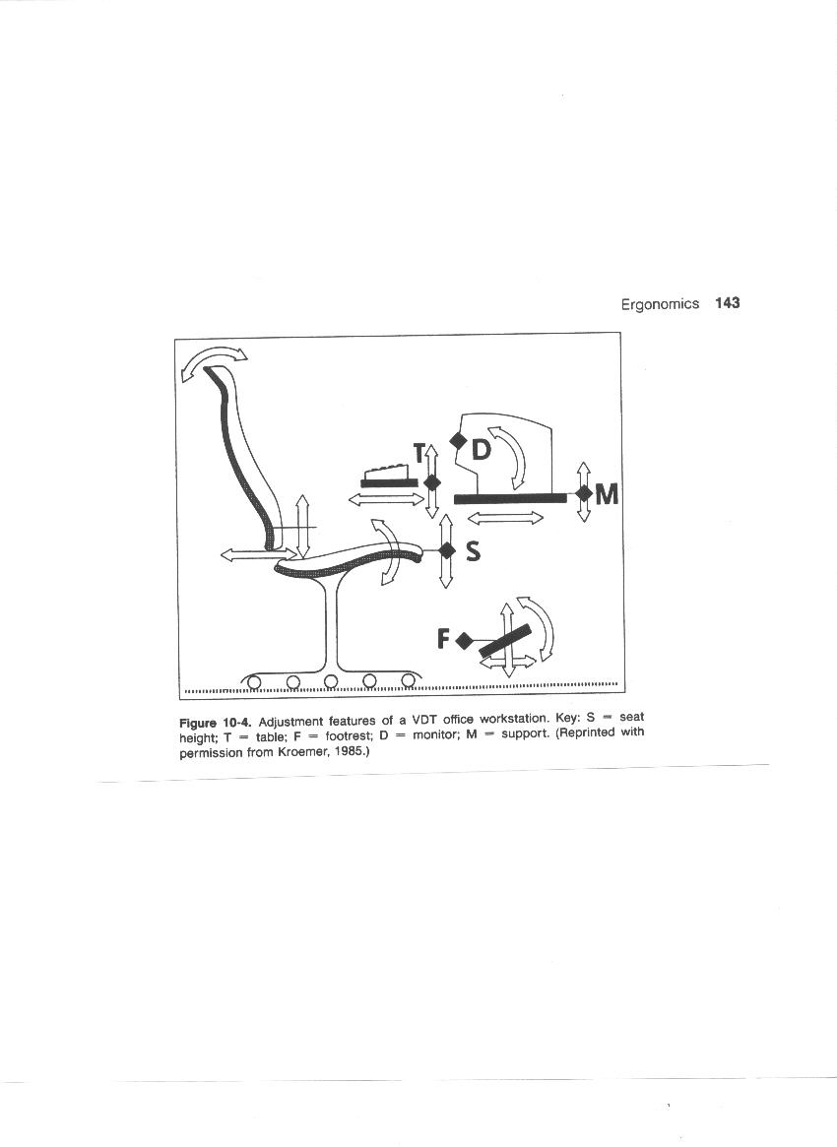

Slide 51
SAFETY
A good plant layout should consider the safety of all personnel.
Lack of adequate storage space which is beyond the control of the foreman, can lead to unsafe practices in the storage of materials. Some of the safety hazards to be watched for in plant layout are:

Slide 52
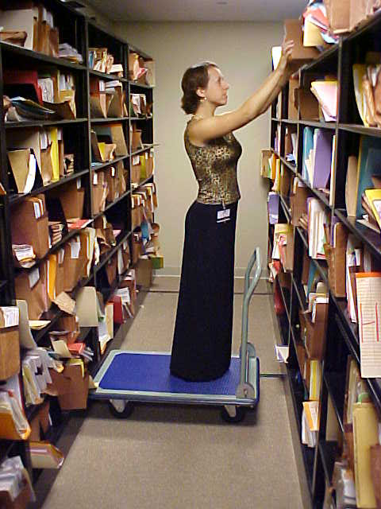
Cont…

Slide 53
inadequate passage,
insufficient storage space allowance for safe handling procedures,
insufficient handling equipment capacity,
floor load capacity,
floor obstructions,
slippery finish floors,
inadequate exits,
inadequate stairs, ramps and ladders,
inaccessible fire extinguisher and first aid boxes
unguarded moving parts of equipment ,
workers located under the above hazards and
improper ventilation for removal of dangerous or toxic gases.

