Slide 1

UNIVERSITY OF GONDAR
SCHOOL OF MECHANICAL AND INDUSTRIAL ENGINEERING
DEPARTMENT OF INDUSTRIAL ENGINEERING

Slide 2
CHAPTER FOUR
Die set and press work
Die Set And Press Work
BY: TESFA G.

Slide 3
Dies and its Types:
The die may be defined as the female part of a complete tool for producing work in a press. It is also referred to a complete tool consists of a pair of mating members for producing work in a press.
Types of dies:
The dies may be classified according to the type of press operation and according to the method of operation.
(A) According to type of press operation:
1 Cutting Dies
These dies are used to cut the metal. They utilize the cutting or shearing action. The common cutting dies are : blanking dies , perforating dies , notching dies , trimming , dies.

Slide 4
2: Forming Dies
These dies change the appearance of the blank without removing any stock. Theses dies include bending, and drawing dies etc.
(B) According to the method of operation:
According to this criterion, the dies may be classified as : single operation or simple dies , compound dies , combination dies , progressive dies .

Slide 5
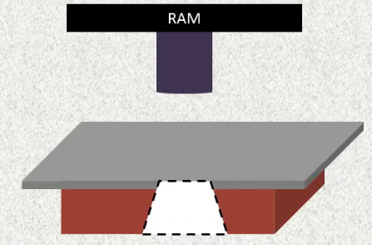
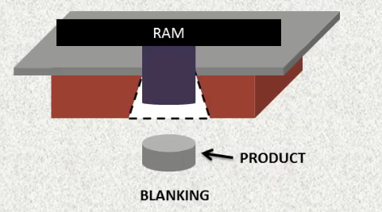
1 Simple Dies
Simple dies or single action dies perform single operation for each stroke of the press slide. The operation may be one of the operation listed under cutting or forming dies.
If only one operation is performed in One Stroke and at One Stage is called as Simple Die.

Slide 6
2: Compound Dies
A compound die performs two operations at a single station, such as blanking and punching. A good example is a compound die that blanks and punches a washer
Such dies are considered as cutting tools since, only cutting operations are carried out.
Compound dies are more accurate and economical in production as compared to single operation dies.

Slide 7
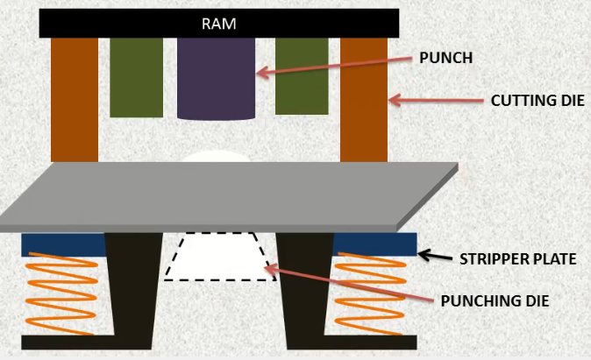
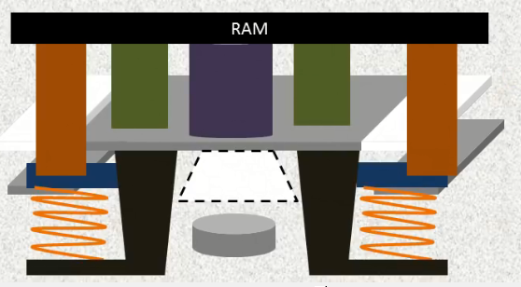

Slide 8
3 Combination Dies
A combination die is performs two operations at two different stations in the die. Examples of applications include blanking two different parts (e.g. right-hand and left-hand parts), or blanking and then bending the same. Exa.
Blanking combined with Deep drawing
Punching combined with Deep drawing
Blanking combined with bending etc.

Slide 9
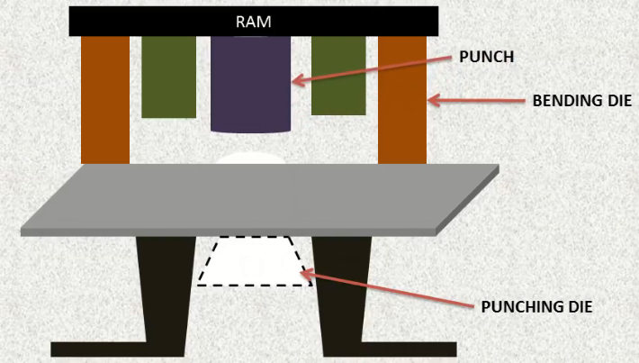
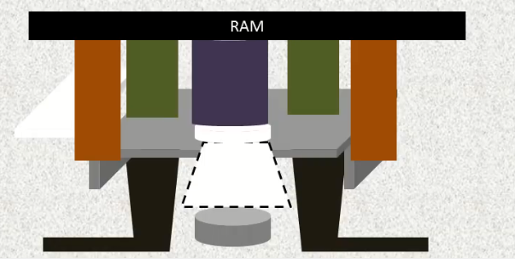


Slide 10
4: Progressive Dies
A progressive die performs two or more operations on a sheet-metal coil at two or more stations with each press stroke. The part is fabricated progressively.
The coil is fed from one station to the next and different operations (e.g., punching, notching, bending, and blanking) are performed at each station.
When the part exits the final station it has been completed and separated (cut) from the remaining coil.
In this, more than one cutting operation will be performed in one stroke but at different stages and punched out sheet is progressing from one stage to another stage for completing the punching operations so that Blanking will be the last operation.

Slide 11
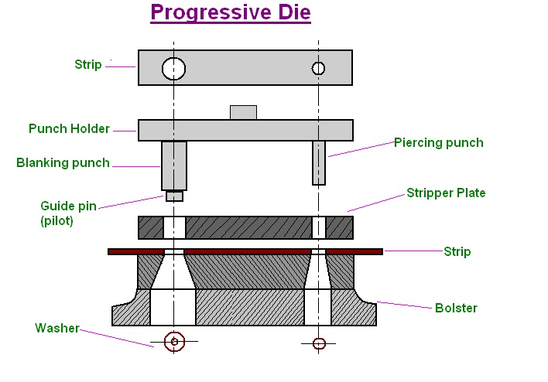
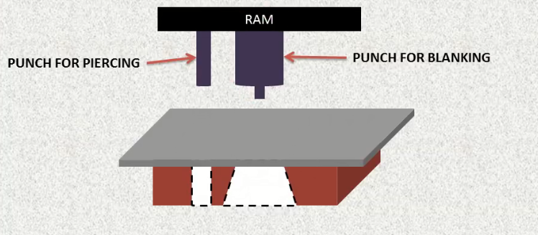
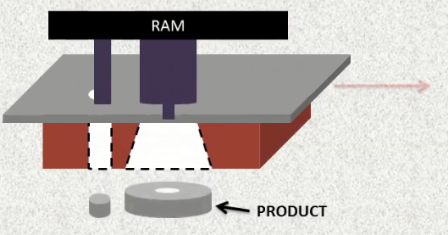

Slide 12
Presswork
The term presswork is used here to describe the process in which force is applied to sheet metal with the result that the metal is cut, i.e. in blanking and piercing, or is formed to a different shape, i.e. in bending.
The press working process is carried out by placing the sheet metal between a punch and die mounted in a press.
The punch is attached to the moving part – the slide or ram – which applies the necessary force at each stroke. The die, correctly aligned with the punch, is attached to the fixed part or bedplate of the press.

Slide 13
It is possible to carry out a wide range of operations in a press, and these include blanking, piercing and bending.
Blanking is the production of an external shape, e.g. the outside diameter of a washer.
Piercing is the production of an internal shape, e.g. the hole in a washer.
Bending – in this case simple bending – is confined to a straight bend across the metal sheet in one plane only.

Slide 14
Types and Selection of press
Classification of presses
Types of presses for sheet metal working can be classified by one or a combination of characteristics, such as source of power, number of slides, type of frame and construction, type of drive,

Slide 15
Classification on the basis of source of power
Manual Presses. These are either hand or foot operated through levers, screws or gears. A common press of this type is the arbor press used for assembly operations.
Mechanical presses. These presses utilize flywheel energy which is transferred to the work piece by gears, cranks, eccentrics, or levers.

Slide 16
Hydraulic Presses These presses provide working force through the application of fluid pressure on a piston by means of pumps, valves, intensifiers, and accumulators. These presses have better performance and reliability than mechanical presses.
Pneumatic Presses. These presses utilize air cylinders to exert the required force. These are generally smaller in size and capacity than hydraulic or mechanical presses, and therefore find use for light duty operations only.

Slide 17
Classification on the basis of number of slides
.Single Action Presses. A single action press has one reciprocation slide that carries the tool for the metal forming operation. The press has a fixed bed. It is the most widely used press for operations like blanking, coining, and drawing.
.

Slide 18
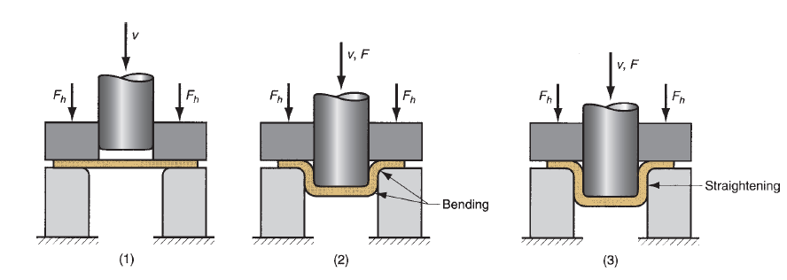
Double Action Presses.
A double action press has two slides moving in the same direction against a fixed bed. It is more suitable for drawing operations, especially deep drawing, than single action press.
For this reason, its two slides are generally referred to as outer blank holder slide and the inner draw slide. The blank holder slide is a hollow rectangle, while the inner slide is a solid rectangle that reciprocates within the blank holder.

Slide 19
Triple Action Presses.
A triple action press has three moving slides. Two slides (the blank holder and the inner slide) move in the same direction as in a double – action press and the third or lower slide moves upward through the fixed bed in a direction opposite to that of the other two slides.
This action allows reverse drawing, forming or bending operations against the inner slide while both upper actions are dwelling.
Cycle time for a triple – action press is longer than for a double – action press because of the time required for the third action.

Slide 20
Press Selection
Proper selection of a press is necessary for successful and economical operation. Press is a costly machine, and the return on investment depends upon how well it performs the job.
Important factors affecting the selection of a press are size, force, energy and speed requirements.
Size. Bed and slide areas of the press should be of enough size so as to accommodate the dies to be used and to make available adequate space for die changing and maintenance. Stroke requirements are related to the height of the parts to be produced. Press with short stroke should be preferred because it would permit faster operation, thus increasing productivity.

Slide 21
Con’t
Size and type of press to be selected also depends upon the method and nature of part feeding, the type of operation, and the material being formed.
Force and Energy. Press selected should have the capacity to provide the force and energy necessary for carrying out the operation.
The major source of energy in mechanical presses is the flywheel, and the energy available is a function of mass of flywheel and square of its speed.

Slide 22
Con’t
Press Speed. Fast speeds are generally desirable, but they are limited by the operations performed. High speed may not, however, be most productive or efficient.
Size, shape and material of work piece, die life, maintenance costs, and other factors should be considered while attempting to achieve the highest production rate at the lowest cost per piece.

