Slide 1

UNIVERSITY OF GONDAR
SCHOOL OF MECHANICAL AND INDUSTRIAL ENGINEERING
DEPARTMENT OF INDUSTRIAL ENGINEERING

Slide 2
CHAPTER FIVE
METAL FORGING
BY: TESFA G.

Slide 3
Forging
Forging is a deformation process in which the work is compressed between two dies, using either impact or gradual pressure to form the part.
It is the oldest of the metal forming operations, dating back to perhaps 5000 B.C.

Slide 4
Forging …cont’d
Today, forging is an important industrial process used to make a variety of high-strength components for automotive, aerospace, and other applications.
These components include engine crankshafts and connecting rods, gears, aircraft structural components, and jet engine turbine parts.
In addition, steel and other basic metals industries use forging to establish the basic form of large components that are subsequently machined to final shape and dimensions.

Slide 5
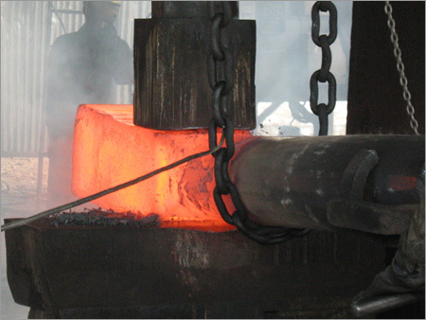
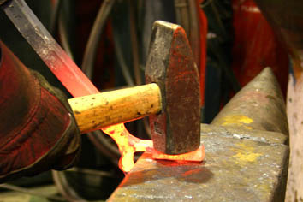
Cont…

Slide 6
Types of forging processes
Forging is carried out in many different ways
Based on working temperature:
Cold forging
Warm forging
Hot forging
Based on source of power
forging hammer ,Applied Impact load
forging press, Applied Gradual pressure

Slide 7
Types of forging processes…cont’d
Based on the degree to which the flow of the work metal:
Open-die forging,
Impression-die forging, and
Flash less forging.

Slide 8
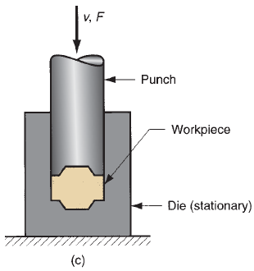
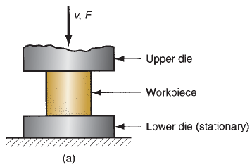
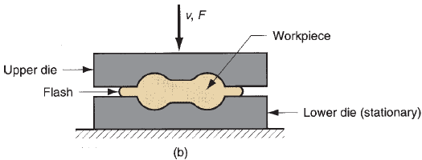
Types of forging processes…cont’d
Fig. 5.1 Three types of forging operation: (a) open-die forging, (b) impression-die forging, and (c) flashless forging.

Slide 9
1. Open-die forging
The work is compressed between two flat (or almost flat) dies, thus allowing the metal to flow without constraint in a lateral direction relative to the die surfaces.
The simplest case of open-die forging involves compression of a work part of cylindrical cross section between two flat dies, much in the manner of a compression test.

Slide 10
Open-die forging…cont’d
This forging operation, known as upsetting or upset forging, reduces the height of the work and increases its diameter.
Analysis of open-die forging
If open-die forging is carried out under ideal conditions of no friction between work and die surfaces, then homogeneous deformation occurs, and the radial flow of the material is uniform throughout its height, as shown in Fig. 5.2.

Slide 11
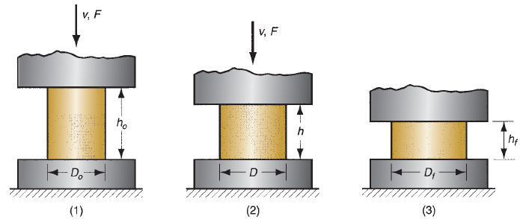
Open-die forging…cont’d
Fig. 5.2 Homogeneous deformation of a cylindrical work part under ideal conditions in an open-die forging operation: (1) start of process with work piece at its original length and diameter, (2) partial compression, and (3) final size

Slide 12
Open-die forging …cont’d
Under these ideal conditions, the true strain experienced by the work during the process can be determined by
(5.1)
Where h_{o} = starting height of the work in mm; and h = the height at some intermediate point in the process in mm. At the end of the compression stroke, h = its final value h_{f} , and the true strain reaches its maximum value.

Slide 13
Open-die forging…cont’d
Estimates of force to perform upsetting can be calculated.
The force (F in N) required to continue the compression at any given height h during the process can be obtained by multiplying the corresponding cross-sectional area (A in mm²) by the flow stress (Y_{f} in MPa):
(5.2)

Slide 14
Open-die forging…cont’d
An actual upsetting operation does not occur quite as shown in Fig. 5.2 because friction opposes the flow of work metal at the die surfaces.
This creates the barreling effect shown in Fig. 5.3.
Friction forces at the die-work interface oppose the spreading of the material near the surfaces, while the material in the center can expand more easily. The result is to create a barrel shape to the part. This effect is called barreling in metal forging terms
When performed on a hot work part with cold dies, the barreling effect is even more pronounced.

Slide 15
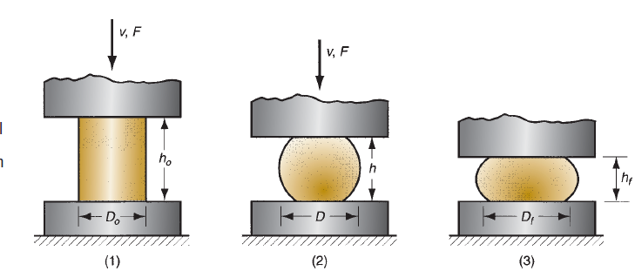
Open-die forging…cont’d
Fig. 5.3 Actual deformation of a cylindrical work part in open-die forging, showing pronounced barreling: (1) start of process, (2) partial deformation, and (3) final shape.

Slide 16
Open-die forging…cont’d
This results from a higher coefficient of friction typical in hot working and heat transfer at and near the die surfaces, which cools the metal and increases its resistance to deformation.
The hotter metal in the middle of the part flows more readily than the cooler metal at the ends.
These effects are more significant as the diameter-to-height ratio of the work part increases, due to the greater contact area at the work-die interface.

Slide 17
Open-die forging…cont’d
All of these factors cause the actual upsetting force to be greater than what is predicted by Equation (5.2).
As an approximation, a shape factor can be applied to Equation (5.2) to account for effects of the D/h ratio and friction:
(5.3)
Where K_{f} is the forging shape factor, defined as

Slide 18
Open-die forging…cont’d
(5.4)
where µ = coefficient of friction; D = work part diameter or other dimension representing contact length with die surface, mm; and h = work part height, mm.

Slide 19
Open-die forging…cont’d
Open-die forging practice
Open-die hot forging is an important industrial process.
Shapes generated by open-die operations are simple; examples include shafts, disks, and rings.
In some applications, the dies have slightly contoured surfaces that help to shape the work.
In addition, the work must often be manipulated (e.g., rotating in steps) to effect the desired shape change.

Slide 20
Open-die forging …cont’d
Skill of the human operator is a factor in the success of these operations.
An example of open-die forging in the steel industry is the shaping of a large square cast ingot into a round cross section.
Open-die forging operations produce rough forms, and subsequent operations are required to refine the parts to final geometry and dimensions.

Slide 21
2. Impression-die forging
Impression-die forging, sometimes called closed-die forging, is performed with dies that contain the inverse of the desired shape of the part.
The raw work piece is shown as a cylindrical part similar to that used in the previous open-die operation.
As the die closes to its final position, flash is formed by metal that flows beyond the die cavity and into the small gap between the die plates.

Slide 22
Impression-die forging…cont’d
Although this flash must be cut away from the part in a subsequent trimming operation, it actually serves an important function during impression-die forging.
As the flash begins to form in the die gap, friction resists continued flow of metal into the gap, thus constraining the bulk of the work material to remain in the die cavity.

Slide 23
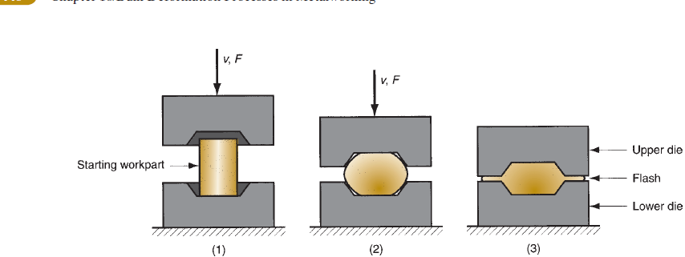
Impression-die forging…cont’d
Fig. 5.5 Sequence in impression-die forging: (1) just prior to initial contact with raw workpiece, (2) partial compression, and (3) final die closure, causing flash to form in gap between die plates.

Slide 24
Impression-die forging…cont’d
Several forming steps are often required in impression die forging to transform the starting blank into the desired final geometry.
Separate cavities in the die are needed for each step. The beginning steps are designed to redistribute the metal in the work part to achieve a uniform deformation and desired metallurgical structure in the subsequent steps.
The final steps bring the part to its final geometry.

Slide 25
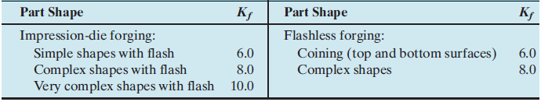
Impression-die forging …cont’d
Forces in this process are significantly greater and more difficult to analyze than in open-die forging.
The force formula is the same as previous Equation (5.3) for open-die forging, but its interpretation is slightly different.
Table 5.1 typical K_{f} (forging shape factor) values for various part shapes in impression-die and flashless forging.

Slide 26
3.Flashless forging
Impression-die forging is sometimes called closed-die forging in industry terminology, however, there is a technical distinction between impression-die forging and true closed-die forging.
The distinction is that in closed-die forging, the raw work piece is completely contained within the die cavity during compression, and no flash is formed.

Slide 27
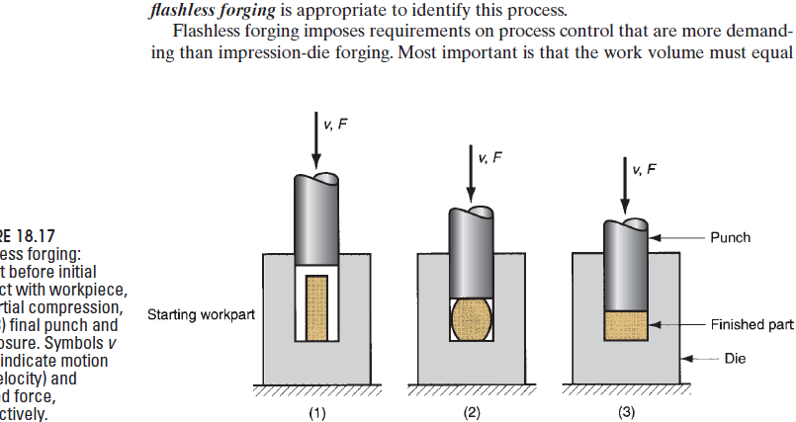
Flashless forging…cont’d
The term flashless forging is appropriate to identify this process.
Fig. 5.8 Flashless forging:
(1) just before initial
contact with workpiece,
(2) partial compression,
and (3) final punch and
die closure. Symbols v
and F indicate motion
(v = velocity) and
applied force,
respectively.

Slide 28
Flashless forging …cont’d
Flashless forging imposes requirements on process control that are more demanding than impression-die forging. Most important is that the work volume must equal the space in the die cavity within a very close tolerance.
It is the best to part geometries that are usually simple and symmetrical, and to work materials such as aluminum and magnesium and their alloys.
Flashless forging is often classified as a precision forging process.

Slide 29
Flashless forging…cont’d
Forces in flashless forging can be computed using the same methods as for impression die forging.
Coining is a special application of closed-die forging in which fine details in the die are impressed into the top and bottom surfaces of the work part.
A common application of coining is, of course, in the minting of coins as shown in Fig. 5.9.
Coining is also used to provide good surface finish and dimensional accuracy on work parts made by other operations.

Slide 30
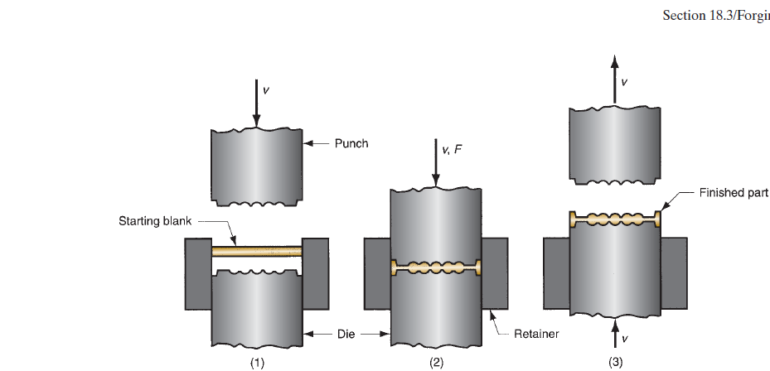
Flashless forging …cont’d
The term flashless forging is appropriate to identify this process.
Fig. 5.9 Coining operation: (1) start of cycle, (2) compression stroke, and (3) ejection of finished part.

Slide 31
Advantages of Forging
Some common advantages of forging are given as under.
1. Forged parts possess high ductility and offers great resistance to impact and fatigue loads.
2. Forging refines the structure of the metal.
3. It results in considerable saving in time, labor and material as compared to the production of similar item by cutting from a solid stock and then shaping it.
4. Forging distorts the previously created unidirectional fiber as created by rolling and increases the strength by setting the direction of grains.
5. Because of intense working, flaws are rarely found, so have good reliability.
6. The forged parts can be easily welded

Slide 32
Disadvantages of Forging
Few dis-advantages of forging are given as under.
1. Rapid oxidation in forging of metal surface at high temperature results in scaling which wears the dies.
2. The close tolerances in forging operations are difficult to maintain.
3. Forging is limited to simple shapes and has limitation for parts having undercuts etc.
4. Some materials are not readily worked by forging.
5. The initial cost of forging dies and the cost of their maintenance is high.
6. The metals gets cracked or distorted if worked below a specified temperature limit.

Slide 33
Applications of Forging
Almost all metals and alloys can be forged.
The low and medium carbon steels are readily hot forged without difficulty,
but the high-carbon and alloy steels are more difficult to forge and require greater care.
Forging is generally carried out on carbon alloy steels, wrought iron, copper-base alloys, aluminum alloys, and magnesium alloys.
Stainless steels, nickel based super-alloys, and titanium are forged especially for aerospace uses

Slide 34
Cont…
Producing of crank shaft of alloy steel is a good example which is produced by forging.
Forging processes are among the most important manufacturing techniques utilized
widely in manufacturing of small tools, rail-road equipment, automobiles and trucks and components of aero plane industries.
These processes are also extensively used in the manufacturing of the parts of tractors, shipbuilding, cycle industries, railroad components, agricultural machinery etc.

Slide 35
Example1
A cylindrical part is warm upset forged in an open die. The initial diameter and height is 50 mm and 40 mm respectively. Final height is 20 mm and Coefficient of friction at the die -work interface = 0.20. The work material has a flow curve defined by: K = 600 MPa and n = 0.12. Determine the force in the operation (a) at h = 30 mm, and (b) at h = 20 mm.

Slide 36
Example 2
Using open-die forging operation, a solid cylindrical piece of 304 stainless steel having 100 mm dia x 72 mm height is reduced in the height to 60 mm at room temperature. Assuming the coefficient of friction as 0.22 and the flow stress for this material at the required true strain as 1000 MPa, calculate the forging force at the end of stroke.

