Slide 1

UNIVERSITY OF GONDAR
SCHOOL OF MECHANICAL AND INDUSTRIAL ENGINEERING
DEPARTMENT OF INDUSTRIAL ENGINEERING

Slide 2
CHAPTER TWO
Introduction to Manufacturing Processes
BY: TESFA G.

Slide 3
What is Manufacturing
Manufacturing is derived from the Latin words,
manus (hand) and
factus (make);
The combination means “made by hand”.
Manufacturing can be also defined, based on technologically, Economically and industrial point of view

Slide 4
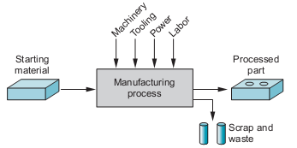
What is ……..Contd
Technologically, manufacturing is the application of physical and chemical processes to alter the geometry, properties, and/or appearance of a given starting material to make parts or products. The processes to accomplish manufacturing involve a combination of machinery, tools, power, and labor.

Slide 5
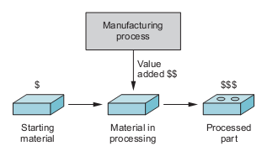
What is ……..Contd
Economically, manufacturing is the transformation of materials into items of greater value by means of one or more processing and /or assembly operations.

Slide 6
What is ……..Contd
Industries point of view, An integrated combination of processes, machine systems, people, organizational structures, information flows, control systems and computers whose purpose is to achieve economic product manufacture and inter-nationally competitive performance.
Machinery
Tooling
Power
Labor
Product
Raw materials
Manufacturing
Process
Profit

Slide 7
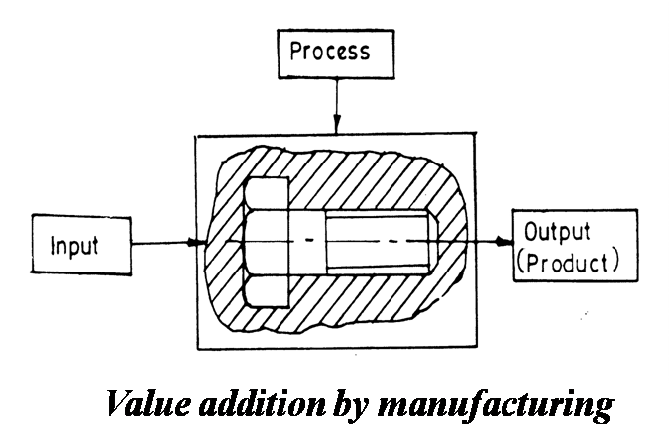
What is ……..Contd
Generally, manufacturing defined as value addition processes by which raw materials of low utility and value due to its inadequate material properties and poor or irregular size, shape and finish are converted into high utility and valued products with definite dimensions, forms and finish imparting some functional ability.

Slide 8
Materials in Manufacturing
Most engineering materials can be classified into one of three basic categories:(1) metals, (2) ceramics, and (3) polymers.
Their chemistries, mechanical and physical properties are different, and these differences affect the manufacturing processes that can be used to produce products from them.
In addition to the three basic categories, there are (4) composites—nonhomogeneous mixtures of the other three basic types rather than a unique category.

Slide 9
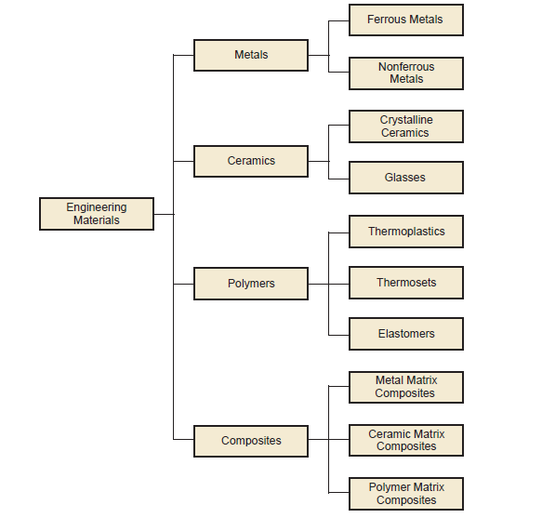
Classification of the four engineering materials.

Slide 10
Manufacturing Processes
A manufacturing process is a designed procedure that results in physical and/or chemical changes to a starting work material with the intention of increasing the value of that material.
Manufacturing process can be divided into two basic types: (1) processing operations and (2) assembly operations

Slide 11
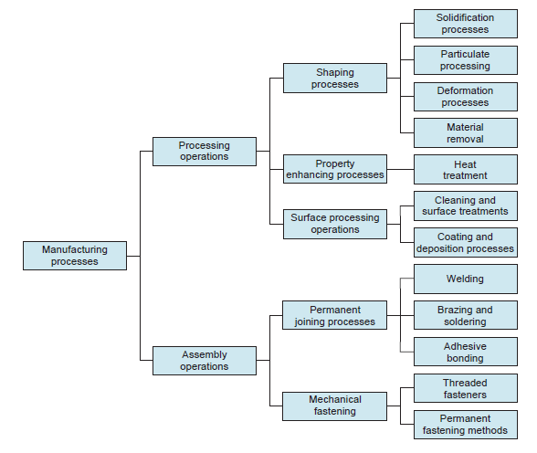
Classification of manufacturing processes

Slide 12
Manufacturing Processes
Two basic types:
Processing operations - transform a work material from one state of completion to a more advanced state that is closer to the final desired product.
  Operations that change the geometry, properties, or appearance of the starting material
Assembly operations - join two or more components to create a new entity called an assembly, subassembly, or some other term that refers to the joining process.

Slide 13
1.Processing Operations
Three categories of processing operations:
A Shaping operations - alter the geometry of the starting work material by various methods. Common shaping processes include casting, forging, and machining.
B Property‑enhancing operations - add value to the material by improving its mechanical and physical properties without changing its shape. Heat treatment is the most common example
C Surface processing operations - are performed to clean, treat, coat, or deposit material onto the exterior surface of the work. Common examples of coating are plating and painting.

Slide 14
A .Shaping Processes – Four Categories
Most shape processing operations apply heat, mechanical force or a combination of these to effect a change in geometry of the work material
Solidification processes - starting material is a heated into liquid or semifluid
Particulate processing - starting material consists of powders;
Deformation processes - starting material is a ductile solid (commonly metal)
Material removal processes - starting material is a ductile or brittle solid

Slide 15
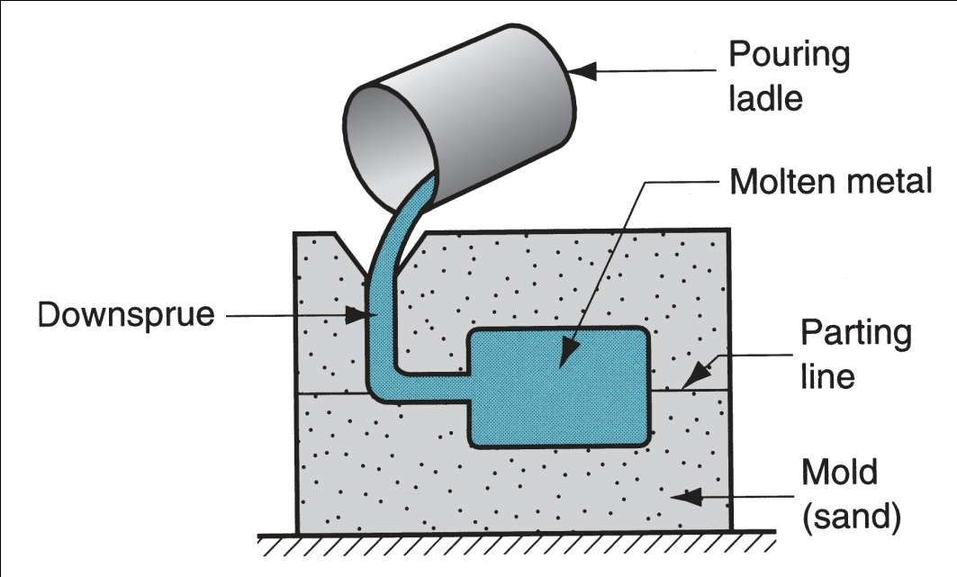
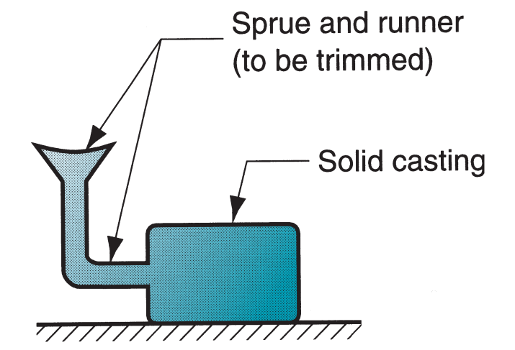
Solidification Processes
In which the starting material is heated into liquid or semifluid that cools and solidifies to form the part geometry; Most processes that operate this way are casting.
Casting process at left and casting product at right

Slide 16
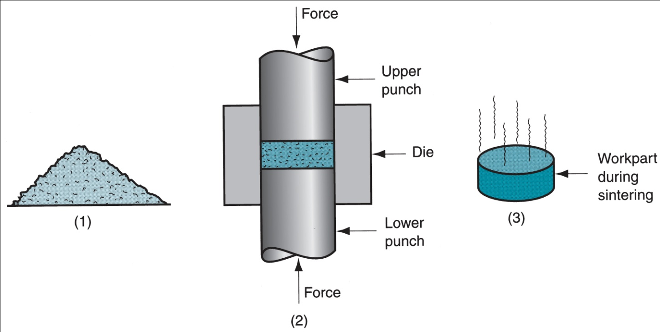
II Particulate Processing
In which the starting material is a powder, and the powders are formed and heated into the desired geometry
(1) Starting materials are metal or ceramic powders, which are (2) pressed and (3) sintered

Slide 17
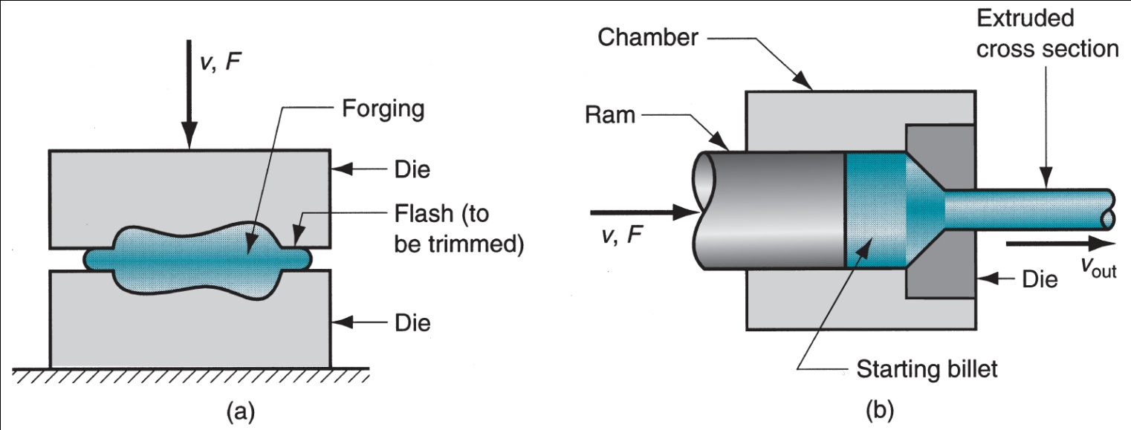
III Deformation Processes
The starting work part is shaped by the application of forces that exceed the yield strength of the material.
For the material to be formed in this way, it must be sufficiently ductile to avoid fracture during deformation.
To increase ductility (and for other reasons), the work material is often heated before forming to a temperature below the melting point. Deformation processes are associated most closely with metalworking and include operations such as forging and
extrusion, shown in Figure: (a) forging and (b) extrusion

Slide 18
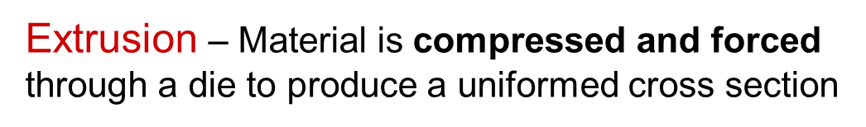
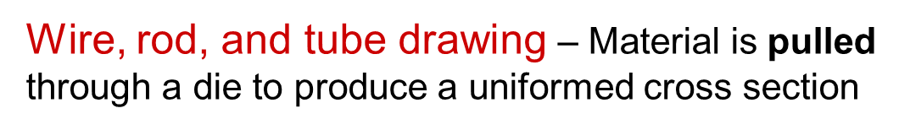
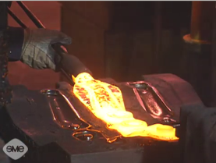
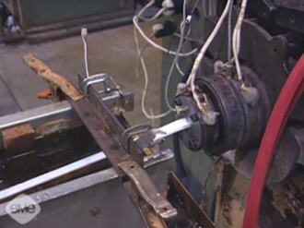
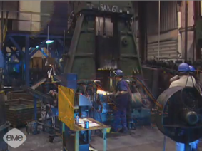
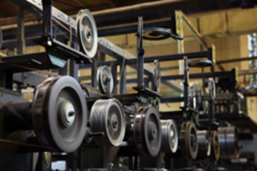
Forming and Metalworking Processes
Rolling – Material passes through a series of rollers, reducing its thickness with each pass
Forging – Material is shaped by the controlled application of force

Slide 19
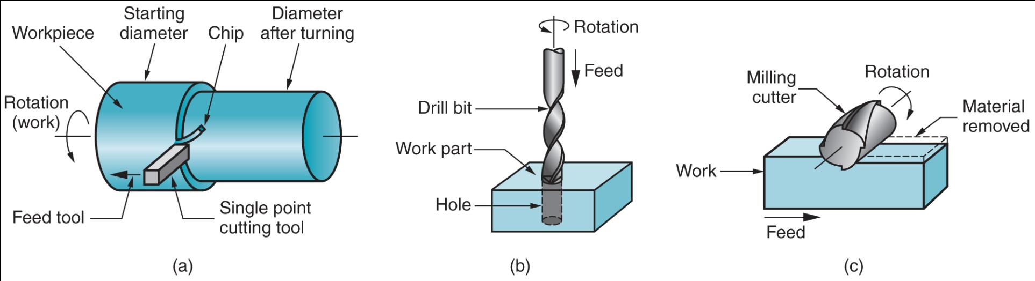
IV Material Removal Processes
These operations remove excess material from the starting workpiece so that the resulting shape is the desired geometry.
The most important processes in this category are machining operations such as (a) turning, (b) drilling, and (c) milling

Slide 20
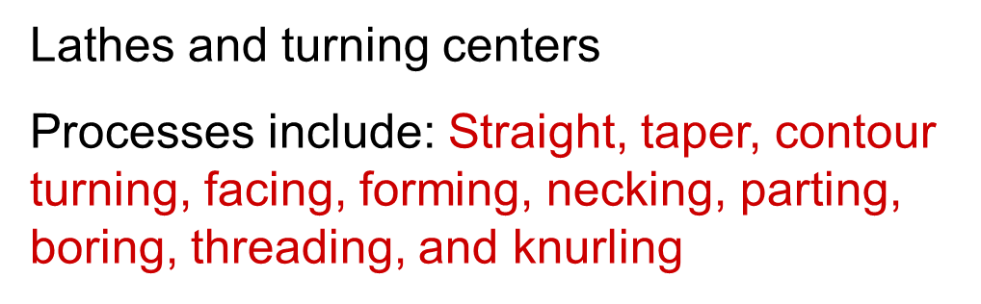
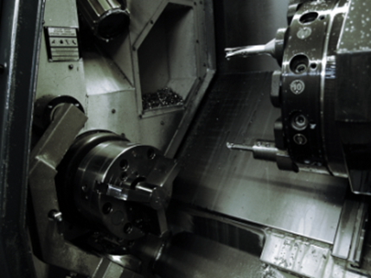
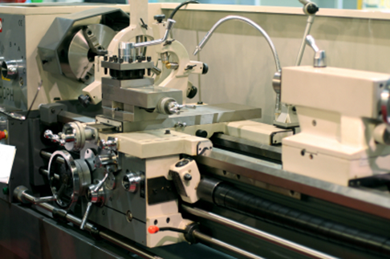
Turning Processes
Machining Processes
Operations that create cylindrical parts
Work piece rotates as cutting tool is fed into the work

Slide 21
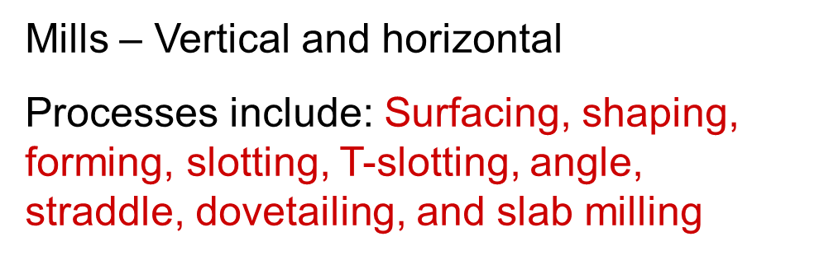
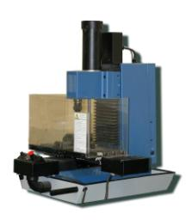
Milling Processes
Machining Processes
Operations that create flat or curved surfaces by progressively removing material
Cutting tools rotate as the work piece is secured and fed into the tool

Slide 22
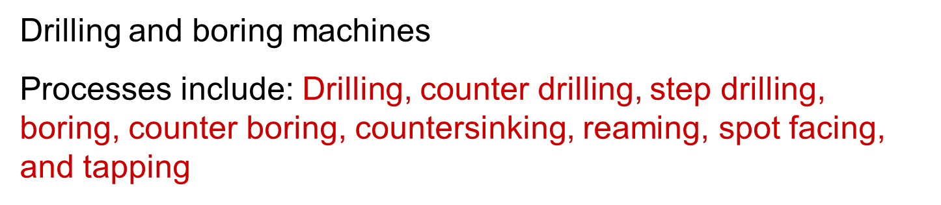
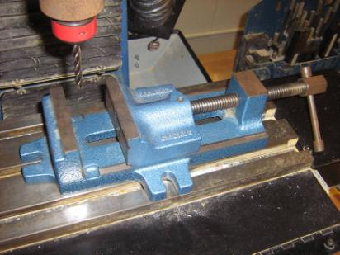
Drilling Processes
Machining Processes
Cutting tools rotate and are fed into nonmoving secured work pieces

Slide 23
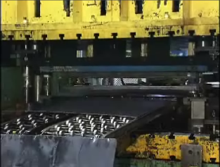
Shearing Processes
Machining Processes
Operations that break unwanted material away from the part
A material is placed between a stationary and movable surface. The movable surface (blade, die, or punch) applies a force to the part that shears away the unwanted material.
Automated hole punch, squaring shear, and rotary cutter
Processes include: Shearing, blanking, cutoff, and parting; punching, perforating, and slotting; notching, lacing, and trimming

Slide 24
B.Property‑Enhancing Processes
to improve mechanical or physical properties of the work material.
These processes do not alter the shape of the part. The most important property-enhancing processes involve heat treatments, which include various annealing and strengthening processes for metals and glasses.
Examples:
  Heat treatment of metals and glasses
  Sintering of powdered metals and ceramics

Slide 25
Heat Treating Processes
Controlled heating and cooling of a material to alter its properties while maintaining its shape
Properties include: Strength, toughness, machinability, wear resistance, and corrosion resistance
90% of heat treating is preformed on steel and other ferrous metals. Types of Heat Treatment Processes
Annealing;
Normalizing;
Hardening;
Tempering;
Surface Hardening.

Slide 26
C.Surface Processing Operations
Surface processing operations include (1) cleaning, (2) surface treatments, and (3) coating and thin film deposition processes.
Cleaning includes both chemical and mechanical processes to remove dirt, oil, and other contaminants from the surface.
Surface treatments include mechanical working such as shot peening and sand blasting, and physical processes such as diffusion and ion implantation.
Coating and thin film deposition processes apply a coating of material to the exterior surface of the work part. Common coating processes include electroplating, anodizing of aluminum physical vapor deposition and chemical vapor deposition to form extremely thin coatings of various substances

Slide 27
2.Assembly Operations
The second basic type of manufacturing operation, in which two or more separate parts are joined to form a new entity.
Components of the new entity are connected either permanently or semi permanently.
Types of assembly operations:
  Permanent joining processes – create a permanent joint
    Welding, brazing, soldering, adhesive bonding
  Mechanical assembly – fastening by mechanical methods
    Threaded fasteners (screws, bolts and nuts);
    Permanent fastening (rivets ,press fitting, expansion fits)

Slide 28
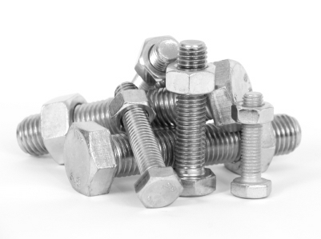
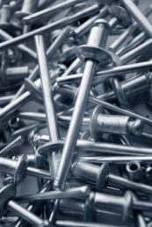
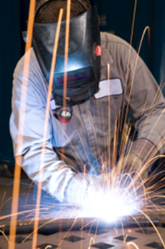
Joining and Assembly Processes
Mechanical Fastening
Use physical force to hold parts together
Mechanical fasteners or part design
Screws, bolts, nails, rivets, cotter pins, retaining clips, and edge design
Welding
Operations that use heat, pressure, or both to permanently join parts
Gas, arc, stud, spot, forge, roll laminating, resistance, and induction welding

Slide 29
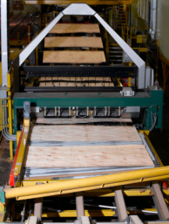
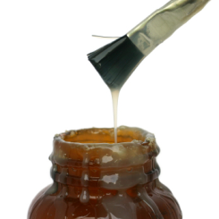
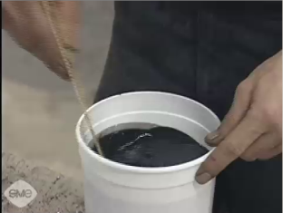
Joining and Assembly Processes
Adhesive bonding
Bonding of adjoining surfaces by filling the gap between each surface with a bonding material
Glue, cement, thermoplastic, thermosetting, and elastomers
©iStockphoto.com
©iStockphoto.com

Slide 30
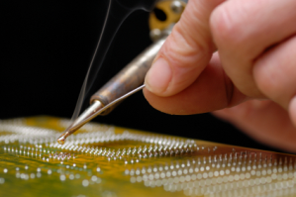
Joining and Assembly Processes
Soldering and Brazing
Operation in which metal surfaces are bonded together by an alloy
Heated molten alloy flows between the adjoining surfaces
When the heat is removed, the molten metal solidifies and the metal surfaces are bonded

Slide 31
Factors to be considered for selecting a manufacturing processes
1. Shape and size to be produced:-
For products with simple shape, machining is best suited. But for complex and intricate shapes, casting is preferred.
The size of the product is also an important factor. For example “long” products such as rails or “thin” products such as car-body panels can be best made by forming process compared to others.

Slide 32
2. Quantity to be produced:-
Both machining and casting can be used for producing large quantity products, but are not suitable for small quantity products, as they are not economical.
3. Types of material:-
Materials possess various properties like ductility, hardness, toughness, brittleness etc. Hard materials cannot be machined easily. Brittle materials cannot be mechanically worked (forming process). In such cases casting is preferred

Slide 33
4. Surface finish and dimensional accuracy :-
Casting does not yield good surface finish. How ever , if casting process is selected, it should be followed by machining process to obtain the desired surface finish and dimensional tolerance
5. Quality and property requirements:-
A defect free product with specific properties serve its purpose for long life . Properties of cast material are generally less when compared to that of mechanically worked materials. Hence a process that gives better properties and quality should be selected

Slide 34
6. Cost of the product:-
Customers often demand for products with more features and performance at reduced prices. Hence, a low cost production process should be selected, but at the same time, see that no compromise is made in terms of quality.

