Slide 1
Chapter Three
Research Design

Slide 2
3.1. Introduction
A research design is the arrangement of conditions for collection and analysis of data in a manner that aims to combine relevance to the research purpose with economy in procedure.
In fact, the research design is the conceptual structure within which research is conducted; it constitutes the blueprint for the collection, measurement and analysis of data.
As such the design includes an outline of what the researcher will do from writing the hypothesis and its operational implications to the final analysis of data.

Slide 3
More explicitly, the design decisions happen to be in respect of:
What is the study about?
Why is the study being made?
Where will the study be carried out?
What type of data is required?
Where can the required data be found?
What periods of time will the study include?
What will be the sample design?
What techniques of data collection will be used?
How will the data be analyzed?
In what style will the report be prepared?

Slide 4
Keeping in view the above stated design decisions, one may split the overall research design into the following parts:
The sampling design which deals with the method of selecting items to be observed for the given study;
The observational design which relates to the conditions under which the observations are to be made;
The statistical design which concerns with the question of how many items are to be observed and how the information and data gathered are to be analyzed; and
The operational design which deals with the techniques by which the procedures specified in the sampling, statistical and observational designs can be carried out.

Slide 5
From what has been stated above, we can state the important features of a research design as under:
It is a plan that specifies the sources and types of information relevant to the research problem.
It is a strategy specifying which approach will be used for gathering and analyzing the data.
It also includes the time and cost budgets since most studies are done under these two constraints.

Slide 6
3.2 Types Research Designs
Different research designs can be conveniently described if we categorize them as:
1 research design in case of exploratory research studies;
2 research design in case of descriptive and diagnostic research studies, and
3 research design in case of hypothesis-testing research studies.

Slide 7
1. Research design in case of exploratory research studies:
The major emphasis in such studies is on the discovery of ideas and insights. As such the research design appropriate for such studies must be flexible enough to provide opportunity for considering different aspects of a problem under study.
Inbuilt flexibility in research design is needed because the research problem, broadly defined initially, is transformed into one with more precise meaning in exploratory studies, which fact may necessitate changes in the research procedure for gathering relevant data.

Slide 8
2. Research design in case of descriptive and diagnostic research studies:
Descriptive research studies are those studies which are concerned with describing the characteristics of a particular individual, or of a group, whereas diagnostic research studies determine the frequency with which something occurs or its association with something else.
The studies concerning whether certain variables are associated are examples of diagnostic research studies. As against this, studies concerned with specific predictions, with narration of facts and characteristics concerning individual, group or situation are all examples of descriptive research studies

Slide 9
Most of the social research comes under this category. From the point of view of the research design, the descriptive as well as diagnostic studies share common requirements and as such we may group together these two types of research studies.
In descriptive as well as in diagnostic studies, the researcher must be able to define clearly, what he wants to measure and must find adequate methods for measuring it along with a clear cut definition of ‘population’ he wants to study.

Slide 10
The design in such studies must be rigid and not flexible and must focus attention on the following:
(a) Formulating the objective of the study (what the study is about and why is it being made?)
(b) Designing the methods of data collection (what techniques of gathering data will be adopted?)
(c) Selecting the sample (how much material will be needed?)
(d) Collecting the data (where can the required data be found and with what time period should the data be related?)
(e) Processing and analyzing the data.
(f) Reporting the findings.

Slide 11
3. Research design in case of hypothesis-testing research studies:
Hypothesis-testing research studies (generally known as experimental studies) are those where the researcher tests the hypotheses of causal relationships between variables.
Such studies require procedures that will not only reduce bias and increase reliability, but will permit drawing inferences about causality.
Usually experiments meet this requirement. Hence, when we talk of research design in such studies, we often mean the design of experiments.

Slide 12
3.3 Sampling design
A sample design is a definite plan for obtaining a sample from a given population. It refers to the technique or the procedure the researcher would adopt in selecting items for the sample.
Sample design may as well lay down the number of items to be included in the sample i.e., the size of the sample. Sample design is determined before data are collected.
There are many sample designs from which a researcher can choose. Some designs are relatively more precise and easier to apply than others. Researcher must select/prepare a sample design which should be reliable and appropriate for his research study.

Slide 13
3.3.1Types of Samples
Probability (Random) Samples each member of the population has a known non-zero probability of being selected for sample
Simple random sample
Systematic random sample
Stratified random sample
Cluster sample
Non-Probability Samples members are selected from the population in some nonrandom manner
Convenience sample
Purposive sample
Quota
Snowball Sampling

Slide 14
Simple Random Sampling:
This method involves very simple method of drawing a sample from a given population used when the population under consideration is homogenous.
The selection, in this type of sampling, is thus free from personal bias because the investigator does not exercise his discretion of preference in the choice of items.
A table of random number or lottery system is used to determine which units are to be selected.

Slide 15
b) Systematic Sampling:
This method of sampling is a common method of selecting a sample when a complete list of the population is available.
A probability sampling procedure that involves selecting every K^{th} element from a list of population elements, after the first element has been randomly selected ,where K refers to the sampling interval or skip interval.

Slide 16
1. Assign a sequence number to each member of the population.
2. Determine the skip or sampling interval by dividing the population’s size by the size of the sample required to be with drawn. Use the next formula for determining the skip interval.
N=n.k, where N = total population
n= sample size k= skip interval
k=N/n
3. Select the first sample unit using lottery method or random number table.
4. Include the item you with drew in step three in a sample and select every K^{th} item there after until total sample has been selected.
In our starting point which is selected randomly between 1 and K,

Slide 17
For example, if we want to select 20 samples from a population of 100 members, our skip interval will be 5 .Our starting point must be selected randomly from the interval. If our starting point is 3, then our sample include members with serial numbers of 3, 8, 13,18, 23, 28,33, 38,
Merits:
The time, cost and work involved in sampling by this method are relatively smaller.
Limitations:
Systematic sampling becomes less representative design or inefficient if we are dealing with populations having hidden periodicities and trend.
Example job satisfaction for IOT Teacher staffs

Slide 18
c) STRATIFIED SAMPLING
Where population embraces a number of distinct categories, the frame can be organized into separate "strata." Each stratum is then sampled as an independent sub-population, out of which individual elements can be randomly selected.
Every unit in a stratum has same chance of being selected.
Using same sampling fraction for all strata ensures proportionate representation in the sample.
Adequate representation of minority subgroups of interest can be ensured by stratification & varying sampling fraction between strata as required.
Example job satisfaction for university of Gondar staff

Slide 19
d) CLUSTER SAMPLING
Cluster sampling is an example of 'two-stage sampling' .
First stage a sample of areas is chosen;
Second stage a sample of respondents within those areas is selected.
Population divided into clusters of homogeneous units, usually based on geographical contiguity.
Sampling units are groups rather than individuals.
A sample of such clusters is then selected.
All units from the selected clusters are studied.

Slide 20
d) Cluster sampling:
In cluster random sampling, the total population is divided into a number of relatively small non overlapping divisions called clusters and some of these clusters can randomly be selected for the inclusion of the over all sample.
Merits:
All members of a selected clusters are included in the sample
Limitations
often lower statistical efficiency (more error) due to subgroups being homogeneous rather than heterogeneous

Slide 21
Non random/Non-probability sampling
Non-probability sampling techniques are based on the concept of non-random selection.
These sampling techniques are less precise than probability sampling techniques since the method of selecting elements is not random. Although, this method is less precise Than probability sampling.
non-probability sampling techniques use less time and cost as compare to that of probability sampling designs. They are less expensive than that of probability sampling.

Slide 22
Types of Non probability Sampling
Convenience Sampling
Purposive Sampling
Quota Sampling
Snowball Sampling

Slide 23
CONVENIENCE SAMPLING
Sometimes known as opportunity sampling or accidental sampling.
A type of nonprobability sampling which involves the sample being drawn from that part of the population which is close to hand. That is, readily available and convenient.
The researcher using such a sample cannot scientifically make generalizations about the total population from this sample because it would not be representative enough.
For example, if the interviewer was to conduct a survey at a shopping center early in the morning on a given day, the people that he/she could interview would be limited to those given there at that given time, which would not represent the views of other members of society in such an area, if the survey was to be conducted at different times of day and several times per week.

Slide 24
Judgmental sampling or Purposive sampling
The researcher chooses the sample based on who they think would be appropriate for the study.
A nonprobability sampling procedure that involves selecting elements based on a researcher's judgment about which elements will facilitate his or her investigation
This is used primarily when there is a limited number of people that have expertise in the area being researched

Slide 25
Quota Sampling
A non probability sampling procedure that involves describing the target population in terms of what are thought to be relevant criteria and then selecting sample elements to represent the “relevant” subgroups in proportion to their presence in the target population

Slide 26
The population is first segmented into mutually exclusive sub-groups, just as in stratified sampling.
Then judgment used to select subjects or units from each segment based on a specified proportion.
For example, an interviewer may be told to sample 200 females and 300 males between the age of 45 and 60.
It is this second step which makes the technique one of non-probability sampling.
In quota sampling the selection of the sample is non-random.
For example interviewers might be tempted to interview those who look most helpful. The problem is that these samples may be biased because not everyone gets a chance of selection. This random element is its greatest weakness and quota versus probability has been a matter of controversy for many years

Slide 27
Snowball Sampling
A nonprobability sampling procedure that involves using members of the group of interest to identify other members of the group

Slide 28
3.4 Design of experiments
Experiments are performed by investigators in virtually all fields of inquiry, usually to discover something about a particular process or system.
Literally, an experiment is a test. More formally, we can define an experiment as a test or series of tests in which purposeful changes are made to the input variables of a process or system so that we may observe and identify the reasons for changes that may be observed in the output response

Slide 29
In engineering, experimentation plays an important role in new product design, manufacturing process development, and process improvement.
The objective in many cases may be to develop a robust process, that is, a process affected minimally by external sources of variability.
In any experiment, the results and conclusions that can be drawn depend to a large extent on the manner in which the data were collected.

Slide 30
Key terms to know:
Experiment: Process of collecting sample data
Design of Experiment: Plan for collecting the sample
Response Variable: Variable measured in experiment (outcome, y)
Experimental Unit: Object upon which the response y is measured
Factors: Independent Variables
Level: The value assumed by a factor in an experiment
Treatment: A particular combination of levels of the factors in an experiment

Slide 31
In production and quality control we want to control the error and learn as much as we can about the process or the underlying theory with the resources at hand.
From an engineering perspective we're trying to use experimentation for the following purposes:
reduce time to design/develop new products & processes
improve performance of existing processes
improve reliability and performance of products
achieve product & process robustness
perform evaluation of materials, design alternatives, setting component & system tolerances, etc.

Slide 32
The four engineering problem classes to which design of experiment is applied in manufacturing are:
Comparison: Compares to see if a change in a single “factor” (variable) has resulted in a process change (ideally an improvement)
Screening/ characterization: Used when you want to see the effect of a whole range of factors so as to know which one(s) is most important. Two factorial experiments usually used

Slide 33
Modeling: Used when you want to be able to construct a mathematical model that will predict the effect on a process of manipulating a variables or multiple variables
Optimization: When you want to determine the optimal settings for all factors to give an optimal process response. For example in an industrial process, the optimal response might be the best product spec or the least cost to manufacture, or some optimal combination of those 2 responses, etc.

Slide 34
Design of Experiment

Slide 35
Design of Experiments
Design of experiments (DOE) refers to Planned Experiments
DOE is statistical technique used to study the effects of multiple variables simultaneously and most economically.
This method studies the effects of individual factors on the results and determine the best factor combination.
DOE is a technique which applies statistical methods to plan efficient experiment procedure and analyze the collected data.

Slide 36
Design of Experiment
DOE is widely used in many fields with broad application across all the natural and social sciences.
It is extensively used by engineers and scientists involved in the improvement of manufacturing processes to maximize yield and decrease variability.
Experimental design techniques become extremely important to develop new products and processes in a cost effective and confident manner.

Slide 37
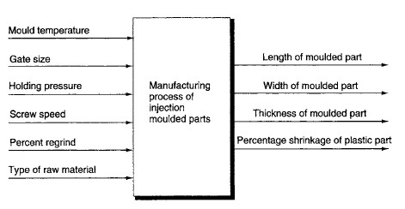
DOE Terminologies
DOE is to establish a relationship between a number of independent variables and a dependent variable of interest.
The dependent variable is called the response, and the independent variables are called factors.
Factors are also referred as variables, and parameters

Slide 38
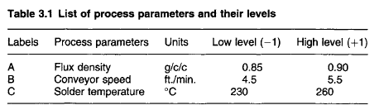
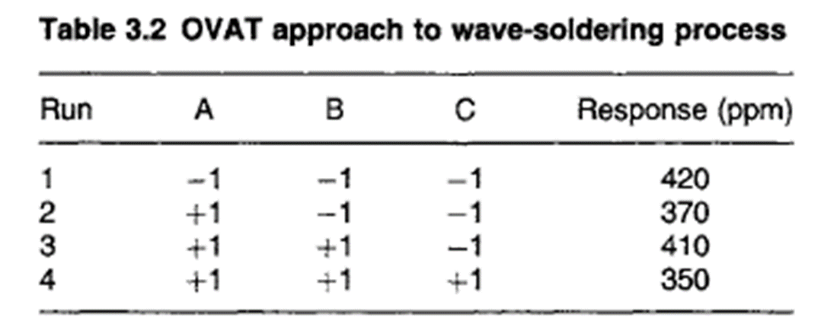
DOE Terminologies
Experiments are run at different factor values, called levels.
Each run of an experiment involves a combination of the levels of the investigated factors
Also called trial or treatment

Slide 39
Applications of DOE
In process development
Improved process yields
Reduced variability and closer conformance to nominal or target requirements
Reduced development time
Reduced overall costs
Basic principles of DOE
The three basic principles of experimental design are replication, randomization, and blocking.

Slide 40
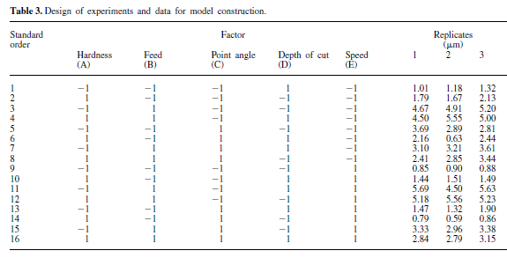
Replication
Replication means repetition of the given treatment in experiment (Completely re-run experiment with same input levels)
Repeated observations at a given treatment are called replicates.

Slide 41
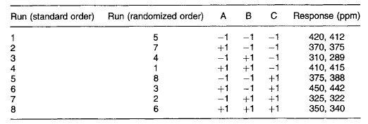
Randomization
Randomization means the order in which the individual runs or trials of the experiment are to be performed at random.
Performed to avoid the influence of experiment setup.
Statistical methods require that the observations (or errors) be independently distributed random variables.

Slide 42
Blocking
Blocking is a method of eliminating the effects of extraneous variation due to noise factors and thereby improves the efficiency of experimental design.
The main objective is to eliminate unwanted sources of variability such as batch-to- batch, day-to-day, shift-to-shift, etc.
Observations collected under the same experimental conditions (i.e. same day, same shift, etc.) are said to be in the same block

Slide 43
Guidelines for designing experiments
Recognition of and statement of the problem.
Choice of factors, levels, and ranges
Selection of the response variable
Choice of experimental design.
Performing the experiment.
Statistical analysis of the data.
Conclusions and recommendations.
Planning phase
Designing phase
Conducting phase
Analysing phase

Slide 44
Major Approaches to DOE
Factorial Design
Taguchi Method
Response Surface Design

Slide 45
Factorial Design
The number of treatments of an experiment is determined on the basis of the number of factor levels being investigated.
For example, if an experiment involving two factors is to be performed, with the first factor having m levels and the second having n levels, then m x n treatment combinations can possibly be run, and the experiment is an m x n factorial design

Slide 46
Full and Fractional Factorial Design
If all m x n combinations are run, then the experiment is a full factorial.
If only some of the m x n treatment combinations are run, then the experiment is a fractional factorial.

Slide 47
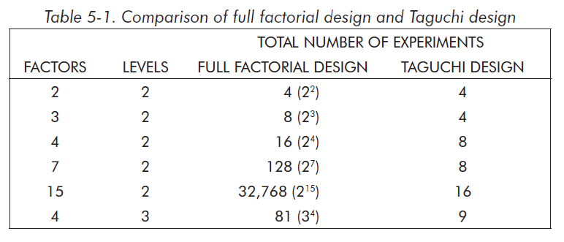
Full Factorial Design
A full factorial design will identify all possible combinations for a given set of factors.
Because most industrial experiments usually involve a significant number of factors, a full factorial design results in a large number of experiments.

Slide 48
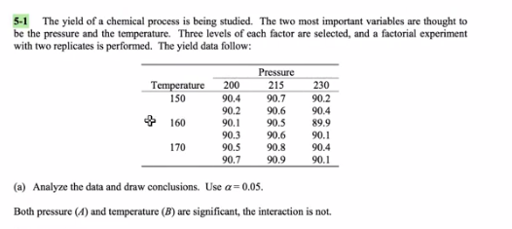
Example

Slide 49
Fractional Factorial Design
To reduce the number of experiments to a practical level, only a small set from all of the possibilities is selected.
The method of selecting a limited number of experiments that produces the most information is known as a fractional factorial experiment.
FRACTIONAL FACTORIAL DESIGN

Slide 50
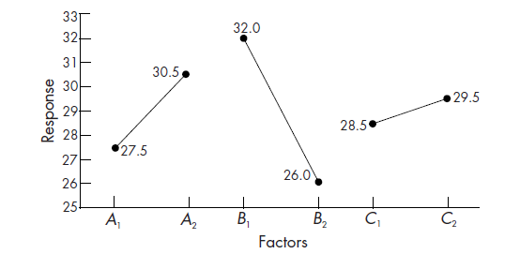
Analytical tools of DOE
Main effects plot
A main effect plot is a plot of the mean response values at each level of a design parameter or process variable.

Slide 51
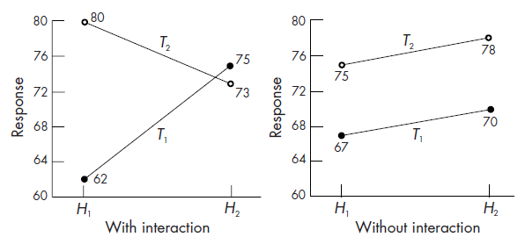
Analytical tools of DOE
Interactions plots
An interactions plot is a powerful graphical tool which plots the mean response of two factors at all possible combinations of their settings.

Slide 52
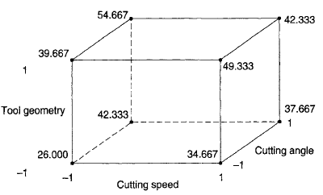
Analytical tools of DOE
Cube plots
Cube plots display the average response values at all combinations of process or design parameter settings. One can easily determine the best and the worst combinations of factor levels for achieving the desired optimum response.

Slide 53
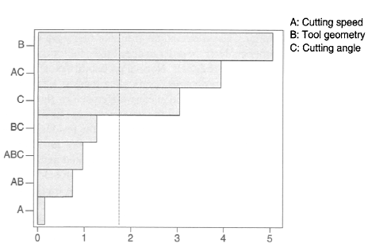
Analytical tools of DOE
Pareto plot of factor effects
The Pareto plot allows one to detect the factor and interaction effects which are most important to the process or design.

Slide 54
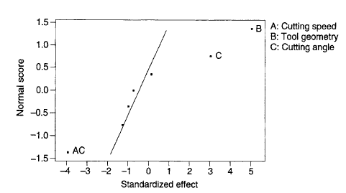
Analytical tools of DOE
Normal Probability Plot of factor effects
For NPPs, the main and interaction effects of factors or process (or design) parameters should be plotted against cumulative probability (per cent).

Slide 55
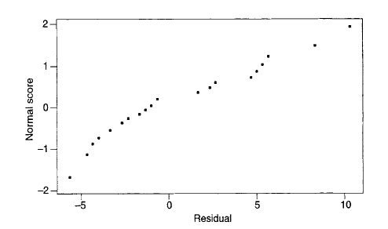
Analytical tools of DOE
Normal Probability Plot of residuals
One of the key assumptions for the statistical analysis of data from industrial experiments is that the data come from a normal distribution.
Normal probability plots are useful for evaluating the normality of a data set, even when there is a fairly small number of observations.

Slide 56
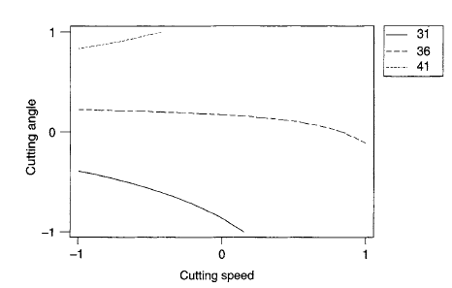
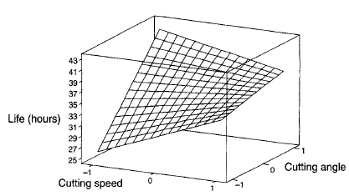
Analytical tools of DOE
Response surface plots
Response surface plots such as contour and surface plots are useful for establishing desirable response values and operating conditions.

Slide 57
Thank you !!!

