Slide 1
Taguchi Method for DOE

Slide 2
Introduction
Taguchi methods of experimental design provide a simple, efficient and systematic approach for the optimization of critical parameters of any process.
It is an effective method in investigating the effects of multiple factors on performance as well as to study the influence of individual factors to determine which factor has more influence, which less.
It minimizes to a great extent, the number of experiments by means of incorporating readily available fractional factorial matrices or orthogonal arrays.
Taguchi experiment can be accomplished within a limited time frame and at a reduced cost, with results comparable to that of a full factorial experiment

Slide 3
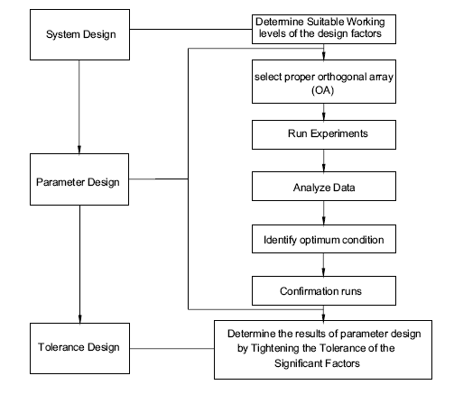
Taguchi’s Design Stages
Taguchi recommends a three-stage process to achieve desirable product quality by design :
System Design
Parameter Design
Tolerance Design.

Slide 4
Parameter Design
The objective of the parameter design is to optimize the settings of the process parameter values for improving performance characteristics.
Optimal process parameter values are insensitive to the variation of environmental conditions and other noise factors. (Robust Design)
Parameter design is the key step in the Taguchi method to achieving high quality without increasing cost.
Orthogonal arrays, variance and signal to noise analysis are the essential tools of parameter design.

Slide 5
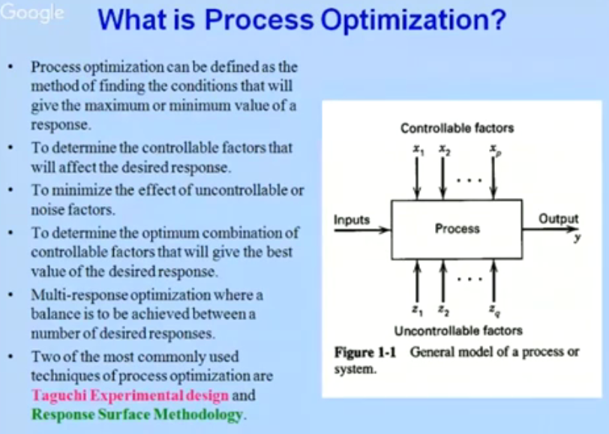

Slide 6
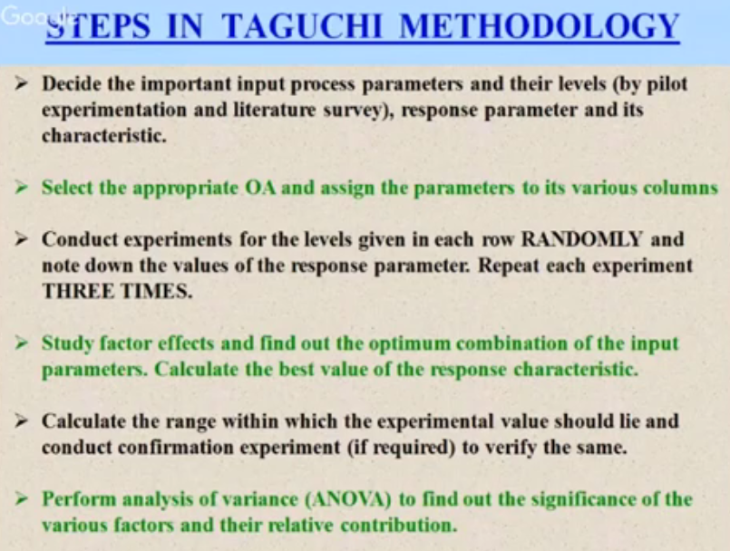

Slide 7
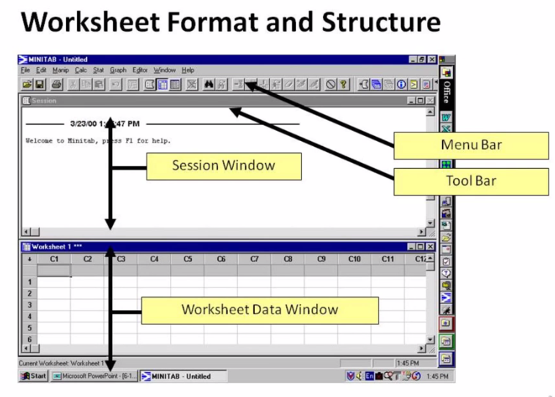

Slide 8
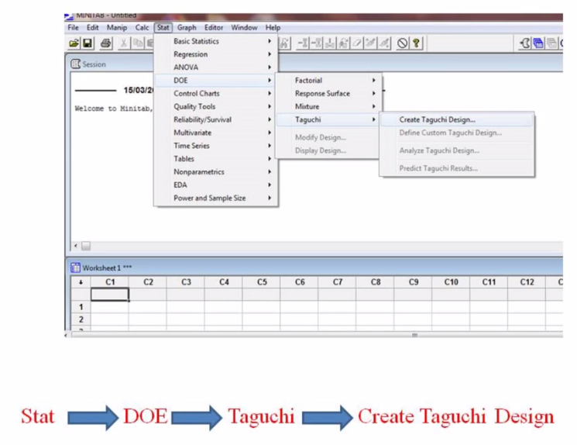

Slide 9
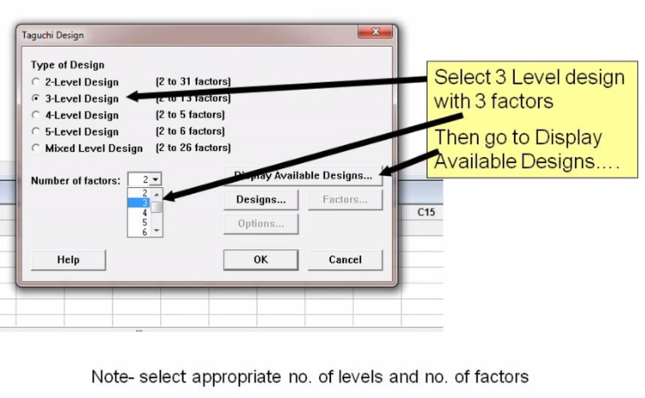

Slide 10
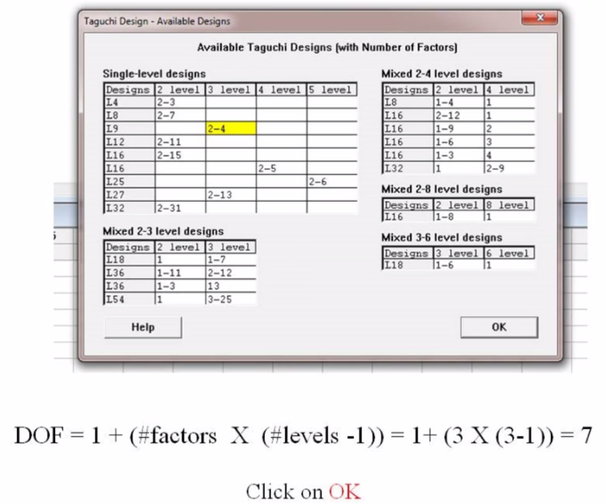

Slide 11
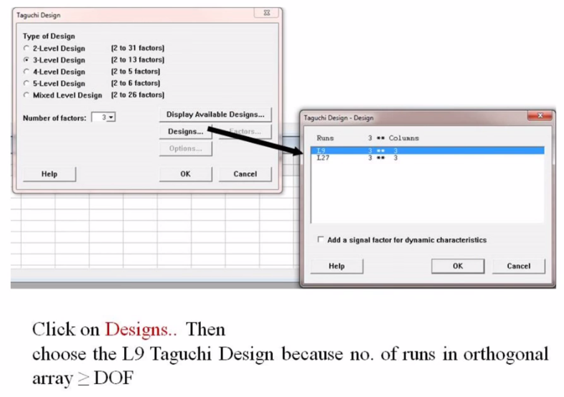

Slide 12
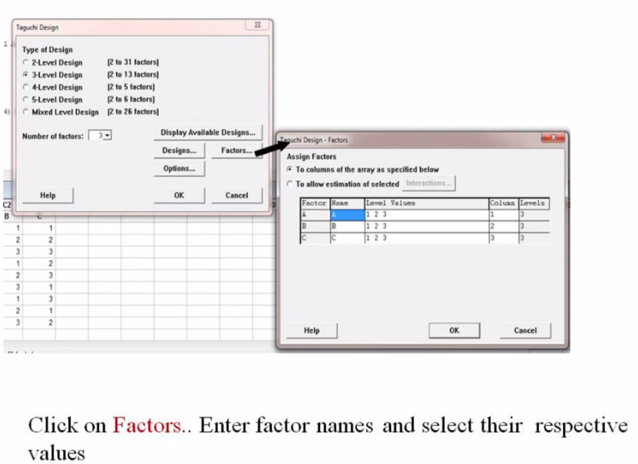

Slide 13
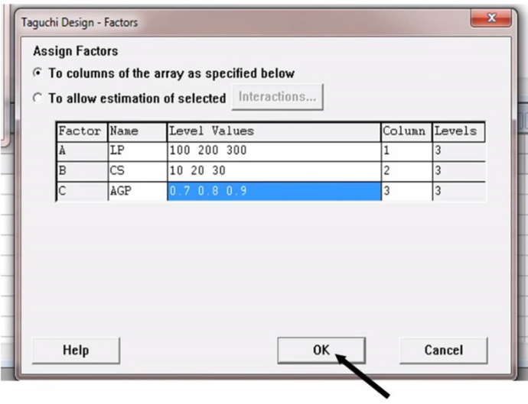

Slide 14
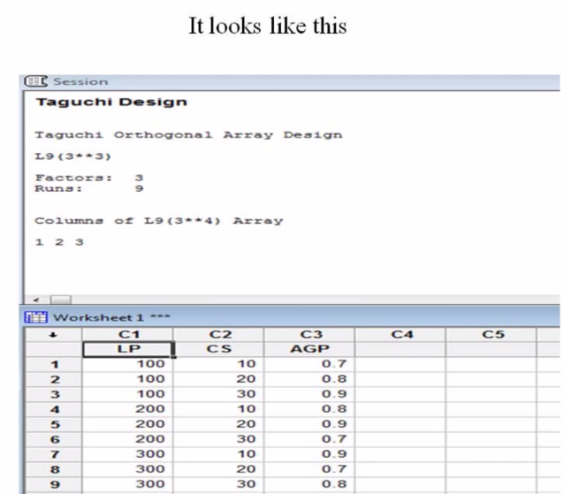

Slide 15
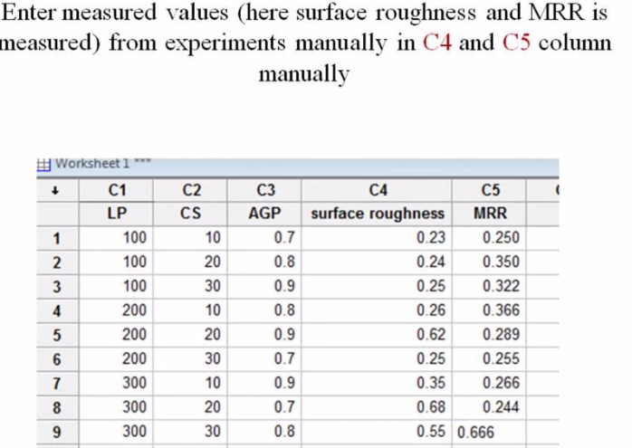

Slide 16
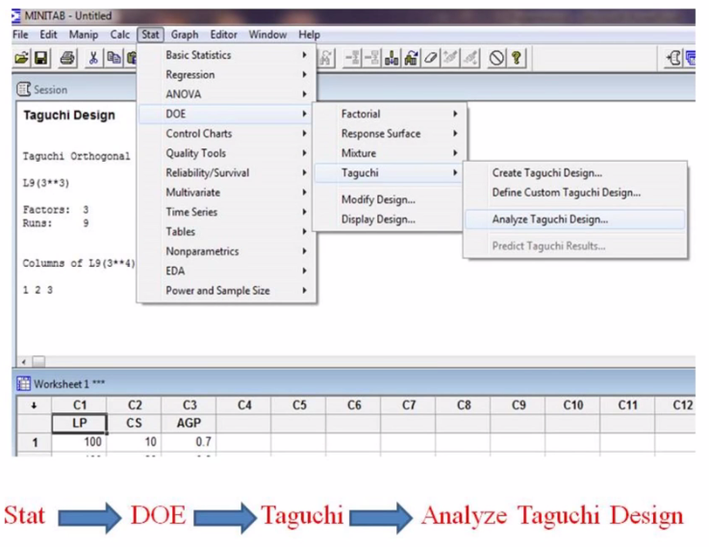

Slide 17
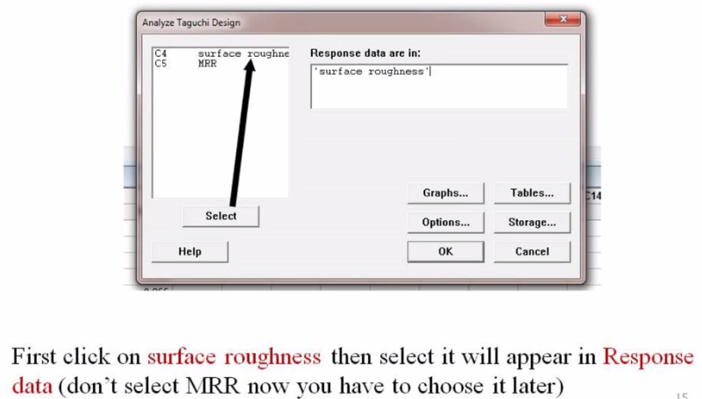

Slide 18
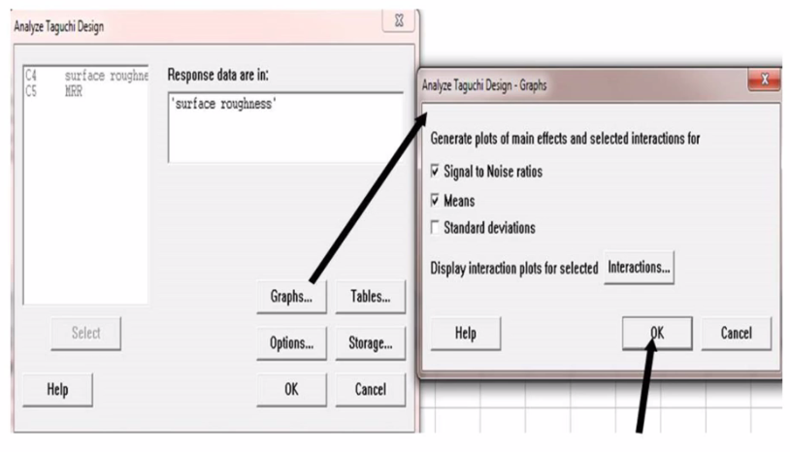

Slide 19
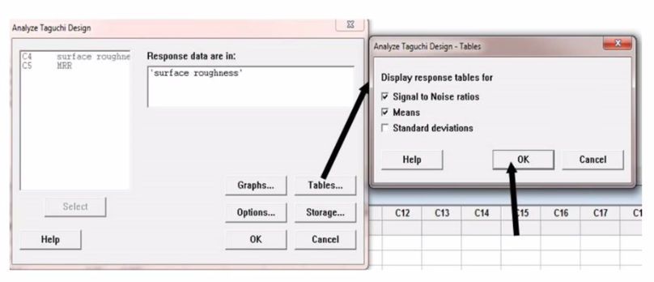

Slide 20
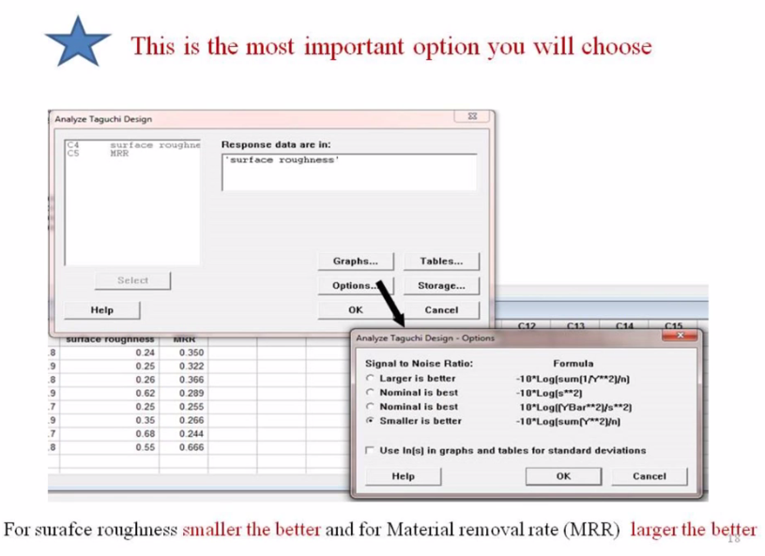

Slide 21
Example
Experimental variable and their levels | Level 1 | Level 2 | Level 3
Spindle speed(rpm) | 250 | 355 | 500
Feed rate(mm/rev) | 0.18 | 0.24 | 0.32
Depth of cut(mm) | 0.5 | 1 | 1.5
Please use Taguchi’s L9 array for this experimental table

Slide 22
Taguchi DOE is a Robust design
Robust design is an engineering methodology for obtaining product and process conditions, which are insensitive to various noise to produce high-quality products with low development and manufacturing costs.
Taguchi’s parameter design is an important tool for robust design.

Slide 23
Insensitivity to Noise
Noise = Factors which the engineer can not or chooses not to control
Unit-to-unit
Manufacturing variations
Aging
Corrosion
UV degradation
wear
Environmental
human interface
temperature
humidity

Slide 24
Taguchi DOE
Dr. Taguchi’s approach has two important areas.
First, he clearly defined a set of Orthogonal Arrays (OAs), each of which can be used for many experimental situations.
Second, he devised a standard method for analysis of the results.
The combination of standard experimental design techniques and analysis methods in the Taguchi approach produces a higher degree of consistency and reproducibility of the predicted performance.

Slide 25
Orthogonal Arrays(OAs)
For designing experiments, Taguchi utilized a special set of tables, called orthogonal arrays (OAs), which represent the smallest fractional factorial experiments
The use of these arrays helps determine the least number of experiments needed for a given set of factors thus reducing the time and cost of experimentation.

Slide 26
Types of OA
There are three types of OAs,
OAs for two-level factors,
OAs for three-level factors
OAs for four-level factors
OAs for mixed-level factors.

Slide 27
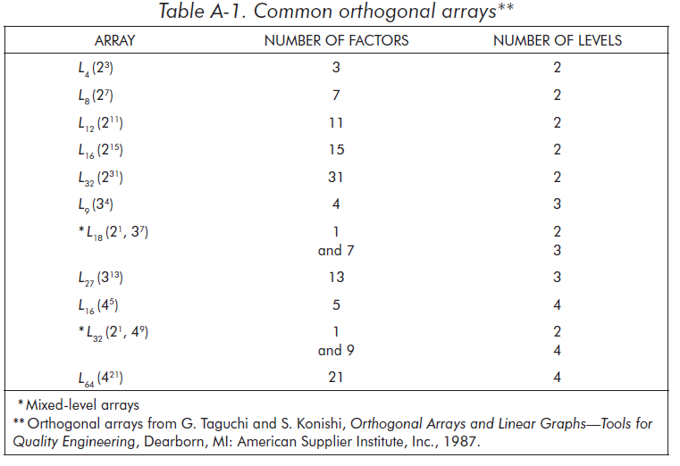
Taguchi Designs

