Slide 1
FLOW EQUIPMENT/Pumps 1087
Pumps
J C Oliveira, University College, Cork, Ireland
Copyright 2002, Elsevier Science Ltd. All Rights Reserved
There is a wide variety of positive displacement pumps, but in general it can be said that they capture a small amount of fluid, cause it to compress in some way, and then deliver the compressed fluid at the outlet. As they deliver a fixed amount of fluid at specific regular intervals, these pumps generally assure a given flow rate, and pressure will be dictated by the piping system and can be estimated by applying Bernoulli's equation.
Centrifugal pumps will obviously cause a sub- stantial amount of kinetic losses due to collisions of molecules with the rotating elements and walls, and between themselves. This can generate a substantial amount of heating and affect thermally sensitive fluids. In addition, the high shearing may also affect molecular networking. Therefore, fluids with del- icate macromolecular structures (for instance, a milk coagulum) should not be run through centrifugal pumps. It also follows that very viscous fluids are not suitable, as heat generation would be substan- tial, and slip is also potentially high (which implies a low pumping efficiency). As a rule of thumb, centrifugal pumps are not generally recommended for fluids with 10 times the viscosity of water or higher. They are obviously not suitable for liquids containing solid particles either. Due to the high velocity of the moving elements, cavitation is a major problem, as it can wear the rotor blades quite extensively and very rapidly (the collapse of a gas bubble when impinging on a moving surface at high speed causes roughly the same type of destruction as the collision with a hard solid particle). In positive displacement pumps, the generation of gas bubbles affects mostly the pumping efficiency, and not so much the actual pump.
On the other hand, centrifugal pumps will deliver a steady flow rate. Positive displacement pumps are more prone to pulses and fluctuations in the flow rate, as the cycle capture-compress-deliver repeats itself. It can also be expected that centrifugal pumps will generally have lower pumping costs, as accelera- tion of a low-viscosity fluid is easy, and pressure is then generated by the slowing-down itself: the energy costs are basically those of accelerating the fluid. Positive displacement pumps must supply the totality of pressure by direct mechanical means, and this can be expected to require generally higher energy levels. However, these are not general rules, as there are very different types of positive displacement pumps. In general, it can also be said that the action of positive displacement pumps can be reversed (inlet and outlet may be swapped), which is totally im-
possible in centrifugal pumps.
Not all pumps will be reviewed in this article, only the more common types.
Introduction
Pumps are small pieces of equipment that promote the circulation of liquids between and through pieces of equipment. When selecting a pump, the main factors to consider are:
The viscosity of the fluid, and whether it is a clear fluid or contains solid particles in suspension.
The sensitivity of the fluid quality characteristics to shearing and viscous shear energy dissipation.
The pumping requirements (pressure, flow rate).
The hygienic requirements of the process (which are high for dairy products).
The cost of the pump and of its maintenance.
The main issues are to ensure that:
The mechanical action of the pump affects the fluid characteristics to the least extent possible.
The pump is operating close to its optimum point.
There is no cavitation (the pressure of the fluid cannot go below its vapour pressure anywhere in the pump).
The mechanical wear of the elements of the pump (moving parts, seals) is not extensive to the point of causing significant loss of pumping efficiency (a preventive maintenance programme would be quite adequate for pumps).
General Classification
Pumps force liquids to flow in one of two ways, which gives rise to the major division between pumps: (1) centrifugal, (2) positive displacement.
Centrifugal pumps have a rotor that rotates at very high speed (thousands of rotations per minute) and accelerates the fluid. As the fluid leaves the rotor, it is suddenly forced to slow down, pressing against the fluid which is already there. By looking at Bernoulli's equation, it is evident that the sudden substantial loss of kinetic energy must correspond to a sudden in- crease in pressure (see eqn [4] in article Flow Equip- ment: Principles of Pump and Piping Calculations). Those that provide particularly accurate flow rates are also called metering pumps. A centrifugal pump does not ensure either a specific flow rate or a specific pressure: both will depend on the piping system after the pump (level differences, head losses, etc.)

Slide 2

















































1088 FLOW EQUIPMENT/Pumps
Centrifugal Pumps
pumps have a static ring between the moving rotor and the casing (usually, with channels having the opposite obliquity to the rotor blades), which pro- vides a further gradual step of conversion from kinetic energy to pressure. Figure 2 illustrates this description schematically.
General Design and Principles of Operation
Figure 1 shows a centrifugal pump, in front and side view. The fluid enters perpendicular to the axis of rotation of the rotor and will leave tangentially in relation to the rotor blades. As the fluid disperses from the centre due to the action of the centrifugal force towards the walls of the rotor casing, it travels in the radial direction through the channel between the blades. It is also accelerated tangentially to the velocity of rotation of the blades. These are con- structed in such a way that the distance between blades increases with the radius - therefore, this channel widens as the fluid moves towards the wall. As the continuity equation shows (see eqn [2] in article Flow Equipment: Principles of Pump and Piping Calculations), the fluid pressure will therefore increase as its kinetic energy decreases, while moving radially between the blades. The fluid then joins the layer moving around the wall towards the exit, pushed by the centrifugal force, which obviously moves slower than the blades, and so the pressure increases again. This layer, close to the casing wall, may also have an increasing flow area as a result of an eccentricity of the axis of the rotor in relation to the centre of the casing - again, the reason for this design is to cause a gradual slow-down and respect- ive pressure increase. This eccentricity, and whether it exists or not, depends on the pump design. At the outlet, another slow-down will occur, as the fluid starts moving at the velocity corresponding to the flow rate through the piping system, and pressure reaches a maximum. The conversion of kinetic energy to pressure is therefore gradual, and it stands to reason that the more gradual it is, the higher the efficiency - a very sudden slow-down implies many collisions between molecules, hence loss of mechan- ical energy, dissipated in the form of heat. Some
Hygienic Requirements
The most obvious hygienic requirement for a cen- trifugal pump is that it should be easy to disassemble, so that every part can be thoroughly cleaned easily. The blades should be rounded to avoid crevices, and therefore hygienic pumps generally have a lower number of blades (see Figure 2).
The pump motor releases a lot of heat, as one would expect from a drive that generates velocities of the order of thousands of rotations per minute. Therefore, the motor casing of normal pumps is corrugated (the higher specific area promotes heat loss). However, this is not satisfactory for hygienic food processing, and food-grade pumps must have a smooth, stainless steel casing. This implies a pump that is built specifically for that, as other means of removing the heat generated by the motor must be improved; if a normal corrugated pump is covered by a smooth casing, it will run the risk of overheating.
Operating Points and Pumping Efficiency
Depending on the piping system to which the pump outlet is connected and on the rotor design and speed, a centrifugal pump will be able to deliver vari- ous flow rates at various pressures. The pump char- acteristic curve indicates all possible operating points of a given pump. Figure 3 shows a typical example. Pump manufacturers usually supply these graphs.
Pumping efficiency is not the same along these curves; it is normally maximum around the top right-hand corner and decreases as one approaches the limits of the curve. Therefore, a pump should
(A)
2
(B)
(C)
Motor
Rotor shaft
Outlet
1
Sharp edges
Figure 2 Rotors of centrifugal pumps. (A) Typical rotor without hygienic design considerations. Note path 1, where the fluid moves towards the wall pushed by the centrifugal force along a channel with increasing cross flow area, thereby increasing pressure; and path 2, where the fluid moves rotationally towards the axis, pushed by the centrifugal force, through a channel of increasing cross flow area due to the eccentricity of the rotor in relation to the casing; (B) rotor encased in a fixed channel distributor; (C) hygienically designed rotor, with smooth edges.
Inlet
SIDE VIEW FRONT VIEW
Figure 1 Front and side view of a centrifugal pump.

Slide 3
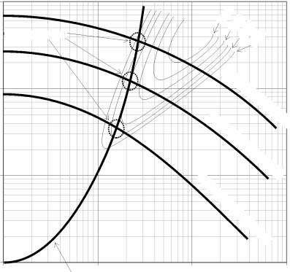
FLOW EQUIPMENT/Pumps 1089
80%
76%
flow rate at a lower pressure than the configuration that gives the maximum flow rate. It should be noted that the characteristic curves of piping systems can be easily modified by operating valves, as they will increase head losses if partially closed. In the example of Figure 3, closing a flow rate control valve would increase head losses and the characteristic curve would be steeper. It would be possible to bring the piping system curve close to the maximum efficiency of the pump only if it would be possible to decrease the head losses.
Possible operating points
72%
70%
Pressure head (m)
Pump configuration 1
Pump configuration 2
Pump configuration 3
Selection of Centrifugal Pumps
In order to select a centrifugal pump, one must know:
The net positive suction head (NPSH) available at the inlet of the pump (see Flow Equipment: Principles of Pump and Piping Calculations).
The characteristics of the system (cross flow areas, level differences, total length of the piping system, localized head losses).
Item (1) is needed only for a verification: the NPSH available must be higher than the NPSH required by the pump chosen, in order to ensure that the vapour pressure is not reached inside the pump, which would cause cavitation and severe wear.
Item (2) is needed so as to apply Bernoulli's equation and determine the characteristic curve of the piping system, from where the operating point and efficiency of the pump can be calculated. The pump, and its operating variables, are chosen that give the maximum efficiency.
Manufacturers may provide graphs that indicate which of their makes/models are generally more suitable depending on pressure head and flow rate required. This helps to narrow choice to pumps that are designed for the type of demand in question. Figure 4 shows a typical example.
Pressure-flow curve for
a given piping system Flow rate (m³ s^{–1})
Figure 3 Typical characteristic curves for a pump in three possible configurations (different rotor design and/or speed), efficiencies and operating points.
Pressure head (m)
type 1
type 3
type 2
type 4
type 5
type 6
type 7
type 10
type 8
type 9
Flow rate (m³ s^{–1})
Figure 4 Typical chart for selection of the type of centrifugal pump better adapted to a given demand.
ideally operate close to the flow rate and pressure combination that gives the maximum efficiency (at the expense of unnecessarily spending more power from the electrical mains to deliver the same amount of energy to the fluid). Lines of constant efficiency are usually drawn on these graphs (see Figure 3).
Checking the operating point of a pump in a given piping system is straightforward. Using Bernoulli's equation, the characteristic curve for the piping system can be constructed by calculating the pressure head at the outlet of a pump for various flow rates. An operating point for a given pump in a given piping system is the intersection of the two charac- teristic curves (pump and piping system). Figure 3 shows a sketch of a situation where the maximum efficiency is achieved with the intermediate pump configuration, that actually delivers a slightly lower
Positive Displacement Pumps
Piston Pumps
General design and principles of operation A typical piston pump, which operates according to a very straightforward principle, is shown in Figure 5. Fluid is admitted to a chamber through the inlet valve, as the piston moves back and sucks the fluid in. The valve closes when the piston reaches its back position and then starts moving forward, compressing the fluid trapped in the chamber. When the specified pressure is reached (for incompressible fluids, this is obviously almost instantaneous), the outlet valve opens and

Slide 4






Piston
Outlet valve
Seal
(Rubber O-ring)
Inlet valve
back to back, so that the piston is actually the same. Figure 6 sketches this design.
Hygienic requirements: diaphragm pumps Piston pumps are not very hygienic because fluid can be trapped in the space between the cylinder side and the chamber wall, at the back (see Figure 5). Dia- phragm pumps were built to solve this problem. The piston is not in direct contact with the fluid, but pushes a rubber diaphragm, which fits totally in the chamber geometry. There are pumps commer- cially available that use compressed air to move the diaphragm.
Figure 7 sketches an example of a single-chamber diaphragm pump. For hygienic design, it would be ideal that the pump expels the totality of the fluid in order to avoid stagnated or dead volumes - the design in Figure 7 shows an example which is par- ticularly poor in this respect.
the fluid is discharged, as the piston expels it while moving forward. When the piston reaches its forward position, the outlet valve closes, the inlet valve opens and the cycle begins again.
A piston pump will therefore deliver a flow rate equal to the volume of the chamber times the number of cycles per unit time. However, it is delivered only when the outlet valve is open, and nothing is deliv- ered during the admission part of the cycle. In order to avoid a pulse in the flow, it is normal to use two chambers with the piston of each moving asynchron- ously, so that when one delivers the other admits and vice versa. Obviously, this can be neatly done by a dual chamber pump, with chambers placed

Slide 5
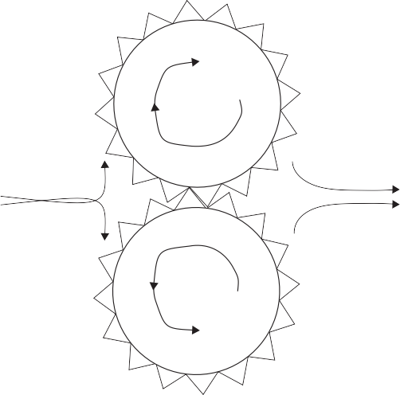
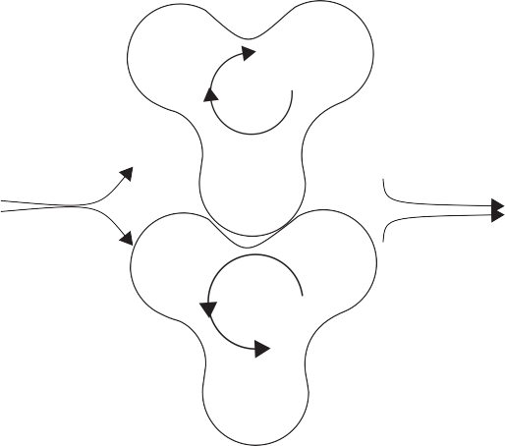
FLOW EQUIPMENT/Pumps 1091
Rotary (Gear) Pumps
General design and principles of operation Rotary pumps are also known as gear pumps. They have two rotors and dented wheels moving in such a way that the dents of one wheel fit snugly inside the other. Thus, the fluid is forced towards the outside wall and must move around. The fluid will be trapped inside chambers formed by two dents and the outside casing and is then forced out at the other side. Figure 8 shows this principle of operation. Rotating speeds are about 100 times lower than those of centrifugal pumps.
These pumps are therefore more similar to cen- trifugal than to piston pumps in the sense that they assure a given flow rate rather than a given pressure: the flow rate is simply given by the volume between each pair of dents and the speed at which this volume is transferred to the other side. Pressure is then given by Bernoulli's equation, as once the flow rate is fixed, the piping system after the pump defines the pressure. Furthermore, while some compression occurs when the fluid is trapped inside the dents, most results from delivering the fluid to the other side and compressing it against the fluid which is already there, a similar situation to that in centrifugal pumps. However, this characteristic makes them the best metering pumps, with the flow rate being quite well controlled, as it is simply proportional to the rotating speed.
fewer dents and therefore fewer points of contact for sealing at the centre. A higher leakage flow between the high-pressure and low-pressure regions through the centre is likely, compared to rotary pumps with more dents and more sealing points.
Single-Rotor (Impeller) Pumps
Single-rotor pumps are also known as impeller pumps. They seem similar to rotary pumps, having only one rotor. However, their operation is quite different, as they can provide mechanical com- pression of the fluid in a much better way than rotary or lobular pumps. The blades are either made of rubber so that they can bend against the casing, or are made of metal, but have a spring at the base, so they can be pushed inwards while moving against the casing. Figure 10 shows both cases.
As the rotor moves, fluid is trapped between two blades. To improve compression, the casing may have a different curvature from the rotor axis, so that the space between them decreases. Therefore, the volume between two blades decreases while the rotor revolves, causing a compression (for relatively incompressible fluids, such as water and milk, this is not so important, while for viscous viscoelastic materials it would be helpful). On reaching the other side, the compressed fluid is expelled. In some pumps with rubber blades, the volume between blades is always the same, and the only compression results from the blades snapping at the inlet and squeezing at the outlet (see Figure 10).
Some fluid will certainly remain and proceed to a second turn - potentially, there could be a problem of stagnant fluid. The blades must therefore be
Hygienic requirements: lobular pumps Rotary pumps such as that shown in Figure 8 are not hygienic because the dents have sharp edges. Thus, lobular pumps have been developed, with well-rounded lobes, such as those shown in Figure 9. The sealing between the counterrotating rotors is obviously less good than in rotary pumps, as the rounded geometry implies
Figure 8 Rotary pump.
Figure 9 Lobular pump with three lobes per rotor.

Slide 6
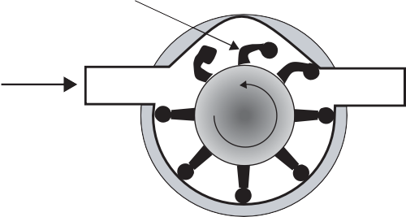
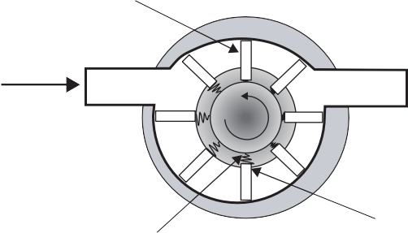
1092 FLOW EQUIPMENT/Pumps
(A)
Rubber blades
Rotor
Inlet
Outlet
Outlet
Inlet
(B)
Steel blades
Stator (rubber casing)
Inlet
Outlet
Figure 11
Progressing cavity pump.
outlet
Spring
Blade retracts pushing against spring
Figure 10 Single-rotor pumps. (A) Pump with rubber blades and no compression in the chambers between blades and outside casing wall; (B) pump with steel blades and with compression caused by decreasing volume between blades.
designed in a way that helps the expulsion at the outlet, which is better achieved with rubber blades.
inlet
Progressing Cavity Pumps
Also known as monopumps, they have a curious design, with a rotating axis that looks like a twisted worm. It is not really a screw, it is more like a twisted bar which rotates against a rubber casing (the stator), that adapts to the movement of the rotor. The rubber casing has a grooved path of a different shape from the rotor curvature, so that at a given position there is a perfect match between grooves of the rubber casing and curved rotor, while a space exists between each two matching points (for instance, the rotor is a single helix and the casing is a double helix). As the rotor revolves, the points of contact appear to move forward. Hence, the fluid is trapped in a chamber formed by the rubber casing grooves and rotor, sealed at the matching points. The curvature of the rotor (and grooves) may show a decreasing amplitude, so as to reduce volume and hence cause compression (particularly helpful for viscoelastic materials). Figure 11 shows this type of pump.
These pumps have a good hygienic design, as all fluid is expelled, there is no need for valves, and there are only rounded edges and surfaces.
Figure 12
Peristaltic pump.
Peristaltic Pumps
Peristaltic pumps require a rubber tube through which the fluid flows. A wheel with rollers moves on top of the rubber tube, so that as the rollers move they squeeze the tube. This gentle squeeze causes a compression and therefore the fluid is trapped be- tween two points of roller compression, forced to move forward and delivered at the outlet. Just like rotary pumps, peristaltic pumps basically deliver a fixed flow rate and most of the compression results from forcing the movement of the fluid. Hence, pressure will depend on the piping system, and it is the flow rate that is fixed by the pump operating characteristics. They can therefore provide good metering (flow rate accuracy and control). Figure 12 shows this design.
These are obviously the most hygienic pumps of all, as there is no contact between pump parts and fluids. They are also the best for solid particles, as particles are not squeezed. The main limitation is that tubes must be relatively small, as it is not viable

Slide 7
FLOW EQUIPMENT/Valves
1093
Table 1
Selection criteria for types of pumps
Type of pump | Good for | Not good for
Centrifugal | Low-viscosity fluids | Viscous fluids
 | Clean fluids | Fluids with solid particles
 | Steady flow rate | Fluids sensitive to heat
 |  | Fluids sensitive to shearing
Piston/diaphragm | Viscous fluids | Fluids with solid particles
 | Clean fluids
 | High pressures
 | Precise pressure control
Rotary/lobular | Viscous fluids | Fluids with solid particles
 | Clean fluids
 | Fluids sensitive to shearing
 | Precise flow rate control
Single-rotor | Viscous fluids | High pressures
 | Fluids with solid particles
 | Fluids sensitive to shearing
Mono | Viscous fluids | High pressures
 | Fluids sensitive to shearing | Fluids with solid particles
Peristaltic | Viscous fluids | High pressures
 | Fluids with solid particles | High flow rates
 | Fluids sensitive to shearing
 | Flow rate control
to compress very large tubes. Flow rate is there- fore more limited than in other pumps. Pumping efficiency is also limited if very large pressures are required. In general, commercial peristaltic pumps can be found for flow rates up to 10 m³ h⁻¹ and pressures up to 1.6 MPa.
Perry R and Chilton C (1984). Perry's Chemical Engineers' Handbook, 6th edn. New York: McGraw-Hill.
Stepanoff AJ (1992). Centrifugal and Axial Flow Pumps:
Theory, Design, and Application. Melbourne, Australia: Krieger Publishing Co.
Wahren U (1997) Practical Introduction to Pumping
Technology: A Basic Guide to Pumps - From Specifica- tion to Installation and Operation. Houston: Gulf Publishing Co.
Walker R (1977) Pump Selection: A Consulting Engineer's Manual. Ann Arbor: Ann Arbor Science Publishers.
Yedidiah S (1996) Centrifugal Pump User's Guidebook:
Problems and Solutions. Dordrecht, The Netherlands: Kluwer.
Summary of Pump Selection Criteria
Table 1 provides an overview of the main selection criteria for pumps. In general practice, centrifugal pumps are used unless the fluid is too viscous, con- tains solid particles, or is too strongly affected by the high shearing and/or internal energy generation.
See also: Flow Equipment: Principles of Pump and Piping Calculations; Valves. Heat Exchangers. Process and Plant Design.
Further Reading
Davidson J (1986) Process Pump Selection: A Systems
Valves
K Cronin and D MacCarthy, University College, Cork, Ireland
Copyright 2002, Elsevier Science Ltd. All Rights Reserved
Approach. Ipswich: Institution of Mechanical Engineers.
Engineering Equipment Users' Association (1972) Guide to the Selection of Rotodynamic Pumps. London: Engineering Equipment Users' Association.
Karassik IJ and Krutzsch WC (1986) Pump Handbook.
New York: McGraw-Hill.
Lobanoff VS and Ross RR (1992). Centrifugal Pumps: Design and Application. Houston: Gulf Publishing Co. McGuire JT (1990) Pumps for Chemical Processing.
New York: Marcel Dekker.
Introduction
Valves are devices for controlling the flow of fluids (liquids and gases), and in some cases granular or powdered materials. This article primarily discusses the valves used in product liquid lines in a dairy

