Slide 1
1346 HOMOGENIZATION OF MILK
Liberti R, Franciosa G, Gianfranceschi M and Aureli P (1996) Effect of combined lysozyme and lipase treatment on the survival of Listeria monocytogenes. International Journal of Food Micrbiology 32: 235-242. Pagan R, Manas P, Alvarez I and Condon S (1999) Resistance of Listeria monocytogenes to ultrasonic waves under pressure at sublethal (manosonication) and lethal (manothermosonication) temperatures. Food
Microbiology 16: 139-148.
Sala FJ, Burgos J, Condon S and Lopez P (1995) Effect of
heat and ultrasound on microorganisms and enzymes. In: Gould GW (ed.) New Methods of Food Preservation, pp. 177-204. New York: Blackie Academic and Professional.
Stadhouders J and Beumer RR (1994) Actual and potential applications of the natural antimicrobial agents of milk in the dairy industry. In: Proceedings of the Interna- tional Dairy Federation Seminar on Indigenous Anti- microbial Agents of Milk: Recent Developments, Document no. 9404, pp. 175-197, Brussels: IDF.
Villamiel M and de Jong P (2000) Influence of high intensity
ultrasound and heat treatment in continuous flow on fat, proteins and native enzymes of milk. Journal of Agri- cultural and Food Chemistry 48: 472-478.
Wandling LR, Sheldon BW and Foegeding PM (1999) Nisin in milk sensitizes Bacillus spores to heat and prevents recovery of survivors. Journal of Food Protection 62: 492-498.
Heifer Rearing and Management see Replacement Management, Cattle: Growth Standards and Nutrient Requirements; Preruminant Diets and Weaning Practices; Growth Diets; Health Management; Breeding Standards and Pregnancy Management.
High-Pressure Processing of Milk see Heat Treatment, Alternatives to: High-Pressure Processing.
HOMOGENIZATION OF MILK
R A Wilbey, University of Reading, Reading, UK
Copyright 2002, Elsevier Science Ltd. All Rights Reserved
velocity, v, of the globule may be expressed as:
v ex
d²(p_{s} - p_{f})
181
and where: d = diameter of the fat globule, p_{s} = density of the milk serum, p_{f} = density of milk fat, 1 = viscosity of milk serum. Those fat globules less than 1 µm will tend to stay in suspension as Brownian motion will have a significant effect in disturbing flotation. However, the presence of cryoglobulins in raw bovine milk will bring about agglomeration of fat globules and hasten creaming. At temperature-time combinations in excess of minimum high-temperature short-time (HTST) pasteurization, the cryoglobulins are denatured
Introduction
Bovine milk contains approximately 4% fat, dispersed as globules enclosed by a milk fat globule membrane (MFGM). These globules vary in size from less than 1 µm to over 10 µm, with a mean of ap- proximately 3-4 µm. Since the milk fat is less dense than milk serum, the fat globules will tend to rise and form a cream layer on top of the milk. This flotation follows Stokes's law, where the rising

Slide 2
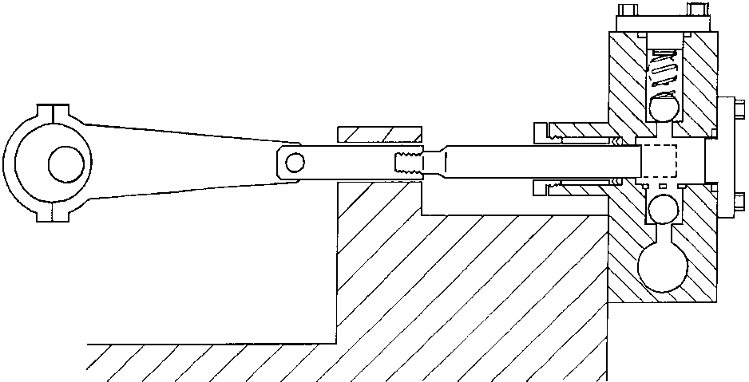
HOMOGENIZATION OF MILK 1347
and the creaming rate in the resulting product is reduced.
The effects of shear forces on milk include disrup- tion of fat globules. The MFGM may not be able to reform immediately, with the result that some fat may be lost as free fat which will promote ag- gregation of fat globules and accelerate creaming. In some instances, the damage to fat globules may be so severe that a plug of agglomerated fat globules will form in containers of pasteurized milk. If the milk is subjected to high shear at a temperature above the melting point of the fat, then the fat globules may be broken into smaller particles, stabilized by a new interfacial membrane, to give a homogenized milk that does not exhibit creaming, i.e. the milk remains homogeneous.
Design of Homogenizers
Most milk homogenization is carried out using high- pressure homogenizers, the invention being attributed to Auguste Gaulin, whose first patent was granted in 1899. Modern high-pressure homogenizers have developed the principles introduced by Gaulin to give better hygiene and higher efficiency (Figure 1). The equipment consists of a piston pump to generate the high pressure that is used as the driving force and a homogenizing valve or valves.
Homogenizer Pump
The pump is usually a triplex design, sometimes with five or seven pistons, operating consecutively to ensure the generation of a steady driving pressure. Single piston pumps generate a pulsating output with fluctuating pressure that is difficult to damp. The pump block should be of stainless steel con- struction, possibly with some components made of ceramic materials.
The milk should be fed to the homogenizer from a preheater at a low pressure. This milk enters the inlet manifold, from which it may be drawn up into each of the pumping chambers. A tubular sieve is often placed in the inlet mani- fold to prevent foreign bodies from entering the pumping chamber. The valves used for milk have mainly been of a poppet design with relatively large contact surfaces; this ensures that a close-fitting seal can be made under optimal conditions. Some- times, the homogenizer may be fitted with ball valves, which can exert a greater pressure on the much smaller seal area and are particularly appro- priate for very high pressure applications, suspen- sions with small particles or where higher viscosity media are to be processed. A mushroom valve has been introduced by Tetra Pak, seeking to combine the advantages of the poppet and ball valves. On the pumping strokes, the liquid is forced past a second set of valves, usually spring-loaded to
Principle of Homogenization
The basic principle of homogenization is to subject the milk fat globule to sufficiently severe conditions to disrupt it and then maintain the new globules in dispersion while a replacement MFGM is formed at the fat-serum interface. These conditions are attributed to a combination of factors:
Shear results from the flow of the milk over the surfaces in the homogenizing device. Velocities of 200-300 m s⁻¹ may be achieved through a 100 µm gap. The shear between the fat globule and the surface will be complemented by the wire-drawing effect as the fat globule is accelerated, the globule becoming progressively less stable as it elongates.
Turbulence results from the high velocity of the milk serum, the eddy currents adding to the shear effects. Impacts between milk fat globules are increased, causing disruption.
High-frequency vibrations (>10 kHz) may be generated mechanically or induced as a result of the flow pattern or be a result of cavitation. These shock waves, which may be >100 MPa in intensity, will disrupt fat globules.
Impact may provide an additional shock force
in some equipment, where a high velocity jet of milk leaving the homogenizing valve at 200-300 m s⁻¹ strikes a perpendicular surface.
The extent to which each of these factors contributes to the homogenizing process will depend on the particular equipment being used.
Homogenization should normally be carried out at a temperature above the melting point of the fat to ensure that the fat has the mobility to form new globules. High temperatures will increase the likelihood of cavitation contributing to the homo- genization process.
Figure 1 General arrangement of a high-pressure homogenizer. (Courtesy of the Society of Dairy Technology.)

Slide 3
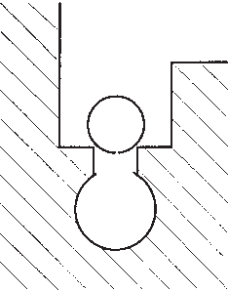
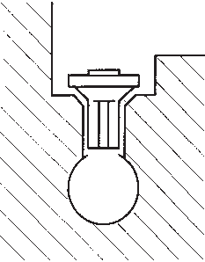
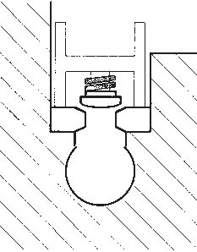
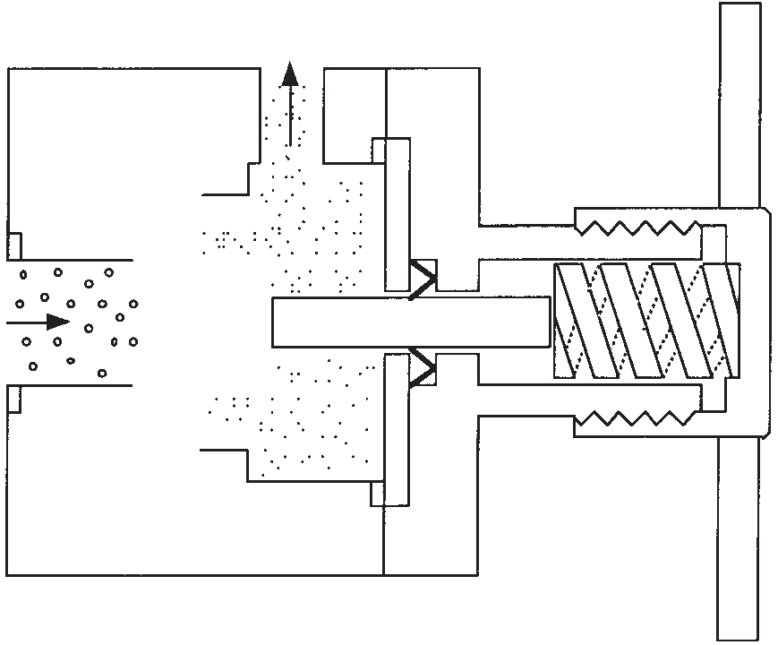
1348 HOMOGENIZATION OF MILK
(A) (B) (C)
Figure 2 Inlet valve types used in high-pressure homo- genizers: (A) ball, (B) poppet and (C) mushroom.
assist rapid closure, into a high-pressure manifold (Figure 2).
The pump pistons have been a source of problems since they need to move through seals that must be capable of resisting both high pressure and microbial colonization. Pressures of up to 20 MPa are common for milk homogenization but may be up to 30 MPa for other dairy applications. In most homogenizers, chevron seals made from relatively soft composite materials are used, held in place by a threaded sleeve so that wear can be taken up and leakage minimized. Piston movement must be sufficient to ensure that the seals are wetted by the cleaning and disinfecting agents. A fine water feed onto the pistons provides lubrication and reduces wear; in hard water areas, care must be taken to avoid a build-up of water scale. Where aseptic pro- cessing is required, the water lubrication must be replaced by a steam box or equivalent disinfection system.
Figure 3 Section through single stage Gaulin-type homogenizing valve assembly.
(A)
(B)
(C)
(D)
Figure 4 Part sections of homogenizing valves: (A) Gaulin,
(B) Gaulin Micro-Gap, (C) Tetra Alex and (D) Rannie Liquid Whirling.
are more likely to occur if homogenizing at an elevated temperature (>65 ºC). The high-velocity jet then impinges on a perpendicular impact ring to inflict a further mechanical shock on the fat globules. The severity of the process conditions can be demon- strated by inspection; worn valves exhibit one or more concentric rings eroded by the turbulence and possibly by cavitation while the impact rings may exhibit an eroded ring. This wear occurs despite their construction from extremely tough and corrosion- resistant materials such as stellite, tungsten carbide or ceramics. Any valve parts exhibiting these fea- tures should be replaced as their efficiency will have declined.
The original MFGM is not sufficient to cover the greater surface area of the newly homogenized fat globules. Proteins, predominantly casein micelles, migrate from the milk serum to form a new composite membrane with the existing MFGM. Some aggrega- tion may occur as the new membrane is formed, attributable to some hydrophobic interaction and the sharing of casein micelles between fat globules. These agglomerated globules would have a larger equivalent diameter and cream more rapidly, thus frustrating the objective of homogenization. The introduction of a second homogenizing step at a
Homogenizing Valve Assembly
Whereas the various pump designs are essentially similar, there is a great variety of homogenizing valves and many conflicting claims for their effi- ciency. Of these, the Gaulin type of valve (Figures 3 and 4A) is still widely used and provides a good model.
Well-mixed liquid at a high pressure enters the centre of the valve seat and is accelerated as it passes into the constriction between the fixed and adjust- able faces of the valve. The gap is maintained against the pressure of the feed by a counter force from either an adjustable heavy-duty spring, torsion bar, hydraulic actuator or a simple screw mechan- ism, the latter being the least favoured as it will not compensate for changes in feed or temperature. Liquid passing across the valve at 200-300 m s⁻¹ will drop in pressure and that pressure may be so low as to drop below the saturation vapour pressure and permit microscopic steam bubbles to form for a few microseconds before collapsing and setting up highly disruptive shock waves. These conditions

Slide 4
HOMOGENIZATION OF MILK 1349
lower pressure drop, about 10% of the primary homogenization pressure or up to 3.5 MPa, will overcome the problem by disrupting these agglom- erates and enable a stable, fine dispersion to be achieved. As well as reducing the mean particle size, the particle size range should be reduced too.
The quest for reduced energy expenditure has led to a wide range of homogenising valve develop- ments. The Rannie Liquid Whirling Valve (Figure 40) uses a series of concentric rings within the valve to create a multistage effect within a single valve, while the Gaulin Micro-Gap homogenizing valve assembly (Figure 4B) splits the flow between a series of rings with a knife-edge across the flow to achieve up to a 40% reduction in pressure for a given particle size in the product. The Tetra Alex valve uses a different configuration (Figure 4C) plus a larger diameter to give up to 30% reduction in energy consumption at pressures up to 20 MPa.
Sometimes, fluctuation will be noticed in the pressure gauge reading. This is seldom due to a fault in the pressure gauge but primarily results from leakage across one or more valves in the homogen- izer pump. This leakage may be due to poor seating, particularly with worn poppet valves, but may be the result of a build-up of particles, e.g. incompletely dispersed stabilizer, on the face of the valve.
Raw milk contains lipoprotein lipase, which will attack damaged milk fat globules, liberating free fatty acids and thus generating off-flavours. Hom- ogenization, by both modifying and increasing the surface area of fat globules, will increase the sus- ceptibility of homogenized milk to lipolysis. Fortu- nately, lipoprotein lipase is heat labile and its effects on the homogenized fat globule can be avoided by heat treatment before or immediately after homogenization.
Upstream homogenization immediately followed by heat treatment avoids microbial hazards asso- ciated with seal problems in homogenizers. Occa- sionally, downstream homogenization is desired, either to minimize shear damage to the product or to avoid thermal stability problems associated with homogenized fat globules. The latter may be a problem with some UHT-treated products and in this case it is essential that the machine be built for aseptic use (see Heat Stability of Milk).
Whereas one homogenization process, whether single or two-stage, is normally sufficient to produce a stable dispersion, a yet finer dispersion with a narrower size distribution range may be achieved by running two high-pressure homogenizers in series. This approach may be used in the produc- tion of cream liqueurs where the product must remain stable at room temperature.
Applications and Significance
High-pressure homogenizers are the main method used for the commercial homogenization of milks. With pasteurized milks, the homogenization step may be regarded as an option, increasingly desirable as longer shelf-lives are achieved.
In the case of semiskim milk, containing 1.5-1.8% milk fat, the advantages of homogenization are as follows: (1) a slight increase in the perceived creami- ness compared to the unhomogenized prod- uct, (2) absence of creaming, which the consumer is likely to view as detrimental in a product chosen for its lower fat content, and (3) stabilization of an emulsion that might have been damaged during the general handling, separation and standardiza- tion processes.
With whole milk, the advantages of homogeniza- tion are not so clear cut, since there is already suf- ficient creaminess from the natural fat content, typically about 4% but which may exceed 5% in the case of Channel Island milk. In one milk product, 'Breakfast Milk', high-fat milk is homogenized so that the richness may be appreciated without the fat content being so apparent.
With the continuing concentration of milk pro- cessing into fewer much larger units there is greater potential for damage to the MFGM from excessive shear. One manifestation of this problem is the formation of cream plug in whole milk, which is most evident in bottled milks, both glass and plastic. While the problem could be avoided by correct sizing of pumps, pipes and valves, the symptoms could be alleviated by homogenization.
See also: Heat Stability of Milk. Lipids: Fat Globules in Milk; Milk Fat Globule Membrane.
Further Reading
Fox PF and McSweeney PLM (1998) Dairy Chemistry and Biochemistry. London: Blackie Academic and Professional.
McClements DJ (1999) Food Emulsions: Principles, Practice and Techniques. Boca Raton: CRC Press.
Phipps LW (1985) The High Pressure Dairy Homogenizer. Reading: National Institute for Research in Dairying.
Walstra P (1985) Formation of emulsions. In Becher P
(ed.) Encyclopaedia of Emulsion Technology, vol. 1, pp. 57-127. New York: Marcel Dekker.
Walstra P and Jenness R (1984) Dairy Chemistry and Physics. Chichester: Wiley-Interscience.

