Slide 1
Quantitative Methods for Energy Studies
1. Review of Probability and Statistics
May, 2019

Slide 2
Statistics
Probability and statistics for Engineering and the sciences by Jay L. Devore
&
Experimental Methods for Engineers by Holman 8th Edition
Populations, Samples, and Processes
  Engineers and scientists are constantly exposed to collections of facts, or data, both in their professional capacities and in everyday activities. The discipline of statistics provides methods for organizing and summarizing data and for drawing conclusions based on information contained in the data.

Slide 3
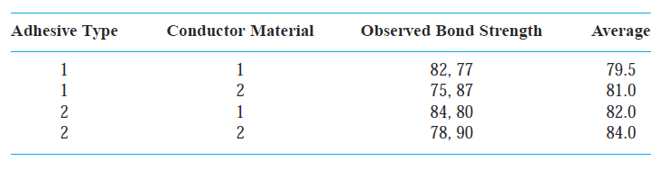
An engineer wishes to investigate the effects of both adhesive type and conductor material on bond strength when mounting an integrated circuit (IC) on a certain substrate. Two adhesive types and two conductor materials are under consideration. Two observations are made for each adhesive-type/conductor-material combination, resulting in the accompanying data:

Slide 4
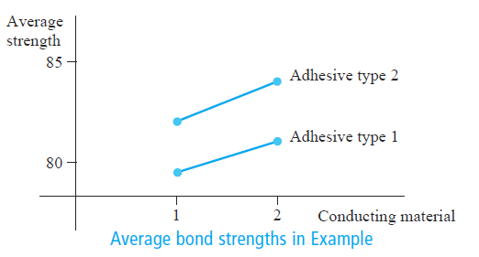
The resulting average bond strengths are pictured in the figure below. It appears that adhesive type 2 improves bond strength as compared with type 1 by about the same amount whichever one of the conducting materials is used, with the 2 × 2 combination being best.
Inferential methods can again be used to judge whether these effects are real or simply due to chance variation.

Slide 5
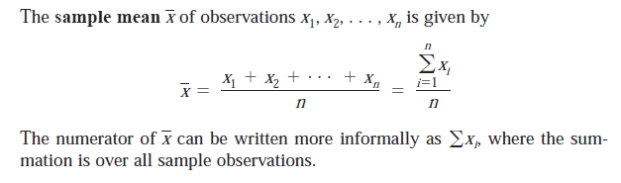
The Mean
  For a given set of numbers x₁, x₂, x₃, … x_{n}, the most familiar and useful measure of the center is the mean, or arithmetic average of the set. Because we will almost always think of the x_{i}‘s as constituting a sample, we will often refer to the arithmetic average as the sample mean and denote it by x̄.
  With a large sample a frequency distribution of the individual x_{i}’s can be used to save time.
  If a particular value of x_{i} occurs in the sample f_{j} times, the mean value can be determined as
  The sample frequency f_{j}/n is an estimate of the probability P_{j} that x has the value of x_{j} in this population sample.

Slide 6
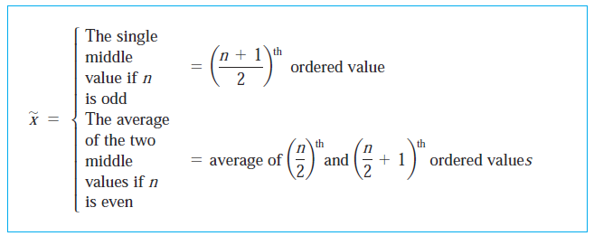
The Median
  The word median is synonymous with “middle,” and the sample median is indeed the middle value once the observations are ordered from smallest to largest. When the observations are denoted by x₁, x₂, x₃, … x_{n}, we will use the symbol x̃ to represent the sample median.
  The sample median is obtained by first ordering the n observations from smallest to largest (with any repeated values included so that every sample observation appears in the ordered list). Then,

Slide 7
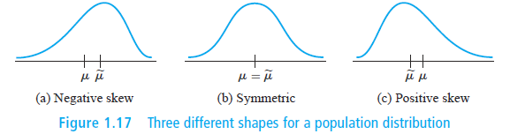
  Three different shapes for a population distribution (Population mean and medium)
The population mean and median will not generally (cecessarily) be identical.

Slide 8
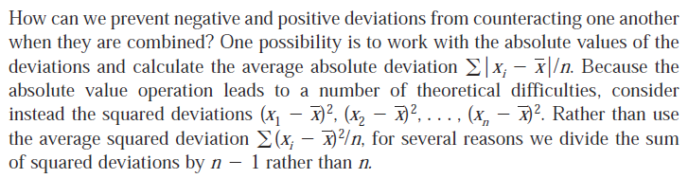
Measures of Variability
For example the mean deviation of all the readings from the mean reading is a good indicator of the uncertainty of the instrument. But unfortunately this value is zero.
The sum square deviation for mean: sample variance and sample standard deviation

Slide 9
σ is called the population or biased standard deviation.
σ² is the variance.
Using the probability distribution P_{j} and noting that P_{j}=f_{j}/n
  For most distributions (both real and theoretical) met in statistical work, more than 94% of all observations in the population are with in the interval

Slide 10
For data collected below 20 we speak of unbiased or sample standard deviation.
  Statisticians designate it by s given by
Sometimes the investigator is interested in estimating the proportion of the data whose values exceed some stated level or fall short of the level.
  As an example for the random number, the cumulative frequency distribution for drawing digits less than 3 is 0.75 and the cumulative frequency distribution for drawing digits >= 3 is 0.25.

Slide 11
Example
The Web site “www.fueleconomy.gov” contains a wealth of information about fuel characteristics of various vehicles. In addition to EPA mileage ratings, there are many vehicles for which users have reported their own values of fuel efficiency (mpg) (miles per gallon). Consider the following sample of 11 (n=11) efficiencies for the 2009 Ford Focus equipped with an automatic transmission (for this model, EPA reports an overall rating of 27 mpg – 24 mpg for city driving and 33 mpg for highway driving):

Slide 12
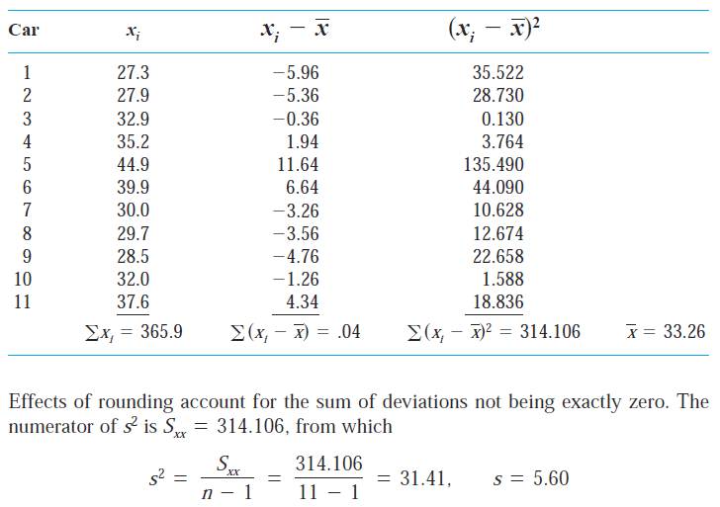

Slide 13
The size of a representative deviation from the sample mean 33.26 is roughly 5.6 mpg. Note:of the nine people who also reported driving behavior, only three did more than 80% of their driving in highway mode; we bet you can guess which cars they drove. We haven't a clue why all 11 reported values exceed the EPA figure - may be only drivers with really good fuel efficiencies communicate their results.

Slide 14
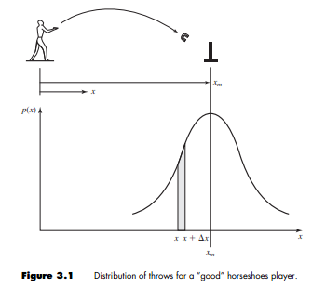
Example:
Suppose we toss a horseshoe some distance x.
  Even though we make an effort to toss the horseshoe the same distance each time, we would not always meet with success.
  On the ﬁrst toss the horseshoe might travel a distance x₁, on the second toss a distance of x₂, and so forth. If one is a good player of the game, there would be more tosses which have an x distance equal to that of the objective. Also, we would expect fewer and fewer tosses for those x distances which are farther and farther away from the target. For a large number of tosses the probability that it will travel a distance is obtained by dividing the number traveling this distance by the total number of tosses.
  Since each x distance will vary somewhat from other x distances, we might and it advantageous to calculate the probability of a toss landing in a certain increment of x between x and x +x. When this calculation is made, we might get something like the situation shown in the following figure For a good player the maximum probability is expected to surround the distance xm designating the position of the target.

Slide 15
Probability
Jay L. Devore
The term probability refers to the study of randomness and uncertainty. In any situation in which one of a number of possible outcomes may occur, the discipline of probability provides methods for quantifying the chances, or likelihoods, associated with the various outcomes.

Slide 16
Sample Spaces and Events
  An experiment is any activity or process whose outcome is subject to uncertainty.
  Although the word experiment generally suggests a planned or carefully controlled laboratory testing situation, we use it here in a much wider sense. Thus experiments that may be of interest include tossing a coin once or several times, selecting a card or cards from a deck, weighing a loaf of bread, ascertaining the commuting time from home to work on a particular morning, obtaining blood types from a group of individuals, or measuring the compressive strengths of different steel beams.

Slide 17
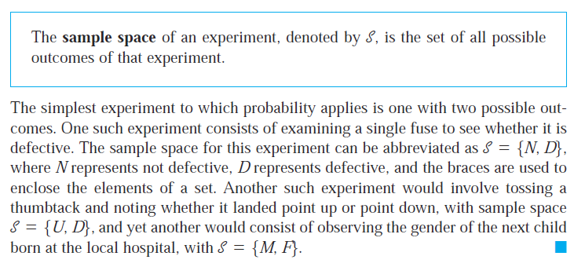
Sample Space: Set of all possible outcomes

Slide 18
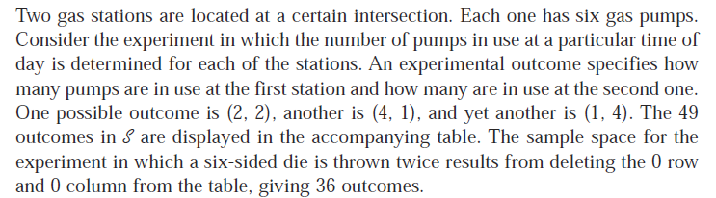
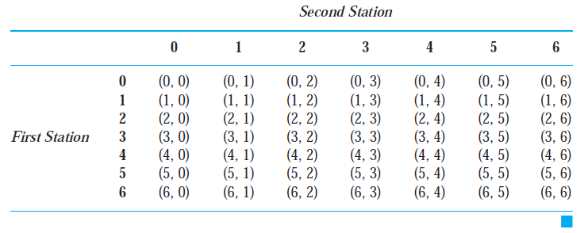

Slide 19
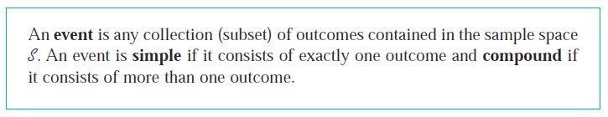
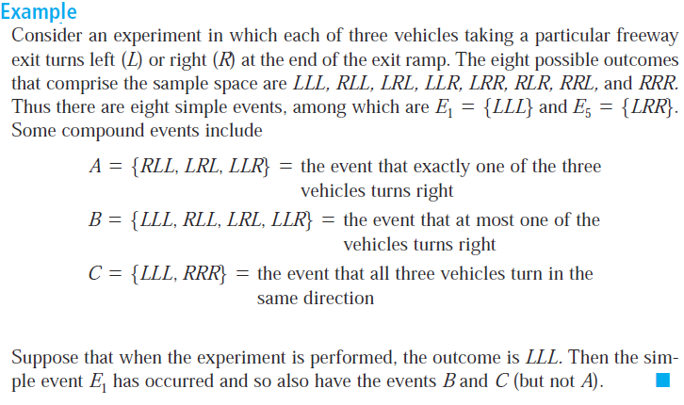
Event

Slide 20
Example
When the number of pumps in use at each of two six-pump gas stations is observed, there are 49 possible outcomes,
So there are 49 simple events:
E₁= {(0,0)}, E₂ = {(0,1)}, ... , E₄₉= {(6,6)}
Examples of compound events are

Slide 21
Some Relations from Set Theory

Slide 22
Assignment
  page 54 excerside 2 and 3

Slide 24
Permutations and Combinations
For example, that a college of engineering has seven departments, which we denote by a, b, c, d, e, f, and g. Each department has one representative on the college’s student council. From these seven representatives, one is to be chosen chair, another is to be selected vice-chair, and a third will be secretary.
How many ways are there to select the three officers? That is, how many permutations of size 3 can be formed from the 7 representatives?

Slide 26
Combinations

Slide 27
Conditional Probability

Slide 29
The Binomial Distribution
In many statistical analysis, the samples may consist of only two kinds of elements; odd or even, pass or fail, male or female, infested or free, dead or alive, etc.
  The investigators interest is in the proportion, the percentage, or the number of data in one of the two classes.
The head and tail case of a coin throw is very typical in this respect.
  The chances of having a head or a tail in one throw is 50% if the coin is not weighted. In other words the frequency of occurrence is the same for both heads and tails.

Slide 30
  Supposing we toss the same coin twice or toss two coins once, the outcomes could be any of the following:
HH HT TH TT
½ x ½ ½ x ½ ½ x ½ ½ x ½
¼ ¼ ¼ ¼
  The chance of getting one H and one T is (¼ + ¼)= ½
  Sum of probabilities is ¼+ ½+¼=1
  For three throws, there will be 8 outcomes
HHH HHT HTT HTH TTH THT THH TTT
  Each occurrence has a chance of (½ x ½ x ½ =⅛ )

Slide 31
3H- only one → gives the chance of ⅛
2H and 1T-3 of them → gives ⅜
2T and 1H-3 of them → gives ⅜
3T- only one → gives ⅛
  The sum of the probabilities is ⅛+ ⅜ + ⅜ +⅛ = 1
  To generalize, if the outcomes are successes (S) and failures (F) with probability of success being (p) and that of failure (q) where (p+q=1), for a sample size of N=2 and N=3, the probabilities of each category of occurrence is the binomial expansion result.
  Each of the success (events) can be determined from
  where n is the number of success.

Slide 32
The other part is the number of mutually exclusive ways in which the n successes and the (N-n) failures can be arranged.
  Statistically this term is called the number of combinations of n letters out of N letters which is given by
  Binomial distribution gives the number of successes n out of N possible independent events when each event has a probability of success p. The probability that n events will succeed is given by
  Since the right one is a binomial expansion expression, the distribution is called the binomial distribution.

Slide 33
The mean of the binomial distribution is to be worked out for events of 0 and 1 designated by x_{j}.
33

Slide 34
One may verify that the complete population lies inside the limits if 0.2<p<0.8. At p=0.21, σ=0.407 and are
(-0.604,1.024)which contains both x_{j}=0 nd x_{j}=1.
  As N becomes large the calculation of the probability becomes cumbersome. The limit of the binomial distribution as N→∞ and p→0, such that
  Np=a=const is called the Poisson distribution and is given by
  & the standard deviation of the Poisson distribution is

Slide 35
3.2.2 The Gaussian or Normal Error Distribution
When experiments are made measurements will always have random errors
  which may make the final reading either too large or too small, depending on many circumstances which are unknown to us.
Assuming there are many small errors contributing to the final error having equal magnitude and equally likely to be positive or negative.
the probability that the measurement will lie between x and x + dx is written as.

Slide 36
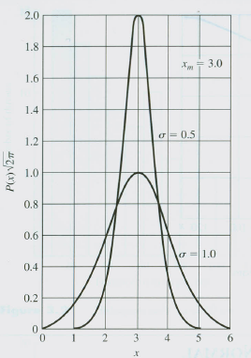
  P(x) is called the Gaussian or normal error distribution and sometimes also called the probability density function.
  The figure is fixing x_{m}=3 at σ=0.5 and 1.0.

Slide 37
The probability density function has the property
The most probable reading is x_{m}.
  The value of the maximum probability density function is
  The standard deviation is a measure of the width of the distribution curve about the mean. Smaller σ produces larger value of the maximum probability and for a measurement this tends to go to more precision. Also the width of the distribution is reduced.
37

Slide 38
The probability that a measurement will fall within a certain range x₁ of the mean reading is given by
Making the variable substitution
  And the resulting Gaussian distribution becomes
  η goes by the name standard normal variate.
Gaussian normal error function is
and the integration values are given in tables

Slide 39
Confidence Interval - Z
Z -expresses the probability that the mean value will lie within a certain number of σ values. Thus
  This will enable to determine the % confidence level.
  Example: for a confidence interval of say 2.57, the mean value is to lie (x_{m}- 2.57σ) < x_{m} <(x_{m}+ 2.57σ). From tables for η=2.57, the area enclosed (probability) on both sides is 2x0.49492=0.98984 ≈ 0.99 . So the confidence level = 99%.
Level of significance = 100% - confidence level =1.0%
  For small data samples zσ should be replaced by

Slide 40
Chauvenet’s Criterion
Chauvenet’s criterion - to eliminate inconsistent data
When measurements are made it is possible that due to gross experimental blunder, measurements can go astray.
  The data thus collected can convey wrong information about the experimental measurement.
The criterion for rejecting is given in the following table.

Slide 41
3.2.3 Probability Graph Paper
If the distribution of random errors is not normal, then Chauvenet criterion ( an elimination technique) will not apply.
It is to our advantage, therefore, to determine if the data are following a normal distribution before making too many conclusions about the mean value, variances, and so forth.
Specially constructed probability graph paper is available for this purpose and may be purchased from a technical drawing shop. The paper uses the coordinate system shown in figure.
If the data follows the Gaussian distribution then the required information such as the probabilities can be determined by using the information already given.

Slide 42
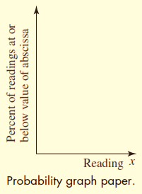
  The ordinate has the percent of readings at or below the value of the abscissa, and the abscissa is the value of a particular reading.
  The ordinate spacings are arranged so that the Gaussian-distribution curve will plot as a straight line on the graph.
  In addition, this straight line will intersect the 50 percent ordinate at an abscissa equal to the arithmetic mean of the data.

Slide 43
The Chi-square Test of Goodness of Fit _ χ²
Other quantitative method of deciding whether data are close to Gaussian or other expected distribution involves the chi-square (χ²) goodness of fit given by
  n = number of cells or group of observations
  This check may be applied to check the validity of various distributions.
  Values are given in the table for different degrees of freedom F given by
F = n – k

Slide 44
  where k is the number of imposed conditions on the expected distribution.
  Table gives the probability P that this value of χ² or higher value could occur by chance.
  A rule of thumb is that if P lies between 0.1 and 0.9, the observed distribution may be considered to follow the assumed or expected distribution.

Slide 45
Standard Deviation of the Mean
The arithmetic mean value of data will be more acceptable if the mean value of the arithmetic means values of sets of data is determined. Statistical analysis shows that the standard deviation of the mean can be determined from one set of measurement using the following relation.
σ_{m} = standard deviation of the mean value
σ = standard deviation of the set of measurements
n = number of measurements in the set

Slide 46
Student’s t-distribution
The relation used for standard deviation of the mean used earlier has been found to be unreliable when n<10.
  A better method for estimating confidence intervals was developed by Student by introducing the variable t such that
  where t is given in tabular form provided we know
  ν =n-1 Degrees of freedom.
  When n→∞ the distribution function approaches the normal distribution.

Slide 47
Assignment
Expermental Methods for Engineers 8th Edition, J.P., Holman
Starting from page 144
Review Questions
  3.6
  3.7
  3.10
  3.11
Problems
  3.1
  3.6
  3.11
  3.23

