Slide 1
Quantitative Methods for Energy Studies
5. Decision Making with Uncertainity
May 2019

Slide 2
Contentas
Decision making under uncertainty
  Expected utility
  Utility theory and rationality
  Utility functions
  Multiattribute utility functions
  Preference structures
  Decision networks
  Value of information

Slide 3
Non-deterministic vs. Probabilistic Uncertainty
?
?
a
b
c
a
b
c
{a,b,c}
decision that is
best for worst case
{a(pa),b(pb),c(pc)}
decision that maximizes
expected utility value
Non-deterministic model
Probabilistic model
~ Adversarial search

Slide 4
Expected Utility
Random variable X with n values x₁,…,x_{n} and distribution (p₁,…,p_{n})
  X is the outcome of performing action A (i.e., the state reached after A is taken)
Function U of X
  U is a mapping from states to numerical utilities (values)
    = Probability of each outcome × Utility of each outcome
The expected utility of performing action A is
EU[A] = S_{i=1,…,n} p(x_{i}|A)U(x_{i})

Slide 5
One State/One Action Example0
s0
U(S0) = 100 x 0.2 + 50 x 0.7 + 70 x 0.1
= 20 + 35 + 7
= 62
A1
s1
s2
s3
0.2
0.7
0.1
100
50
70

Slide 6
One State/Two Actions Example
s0
U1(S0) = 62
U2(S0) = 74
U(S0) = max{U1(S0),U2(S0)}
= 74
A1
A2
s1
s2
s3
s4
0.2
0.7
0.2
0.1
0.8
100
50
70
80

Slide 7
Introducing Action Costs
s0
U1(S0) = 62 – 5 = 57
U2(S0) = 74 – 25 = 49
U(S0) = max{U1(S0),U2(S0)}
= 57
A1
A2
-5
-25
s1
s2
s3
s4
0.2
0.7
0.2
0.1
0.8
100
50
70
80

Slide 8
MEU Principle
Decision theory: A rational agent should choose the action that maximizes the agent’s expected utility
Maximizing expected utility (MEU) is a normative criterion for rational choices of actions
….too bad it’s intractable, even if we could represent utility functions and probabilistic outcomes perfectly…

Slide 9
Must have complete model of:
  Actions
  Utilities
  States
Even if you have a complete model, will be computationally intractable
In fact, a truly rational agent takes into account the utility of reasoning as well: This is called bounded rationality
Nevertheless, great progress has been made in this area recently, and we are able to solve much more complex decision theoretic problems than ever before

Slide 10
Comparing outcomes
Which is better:
A = Being rich and sunbathing where it’s warm
B = Being rich and sunbathing where it’s cool
C = Being poor and sunbathing where it’s warm
D = Being poor and sunbathing where it’s cool
Multiattribute utility theory
  A clearly dominates B: A > B. A > C. C > D. A > D. What about B vs. C?
  Simplest case: Additive value function (just add the individual attribute utilities)
Lottery: General model for assessing the relative preference between outcomes
L =[p1, C1 ; p2, C2 ; … ; pn, Cn]
is a lottery with possible outcomes C1…Cn that occur with probabilities p1…pn
Which is better:
[.5, A ; .5, B] You go to Ocean City and it might be warm
[.6, C, .4, D] You go to Bermuda and it will probably be warm

Slide 11
Axioms of utility theory
(properties of utility functions)
Orderability: Given two states, one or the other should be better, or the agent can not care.
Transitivity: If A is better than B and B is better than C, then A is better than C.
Continuity: If A is better than B and B is better than C, then you can “interpolate” A and C with some probability p to get an outcome that’s equally desirable to B:
  ∃ p: [p, A ; 1-p, C] == B

Slide 12
Substitutability: If you are indifferent between A and B, then you can substitute A for B in any lottery and the results will be the same.
Monotonicity: If A is better than B, then a lottery that differs only in assigning higher probability to A is better:
  p ≥q ↔ [p, A; 1-p, B] ≥ [q, A; 1-q, B]
Decomposability: Compound lotteries can be reduced using the laws of probability (“no fun in gambling” – you don’t care whether you gamble once or twice, as long as the results are the same)

Slide 13
Some notes on utility
Money <> utility
  Empirically, money typically converts logarithmically to utility
Attitudes towards risk vary:
Ordinal utility function: Gives relative rankings, but not numerical utilities
Ascetic
Risk-averse
Risk-seeking
Risk-neutral
“Money can’t buy happiness”

Slide 14
Decision networks
Extend Bayes nets to handle actions and utilities
  a.k.a. influence diagrams
Make use of Bayes net inference
Useful application: Value of Information

Slide 15
Decision network representation
Chance nodes: random variables, as in Bayes nets
Decision nodes: actions that decision maker can take
Utility/Value nodes: the utility of the outcome state.

Slide 16
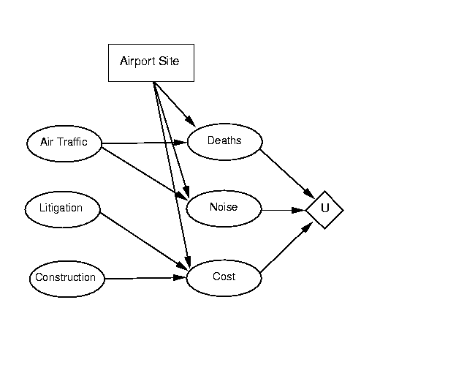
R&N example

Slide 17
Evaluating decision networks
Set the evidence variables for the current state.
For each possible value of the decision node (assume just one):
  Set the decision node to that value.
  Calculate the posterior probabilities for the parent nodes of the utility node, using BN inference.
  Calculate the resulting utility for the action.
Return the action with the highest utility.

Slide 18
Exercise: Umbrella network
take/don’t take
P(rain) = 0.4
Umbrella
Weather
Lug umbrella
P(lug|take) = 1.0
P(~lug|~take)=1.0
Forecast
Happiness
f w p(f|w)
sunny rain 0.3
rainy rain 0.7
sunny no rain 0.8
rainy no rain 0.2
U(lug, rain) = -25
U(lug, ~rain) = 0
U(~lug, rain) = -100
U(~lug, ~rain) = 100

Slide 19
Value of Perfect Information (VPI)
How much is it worth to observe (with certainty) a random variable X?
Suppose the agent’s current knowledge is E. The value of the current best action α is:
EU(α | E) = max_{A} ∑_{i} U(Result_{i}(A)) p(Result_{i}(A) | E, Do(A))
The value of the new best action after observing the value of X is:
EU(α’ | E,X) = max_{A} ∑_{i} U(Result_{i}(A)) p(Result_{i}(A) | E, X, Do(A))
…But we don’t know the value of X yet, so we have to sum over its possible values
The value of perfect information for X is therefore:
VPI(X) = ( ∑_{k} p(x_{k} | E) EU(α_{xk} | x_{k}, E)) – EU (α | E)
Expected utility
of the best action
if we don’t know X
(i.e., currently)
Probability of
each value of X
Expected utility
of the best action
given that value of X

Slide 20
VPI exercise: Umbrella network
What’s the value of knowing the weather forecast before leaving home?
take/don’t take
P(rain) = 0.4
Umbrella
Weather
Lug umbrella
P(lug|take) = 1.0
P(~lug|~take)=1.0
Forecast
Happiness
f w p(f|w)
sunny rain 0.3
rainy rain 0.7
sunny no rain 0.8
rainy no rain 0.2
U(lug, rain) = -25
U(lug, ~rain) = 0
U(~lug, rain) = -100
U(~lug, ~rain) = 100

