Slide 1
Ceramic processing
Part IV

Slide 2
Powder Synthesis
Compound formation during firing and densification during sintering require diffusion between neighboring particles.
Diffusional processes are proportional to the square of the particle size.
▪ Mechanical
▪ Chemical
▪ Vapor phase
Mechanical method :- undergoing coarse-grained materials through a series of comminution steps. used widely in the production of traditional ceramic products where high purity powders are not required
Chemical methods:- allow exceptional control over particle morphology and
Purity. used widely in the production of advanced ceramic materials
Vapor-phase processes:- expensive Advantageous to produce nonoxide particles

Slide 3
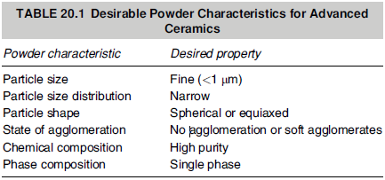

Slide 4
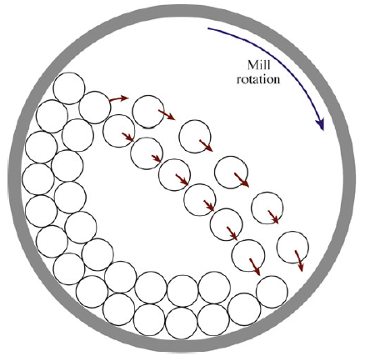
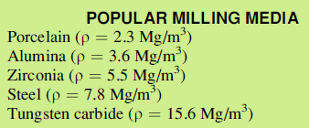
Mechanical method
The most common method for reducing particle size is ballmilling.
A ballmill constituent of barrel, usually made of ceramic, ( or plastic bottle for lab scale), grinding medium, and liquid with a surface-active agent.
The media could range from >8 cm in diameter to 0.6 cm
Ball milling eliminates aggregates and can typically reduce the particle size down to 1–10 mm.

Slide 5
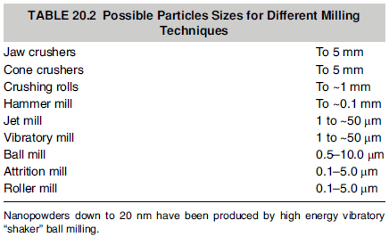

Slide 6
Chemical methods
Sols-Gels synthesis
advantages offered by the sol–gel process.
It uses relatively low temperatures.
It can create very fine powders.
It produces compositions not possible by solid-state fusion.
some disadvantages of the sol–gel process
The cost of the raw materials (the chemicals) may be high. As an example, MgO powder with a purity of 98% is available in small quantities for $30 kg-1. Magnesium ethoxide, a chemical source for making MgO, costs about $200 kg-1.
There is often large volume shrinkage and cracking during drying (we have to remove the “organics”).

Slide 7
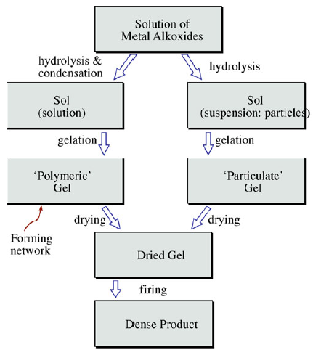
Consists of two steps. First we form a sol. Then we transform it into a gel.
M(OR)z
The size of the precipitate particles usually ranges from 0.01 to 1.0 um

Slide 8
Hydrothermal Synthesis
Hydrothermal synthesis involves crystallization of a composition in hot, pressurized water.
Typical temperatures range from 100°C to 350°C (212°F to 630°F) at pressures up to 15 Mpa (2175 psi).
Under these conditions, a wide variety of pure, fine-particle ceramic compositions can be synthesized. The feedstock can be oxides, hydroxides, salts, gels, organics, acids, and bases.

Slide 9
Shaping and Forming
Once the constituent powders have been prepared in the desired purity and particle size, the next step in the processing of most ceramic products is fabricating them into useful shapes
Shaping methods three basic categories
  1. Powder compaction: e.g., dry pressing, hot pressing, cold isostatic pressing
  2. Casting: using a mold with the ceramic as, or containing, a liquid or slurry
  3. Plastic forming: e.g., extrusion, injection molding— using pressure to shape the green ceramic
Common terms:-
Binder: a component that is added to hold the powder together while we shape the body.
Slurry: a suspension of ceramic particles in a liquid.
Plasticizer: the component of a binder that keeps it soft or pliable. It improves the rheological properties.
Green: a ceramic before it’s fired. Brown, white, or gray potter’s clays are well-known green ceramics.
Slip: the liquid-like coating used to form the glaze when fired.

Slide 10
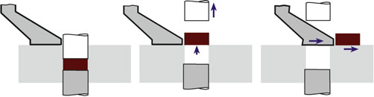
Powder compaction
DRY PRESSING:- very simple three step process, filling the die → compacting the contents → ejecting the pressed solid.
Powder should be free-flowing (should not be sticky), often with a particle size distribution of 20–200 um.
Powder mixture contains 0–5 wt% of a binder. Poly(vinyl alcohol) (PVA) and poly(ethylene glycol) (PEG) are the two most popular binders preferred for dry pressing
Pressure as high as 300 MPa can be used for pressing

Slide 11
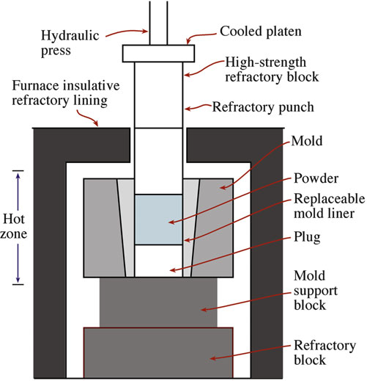
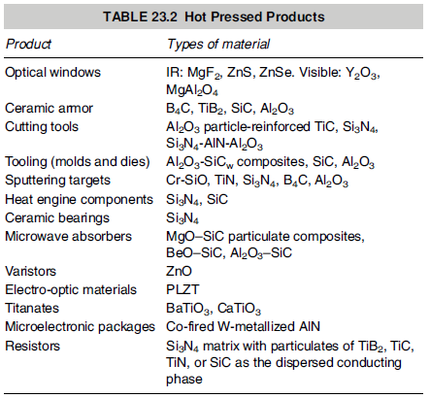
HOT PRESSING
in hot pressing the die assembly is contained within a high temperature furnace
During hot pressing the ceramic powders may sinter together to form a high-density component

Slide 12
Advantages of this process:-
The powder does not have to be of the highest quality.
Large pores that are caused by nonuniform mixing are easily removed.
We can densify at lower temperatures (typically half the melting temperature of the material) than are needed for conventional pressureless sintering.
Extensive grain growth or secondary recrystallization does not occur when we keep the temperature low during densification.
We can densify covalently bonded materials such as B₄C, SiC, and Si₃N₄ without additives. The principal disadvantage is also important.
Disadvantage
Dies for use at high temperatures are expensive and generally don’t last long.
Like dry pressing, is limited to simple solid shapes, such as flat plates, blocks, and cylinders

Slide 13
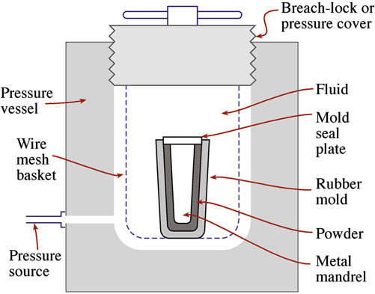
ISOSTATIC PRESSING:-
Involves the application of hydrostatic pressure to a powder in a flexible container
More uniform compaction of the powder and more complex shapes can be produced than with uniaxial pressing
  COLD ISOSTATIC PRESSING (CIP)
Advantages of the wet-bag process:
Wide range of shapes and sizes that can be produced
Uniform density of pressed product
Low tooling costs
Disadvantages:
Poor shape and dimensional control (particularly for complex shapes)
Products often require green machining after pressing
Long cycle times (typically 5–60 min) that give low production rates
Wet-bag isostatic pressing system

Slide 14
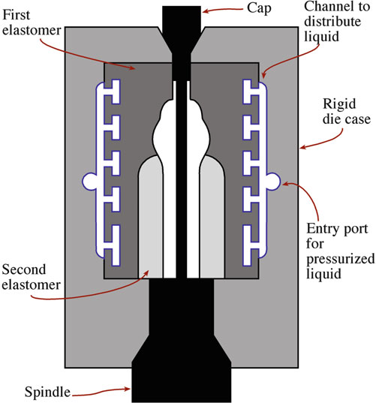
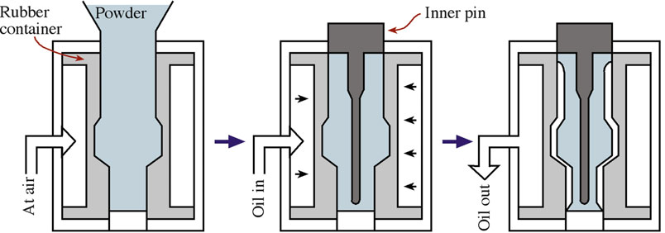
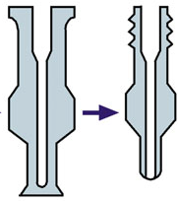
DRY-BAG PROCESS
rubber mold is now an integral part of the press
After pressing, the pressed part is removed without disturbing the mold at all.
Can be fully automated and widely used in high-volume production of ceramic parts
A die for dry-bag isostatic pressing

Slide 15
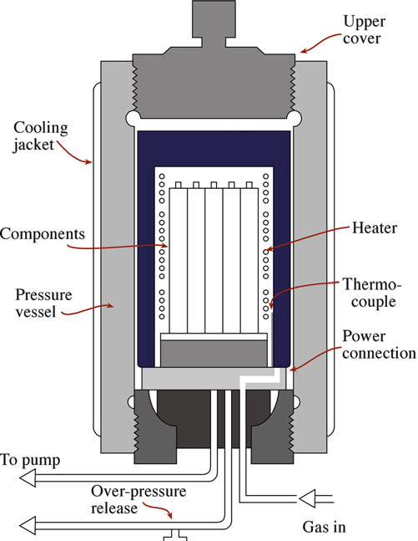
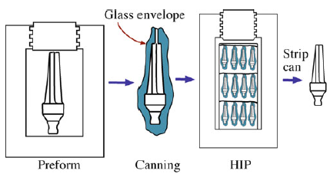
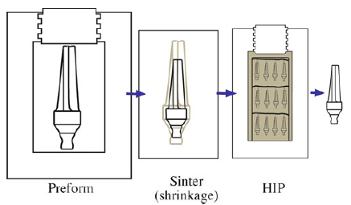
HOT ISOSTATIC PRESSING (HIP)
Uses the simultaneous application of heat and pressure
Gas is used as the pressure medium
Temperatures can be up to 2,000oC, and pressures are typically in the range 30–100 MPa
Encapsulated: using a deformable container
Hot isostatic pressing apparatus.
Not encapsulated: shape and sinter first, then HIPed

Slide 16
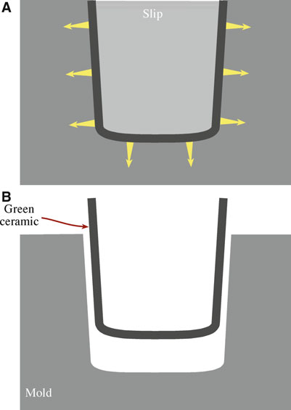
Casting
Slip casting
The slip is poured into a mold (usually plaster of Paris: 2CaSO₄H₂O)
The fineness of the powder (in the slip) and the consequent high surface area ensure that electrostatic forces dominate gravity so that settling does not occur
The water passes, via capillary action, into the porous plaster, leaving a layer of the solid on the wall of the mold
Once a sufficient thickness has been cast, the surplus slip is poured out, and the mold and cast are allowed to dry
Slip casting is a low-cost way to produce complex shapes.
It is the standard method used to make alumina crucibles and has also been used to make complex structural ceramic components such as gas-turbine rotors.

Slide 17
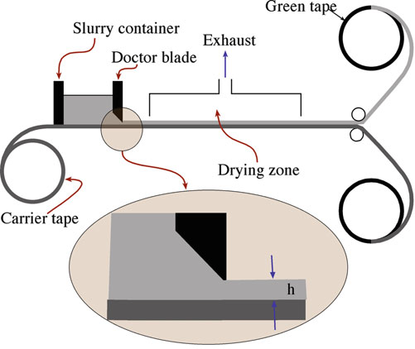
TAPE CASTING
Used to make flat ceramic sheets having a thickness up to about 1 mm
A slurry (also called a slip) containing a powdered ceramic together with a complex mixture of solvents and binders is spread onto a moving polymer (e.g., Mylar™) sheet
Thickness of the deposited layer is determined by the height of the doctor blade above the polymer sheet
The slurry contains:-
solvent to controls the viscosity of the slurry, allowing it to be spread on the polymer sheet.
binder to holds the ceramic particles together until the tape is sintered and must be removed during the sintering process.
Plasticizers to increase the flexibility of the green tape.
Dispersants (deflocculants) to avoid settling of the powder particles.
Tape-casting process

Slide 18
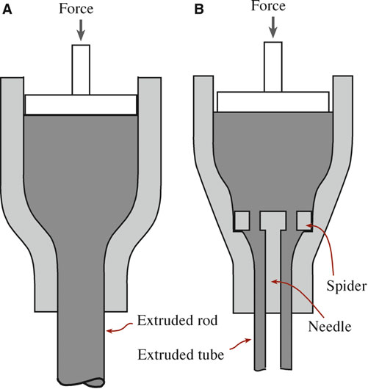
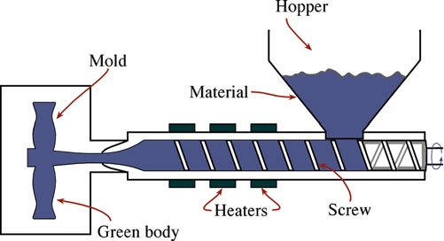
Extrusion
Involves forcing a deformable mass through a die orifice
Used to produce ceramic components having a uniform cross section and a large length-to-diameter ratio, such as ceramic tubes and rods
Injection molding can be applied to shaping and forming ceramic components if the ceramic powder is added to a thermoplastic polymer.

Slide 19
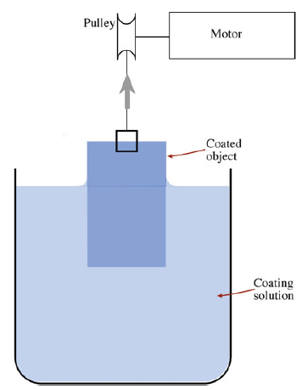
Coatings
DIP COATING
Ceramic film can be formed very easily on a substrate by dip coating,
The substrate, or object to be coated, is lowered into the solution and withdrawn at rates of 10–30 cm/min.
The solution must wets and spreads over the surface of the substrate, so the contact angle must be low
advantages
It is simple.
It is inexpensive.
Complex shapes can be coated.
Planar substrates can be coated on both sides at once.
Simple dip-coating process

Slide 20
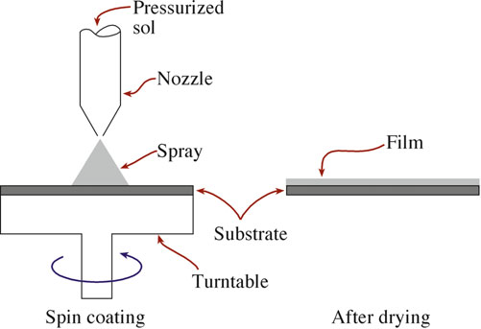
SPIN COATING
There are two types:-
Static spin process:- a few volumes of solution are dropped onto the substrate and allowed to spread until they cover most of the surface, then accelerated to a predetermined speed, on the order of 20,000 rpm
Dynamic spin process:- the solution is dispensed onto the substrate surface, which is spinning at a low speed of about 500 rpm.
Spin coating can be used only for single-side coatings and generally is applicable only to fairly simple planar shapes.

Slide 21
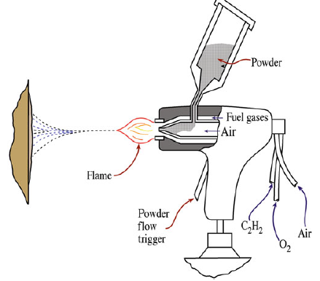
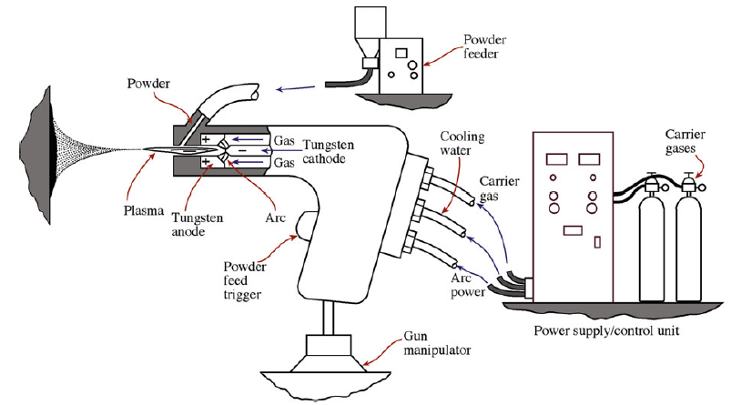
SPRAY COATING
Ceramic coatings by spraying are common in particular for applying wear-resistant and thermal-barrier coatings
Thermal spraying, illustrated in the powder is melted or softened by passing it through an oxyacetylene flame
Plasma spraying, utilizes a plasma heat source. The plasma temperature is typically >28,000C, well above that attained in gas combustion processes
The velocity of the plasma/droplet stream that exits the nozzle is usually subsonic
spraying with a gas combustion/powder gun
spraying using a plasma arc

Slide 22
Thin Films and Vapor Deposition
Thin films are generally prepared from the vapor phase
Thin films are often crystallographically oriented in a particular way with respect to the underlying substrate
Deposition techniques can be divided into two basic classes
Chemical vapor deposition (CVD):-use either gas phase reactions or gaseous decomposition as the source of material
Physical vapor deposition (PVD):- rely on excitation of a source (sometimes called the target), which is usually solid to produce the necessary material for film formation
There are four general characteristics that we usually want to control when growing ceramic thin films.
Crystal structure
Stoichiometry
Phase
Surface morphology/topography

Slide 23
Chemical Vapor Deposition (CVD)
Two possible reactions commonly leads to CVD
  Chemically reacting a volatile compound of a material to be deposited with other gases to produce a nonvolatile solid or
Pyrolysis (decomposition) of a compound at high temperature to produce a solid
It is important that the reaction takes place only on the substrate surface
As an example of a CVD reaction we can consider the formation of SiC from silicon tetrachloride (SiCl₄) and methane (CH₄)
SiCl₄(g) + CH₄(g) → SiC (s) + 4HCl (g) at 1400ºC
Temperature must be sufficiently high that the reaction occurs. If an epitactic deposit is required, it must be high enough to allow the condensing species to diffuse across the crystal surface to find their required lattice crystal positions.

Slide 24
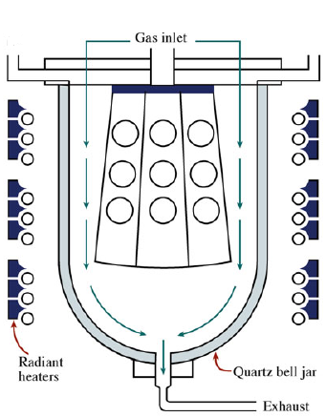
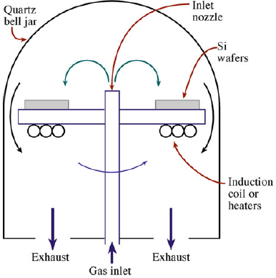
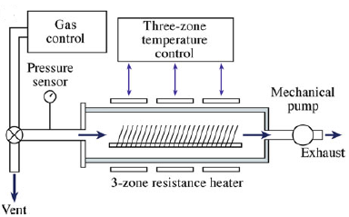
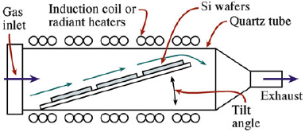
There are several (CVD) reactor configurations
Pancake
Barrel
Horizontal
Low-pressure (LP)CVD

Slide 25
Physical Vapor Deposition (PVD)
Evaporation
Is a very simple method for forming thin films
Source is either a liquid or a solid that is heated to produce a flux of atoms or molecules
Films formed directly from evaporation of some ceramics like ZrO₂ tend to be metal-rich. Thus, to maintain the desired stoichiometry, it is necessary to perform the evaporation in an oxygen-rich environment which is called reactive evaporation (RE)
Some ceramics sublime

Slide 26
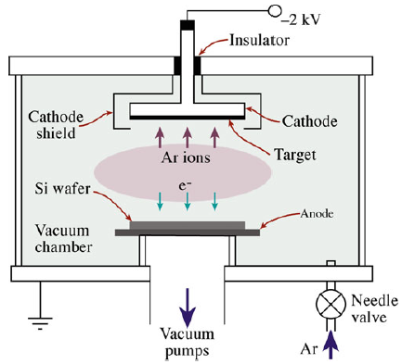
Sputtering
Atoms are dislodged from a solid target through the impact of energetic gaseous ions.
The usual sputtering gas is argon, which is ionized, forming a plasma
Things to be considered while using spattering
It does not involve melting, and therefore materials with high melting points can be deposited.
It is a relatively slow process.
It may be difficult to maintain stoichiometry of a multicomponent target due to different sputtering rates of the constituents.
When the substrate and target are facing each other (on-axis configuration), the growing film may be damaged by bombardment with energetic species from the plasma.

Slide 27
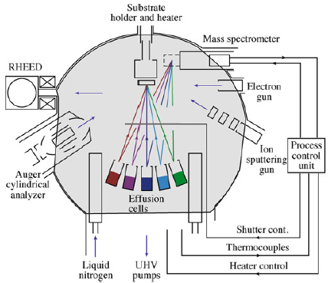
Molecular-beam epitaxy
Technique that has mainly been used by the semiconductor industry for producing thin films of compound semiconductors (e.g., GaAs, InP) used in the fabrication of LEDs, laser diodes, etc.
The materials to be deposited are usually evaporated from separate furnaces called Knudsen effusion cells
MBE of semiconductors requires the use of an ultrahigh vacuum (UHV) chamber (background pressure 10 8–10 10 Torr).
The equipment is expensive (>$1 million), so the value added must be high.
Deposition rates are low: 1 mm/h is typical.

Slide 28
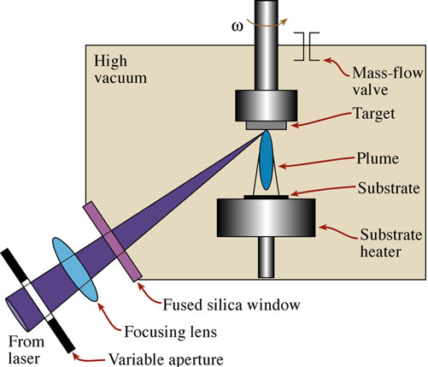
Pulsed-laser deposition
Laser beam is used to ablate material from a solid target
Excimer lasers operating in the ultraviolet (UV) range are the lasers of choice for most PLD systems
PLD offers several advantages over other PVD methods.
The interaction of the laser beam and the target produces a plasma consisting of species having high kinetic energy, which enables epitactic film growth at low substrate temperatures.
There is growth of films having complex stoichiometry.
The irradiation source is outside the deposition chamber, allowing flexibility. Multiple chambers can use a single laser, and the irradiation source can be easily changed.
Relatively high deposition rates (>10 nm/s) can be achieved.
It is fairly inexpensive

Slide 29
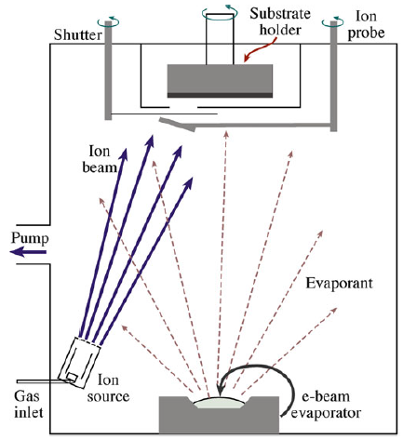
Ion-beam-assisted deposition
Involves ion bombardment during film growth
Can modify film properties For example, IBAD of SiO₂ with 300 eV O₂ ⁺ ions during growth can change the refractive index.
It is also possible to:
Increase film adhesion
Modify grain shape
Induce crystallization

