Slide 1
Engineering Ceramics
Class -1
Introduction

Slide 2
Introduction to ceramics
What are ceramics?
The word ‘ceramic’ is originated from Greek word keramos, which means ‘burnt stuff’.
Modern definition
“the art and science of making and using solid articles which have as their essential component, and are composed in large part of, inorganic nonmetallic materials.”
  This definition essentially says that a ceramic is anything that is not an organic material or a metal.
Usually it is a compound, or a combination of compounds, between metallic and nonmetallic elements (mainly, O, N, C, B)

Slide 3
Cont..
Chemically , ceramic are inorganic compounds.
Bonds are either totally ionic, or combination of ionic and covalent.
  Silicates: kaolinites (Al₂Si₂O₅(OH)₄) and mullites (Al₆Si₂O₁₃);
  Simple oxides: alumina (Al₂O₃) and zirconia (ZrO₂)
  Complex oxides: barium titanate (BaTiO₃) & superconducting materials YBa₂Cu₃O_{6+δ} (0≤δ≤1)
  Carbides: silicon carbides (SiC) & boron carbide (B₄C);
  Nitrides: silicon nitride(Si₃N₄) and boron nitride(BN);
  Borides: titanium diborides (TiB₂);
  Silicides: molybdium disilicides (MoSi₂);
  Halides such as lithium floride (LiF)
  Nitride-oxides or oxynitride systems: (eg β’-sialons with the general formula Si_{6-z}Al_{Z}N_{8-z}O_{z} where 0<z<4.
Structurally all materials are either crystalline or amorphous (glass).

Slide 4
Cont..
In ceramics we are concerned about two types of structure which have profound effect on materials properties.
  A) At the atomic level scale: The type of bond and the crystal structure (for crystalline ceramics and the amorphous structure (if it is glass)
  B) At larger scale: the microstructure, which refers to the nature, quality, and distribution of the structural elements or phases in the ceramics.
It is useful to distinguish between the intrinsic properties of a material and the properties that depend on the microstructure.
Intrinsic properties are determined by the structure at atomic scale and are properties that are not susceptible to significant change by modification of the materials. E.g mp, elastic modulus, coefficient of thermal expansion and factors such as whether or not the material is brittle, magnetic, ferroelectric, or semiconducting.
In contrast, many of the properties critical to the engineering applications of materials are strongly dependent on the microstructure (mechanical strength, dielectric constant and electrical conductivity)

Slide 5
Historic development of ceramics
Approximate | Description of Milestone
24,000 bc | Clay mixed with water, molded into a shape, dried, and fired to produce the first human-made ceramic earthenware
10,000 bc | Early use of earthenware for useful articles such as containers
7,000 – 6,000 bc | Lime mortar used for filling spaces between stones in construction and for making thick-walled containers
7,000–5,000 bc | Widespread use of earthenware for food storage and cooling and Widespread use of plaster-like cementitious ceramics in floor construction and as decorated interior wall coatings
4,500 bc | Ceramics used to line crude kilns to smelt copper from its ores and make possible the Chalcolithic, Bronze, and Iron Ages
4,500–3,500 bc | Fired brick shown to be more durable than dried mud bricks and Development of early faience to produce white ceramics with bright blue glassy coatings; precursor to development of glass and glazes
3,500–2,800 bc | Evolution of first writing consisting of pictographs and cuneiform symbols inscribed in clay tablets
3,300 bc | Potter’s wheel invented, making earthenware pottery available and affordable for just about everyone
2,500–1,600 bc | From early isolated examples of glass to well-established craft
1,750–1,150 bc | Variety of glazes developed including lead glazes and colored glazes

Slide 6
Approximate | Description of Milestone
1,025–750 bc | Early developments in China of stoneware, which was lighter in color, stronger, and less porous than earthenware
500–100 bc | High-strength concrete developed by Greeks and Romans and used widely in construction especially by the Romans
100–50 bc | Glass blowing invented, making glass items available to other than royalty and aristocrats
600–800 ad | Evolution of high-quality porcelain in China
800–900 ad | Islamic refinements of the use of white tin-based glazes and lustrous overglazes
1740s | “Transfer printing” invented to greatly increase the rate of production of tiles
1840s | “Dust pressing” invented to further dramatically increase rate of production of tiles and eventually become the uniaxial pressing process and workhorse of modern high-volume production of polycrystalline ceramics
Late 1800s | Demonstration of successful laboratory synthesis of single crystals of ruby and sapphire
Early 1900s | Increase in temperature capability of production kilns to greater than 1400°C and later to above 1600°C
Mid-1900s | Establishment of alumina-based ceramics and introduction of a wide range of new engineered ceramics
Late 1900s | Development of ultrahigh-temperature, high-strength, and high-toughness ceramics and ceramic matrix composites

Slide 7
Classifications of ceramics
Different classification mechanisms are employed for ceramics such as: classification based on Engineering application, based on Composition, and based on Crystallinity.
Based on their Engineering applications, ceramics are classified into two groups as:
Traditional ceramics: those distinguished by being
  The older and more generally known types (porcelain, brick, earthenware, etc.)
  Based primarily on natural raw materials of clay and silicates
  Applied
  building materials (brick, clay pipe, glass)
  household goods (pottery, cooking ware)
  manufacturing ( abbrasives, electrical devices, fibers)

Slide 8
Cont..
Advanced ceramics(Engineering ceramics)-
  have been developed over the past half century
  Include artificial raw materials, exhibit specialized properties, require more sophisticated processing
  includes ceramics for electrical, magnetic, electronic and optical application
  Applied as thermal barrier coatings to protect metal structures, wearing surfaces,
  Engine applications (silicon nitride (Si3N4), silicon carbide (SiC), Zirconia (ZrO2), Alumina (Al2O3))

Slide 9
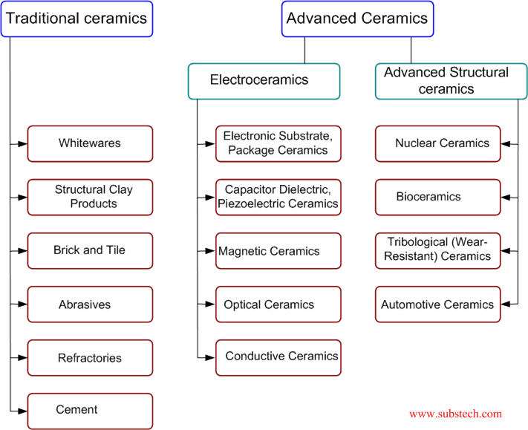
Cont..

Slide 10
Cont..
Based on composition ceramics can be classified as:-
  Oxides: Alumina, zirconia
  Non-oxides: Carbides, borides, nitrides, silicides
  Composites: Particulate reinforced, combinations of oxides and non-oxides
CERAMICS
Oxides
Nonoxides
Composite

Slide 11
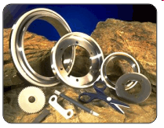
Cont..
Oxide Ceramics:
Oxidation resistant
chemically inert
electrically insulating
generally low thermal conductivity
slightly complex manufacturing,
low cost for alumina
more complex manufacturing,
higher cost for zirconia.
zirconia

Slide 12
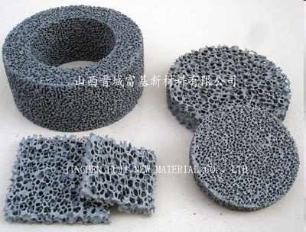
Cont..
Non-Oxide Ceramics:
Low oxidation resistance
extreme hardness
chemically inert
high thermal conductivity
electrically conducting
difficult energy dependent manufacturing and high cost.
Silicon carbide cermic foam filter (CFS)
http://images.google.com.tr/imgres?imgurl=http://www.made-in-china.com/image/2f0j00avNtpdFnLThyM/Silicon-Carbide-Ceramic-Foam-Filter-CFS-.jpg&imgrefurl

Slide 13
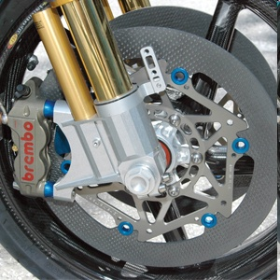
Cont..
Ceramic-Based Composites:
Toughness
low and high oxidation resistance (type related)
variable thermal and electrical conductivity
complex manufacturing processes
high cost.
Ceramic Matrix Composite (CMC) rotor
http://images.google.com.tr/imgres?imgurl=http://www.oppracing.com/images/cmsuploads/Large_Images/braketech%2520cmc%2520rotor%2520oppracing%2520cbr1000rr.jpg&imgrefurl

Slide 14
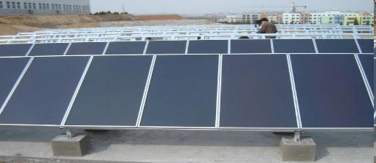
Cont..
Based on crystalinity ceramics can be classified as amorphous and crystalline.
CERAMICS
amorphous
crystalline
Amorphous
the atoms exhibit only short-range order
no distinct melting temperature (Tm) for these materials as there is with the crystalline materials
Na₂0, Ca0, K₂O, etc
Amorphous silicon and thin film PV cells

Slide 15
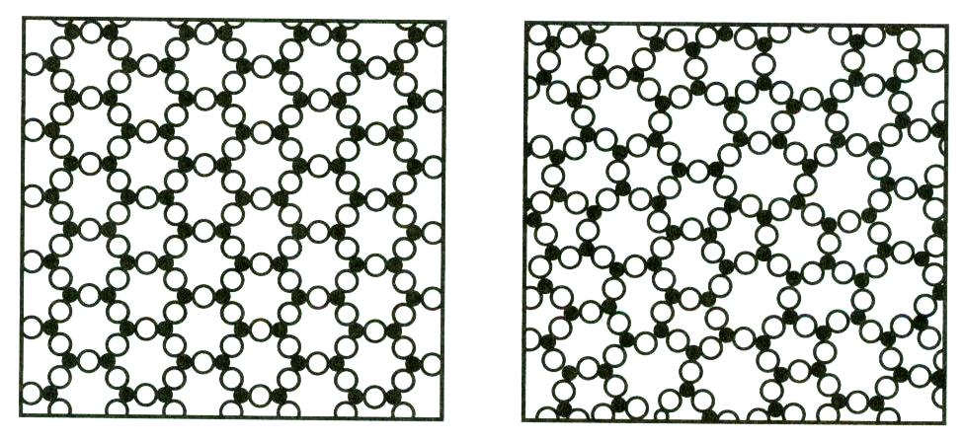
Cont..
Crystalline
atoms (or ions) are arranged in a regularly repeating pattern in three dimensions (i.e., they have long-range order)
Crystalline ceramics are the “Engineering” ceramics
– High melting points
– Strong
– Hard
– Brittle
– Good corrosion resistance
  a ceramic (crystalline) and a glass (non-crystalline)

Slide 16
Properties of Ceramics
  Generally ceramics have the following properties:-
  high temperature stability
  high mechanical strength
  low elongation under application of stress
  low thermal and electrical conductivities
  Low density compared to metals
  High melting point or decomposition temperature
  High hardness and very brittle
  High electrical resistivity
  Low thermal conductivity
  High corrosion resistance

Slide 17
Cont..
Thermal properties
Most important thermal properties of ceramic materials:
Heat capacity : amount of heat required to raise material temperature by one unit (ceramics > metals)
Thermal expansion coefficient: the ratio that a material expands in accordance with changes in temperature
Thermal conductivity : the property of a material that indicates its ability to conduct heat
Thermal shock resistance: the name given to cracking as a result of rapid temperature change

Slide 18
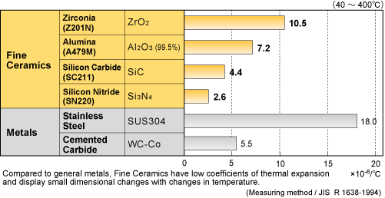
Cont..
Thermal expansion
The coefficients of thermal expansion depend on the bond strength between the atoms that make up the materials.
Strong bonding (diamond, silicon carbide, silicon nitrite) → low thermal expansion coefficient
Weak bonding ( stainless steel) → higher thermal expansion coefficient in comparison with fine ceramics
Comparison of thermal expansion coefficient between metals and fine ceramics

Slide 19
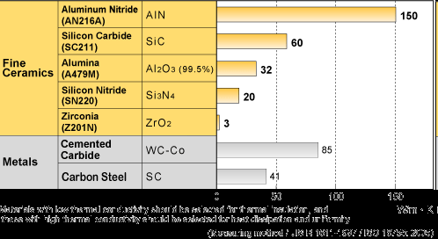
Cont..
Thermal conductivity
generally less than that of metals such as steel or copper
ceramic materials, in contrast, are used for thermal insulation due to their low thermal conductivity (except silicon carbide, aluminium nitride)
http://global.kyocera.com/fcworld/charact/heat/images/thermalcond_zu.gif

Slide 20
Cont..
Thermal shock resistance
A large number of ceramic materials are sensitive to thermal shock
Some ceramic materials → very high resistance to thermal shock despite low ductility (e.g. fused silica, Aluminium titanate )
Result of rapid cooling → tensile stress (thermal stress)→cracks and consequent failure
The thermal stresses responsible for the response to temperature stress depend on:
-geometrical boundary conditions
-thermal boundary conditions
-physical parameters (modulus of elasticity, strength…)

Slide 21
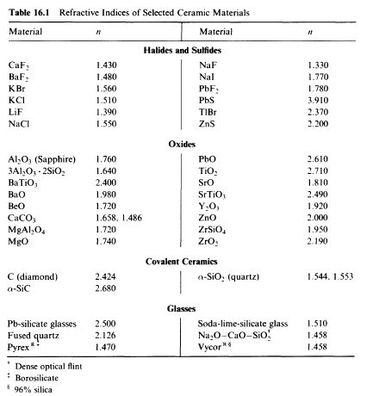
Cont..
Optical properties of ceramics
Refractive index, (n)
Refractive index of a material is the ratio of the speed of light in a vacuum (c = 3 x 10⁸ m/s) to the speed of light in that material.
n = c/v
Callister, W., D., (2007), Materials Science And Engineering, 7th Edition,

Slide 22
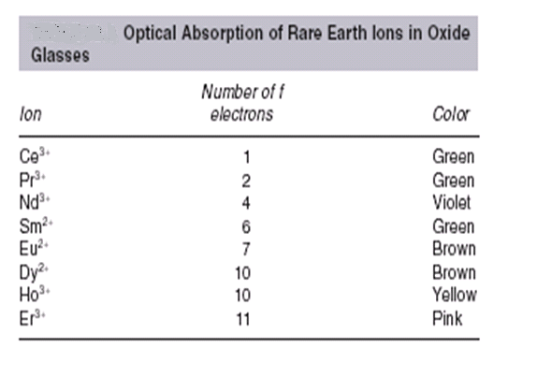
Cont..
ABSORPTION
Color in ceramics
Most dielectric ceramics and glasses are colorless.
By adding transition metals (TM)
Ti, V, Cr, Mn, Fe, Co, Ni, color can be obtained in ceramics

Slide 23
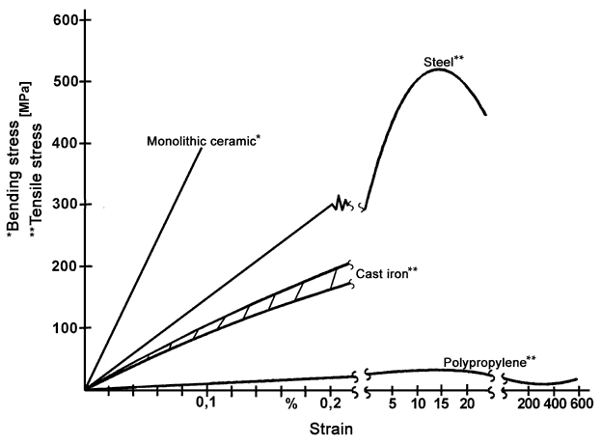
Cont..
Mechanical properties of ceramics
STRESS-STRAIN BEHAVIUR of selected materials
http://www.keramvaerband.de/brevier_engl/5/5_2.htm

Slide 24
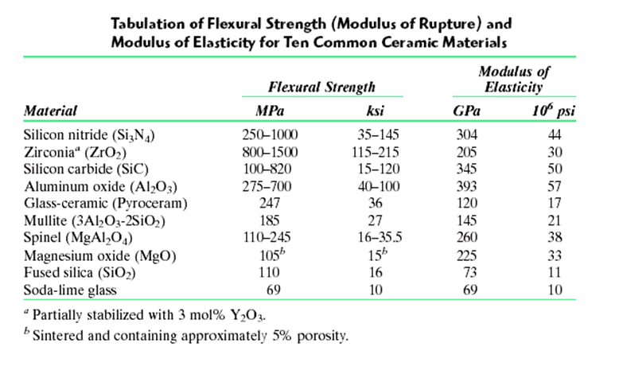
Cont..

Slide 25
Cont..
Hardness
Hardness implies a high resistance to deformation and is associated with a large modulus of elasticity.
In metals, ceramics and most polymers, the deformation considered is plastic deformation of the surface.
For elastomers and some polymers, hardness is defined at the resistance to elastic deformation of the surface.
Technical ceramic components are therefore characterised by their stiffness and dimensional stability.
Hardness is affected from porosity in the surface, the grain size of the microstructure and the effects of grain boundary phases.

Slide 26
Cont..
Some typical hardness values for ceramic materials are provided below:
Material ClassC | Vickers Hardness (HV) GPa
Glasses | 5 – 10
Zirconias, Aluminium Nitrides | 10 - 14
Aluminas, Silicon Nitrides | 15 - 20
Silicon Carbides, Boron Carbides | 20 - 30
Cubic Boron Nitride CBN | 40 - 50
Diamond | 60 – 70 >
The high hardness of technical ceramics results in favorable wear resistance. Ceramics are thus good for tribological applications.

Slide 27
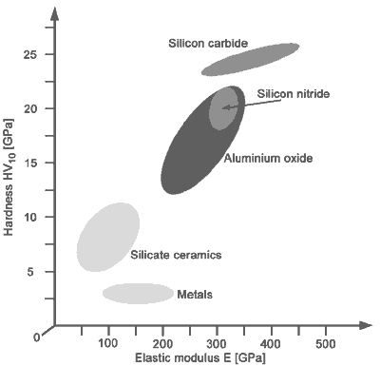
Cont..
Elastic modulus
The elastic modulus E [GPa] of almost all oxide and non-oxide ceramics is consistently higher than that of steel.
This results in an elastic deformation of only about 50 to 70 % of what is found in steel components.
The high stiffness implies, however, that forces experienced by bonded ceramic/metal constructions must primarily be taken up by the ceramic material.

Slide 28
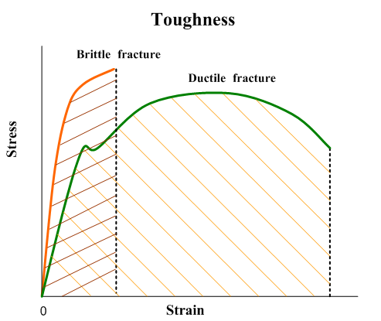
Cont..
Toughness
Ability of material to resist fracture
affected from,
  temperature
  strain rate
  relationship between the strenght and ductility of the material and presence of stress concentration (notch) on the specimen surface

Slide 29
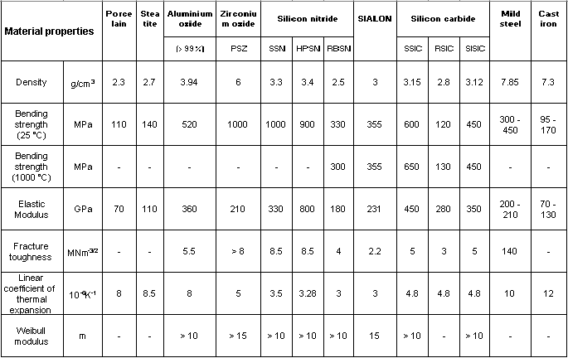
Cont..
A comparison of typical mechanical characteristics of some ceramics with grey cast-iron and construction steel

Slide 30
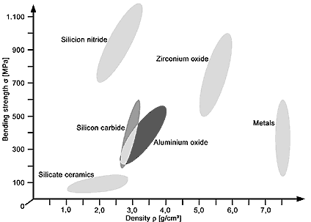
Cont..
Density
The density, ρ (g/cm³) of technical ceramics lies between 20 and 70% of the density of steel.
The relative density, d [%], has a significant effect on the properties of the ceramic.

Slide 31
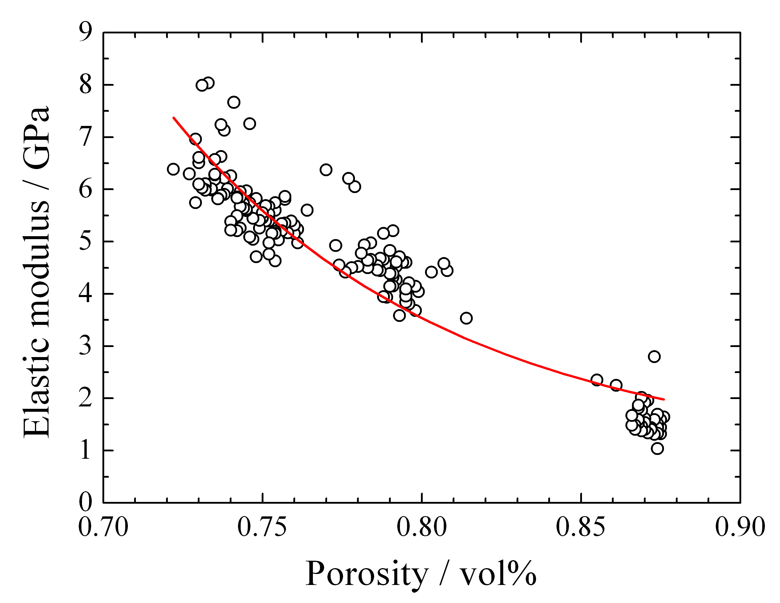
Cont..
Porosity
Change in elastic modulus with the amount of porosity in SiOC ceramic foams obtained from a preceramic polymer
Technical ceramic materials have no open porosity.
Porosity can be generated through the appropriate selection of raw materials, the manufacturing process, and in some cases through the use of additives.
This allows closed and open pores to be created with sizes from a few nm up to a few µm.
http://www.ucl.ac.uk/cmr/webpages/spotlight/articles/colombo.htm

Slide 32
Cont..
Electrical properties of ceramics
Electrical conductivity of ceramics varies with
  The Frequency of field applied effect
charge transport mechanisms are frequency dependent.
  The temperature effect
The activation energy needed for charge migration is achieved through thermal energy and immobile charge career becomes mobile.

Slide 33
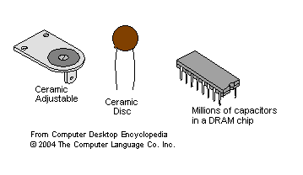
Cont..
Most of ceramic materials are dielectric. (materials, having very low electric conductivity, but supporting electrostatic field).
Dielectric ceramics are used for manufacturing capacitors, insulators and resistors.

Slide 34
Cont..
Superconductive properties of ceramics
Despite of very low electrical conductivity of most of the ceramic materials, there are ceramics, possessing superconductivity properties (near-to-zero electric resistivity).
Lanthanum (yttrium)-barium-copper oxide ceramic may be superconducting at temperature as high as 138 K. This critical temperature is much higher, than superconductivity critical temperature of other superconductors (up to 30 K).
The critical temperature is also higher than boiling point of liquid Nitrogen (77.4 K), which is very important for practical application of superconducting ceramics, since liquid nitrogen is relatively low cost material.

Slide 35
Applications of Ceramics
Ceramics are used in a wide range of technologies such as refractories, spark plugs, dielectrics in capacitors, sensors, abrasives, magnetic recording media, etc.
The space shuttle makes use of ~25,000 reusable, lightweight, highly porous ceramic tiles that protect the aluminum frame from the heat generated during re-entry into the Earth’s atmosphere.

Slide 36
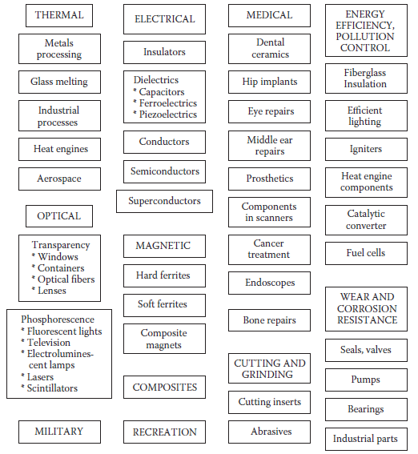
Applications where ceramic materials play a critical role.

Slide 37
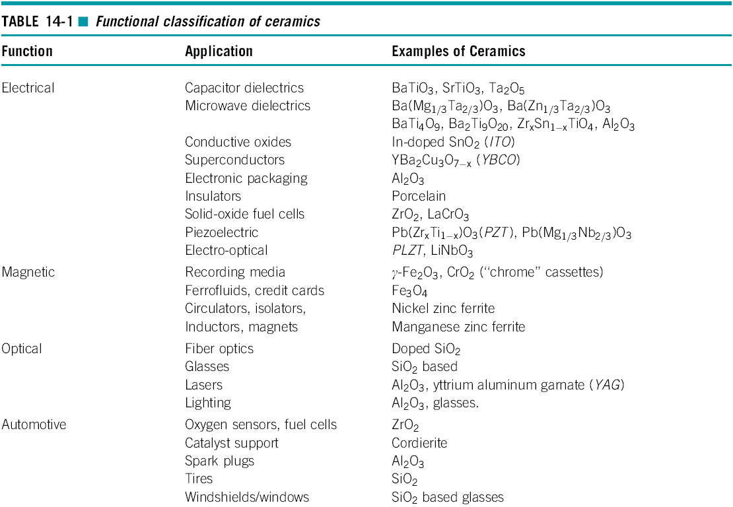
Cont..

Slide 38
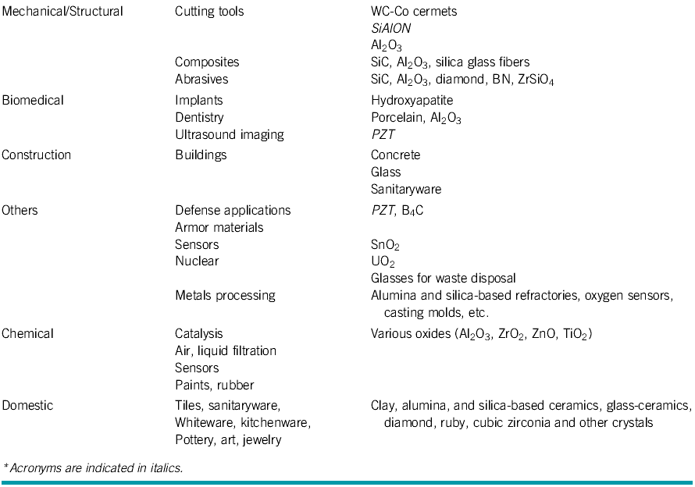
Cont..

Slide 39
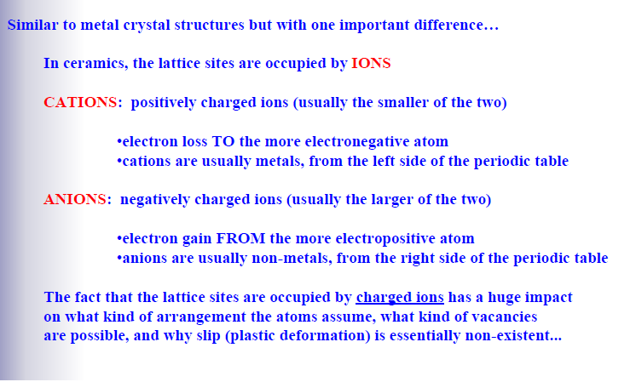
Ceramic crystal structure

Slide 40
Crystal chemistry concept
The following are some of an important reasons why it necessary to understand crystal chemistry:
  It provides a simple means of understanding how atoms join together to form ceramics structure.
  It provides a basis understanding how atoms can substitute into structure by solid solution and alter the behavior of materials: electrical, magnetic, optical, thermal and mechanical properties of ceramics.
  It explains how distorted and defect structure occur or can be produced.
  It explains why ceramics behave differently from each other, and from metals and organic compounds.

Slide 41
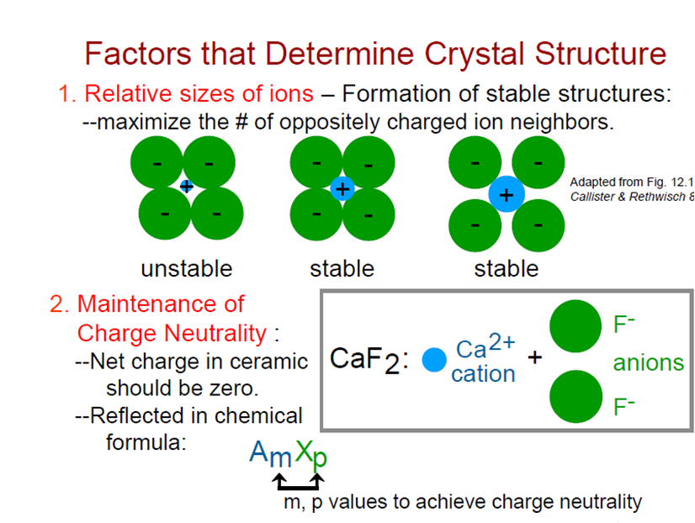
3. Degree of directionality of the bonds

Slide 42
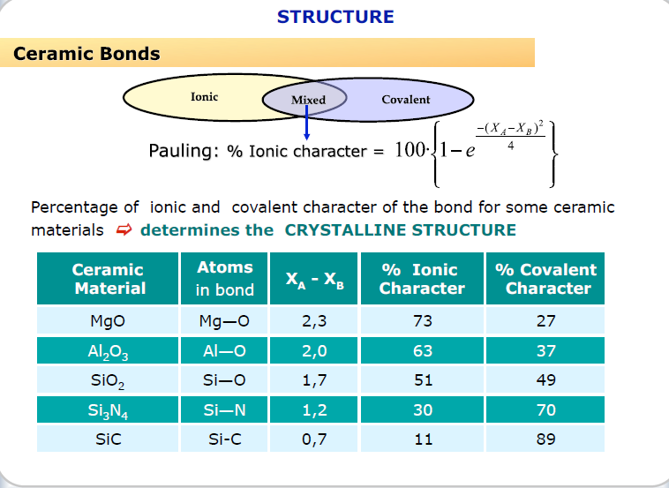

Slide 43
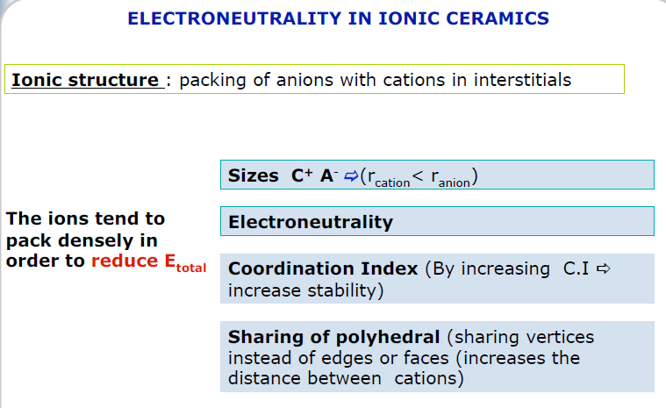

Slide 44
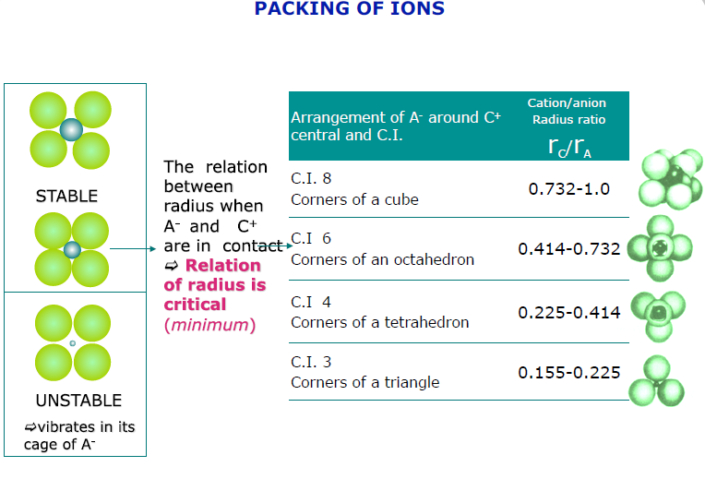

Slide 45

Effect of Charge
Electrical neutrality is required at the unit-cell level as well as throughout the crystal structure.
The charge of each cation and anion must be mutually balanced by the combined charge of the surrounding ions of the opposite charge
The portion of the charge of each cation is equal to the valence of the cation VC divided by the CN of the cation (CN)C. similar is the case for anions
Example:- What are the CNs of Na⁺ and Cl⁻ in NaCl and what type of structural arrangement results? the ionic radius of Na⁺ is 1.16 Å and of Cl⁻ is 1.67 Å

Slide 46
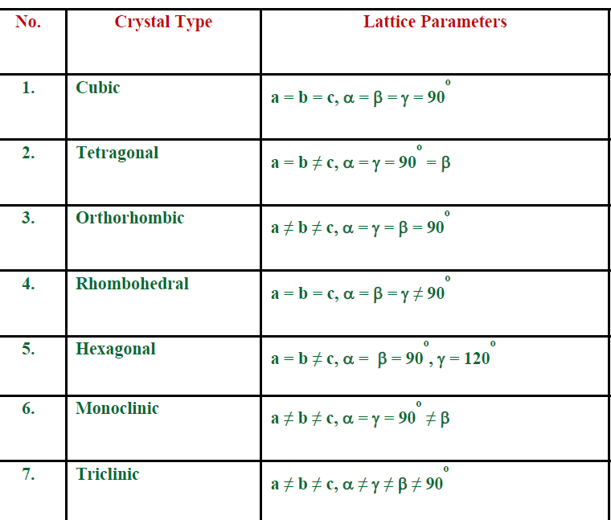

Slide 47
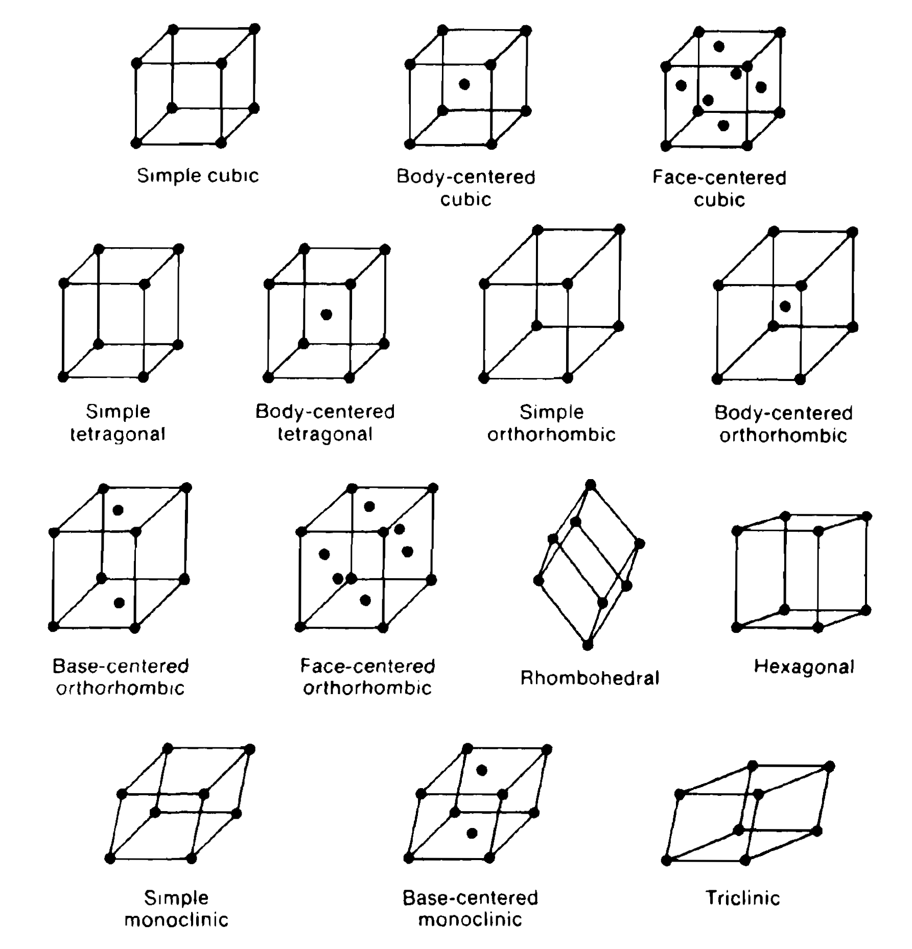

Slide 48
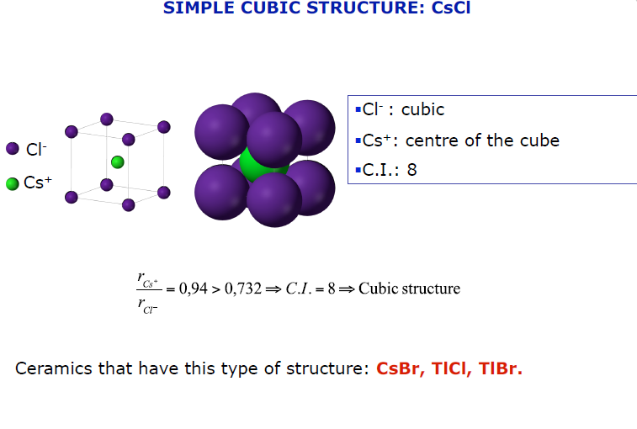

Slide 49
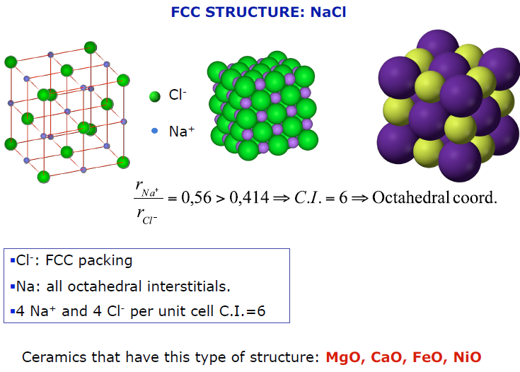

Slide 50
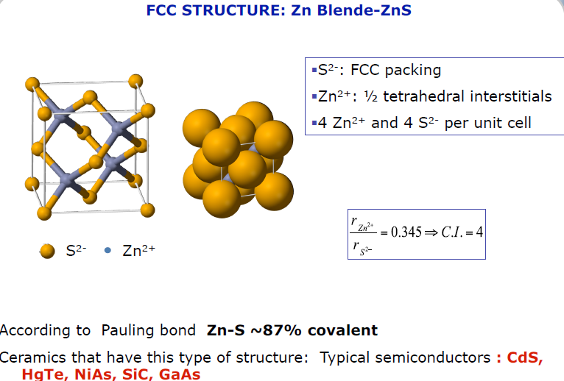

Slide 51
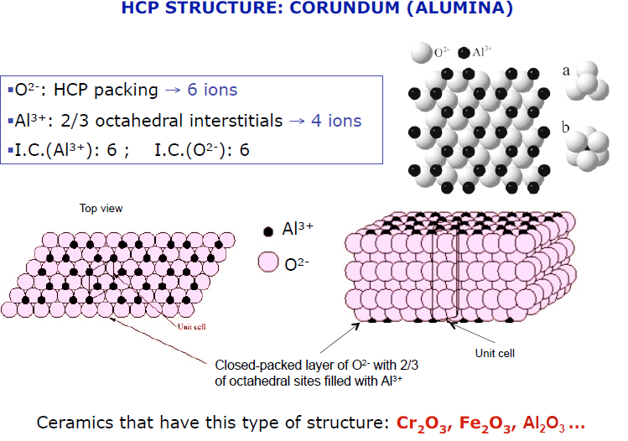

Slide 52
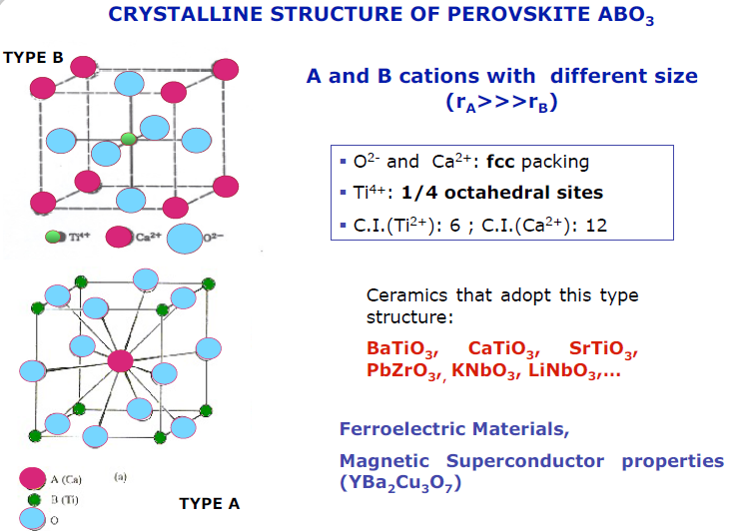

Slide 53
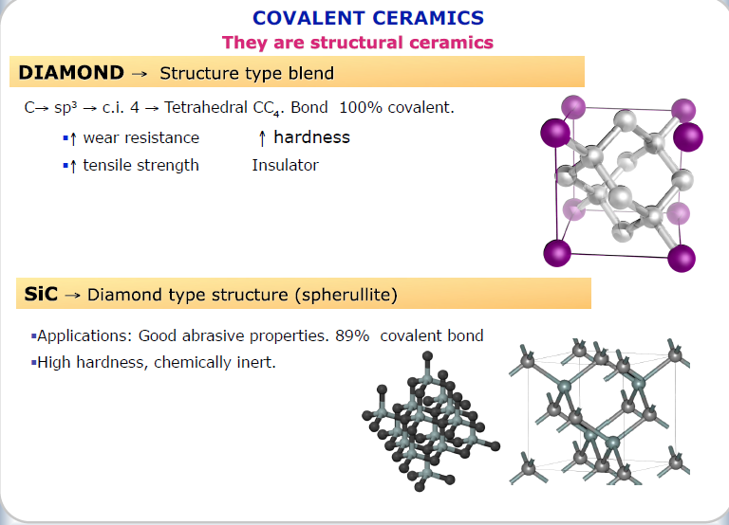

Slide 54
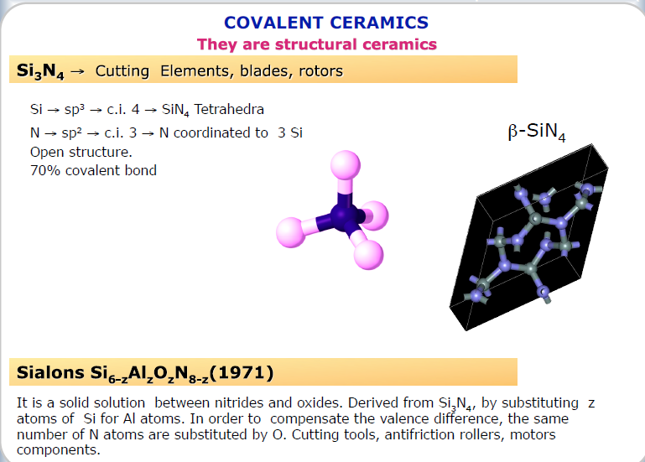

Slide 55
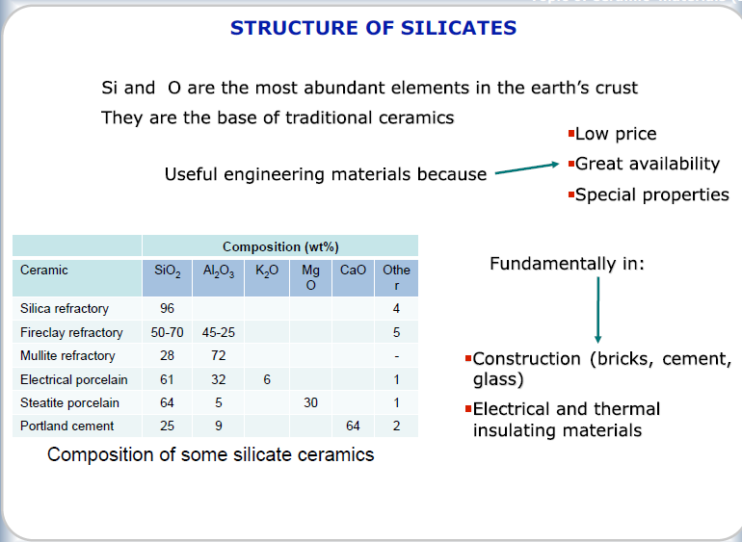

Slide 56
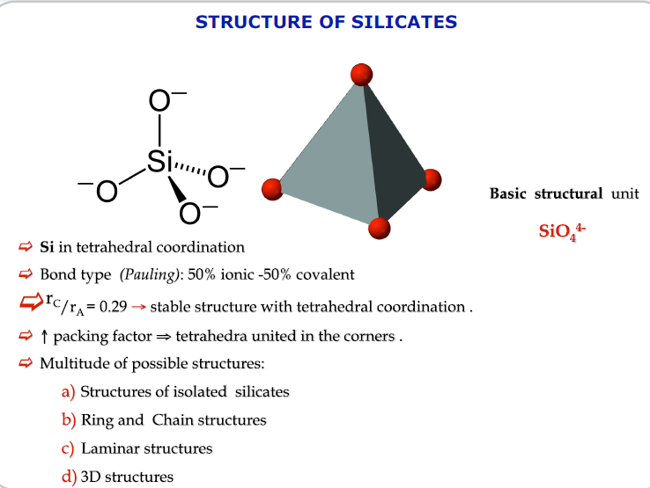

Slide 57
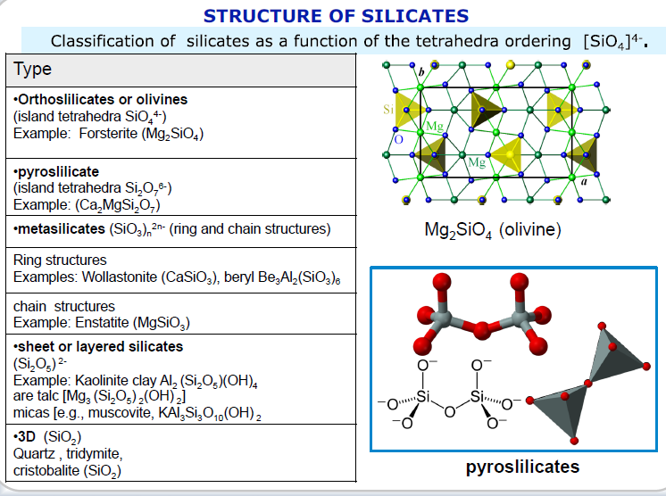

Slide 58
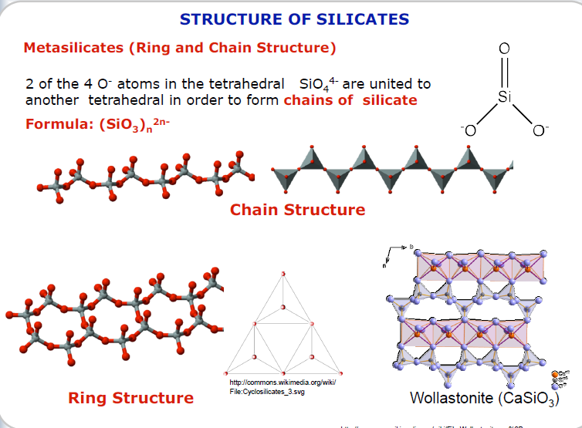

Slide 59
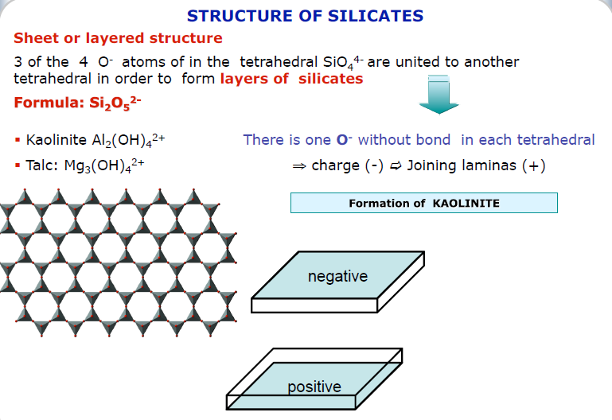

Slide 60
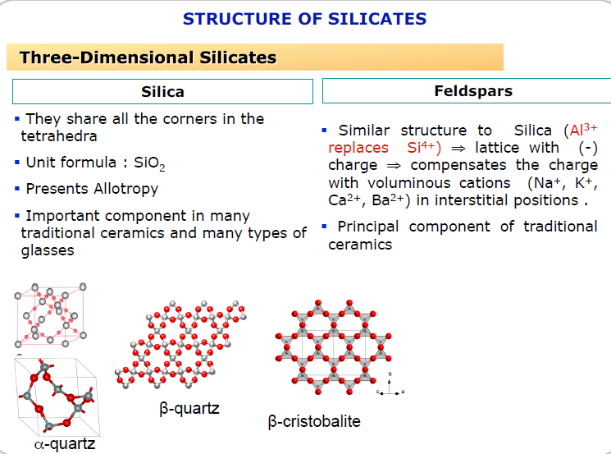

Slide 61
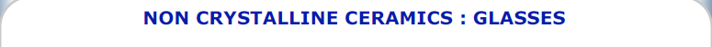
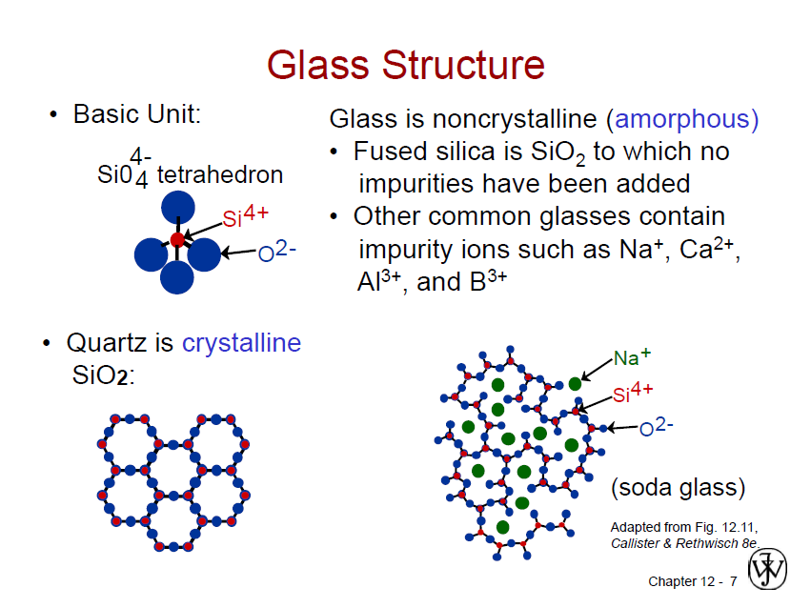

Slide 62
