Slide 1
Phase equilibrium in ceramics
Part III

Slide 2
Common terms
System:
Any portion of the material universe which can be isolated completely and arbitrarily from the rest for consideration of the changes which may occur within it under varying conditions.
Phase:
Any portion including the whole of a system which is physically homogeneous within itself and bounded by a surface so that it is mechanically separable from any other portions.
Phases are considered to be distinguished mainly by their physical character, such as density, X-ray diffraction behavior, or optical properties etc.
Equilibrium
A state of a system which represents a condition in which:
  (1) the properties of a system do not change with the passage of time, and
  (2) the same state can be obtained by approaching this condition in more than one manner with respect to the variables of the system.
A more precise definition is the thermodynamic definition which states that a system at equilibrium has a minimum free energy.

Slide 3
The Phase Rule
Serves to define the conditions of equilibrium in terms of a relationship between the number of phases and the components of a system.
where F= the variance or degrees of freedom, C= the number of components,
and P= the number of phases.

Slide 4

One-Component System
For a one component system, C= 1, the statement of the phase rule is as follows:
In a one-component system, a phase experiences two degrees of freedom: F= 3 - 1 = 2.
The two variables which must be specified to define the system are temperature and pressure. Chemical composition is not a variable, since only one component is being considered.
Where two phases (P=2) coexist in a one-component system, there is one degree of freedom, F= 3 - 2 = 1.
Where three phases (P= 3) coexist in a one-component system, the degrees of freedom equal zero, F= 3 - 3 = 0, as is the case for point I in Fig. below, which shows a hypothetical one-component system.

Slide 5
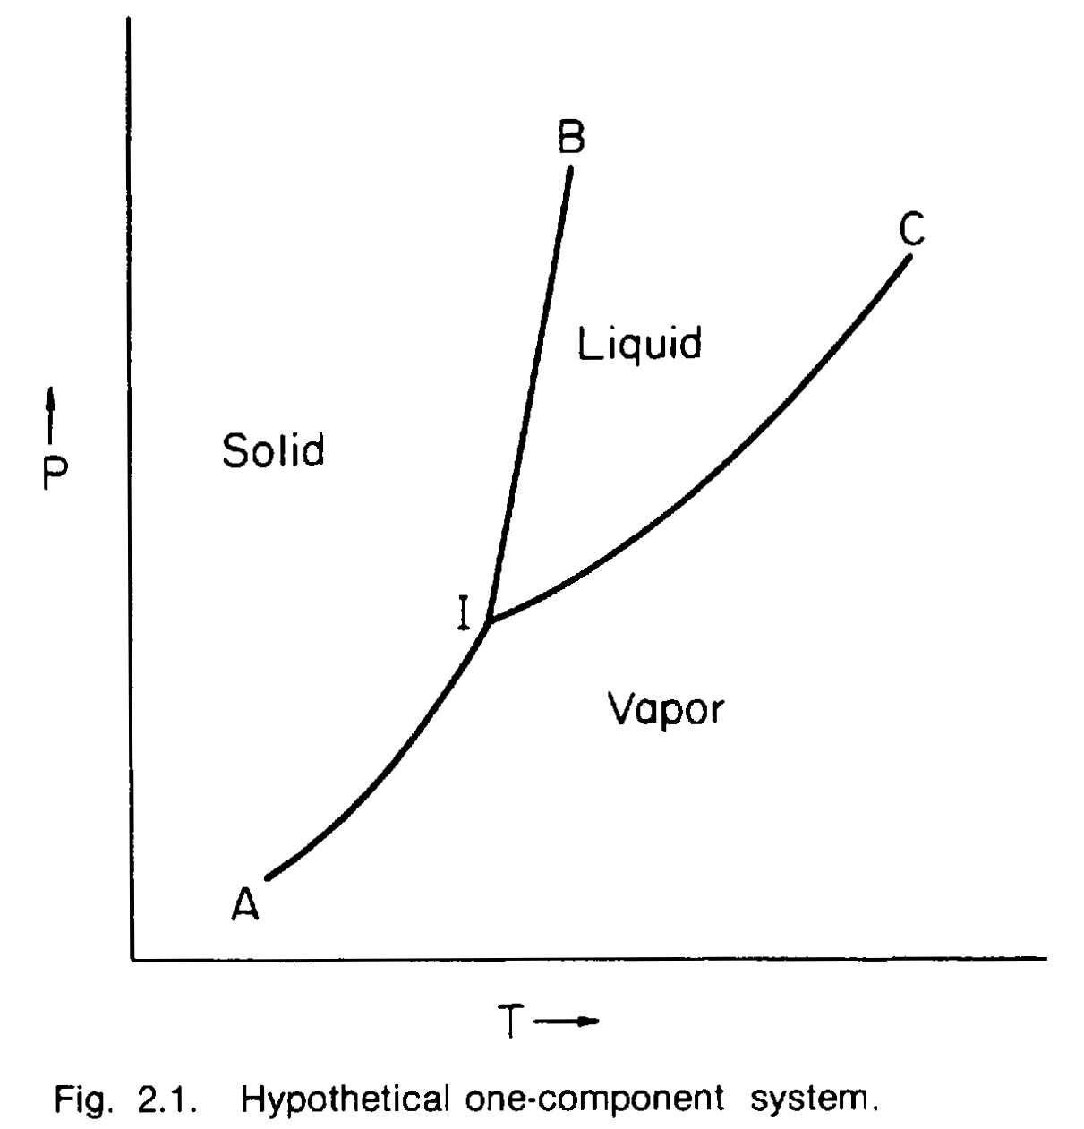

Slide 6
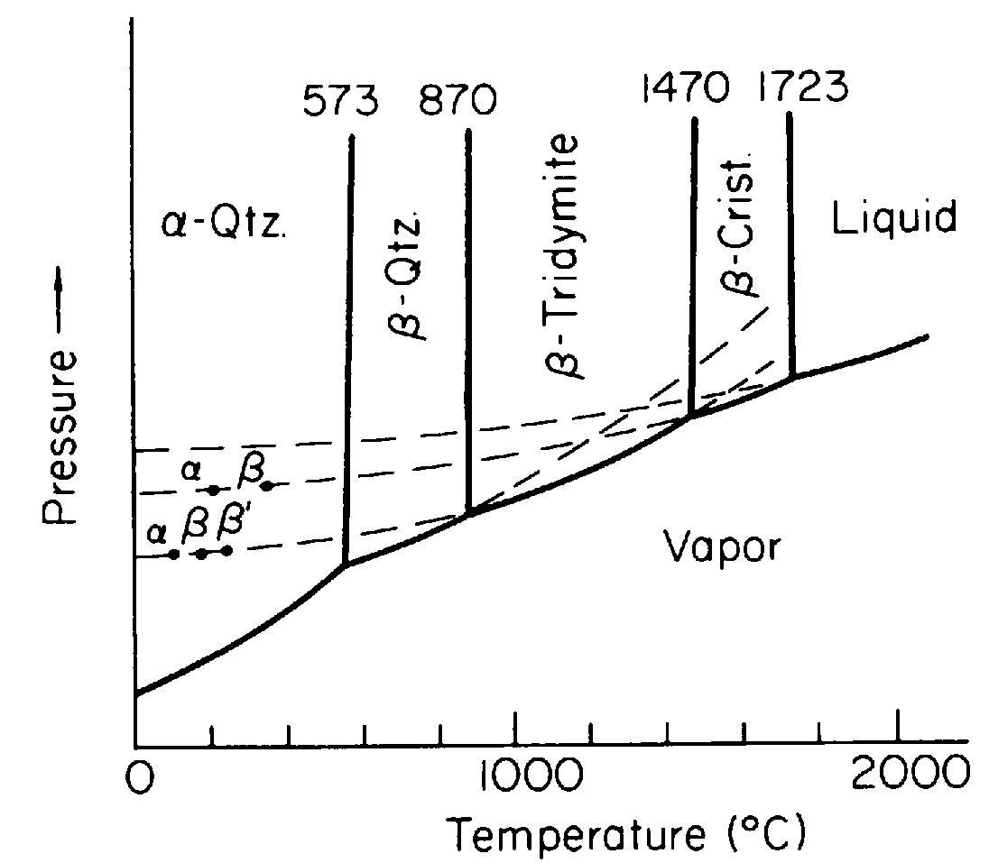
The Silica System
Rapid inversion of alpha- to beta-quartz or alpha- to beta cristobalite, the change in volume is so large
In the manufacture of silica brick, for example, an important goal is to convert a large percentage of the quartz to tridymite so that this damaging alpha- to beta-quartz reaction will not appear again.

Slide 7
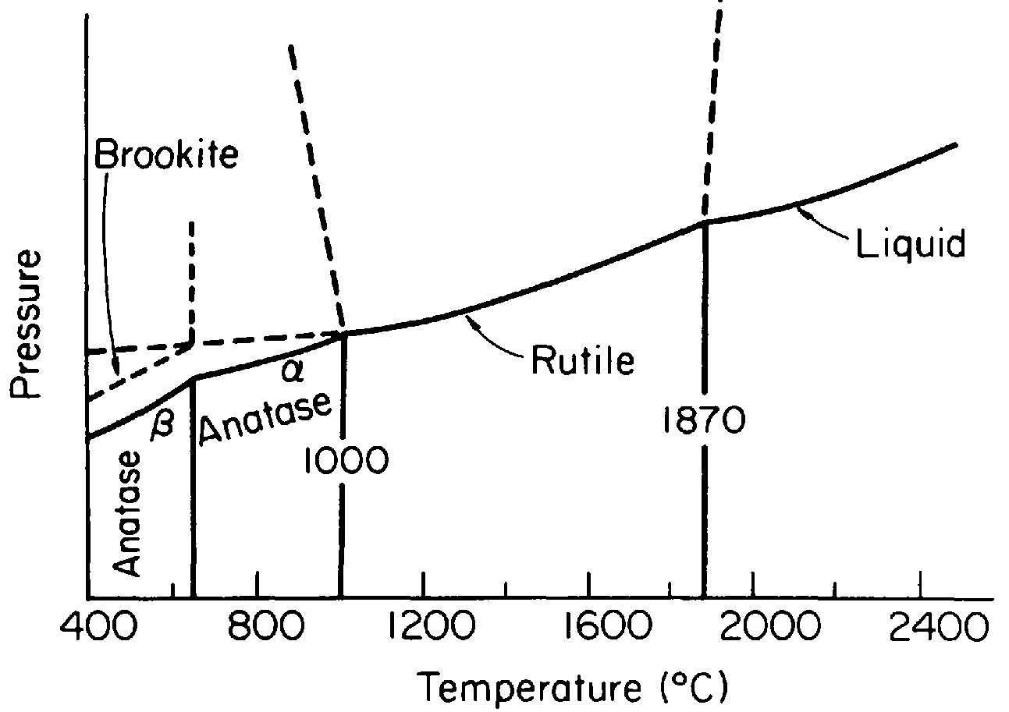
Titania system

Slide 8
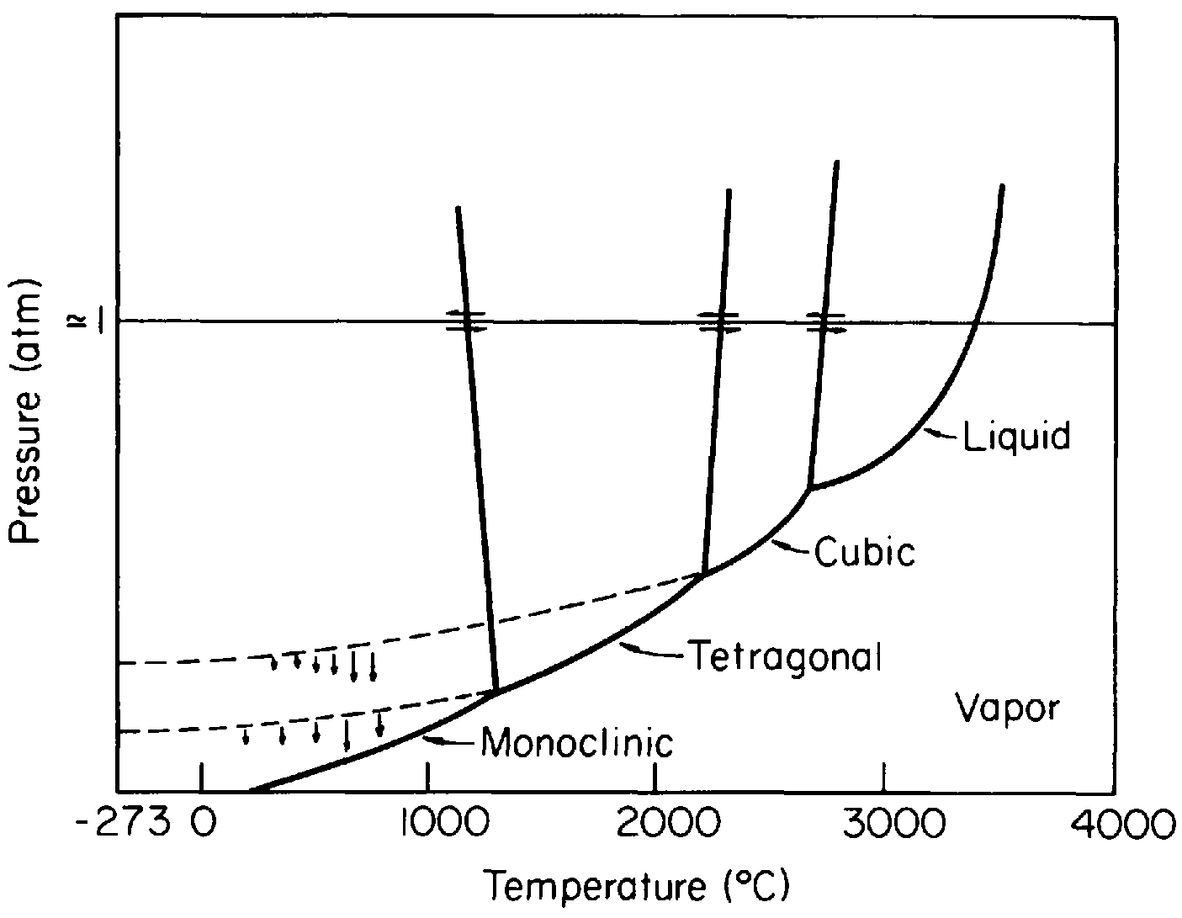
Zirconia Systems

Slide 9
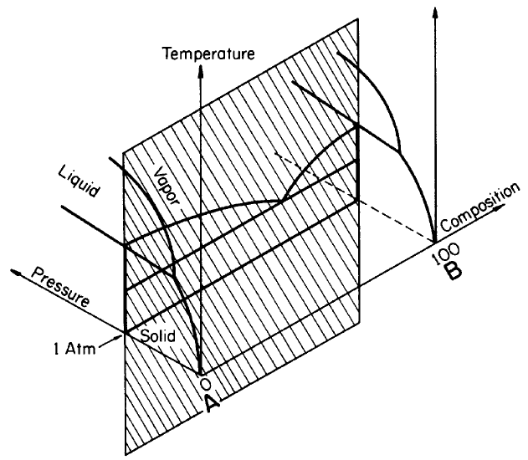
Two-Component System
Is a system consisting of only two components and is also called a binary system
Influenced by three variables: temperature, pressure, and composition.
Represented by a three-dimensional model as shown below

Slide 10
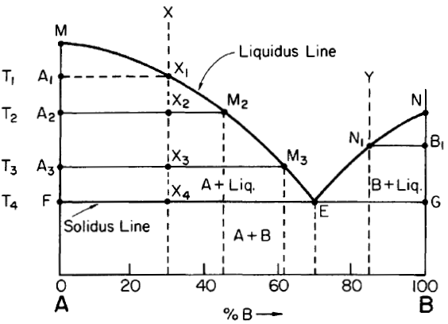
In most systems of ceramic materials, the phase relations are determined at atmospheric pressure thus the phase diagram is reduced to constitution-temperature diagram
Point M and N, freezing points of 100% A and 100%B
ME and NE, locus of the freezing points of the melt at different compositions, called liquidus lines
FG is a line below which no liquid exist, called solidus line
In 1 phase region two variables are needed to uniquely determine the system
In a 2 phase region specifying 1 intensive variable is enough to determine the system
The two phases which are in equilibrium are connected by tie lines (conode), like A₁X₁

Slide 11
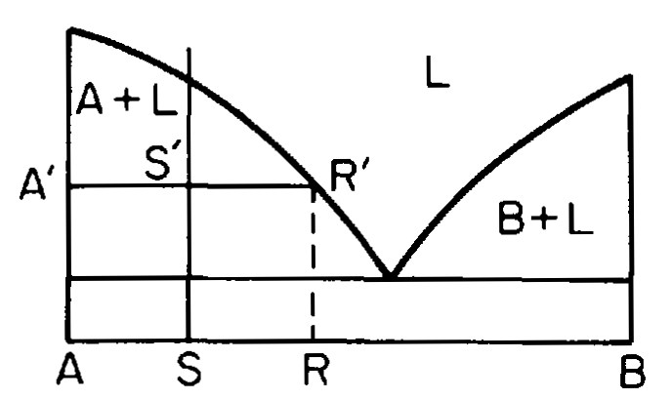

The relative proportions of liquid and crystals of A can be calculated from a relation called the lever rule
Let L = the weight fraction of liquid of composition X_{A}^{l}= RB/AB, X_{B}^{l}= AR/AB
(1 - L) = the weight fraction of solid of composition X_{A}^{s}= AB/AB, X_{B}^{s}= 0
W = the weight of the sample of composition
X_{A}= SB/AB, X_{B}= AS/AB
total weight of A in the sample is equal to the weight of A in the liquid plus the weight of A in the solid phase
X_{A}W= X_{A}^{l} LW + X_{A}^{S} (1-L)W
X_{A} = X_{A}^{l} L+ X_{A}^{S} (1-L)
X_{A}^{S} - X_{A} = L(X_{A}^{S} + X_{A}^{l} )
L= (X_{A}^{S} - X_{A})/(X_{A}^{S} + X_{A}^{l} )= (AB-SB)/(AB-RB)
1-L= (SB-RB)/(AB-RB)

Slide 12
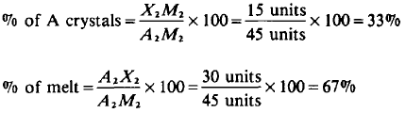
Tracing a cooling melt through a two-phase region (Isoplethal Study)
Melt X is completely liquid
On cooling down to point X, crystals of A begin to appear at point X₁
Cooling the melt from X ₁ to X₂ causes a measurable amount of A crystals to form
Amount and composition of the crystals and melt present at this temperature T₂ are determined by the use of a tie line and the lever rule
Point X₂ is the fulcrum of a lever. One lever arm is A₂X_{2 ,}the distance from point A₂ to point X_{2.}T he other lever arm is X₂M₂
The relative amount of A crystals is given by the lever arm X₂M₂ divided by the sum of the lever arms, A₂M₂. Thus, the percentage of phases at point X₂ is given by

Slide 13
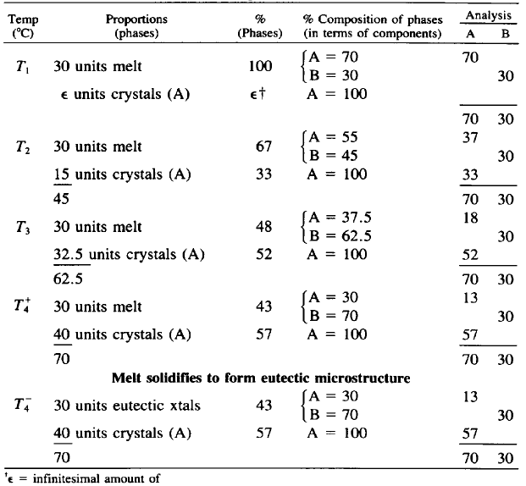
Calculations on Cooling Melt X, 70% A, 30% B

Slide 14
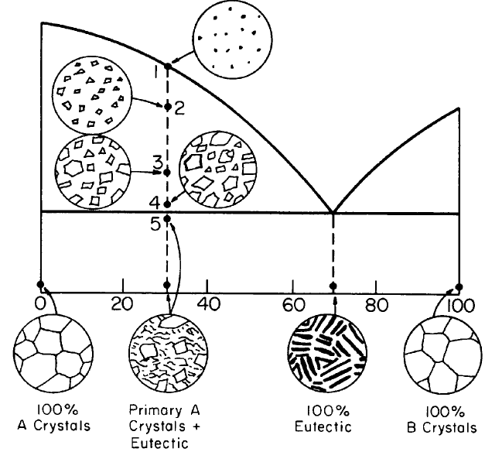

Slide 15

The Binary Eutectic
At point E , the last liquid remaining would crystallize on cooling to form a crystalline mixture of both A and B. This reaction involving a liquid changing to two crystalline phases is called the eutectic reaction
The eutectic reaction is an isothermal three-phase reaction in which a liquid is in equilibrium with two crystalline phases.
In a binary system a melt of eutectic proportions solidifies to form a characteristic microstructure* in which the two phases can always be distinguished
Sometimes the eutectic structure consists of alternate bands of the two phases.
There are many different kinds of eutectic structures; probably the most commonly observed is that described as lamellar-alternate layers or lamellae of the two crystalline phases shown below

Slide 16
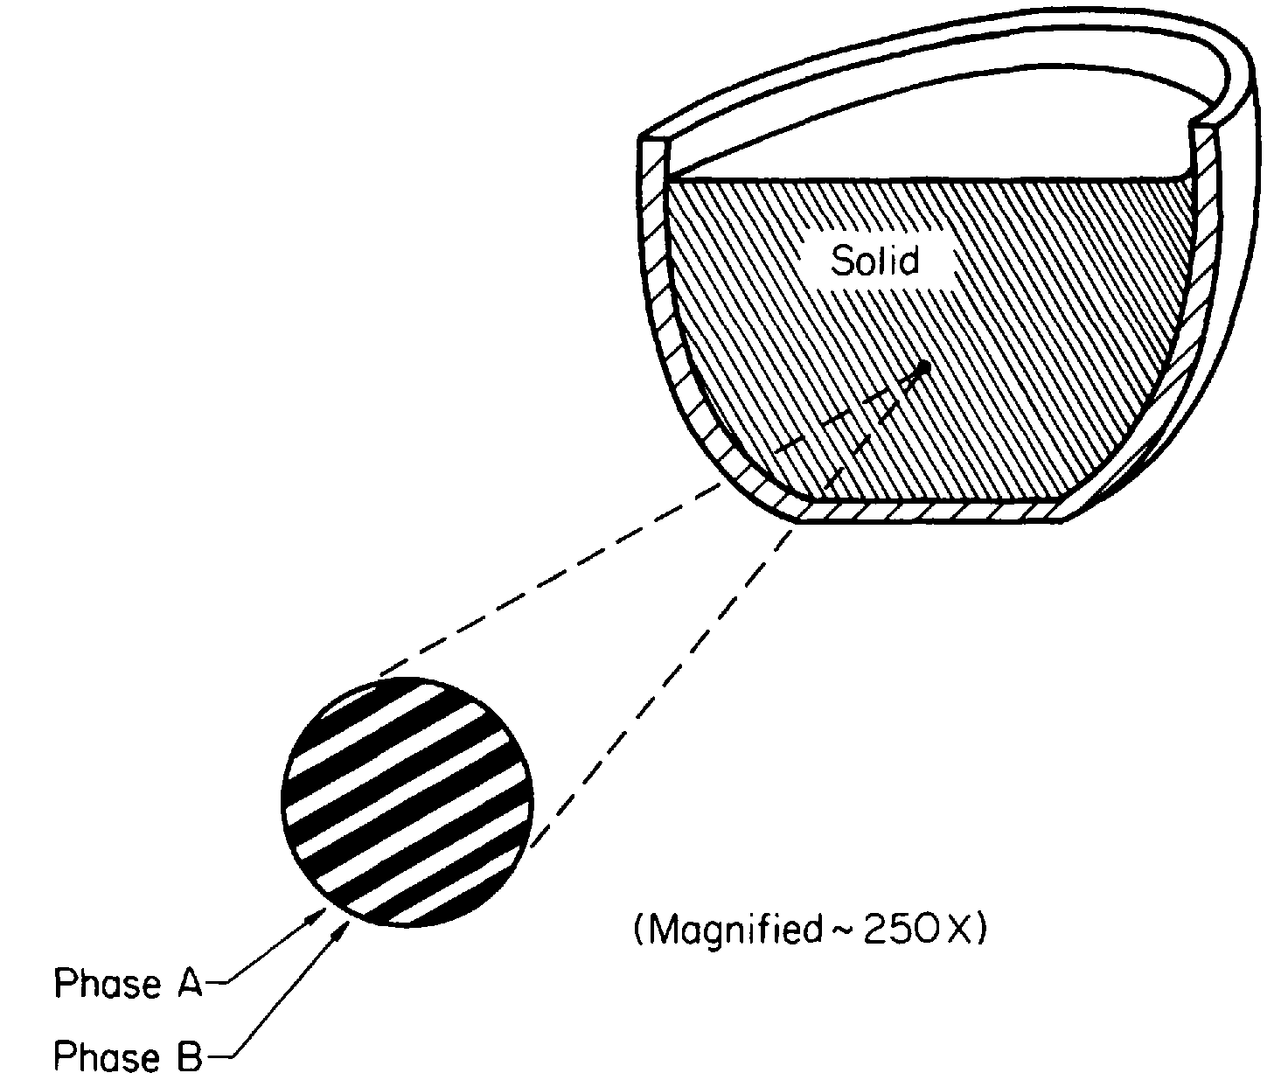
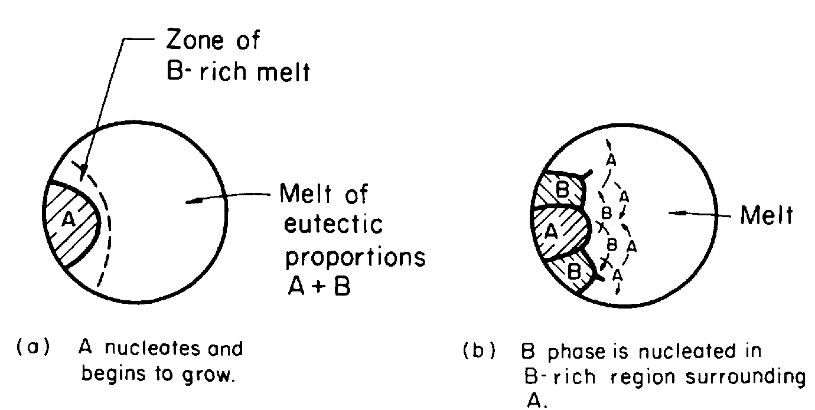

Slide 17
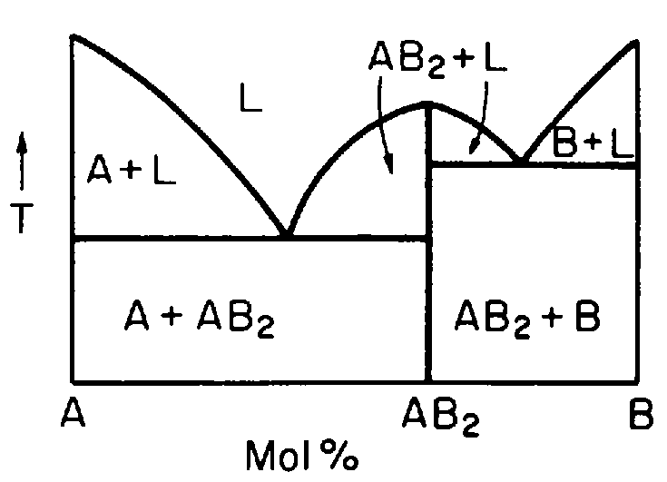
Intermediate Compounds
Compounds composed of two or more components referred to as intermediate compounds
Intermediate compounds are classified as:-
  congruently melting compound:- melts directly to a liquid of chemical composition identical to that of the crystalline compound
  Incongruently melting compounds :- do not melt to a liquid of the same composition but change to a different liquid and another crystalline phase
Congruently melting compounds divide the system into separate, smaller binary systems
The figure shows the compound AB₂ divides the system A-B into the systems AB₂-A and AB₂-B, both of which are simple eutectic systems

Slide 18

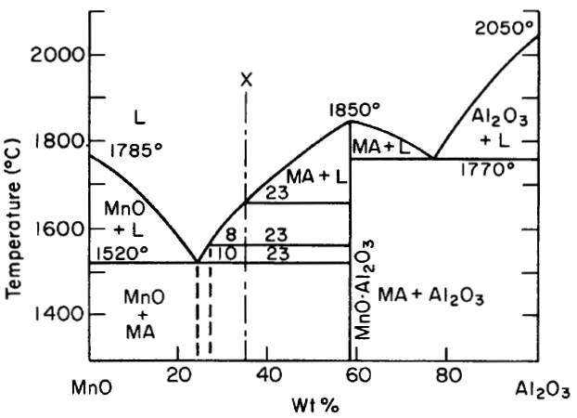
Example of congruently melting system

Slide 19
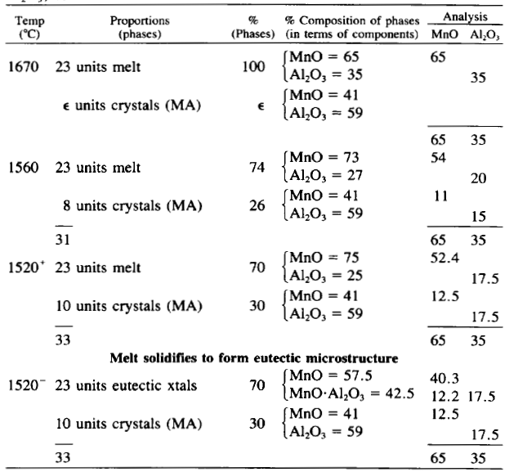
Isoplethal study

Slide 20

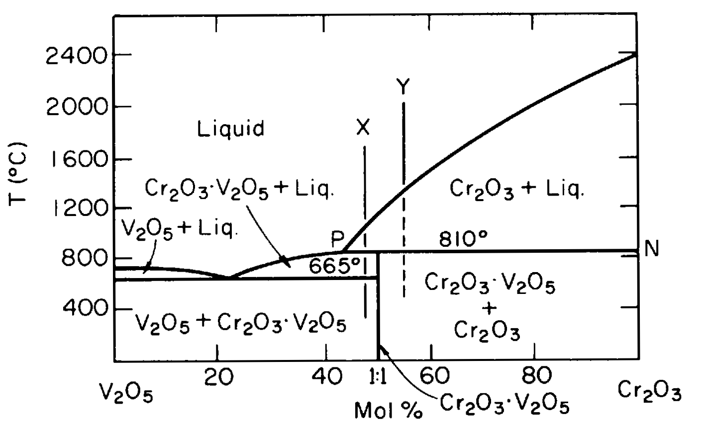
Example of Incongruently melting system
V₂0₅-Cr₂0₃ system in which the intermediate compound Cr₂0₃.V₂0₅ transforms, on heating, to Cr₂0₃ and melt.
(often called peritectic reaction)
A peritectic reaction is an isothermal three-phase reaction in which a crystalline phase is in equilibrium with another crystalline phase and a liquid.
Point P is peritectic point

Slide 21
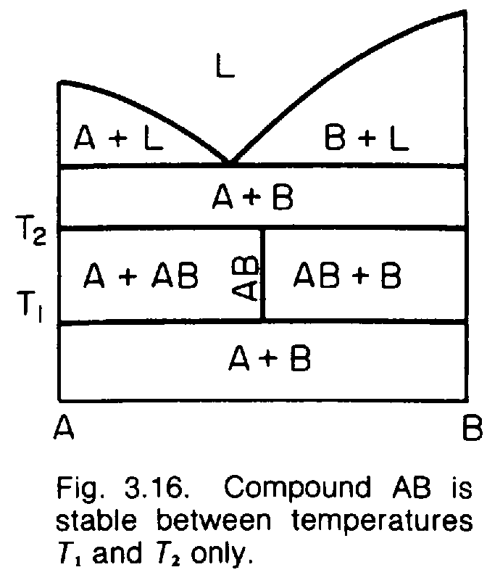
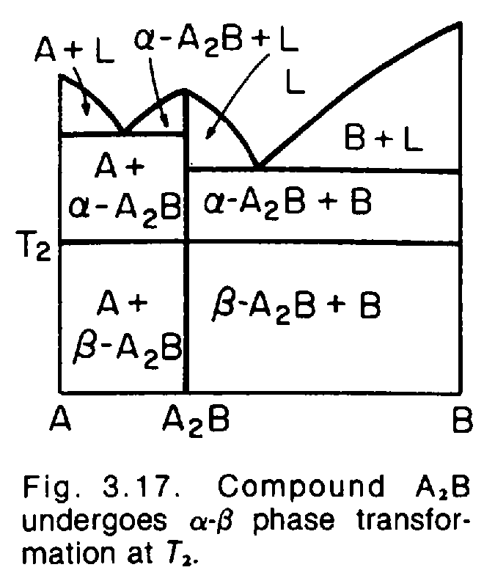
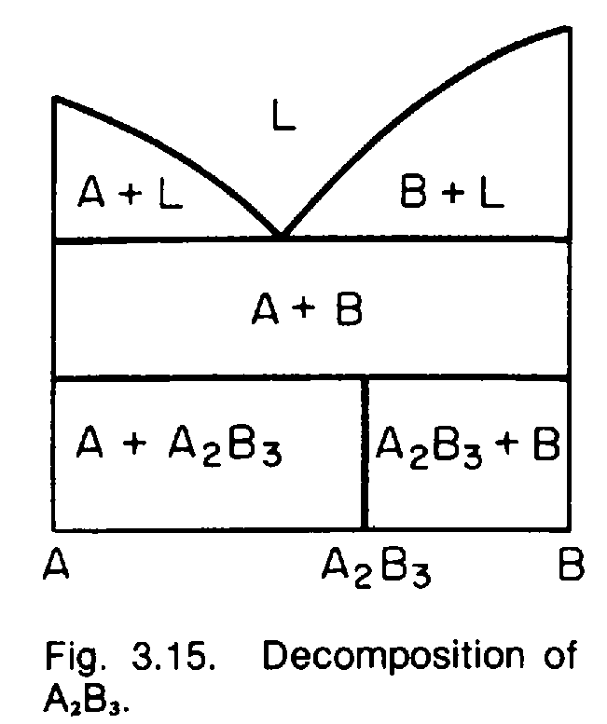
Decomposition
Intermediate compounds may also decompose on heating or cooling, forming two other crystalline phases

Slide 22
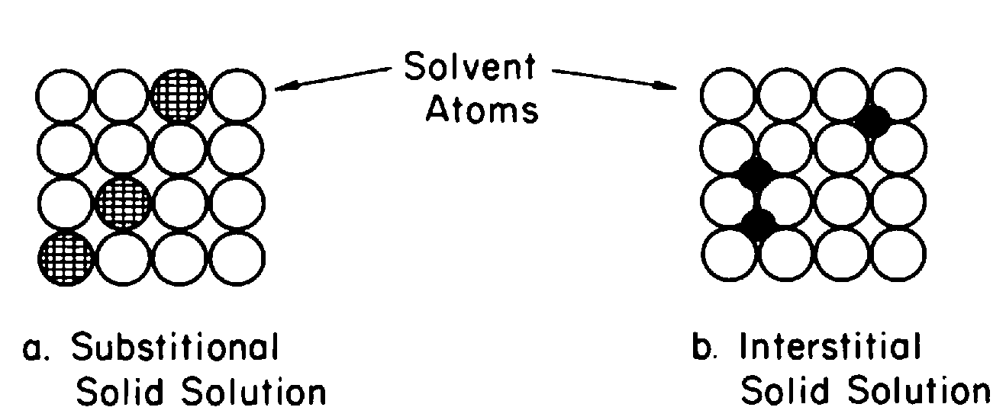
Solid Solution
Solid solution in ceramic materials usually involves systems containing more than two kinds of atoms. E.g. NiO and MgO involves three kinds of atoms: Mg, Ni, and 0.

Slide 23
