Slide 1

Study of Transition Metal (Ni, Co) and Carbon-Based Hybrid Materials for Electrochemical Energy Storage
A Dissertation defense
by
Sintayehu Nibret
June 08, 2018
Supervisor: Prof. Yoon Dae Ho

Slide 2
Contents
Overview
Lamellar structured Co-Ni(OH)₂/reduced Graphene Oxide hybrids (Co-Ni(OH)₂/rGO)
Nickel Cobalt Sulfides/Holey Defect Graphene Hydrogel hybrids (NiCo₂S₄@HGH)
Millerite Core–Nitrogen-Doped Carbon Hollow Shell hybrid Structures (NiS-NC HS)
Conclusions
Publications

Slide 3
Overview

Slide 4
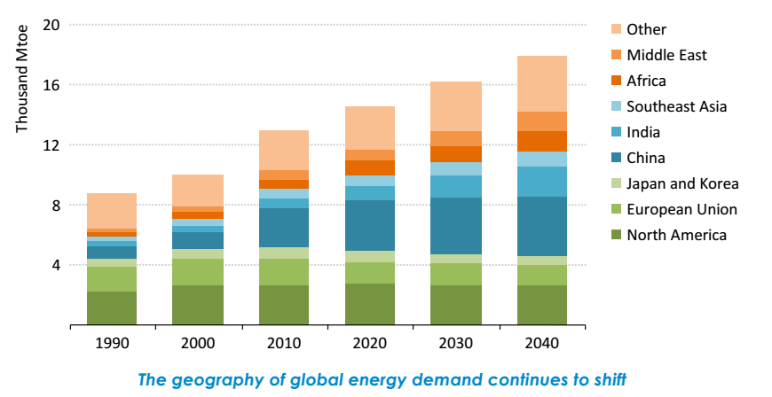
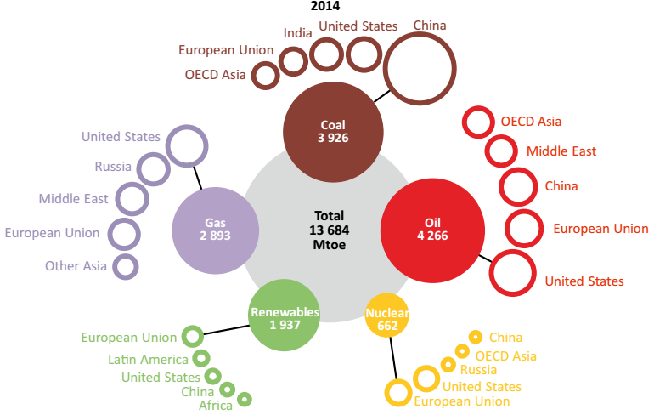
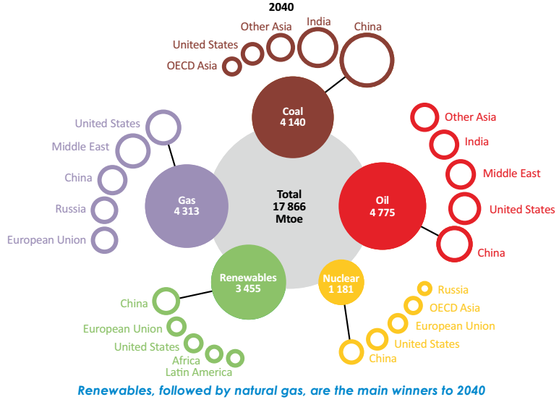
General survey
Rapid growth in energy consumption in the world
Energy scarcity is a primary issue nowadays
Mtoe - Million tonnes of oil equivalent
Source: World Energy Outlook 2016
Renewable energies

Slide 5
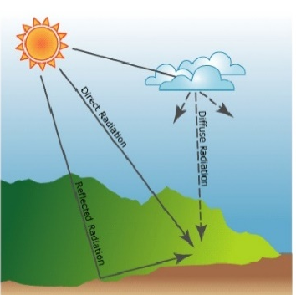

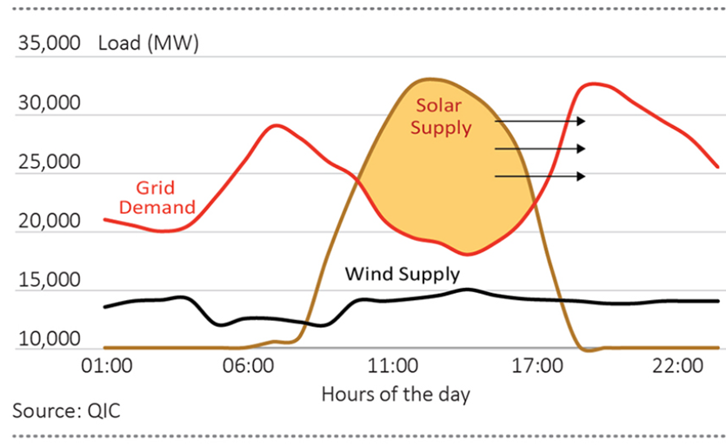
Intermittency of Renewables ??
Wind and solar
add variability and uncertainty to the generation supply
increase the need for grid flexibility.

Slide 6




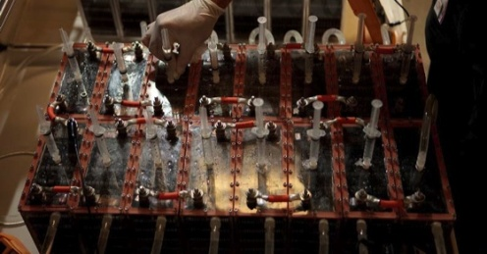
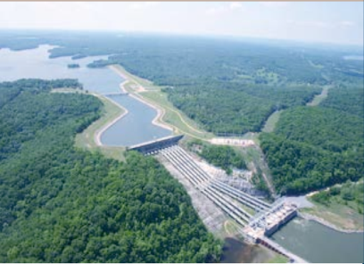



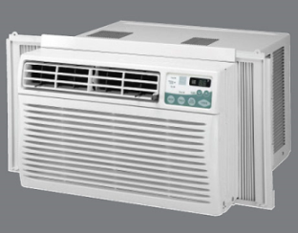

Sustainable Energy Futures
GENERATION:
Wind
Solar
Nuclear
Natural Gas
ENERGY STORAGE:
Battery
Pumped Hydro
Ultracapacitor
ELECTRIC GRID:
Power Lines
APPLICATION:
Electric Car
Appliances
Industry

Slide 7
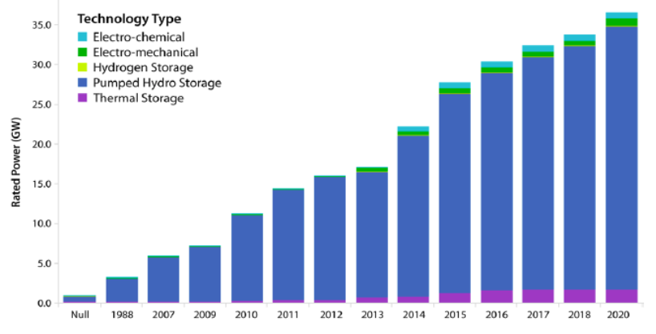
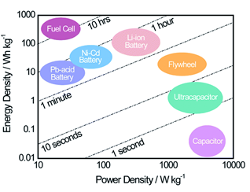
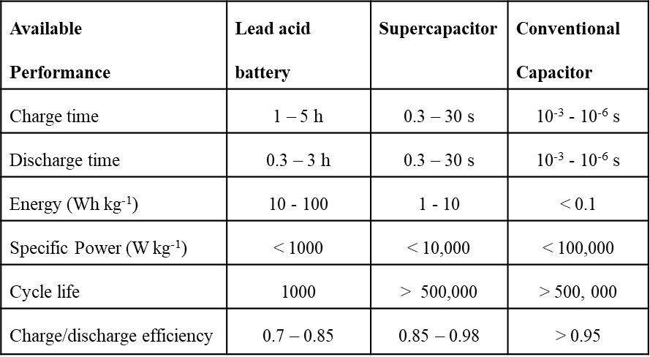
Electrochemical capacitors/Ultracapacitors/Supercapacitors
Source: National Renewable Energy Laboratory
under study to mitigate short-term fluctuations as well as compensate supply and demand.
high power density, long lifespan, and safety in use
bridges the gap between conventional capacitors and rechargeable batteries

Slide 8
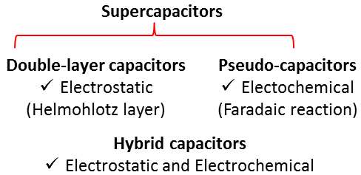
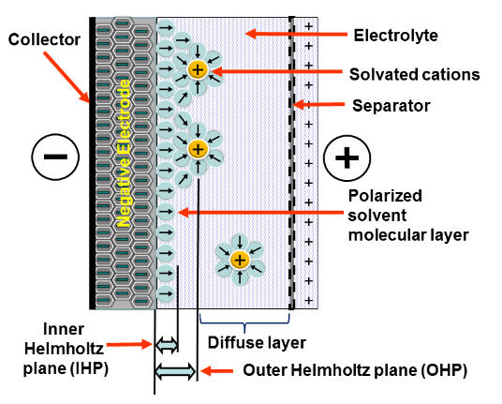
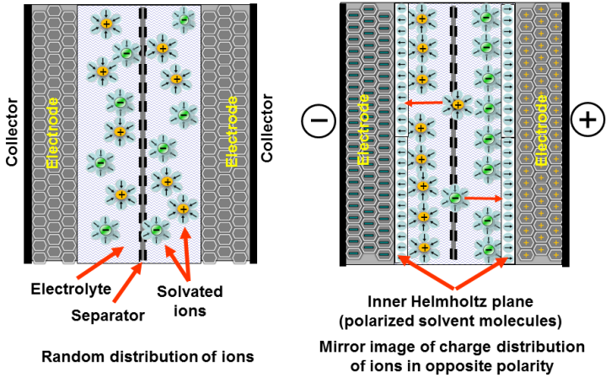
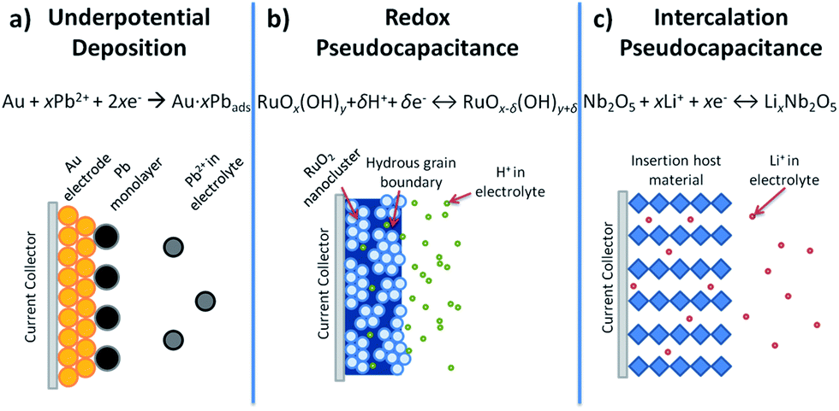
Supercapacitors
Capacitor discharged
Capacitor charged

Slide 9
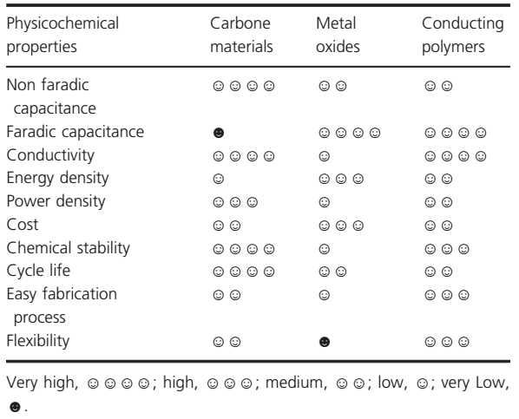
Supercapacitive materials
Energy Science and Engineering 2015; 3(1): 2–26

Slide 10
Issues and Challenges
High energy density, high power density, and durability
Transition metals: low power density but higher energy density
Carbonaceous materials: low energy density but higher power density
Cost of electrode materials (RuO₂ expensive)
Aggregation of active materials during synthesis and cycling ( e.g. graphene, transition metal-based materials)
Rational design of electrode materials

Slide 11
2. Lamellar structured Co-Ni(OH)₂/reduced Graphene Oxide hybrids (Co-Ni(OH)₂/rGO)

Slide 12
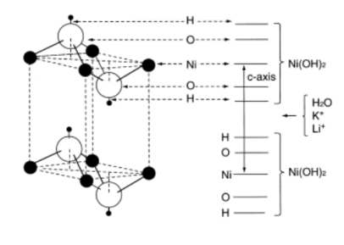
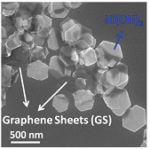
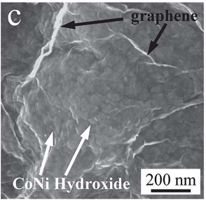
Lamellar Co-Ni(OH)₂/rGO (motivation)
Nickel hydroxide, Ni(OH)₂
Widely used for batteries and potential material for SCs.
low cost, well-defined redox behavior, and high theoretical capacitance (~ 2100 F/g)
But, low electrical conductivity (~ 10 ⁻ ⁵ to 10 ⁻ ⁹ s cm ⁻¹)
Substitution with cobalt, composites with graphene or CNT can improve its conductivity
Ni(OH)₂ grown on lightly oxidized graphene sheets was able to deliver a specific capacitance (Cs) of 1335 F g ⁻¹
Solvothermal
low mass loading (~ 1.5 mg cm⁻²; commercially ~ 10 mg cm⁻²))
J. AM. CHEM. SOC. 9 VOL. 132, NO. 21, 2010
Co-Ni(OH)₂/Graphene/CNT composite delivered ~ 2360 F g ⁻¹ & ~ 1000 F g ⁻¹ without CNT
Poorly crystalline samples, which may decrease discharging capability
Energy Environ. Sci., 2013, 6, 3314–3321

Slide 13
Lamellar Co-Ni(OH)₂/rGO (Approach)
▼ Co precipitation and Hydrothermal synthesis
Unique morphology: supports ion transfer and facilitates electron conduction
Improve crystallinity: electrical conductivity
Ease of synthesis: hydrothermal than solvothermal
Mass loading: relatively higher
Hybrid structure
Lamellar structured Co-Ni(OH)₂ /reduced graphene oxide composite

Slide 14





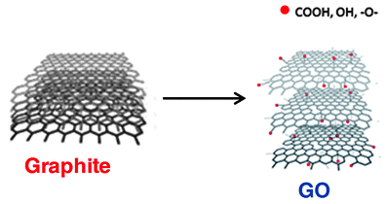
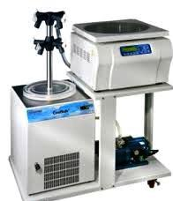
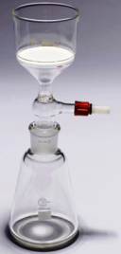
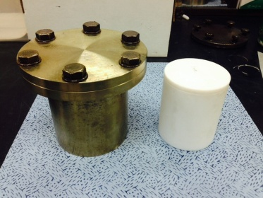
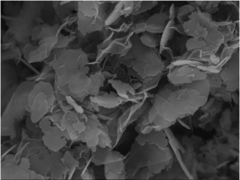
Lamellar Co-Ni(OH)₂/rGO (Experimental procedures)
a
Graphite
Oxide
Graphene
oxide
dispersion
NH₄OH ~ pH = 9
N₂H₄.H₂O
(1 µl / 1 mg GO)
28 ml
DI water
3 hr
Sonication
Ni(NO₃).6H₂O
140 mg
Precipitation
15 minutes
stirring
Co-Ni(OH)₂/rGO
3 hr, 90 °C
stirring
modified
Hummer’s
Method
Co(NO₃).6H₂O
140 mg
Sample@room temperature
1 µm
10 hr,
90 °C
120 °C
150 °C
180 °C
Washing
DI H₂O
60 ml

Slide 15

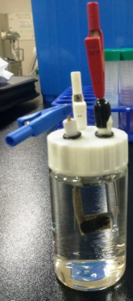
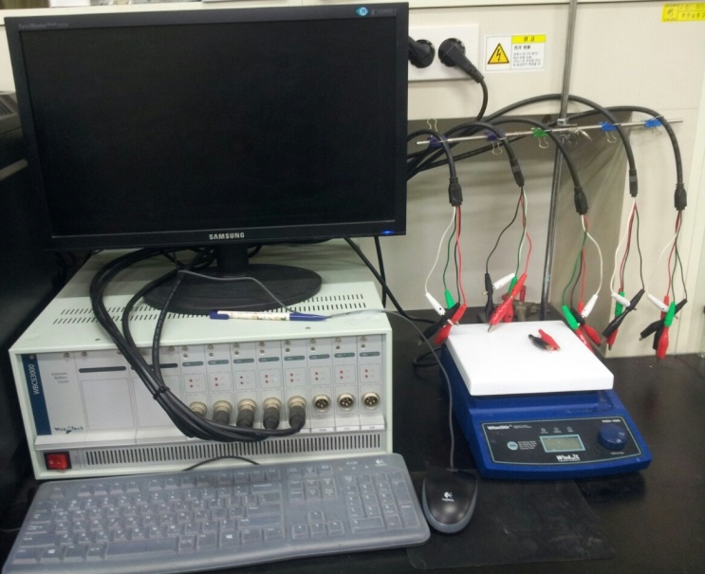
Lamellar Co-Ni(OH)₂/rGO (Electrode Fabrication)
Analysis
< Electrodes >
Ag/AgCl: reference electrode (R)
Pt wire: Counter electrode (C)
Samples: Working electrodes (W)
< Materials>
Carbon black : 10 %
PVDF: 10 %,
Samples: 80 %
< Solvent>
Iso-propanol
Cyclic voltammetry
Galvanostatic charge discharge
Electrochemical impedance spectroscopy
< Mass Loading>
On Ni foam and pressed
120 °C, 24 hr
Soaking in 2M KOH, 24 hr
Working electrode (W)
Potentiostat
Notes:
To synthesize Carbon@rare earth doped Ga(OH)CO3 core-shell structures, we choose the raw materials. The controlled temperature profile was based on the TG/DTA data. So, The obtained hollow Ga2O3 nanostructures are converted GaN in NH3 at from 800 ~ 1000 degree C. and then synthesized particles were analyzed by

Slide 16
Results: Lamellar Co-Ni(OH)₂/rGO
Room temp , ( b) 90 °C, (C) 120 °C (d) 150 °C, (e) 180 °C and (f) XRD patterns
Flakes ~ 1 µm
rGO can be seen from wrinkles
Plates can be taken as Co-Ni(OH)₂
Coated on top/bottom of rGO or sandwich it.
All are Planes of β-Ni(OH)₂ except (003) and (006) planes which indicate hydrotalcite like structure
Phase transition α to β-Ni(OH)₂ for T > 90 °C
No diffraction peaks ~ 25 ° and 42 °
indicates Co-Ni(OH)₂ on rGO can prevent graphene sheets from stacking into multilayers
Hydrothermal synthesis can improve crystallinity of the composite
β-Ni(OH)₂ (JCDPS card No-14-0117)
GO : metal precursor is 1:10, Time = 10 h

Slide 17
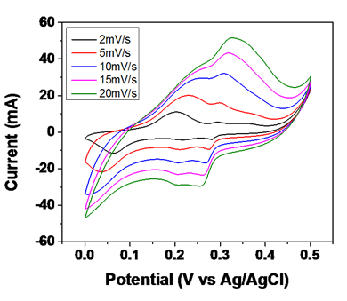
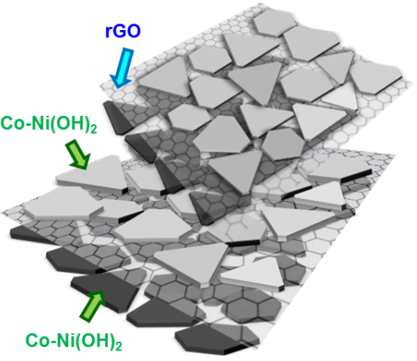
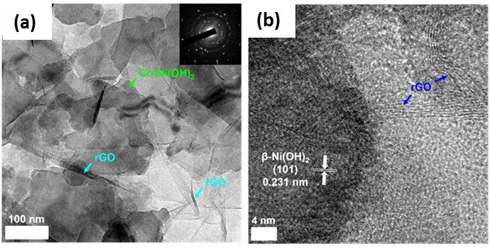
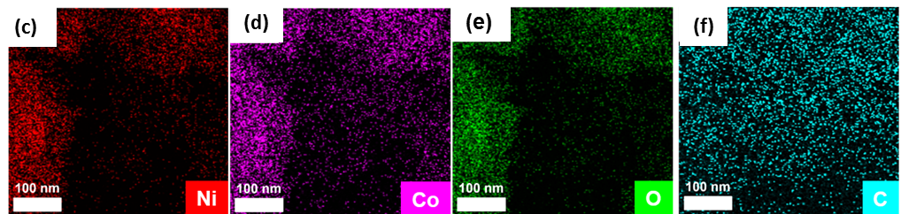
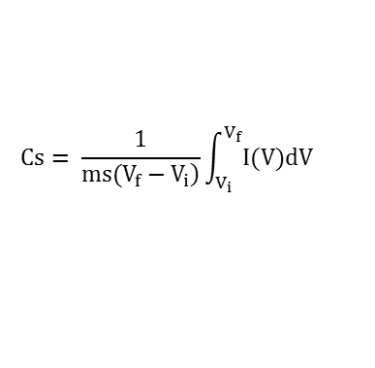
Results: Lamellar Co-Ni(OH)₂/rGO
Specific Capacitance , Cs [F g⁻¹]
Scan rate [mV s⁻¹] | Temperature
 | RT | 90 °C | 120 °C | 150 °C | 180 °C
2 | ~ 395 | ~ 349 | ~ 515 | ~ 500 | ~ 264
5 | ~ 335 | ~ 296 | ~ 408 | ~ 455 | ~ 226
10 | ~ 290 | ~ 253 | ~ 315 | ~ 404 | ~194
15 | ~ 255 | ~ 224 | ~ 257 | ~ 360 | ~ 170
20 | ~ 149 | ~ 160 | ~ 182 | ~ 327 | ~ 141
$$Cs= \frac{1}{\left.ms(V_{f}−V_{i}\right)}\int_{V_{i}}^{V_{f}}{I(V)dV}$$
Cs retention:
150 °C ~ 66%
120 °C ~ 35 %
Redox peaks
Co(OH)₂ + OH⁻ ↔ CoOOH + H₂O + e⁻
Ni(OH)₂ + OH⁻ ↔ NiOOH + H₂O + e⁻
High crystallinity gives higher conductivity but loss of surface area might occur simultaneously (e.g. Cs@180 °C).
T@150 °C & Time@10 h, different GO: metal precursor, 1:10, 1:7.5, and 1:5

Slide 18
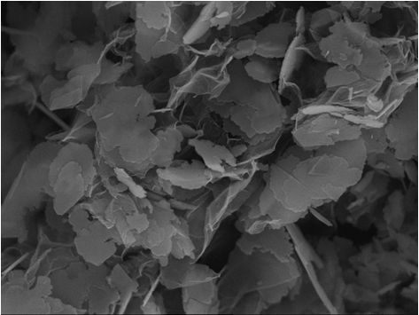
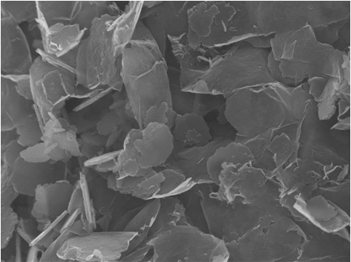
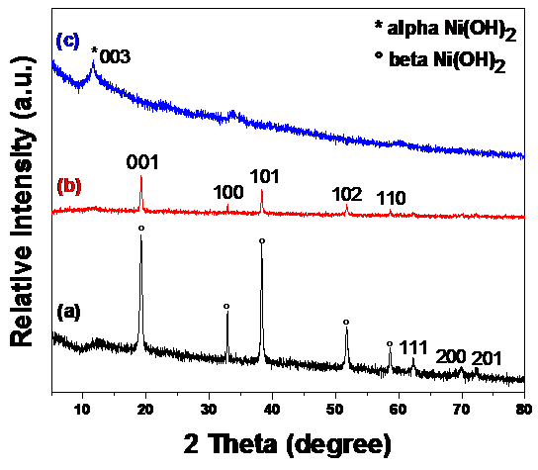
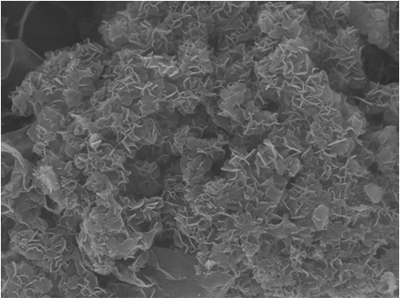
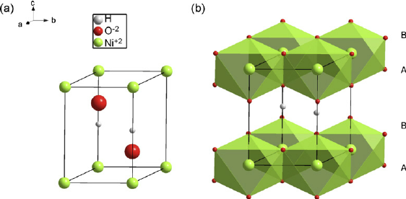
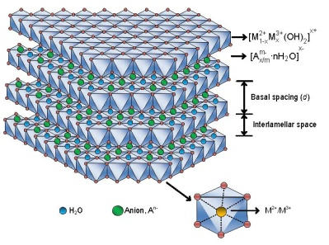
Lamellar Co-Ni(OH)₂/rGO: (a) 1:10, (b) 1:7.5, & (C)1:5
(a)
(b)
1 µm
1 µm
(c)
1 µm
T@150 °C & Time@10 h
( For different GO: metal precursor)
At low and moderate amount of GO (a & b), plate like structures were observed
At high amount of GO (c), metal hydroxides grew vertically on rGO
As amount of GO increases, degree of crystallinity decreases
(a) and (b) kept similar peaks with beta form of Ni(OH)₂ while (c) has hydrotalcite like structure

Slide 19
Lamellar Co-Ni(OH)₂/rGO; GO: metal precursor ratios
Specific Capacitance , Cs (F g⁻¹)
Scan rate (mV s⁻¹) | 1:5 ratio 10 h | 1:7.5 ratio 10 h | 1:10 ratio 10 h | 1:5 ratio12 h
2 | ~ 646 | ~ 521 | ~ 500 | ~ 617
5 | ~ 472 | ~ 396 | ~ 455 | ~ 539
10 | ~ 375 | ~ 333 | ~ 404 | ~ 416
15 | ~ 329 | ~ 292 | ~ 360 | ~ 344
20 | ~ 297 | ~ 265 | ~ 327 | ~ 294
Specific Capacitance , Cs (F g⁻¹)
Current density (A g ⁻¹) | 1:5 ratio 10 h | 1:7.5 ratio 10 h | 1:10 ratio 10 h | 1:5 ratio 12 h
0.5 | ~ 1294 | ~ 536 | ~ 611 | ~ 811
1 | ~ 1171 | ~ 530 | ~ 581 | ~ 784
2 | ~ 891 | ~ 461 | ~ 542 | ~ 730
(a &b) Lamellar Co-Ni(OH)₂/rGO; 150 °C, 1:5 ratio, and 12 h.
High Cs displayed by poorly crystalline Co-Ni(OH)₂/rGO
Higher Cs retention by crystalline Co-Ni(OH)₂/rGO
Trade off
Increase T from 10 h to 12 h
Poorly crystalline, its surface area might be higher but will have low electrical conductivity due to tendency of forming highly porous microstructure
Lamellar Co-Ni(OH)₂/rGO; 150 °C, 1:5 ratio, and 12 h

Slide 20
Lamellar Co-Ni(OH)₂/rGO; 150 °C, 1:5, & 12 h
Co: 782.36 & 797.8 eV
Ni: 856.96 & 874.56 eV
Spin energy separation ~ 17.6 eV
XPS spectra (a) C 1s, (b) O 1s, (c) Co 2p, and (d) Ni 2p
Rct values:
150 °C, 1:10, & 10 h = 0.608 Ω
150 °C, 1:5, & 12 h = 0.885 Ω
150 °C, 1:5, & 10 h = 1.044 Ω
RT = 2.51 Ω
(a) EIS and (b) Stability analysis

Slide 21
Results: Lamellar Co-Ni(OH)₂/rGO
Material | Method of synthesis | Mass loading [mg cm ⁻²] | Cs [F g⁻¹] | Current density [A g⁻¹] | Remarks (mass loading) | Reference
Co-Ni(OH)₂/rGO | Co precipitation followed by hydrothermal | 4.5-5.5 | 811 | 0.5 | High | This study
rGO/Co(OH)₂ | One-pot process at 95 °C | - | 474 | 1 | - | [41]
Ni-Co binary hydroxide | Hydrolysis in the presence of a surfactant | 1 | 1030 | 3 | small | [40]
Ni-Co binary hydroxide | Hydrolysis in the presence of a surfactant | 2.8 | 804 | 3 | small | [40]
NiCo₂O₄@RGO | Hydrothermal | 5.6–10.2 | 737 | 1 | - | [42]
NiCo₂O₄–rGO | Hydrothermal (water-ethanol mixture) | 3.5 | 882 | 1 | Small | [43]
Co(OH)₂/graphene/Ni foam nano-electrodes | RF-PECVD and electrodeposition | - | 693.8 | 2 | - | [44]
Co−Al LDHs/graphene nanosheets | Hydrothermal | - | 581.6 | 2 | - | [45]
NiCo₂O₄–RGO | Self-assembly and subsequent thermal treatment | 2 | 835 | 1 | Small | [46]
A small mass loading change can reduce the Cs significantly.
There was a 226 F/g decrease in Cs for the same sample [40]

Slide 22
Summary
Unique lamellar structured Co-Ni(OH)₂/rGO were synthesized
Crystallinity of the samples increases with hydrothermal synthesis temperature
Crystalline samples show higher Cs values than poorly crystalline samples
Crystalline samples have good capacitance retention due to their enhanced conductivity
Highest Cs ~ 811 F/g @0.5 A g⁻¹ (@150 °C, 1:5 ratio for 12 h)

Slide 23
3. Nickel Cobalt Sulfides/Holey Defect Graphene Hydrogel
Hybrids (NiCo₂S₄@HGH)

Slide 24
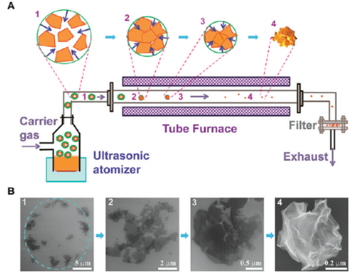
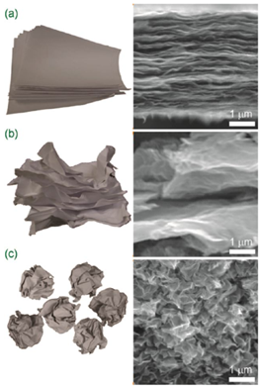
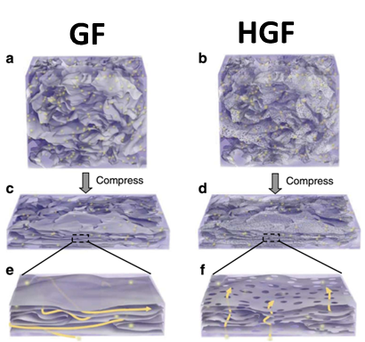
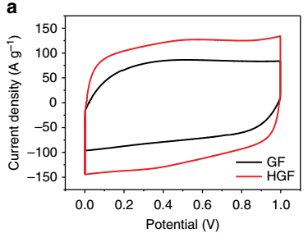
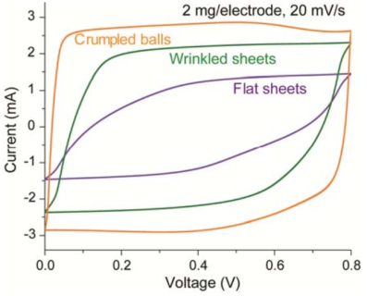

Background: Graphene
Graphene has ultrahigh theoretical specific surface area ~ 2,630 m² g ⁻¹
But tends to agglomerate and restack to form graphite
π–π stacking and van der Waals interactions
Suppresses its high surface area and reduces kinetic ion transport
Y. Xu, Z. Lin, X. Zhong, X. Huang, N.O. Weiss, Y. Huang, X. Duan, Nat. Commun. , 2014, 5, 4554
GF film
Ions need to travel much longer distance to find the broken edge of graphene sheet to cross each layer
HGF film
Nanopores act as ion transport shortcuts between neighboring layers of graphene
Greatly speed up the ion transport across the entire HGF film
J. Luo, H.D. Jang, J. Huang, ACS Nano, 2013, 7, 1464-1471
Aggregation-resistant properties of the crumpled particles allow:
High accessible surface area and thus high Cs
Free space inside and between the crumpled particles can facilitate charge transport

Slide 25
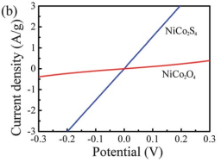
Background: Metal sulfides
Pseudocapacitors
Specific capacitance ~ 10 -100 x EDLC
Mechanical degradation and low conductivity
Pseudocapacitive electrodes are prepared by mixing the active material with binders and conducting agents; creating dead surface
Metal sulfides
Good electrochemical activity and electrical conductivity than metal oxides/hydroxides
Approach:
Synthesize hybrid electrode material
less agglomerated
mechanically stable
Free of binder and conducting agents
Better conductivity
Improved electrochemical performance
Nanoscale, 2013, 5, 8879
Ni-Co Sulfide Embedded in Free-Standing Holey Defect Graphene Hydrogel (HGH)

Slide 26
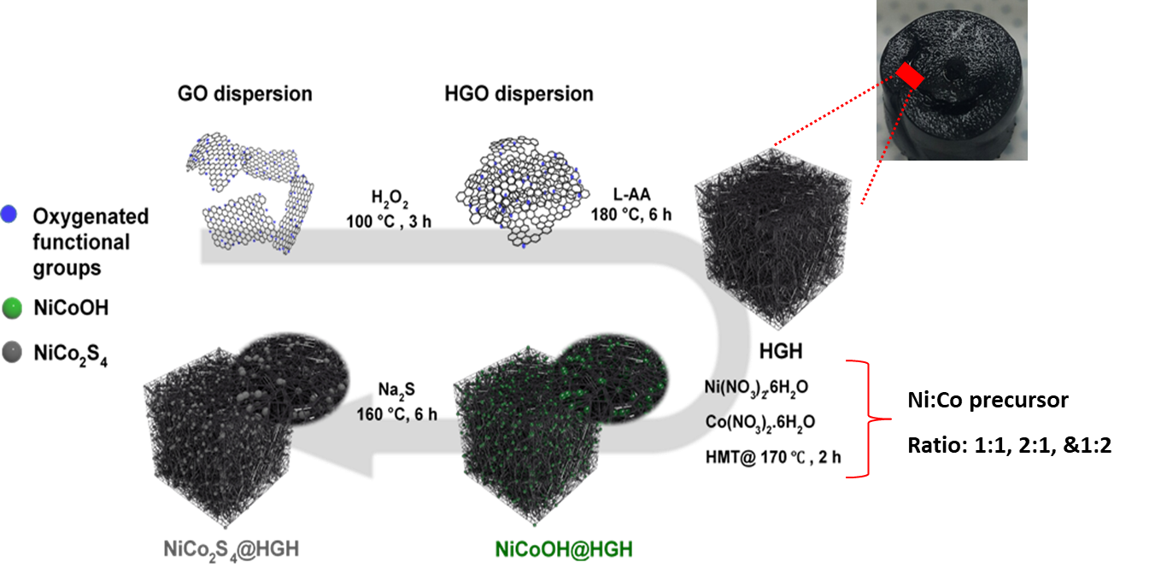
Schematic illustration: NiCo₂S₄@HGH

Slide 27
Results: SEM, XRD, and Raman
(a) HGH, (b) NiCo₂S₄, (c) Ni₂CoS₄@HGH (2:1 ratio), & (d) NiCoS@HGH (1:1 ratio)
24.7° and 43° correspond to (002) and (101) planes of HGH
31.3°, 38.1°, 50.2°, 55.2°, 58.5° & 62.1°correspond to (311), (400), (511), (440), (531) and (620) planes of cubic-type NiCo₂S₄ (JCPDS 20-0782)
1340 cm⁻¹ and 1590 cm⁻¹ are ascribed to the D and G bands of HGH
478 cm⁻¹ can be assigned to a typical Raman vibration mode of NiCo₂S₄
Porous networks are observed in all the hybrids and HGH
Nickel cobalt sulfide nanoparticles were obtained in the hybrid structure
larger particles sizes for bare NiCo₂S₄

Slide 28
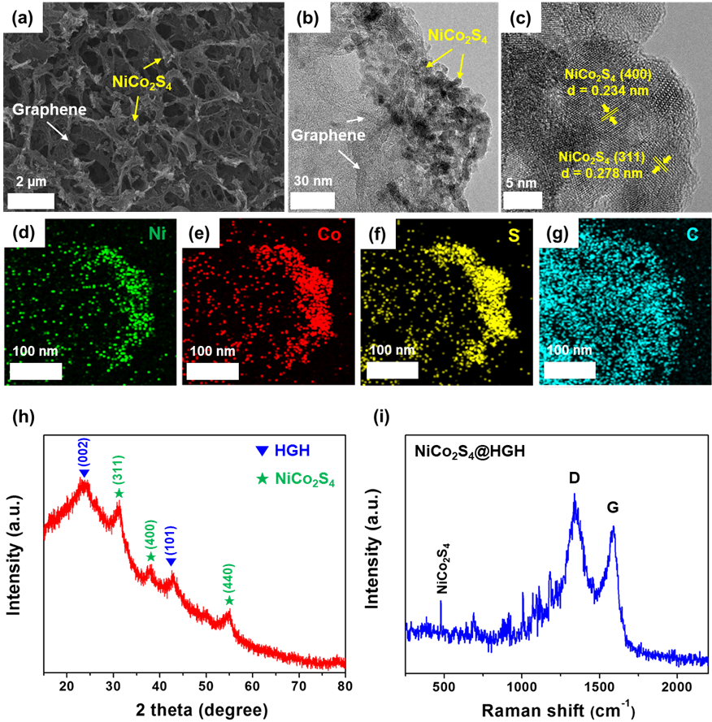
NiCo₂S₄@HGH
Entrapped NiCo₂S₄ nanoparticles in the HGH
HRTEM result matches well with XRD
Even distribution of the elements Ni, Co, & S in HGH
HGH is responsible for the formation of NiCo₂S₄ nanoparticles
Two diffraction peaks from the HGH in the NiCo₂S₄@HGH are weaker than those from pristine HGH because of the incorporation of the NiCo₂S₄
Successful preparation of NiCo₂S₄@HGH

Slide 29
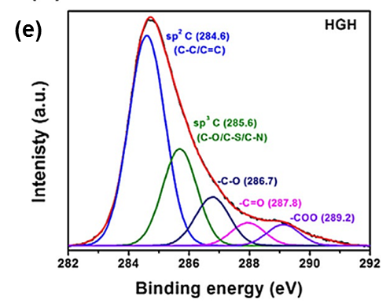
NiCo₂S₄@HGH
Aromatic linked carbon (C-C/C=C) at 284.6 eV (C-O) at 285.9 eV, and (C=O) at 286.7 eV
(-C=O- at 287.8 eV and –COO at 289.2 eV) disappeared in the C 1s spectrum of the composite
further reduction of the HGH during the Solvothermal process
Near surface of the NiCo₂S₄@HGH sample has a composition of Ni²⁺, Ni³⁺, Co²⁺, Co³⁺, and S²⁻
NiCo₂S₄ was successfully embedded in HGH

Slide 30
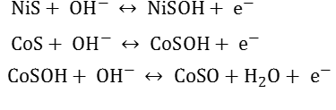
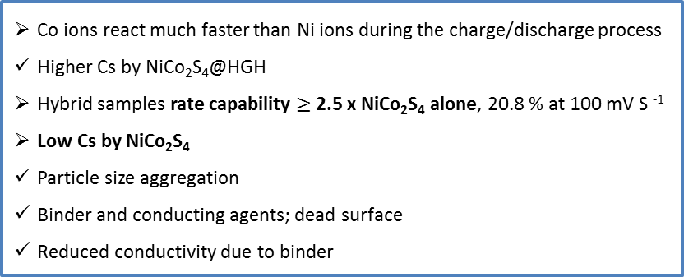
NiCo₂S₄@HGH: 3-electrode configuration
(a) CV curves, (b) Specific capacitances, (c &d) GCD curves & Cs of NiCo₂S₄@HGH, (e) Nyquist plot, & (f) Cyclic stability of NiCo₂S₄ @HGH
Redox couples Ni^{2+/}Ni³⁺ and
Co²⁺/Co³⁺/Co⁴⁺
Co ions react much faster than Ni ions during the charge/discharge process
Higher Cs by NiCo₂S₄@HGH
Hybrid samples rate capability $≥$2.5 x NiCo₂S₄ alone, 20.8 % at 100 mV S ⁻¹
Low Cs by NiCo₂S₄
Particle size aggregation
Binder and conducting agents; dead surface
Reduced conductivity due to binder
Ni₂CoS₄@HGH highest R_{ct} ~ 0.428 Ω < NiCoS@HGH (~ 0.326 Ω)
Inappreciable R_{ct} was observed for NiCo₂S₄@HGH
HGH ~ 0.58 Ω, that of NiCo₂S₄ ~ 0.917 Ω
Neither HGH nor NiCo₂S₄ alone, but rather the combination of NiCo₂S₄ and HGH, which displays good electrochemical performance

Slide 31
NiCo₂S₄@HGH: symmetric solid state Supercapacitor
P 21.3 to 9.34 Wh kg⁻¹
E 2.1 to 8.4 kW kg⁻¹
(a) Symmetric NCSH/NCSH supercapacitor, (b) CV curves (c) GCD curves (d) Specific capacitances (e) Ragone plot (f) Cyclic performance of NCSH/NCSH

Slide 32
Summary
Ni–Co sulfide@HGH hybrid structures have been successfully synthesized
NiCo₂S₄@HGH ~ Cs of 1000 F g⁻¹ @ 0.75 A g⁻¹ and 96.6% after 2100 cycles
Symmetric solid-state NCSH/NCSH supercapacitor exhibited high energy and power densities with remarkable cycling stability
Excellent electrochemical performances
Unique structure which decrease the diffusion limitations for electrolyte ions
Exclusion of binders and conducting agents, which create a dead zone in the electrode
Richer oxidation states of Ni and Co
High electronic conductivity of the as-prepared NiCo₂S₄@HGH electrode

Slide 33
4. Millerite Core–Nitrogen-Doped Carbon Hollow Shell hybrid Structures (NiS-NC HS)

Slide 34
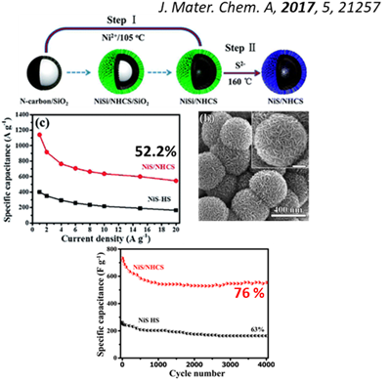
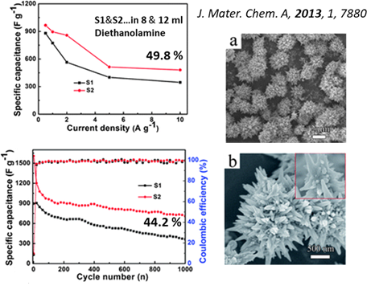
Background: Motivation
Metal sulfides
Good electrochemical activity and electrical conductivity than metal oxides/hydroxides.
Nickel sulfides phases: NiS, NiS₂, Ni₃S₂, Ni₃S₄, Ni₇S₆, and Ni₉S₈
Issues
Poor conductivity, aggregation, and cycling stability.
Collapse of the flower-like β-NiS structure
Susceptible design, 76 % after 4000 cycles

Slide 35
Approach
Hollow Carbon
high electronic conductivity
substantial electrochemical steadiness
Prevents aggregation of metal sulfides
Metal sulfides
Provide high Cs
NiS core – Nitrogen doped carbon hollow shell (NiS-NC HS)

Slide 36

Schematic illustration: NiS-NC HS

Slide 37



Results: NiS-NC HS
Stretching (1572 cm⁻¹) and deformation (1372 cm⁻¹)of the PDA aromatic rings (a)
G-band :- Vibration of the sp2-hybridized C atoms in a two-dimensional hexagonal lattice
D-band:- Vibrations of the sp3-hybridized C atoms with the dangling bonds in the termination plane of the disordered graphite
2D:- higher extent of graphitic ordering
Dopamine hydrochloride : Ni ratio
1:2 optimum
Etching time
45 min optimum

Slide 38

Results: NiS-NC HS
FE-SEM images of (a) Ni-NC, (b) 45 min etched Ni-NC HS (Inset: BSE image), and (c) NiS-NC HS/18h. (d) TEM, (e) HR-TEM, (f) STEM, and (g-j) EDS mapping images of NiS-NC HS/18h. (k) XRD patterns of NiS-NC HS prepared at different sulfidation times.

Slide 39

Results: Pristine Ni₃S₂ and the Ni₃S₂–NC
FE-SEM images of (a) Pristine Ni₃S₂ and (b) Ni₃S₂-NC/6h. (C) XRD patterns of Pristine Ni₃S₂ and Ni₃S₂-NC/6h.
Lack of the void space to accommodate the volume expansion
Collapse of the NC shell accompanied by aggregation

Slide 40

Results: NiS-NC HS
C 1s :- 284.6 eV, 285.9 eV, 287.1 eV,
and 288.7 eV
Appearance of the N 1s peak is
direct evidence of the N doping
398 eV, 399.15 eV, and 400.7 eV
Ni 2p:- Two spin-orbit doublets with two shakeup satellites for each
853.2 and 870.6 eV
855.5 and 873.1 eV
Binding energies suggest the characteristic of Ni²⁺
S 2p :- 161.7 eV and 162.9 eV
correspond to S 2p_{3/2} and S 2p_{1/2}
orbitals of S²⁻
163.9 eV is typical of the metal–S bonds
XPS: formation of NiS-NC HS

Slide 41


Results: Electrochemical properties
$$NiS+ {OH}^{− }↔ NiSOH+ e^{−}$$
Pristine-Ni₃S₂ 36.8 %
NiS-NC HS/6h 49.2 %
NiS-NC HS/12h 57.1 %
NiS-NC HS/24h 67.1 %
NiS-NC HS/24h:- 1033 F g⁻¹ at 0.5 A g⁻¹
73.1 % at 10 A g⁻¹ (twofold-higher rate capability than Ni₃S₂⁾
EIS:- 4.165 Ω (Pristine-Ni₃S₂) and 0.821 Ω (NiS-NC HS/18 h after 4000 cycles)

Slide 42


Results: Electrochemical properties
low Cs value of the Ni₃S₂
aggregation of the Ni₃S₂ particles
low Cs value of the Ni₃S₂–NC
aggregation of the Ni₃S₂ particles
breakage of the NC shell
Core shell structure

Slide 43

Results: Asymmetric supercapacitor
15.4 Wh kg⁻¹ at 400 W kg⁻¹, and still maintained 3.5 Wh kg⁻¹ at 10.5 kW kg⁻¹
Rs ~ 1.01 Ω and Rct ~ 3.6 Ω

Slide 44
Summary
A millerite core–N-doped hollow carbon shell has been successfully synthesized
NC shells and intentionally created void space improve the electrochemical performances by:
providing a conductive channel
accommodating the NiS particles
inhibiting NiS aggregation and
preventing pulverization
Cs of 1033 F g⁻¹ at 0.5 A g⁻¹ and outstanding Cs retention (90.71 % after 4000 cycles)
The NiS–NC HS/18h//AC delivered a promising energy and power densities.

Slide 45
5. Conclusions

Slide 46
Conclusions
Energy storage is the key component in crafting sustainable energy systems and can blur the line between variable and dispatchable renewables.
High energy density, high power density, durability, and low-cost of an electrode material can be realized by developing a hybrid material using inexpensive carbon and transition metal-based materials.
Lamellar Co-Ni(OH)₂/rGO hybrid structures have been synthesized
Crystalline Co-Ni(OH)₂/rGO hybrid electrode delivered enhanced Cs and rate capability than poorly crystalline composites due to an improved electronic conductivity.
NiCo₂S₄@HGH hybrid structures have been synthesized
HGH served as an anchoring site and particle size determinant in the formation of nickel cobalt sulfide nanoparticles to boost Cs.

Slide 47
Conclusions
A novel millerite core–nitrogen-doped carbon hollow shell (NiS–NC HS) hybrid structures have been synthesized
Intentionally created void space accommodates and prevents aggregation of neighboring NiS particles during sulfidation.
NC HS casing enhances the ion and electron transport and the cycling stability.
Each hybrid structures presented possess an enhanced electrochemical performance and are attractive electrode materials for energy storage applications.

Slide 48
Publications
1. Millerite Core–Nitrogen-Doped Carbon Hollow Shell Structure for Electrochemical Energy Storage
SN Tiruneh, B. K. Kang, H. W. Choi, S. B. Kwon, M. S. Kim and D. H. Yoon (J. Materials Chemistry A (under review)) (2018)
2. Synergistically Active NiCo₂S₄ Nanoparticles Coupled Holey Defect Graphene Hydrogel for High‐Performance Solid‐State Supercapacitors SN Tiruneh, BK Kang, SH Kwag, YH Lee, MS Kim, DH Yoon (Chemistry–A European Journal 24 (13), 3263-3270) (2018)
3. On the crystal structure and luminescence characteristics of a novel deep red emitting SrLaScO4: Mn4+
UB Humayoun, SN Tiruneh, DH Yoon (Dyes and Pigments 152, 127-130)(2018)
4. Nickel cobalt sulfide anchored in crumpled and porous graphene framework for electrochemical energy storage
SN Tiruneh, BK Kang, SH Kwag, UB Humayoun, DH Yoon (Current Applied Physics, https://doi.org/10.1016/j.cap.2017.11.018) (2017)
5. Hollow Reduced Graphene Oxide-NiCo Hydroxide Nanowall Hydrid Structure for High-Performance Supercapacitor
HD Lim, BK Kang, SN Tiruneh, DH Yoon (Science of Advanced Materials 9 (7), 1241-1247) (2017)
6. Enhanced electrochemical performance of lamellar structured Co–Ni (OH)₂/reduced graphene oxide via hydrothermal synthesis
SN Tiruneh, BK Kang, QT Ngoc, DH Yoon (RSC Advances 6 (6), 4764-4769) (2016)
7. Design of Advanced MnO/N‐Gr 3D Walls through Polymer Cross‐Linking for High‐Performance Supercapacitor
NQ Tran, BK Kang, SN Tiruneh, DH Yoon (Chemistry-A European Journal 22 (5), 1652-1657) (2015)

Slide 49

Thank you!!

