Slide 1
Research Methods (MatE 6080)
Lecture 1: Research methods: The basics

Slide 2
INTRODUCTION
Research Methods are the tools and techniques for doing research.
any kind of investigation that is intended to uncover interesting or new facts.
Research methods are a range of tools that are used for different types of enquiry,
just as a variety of tools are used for doing different practical jobs

Slide 3
RESEARCH THEORY AND PRACTICE:RESEARCH BASICS
Research is a very general term for an activity that involves finding out, in a more or less systematic way, things you did not know.
A more academic interpretation is that research involves finding out about things that no-one else knew either.
It is about advancing the frontiers of knowledge.

Slide 4
Cont…
Research methods are the techniques you use to do research.
They represent the tools of the trade, and provide you with ways to collect, sort and analyse information so that you can come to some conclusions.
If you use the right sort of methods for your particular type of research, then you should be able to convince other people that your conclusions have some validity, and that the new knowledge you have created is soundly based.

Slide 5
Cont…
Being a researcher is as much about doing a practical job as being academically competent.
Identifying a subject to research, finding and collecting information and analysing it, presents you with a range of practical problems that need to be solved.

Slide 6
WHAT YOU CAN DO WITH RESEARCH
So what can we use research to do in order to gain this new knowledge? Some of the ways it can be used one to:
Categorise. This involves forming a typology of objects, events or concepts, i.e. a set of names or ‘boxes’ into which these can be sorted.
This can be useful in explaining which ‘things’ belong together and how.

Slide 7
Cont…
Describe. Descriptive research relies on observation as a means of collecting data.
It attempts to examine situations in order to establish what is the norm, i.e. what can be predicted to happen again under the same circumstances.

Slide 8
Cont…
Explain. This is a descriptive type of research specifically designed to deal with complex issues. It aims to move beyond ‘just getting the facts’ in order to make sense of the myriad other elements.
Evaluate. This involves making judgements about the quality of objects or events. Quality can be measured either in an absolute sense or on a comparative basis. To be useful, the methods of evaluation must be relevant to the context and intentions of the research.

Slide 9
Cont…
Compare. Two or more contrasting cases can be examined to highlight differences and similarities between them, leading to a better understanding of phenomena.
Correlate. The relationships between two phenomena are investigated to see whether and how they influence each other. The relationship might be just a loose link at one extreme or a direct link when one phenomenon causes another. These are measured as levels of association.

Slide 10
Cont…
Predict. This can sometimes be done in research areas where correlations are already known. Predictions of possible future behaviour or events are made on the basis that if there has been a strong relationship between two or more characteristics or events in the past, then these should exist in similar circumstances in the future, leading to predictable outcomes.

Slide 11
Cont…
Control. Once you understand an event or situation, you may be able to find ways to control it. For this you need to know what the cause and effect relationships are and that you are capable of exerting control over the vital ingredients. All of technology relies on this ability to control.
You can combine two or more of these objectives in a research project

Slide 12
RESEARCH DESIGNS
There are numerous types of research design that are appropriate for the different types of research projects.
The choice of which design to apply depends on the nature of the problems posed by the research aims.
Each type of research design has a range of research methods that are commonly used to collect and analyse the type of data that is generated by the investigations.
Here is a list of some of the more common research designs, with a short explanation of the characteristics of each.

Slide 13
HISTORICAL
This aims at a systematic and objective evaluation and synthesis of evidence in order to establish facts and draw conclusions about past events.

Slide 14
DESCRIPTIVE
This design relies on observation as a means of collecting data. It attempts to examine situations in order to establish what is the norm, i.e. what can be predicted to happen again under the same circumstances. ‘Observation’ can take many forms. Depending on the type of information sought, people can be interviewed, questionnaires distributed, visual records made, even sounds and smells recorded.
The scale of the research is influenced by two major factors: the level of complexity of the survey and the scope or extent of the survey.

Slide 15
CORRELATION
This design is used to examine a relationship between two concepts. There are two broad classifications of relational statements:
an association between two concepts – where there is some kind of influence of one on the other; and a causal relationship – where one causes changes to occur in the other. Causal statements describe what is sometimes called a ‘cause and effect’ relationship. The cause is referred to as the ‘independent variable’, the variable that is affected is referred to as the ‘dependent variable’.

Slide 16
Cont…
The correlation between two concepts can either be none (no correlation); positive (where an increase in one results in the increase in the other, or decrease results in a decrease); or negative (where the increase in one results in the decrease in the other or vice versa). The degree of association is often measurable.

Slide 17
COMPARATIVE
This design is used to compare past and present or different parallel situations, particularly when the researcher has no control over events.
Analogy is used to identify similarities in order to predict results – assuming that if two events are similar in certain characteristics, they could well be similar in others too. In this way comparative design is used to explore and test what conditions were necessary to cause certain events, so that it is possible, for example, to understand the likely effects of making certain decisions.

Slide 18
EXPERIMENTAL
Experimental research attempts to isolate and control every relevant condition which determines the events investigated and then observes the effects when the conditions are manipulated.
At its simplest, changes are made to an independent variable and the effects are observed on a dependent variable – i.e. cause and effect.

Slide 19
Cont…
Although experiments can be done to explore a particular event, they usually require a hypothesis (prediction) to be formulated first in order to determine what variables are to be tested and how they can be controlled and measured.

Slide 20
SIMULATION
Simulation involves devising a representation in a small and simplified form (model) of a system, which can be manipulated to gauge effects.
It is similar to experimental design in the respect of this manipulation, but it provides a more artificial environment in that it does work with original materials at the same scale.

Slide 21
Cont…
Models can be mathematical (number crunching in a computer) or physical, working with two- or three-dimensional materials. The performance of the model must be checked and calibrated against the real system to check that the results are reliable.
Simulation enables theoretical situations to be tested – what if?

Slide 22
ACTION
Essentially, this is an ‘on the spot’ procedure, principally designed to deal with a specific problem found in a particular situation. There is no attempt made to separate the problem from its context in order to study it in isolation. What are thought to be useful changes are made and then constant monitoring and evaluation are carried out to see the effects of the changes. The conclusions from the findings are applied immediately, and further monitored to gauge their effectiveness.

Slide 23
DECIDING ON YOUR TYPE OF RESEARCH
It is your research interest that decides the nature of your research problem, and this will indicate the appropriate type of research to follow.
Once the objectives of a research project have been established, the issue of how these objectives can be met leads to a consideration of which research design should be chosen.

Slide 24
Cont…
The research design provides a framework for the collection and analysis of data and subsequently indicates which research methods are appropriate.

Slide 25
STRUCTURING THE RESEARCH PROJECT
Research projects are set up in order to explain a phenomenon or to test a theory.
Research methods are the practical techniques used to carry out research.
They are the ‘tools of the trade’ that make it possible to collect information and to analyse it.

Slide 26
Cont…
What information you collect and how you analyse it depends on the nature of the research problem, the central generating point of a research project.

Slide 27
THE RESEARCH PROCESS
It is necessary to first define some kind of research problem in order to provide a reason for doing the research.
The problem will generate the subject of the research, its aims and objectives, and will indicate what sort of data need to be collected in order to investigate the issues raised and what kind of analysis is suitable to enable you to come to conclusions that provide answers to the questions raised in the problem.

Slide 28
Cont…
Some projects are aimed at testing and refining existing knowledge, others at creating new knowledge.
The answers to four important questions underpin the framework of any research project:
What are you going to do? The subject of your research.
Why are you going to do it? The reason for this research being necessary or interesting.
How are you going to do it? The research methods that you will use to carry out the project.
When are you going to do it? The programme of the work.

Slide 29
Cont…
The answers to these questions will provide a framework for the actual doing of the research. The answers to these questions are not simple.

Slide 30
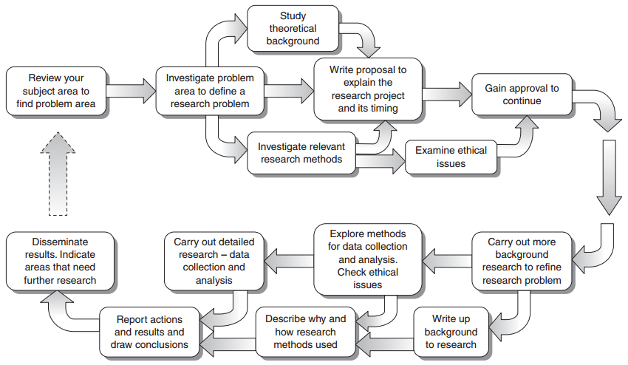
THE STRUCTURE OF A TYPICAL RESEARCH PROJECT

Slide 31
THE RESEARCH PROBLEM
There is no shortage of problems throughout the world, but for a problem to be researchable, it needs to have several crucial features. It must be:
stated clearly and concisely;
significant i.e. not trivial or a repeat of previous work;
delineated, in order to limit its scope to practical investigation
possible to obtain the information required to explore the problem;
possible to draw conclusions related to the problem, as the point of research is to find some answers.

Slide 32
Cont…
A research problem can be based on a question, an unresolved controversy, a gap in knowledge or an unrequited need within the chosen subject.
An awareness of current issues in the subject and an inquisitive and questioning mind and an ability to express yourself clearly is required in order to find and formulate a problem that is suitable for a research project.

Slide 33
Research Methods and Experimental Design
Lecture 2: Research methods: How to Write a scientific paper

Slide 34
How to write a scientific paper
A scientific experiment is not complete until the results have been published and understood.
A scientific paper is a written and published report describing original research results.

Slide 35
What is Scientific Writing
The purpose of scientific writing is to communicate new scientific findings
Thus it has to be clear, simple and well ordered communication to transmit new scientific findings
Scientific writing must use proper English which gives the sense in the fewest short words

Slide 36
Origins of Scientific Writing
Knowledge is lost without written records
Cave paintings and inscriptions were the first attempts to leave records
About 2000 BC, Papyrus paper was used as a medium of communication
In 190 BC, parchment made from animal skin came into use
In 105 AD, the Chinese invented paper

Slide 37
Origins of Scientific Writing
Knowledge could not be widely circulated with no effective duplication
In 1100 AD, the Chinese invented movable type
In 1455 AD, Gutenberg printed his 42-line Bible from movable type on a printing press
By the year 1500 thousands of copies of hundreds of books (called “incunabula”) were printed
In 1665, the first scientific journals were published

Slide 38
IMRAD Story (Introduction, Methods, Results and Discussion)
Early journals published descriptive papers (still used in case reports, geological surveys etc..)
By the second half of the 19th century, reproducibility of experiments became a fundamental principle of the philosophy of science.
The methods section became all important since Louis Pasteur confirmed the germ theory of disease
IMRAD organization of a scientific paper started to develop
IMRAD format slowly progressed in the latter half of the 19th century

Slide 39
IMRAD Format
I = Introduction, what question (problem) was studied
M = Methods, how was the problem studied
R = Results, what are the findings
A = and
D = Discussion, what do these findings mean

Slide 40
Organization of a scientific paper
The most common is the IMRAD
If a number of methods were used to achieve directly related results:
M + R = Experimental section
The results are so complex that they need to be immediately discussed:
R + D = Results and Discussion section

Slide 41
What is a scientific paper
A scientific paper is a written and published report describing original research results.
It must be the first publication of original research results,
In a form whereby peers of the author can repeat the experiments and test the conclusions, and
In a journal or other source document readily available within the scientific community

Slide 42
Definition of Scientific paper
An accepted original scientific publication containing scientific information to enable peers:
To assess observations
To repeat experiments
To evaluate intellectual processes
Must have an impact
Available to scientific community without restriction
Available for regular screening by one or more of the major recognized secondary services (Biological abstracts, Index Medicus, Pub Med etc…)

Slide 43
Some important Language points:
Poor experimentation cannot be masked by brilliant writing; however, poor writing can mask brilliant experimentation
Avoid complex sentence structure
Use simple and clear English
Always keep in mind that the paragraph is the essential unit of thought

Slide 44
Before Starting to Write the Paper
Record your readings (results)
Make tables
Draw graphs
Keep file to record summaries of results and any observation however insignificant
Date the files
Revise your readings, you may need to repeat an experiment while you still have the materials.
Write ideas when ever they come to you

Slide 45
Essential Parts of a Scientific paper
Title: Describe concisely the core contents of the paper
Abstract: Summarize the major elements of the paper
Introduction: provide context and rationale for the study
Materials: Describe the experimental design so it is reproducible
Methods: Describe the experimental procedures
Results: Summarize the findings without interpretation
Discussion: Interpret the findings of the study
Summary: Summarize the findings
Acknowledgement: Give credit to those who helped you
References: List all scientific papers, books and websites that you cited

Slide 46
The Title
A good title is defined as the fewest possible words that adequately describe the contents of the paper.
The title is extremely important and must be chosen with great care as it will be read by thousands, whereas few will read the entire paper
Indexing and abstracting of the paper depends on the accuracy of the title. An improperly titled paper will get lost and will never be read.

Slide 47
The Title
Titles should neither be too short nor too long as to be meaningless
Waste words (studies on, investigations on, a, an, the etc) should not be used.
Syntax (word order) must be very carefully considered
It should contain the keywords that reflect the contents of the paper.
It should be meaningful and not general
It should be concise, specific and informative
It should capture the fundamental nature of the experiments and findings

Slide 48
Examples
Effect of semiconductor on bacteria
Effect: should be defined
Semiconductor: should be listed
Bacteria: should be listed
Photocatalytic inactivation of TiO² on gram negative bacteria

Slide 49
How to Prepare the Title
Make a list of the most important keywords
Think of a title that contains these words
The title could state the conclusion of the paper
The title NEVER contains abbreviations, chemical formulas, proprietary names or jargon
Think, rethink of the title before submitting the paper
Be very careful of the grammatical errors due to faulty word order
Avoid the use of the word “using”

Slide 50
The Abstract
An abstract can be defined as a summary of the information in a document
It is of fundamental importance that the abstract be written clearly and simply, as it is the first and sometimes the only part of the manuscript read.
It should provide a brief summary of each of the main sections (IMRAD) of the paper:
State the principal objective and scope of the investigation
Describe the methods used

Slide 51
Cont…
Summarize the results, and
State the principal conclusions
It is easier to write the abstract after completion of the paper

Slide 52
Criteria of the Abstract
It should not exceed 250 words
It should be written in one paragraph.
It should be written in the past tense as it refers to work done.
Long words should be followed by its abbreviation which would be used through out the abstract and paper.
It should not cite any references (except in rare cases)
It should never give any information or conclusion that is not stated in the paper
Must be accurate with respect to figures quoted in the main text.

Slide 53
The Introduction
The introduction should answer the following questions:
What was I studying?
Why was this an important question?
What did I know about this topic before I did this study?
What model was I testing? and
What approach did I take in this study?

Slide 54
Suggested rules for a good introduction:
It should present the nature and scope of the problem investigated
Review the pertinent literature
State the method of investigation
State the principal results of the investigation
State the principal conclusion(s) suggested by the results

Slide 55
General rules
Use the present tense when referring to work that has already been published, but past tense when referring to your own study.
Use the active voice as much as possible
Avoid lengthy or unfocused reviews of previous research.
Cite peer-reviewed scientific literature or scholarly reviews. Avoid general reference works such as textbooks.
Define any specialized terms or abbreviations

Slide 56
How to write the Materials and Methods section
Provide full details so that the experiments are reproducible
If the peer reviewer has doubts that the experiments could be repeated, the manuscript will be rejected.
Organize the methods under subheadings, with related methods described together (e.g. subjects, experimental design, Measurement of…, Characterization of….,etc…).
Describe the experimental design in detail
Do not mix some of the Results in this section
Write in the past tense

Slide 57
Materials
Must identify accurately experimental chemicals, reagents, equipment….etc
The source of subjects studied, number of expriments
For chemicals used, include exact technical specifications and source or method of preparation.
Avoid the use of trade names of chemicals, generic or chemical names are preferred.

Slide 58
Methods
This part of the manuscript must be clear, precise and concise so that it can be reproducible
If the method is new, all details must be provided
If the method has been previously published in a scientific journal, only the reference should be given with some identification:
e.g. “The preparation of N-doped TiO2 was carried out using ammonia solution (28%) as nitrogen source based on optimized synthesis parameters from our previous work [reference] ”

Slide 59
Cont…
Questions such as “how” or “how much” must be answered and not left to be puzzled over
Methods used for statistical analyses must be mentioned; ordinary ones without comments, but advanced or unusual ones require literature citation

Slide 60
How to write the Results
Results section is written in the past tense
It is the core or heart of the paper
It needs to be clearly and simply stated since it constitutes the new knowledge contributed to the world
The purpose of this section is to summarize and illustrate the findings in an orderly and logical sequence, without interpretation
The text should guide the reader through the findings, stressing the major points
Do not describe methods that have already been described in the M&M section or that have been inadvertently omitted

Slide 61
Methods of presenting the data
Directly in the text
In a table
In a figure
All figures and tables must be accompanied by a textual presentation of the key findings
Never have a table or figure that is not mentioned in the text

Slide 62
Tables and figures
Tables are appropriate for large or complicated data sets that would be difficult to explain clearly in text.
Figures are appropriate for data sets that exhibit trends, patterns, or relationships that are best conveyed visually.
Any table or figure must be sufficiently described by its title and caption or legend, to be understandable without reading the main text of the results section.
Do not include both a table and a figure showing the same information

Slide 63
How to write the Discussion
It is the hardest section to write.
Its primary purpose is to show the relationships among observed facts
It should end with a short summary or conclusion regarding the significance of the work.

Slide 64
Components of the discussion
Try to present the principles, relationships, and generalizations shown by the Results
Point out any exceptions or any lack of correlation and define unsettled points.
Show how your results and interpretations agree or contrast with previously published work
Discuss the theoretical implications of your work, and any possible practical applications.
State your conclusions as clearly as possible
Summarize your evidence for each conclusion

Slide 65
How to State the Acknowledgments
You should acknowledge:
Any significant technical help that you have received from any individual in your lab or elsewhere
The source of special equipment, or any other material
Any outside financial assistance, such as grants, contracts or fellowships
Do not use the word “wish”, simply write “I thank …..” and not “I wish to thank…”
Show the proposed wording of the Acknowledgement to the person whose help you are acknowledging

Slide 66
References
What is referencing?
Referencing is a standardized way of acknowledging the sources of information and ideas that you have used in your document.
A list of ALL the references used in the text must be written.
Reference format varies widely:
Harvard format (the name and year system) is the most widely used
Alphabet-Number system is a modification of name and year system
Citation order system

Slide 67
In-text citations
In name and year system:
Citation in the text is followed by the author’s last name and year of publication between parentheses.
If they were two authors then both last names are written.
If more than two then the only first author’s name is written followed by the abbreviation et al
If a single statement requires more than one citation then the references are arranged chronologically from oldest to more recent, separated by semicolons.
If more than one reference share the same year then they are arranged alphabetically within the year.

Slide 68
Cont…
In alphabet-number system:
Citation by number from an alphabetically arranged numbered reference list.
In Citation order system:
The references are numbered in the order they are mentioned in the text

Slide 69
Reference List
Any papers not cited in the text should not be included.
Reference lists allow readers to investigate the subject in greater depth.
A reference list contains only the books, articles, and web pages etc that are cited in the text of the document. A bibliography includes all sources consulted for background or further reading.

Slide 70
Cont….
In name and year system:
The reference list is arranged alphabetically by author. If an item has no author, it is cited by title, and included in the alphabetical list using the first significant word of the title.
If more than one item has the same author, list the items chronologically, starting with the earliest publication.
Each reference appears on a new line.
There is no indentation of the references
There is no numbering of the references

Slide 71
Cont…
In alphabet-number system:
It the same as above in addition each reference is given a number
In Citation order system:
The reference list is arranged by the number given to the citation by the order that it were mentioned in the text

Slide 72
Example
Book
1. Okuda M, Okuda D. Star Trek Chronology: The History of the Future. New York: Pocket Books; 1993.
Journal or Magazine Article (with volume numbers)
2. Wilcox RV. Shifting roles and synthetic women in Star trek: the next generation. Stud Pop Culture. 1991;13:53-65.
Newspaper, Magazine or Journal Article (without volume numbers)
3. Di Rado A. Trekking through college: classes explore modern society using the world of Star trek. Los Angeles Times. March 15, 1995:A3.
Encyclopedia Article
4. Sturgeon T. Science fiction. In: Lorimer LT, editorial director; Cummings C, ed-in-chief; Leish KW, managing ed. The Encyclopedia Americana. Vol 24. International ed. Danbury, Conn: Grolier Incorporated; 1995:390-392.

Slide 73
Example
Book Article or Chapter
5. James NE. Two sides of paradise: the Eden myth according to Kirk and Spock. In: Palumbo D, ed. Spectrum of the Fantastic. Westport, Conn: Greenwood; 1988:219-223.
ERIC Document
6. Fuss-Reineck M. Sibling Communication in Star Trek: The Next Generation: Conflicts Between Brothers. Miami, Fla: Annual Meeting of the Speech Communication Association; 1993. ERIC Document Reproduction Service ED364932.
Website
7. Lynch T. DSN trials and tribble-ations review. Psi Phi: Bradley's Science Fiction Club Web site. 1996. Available at: http://www.bradley.edu/campusorg/psiphi/DS9/ep /503r.htm. Accessed October 8, 1997.
Journal Article on the Internet
8. McCoy LH. Respiratory changes in Vulcans during pon farr. J Extr Med [serial online]. 1999;47:237-247. Available at: http://infotrac.galegroup.com/itweb/nysl_li_liu. Accessed April 7, 1999.

Slide 74
Research Methods and Experimental Design
Lecture 3: Research methods: How to Write a Thesis

Slide 75
How to Write a Thesis
A PhD thesis in the science is supposed to present the candidate’s original research i.e. it is a scientific paper
Unlike the scientific paper, the thesis may describe more than one topic, and it may present more than one approach to some topics.
The thesis may present all or most of the data obtained in the student’s thesis related research.
Thus it is more involved and longer than a scientific paper.
Think of a thesis as a good thriller, and write in a logical way so that a reader will find it interesting and will not be bored.

Slide 76
Ethics, Rights and Permissions
Beware of originality and copyrights of others.
Do not copy anything without giving the credit to the owner by referencing it.
In some cases permissions are needed
Repetitive publication of the same data is considered plagiarism

Slide 77
Finally…Avoiding Plagiarism
What is it?
All knowledge in your head has either been copied from some place or originally discovered by you.
Most knowledge was copied.
This is true in most settings. General knowledge is copied. Most teachers’ lectures are copied knowledge.
Humans are naturally copiers, but this is not what we would typically call “plagiarism.”

Slide 78
Cont…
Among other things, plagiarism refers to taking others’ work and representing it as if it were your own.
In academics this is bad because with plagiarism:
One cannot assess students’ development accurately
The person who makes his or her livelihood by scholarly pursuit is being robbed of credit
It masks the lineage of ideas and facts.

Slide 79
Cont…
Lineage of Ideas:
Original sources of research are all the proof we have for some facts. Without the “paper trail” of academic thought:
People could pass incorrect ideas off as facts
We would have to keep “re-proving” things.
The contexts that generated facts and ideas get lost.
Research becomes highly inefficient as it becomes incredibly difficult to find “full information” on a topic.

Slide 80
To avoid plagiarism:
Document every source for information that is not “general knowledge”—this includes facts and ideas.
Cite every time a fact or idea is used unless it is clear that one citation is referring to a group of facts or ideas.
If you quote material, put quotation marks around the quoted stuff and include a page number within the citation.
It is alright to paraphrase material, but you still have to cite from where the paraphrased material came.
When in doubt, cite the source.

Slide 81
Plagiarism v. Paraphrasing Samples
Direct quote from research:
“Japan’s beautiful Mount Fuji last erupted in 1707 and is now classified as dormant. Dormant volcanoes show no signs of activity, but they may erupt in the future.”
Non-plagiarized paraphrase:
Mount Fuji, the highest mountain in Japan, is actually a dormant volcano. Dormant means that it is not active. The last time Mount Fuji erupted was in 1707, and there is always the possibility of a future eruption.

Slide 82
Cont…
Direct quote from research:
“Three weeks after Katrina, warnings of the arrival of Hurricane Rita sent residents of cities such as Houston, Texas, rushing to evacuate, fearing for their lives. Fortunately, Hurricane Rita turned out to be much less severe than Katrina. However, mass evacuations like this bring hazards of their own, as panicking drivers may cause accidents on the jammed roads.”
Non-plagiarized paraphrase:
Shortly after Hurricane Katrina devastated the city of Houston, Texas, a warning for a new hurricane named Rita was broadcast, which caused many people to panic and flee the city. However, the mass departure of people leaving Houston at the same time could have caused many car accidents, even though the hurricane turned out to be not as dangerous as Katrina.

Slide 83
Some Technical Points of Style
Page margins and line spacing – these can vary
Mathematical and statistical notation – publications vary in what is acceptable
Citations and reference notes – footnotes and referencing
Tables, charts, and graphs – should be clear and “stand alone”
Verb tense – don’t vary within a section
Personal pronoun form – generally third person for formal papers and first of second person for less formal writing

Slide 84
Proofread, Proofread, & Proofread!!!
Are all words spelled correctly? (Use a paper or online dictionary is unsure!)
Did I capitalize the beginning of each sentence and all proper nouns?
Did I punctuate correctly?
Do I use grammar correctly?
Did I answer all of the topic questions, and fulfill all of the requirements on my rubric.
Did I include an introduction and conclusion?

Slide 85
Proofread, Proofread, & Proofread!!!
Did I type the paper using the correct font type, size, line spacing and margin requirements?
Did I paraphrase all content?
Did I use parenthetical notations for quotes?
Do my sentences make sense when read aloud?
Have I had my paper peer edited?
Does my paper flow well?
Did I include a bibliography page?

Slide 86
Important Software
Mendeley Desktop
Endnote
OriginPro
Sigma plot

Slide 87
Research Methods and Experimental Design
Lecture 4: Research methods: How to Write a research proposal

Slide 88
Research proposal
A research plan is the key to successful research. The approach to the research needs to be carefully constructed and designed.
“the heart of the research plan is the research proposal”
The intent is not to limit creativity … the most insightful discovery usually occur within structured inquiry.

Slide 89
Research proposal
Statement of intent
Academically prepared to complete the research
Audience: peers, supervisors, examiners
A research proposal is your PLAN
It describes in detail your study
Decisions about your study are based on the quality of the proposal
Approvals to proceed by the Institutional Review Board

Slide 90
Research proposal
It is like a blue print of a building plan before the construction starts
Writing a research proposal is both science and art
A good research proposal is based on scientific facts and on the art of clear communication
Writing a formal research proposal should be started by the time one has decided on the topic for the study

Slide 91
Research proposal
Proposals are generally required by all entities that support or encourage research
They can seek financial support or simply serve as a guide for the research. The most stringent and complex are Ph.D. dissertation proposals.
Some funding sources (eg. industry groups), may prefer short, concise plans without “academic” aspects.
Rarely a proposal may be delivered orally (but these are usually backed by a written proposal).

Slide 92
Research proposal
Effective communication skills are essential. Thoughts must be clear and well developed.
Proposals serve dual purposes:
Provides an operational plan for the researcher. This forces clear understanding of the intent of the research and anticipation of potential problems.
For evaluators (including graduate committees) a proposal clarifies the intent of the research and allows decisions on approval or disapproval.

Slide 93
Importance of a research proposal?
Contract between you and your committee
Serves to protect the student
Demanding additional requirements
Protects the committee from the student
From delivering a degree of poor quality

Slide 94
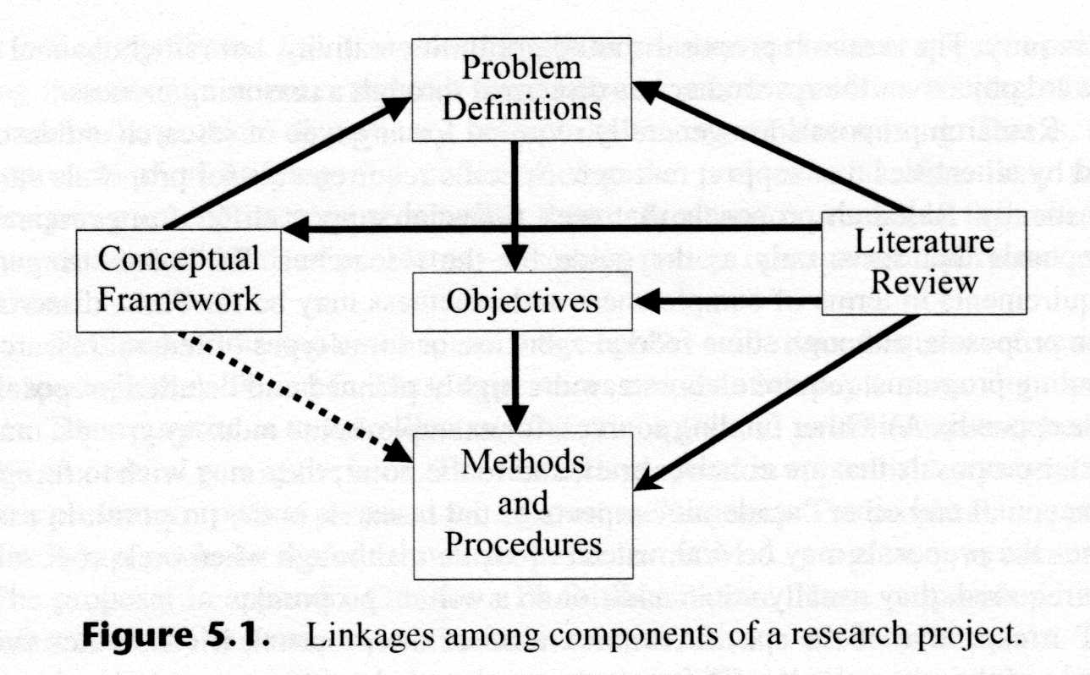
Elements of the Research Proposal
Although varying in complexity and form, there are common elements to all proposals. The figure below shows components and linkages.

Slide 95
What are the essential ingredients?
The Issue
What problem does your research address?
Research Design
How will the research achieve its objective?
Benefit
What will the research contribute?

Slide 96
Research proposals make you:
OUTLINE steps in your proposed research
Provide yourself with intellectual CONTEXT
JUSTIFY your research
Be CREATIVE
THINK through your experiments
Anticipate potential PROBLEMS
Anticipate a realistic TIMETABLE
96

Slide 97
Formal Structure of Scientific Proposal
Title
Introduction
Background /Review of literature
Justification/Problem statement
Objective
Methodology
Time frame and work schedule/Gantt chart
Personnel needed / available
Facilities needed / available
Budget
Outcomes

Slide 98
Title
Project title should be descriptive of the main focus, but no longer than necessary
NOT a detailed description – but still provide an accurate impression of the central focus
(For further information refer slide # 45)

Slide 99
Identifying information
Describes the people and organizations involved in the research, and other summary information
Names, titles, addresses, phone numbers
People may be grouped: Project Leader, Cooperators, students (committee members) or primary investigators and co- investigators, their qualifications, research experience etc
Total budget amount, dates …

Slide 100
Introduction
The problem proposed to be studied is introduced in this section
It should help the reader to acquaint with the topic
Introduction should be short about one or two pages
The problem should be stated in such a way that it’s importance and relevance is realized by any one who reads it

Slide 101
Background (Review of Literature)
Provides the base of knowledge on what is known about the problem to be studied
This section reflects extensive review of literature done by the investigator
In this section what is already known about the topic is written including the lacunae
Just quoting the literature verbatim will not serve the purpose
It is important to make it coherent, relevant and easily readable knowledge

Slide 102
Background (Review of Literature)
It helps the investigator to gain good knowledge in that field of inquiry
It also helps the investigator to have insight on different methodologies that could be applied

Slide 103
Background (Review of Literature)
This is NOT just a summary of literature
Show how your project:
̶̶ Literature SUPPORTS your hypothesis
̶̶ EXTENDS previous work
̶̶ AVOIDS previous mistakes
̶̶ IS UNIQUE to previously followed paths

Slide 104
Background (Review of Literature)
Selecting Sources
Select literature that is relevant or closely related to the problem and purpose
Emphasize the primary sources
Use secondary sources selectively
Concentrate on scholarly research articles
Discuss your criteria for inclusion of articles

Slide 105
Background (Review of Literature)
Organize the review by topics or ideas, not by author
Organize the review logically (least to most relevant – evolution of topic –by key variables)
Discuss major studies/theories individually and minor studies with similar results or limitation as a group

Slide 106
Background (Review of Literature)
Adequately criticize the design and methodology of important studies so readers can draw their own conclusions
Compare and contrast studies.
Note for conflicting and inconclusive results
Explicitly show the relevance of each to the problem statement

Slide 107
Example
Authors | Study parameter | Experimental response | Optimization method
(Lin et al. 2013) | N atom and calcination temperature | XRD, BET, TG-DTA, TEM, optical property, and ethylene photooxidation | One parameter at a time approach
(Dunnill et al. 2011) | Sintering temperatures and dopant concentrations. | UV-Visible-NIR, XRD, Raman, FT-IR and Rate of stearic acid destruction | None
(Yu et al. 2007) | Acidity of the solution of precursor, calcination temperature, | photodegradation of methylene blue (MB), XRD, and TEM | One parameter at a time approach
(Nosaka et al. 2005) | Nitrogen source compound, calcination temperature | XRD, XPS, DRS, and decomposition of propanol | None
(Wang et al. 2011) | Source of precursor | photocatalytic oxida tion of propylene, XRD, XPS, DRS, and ESR | None

Slide 108
Example cont…
(Qin et al. 2008) | Ti/N molar ratio | TG-DSC, XRD, BET, TEM, DSC and photodegradation of Methyl orange (MO) and 2-mercaptobenzothiazole (MBT) | None
(Huang et al. 2005) | Calcination temperature | XRD, DRS, DT-TGA,DSC, and photocatalytic oxidation of methylene orange | None
(Ananpattarachai et al. 2009) | Types of nitrogen dopants | XRD, TEM, UV–vis spectra,XPS, and degradation of 2-chlorophenol (2-CP) | One parameter at a time approach
(Kuo et al. 2011) | Nitrogen sources, nitrogen source concentration, stirring time, and calcined temperature | photodecolorization of methyl blue (MB) | Taguchi method with an L9 orthogonal array
This report | N/Ti molar ratio, calcination temperature, calcination time | XRD, BET, photo decolorization of methyl blue (MB) | Response surface methodology, Box-Behnken design

Slide 109

The narrative of a good literature review
Reader knows
Reader doesn't know

Slide 110
The narrative of a good literature review
Introduce the field:
broad focus
Focus on certain aspects in field of interest
End with gap analysis

Slide 111
Problem statement
From the literature review, gap analysis can be conducted in order to see how the propose research would fill in the gap in the area of research.
How does the proposed research relate to the existing knowledge in the area.
Explicitly state the significance of your purpose or the rationale for your study. A significant research is one that:
Develops knowledge of an existing practise
Develops theory
Expands the current knowledge or theory base
Advances current research methodology
Related to a current technological issue
Exploratory research on an unexamined issue

Slide 112

Problem statement
Short SO WHAT statement
Purpose
Blueprint for your literature review
Focus your committee at the beginning
Keep them on track throughout your proposal

Slide 113
Problem statement
Often, a two step procedure:
Develop a general perspective of the broad problem area
Focus on the part of the problem area to be studied, within resource constraints of the project
This is the reason (justification) for the research.

Slide 114
Example
“…. In most previous studies, it has been tried to investigate the effects of sol–gel synthesis parameters on the preparation of N-doped TiO₂ using the conventional “one-parameter-at-a-time approach”. Although this approach is widely acceptable, it has a limitation in estimating the interaction effects between the factors and lacks a predictive capability. …. In this paper, optimization of some of the significant sol–gel synthesis parameters by using BBD is reported. ”

Slide 115
Objectives
The purpose of this research is to……
Aims
- short but general statement of intent
Objectives
- very specific statements that define the practical steps you will take to achieve your aim(s)

Slide 116
Objectives
This is a very important and pivotal section and everything else in the study is centered around it
The objective of the proposed study should be stated very clearly
The objective stated should be specific, achievable and measurable
Too many objectives to be avoided
Even just one clearly stated relevant objective for a study would be good enough
If there is more than one objective the objectives can be presented in the appropriate order of importance

Slide 117
Research methodology
Research methodology is a way to systematically solve the research problem. It may be understood as a science of studying how research is done scientifically
It is necessary for the researcher to know not only the research methods/techniques but also the methodology.
It is essential to discuss procedures clearly and completely with considerable amount of details

Slide 118
Research methodology
Study design
Study population / Sampling specifications
Sample size needed
Instrumentation
Specific procedures
Etc…

Slide 119
Study design
Definition: A study design is a specific plan or protocol for conducting the study, which allows the investigator to translate the conceptual hypothesis into an operational one.
The study design should be clearly stated
The study design to be used should be appropriate for achieving the objective of the study

Slide 120
Study population / Sample specifications
It is important to describe which would be the study population
How study subjects would be selected, randomization process and other details should be given

Slide 121
Sample size
It is important to mention in the protocol what would be the minimum sample required and how it is arrived
Determination of sample size is a bargain between precision and the price (Resources & expenses involved)

Slide 122
Description of process
Proposal should include the details of all process to be adopted in the study
How exposures, outcome variables and other variables are going to be measured should be described in detail
A brief description of how the data will be processed and use of statistical package if any should be given
What statistical tests of significance would be used?

Slide 123
Time Frame & Work Schedule
The proposal should include the sequence of tasks to be performed, the anticipated length of time required for its completion and the personnel required
It can be presented in tabular or graphic form (Gantt chart)
Flow charts and other diagrams are often useful for highlighting the sequencing and interrelationship of different activities in the study

Slide 124
Facilities
The proposal should also include the important facilities required / available for the study namely computers, laboratories, special equipment etc

Slide 125
Budget
Give you an appreciation of research costs
Prevents you from overspending!
Provide specific explanations for:
Need for specific technologies
Need for other financial requests (e.g. conference, instrumentation, staff, bursaries etc).
Do you really need this kit?

Slide 126
Budget
The budget translates project activities into monetary terms
It is a statement of how much money will be required to accomplish the various tasks
Major items
Payment for external laboratory analysis
Travel (material collection)
Labor cost
Purchase of equipment
Printing ,data storage
Consultancy charges
Institutional overheads

Slide 127
Outcomes
What do you expect the results to be?
Measurable
E.g. you will get a degree
New patent / paper
Qualitative
Contribute understanding to subject / new technology / application

Slide 128
Research Methods and Experimental Design
Lecture 5: Experimental Design : Experimental Design and Analysis

Slide 129
Introduction
It is important to obtain maximum realistic information with the minimum number of well designed experiments.
An experimental program recognizes the major “factors” that affect the outcome of the experiment.
The factors may be identified by looking at all the quantities that may affect the outcome of the experiment.
The most important among these may be identified using:
A few exploratory experiments or
From past experience or
based on some underlying theory or hypothesis.

Slide 130
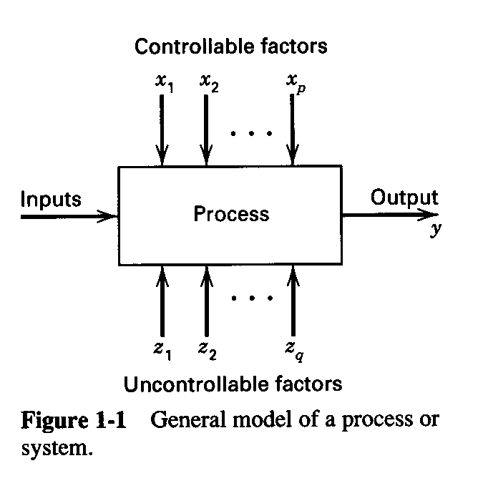
Engineering Experiments
Some of the objectives
Reduce time to design/develop new products & processes
Improve performance of existing processes
Improve reliability and performance of products
Achieve product & process robustness
Evaluation of materials, design alternatives, setting component & system tolerances, etc.

Slide 131
Design of Experiments (DOE)
A statistics-based approach to design experiments
A methodology to achieve a predictive knowledge of a complex, multi-variable process with the fewest acceptable trials.
An optimization of the experimental process itself

Slide 132
Design of Experiments (DOE)
An experiment is a test or a series of tests
Experiments are used widely in the engineering world
Process characterization & optimization
Evaluation of material properties
Product design & development
Component & system tolerance determination
“All experiments are designed experiments, some are poorly designed, some are well-designed”

Slide 133
Some major players in DOE
Sir Ronald A. Fisher - pioneer
invented ANOVA and used of statistics in experimental design while working at Rothamsted Agricultural Experiment Station, London, England.
George E. P. Box - married Fisher’s daughter
still active (86 years old)
developed response surface methodology (1951)
plus many other contributions to statistics
Others
Raymond Myers, J. S. Hunter, W. G. Hunter, Yates, Montgomery, Finney, etc..

Slide 134
Four eras of DOE
The agricultural origins, 1918 – 1940s
R. A. Fisher & his co-workers
Profound impact on agricultural science
Factorial designs, ANOVA
The first industrial era, 1951 – late 1970s
Box & Wilson, response surfaces
Applications in the chemical & process industries
The second industrial era, late 1970s – 1990
Quality improvement initiatives in many companies
Taguchi and robust parameter design, process robustness
The modern era, beginning circa 1990
Wide use of computer technology in DOE
Expanded use of DOE in Six-Sigma and in business
Use of DOE in computer experiments

Slide 135
Strategy of Experimentation
Strategy of experimentation
Best guess approach (trial and error)
can continue indefinitely
cannot guarantee best solution has been found
One-factor-at-a-time (OFAT) approach
inefficient (requires many test runs)
fails to consider any possible interaction between factors
Factorial approach (invented in the 1920’s)
Factors varied together
Correct, modern, and most efficient approach
Can determine how factors interact
Used extensively in industrial R and D, and for process improvement.

Slide 136
Statistical Design of Experiments
DOE is a methodology for systematically applying statistics to experimentation.
DOE lets experimenters develop a mathematical model that predicts how input variables interact to create output variables or responses in a process or system.
DOE can be used for a wide range of experiments for various purposes including nearly all fields of engineering and even in business marketing.
Use of statistics is very important in DOE and the basics are covered in a first course in an engineering program.

Slide 137
Statistical Design of Experiments
In general, by using DOE, we can:
Learn about the process we are investigating
Screen important variables
Build a mathematical model
Obtain prediction equations
Optimize the response (if required)
Statistical significance is tested using ANOVA, and the prediction model is obtained using regression analysis.

Slide 138
Example

Slide 139
Basic Principles
Statistical design of experiments (DOE)
the process of planning experiments so that appropriate data can be analyzed by statistical methods that results in valid, objective, and meaningful conclusions from the data
involves two aspects: design and statistical analysis

Slide 140
Basic Principles
Every experiment involves a sequence of activities:
Conjecture - hypothesis that motivates the experiment
Experiment - the test performed to investigate the conjecture
Analysis - the statistical analysis of the data from the experiment
Conclusion - what has been learned about the original conjecture from the experiment.

Slide 141
Three basic principles of Statistical DOE
Replication
allows an estimate of experimental error
allows for a more precise estimate of the sample mean value
Randomization
cornerstone of all statistical methods
“average out” effects of extraneous factors
reduce bias and systematic errors
Blocking
increases precision of experiment
“factor out” variable not studied

Slide 142
Guidelines for Designing Experiments
Recognition of and statement of the problem
need to develop all ideas about the objectives of the experiment - get input from everybody - use team approach.
Choice of factors, levels, ranges, and response variables.
Need to use engineering judgment or prior test results.
Choice of experimental design
sample size, replicates, run order, randomization, software to use, design of data collection forms.

Slide 143
Guidelines for Designing Experiments
Performing the experiment
vital to monitor the process carefully. Easy to underestimate logistical and planning aspects in a complex R and D environment.
Statistical analysis of data
provides objective conclusions - use simple graphics whenever possible.
Conclusion and recommendations
follow-up test runs and confirmation testing to validate the conclusions from the experiment.
Do we need to add or drop factors, change ranges, levels, new responses, etc.. ???

Slide 144
Using Statistical Techniques in Experimentation - things to keep in mind
Use non-statistical knowledge of the problem
physical laws, background knowledge
Keep the design and analysis as simple as possible
Don’t use complex, sophisticated statistical techniques
If design is good, analysis is relatively straightforward
If design is bad - even the most complex and elegant statistics cannot save the situation
Recognize the difference between practical and statistical significance
statistical significance ≠ practically significance

Slide 145
Using Statistical Techniques in Experimentation - things to keep in mind
Experiments are usually iterative
unwise to design a comprehensive experiment at the start of the study
may need modification of factor levels, factors, responses, etc.. - too early to know whether experiment would work
use a sequential or iterative approach
should not invest more than 25% of resources in the initial design.
Use initial design as learning experiences to accomplish the final objectives of the experiment.

Slide 146
Factorial v.s. OFAT
Factorial design - experimental trials or runs are performed at all possible combinations of factor levels in contrast to OFAT experiments.
Factorial and fractional factorial experiments are among the most useful multi-factor experiments for engineering and scientific investigations.

Slide 147
Factorial v.s. OFAT
The ability to gain competitive advantage requires extreme care in the design and conduct of experiments. Special attention must be paid to joint effects and estimates of variability that are provided by factorial experiments.
Full and fractional experiments can be conducted using a variety of statistical designs. The design selected can be chosen according to specific requirements and restrictions of the investigation.

Slide 148
Special Terminology : Design of Experiments
Experiment: Process of collecting sample data
Design of Experiment: Plan for collecting the sample
Response Variable: Variable measured in experiment (outcome, y)
Experimental Unit: Object upon which the response y is measured
Factors: Independent Variables
Level: The value assumed by a factor in an experiment
Treatment: A particular combination of levels of the factors in an experiment

Slide 149
Special Terminology : Design of Experiments
Replication: Completely re-run experiment with same input levels Used to determine impact of measurement error
Interaction: Effect of one input factor depends on level of another input factor

Slide 150
Volume and “Noise”
Volume: quantity of information in an experiment
Increase with larger sample size, selection of treatments such that the observed values (y) provide information on the parameters of interest
Noise: experimental error
Reduce by assigning treatments to experimental units

Slide 151
Factorial Designs
In a factorial experiment, all possible combinations of factor levels are tested

Slide 152
One-factor-at-a-time experiments (OFAT)
OFAT is a prevalent, but potentially disastrous type of experimentation commonly used by many engineers and scientists in both industry and academia.
Tests are conducted by systematically changing the levels of one factor while holding the levels of all other factors fixed. The “optimal” level of the first factor is then selected.
Subsequently, each factor in turn is varied and its “optimal” level selected while the other factors are held fixed.

Slide 153
One-factor-at-a-time experiments (OFAT)
OFAT experiments are regarded as easier to implement, more easily understood, and more economical than factorial experiments. Better than trial and error.
OFAT experiments are believed to provide the optimum combinations of the factor levels.
Unfortunately, each of these presumptions can generally be shown to be false except under very special circumstances.
The key reasons why OFAT should not be conducted except under very special circumstances are:
Do not provide adequate information on interactions
Do not provide efficient estimates of the effects

Slide 154
Factorial vs OFAT ( 2-levels only)
Factorial
OFAT
2 factors: 4 runs
3 effects
3 factors: 8 runs
7 effects
5 factors: 32 or 16 runs
31 or 15 effects
7 factors: 128 or 64 runs
127 or 63 effects
2 factors: 6 runs
2 effects
3 factors: 16 runs
3 effects
5 factors: 96 runs
5 effects
7 factors: 512 runs
7 effects

Slide 155
Example: Factorial vs OFAT
Factorial
OFAT
high
high
B
low
low
low
high
low
high
Factor A
A
E.g. Factor A: Reynold’s number, Factor B: k/D

Slide 156
Research Methods and Experimental Design
Lecture 6: Experimental Design: Brief Introduction-Probability, Sampling, descriptive statistics

Slide 157
Probability

Slide 158
Sample Spaces and Events
Example
If we measure the current in a thin copper wire, we are conducting an experiment.
+++day-today repetitions of the measurement can differ slightly
+++small variations in variables that are not controlled in our experiment
changes in ambient temperatures, slight variations in gauge and small impurities in the chemical composition of the wire, and current source drift

Slide 159
Sample Spaces and Events…
this experiment (as well as many we conduct) is said to have a random component
no matter how carefully our experiment is designed and conducted, the variation is almost always present, and its magnitude can be large enough that the important conclusions from our experiment are not obvious

Slide 160
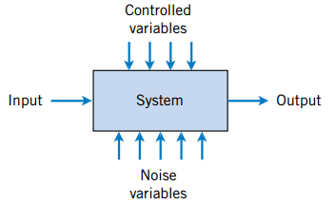
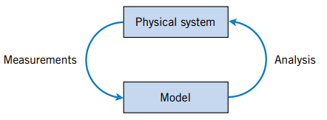
modelling and analysing experimental results
Our goal is to
understand, quantify, and model the type of variations that we often encounter
Make informed judgments from our results
Continuous iteration between model and physical system.
Noise variables affect the transformation of inputs to outputs.

Slide 161
Definitions
Random Experiment
Sample Spaces
Discrete and Continuous Sample Spaces
An experiment that can result in different outcomes, even though it is repeated in the same manner every time, is called a random experiment.
The set of all possible outcomes of a random experiment is called the sample space of the experiment. The sample space is denoted as S.
A sample space is discrete if it consists of a finite or countable infinite set of outcomes. A sample space is continuous if it contains an interval (either finite or infinite) of real numbers.

Slide 162
Continuous Random Variables and Probability Distributions
Continuous random variable is a random variable with an interval (either finite or infinite) of real numbers for its range
Example
dimensional length is measured on a manufactured part selected from a day’s production
the number of possible values of X (random variable) is uncountably infinite

Slide 163
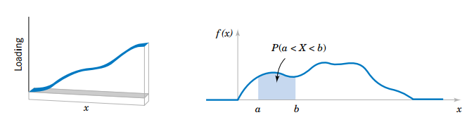
PROBABILITY DISTRIBUTIONS AND PROBABILITY DENSITY FUNCTIONS
Density functions are commonly used in engineering to describe physical systems
For example, consider the density of a loading on a long, thin beam. For any point x along the beam, the density can be described by a function (in grams/cm). Intervals with large loadings correspond to large values for the function. The total loading between points a and b is determined as the integral of the density function from a to b. This integral is the area under the density function over this interval, and it can be loosely interpreted as the sum of all the loadings over this interval.
Density function of a loading on a long, thin beam
Probability determined from the area under f(x)

Slide 164
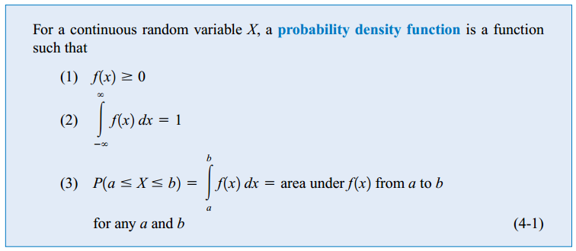
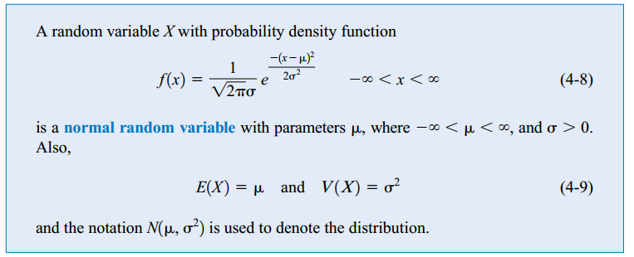
Probability Density Function

Slide 165
Example
Let the continuous random variable X denote the diameter of a hole drilled in a sheet metal component. The target diameter is 12.5 millimeters. Most random disturbances to the process result in larger diameters. Historical data show that the distribution of X can be modeled by a probability density function
If a part with a diameter larger than 12.60 millimeters is scrapped, what proportion of parts is scrapped?

Slide 166
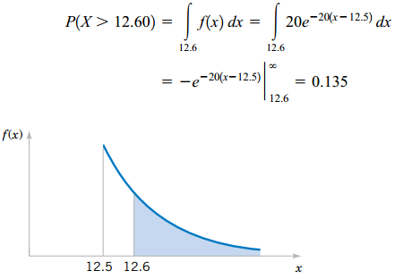
Solution
Probability density function

Slide 167
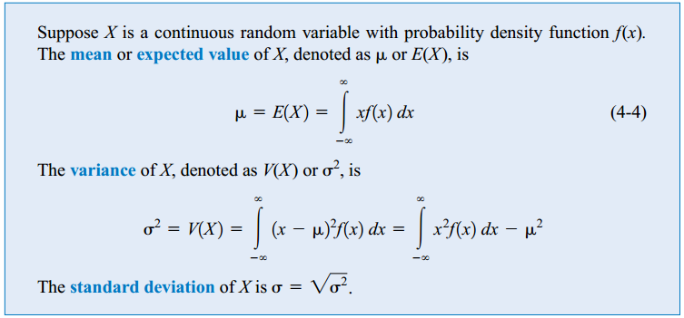
MEAN AND VARIANCE OF A CONTINUOUS RANDOM VARIABLE

Slide 168
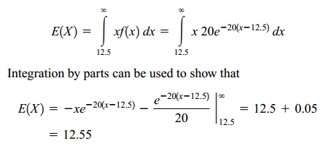
Previous Example

Slide 169
NORMAL DISTRIBUTION
the most widely used model for the distribution of a random variable is a normal distribution.
Whenever a random experiment is replicated, the random variable that equals the average (or total) result over the replicates tends to have a normal distribution as the number of replicates becomes large.
a normal distribution is also referred to as a Gaussian distribution

Slide 170
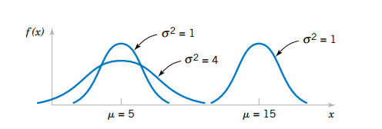
NORMAL DISTRIBUTION
Normal probability density functions for selected values of the parameters µ and σ²
Random variables with different means and variances can be modeled by normal probability density functions with appropriate choices of the center and width of the curve. The value of E(X)= µ determines the center of the probability density function and the value of V(X)=σ² determines the width

Slide 171
Normal Distribution

Slide 172
EXAMPLE
Assume that the current measurements in a strip of wire follow a normal distribution with a mean of 10 milliamperes and a variance of 4 (milliamperes)². What is the probability that a measurement exceeds 13 milliamperes?
Let X denote the current in milliamperes. The requested probability can be represented as This probability P(X >13).
Unfortunately, there is no closed-form expression for the integral of a normal probability density function, and probabilities based on the normal distribution are typically found numerically or from a table (that we will later introduce)

Slide 173

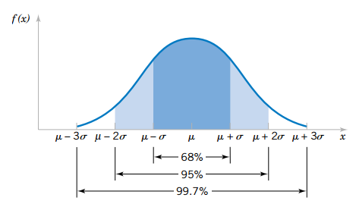
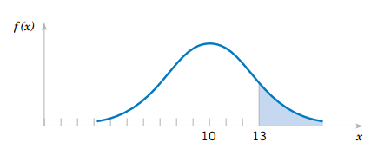
Normal distribution
from the symmetry of Because f(x) is positive for all x, this model assigns some probability to each interval of the real line.
Probability that X >13 for a normal random variable with µ =10 and σ² =4
Probabilities associated with a normal distribution.

Slide 174
Normal Distribution
probability density function decreases as x moves farther from µ .
Consequently, the probability that a measurement falls far from µ is small, and at some distance from µ the probability of an interval can be approximated as zero.
The area under a normal probability density function beyond 3 σ from the mean is quite small.

Slide 175
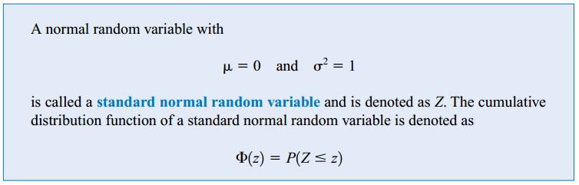
Standard Normal Random Variable

Slide 176
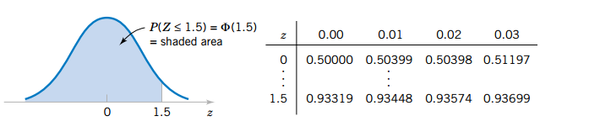
EXAMPLE
P(Z ≤1.5)=0.93319
P(Z ≤1.53)=0.93699

Slide 177
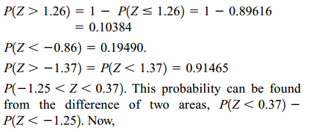
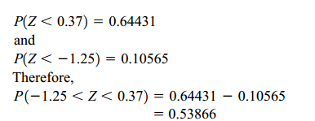
practice

Slide 178
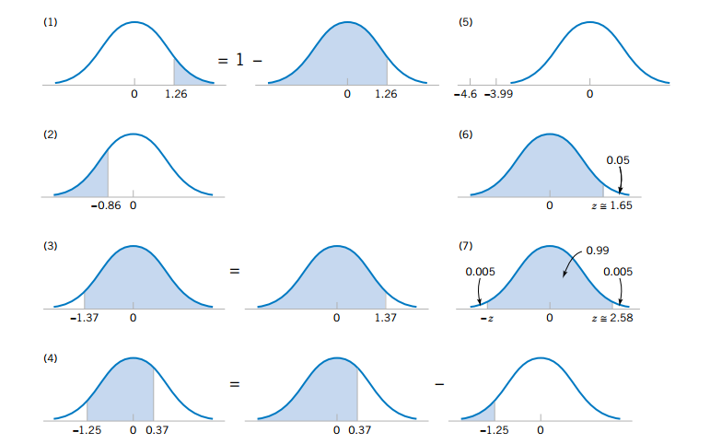
Graphical displays for standard normal distributions.

Slide 179
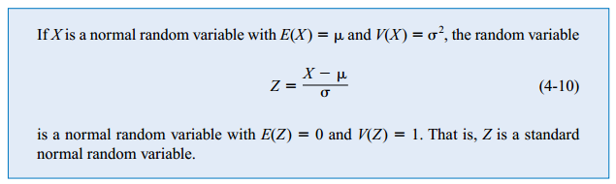
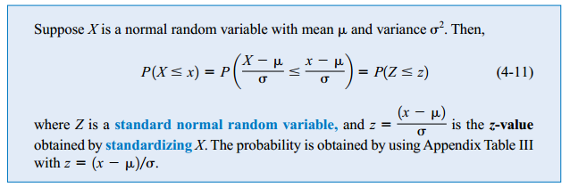
Standardizing a Normal Random Variable
Creating a new random variable by this transformation is referred to as standardizing.

Slide 180


EXAMPLE
Suppose the current measurements in a strip of wire are assumed to follow a normal distribution with a mean of 10 milliamperes and a variance of 4 (milliamperes)². What is the probability that a measurement will exceed 13 milliamperes?

Slide 181
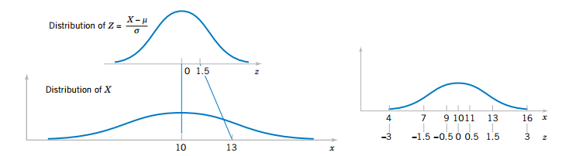
Standardizing a normal random variable.

Slide 182
Standardizing to Calculate a Probability

Slide 183
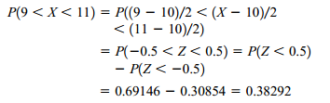



EXAMPLE
what is the probability that a current measurement is between 9 and 11 milliamperes?
Determine the value for which the probability that a current measurement is below this value is 0.98.

Slide 184
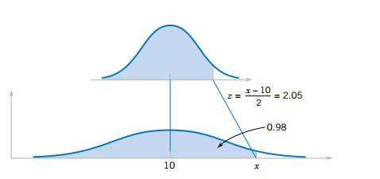
Example
Determining the value of x to meet a specified probability.

Slide 185
Exercise
The compressive strength of samples of cement can be modelled by a normal distribution with a mean of 6000 kilograms per square centimetre and a standard deviation of 100 kilograms per square centimetre.
(a) What is the probability that a sample’s strength is less than 6250 Kg/cm²?
(b) What is the probability that a sample’s strength is between 5800 and 5900 Kg/cm²?
(c) What strength is exceeded by 95% of the samples?

Slide 186
EXCEL EXAMPLE
NORM.DIST
NORM.S.DIST
NORM.INV
NORM.S.INV
.DIST gets you probability or height
.INV gets you a particular value

Slide 187
Sampling

Slide 188
Important statistical terms
Population:
a set which includes all
measurements of interest
to the researcher
(The collection of all responses,
measurements, or counts that
are of interest)
Sample:
A subset of the population

Slide 189
Why sampling?
Get information about large populations
Less costs
Less field time
More accuracy i.e. Can Do A Better Job of Data Collection
When it’s impossible to study the whole population

Slide 190
Sampling
Target Population:
The population to be studied/ to which the investigator wants to generalize his results
Sampling Unit:
smallest unit from which sample can be selected
Sampling frame
List of all the sampling units from which sample is drawn
Sampling scheme
Method of selecting sampling units from sampling frame

Slide 191
Types of Sampling
Simple Random Sampling
Stratified Random Sampling
Cluster Sampling
Systematic Sampling
Representative Sampling (Can be stratified random or quota sampling)
Convenience or Haphazard Sampling
Sampling with Replacement vs. Sampling without Replacement

Slide 192
Representative Sample
Sample should be representative of the target population
so you can generalize to population
Random sampling
All members of pop have equal chance of being selected
Roll dice, flip coin, draw from hat

Slide 193
Errors in sample
Systematic error (or bias) Inaccurate response (information bias) Selection bias
Sampling error (random error)

Slide 194
Type 1 error
The probability of finding a difference with our sample compared to population, and there really isn’t one….
Known as the α (or “type 1 error”)
Usually set at 5% (or 0.05)

Slide 195
Type 2 error
The probability of not finding a difference that actually exists between our sample compared to the population…
Known as the β (or “type 2 error”)
Power is (1- β) and is usually 80%

Slide 196
Sample size
Sample size
Quantitative
Qualitative

Slide 197
EXAMPLE
A study is to be performed to determine a certain parameter in a community. From a previous study a sd of 46 was obtained.
If a sample error of up to 4 is to be accepted. How many subjects should be included in this study at 99% level of confidence?

Slide 198
Answer

Slide 199
Types of Variables
Quantitative
Measured in amounts
Ht, Wt, Test score
Discrete:
separate categories
Letter grade
Qualitative
Measured in categories
Gender, race, diagnosis
Continuous:
infinite values in between
GPA

Slide 200
Types of Statistics
Descriptive statistics:
Organize and summarize scores from samples
Inferential statistics:
Infer information about the population based on what we know from sample data
Decide if an experimental manipulation has had an effect

Slide 201
Descriptive Statistics

Slide 202
Introduction
Presenting, Organizing, and summarizing data
The values that describe the characteristics of a sample or population
Determine if the sample is normally distributed (bell curve).Most statistical tests required the sample to have normally distributed.
Determine if the sample can be compared larger population
Are display as tables, charts, percentages, frequency distribution, and reported as measures of central tendency

Slide 203
Introduction
Descriptive statistics are used to summarize data from individual respondents, etc.
They help to make sense of large numbers of individual responses, to communicate the essence of those responses to others
They focus on typical or average scores, the dispersion of scores over the available responses, and the shape of the response curve

Slide 204
Information about the sample
Central tendency-the sample mean (average), median (midpoint), mode (most frequent occurring numbers)
Measures of variability-range (the difference between the largest and smallest variables), variance (how far the numbers are spread-out), and standard deviation (how much variation exists from the average/mean)
Skewness (how symmetrical the distribution of variables)
Kurtosis (peakedness or flatness of the distribution)
Shape (includes modality, outliers)

Slide 205
Measuring central tendency
Sample mean
Population mean
The mean is sensitive to extreme scores (outliers) in the sample

Slide 206
Measuring central tendency
When data are listed in order, the median is the point at which 50% of the cases are above and 50% below it.
The median is the better representative of the sample
When scores are extrem. The median is not sensitive to
extreme scores (outliers) in the sample

Slide 207
variance

Slide 208
standard deviation
square root of variance:

Slide 209
Exampel
List of chemical concentration taken from a reactor
69,77,77,77,84,85,85,87,92,98

Slide 210
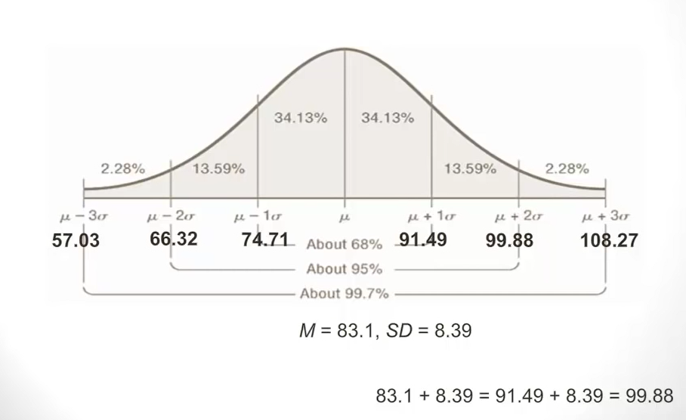
Normal Distribution

Slide 211
Skewness of distributions
Measures look at how lopsided distributions are—how far from the ideal of the normal curve they are
When the median and the mean are different, the distribution is skewed. The greater the difference, the greater the skew.
Distributions that trail away to the left are negatively skewed and those that trail away to the right are positively skewed
If the skewness is extreme, the researcher should either transform the data to make them better resemble a normal curve or else use a different set of statistics—nonparametric statistics—to carry out the analysis

Slide 212
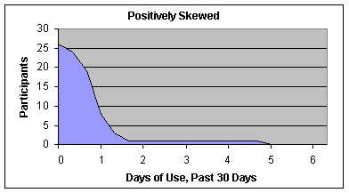
Positively skewed

Slide 213
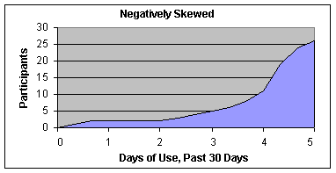
Negatively skewed

Slide 214
Mode
It may give you the most likely experience rather than the “typical” or “central” experience.
In symmetric distributions, the mean, median, and mode are the same.
In skewed data, the mean and median lie further toward the skew than the mode.
Skewed
Symmetric
Mode
Median
Mean
Mean
Median
Mode

Slide 215
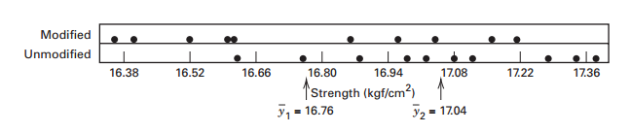
Graphical Description of Variability
simple graphical methods often assist in analysing the data from an experiment.
The dot diagram, illustrated in Figure below a very useful device for displaying a small body of data (say up to about 20 observations).
Dot diagram

Slide 216
Graphical Description of Variability
The dot diagram enables the experimenter to see quickly the general location or central tendency of the observations and their spread or variability.
If the data are fairly numerous, the dots in a dot diagram become difficult to distinguish and a histogram may be preferable.
Figure presents a histogram for 200 observations on the metal recovery, or yield, from a smelting process.

Slide 217
Graphical Description of Variability
The histogram shows the central tendency, spread, and general shape of the distribution of the data.
The histogram is a large-sample tool. When the sample size is small the shape of the histogram can be very sensitive to the number of bins, the width of the bins, and the starting value for the first bin.
Histograms should not be used with fewer than 75–100 observations.

Slide 218
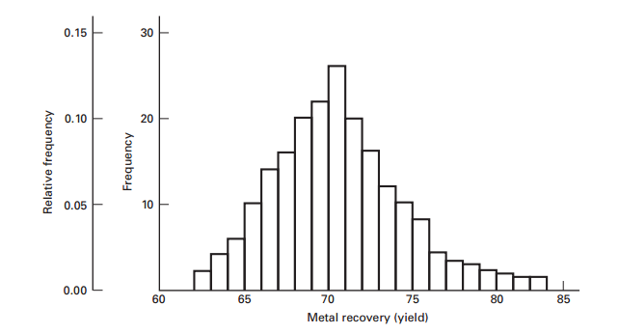
Graphical Description of Variability
Histogram for 200 observations

Slide 219
Graphical Description of Variability
The box plot (or box-and-whisker plot) is a very useful way to display data. A box plot displays the minimum, the maximum, the lower and upper quartiles (the 25th percentile and the 75th percentile, respectively), and the median (the 50th percentile) on a rectangular box aligned either horizontally or vertically.
The box extends from the lower quartile to the upper quartile, and a line is drawn through the box at the median. Lines (or whiskers) extend from the ends of the box to (typically) the minimum and maximum values.

Slide 220
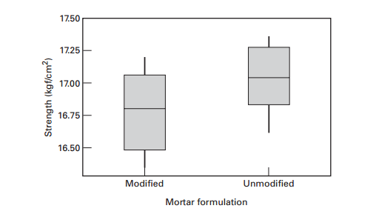
Graphical Description of Variability
Box plots

Slide 221
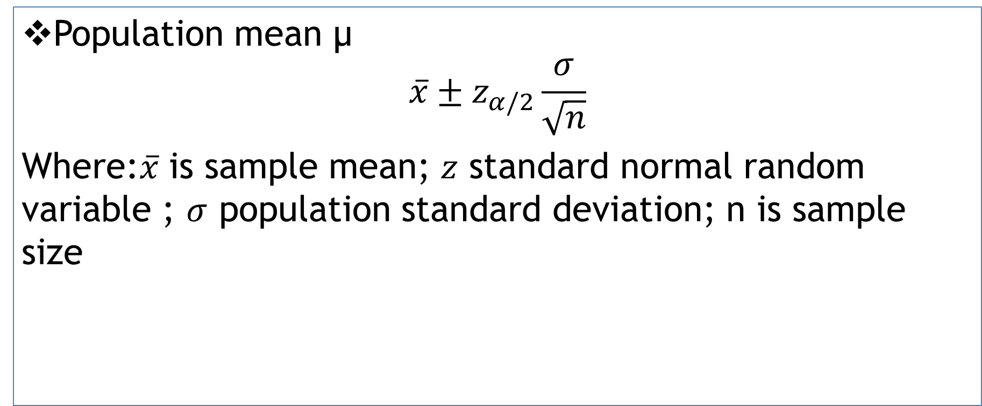
Confidence interval Using z distribution (a population mean – when σ known)
Population mean μ
$$\overline{x}±z_{α/2}\frac{σ}{\sqrt{n}}$$
Where:$\overline{x}$ is sample mean;$z$ standard normal random variable ;$σ$ population standard deviation; n is sample size

Slide 222
Research Methods and Experimental Design
Lecture 7: Experimental Design: Inferential Statistics

Slide 223
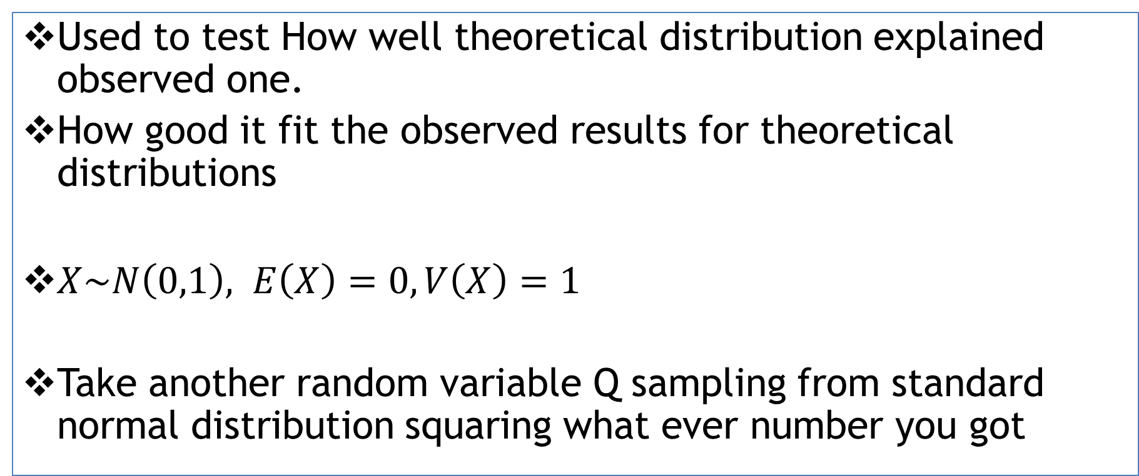
Chi-square distribution
Used to test How well theoretical distribution explained observed one.
How good it fit the observed results for theoretical distributions
$X\sim N\left(0,1\right), E\left(X\right)=0, V\left(X\right)=1$
Take another random variable Q sampling from standard normal distribution squaring what ever number you got

Slide 224
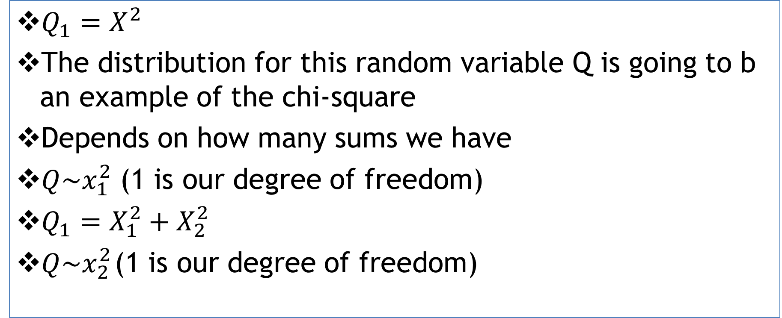
Chi-square distribution
$Q_{1}=X^{2}$
The distribution for this random variable Q is going to b an example of the chi-square
Depends on how many sums we have
$Q\sim x_{1}^{2}$ (1 is our degree of freedom)
$Q_{1}=X_{1}^{2}+X_{2}^{2}$
$Q\sim x_{2 }^{2}$(1 is our degree of freedom)

Slide 225
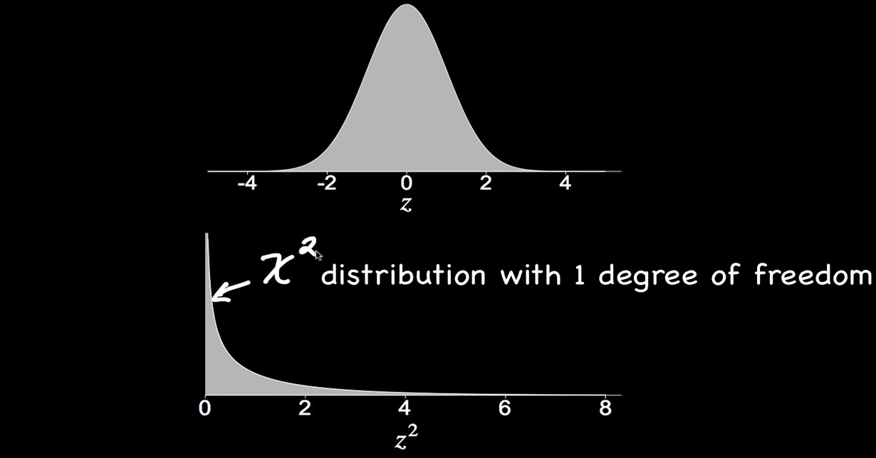
Normal distribution curve

Slide 226
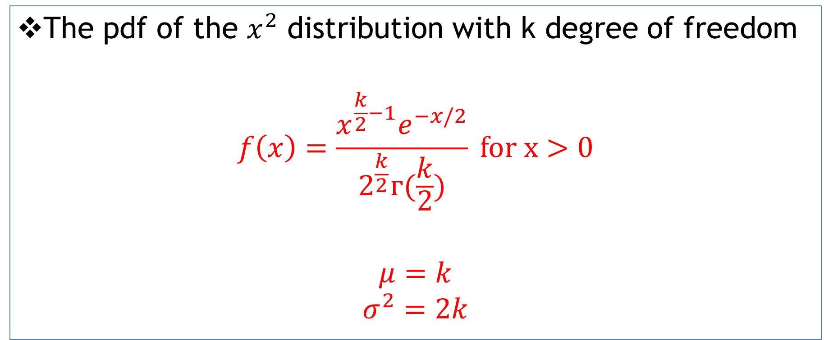
Chi-square distribution
The pdf of the $x^{2}$ distribution with k degree of freedom
$$f\left(x\right)=\frac{x^{\frac{k}{2}−1}e^{−x/2}}{2^{\frac{k}{2}}г(\frac{k}{2})} for x>0$$
$$μ=k$$
$$σ^{2}=2k$$

Slide 227
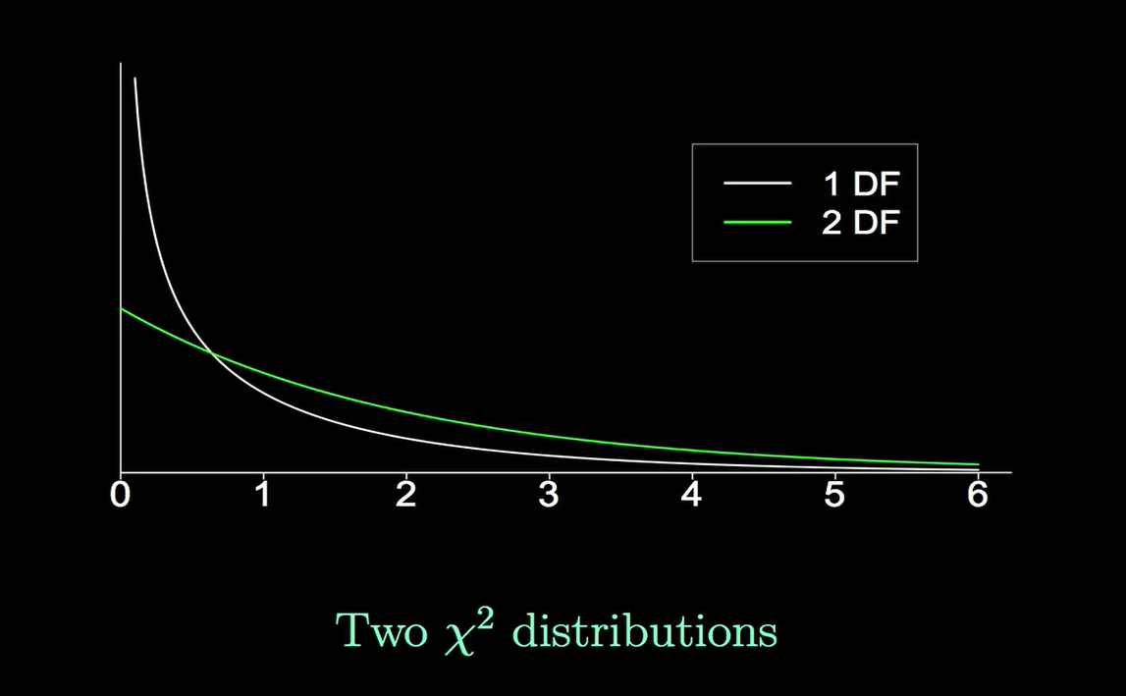
Chi-square plot

Slide 228
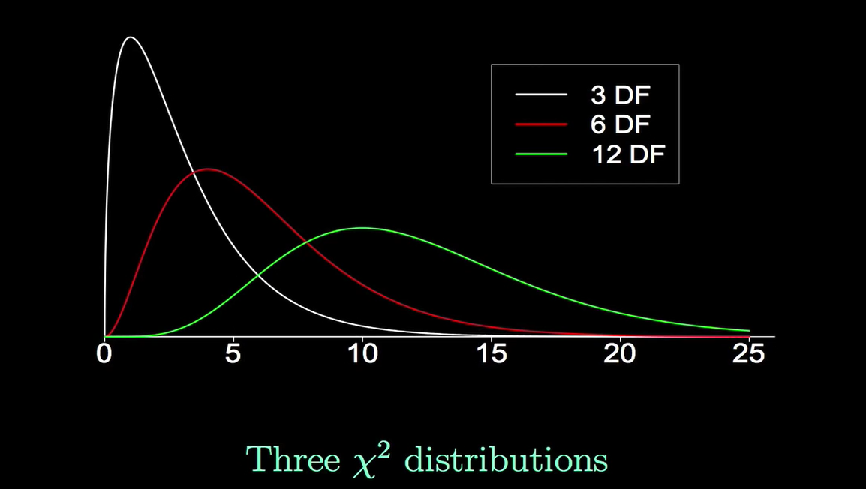
Chi-square plot

Slide 229
Example
observed
# | 1 | 2 | 3 | 4 | 5 | 6
Freq. | 22 | 24 | 38 | 30 | 46 | 44
expected
# | 1 | 2 | 3 | 4 | 5 | 6
Freq.

Slide 230
Hypothesis testing steps
State null(H_{o}) and alternative (H₁) hypothesis
Choses the level of significance
Find the critical values
Find the test statistics
Draw your conclusion

Slide 231
solution
Total is 24
Expected value for every outcomes can be calculated by
1/6*204=34
# | 1 | 2 | 3 | 4 | 5 | 6
Freq. | 22 | 24 | 38 | 30 | 46 | 44

Slide 232
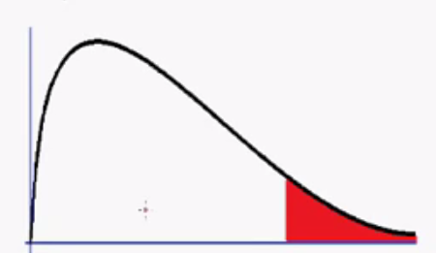

Solution
$H_{o}:μ die is fair$
$H_{o}:μ die is unfair$
Rejection region
α=0.01

Slide 233
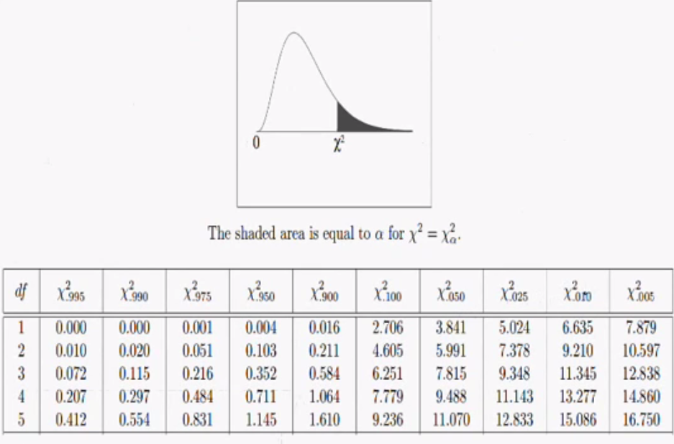
solution
A critical value=15.086

Slide 234
15.086

Slide 235

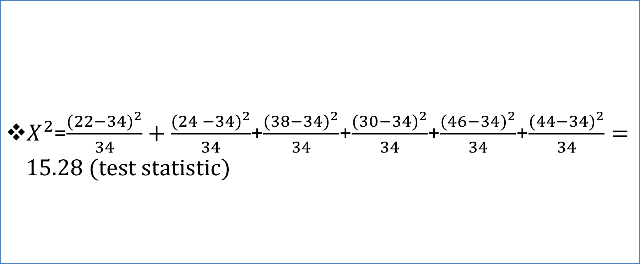
Solution
$X^{2}$=$\frac{({22−34)}^{2}}{34}+\frac{({24 −34)}^{2}}{34}$+$\frac{({38−34)}^{2}}{34}$+$\frac{({30−34)}^{2}}{34}$+$\frac{({46−34)}^{2}}{34}$+$\frac{({44−34)}^{2}}{34}=15.28 (test statistic)$
$$X^{2}=\sum_{i=1}^{n}{\frac{({O−E)}^{2}}{E}}$$

Slide 236
solution
15.086
15.28

Slide 237
Conclusion
We reject the null hypothesis and we accept the alternative hypothesis

Slide 238
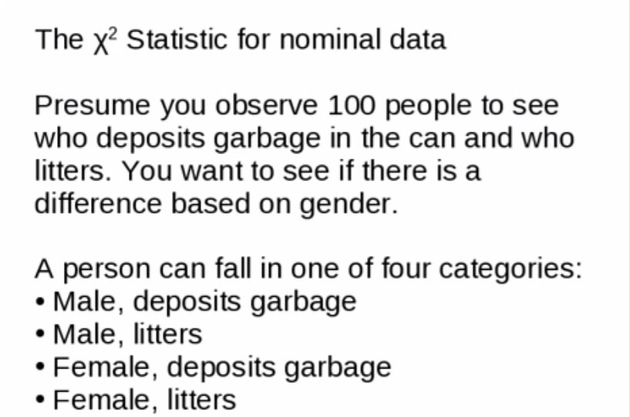

Slide 239
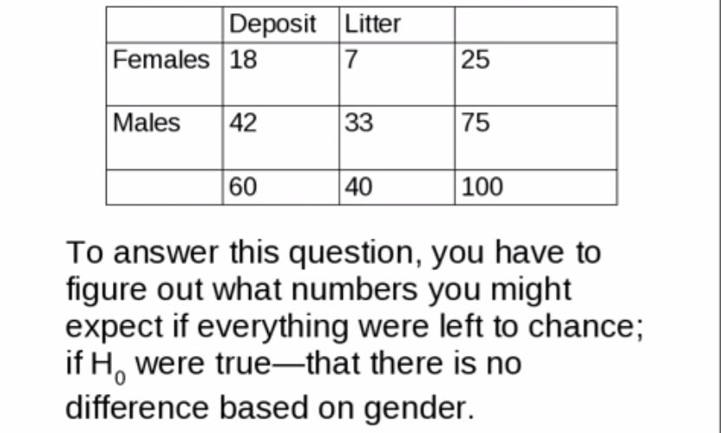

Slide 240
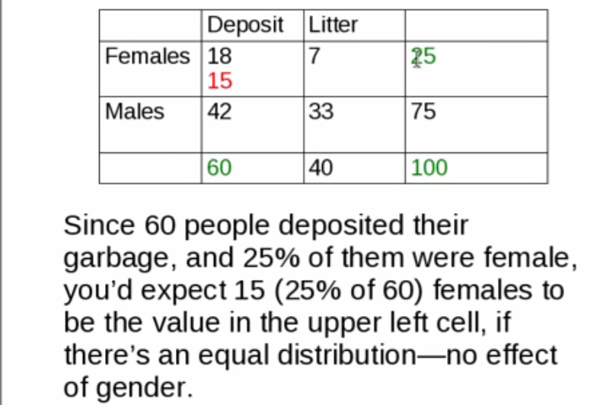

Slide 241
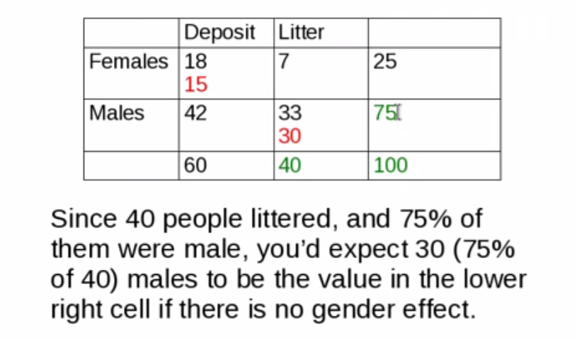

Slide 242
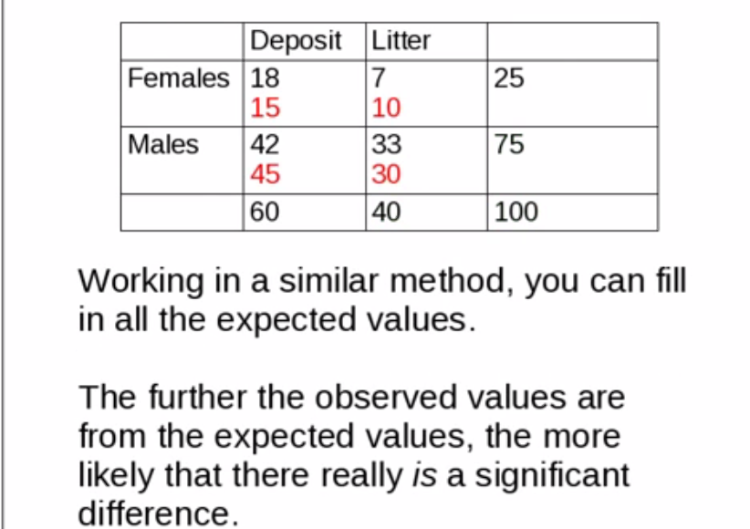

Slide 243
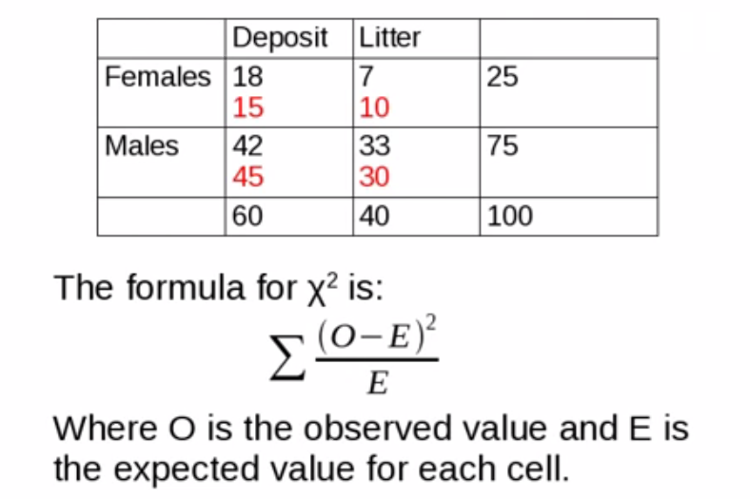

Slide 244
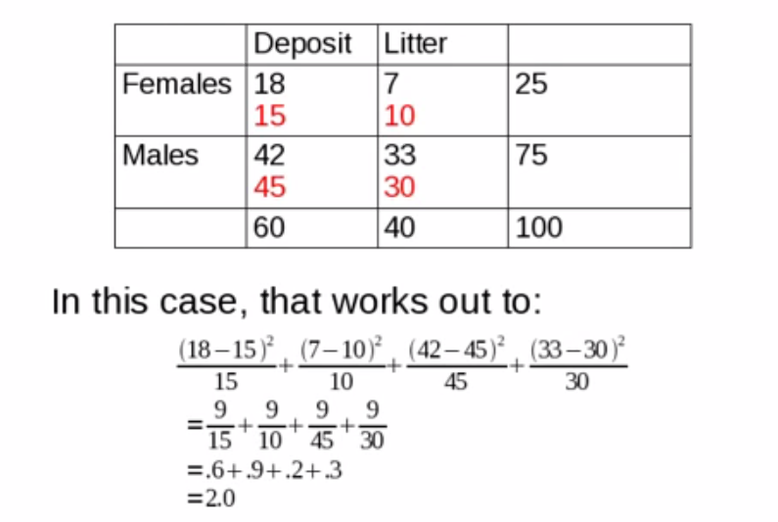

Slide 245
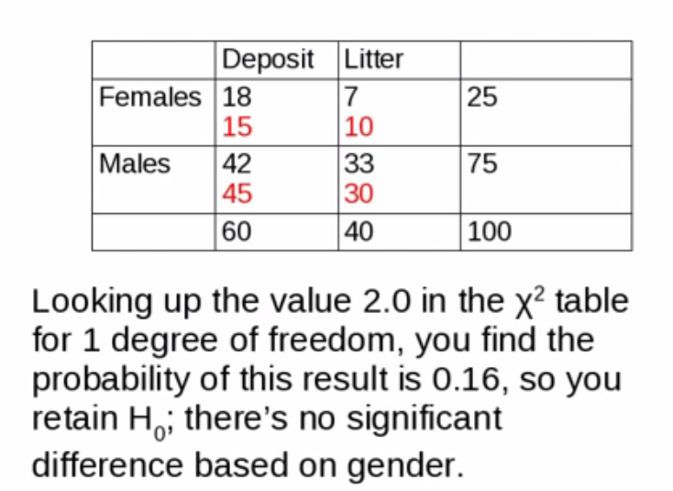

Slide 246
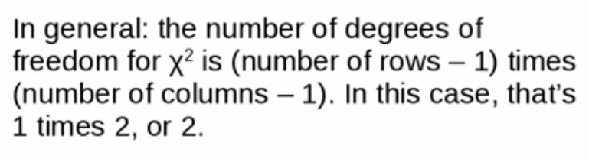
Degree of freedom

Slide 247

Confidence interval
Constructed form sample data in the range of values that is likely include the population parameter at some specified confidence level.
The confidence interval for Population mean μis determined by:
$$\text{μ}=\overline{x}±E$$
Where:$\overline{x}$ is sample mean (the point estimate);$E$ margine of error

Slide 248

Confidence interval
If $σ$ is known E is can be determined from
$E=z_{α/2}\frac{σ}{\sqrt{n}}$
Command In excel: Confidence ($α$,$σ$,$n$)
$α$ is a significance level $α$=1-CL (Confidence level)
Cl=1-$α$

Slide 249




Confidence interval
Example
CL=95%; $α$=1-0.95=0.05
The critical value ( ) is can be found from normal tables
$α$/2
$$z_{α/2}$$

Slide 250

Confidence interval

Slide 251
Example
Suppose the moisture content measurements in a coffee bines are assumed to follow a normal distribution with population standard deviation of 5.6%. A random sample of 40 test has a mean of 32%.
Estimate the population mean with
80% confidence
90% confidence
98% confidence

Slide 252


Solution
$\overline{x}±z_{α/2}\frac{σ}{\sqrt{n}}$
$σ$=5.6;$\overline{x}$=32;$n$=40

Slide 253

Solution

Slide 254

Solution

Slide 255

Solution

Slide 256

Solution
We are 80% confident that the population mean
test is between 30.87% and 33.13%

Slide 257
Exercise
Repeat the steps for the 90% and 98% confidence level
Compare the Critical values, Marginal Error and Confidence interval with the given confidence level
(support you answer with table)

Slide 258
t-test
Consider experiments to compare two conditions
Simple comparative experiments
Example:
The strength of Portland cement mortar
Two different formulations: modified v.s. unmodified
Collect 10 observations for each formulations
Formulations = Treatments (levels)

Slide 259
t-test
Observation (sample), j | Modified Mortar (Formulation 1) | Unmodified Mortar (Formulation 2)
1 | 16.85 | 17.50
2 | 16.40 | 17.63
3 | 17.21 | 18.25
4 | 16.35 | 18.00
5 | 16.52 | 17.86
6 | 17.04 | 17.75
7 | 16.96 | 18.22
8 | 17.15 | 17.90
9 | 16.59 | 17.96
10 | 16.57 | 18.15

Slide 260
t-test
Which one of this has a higher strength?
We can figure out the mean/average of each smaple
Dot diagram: Form 1 (modified) v.s. Form 2 (unmodified)
unmodified (17.92) > modified (16.76)
Look like the average of unmodified is greater than modified
It is only part of the picture. The means do not tell us so much

Slide 261
t-test

Slide 262



t-test

Slide 263

t-test
The variance with in that samples statically significance difference between the to or not.
That is why the t-value is comes in handy
It is a ratio of
$$\frac{signal}{noise}=\frac{difference between group means}{variability of groups}=\frac{|\overline{X_{1}}−\overline{X_{2}}|}{\sqrt{\frac{S_{1}^{2}}{n_{1}}+\frac{S_{2}^{2}}{n_{2}}}}$$
Signal is numbers indicate the difference between two samples
Noise is variability

Slide 264


Example

Slide 265


Example

Slide 266


Example

Slide 267




Slide 268


Slide 269
Conclusion
There is statistically significance between these two samples.

Slide 270
Exercise
Perform t-test on strength of Portland cement mortar problem indicated in slide # 258

Slide 271
Confidence interval Using t distribution (a population mean - σ unknown)
When to use t-value
σ is unknown
Sample size is less than 30

Slide 272
Confidence interval
Constructed form sample data in the range of values that is likely include the population parameter at some specified confidence level.
The confidence interval for Population mean μis determined by:
$$\text{μ}=\overline{x}±E$$
Where:$\overline{x}$ is sample mean (the point estimate);$E$ margine of error

Slide 273

Confidence interval Using t distribution (a population mean - σ unknown)
Population mean μ
$$\overline{x}±t∗\frac{s}{\sqrt{n}}$$
Where:$\overline{x}$ is sample mean;$t$ distribution value;$s$ sample standard deviation; n is sample size

Slide 274

Confidence interval
If $σ$ is unknown E is can be determined from
$E=t∗\frac{s}{\sqrt{n}}$
Command In excel:T.INV($probability$,degree of freedom)

Slide 275
Example
A Biological Oxygen Demand (BOD) concentration measurement of 9 randomly selected wastewater samples are
Compute the 99% confidence interval of the true mean
83 | 73 | 62 | 63 | 71 | 77 | 77 | 59 | 92

Slide 276


Solution
Sample mean $\overline{x}$=73
Sample standard
deviation s=10.69
t-value=3.355
n sample size 9

Slide 277

Solution
$μ=73±2.896∗\frac{10.69}{\sqrt{9}}$=11.95
$μ$= (61.05,84.95)
Command In excel:CONFIDENCE.T ($alpha,$,degree of freedom, size)
We are 99% confident that the population mean
test is between 61.05% and 84.95%

Slide 278
Exercise
Repeat the above problem with 90% and 95% confidence interval.

Slide 279
Hypothesis Testing
The average protein content for soybean 100 mg/g with standard deviation of 15 mg/g. A researcher believes this value has changed. The researcher decides to test the protein content of 75 random samples. The average protein content of the sample is 105 mg/g. is there enough evidence to suggest the average protein content is changed?

Slide 280
Solution
Hypothesis testing steps
State null(H_{o}) and alternative (H₁) hypothesis
Choses the level of significance
Find the critical values
Find the test statistics
Draw your conclusion

Slide 281


Solution
$H_{o}:μ=100$
$H_{o}:μ≠100$
we will follow the 2 tailed test
0.95
0.025
0.025

Slide 282

Solution

Slide 283
solution
Rejection region
0.95
0.025
0.025
-1.96
1.96

Slide 284

solution
t=$\frac{\overline{X}−μ}{\frac{σ}{\sqrt{n}}}=\frac{105−100}{\frac{15}{\sqrt{75}}}=2.89 (test statistics)$
0.95
0.025
0.025
-1.96
1.96

Slide 285
Solution
It is in rejection region
There for we reject null(H_{o}) and accept alternative (H₁) hypothesis

Slide 286
Conclusion
Yes! There is enough evidence to suggest the average protein content is changed with 95 % confidence.

Slide 287
Hypothesis Testing - one tailed 't' distribution
The average compressive strength of a PVC pipe is 100 psi. A customer believes the average strength of the pipe is lower. A random sample of 5 pipes are tested and scored:69,79,89,99,109. (s.d=15.81)
Is there enough evidence to suggest the average strength is lower?

Slide 288
solution
Hypothesis testing steps
State null(H_{o}) and alternative (H₁) hypothesis
Choses the level of significance
Find the critical values
Find the test statistics
Draw your conclusion

Slide 289



Solution
$H_{o}:μ=100$
$H_{o}:μ<100$
we will follow the one tailed test
$$μ$$

Slide 290
solution
When to use t-value
σ is unknown
Sample size is less than 30

Slide 291

Soution

Slide 292


Solution
t=$\frac{\overline{X}−μ}{\frac{σ}{\sqrt{n}}}=\frac{89−100}{\frac{15.81}{\sqrt{5}}}=−1.56 (test statistics)$
Rejection region
$$μ$$
-2.132
-1.56

Slide 293
Conclusion
We fail to reject the null hypothesis. Which means the customer is wrong on the strength of the pipe

Slide 294

The F-test
Tells us if the standard deviations from two sets of data are statistically different.
Example
If we have two type of method to calculate the percentage of zinc in wastewater. We can compare weather there is statistical significant difference between this two method
F can be calculated by $F=\frac{S_{1}^{2}}{S_{2}^{2}}$

Slide 295


Example
 | Method 1 | Method 2
$$Mean±standard deviation (\% Zn)$$ | $$96.8\%±0.5\%$$ | $$97.9\%±0.8\%$$
$$number of measurement (n)$$ | 10 | 5
$$F=\frac{{0.8}^{2}}{{0.5}^{2}}=2.56$$

Slide 296


solution
$$3.63$$

Slide 297
Conclusion
If F calculated is smaller than F from the table then we can say 95% confident that any difference in standard deviation is due to random error. There for these two set of data is statistically similar.

Slide 298
Introduction to Analysis of Variance (ANOVA)
Purpose: To compare the differences of more than two populations means.
Also known as factorial experiments.
The approach that allows us to use sample data to see if the values of more than two populations means are likely to be different from each other.
This name is derived from the fact that in order to test for statistical significance between means, we are actually comparing variances. (so F-distribution will be used).

Slide 299
Cont…
There are two-types of ANOVA:
One-way ANOVA – involve one factor
Two-way ANOVA – involve two factors

Slide 300
Example
a) Will three different levels of a chemical concentration have different effect on an electroplating process?
H₀ : The mean effect of electroplating process is the same for all three concentration levels.
One-way ANOVA
b) Will three different levels of a chemical concentration have different effect on four electroplating processes?

Slide 301
Cont..
H0 : Different levels of a chemical concentration have no effect on the electroplating processes.
(There is no interaction effect between chemical concentration and electroplating processes)
-Two-way ANOVA

Slide 302
The Procedural Steps for an ANOVA Test
State the Null (H0) and Alternative (H1) hypotheses.
Determine the test statistic to be used - Ftest.
Establish the test criterion by determining the critical value (point) and rejection region, based on significance level, a – Fcritical.
Make a decision to reject or fail to reject the null hypothesis based on the comparison between test statistic and critical values. The test is right tailed only. Graphical illustration can help to determine where the statistic value lies either within the rejection or acceptance region.
Draw a conclusion to reject or not to reject the claim.

Slide 303

General procedure of ANOVA

Slide 304

ONE-WAY ANOVA
Assumptions for one-way ANOVA:
To use the one-way ANOVA test, the following assumptions of data should be considered:
The populations under study follow normal distribution.
The samples are drawn randomly, and each sample is independent of the other samples.
All the populations from which the samples values are obtained, have the same unknown population variances, that is for k number of populations,

Slide 305

Tabulation of Data for One-Way ANOVA

Slide 306

Model for one-way ANOVA

Slide 307

The Null and Alternative hypotheses

Slide 308


One-way ANOVA Table

Slide 309

Example
An experiment was performed to determine whether the annealing temperature of ductile iron affects its tensile strength. Five specimens were annealed at each of four temperatures. The tensile strength (in kilo-pounds per square inch, ksi) was measured for each temperature. The results are presented in the following table.

Slide 310

solution
a) Write down the model, assumptions and rules of the one-way ANOVA for the given data.

Slide 311

Cont…
(b) Perform the ANOVA and test the hypothesis at 0.01 level of significance that the mean data provided by the tensile strength is the same for all four temperatures.
From the model above, clearly can be seen that thus the table above can be explained as k=4 and n=5

Slide 312


Cont…

Slide 313

Cont…

Slide 314

Solve one-way ANOVA using Microsoft EXCEL
1. Excel - Key in data:

Slide 315

Cont…
2. Follow the steps below:
Click menu: Data → Data Analysis → ANOVA single factor → enter the data range → set a value of a → OK

Slide 316

Cont…
3. Output:

Slide 317
The Two-Factor Factorial Design
The simplest types of factorial designs involve only two factors or sets of treatments. There are a levels of factor A and b levels of factor B, and these are arranged in a factorial design; that is, each replicate of the experiment contains all ab treatment combinations. In general, there are n replicates.

Slide 318
Example
an engineer is designing a battery for use in a device that will be subjected to some extreme variations in temperature. The only design parameter that he can select at this point is the plate material for the battery, and he has three possible choices. When the device is manufactured and is shipped to the field, the engineer has no control over the temperature extremes that the device will encounter, and he knows from experience that temperature will probably affect the effective battery life. However, temperature can be controlled in the product development laboratory for the purposes of a test.

Slide 319
Example
The engineer decides to test all three plate materials at three temperature levels—15, 70, and 125°F—because these temperature levels are consistent with the product end-use environment. Because there are two factors at three levels, this design is sometimes called a 3² factorial design. Four batteries are tested at each combination of plate material and temperature, and all 36 tests are run in random order. The experiment and the resulting observed battery life data are given in Table 5.1.

Slide 320

Example

Slide 321
Example
In this problem the engineer wants to answer the following questions: 1. What effects do material type and temperature have on the life of the battery? 2. Is there a choice of material that would give uniformly long life regardless of temperature?

Slide 322
Example
This last question is particularly important. It may be possible to find a material alternative that is not greatly affected by temperature. If this is so, the engineer can make the battery robust to temperature variation in the field. This is an example of using statistical experimental design for robust product design, a very important engineering problem

Slide 323
Exampel
This design is a specific example of the general case of a two-factor factorial. To pass to the general case, let yijk be the observed response when factor A is at the ith level (i 1, 2, . . . , a) and factor B is at the jth level ( j 1, 2, . . . , b) for the kth replicate (k 1, 2, . . . , n).
In general, a two-factor factorial experiment will appear as in Table 5.2. The order in which the abn observations are taken is selected at random so that this design is a completely randomized design.

Slide 324

Example

Slide 325

General Arrangement for a Two-Factor Factorial Design

Slide 326

Exampel

Slide 327


Slide 328


Slide 329


Slide 330


Slide 331


Slide 332


Slide 333

The total sum of squares

Slide 334


Slide 335

The Analysis of Variance Table for the Two-Factor Factorial, Fixed Effects Model

Slide 336

Solution

Slide 337

Solution

Slide 338

Solution

Slide 339

Solution

Slide 340

Solution

Slide 341


Solution

Slide 342
Example-2
A chemical engineer is studying the effects of various reagents and catalyst on the yield of a certain process. Yield is expressed as a percentage of a theoretical maximum. 2 runs of the process were made for each combination of 3 reagents and 4 catalysts.
Catalyst | Reagent
 | 1 | 2 | 3
A | 86.8 82.4 | 93.4 85.2 | 77.9 89.6
B | 71.9 72.1 | 74.5 87.1 | 87.5 82.7
C | 65.5 72.4 | 66.7 77.1 | 72.7 77.8
D | 63.9 70.4 | 73.7 81.6 | 79.8 75.7
Construct an ANOVA table.
Test is there an interaction effect between reagents and catalyst. Use α = 0.05.
Do we need to test whether there is an effect that is due to reagents or catalyst? Why? If Yes, test is there an effect from reagents or catalyst.

Slide 343

Solution
a) How many treatments involved in this experiment?
Factor A has 4 levels, factor B has 3 levels and each sample has 2 replicates.
Thus, a = 4, b = 3, and r = 2. Total treatment = 12.

Slide 344

Cont…
Calculate sum of square values:

Slide 345

Cont…

Slide 346

(d) Test if there is an interaction effect between reagents and catalysts on the yield of a chemical process at 5% significance level

Slide 347

Cont…

Slide 348

Solve two-way ANOVA by using Microsoft EXCEL
1. Excel – Key in data

Slide 349

Cont…
2. Follow the steps below:
Data-Data Analysis → ANOVA two factor with replication → enter the data range → set a value for a → OK

Slide 350

Cont…
3. ANOVA table:

Slide 351

Cont…
3. ANOVA table:

Slide 352
Exercise
A study was done to determine the effects of two factors on the lather ability of soap. The two factors were type of water and glycerol. The outcome measured was the amount of foam produced in mL. The experiment was repeated 3 times for each combination of factors. The result are presented in the following table..
Water type | Glycerol | Foam (mL)
De-ionized | Absent | 168 178 168
De-ionized | Present | 160 197 200
Tap | Absent | 152 142 142
Tap | Present | 139 160 160
Construct an ANOVA table and test is there an interaction effect between factors. Use α = 0.05.

Slide 353
3 way anova

Slide 354
introduction
Three way ANOVA means three variables,each have two or more than two levels.
If there are ‘n’ levels of one variable,’m’ levels of second variables, and ‘I’ variables of third variable,then it can be called ‘nxmxI’ factorial design ANOVA.

Slide 355


Slide 356

Solution

Slide 357


Slide 358
Research Methods and Experimental Design
Lecture 8: Experimental Design: Fractional factorial design

Slide 359
How to handle large number of factorial
When testing or developing a new process, we do not know which factors influencing it and to what extent.
Hence we need to include a large number of factors so that no potential influential factor is excluded.

Slide 360
How to handle large number of factorial
However, even a 2^{n} factorial design involving all these factor require considerable manpower and investment.
Hence, we may do a sequential study wherein a subset of (called as the fraction) of the overall 2^{n} design if first carried out and those results are analyzed.

Slide 361
Closer look at 2^{n} design
The 2^{n} design models the response in terms of main factors, two-factor interaction, three factor interactions etc.
Further, the level of significance of the interaction may decline with increasing order.(i.e. binary >tertiary >quarterly etc.)
When repeated are not carried out, the higher order interaction effects may be clubbed and their total sum of sqared may be used for mean square error estimation.

Slide 362

Closer look at 2^{n} design
Among n factors,we have
n-main factors
nC₂-two factorial interaction,
nC₃-three factorial interaction
$${nC}_{n}=\frac{n!}{\left(n−r\right)!r!}$$

Slide 363
Closer look at 2^{n} design
Hence in a 2⁵ design, we have
5 main factorial
10 two factorial interaction
10 three factorial interaction
5 four factorial interaction
1 five factor interaction

Slide 364
Closer look at 2^{n} design
Hence, more than 50% of the total number of factors are three factors interaction and above
This fact may be exploited while running fractional factorial design involving many factors.

Slide 365
Construction of the fractions in the 2^{n} design
An allowable fraction may be (1/2) or (1/4) or (1/8) fraction of the overall design depending on the value of n.
For example in 2⁴ design we have a half (1/2) fraction comprising of 8 runs or a quarter (1/4) fraction comprising 4 runs.

Slide 366

Construction of the fractions in the 2^{n} design
A fraction may be denoted as follow
$$\frac{1}{2^{p}}2^{n}=2^{n−p} where, n>p$$
The table of contrasts may be used to set up the different fractions
It is evident that while dealing with individual fractions there could be a potential loss of information

Slide 367
Identification of fractions
Most important is to ensure that atleast the main effects (single factor) are identified without them getting aliased with other main factors.
Even interactions are important ,sometimes more so.

Slide 368
Identification of fractions
Let us work with the fairly large 2⁴ design
A full set comprising of 16 experiments
Let us start with a 2⁴⁻¹ design i.e. constructing two half fractions of 2³ runs each from the full 2⁴ design

Slide 369
Identification of fractions
We may look at the highest order interaction factors ABCD and split the overall design into two fractions according to the “+1” and “-1” sign in the ABCD column

Slide 370

Identification of fractions

Slide 371


Slide 372


Slide 373


Slide 374


Slide 375


Slide 376

Example

Slide 377


Slide 378


Slide 379


Slide 380


Slide 381


Slide 382


Slide 383


Slide 384


Slide 385


Slide 386


Slide 387

Example

Slide 388
Research Methods and Experimental Design
Lecture 8: Experimental Design: Response surface method (RSM)

Slide 389
Introduction: Response surface method (RSM)
Response surface method (RSM) is one of the powerful statistical experimental design techniques that is applied t build models and investigate individual and interaction effects of the selected operating condition on the give response in a given experiment.
It is a very effective approach for optimization of complex processes in a more convenient way resulting in saving time, labor, and cost.

Slide 390
Introduction: Response surface method (RSM)
Response-surface methodology comprises a body of methods for exploring for optimum operating conditions through experimental methods.
Typically, this involves doing several experiments, using the results of one experiment to provide direction for what to do next.

Slide 391
Introduction…
Response surface methodology (RSM) is a collection of mathematical and statistical techniques for empirical model building.
By careful design of experiments, the objective is to optimize a response (output variable) which is influenced by several independent variables (input variables).
An experiment is a series of tests, called runs, in which changes are made in the input variables in order to identify the reasons for changes in the output response.

Slide 392

Introduction…
A sequential procedure
The objective is to lead the experimenter rapidly and efficiently along a path of improvement toward the general vicinity of the optimum.
First-order model => Second-order model
Climb a hill

Slide 393
Introduction…
Models are simple polynomials
Include terms for interaction and curvature
Coefficients are usually established by regression analysis with a computer program
Insignificant terms are discarded

Slide 394
RESPONSE SURFACE MODEL FOR TWO FACTORS
Response Surface Model for two factors X₁ and X₂ and measured response Y (Regardless of number of levels):
Y = β₀ constant
+ β₁X₁ + β₂X₂ main effects
+ β₃X₁² + β₄X₂² curvature
+ β₅X₁X₂ interaction
+ ε error

Slide 395
RESPONSE SURFACE MODEL FOR THREE FACTORS TWO LEVELS
Y = β₀ constant
+ β₁X₁ + β₂X₂ + β₃X₃ main effects
+ β₁₁X₁² + β₂₂X₂² + β₃₃X₃² curvature
+ β₁₂X₁X₂ + β₁₃X₁X₃ + β₂₃X₂X₃ interactions
+ ε error
(Note that higher order interactions are not included.)

Slide 396

THREE LEVEL FACTORIAL EXPERIMENTS FOR TWO FACTORS
3² Factorial Experiments
Geometric Presentation
X₂
X₁
Mathematical Model
Y = β₀ + β₁X₁+ β₂X₂ + β₃X₁² + β₄X₂² + β₅X₁X₂
+ β₆X₁²X₂ + β₇X₁X₂² + β₈X₁²X₂² + ε

Slide 397
RESPONSE SURFACE MODEL FOR TWO FACTOR EXPERIMENT
Y = β₀ constant
+ β₁X₁ + β₂X₂ main effects
+ β₃X₁² + β₄X₂² curvature
+ β₅X₁X₂ interaction
+ ε error
All the other terms are dropped into the error term.

Slide 398

THREE LEVEL FACTORIAL EXPERIMENTS FOR THREE FACTORS
3³ FACTORIAL EXPERIMENT
Geometric Presentation
X₃
X₂
X₁

Slide 399
THREE LEVEL FACTORIAL FOR THREE FACTOR EXPERIMENT
Mathematical Model
Y = β₀ + β₁X₁+ β₂X₂ + β₃X₃ + β₄ X₁X₂ + β₅X₁X₃ + β₆X₂X₃
+ β₇X₁² + β₈X₂² + β₉X₃² + β₁₀X₁²X₂ + β₁₁X₁²X₃
+ β₁₂X₁X₂² + β₁₃X₂²X₃ + β₁₄X₁X₃² + β₁₅X₂X₃²
+ β₁₆X₁²X₂² + β₁₇X₁²X₃² + β₁₈X₂²X₃² + β₁₉X₁X₂X₃
+ β₂₀X₁²X₂X₃ + β₂₁X₁X₂²X₃ + β₂₂X₁X₂X₃² + β₂₃X₁²X₂²X₃
+ β₂₄X₁²X₂X₃² + β₂₅X₁X₂²X₃² + β₂₆X₁²X₂²X₃² + ε

Slide 400
RESPONSE SURFACE MODEL FOR THREE FACTOR EXPERIMENT
Y = β₀ constant
+ β₁X₁ + β₂X₂ + β₃X₃ main effects
+ β₁₁X₁² + β₂₂X₂² + β₃₃X₃² curvature
+ β₁₂X₁X₂ + β₁₃X₁X₃ + β₂₃X₂X₃ interaction
+ ε error
All the other terms are dropped into the error term.

Slide 401

NUMBER OF RUNS FOR A 3k FACTORIAL EXPERIMENT
The number inside [brackets] is the number of runs needed for a third replicate of the full 3^{k} factorial experiment

Slide 402
Types of RSM
Central composite design (CCD)
Box–Behnken design (BBD)

Slide 403
CCD
The most popular response surface method (RSM) design is the central composite design (CCD).
A CCD has three groups of design points:
(a) two-level factorial or fractional factorial design points
(b) axial points (sometimes called "star" points)
(c) centre points

Slide 404


CCD
CCD's are designed to estimate the coefficients of a quadratic model. All point descriptions will be in terms of coded values of the factors.

Slide 405
3 FACTOR CENTRAL COMPOSITE DESIGNS
+
Factorial + Star points
=
CCD

Slide 406

Determining in Central Composite Designs
the value of depends on the number of experimental runs in the factorial portion of the central composite design:

Slide 407
Upper and Lower Limits
Upper star level
High star value =(Average of factor level at (-1) and (+1)) + Alpha((range between the (-1) and (+1) level)/2)
Lower star level
High star value =(Average of factor level at (-1) and (+1)) - Alpha((range between the (-1) and (+1) level)/2)

Slide 408

Determining for Rotatability

Slide 409
1. Factorial Points
The two-level factorial part of the design consists of all possible combinations of the +1 and -1 levels of the factors. For the two factor case there are four design points:
(-1, -1) (+1, -1) (-1, +1) (+1, +1)

Slide 410
2. Star or Axial Points
The star points have all of the factors set to 0, the midpoint, except one factor, which has the value +/- Alpha. For a two factor problem, the star points are:
(-Alpha, 0) (+Alpha, 0) (0, -Alpha) (0, +Alpha)
The value for Alpha is calculated in each design for both rotatability and orthogonality of blocks. The experimenter can choose between these values or enter a different one. The default value is set to the rotatable value.

Slide 411
2. Star or Axial Points
Another position for the star points is at the face of the cube portion on the design. This is commonly referred to as a face-centered central composite design.
You can create this by setting the alpha value equal to one, or choosing the Face Centered option. This design only requires three levels for each factor.

Slide 412
3. Center Points
Center points, as implied by the name, are points with all levels set to coded level 0 - the midpoint of each factor range:
(0, 0)
Center points are usually repeated 4-6 times to get a good estimate of experimental error (pure error). For example, with two factors the design will be created with five center points by default. These runs can be identified in the design layout by doing a right mouse click on the Block column heading and choosing Show Point Type.

Slide 413
3. Center Points
To summarize, central composite designs require 5 levels of each factor: -Alpha, -1, 0, 1, and +Alpha.
One of the commendable attributes of the central composite design is that its structure lends itself to sequential experimentation.
Central composite designs can be carried out in blocks.

Slide 414
Categorical Factors
You may also add categorical factors to this design.
This will cause the number of runs generated to be multiplied by the number of combinations of the categorical factor levels.

Slide 415
Response model
If the response is well modeled by a linear function of the independent variables, then the approximating function is the first-order model (linear):
Y = β₀ + β₁ x₁ + β₂ x₂ + … + β_{k} x_{k} + ε
This model can be obtained from a 2^{k} or 2^{k-p} design.
If there is curvature in the system, then a polynomial of higher degree must be used, such as the second-order model:
Y = β₀ + Σβ_{i} x_{i} + Σβ_{ii} x²_{i} + ΣΣβ_{ij} x_{i} x_{j} + ε
This model has linear + interaction + quadratic terms.

Slide 416
COMPARISON OF CCD WITH 3^{k} FACTORIAL EXPERIMENTS
Are as efficient as 3^{k} factorial experiments
- minimum number of trials for estimating main effects and quadratic terms
Require less runs than 3^{k} factorial experiments
Allow sequential experimentation, which provides flexibility in running the experiment

Slide 417

BBD
The Box-Behnken design is an independent quadratic design in that it does not contain an embedded factorial or fractional factorial design.
In this design the treatment combinations are at the midpoints of edges of the process space and at the centre.

Slide 418


A Box-Behnken Design for Three Factors

Slide 419
BBD
is one kind of RSM, which helps to design a second-order response model.
can provide a maximum amount of complex information with minimum experimental time.
In comparison with other statistical methods, such as full factorial design, it requires a few number of runs.
it avoids the analyses at their extreme combinations (such as at highest and lowest levels) for which unsatisfactory results might occur

Slide 420

BBD
the total number of experiment can be calculated as
where k is a number of factors, and Cp is a central replication point
$$N=k^{2}+k+C_{p}$$

Slide 421

Comparisons of response surface designs

Slide 422

Number of Runs Required by Central Composite and Box-Behnken Designs

Slide 423


Summary of Properties of Classical Response Surface Designs

Slide 424
Exercise
There will be class exercise on three way anova, RSM (CCD&BBD),Fractional Factorial using different software packages
Such as: Excel, Design expert, Mintab, Reliasoft, JMP, SPSS
Case studies will be selected respected to each stream
Food Engineering
Process Engineering
Environmental Engineering
Material Engineering
Students can make themselves familiar with the listed software specially with Design expert form different tutorial from internate (YouTube)

Slide 425
“There is no end to learning,
but there are many beginnings”
Tim Johnson

