Slide 1
Electronic Devices: A very brief history
Electronic systems are circuits of interconnected electronic devices
The entity, the electron was discovered in 1897 by J.J Thomson
Resistors, capacitors and inductors are very simple devices, but most electronic systems rely on non-linear devices, the simplest being the diode, which allows conduction for one polarity of applied voltage but not for the other
The ﬁrst use of diodes was for detecting radio signals. In the early 1900’s, semiconductor diodes were demonstrated as were vacuum tube diodes
The widespread application of vacuum tubes transformed communications and entertainment and enabled the ﬁrst digital computers, but vacuum tubes had problems –they were large, fragile, and consumed a lot of power.

Slide 2
Electronic Devices: A very brief history
In the 1920’s, Julius Lilienfeld and Oskar Heil independently patented a concept for a “solid-state” replacement for the vacuum tube triode
The result, in December 1947, was the transistor – not the ﬁeld-eﬀect transistor (FET) of Lilienfeld and Heil but a point contact bipolar transistor
Over the years, however, the technological problems associated with FETs were solved, and today, the Metal-Oxide-Semiconductor Field-Eﬀect Transistor (MOSFET) is the mainstay of electronic systems
By 1960, technologists learned how to manufacture several transistors in one, monolithic piece of semiconductor and to wire them up in circuits as part of the manufacturing process

Slide 3
Electronic Devices: A very brief history
Gordon Moore noticed in 1965 that the number of transistors on these integrated circuit “chips” was doubling every technology generation (about two years)
The doubling of the number of transistors per chip each technology generation (now known as Moore’s Law) was accomplished by down-scaling the size of transistors
Because transistor dimensions were ﬁrst measured in micrometers, electronics technology became known as “microelectronics.”
About the year 2000, the length of the transistor channel reached 100 nanometers, microelectronics became nanoelectronics, and the nanotransistor became a high-impact success of the nanotechnology revolution.

Slide 4
Unit 1: Material Properties
Lecture 1.1:
Energy levels to energy bands
Georgies Alene (PhD)
georgies262@gmail.com
Center for Materials Engineering
Addis Ababa, Ethiopia

Slide 5
Basic materials properties of semi-conductors

Slide 6
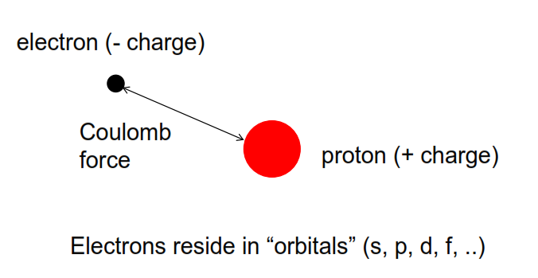
The hydrogen atom
So let us begin with the simplest possible atom (The hydrogen atom)
and we label these states or these orbitals, s, p, d and f

Slide 7
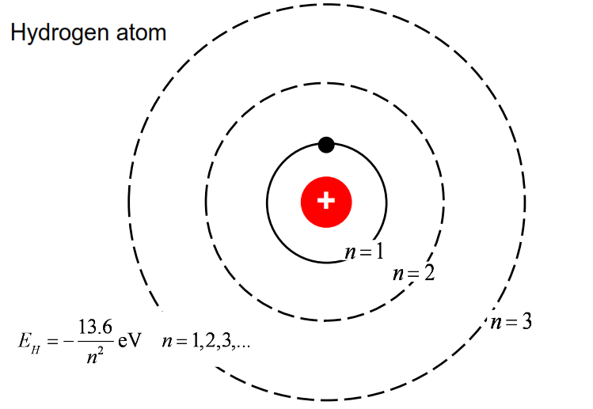
Quantization of energy levels
Another label for the states is
the principle quantum number n
This is some basic fundamentals that we learned about hydrogen atoms

Slide 8
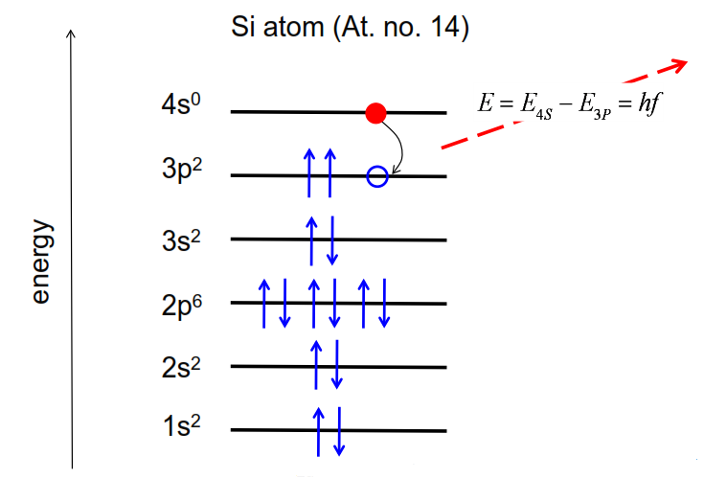
Silicon atom energy levels
Silicon is much more complicated than a hydrogen atom

Slide 9
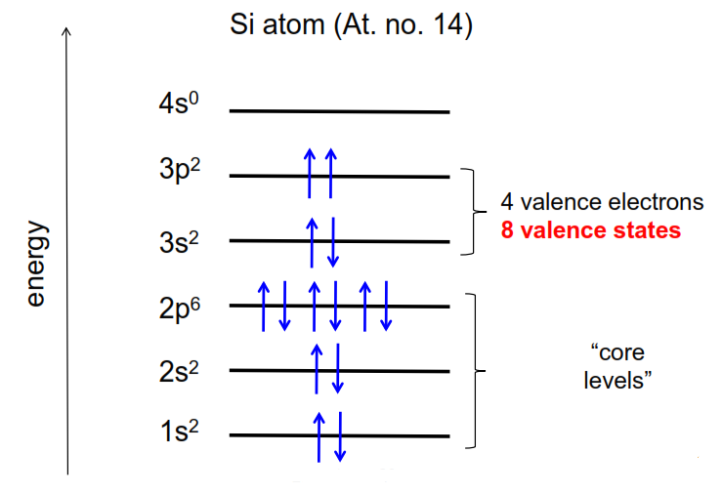
Valence vs. core levels

Slide 10
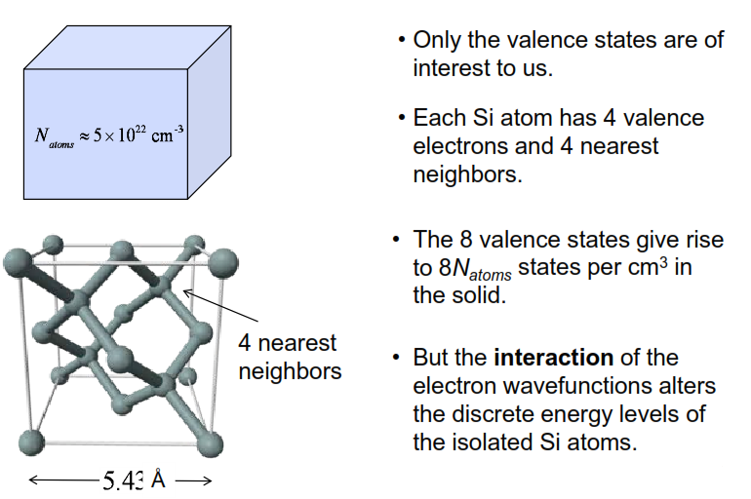
Silicon energy levels / energy bands
But something very important happens when the silicon atoms are put in a lattice a short distance away from each other, the chemical bonds form and the orbitals interact, and discrete energy levels broaden and become bands of energies

Slide 11
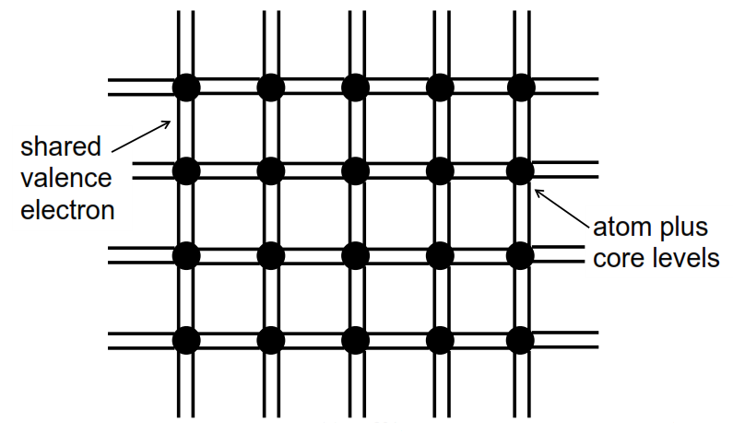
Bonding (cartoon)
This is a much simpler picture of silicon lattice that we will use frequently in this course

Slide 12
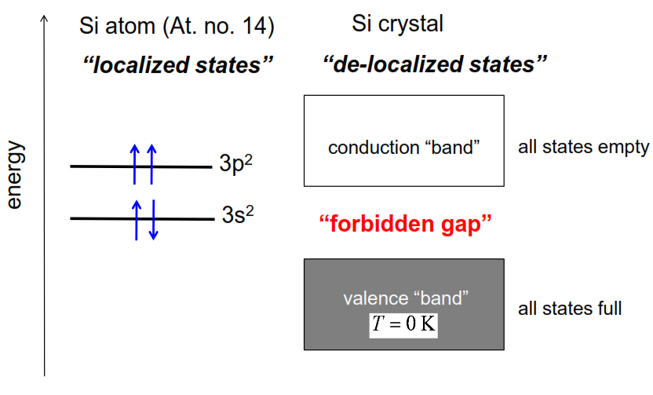
Silicon energy levels energy bands
Orbitals overlap and the bonding occurs. Instead of becoming discrete, they spread out and they change in energy

Slide 13
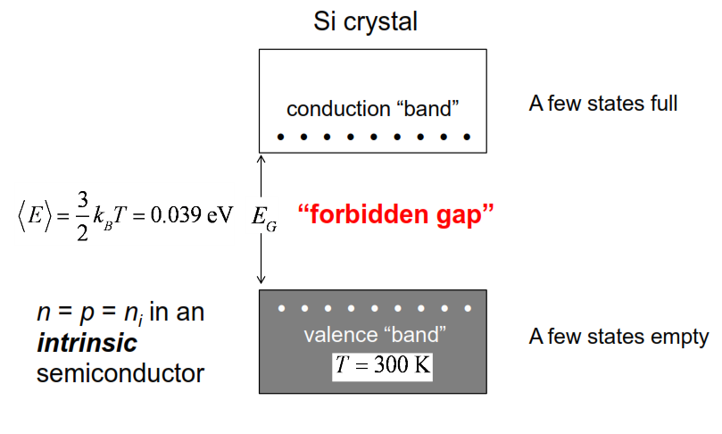
Above T = 0 K

Slide 14

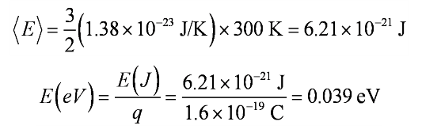
Joules and electron volts
We should do our calculations in SI (MKS) units, but it is convenient to express energies in electron volts, which is not a proper SI unit. Electron volts should be converted to Joules before using them in calculations.

Slide 15
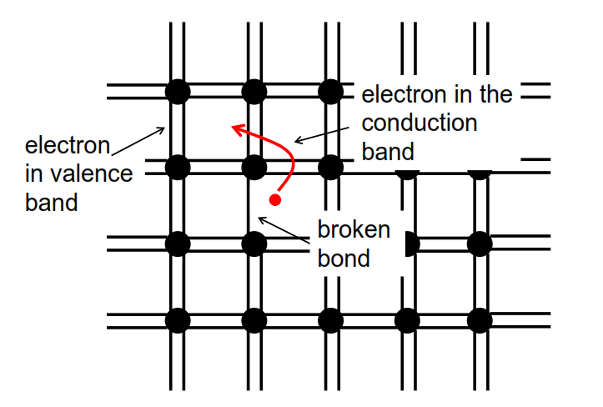
Another view
There's another picture of what is happening when we break bands and create carriers.

Slide 16
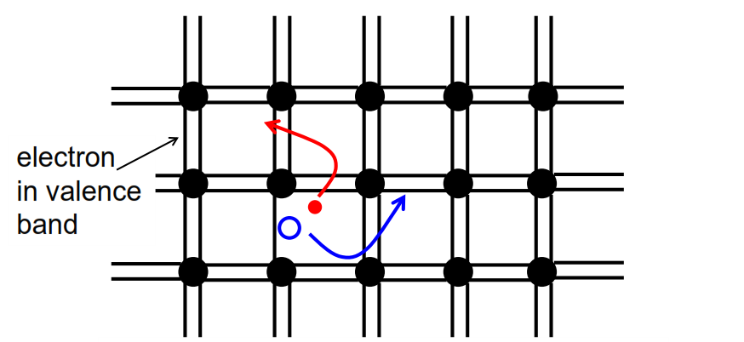
Electrons and holes in semiconductors
The hole is an absence of a negative charge, so it behaves like a positively charged particle.
1) Electrons in the conduction can move
2) Holes in the valence band can also move
3) Electrons and holes can recombine

Slide 17
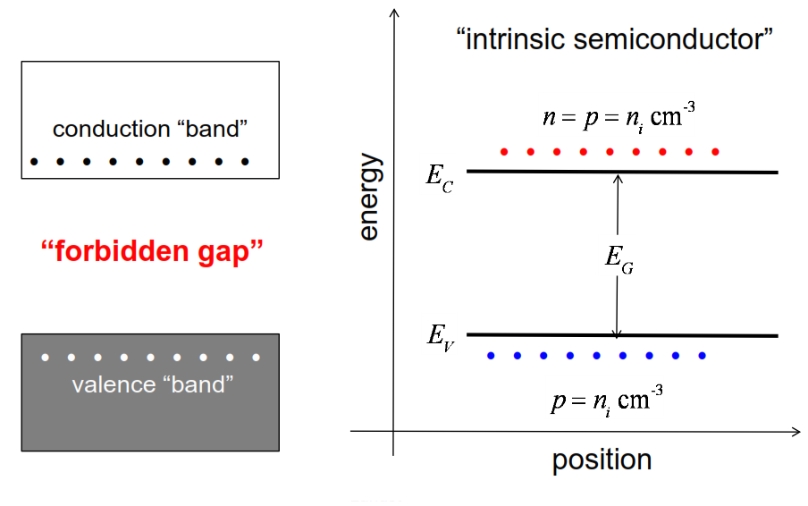
Energy band diagrams
An energy band diagram is a plot of energy versus position
when we draw energy band diagrams, we will simply draw the top of the valence band and the bottom of the conduction band.

Slide 18
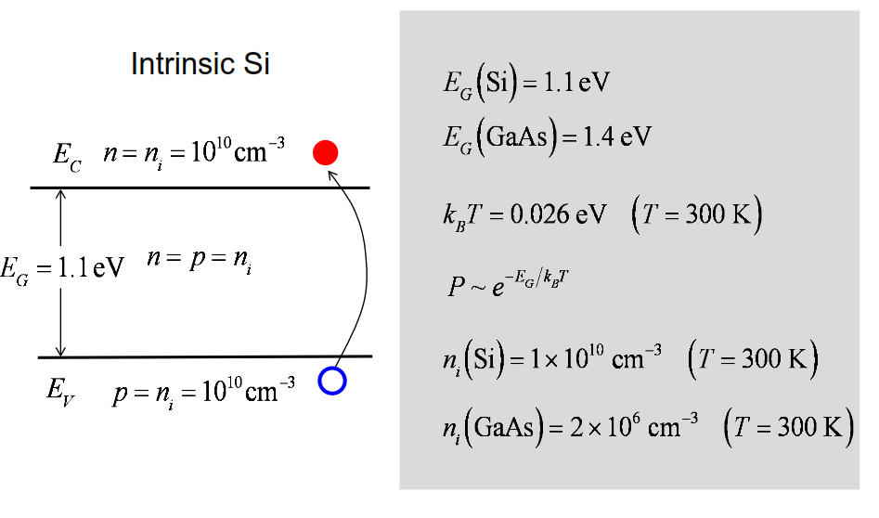
Two key parameters: intrinsic carrier concentration and band gap
The probability of breaking one of these bonds grows exponentially with the band gap (The bigger the band gap, exponentially harder, to break those bonds.)

Slide 19
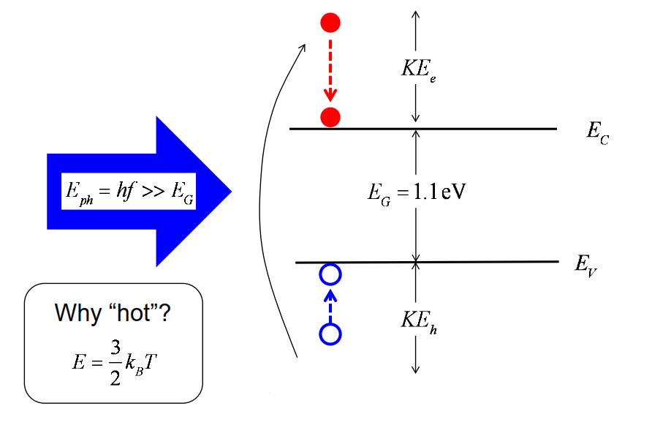
“Hot electrons” and “hot holes”
The reason we would call these hot carriers before they relaxed to the band edges is because we like to sort of think about energy and temperature. Temperature is a way of measuring the energy of a carrier. So, when we are talking about effects like this, we talk about hot electrons or hot holes.

Slide 20
Metals insulators and semiconductors
Metals: conduct electricity (and heat) well.
Insulators: don’t conduct electricity well
usually don’t conduct heat well
Semiconductors: in-between, but
their properties can be reproducibly controlled

Slide 21
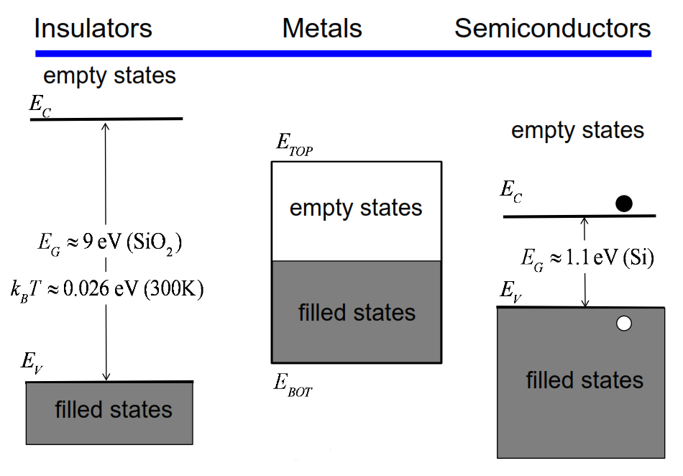

Slide 22
Summary
The localized energy levels in isolated atoms become delocalized energy bands in a solid.
Everything happens very near the top of the valence band and very near the bottom of the conduction band.
The electrical current in a semiconductor is carried by electrons in the conduction band and by holes in the valence band.
The band gap and intrinsic carrier concentration are key parameters for semiconductors.

Slide 23
Unit 1: Material Properties
Lecture 1.2:
Crystalline, polycrystalline, and amorphous semiconductors

Slide 24
Three main types of semiconductor materials
1) In a semiconductor crystal, each atom occupies a specific location in a “crystal lattice”.
2) Polycrystalline semiconductors consist of many crystalline “grains” with different orientations.
3) In amorphous semiconductors, the atoms are more or less randomly distributed throughout the solid.

Slide 25
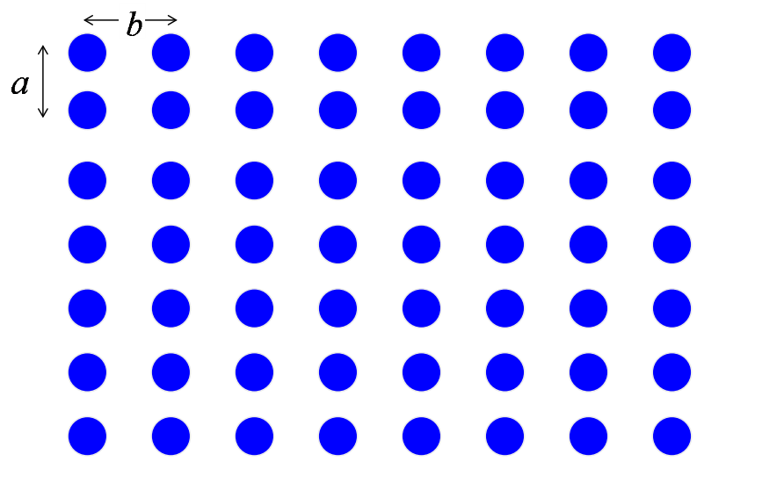
A 2D crystal
2 dimensional crystal lattice.

Slide 26
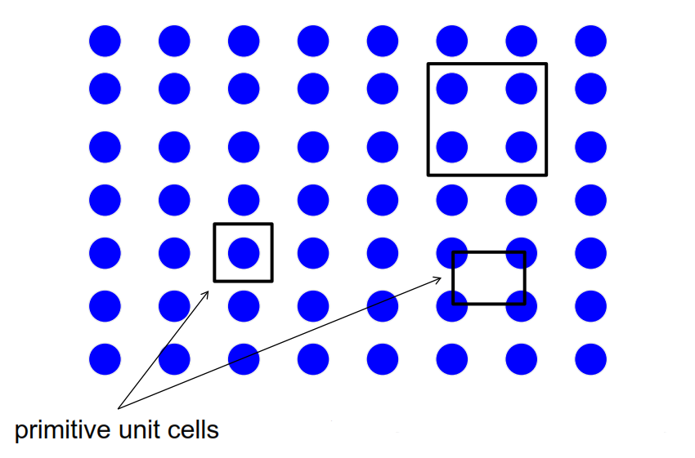
Unit cells
unit cells are not unique
If the unit cell consists of only one atom, then we call it a primitive unit cell
A unit cell is the smallest unit that can be used to reproduce the entire crystals simply by translating it around.

Slide 27
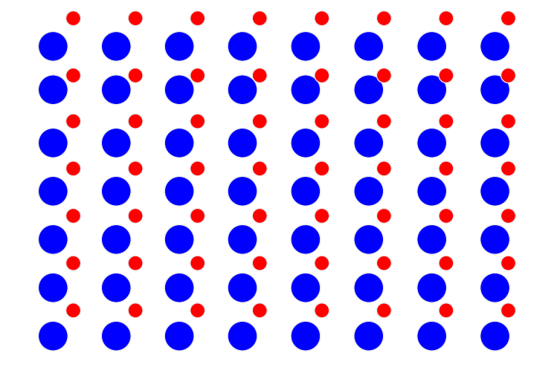
Lattice plus basis
At each point, there will be additional atoms that are associated with it. So we talk about a lattice plus a basis.

Slide 28
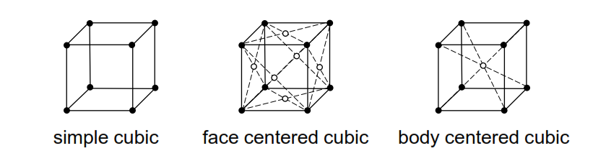
3D crystal structures
In 3D, there are 14 different ways to arrange lattice points such that at any point, the view is the same as at any other point.
14 Bravais lattices; 3 are cubic:
It turns out that in 3 dimensions, if you ask yourself how many ways are there that we can arrange a set of points, such that if I sit at any point and look around the environment will be identical to any other point. And it turns out there are only 14 different ways to do that. These are called the 14 Bravais lattices

Slide 29
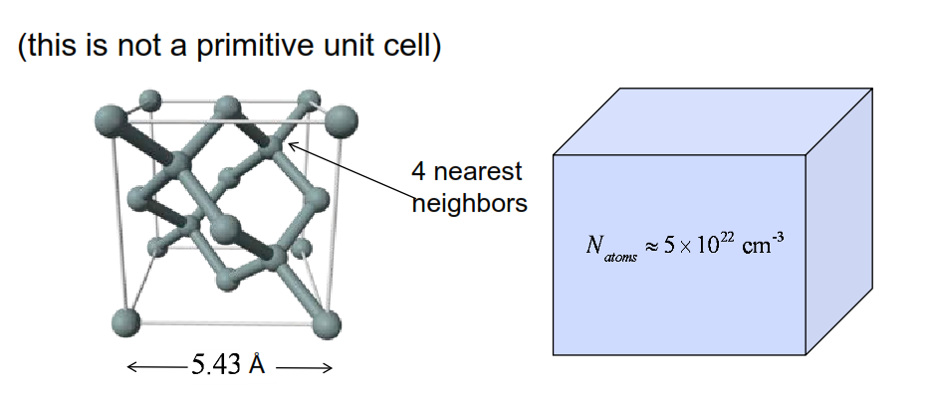
Si crystal structure (diamond lattice)
This is the way we’ve
been drawing the
silicon lattice

Slide 30
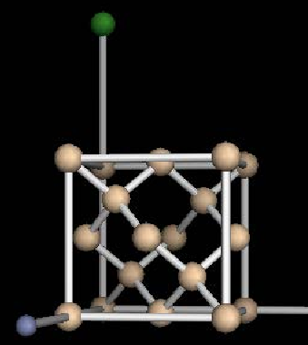
Diamond lattice
This is the lattice
We should try to understand this particular lattice because this is an important one, that represents not only silicon but
other common semiconductors as well

Slide 31
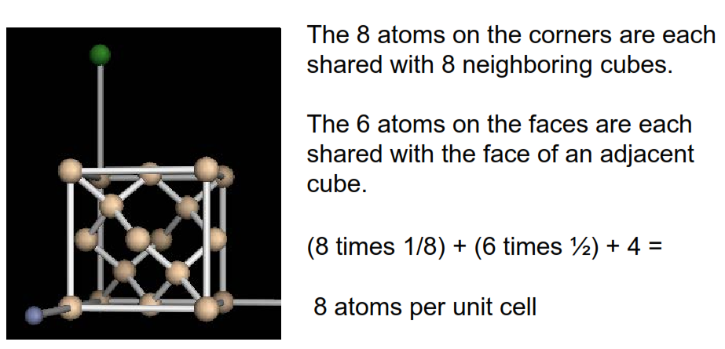
Diamond lattice: atoms per unit cell

Slide 32
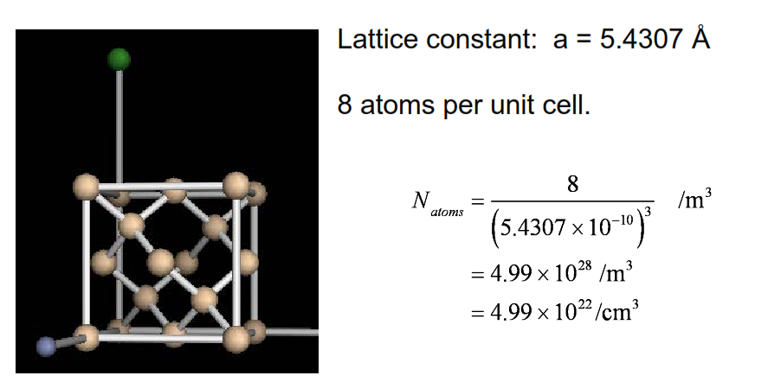
Silicon: # atoms / cc

Slide 33
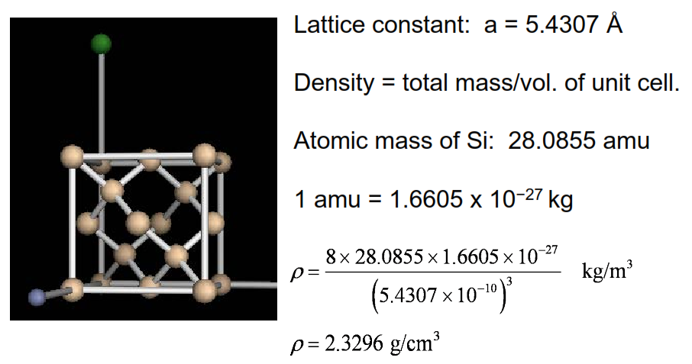
Silicon: density

Slide 34
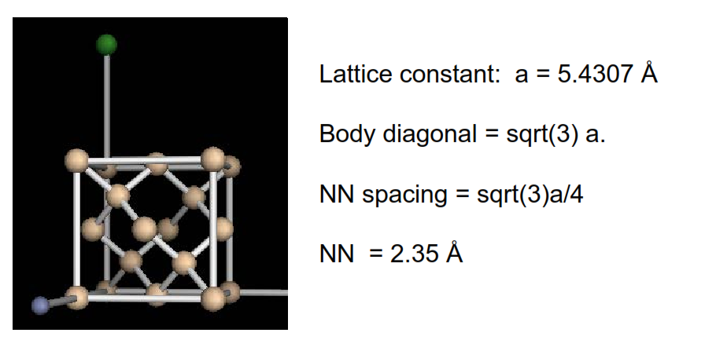
Silicon: NN spacing
How close at the silicon atoms in a silicon lattice?

Slide 35
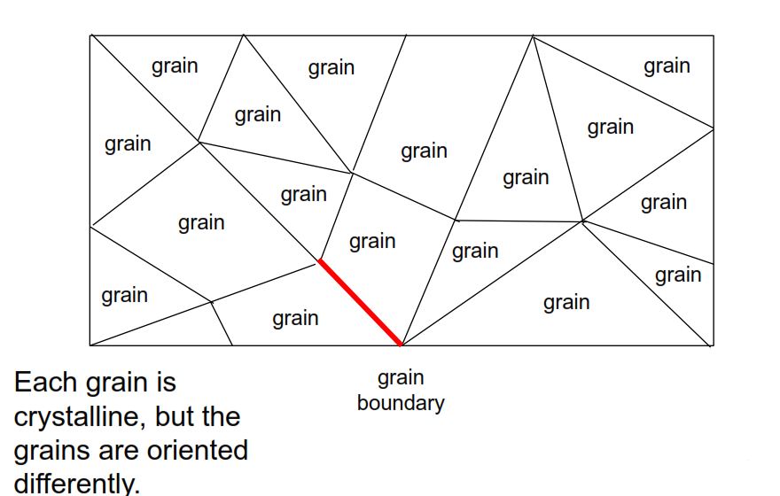
Polycrystalline materials
Polycrystalline material is just a material that consists of many crystals
A grain boundary is the source of a lot of defects. And these defects affect the electronic performance of a material. They degrade the electronic performance in general.

Slide 36
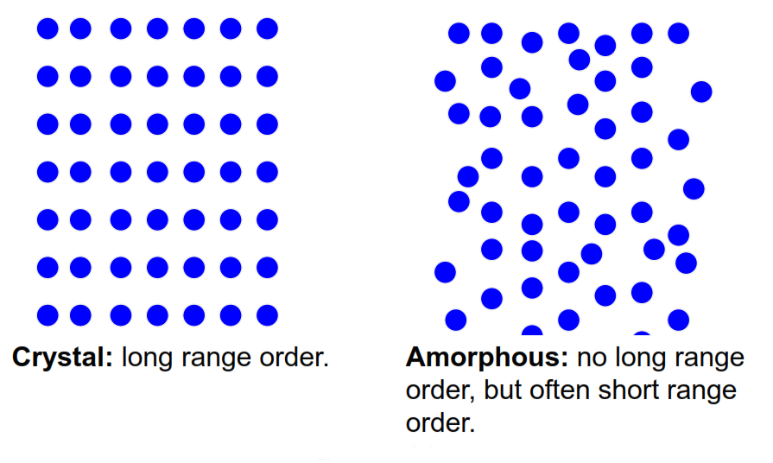
Crystalline vs. amorphous
The atoms are not in a precise location specified by a crystal lattice and basis.

Slide 37
Crystalline, polycrystalline, and amorphous
Crystalline semiconductors are the most expensive, but they are the highest quality because they have the fewest defects.
Polycrystalline semiconductors are less expensive, but grain boundaries can impede current flow. They are used when the highest quality is not needed, but cost is important (e.g. solar cells).
Amorphous semiconductors are the least expensive, but their electrical properties are the poorest. They are used when cost is a critical consideration (e.g. flat panel displays).

Slide 38
Summary
Semiconductors crystalize in specific structures (e.g. the diamond lattice for Si and Ge).
Crystalline, polycrystalline, and amorphous semiconductors are all used – depending on cost and performance considerations.
We will focus on crystalline semiconductors, but the general concepts apply to polycrystalline and amorphous semiconductors as well.

Slide 39
Unit 1: Material Properties
Lecture 1.3:
Miller indices

Slide 40
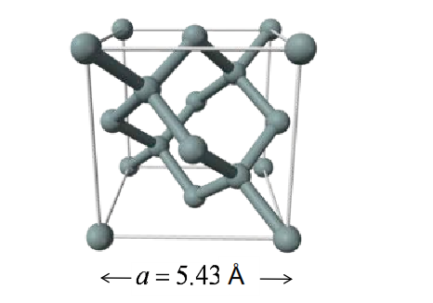
Si crystal structure (diamond lattice)
How do we specify planes and directions in a crystal?
For cubic crystals, there is a simple prescription.
There's a very convenient and easy way to do this. It's especially easy for cubic systems like silicon and it's called Miller Indices.

Slide 41
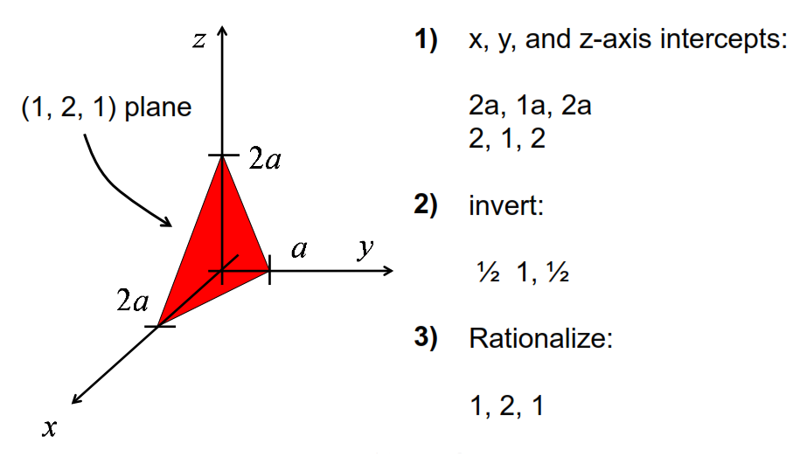
Miller index prescription for describing planes

Slide 42
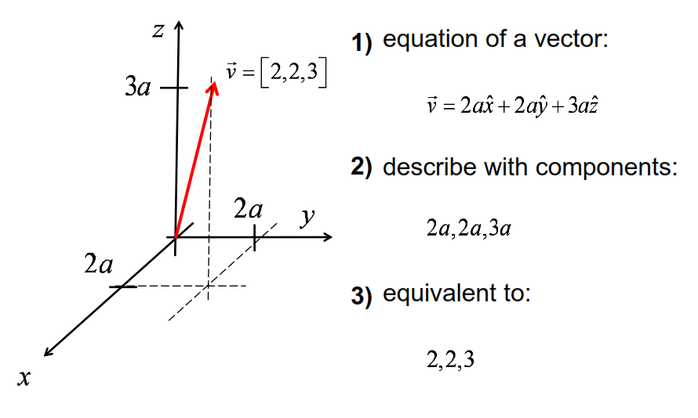
Prescription for describing directions

Slide 43
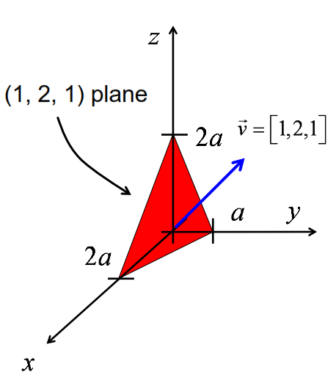
Direction normal to a plane
The vector [1, 2, 1] is normal
to the plane (1, 2, 1).

Slide 44
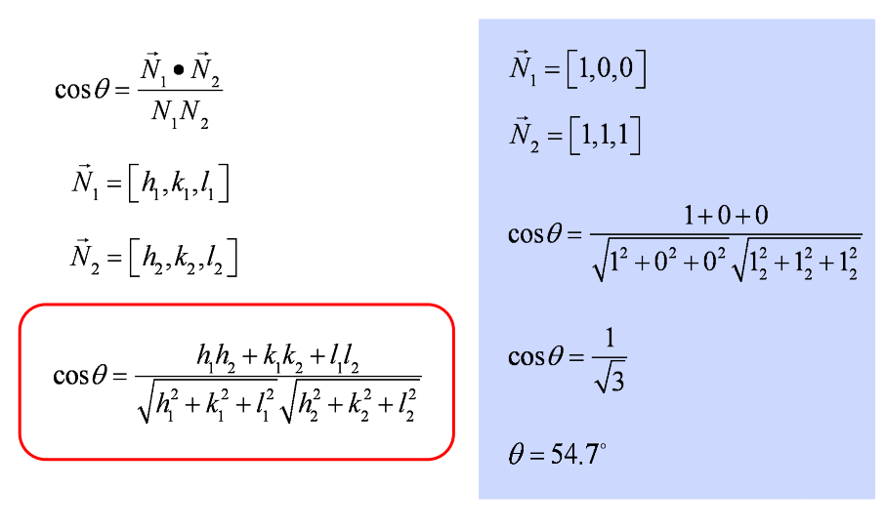
Angle between planes

Slide 45
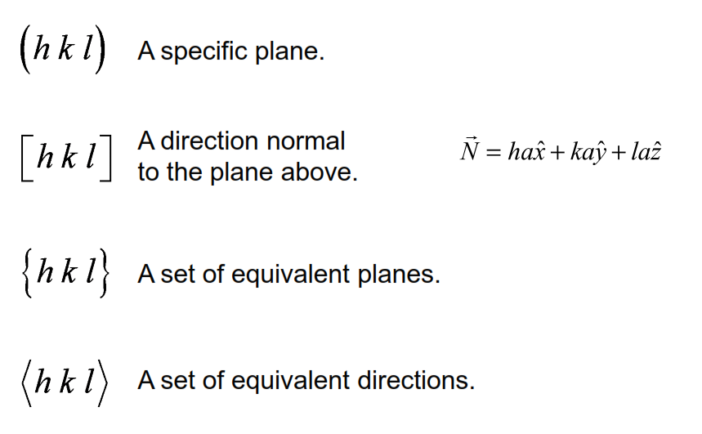
Notation for planes and directions

Slide 46
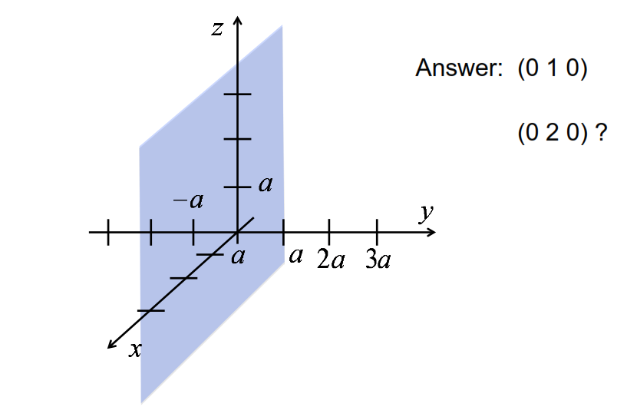
What plane is this?

Slide 47
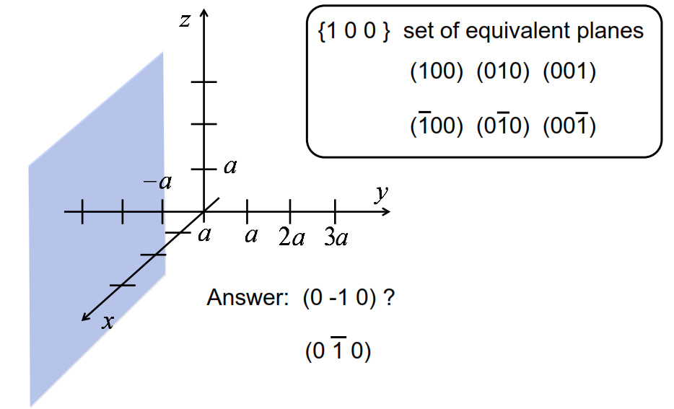
What plane is this?
crystallographically
equivalent planes.

Slide 48
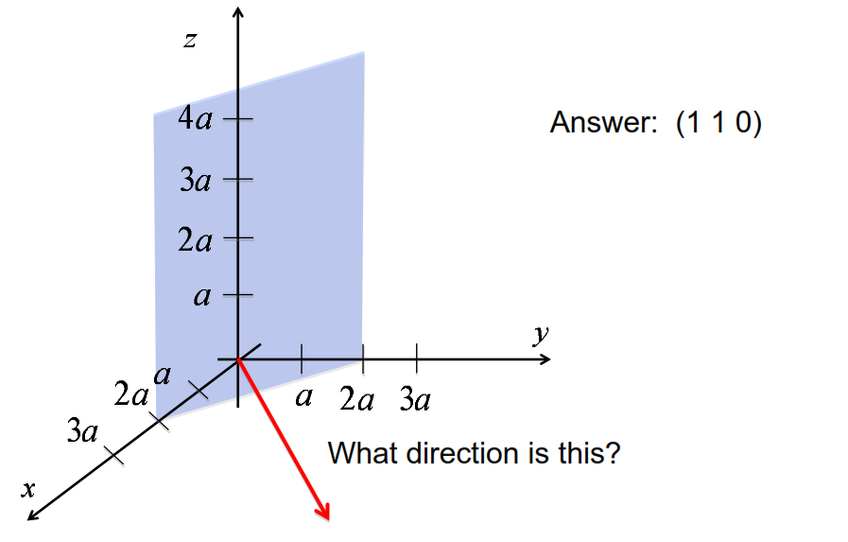
What plane is this?

Slide 49
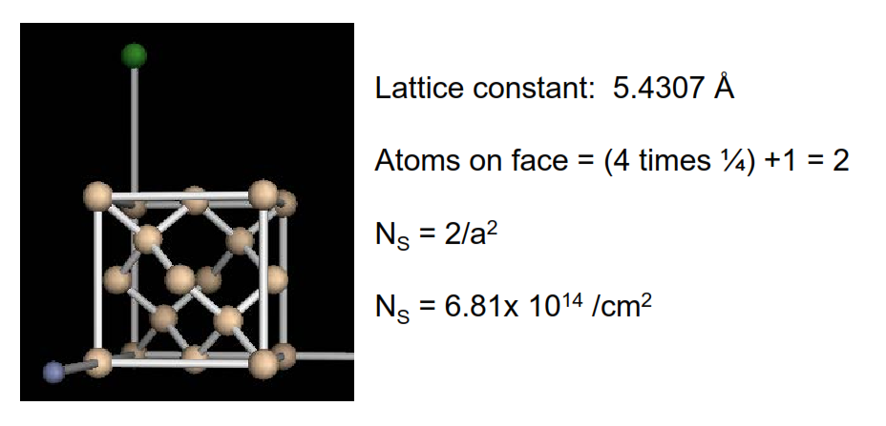
Silicon: atoms / cm2 on a {100} plane

Slide 50
Summary
Miller indices provide a simple way to describe planes and directions in crystals.
For cubic systems, the prescription is simple.

Slide 51
Unit 1: Material Properties
Lecture 1.4:
Properties of
common semiconductors

Slide 52
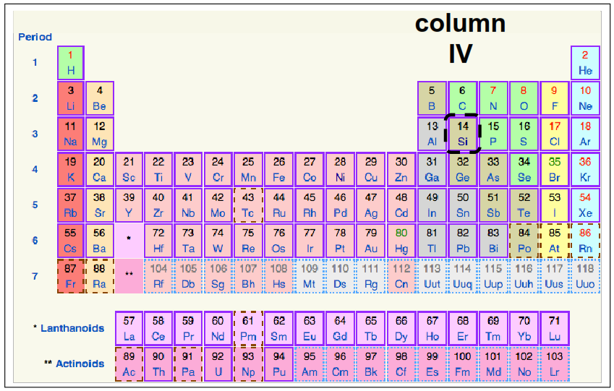
Semiconductors
Column four is
particularly
important for us
because it's a
column that the
most common
semiconductors
occur in

Slide 53
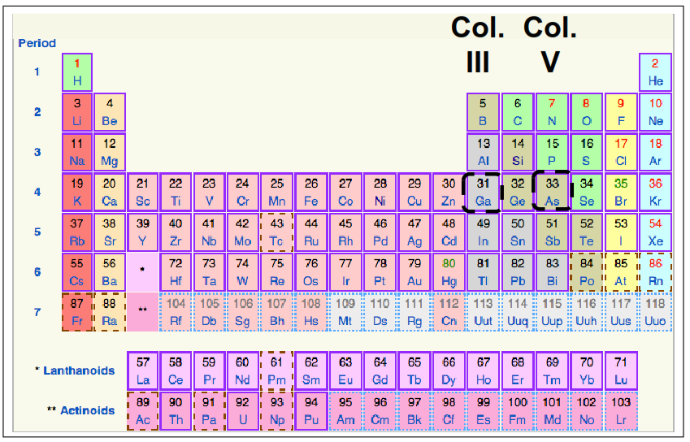
III-V semiconductors
There are other semiconductors that are made from other columns

Slide 54
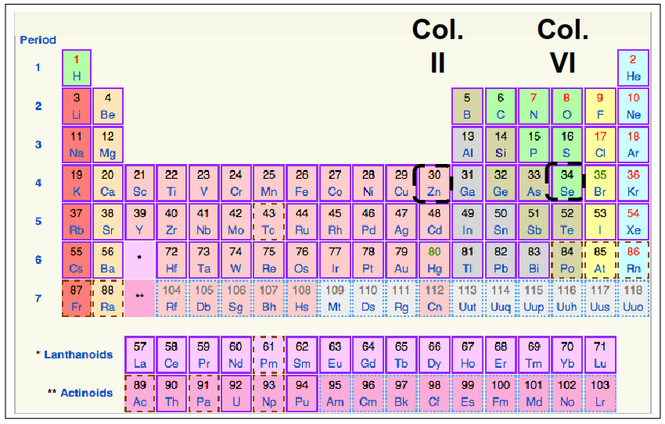
II-VI semiconductors
There are other materials that also have properties of semiconductors but a lot of the most common semiconductors come from this part of the Periodic Table. Column four or columns adjacent to column four, such that we get an average number of valence electrons that is equal to four.

Slide 55
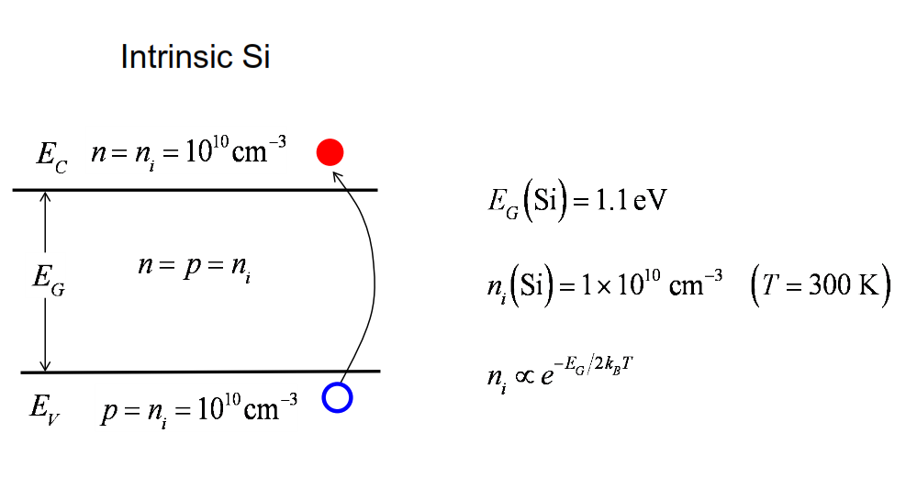
Two key numbers
Remember that there is a very tight relation between band gap and intrinsic carrier concentration.

Slide 56
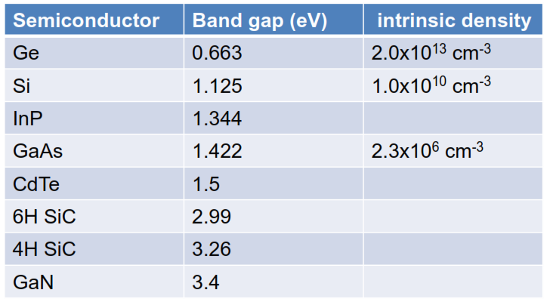
A few common semiconductors
Later, we will learn how to calculate ni

Slide 57
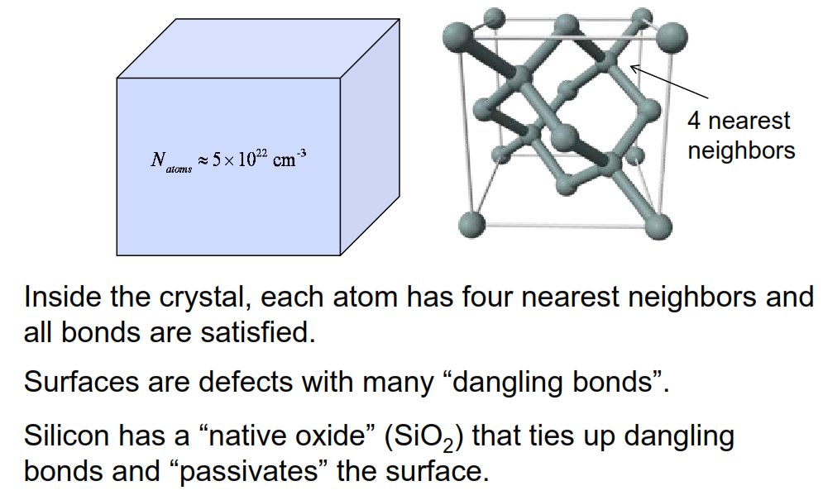
Why is Si so common in electronics?

Slide 58
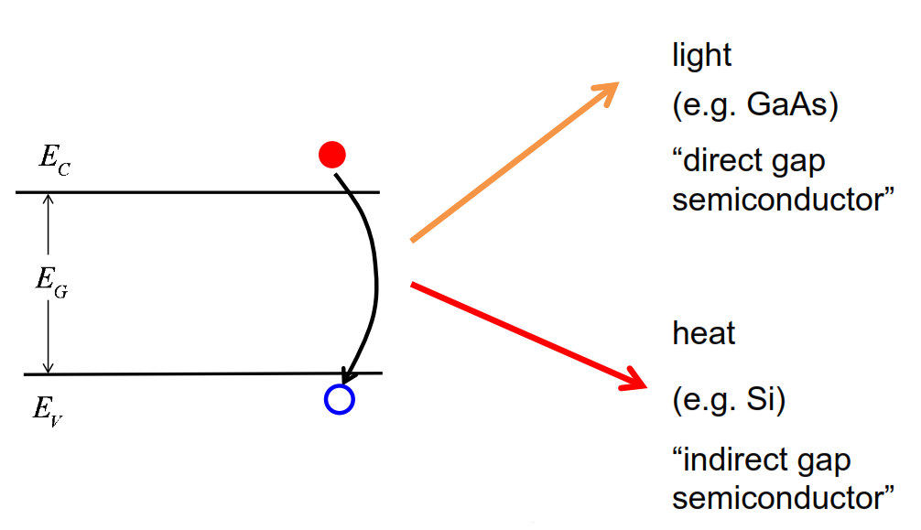
Recombination
When the electron drops down to the valence band, there's some energy that has to be given up that energy
has to go somewhere

Slide 59
Other properties
How fast do charge carriers move (mobility)?
What is the thermal conductivity?
At what electric field does the semiconductor “break
down”?
Effective mass?
etc.

Slide 60
Summary
Silicon is the most commonly used semiconductor because it has a native oxide that passivates the surface.
Other semiconductors are used when Si isn’t suitable (e.g. to make light-emitting devices).
The bandgap and intrinsic carrier concentration are two key (related) parameters for a semiconductor. We will encounter several other important parameters later.

Slide 61
Unit 1: Material Properties
Lecture 1.5:
Free carriers in semiconductors

Slide 62
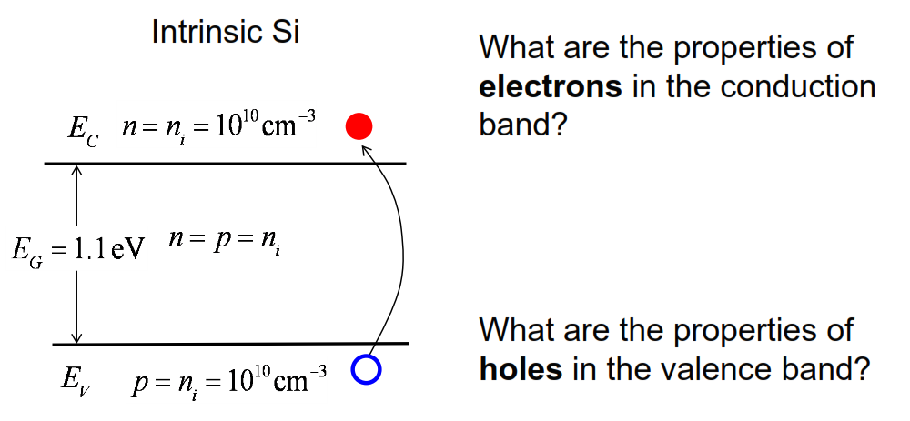
Electrons and holes in semiconductors
The most important thing for us about semiconductors is the behavior of the free carriers

Slide 63
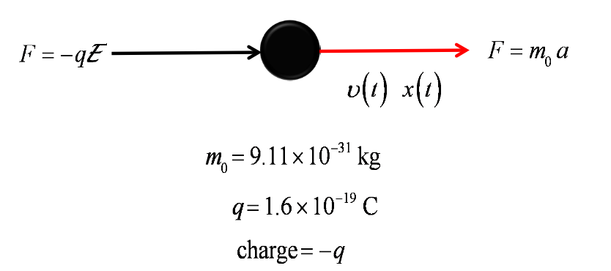
Free electron mass
Let's think of a free electron in a vacuum, So this electron has a mass. We'll call it a rest mass, m₀

Slide 64
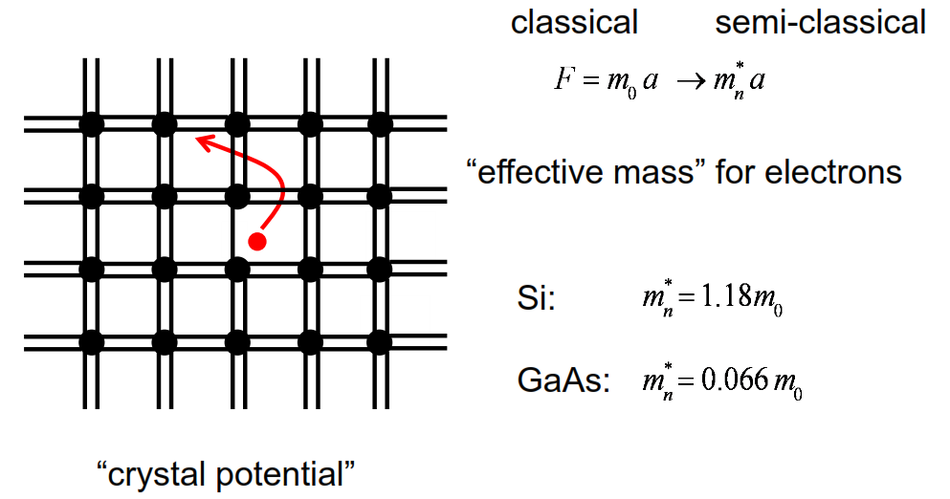
“Effective mass” of electrons
Now we have a much more complicated situation that we're dealing with here. We have electrons in the conduction band that are wandering around this crystal lattice. And they are experiencing all kinds of Coulomb forces due to the bonds and the atoms
All of these complicated forces that act upon the electron in a crystal lattice, we can wrap into something that we call an effective mass. And we can use Newton's laws to compute the motion of electrons in the crystal

Slide 65
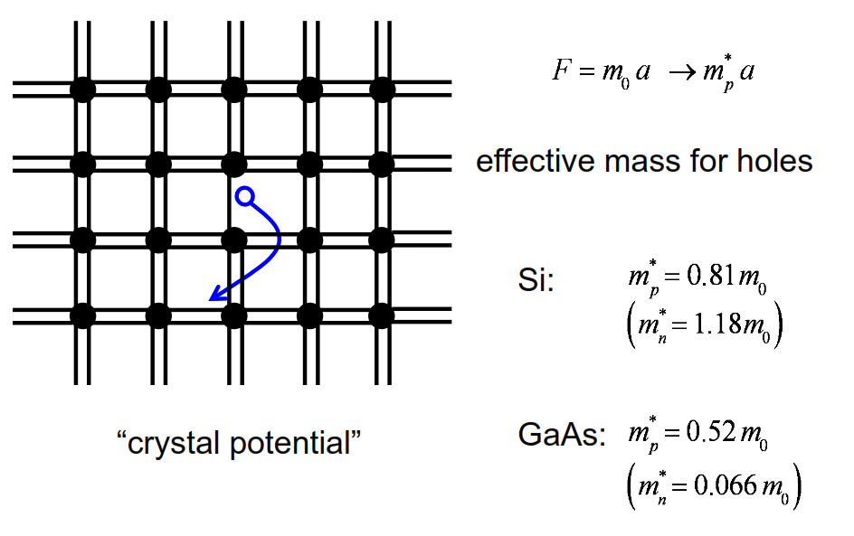
Effective mass of holes
The hole effective mass will be different from the electron effective mass.

Slide 66
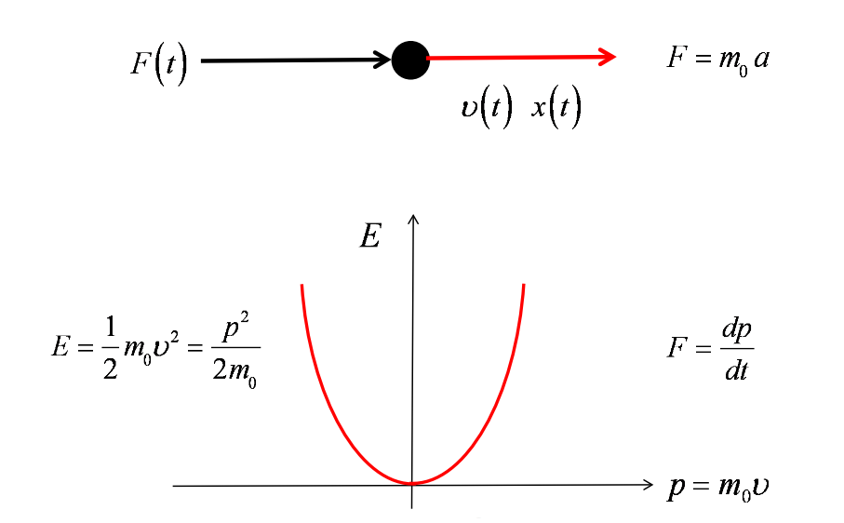
Energy and momentum (free electron)
For common semiconductors, we can often describe energy versus momentum as a parabola, just as for a free particle

Slide 67
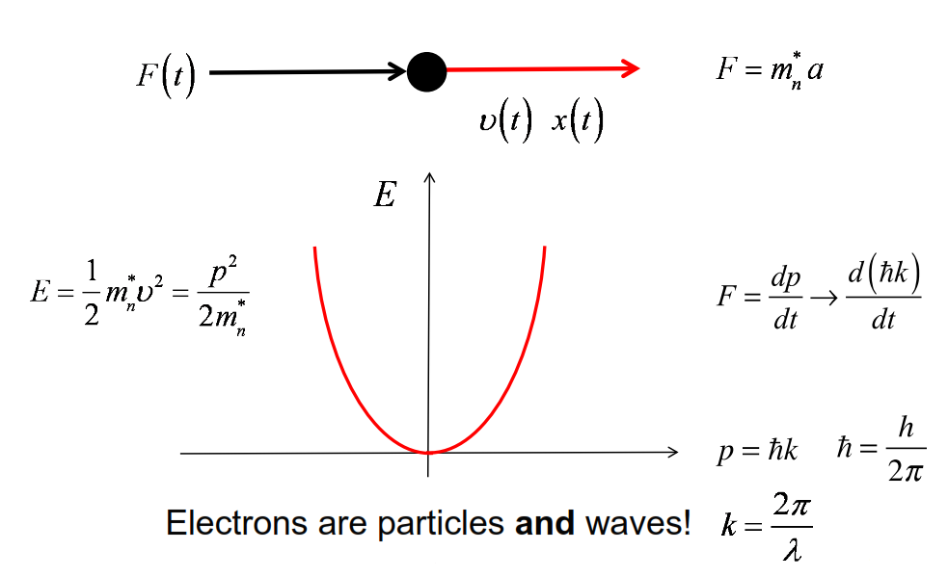
Energy and “crystal momentum” (electron in cb)

Slide 68

Conduction and valence band
The valence band bends down, remember, it has to bend down with increasing momentum because the states are all below the top of the valence band.

Slide 69

“Direct gap semiconductors”
In a direct gap semiconductor, the minimum of the conduction band and the maximum of the valence band occur at the same momentum

Slide 70

Band structure vs. energy band diagram

Slide 71

“Indirect gap semiconductors”
The bottom of the conduction band and the top of valence band occur at different momentum. They tend to recombine in a way that gives off heat rather than light

Slide 72
Summary
1) Electrons in the conduction band (“electrons”):
Free to move about within the crystal.
Can often be treated as Newtonian particles with an effective mass.
2) Holes in the conduction band (“holes”):
Free to move about within the crystal.
Can often be treated as Newtonian particles with a different effective mass.

Slide 73
Unit 1: Material Properties
Lecture 1.6:
Doping

Slide 74
So now we're ready to talk about the most important property of semiconductors, the fact that they can be doped.
Doping is ……

Slide 75

Doping makes semiconductors useful

Slide 76

Recall: Bonding cartoon of Si lattice

Slide 77

Doping a semiconductor
By doping it means we introduce other atoms into the crystalline lattice.

Slide 78

Dopants in Si
So to understand how this works, we go back to our periodic table.

Slide 79

N-type doping

Slide 80

Ionized donor
Now that we've broken the bond and the electron is free to wander away throughout
the silicon lattice, the phosphorus atom is ionized.
there are some intrinsic carriers there that were before we did the doping.
Typical doping concentrations overwhelm those intrinsic carriers

Slide 81

Be careful about units
We will be working in SI (MKS) units. The carrier concentration should be given per cubic meter, but semiconductor people like to mix their units.
It is safest to do the calculations in SI units, and then convert to cubic cm.

Slide 82

Energy band view (n-type)
How would we draw this doping process on an energy band diagram
what changes is that we now have introduced states into the forbidden region where there are supposed to be no states

Slide 83

P-type doping
If we replace one of the silicon atoms with an atom from column three, we don't have enough electrons to share with the four nearest neighbors and make covalent bonds. One of those bonds is missing, we've got a hole in one of those bonds.

Slide 84

Ionized acceptor

Slide 85

Energy band view (p-type)

Slide 86

“Deep donors” and “deep acceptors”
A deep donor would be one that is hard to ionize because it has a strong bonding energy.

Slide 87
Question
1) What type of dopant is Si in GaAs?
a) n-type
b) p-type
c) either n-type or p-type
d) neither n-type nor p-type
e) don’t know

Slide 88

Si vs. GaAs crystals
The crystal structure of gallium arsenide, very similar to the diamond structure of silicon, just two different types of atoms

Slide 89

GaAs bonding cartoon

Slide 90

Si in GaAs: Two possibilities

Slide 91

How does the carrier concentration vary with T?

Slide 92

Low temperature

Slide 93

Room temperature (shallow dopants)

Slide 94

High temperature

Slide 95
Comment
At high temperatures, the intrinsic carriers produced by thermal excitation across the bandgap overwhelm the extrinsic carriers produced by doping.
Because semiconductor devices are produced by selective doping, the device ceases to operate.
Semiconductor devices for operation at high temperature should be made with materials with large band gaps, such as SiC and GaN.

Slide 96

Carrier concentration vs. temperature

Slide 97
Summary
To dope a semiconductor, we replace a few atoms with atoms from a different column of the periodic table.
Ionized dopants produce electrons in the conduction band or holes in the valence band.
Dopants can be energetically shallow or deep.
The carrier concentration vs. temperature characteristic has freeze out, extrinsic, and intrinsic regions.
A low temperatures, semiconductors become insulators.

Slide 98
Unit 1: Material Properties
Lecture 1.7:
Summery

Slide 99

Semiconductors

Slide 100

Example semiconductor: Si
In a solid, the energy levels of the discreet silicon atoms, broaden and smear out and become energy bands.

Slide 101

Silicon energy levels energy bands
The two valence energy levels become valence bands and conduction bands

Slide 102

Energy band diagram
We indicate the top of the valence band only, because that's where most of the holes will end up being. We indicate the bottom of the conduction band only, because that's where most of the electrons will be.

Slide 103

Energy vs. momentum: E(k)

Slide 104
Energy band structure vs. energy band diagram
Band structure is a plot of energy vs. crystal momentum (or k).
An energy band diagram is a plot of the bottom of the conduction band and top of the valence band vs. position.

Slide 105

Bandgap and intrinsic carrier concentration

Slide 106

Optical generation: E(k)
kinetic energy is rapidly dissipated through various processes that release either phonons, or heat, or thermal vibrations and the electron quickly thermalizes and approaches the bottom of the conduction band.

Slide 107

Direct recombination: E(k)
An electron in the conduction band can drop down and fill up a hole in the valence band

Slide 108

Bonding model view: intrinsic semiconductor

Slide 109

Doping
The most important property of semiconductors is that their electronic properties. Could be reproducibly and controllably changed by introducing small amounts of other elements into the silicon lattice. This process is called doping.

Slide 110

N-type doping: Energy band view

Slide 111

P-type doping: Energy band view

Slide 112


Slide 113

Carrier concentration vs. temperature

Slide 114
Summary
1. Quantization of energy levels
2. Energy bands
3. Electrons and holes
4. Doping
5. Insulators, metals, and semiconductors

