Slide 1
Lecture 2
Density of states

Slide 2
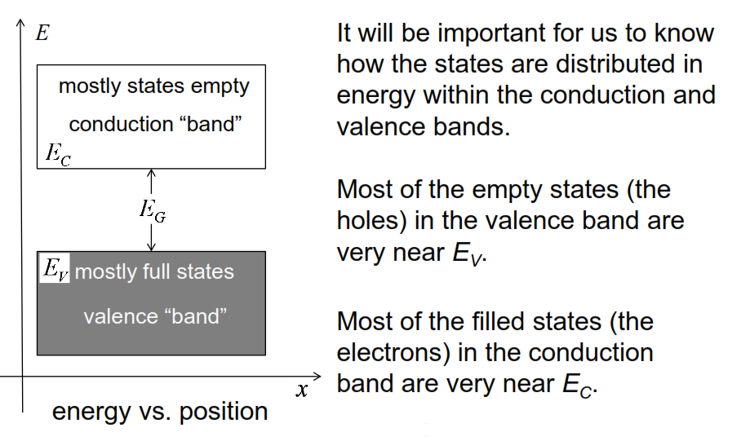
Conduction and valence bands
we only really need to be worried about how the states are distributed in energy near the edges of the band

Slide 3
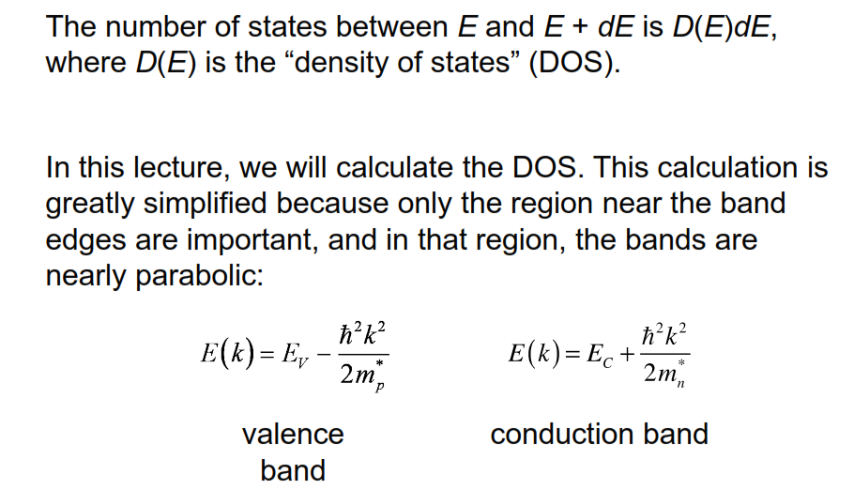
Density of states

Slide 4
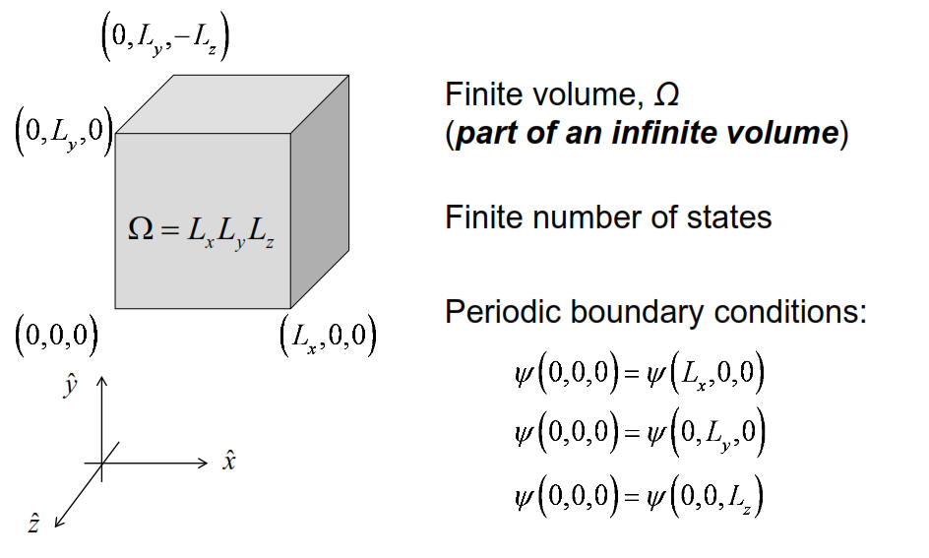
States in a finite volume of semiconductor
So let's begin by thinking about a large chunk of semiconductor crystal with a volume omega

Slide 5
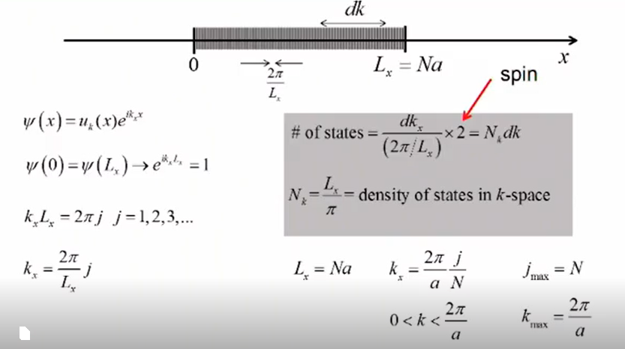
x-direction

Slide 6
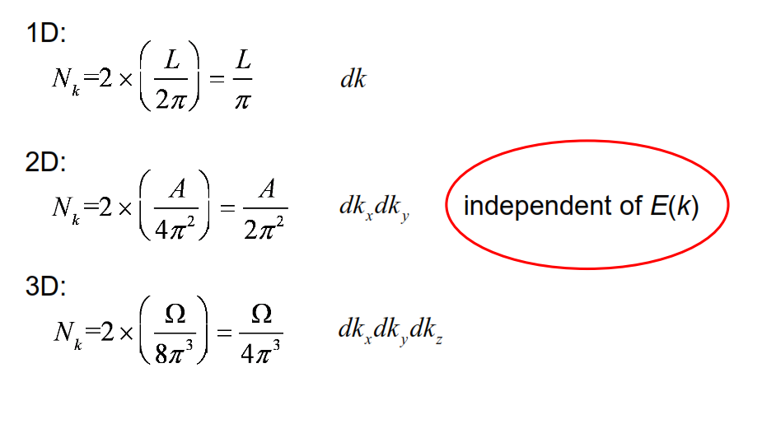
Density-of-states in k-space

Slide 7
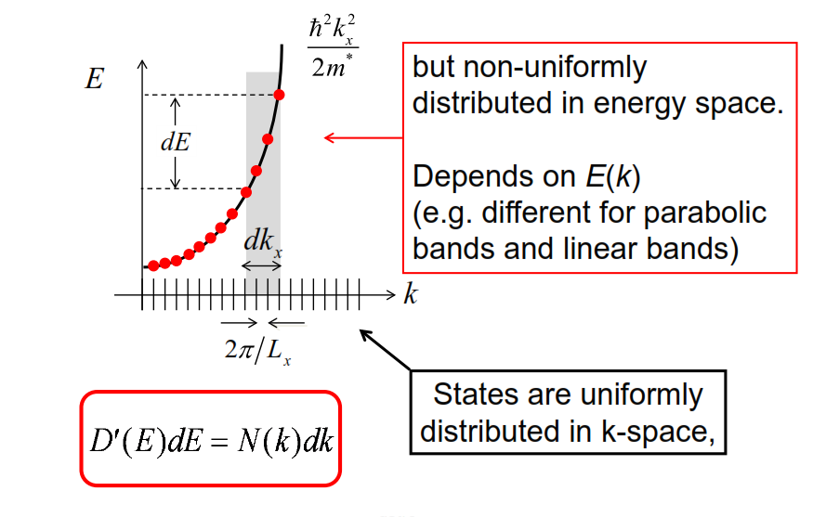
DOS: k-space vs. energy space

Slide 8
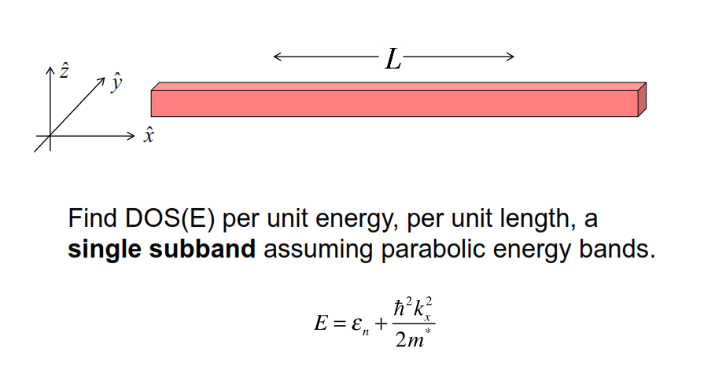
Example 1: DOS(E) for 1D nanowire

Slide 9
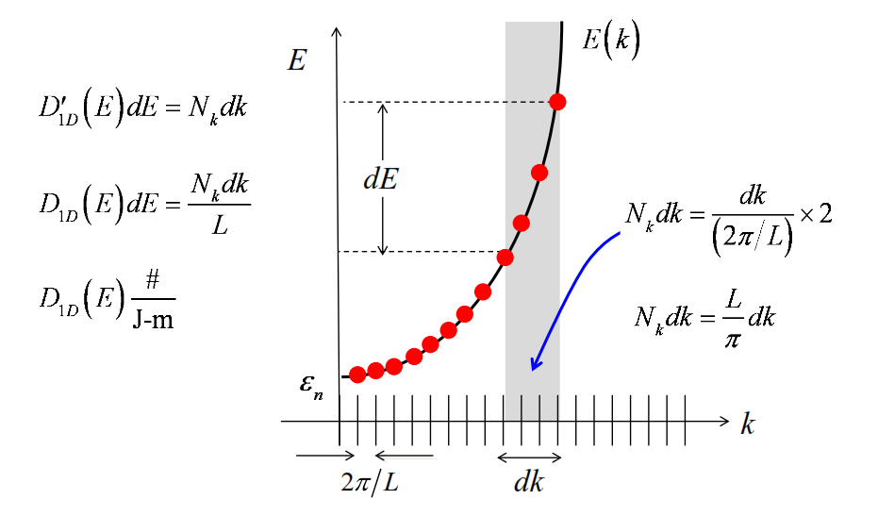
1D (single subband)

Slide 10
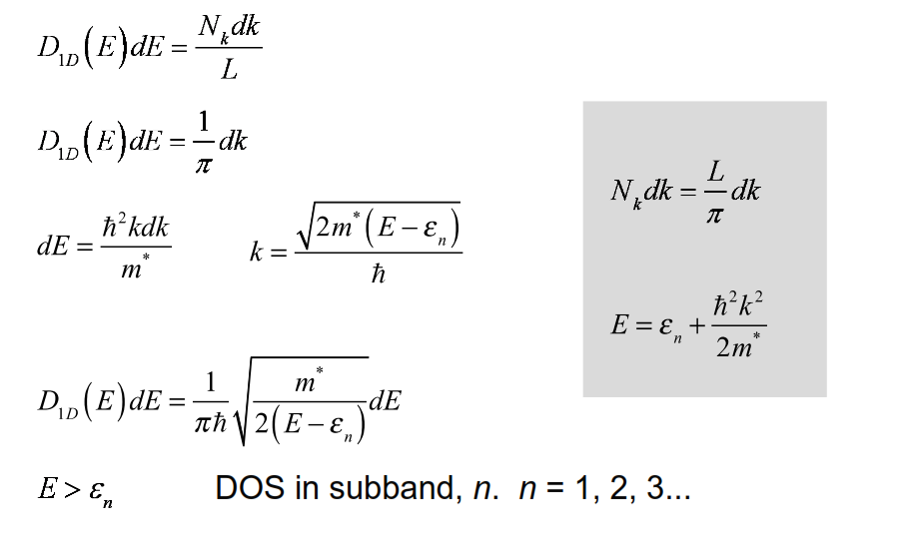
1D DOS

Slide 11
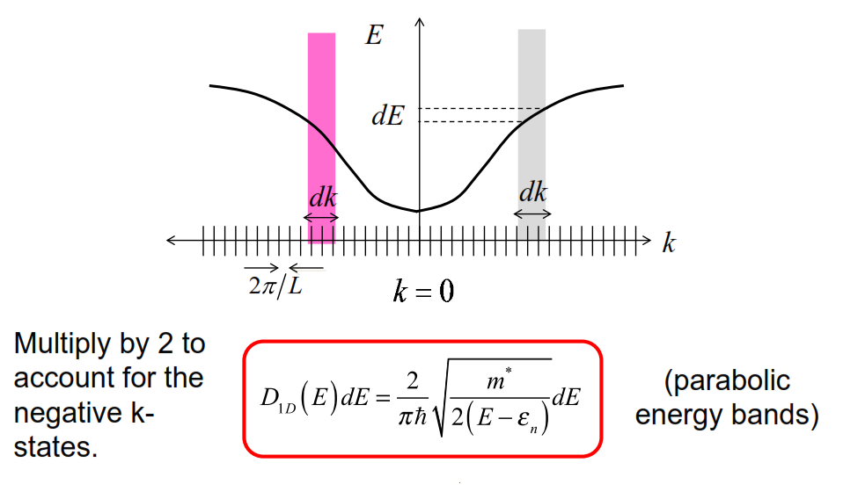
Don’t forget to multiply by 2

Slide 12
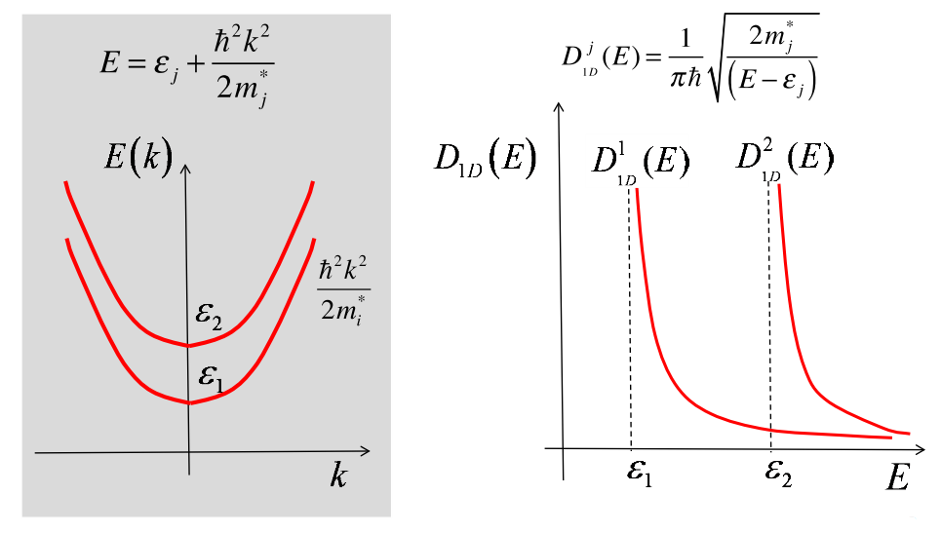
Multiple subbands

Slide 13
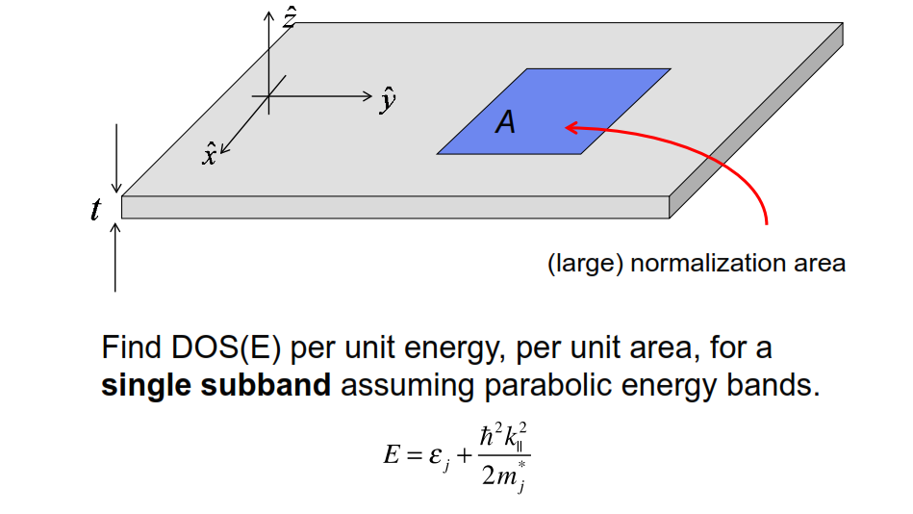
Example 2: DOS(E) for 2D electrons

Slide 14
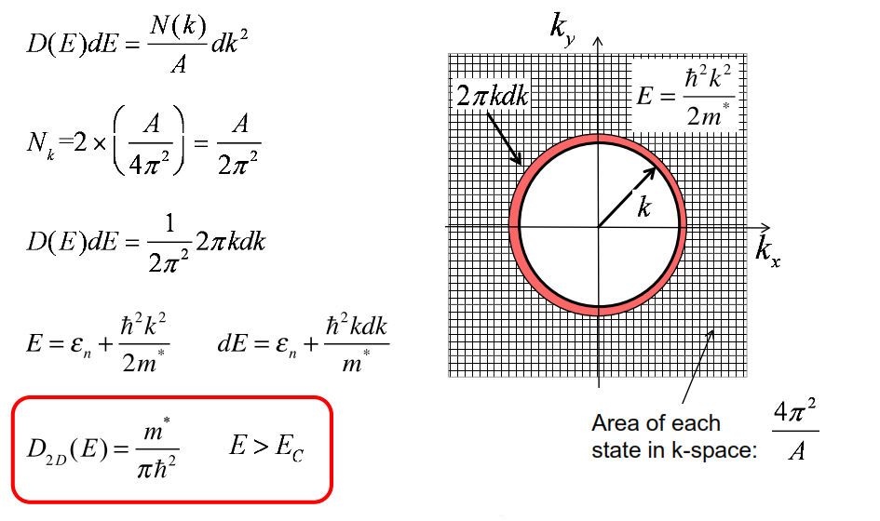
Example 2: DOS(E) for 2D electrons

Slide 15
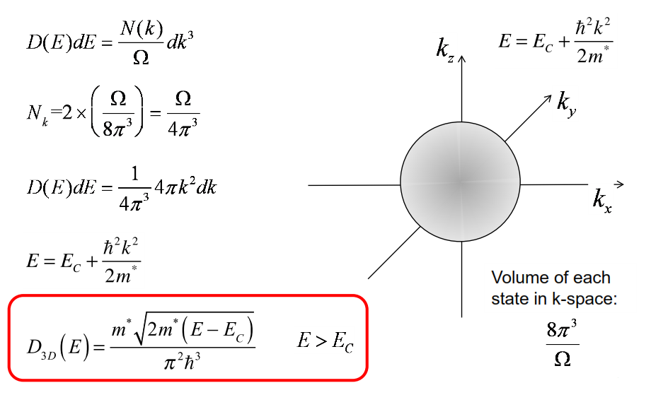
Example 3: DOS(E) for 3D electrons

Slide 16
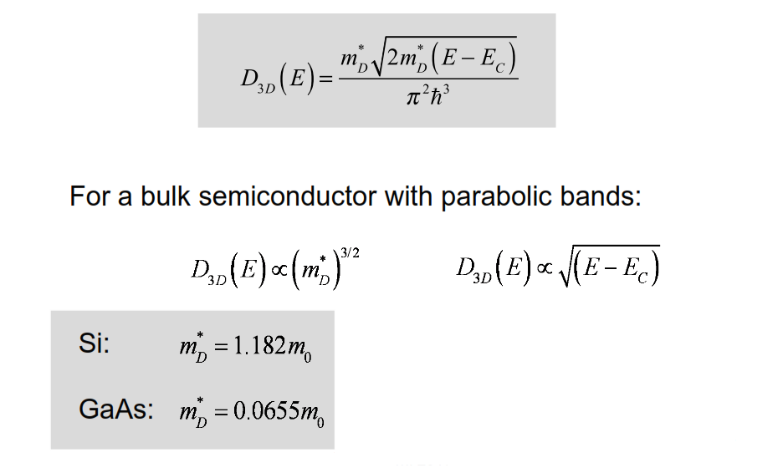
Comments on 3D DOS

Slide 17
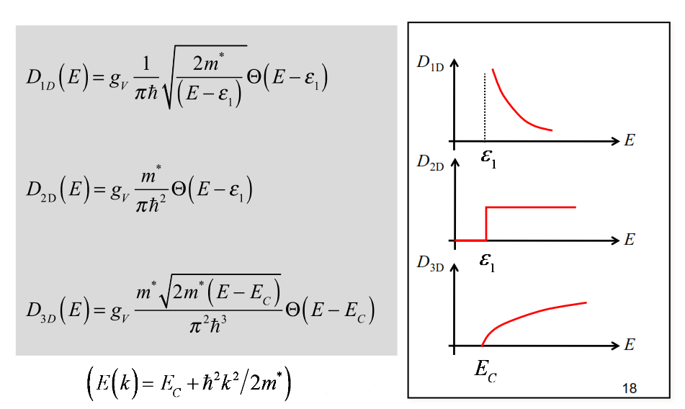
Parabolic bands: 1D, 2D, and 3D

Slide 18
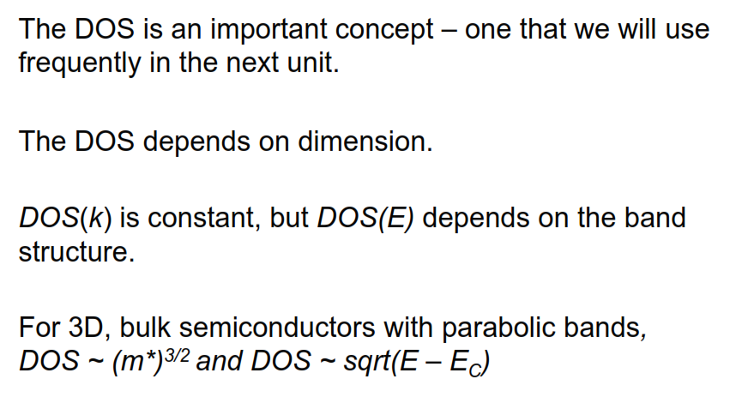
Summary

