Slide 1
Unit 5: The Semiconductor Equations
Lecture 5.1: Mathematical formulation

Slide 2
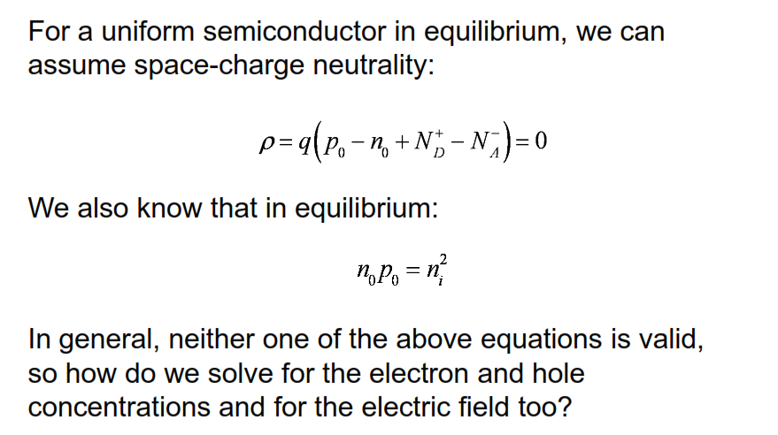
Solving semiconductor problems
(we may be out of equilibrium!)

Slide 3
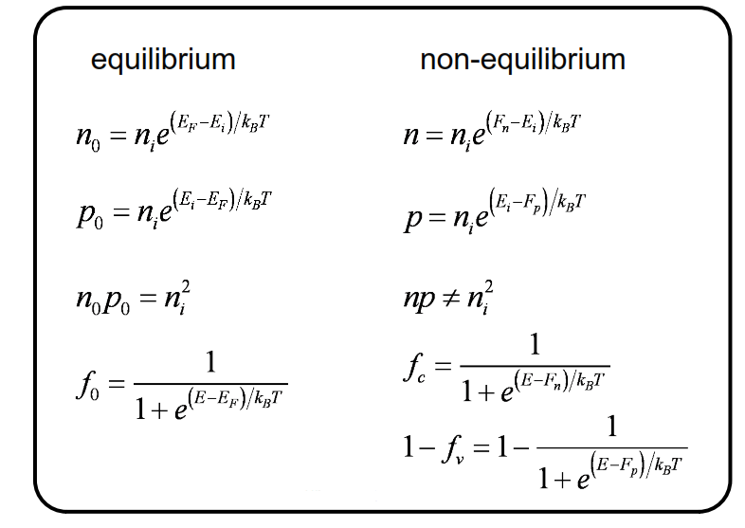
Equilibrium vs. non-equilibrium

Slide 4
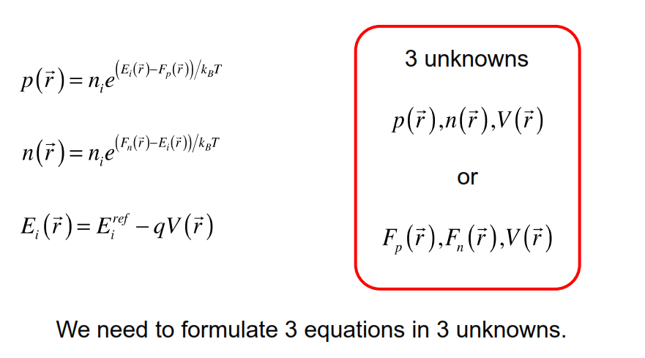
The unknowns
The three unknowns are the two quasi Fermi levels and the electrostatic potential. We need three equations in three unknowns

Slide 5
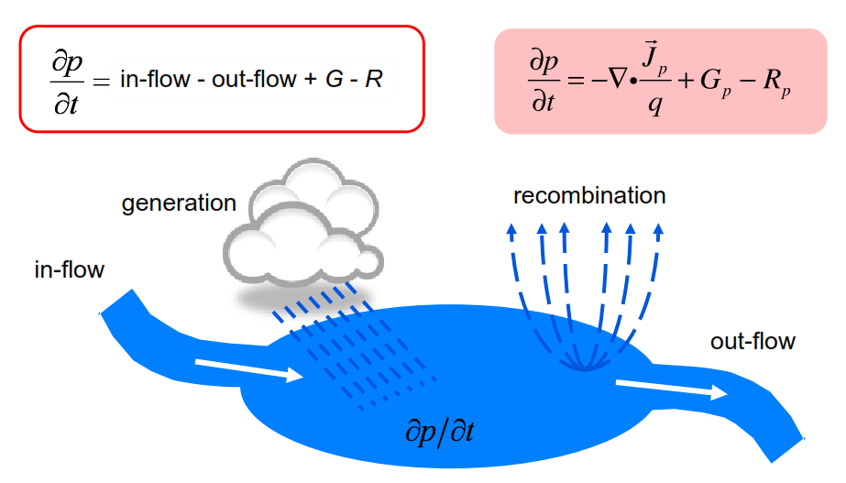
First equation: Continuity equation for holes
The first equation is an equation for the hole density.
divergence of that flux physically represents a net flow out minus divergence represents a net flow in.

Slide 6
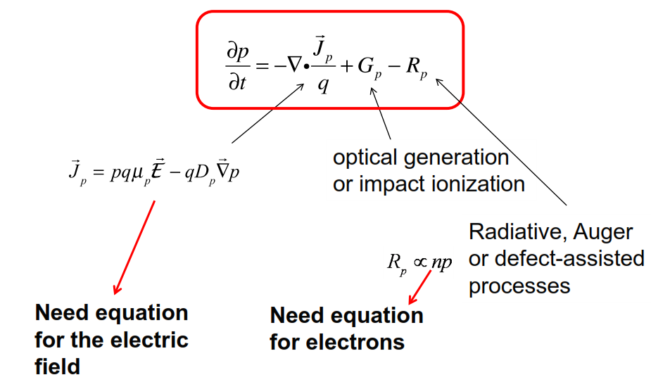
One equation in 3 unknowns

Slide 7
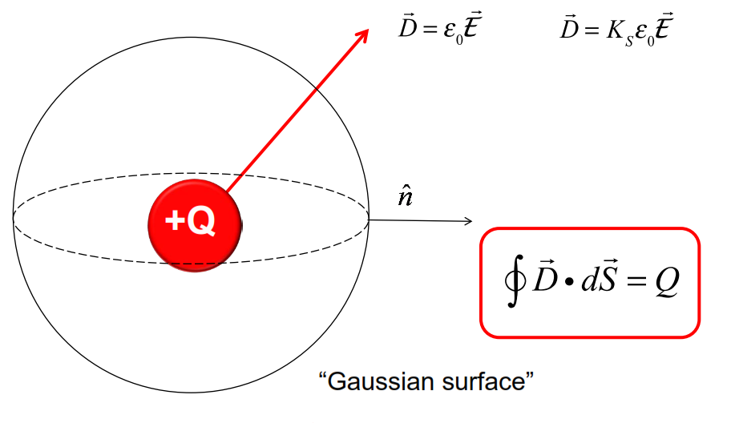
Gauss’s Law
In a semiconductor not in a vacuum, we will have the material will respond and polarize, and the permittivity of free space needs to be replaced by the relative dielectric constant of the semiconductor times epsilon sub 0.

Slide 8
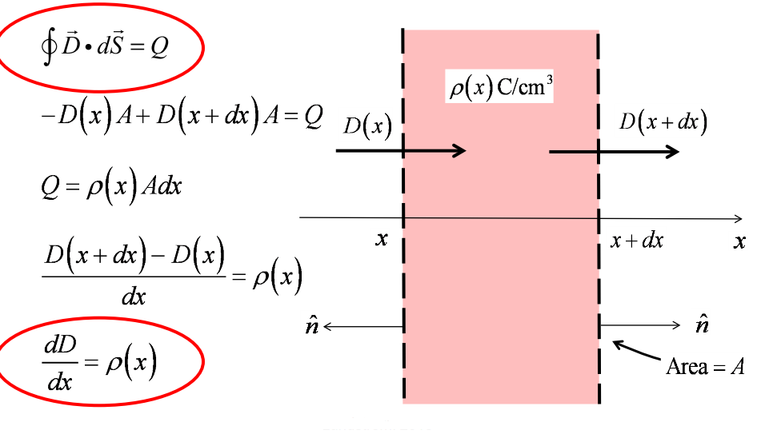
Gauss’s Law in 1D

Slide 9
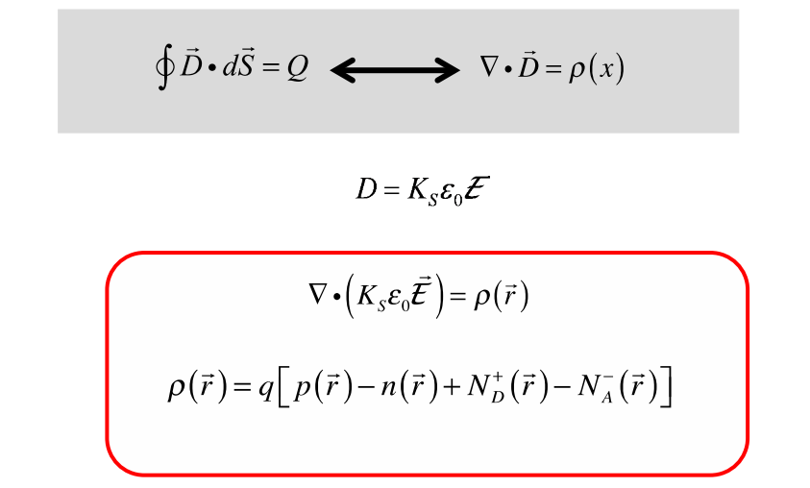
The Poisson equation

Slide 10
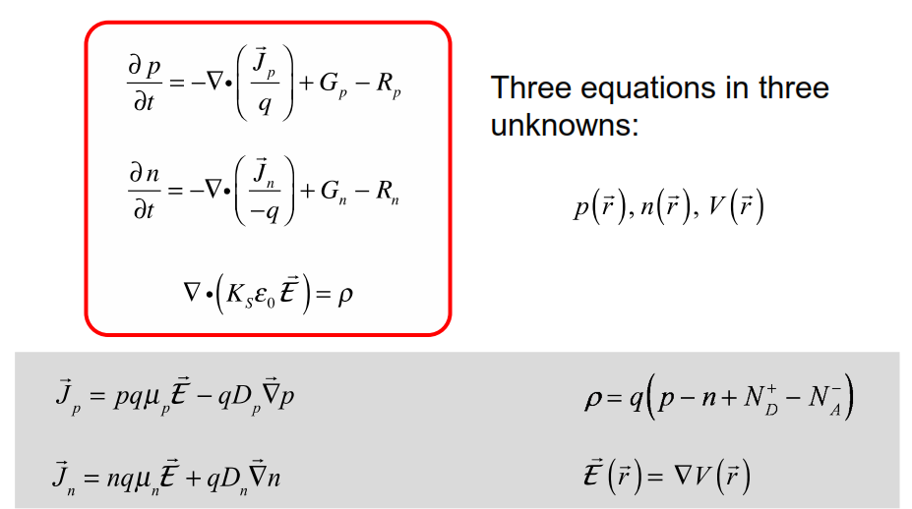
The “semiconductor equations”
These are sometimes called the semiconductor equations because they're often taken as the fundamental description of any semiconductor device.
If we simply solve these for a semiconductor device, we can understand the operation of the semiconductor device.

Slide 11
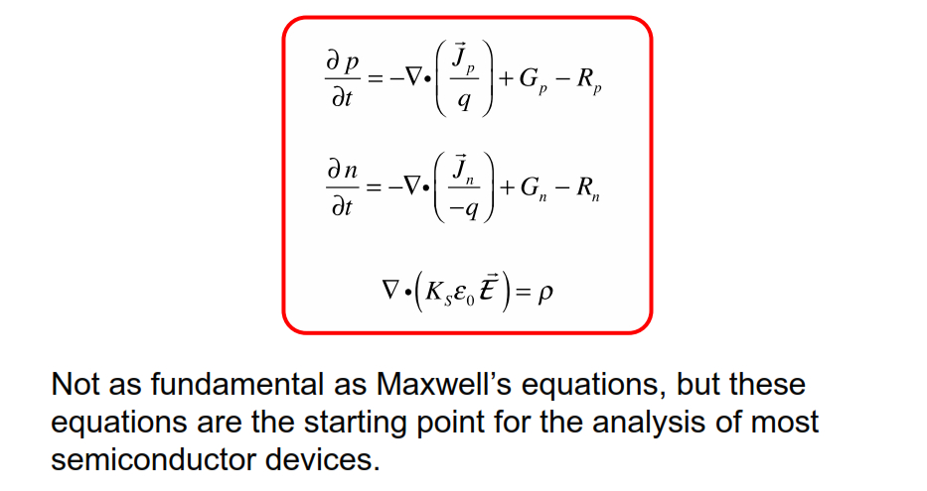
Semiconductor equations
These are three coupled, partial differential equations, they're non-linear, so their solution is not completely trivial,

Slide 12
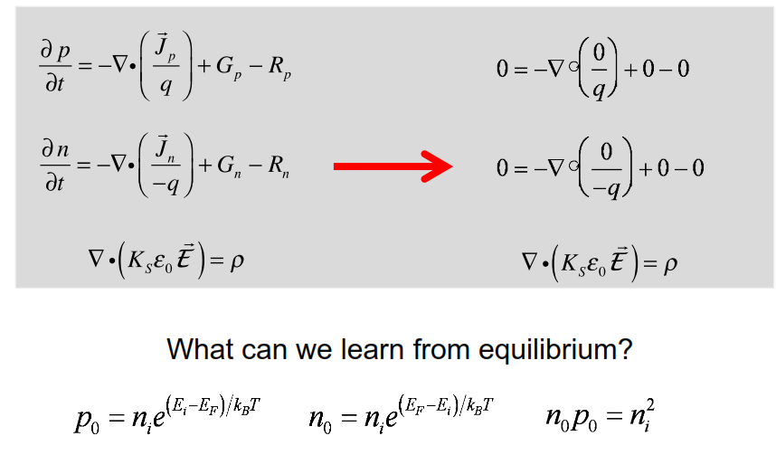
Discussion: Equilibrium

Slide 13
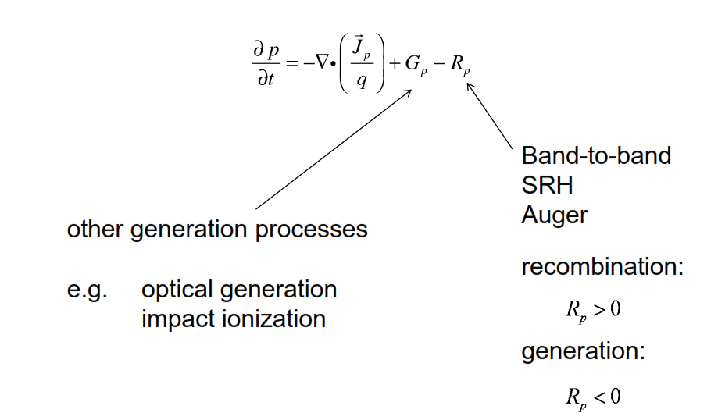
Reminder: Generation and recombination

Slide 14
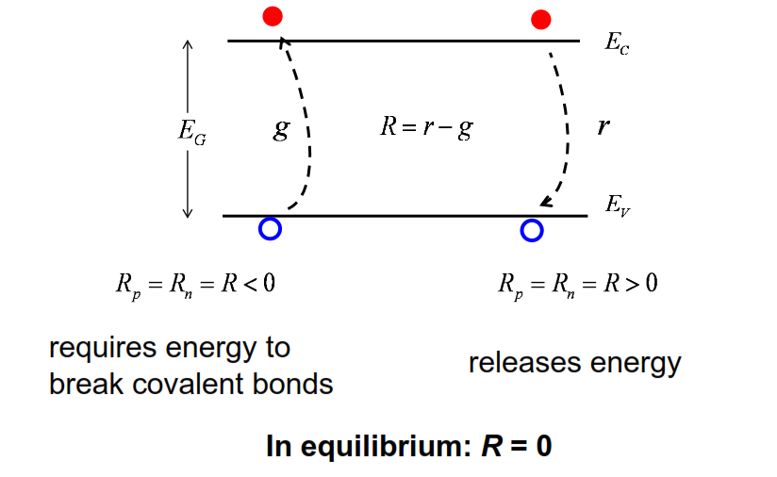
Discussion

Slide 15

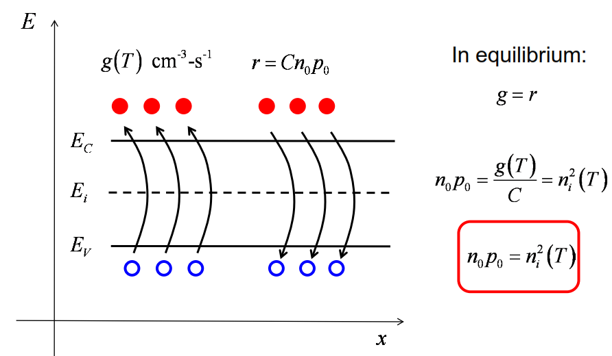
The product of n and p is some material and temperature dependent parameter, this is what we call the intrinsic carrier concentration squared

Slide 16
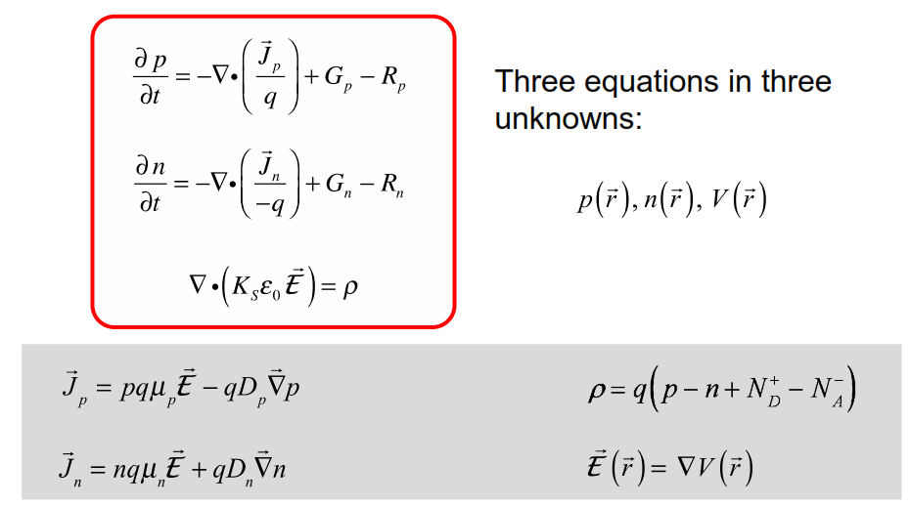
Summary: The semiconductor equations

Slide 17
Unit 5: The Semiconductor Equations
Lecture 5.2:
Energy band diagrams

Slide 18
In this unit we discuss very powerful qualitative way that will provide us with insightful, qualitative solutions to the semiconductor equations without doing any mathematics whatsoever.

Slide 19
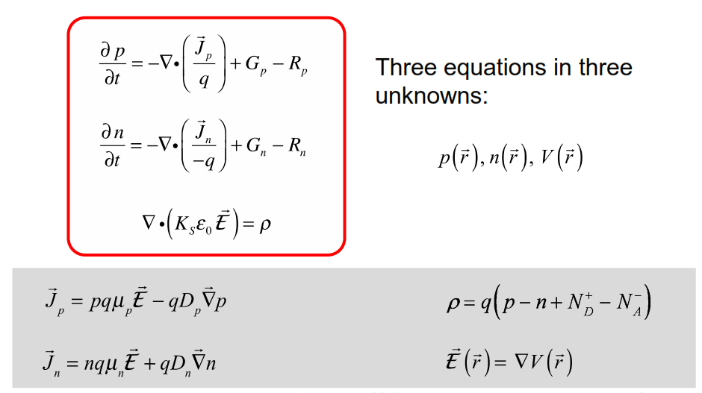
The semiconductor equations

Slide 20
Energy band diagrams
An energy band diagram is a plot of the bottom of the conduction band and the top of the valence band vs. position.
Energy band diagrams are a powerful tool for understanding semiconductor devices because they provide qualitative solutions to the semiconductor equations.

Slide 21
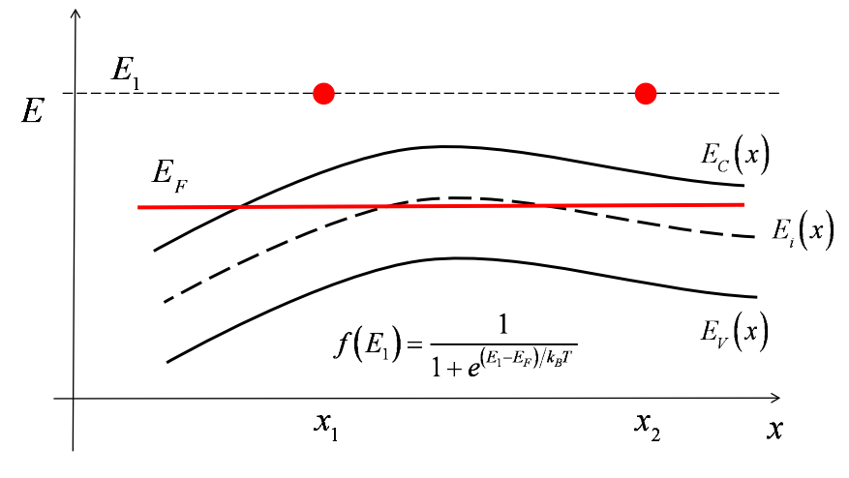
An important principle (in equilibrium)

Slide 22
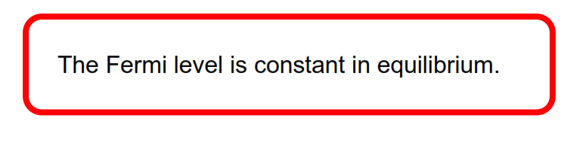
The Fermi level in equilibrium

Slide 23
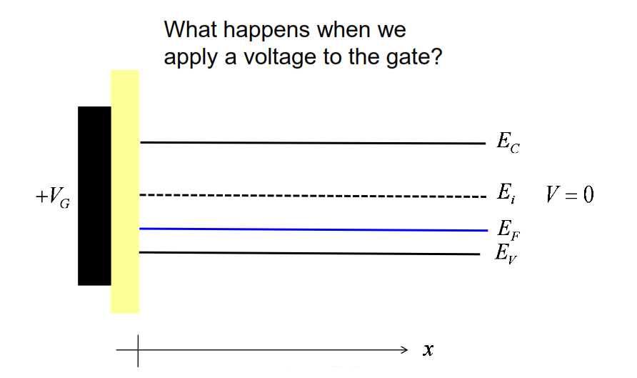
Band bending

Slide 24
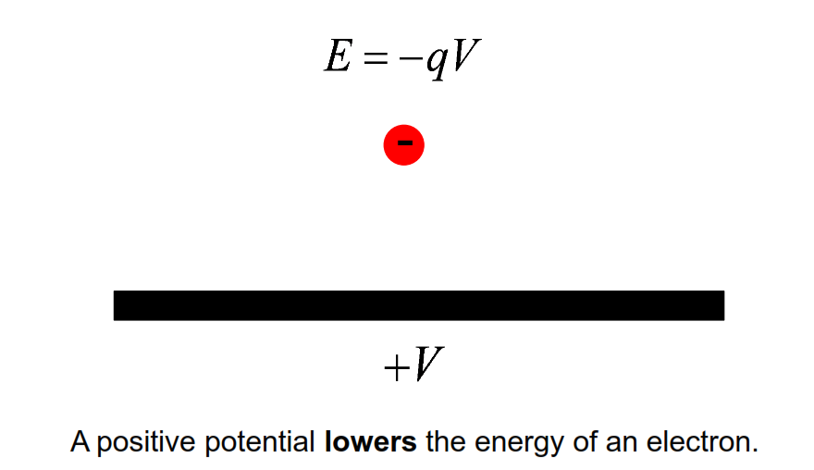
Voltage and electron potential energy

Slide 25
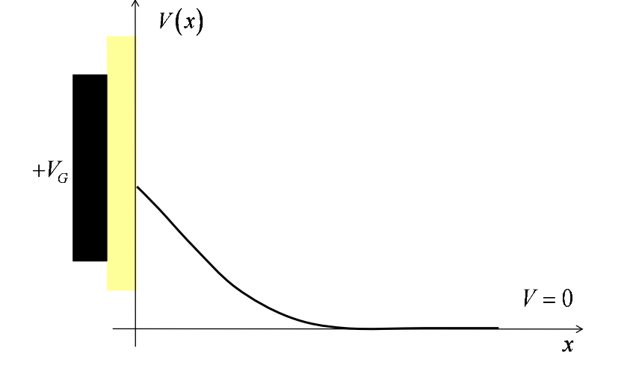
Electrostatic potential vs. position

Slide 26
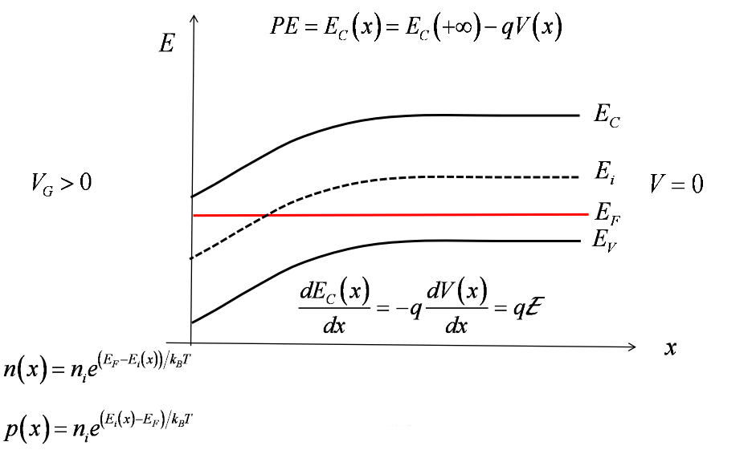
Electrostatic potential causes band bending

Slide 27
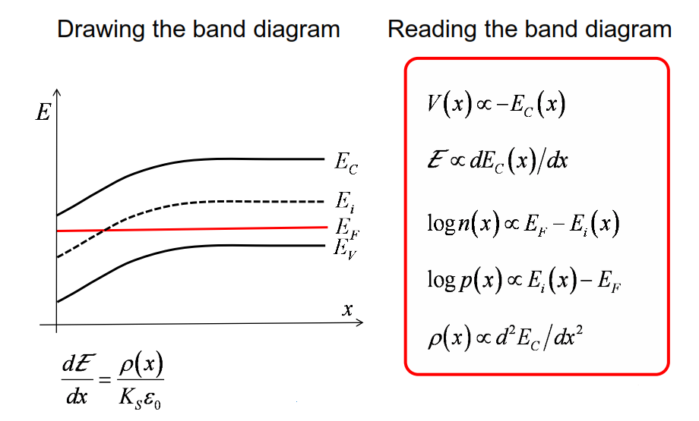
Band diagrams

Slide 28
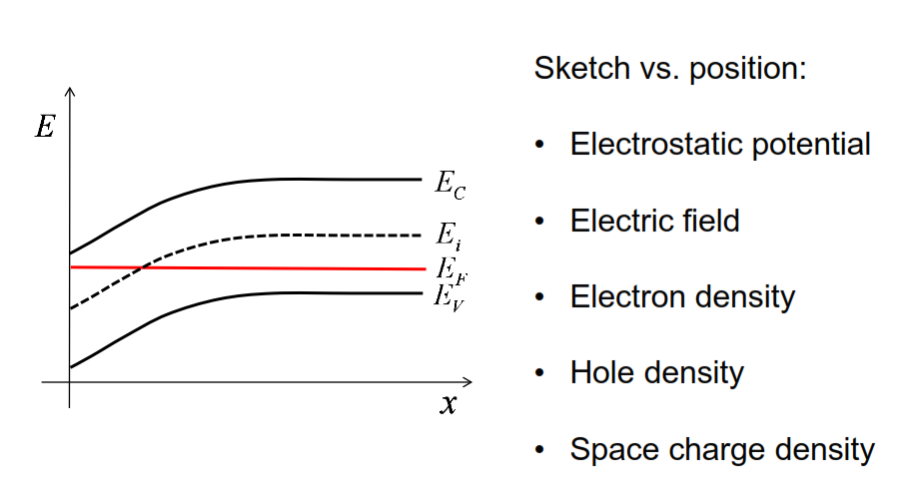
Practice

Slide 29
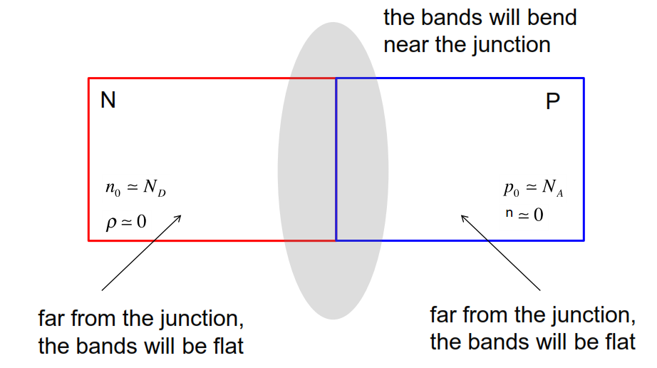
Another example: NP junction in equilibrium

Slide 30
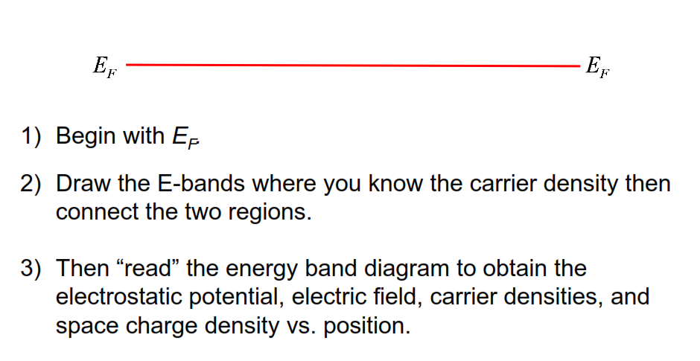
Procedure: Equilibrium energy band diagram

Slide 31
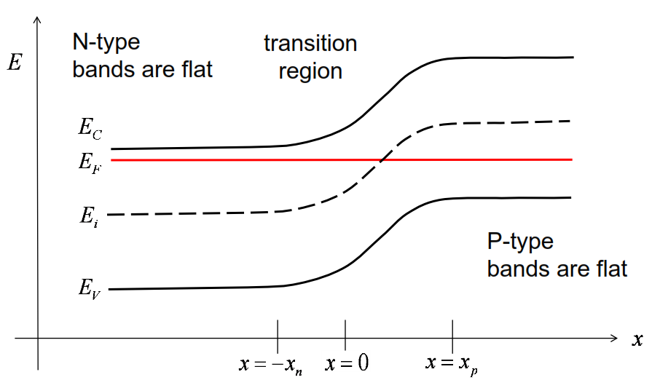
Energy band diagram

Slide 32
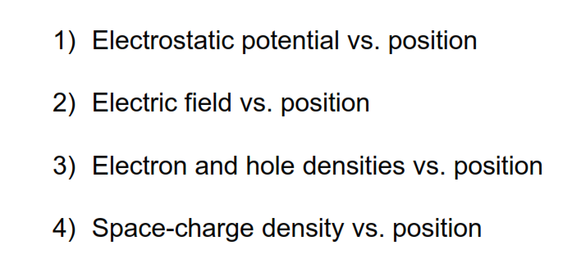
Now, “read” the e-band diagram

Slide 33
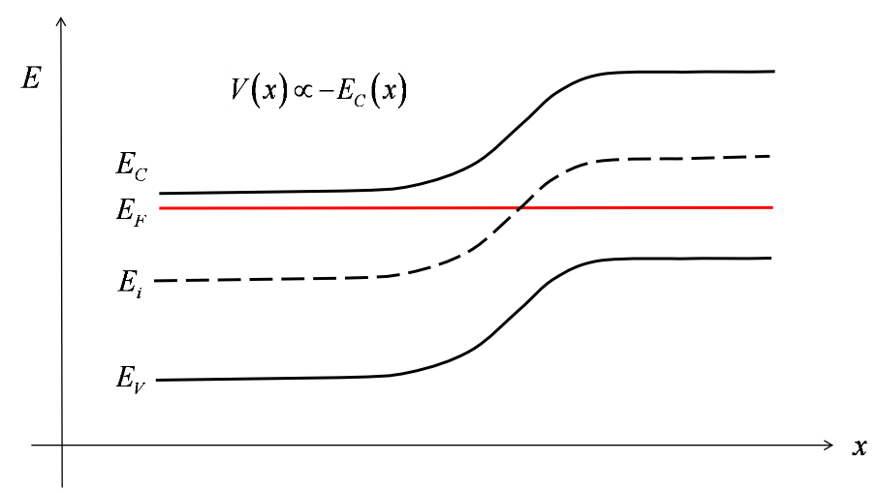
Electrostatic potential?

Slide 34
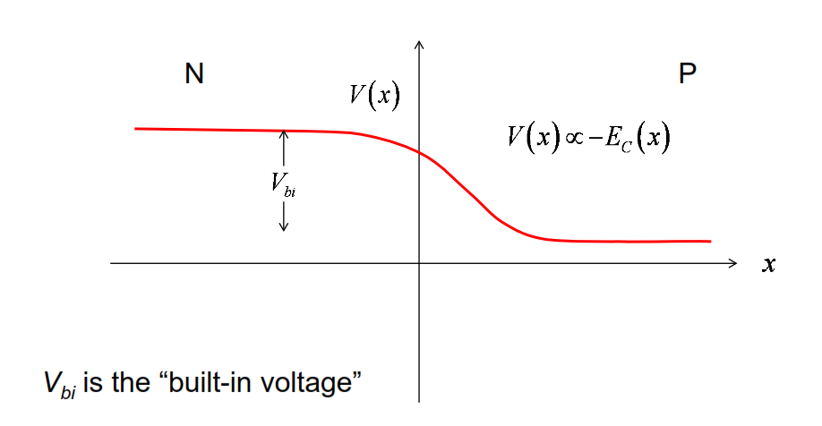
Electrostatics: V(x)

Slide 35
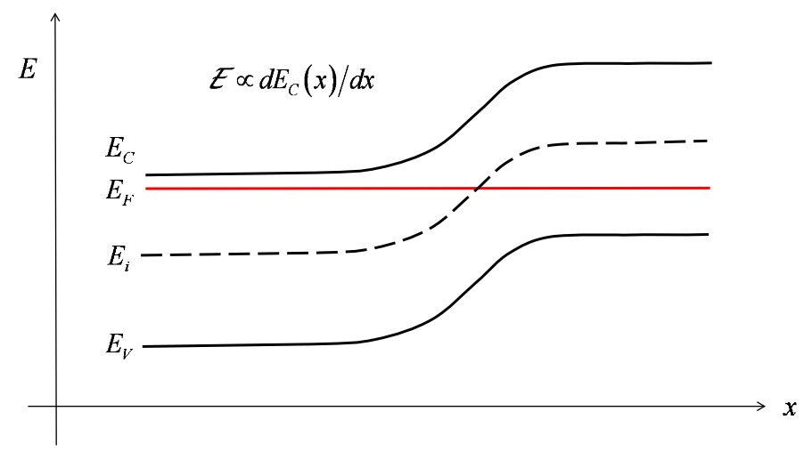
Electric field?

Slide 36
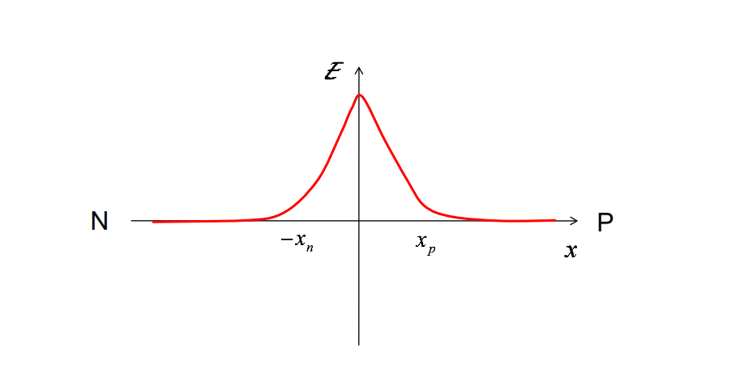
Electric field: E (x)

Slide 37
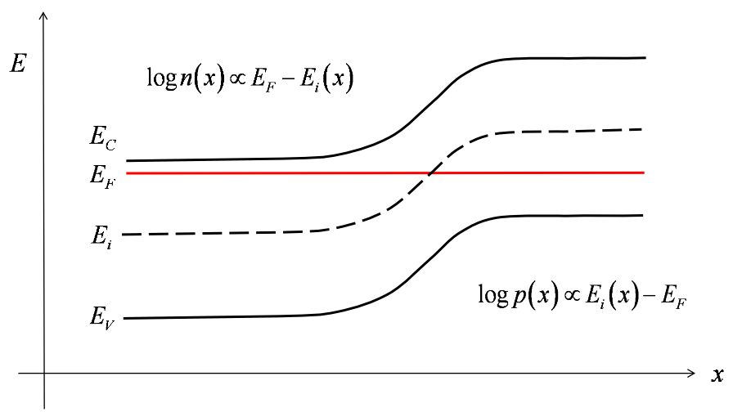
Carrier densities?

Slide 38
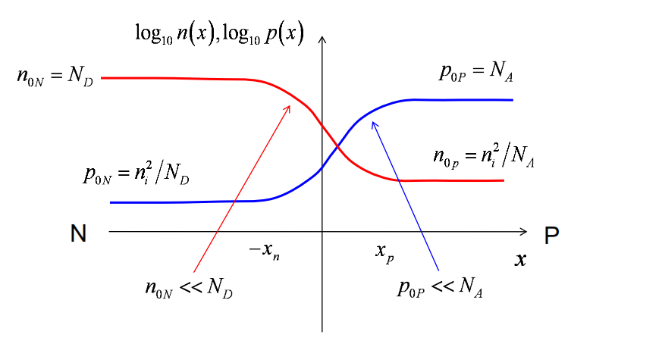
Carrier densities vs. x

Slide 39
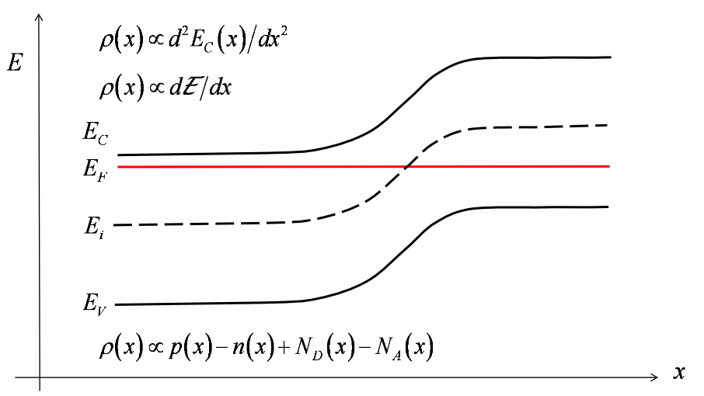
Space charge?

Slide 40
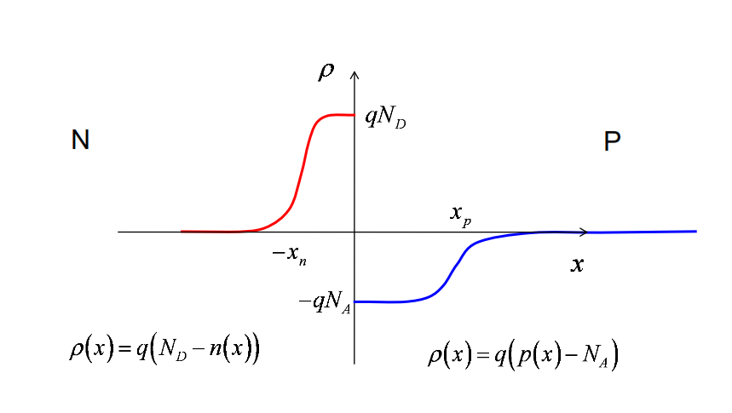
Electrostatics: rho(x)

Slide 41
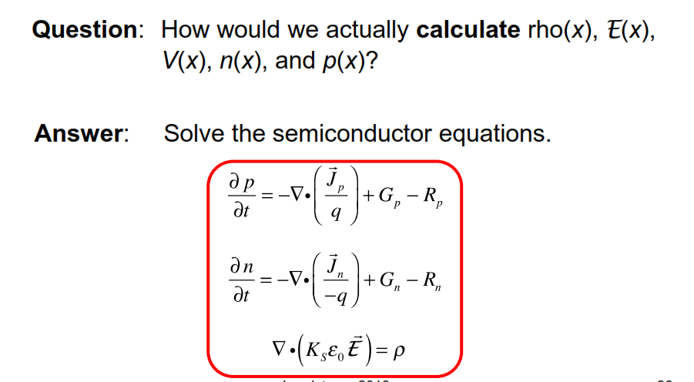
NP junction electrostatics

Slide 42
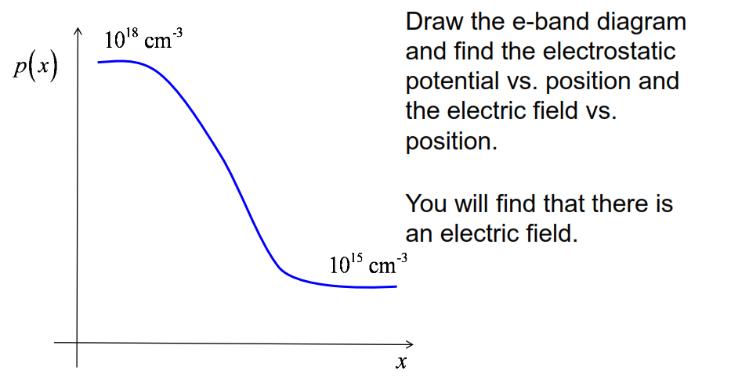
More practice

Slide 43
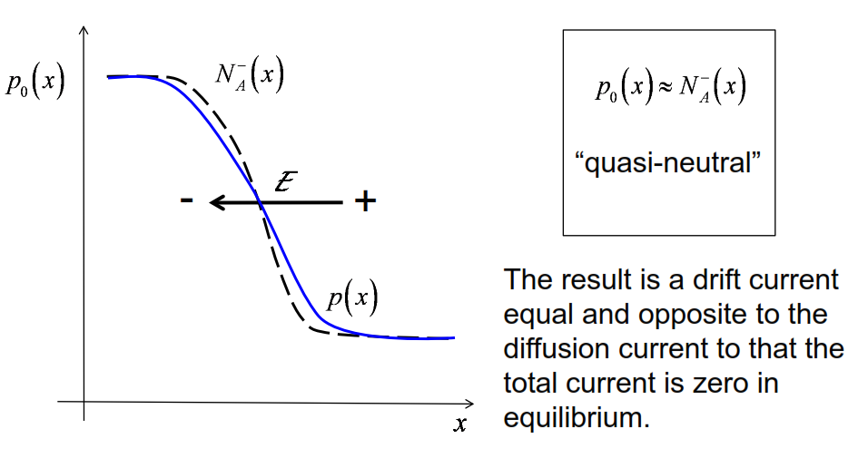
Where does the electric-field come from?

Slide 44
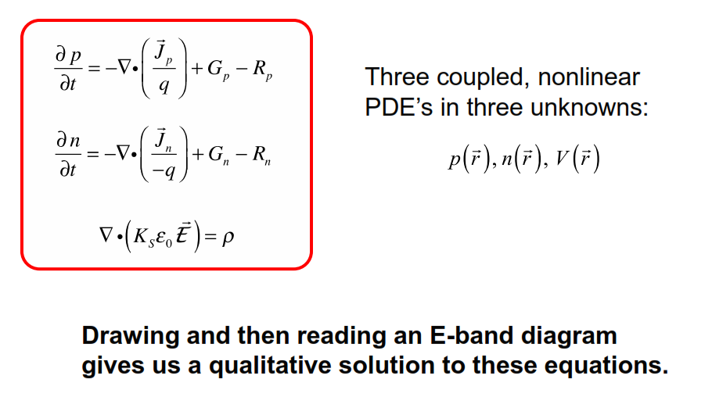
Summary

Slide 45
Unit 5: The Semiconductor Equations
Lecture 5.3:
Quasi-Fermi levels

Slide 46
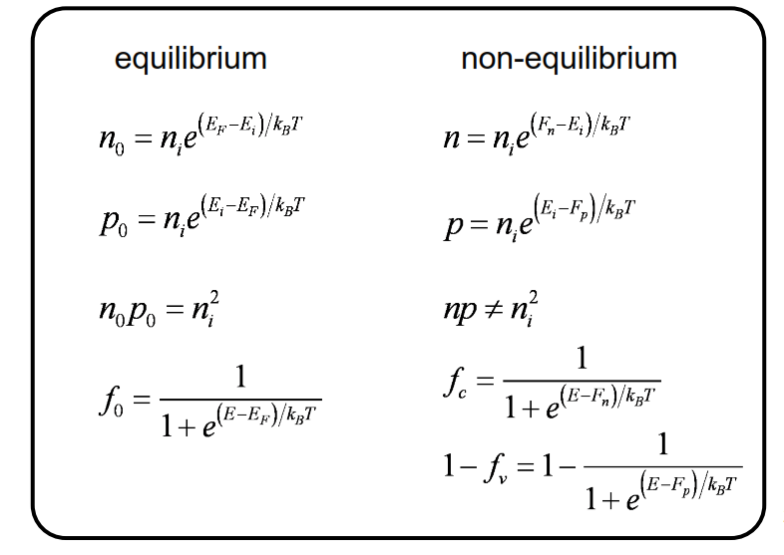
Equilibrium vs. non-equilibrium

Slide 47
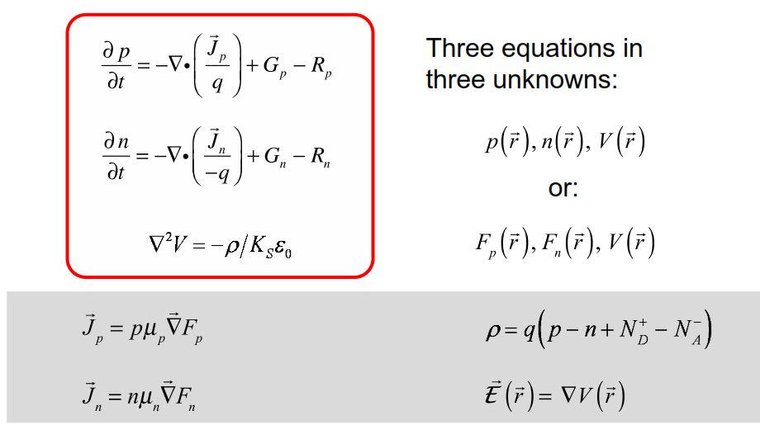
The semiconductor equations

Slide 48
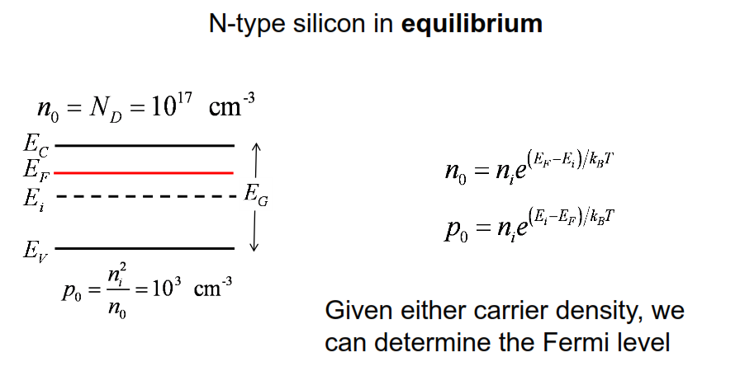
Where is the Fermi level?

Slide 49
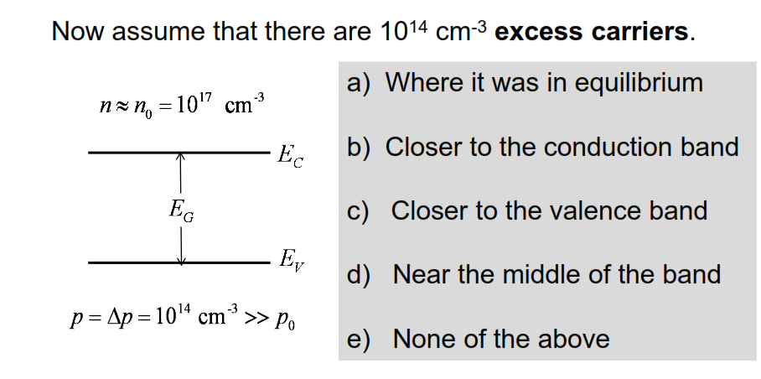
Now where is the Fermi level?
Same # of electrons, more holes -> need 2 Fermi levels!

Slide 50
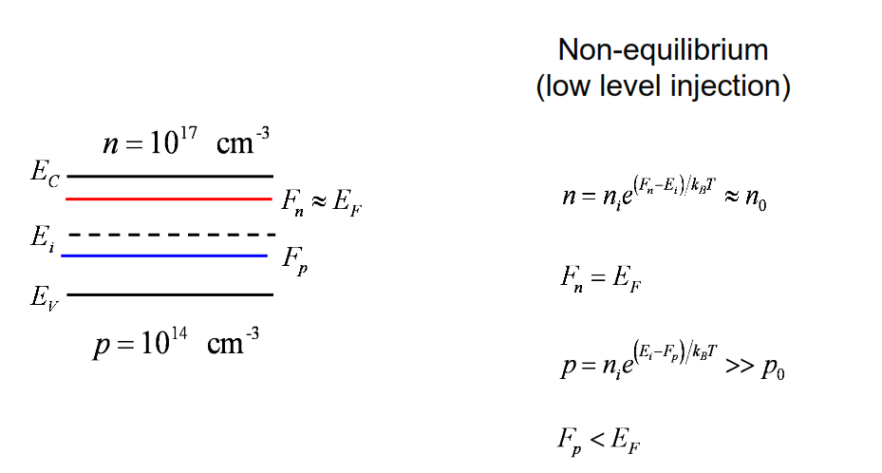
Quasi-Fermi levels

Slide 51
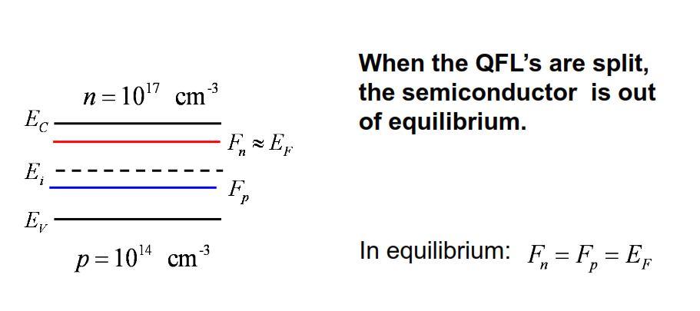
Non-equilibrium

Slide 52
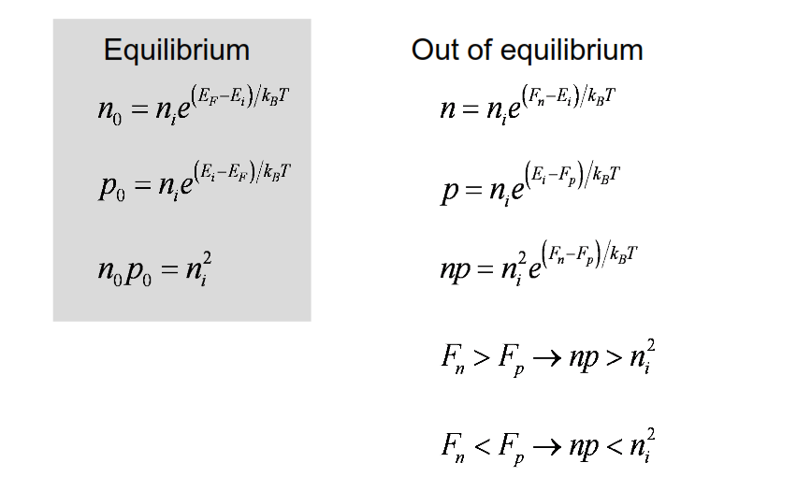
NP product

Slide 53
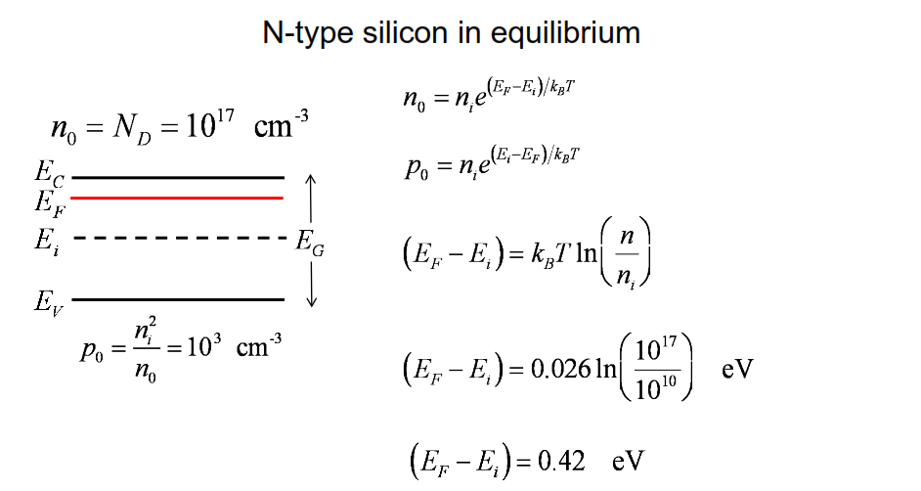
Some numbers (equilibrium)

Slide 54
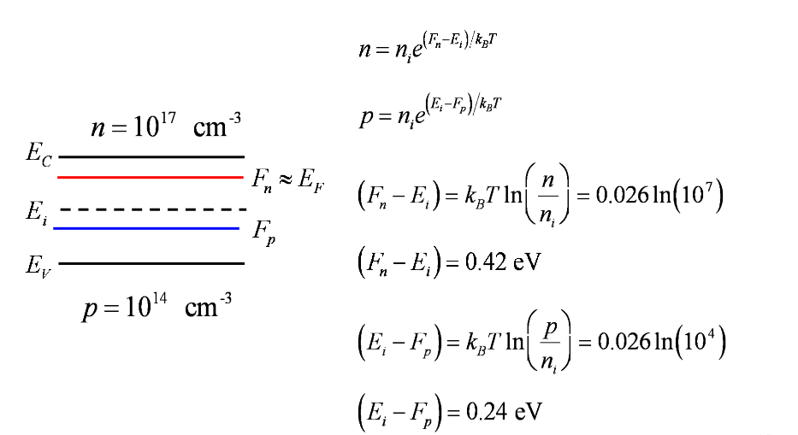
Some numbers (LL injection)

Slide 55
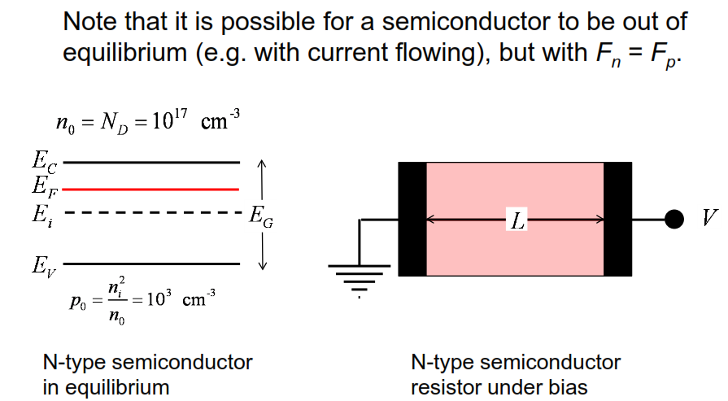
Discussion

Slide 56

E-band diagram of an N-type resistor

Slide 57

Assumptions

Slide 58

Summary

Slide 59
Unit 5: The Semiconductor Equations
Lecture 5.4:
Minority carrier diffusion equation

Slide 60
There are sort of two broad classes of semiconductor devices. There's one class that relies on minority carriers for their operation. Some examples would be solar cells or bipolar transistors. There are other devices that do not rely on the operation of excess carriers, which, there may be no excess carriers present, even under non-equilibrium conditions. example just a simple n-type resistor with two ideal contacts on it.
In this lecture, we're going to focus on minority carriers and show how we can mathematically solve the semiconductor equations analytically, relatively simply, by making suitable approximations for minority carrier devices.

Slide 61

Semiconductor equations

Slide 62

Solving the semiconductor equations
In order to solve them we basically
have three options:

Slide 63

Outline of the lecture

Slide 64

Minority carrier diffusion equation

Slide 65

Minority carrier diffusion equation

Slide 66

Reminder: Low level injection

Slide 67

Example: MCDE for electrons in Si
Okay, so now we're going to go ahead and solve this problem with these numerical parameters under a number of different situations.

Slide 68

Example 1: Steady-state, uniform illumination

Slide 69

Example 1: Solution

Slide 70

Example 1: Equilibrium Fermi level

Slide 71

Example 1: Quasi-Fermi levels

Slide 72

Example 2: Transient decay to equilibrium

Slide 73

Example 2: Solution

Slide 74

Example 2: Solution

Slide 75

Example 2: Solution

Slide 76

Example 3: SS diffusion in a long sample

Slide 77

Example 3: Continued

Slide 78

Example 3: Solution

Slide 79

Example 4: SS diffusion in a short sample

Slide 80

Example 4: Continued

Slide 81

Example 4: Solution

Slide 82

Example 5

Slide 83

Example 5: Solution

Slide 84

Example 5: Solution

Slide 85

Example 6:

Slide 86

Example 6: Solution

Slide 87

Example 6: Energy band diagram
Now, there's a gradient of the quasi Fermi level here. That means there's an electron current in this problem. That represents the flow of electrons to the surface as they recombine and continue to, they're generated in the bulk, they diffuse to the surface, and continually recombine under these steady state conditions. That gives us a current towards the surface.

Slide 88

Summary (i)

Slide 89

Summary (ii)

