Slide 1
CNC Machine Tool System -
Manual NC Part
Programming
April 2020

Slide 2
Manual NC Part Programming
1.1. Programming fundamentals
a. Coordinates systems and references points
Part programming requires establishment of some reference points.
Three reference points are either set by manufacturer or user.
i. Machine Zero (machine coordinate system)
  Its is a fixed point set by the machine tool builder.
  Usually, it cannot be changed.
  Any tool movement is measured from this point and the controller always remembers tool distance from the machine origin.

Slide 3
Cont’d…
ii. Program Origin
  It is also called home position of the tool.
  It is point from where the tool starts for its motion while executing a program and returns back at the end of the cycle.
  This can be any point within the workspace of the tool which is sufficiently away from the part.
  In case of CNC lathe, it is a point where tool change is carried out.
iii. Part Origin (work piece coordinating systems)
  It can be set at any point inside the machine's electronic grid system.
  Establishing the part origin is also known as zero shift, work shift, floating zero or datum.
  Usually part origin needs to be defined for each new setup.

Slide 4
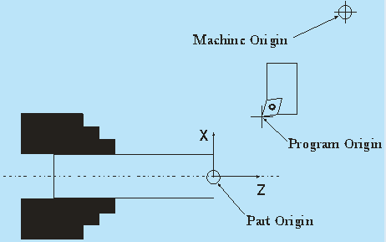
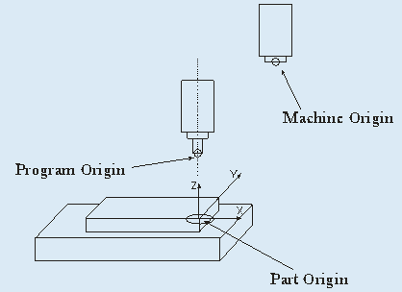
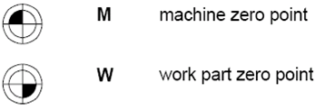
Cont’d…
  Generally, Z axis of the workpiece coordinate system coincides with the spindle axis.
  The programmer use this point as a base to write the intended movement of the tooling.

Slide 5
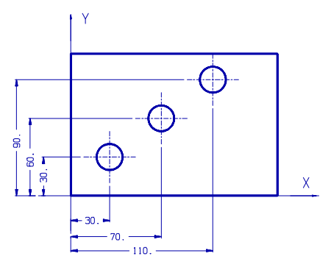
1.2: Positioning
The way of specifying coordinate values of path’s end point or target position in programming are 3 in kinds:
a. Absolute programming
  All references are made to the origin of the coordinate system.
  X/Z axis absolute coordinate values are presented by X--, Z—
Cont’d…

Slide 6
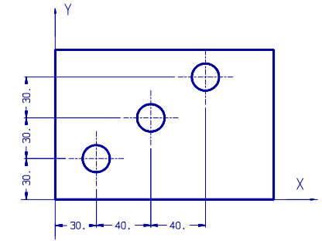
2. Incremental programming
  It uses the preceding point in a sequence of points as a reference.
  X/Z axis incremental coordinate values are presented by U--, W–
3. Compound programming
  Uses the absolute programming and incremental program together.
  Specified by X--,W-- or U--, Z--

Slide 7
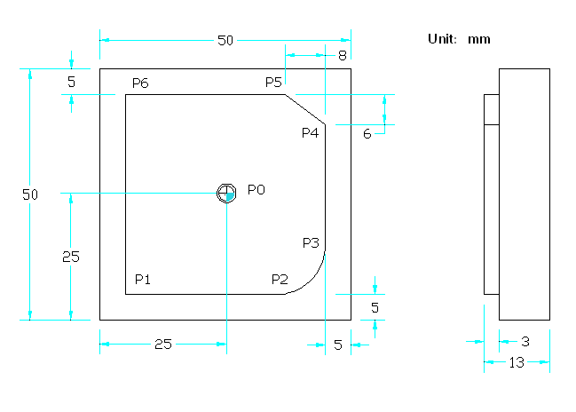
Ex. 1: Define the coordinates of points p0-p6 both in absolute & incremental mode.

Slide 8
Soln:
Cont’d…
G90 Absolute | X | Y | G91 Increment | X | Y
P0 | X0 | Y0 | P0 | X0 | Y0
P0-P1 | X-20 | Y-20 | P0-P1 | X-20 | Y-20
P0-P2 | X12 | Y-20 | P1-P2 | X32 | Y0
P0-P3 | X20 | Y-12 | P2-P3 | X8 | Y8
P0-P4 | X20 | Y14 | P3-P4 | X0 | Y26
P0-P5 | X12 | Y20 | P4-P5 | X-8 | Y6
P0-P6 | X-20 | Y20 | P5-P6 | X-32 | Y0

Slide 9
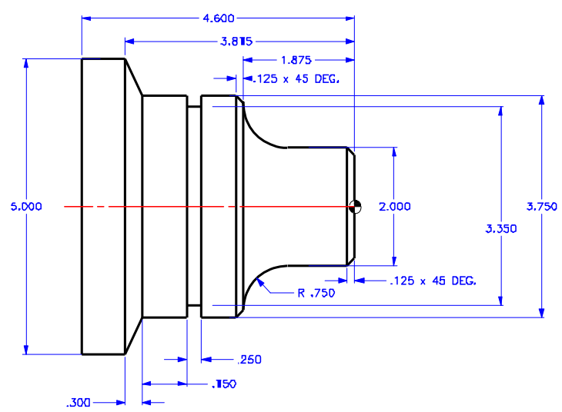
Example 2

Slide 10
1.3. Interpolation Methods
Interpolation is defined as a planar or three dimensional contour formed by path of 2 or multiple axes moving at the same time.
Here four methods are discussed:
  Linear interpolation: Straight line between two points in space.
  Circular interpolation: Circular arc defined by starting point, end point, center or radius, and direction.
  Helical interpolation: Circular plus linear motion.
  Parabolic and cubic interpolation: Free form curves using higher order equations.

Slide 11
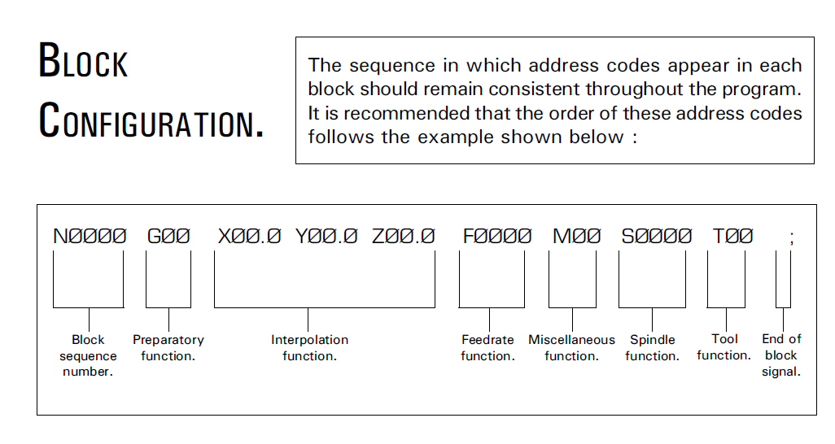
1.4. Structure of NC program

Slide 12
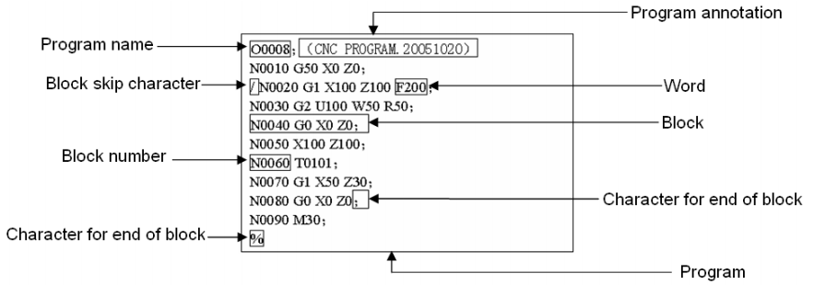
Cont’d…
A program consists of a sequence of blocks, beginning with “OXXXX” (program name) and ending with “%”; a block begins with block number and ends with “;”.
See the general structure of program as follows:
A CNC program consists of blocks, words and address.

Slide 13
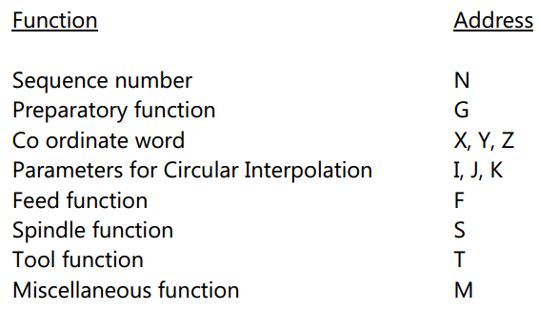
Block
    It’s a command given to the control unit.
    A block is composed of one or more words.
Word
    It is composed of an identification letter and several numerals. example: the command for a feed rate of 200mm/min is F200.
Address
  It’s the identification letter at the beginning of each word.
Cont’d…
Notes:
c.

Slide 14
1.4.1: Explanation of Words
Sequence number (N address):
  Its used to identify the block and its always placed at the beginning of the block.
  The sequence number need not to be consecutive.
Coordinate word (X/Y/Z Address)
  It specifies the target point of the tool movement (absolute dimension system) or the distance to be moved (incremental dimension)
  The word is composed of the address of the axis to be moved and the value and direction of the movement.
Parameter for circular interpolation (I/J/K address)
  It specify the distance measured from the start point of the arc to the centre.

Slide 15
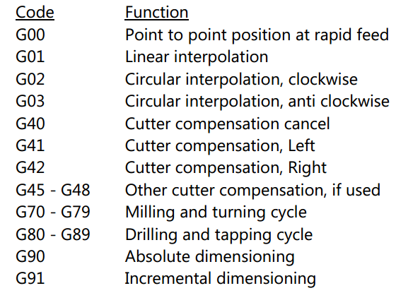
4. Preparatory function (G address)
  It determines how the tool is to move to the programmed target. The most common G codes are listed below

Slide 16
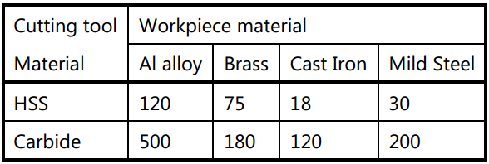
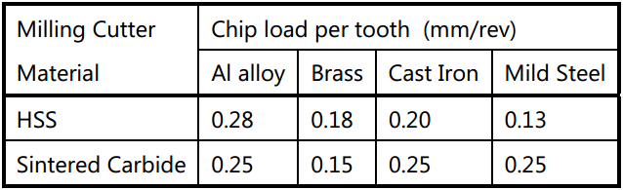
5. Spindle function (S Address)
  The spindle speed is commanded under an S address and is always in revolution per minute.
  The following table gives the surface cutting speeds for some common materials:
6. Feed function (F Address)
  The unit may be in mm/min (in the case of milling machine) or in mm/rev (in the case of turning machine).
  The following table gives the chip load per tooth of milling cutters cutting some common materials:

Slide 17
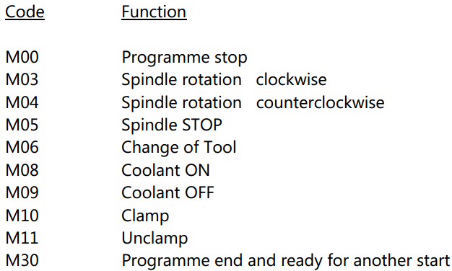
7. Tool Function (T Address)
  The selection of tool is commanded under a T address.
8. Miscellaneous functions
  It’s a function programmed to control the machine operation other than coordinate movement.
  The most common M functions are as follows:

Slide 18

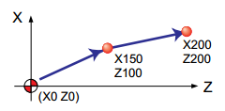
2: Manual Part Programming For NC Lathe
2.1: G codes(preparatory functions)
  G00 (Positioning)
    Each axes moves as much as commanded data in rapid feed rate.
    Command Format: G00 X(U)__Z(W)__
Absolute programming
G00 X150.0 Z100.0
X200.0 Z200.0
Incremental programming
G00 U150.0 W100.0
U50.0 W100.0

Slide 19
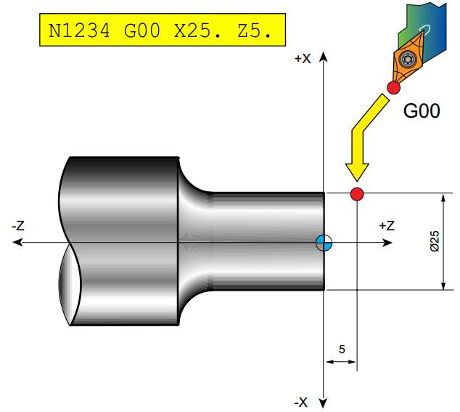
Example:
N100 G00 X25 Z5;

Slide 20

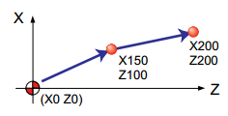
  G01 (Linear interpolation)
    Each axes moves straightly as much as commanded data in commanded rate.
    Command Format: G01 X(U)___ Z(W)___ F___
Absolute programming
G01 X150.0 Z100.0 F0.2;
X200.0 Z200.0;
Incremental programming
G01 U150.0 W100.0 F0.2
U50.0 W100.0

Slide 21
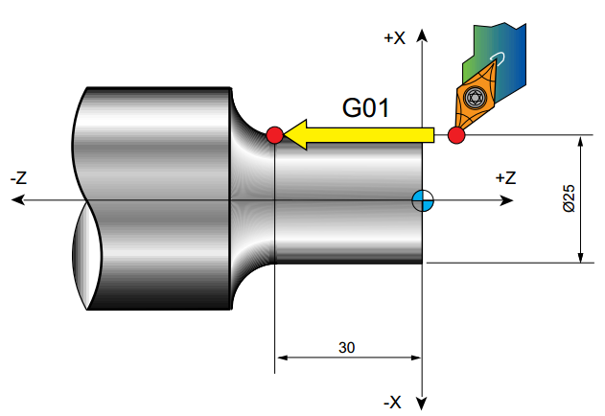
Example 1:
N100 G01 X25.0 Z-30.0 F0.2

Slide 22
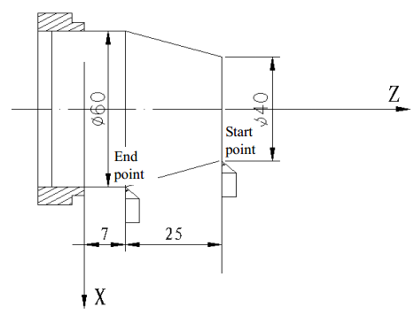
Example 2: Cutting path from Φ40 to Φ60
Absolute programming
G01 X60 Z7 F0.2;
Incremental programming
G01 U20 W-25F0.2;
Compound programming
G01 X60 W-25F0.2；
Compound programming
G01 U20 Z7 F0.2；

Slide 23

  Circular interpolation: G02 & G03
  Command format:
  Command function:
  G02 movement path is clockwise arc from starting point to end point.
  G03 movement path is counterclockwise arc from starting point to end point.
  I = Coordinates of center point – that of starting point in X direction;
  K = Coordinates of center point – that of starting point in Z direction.

Slide 24
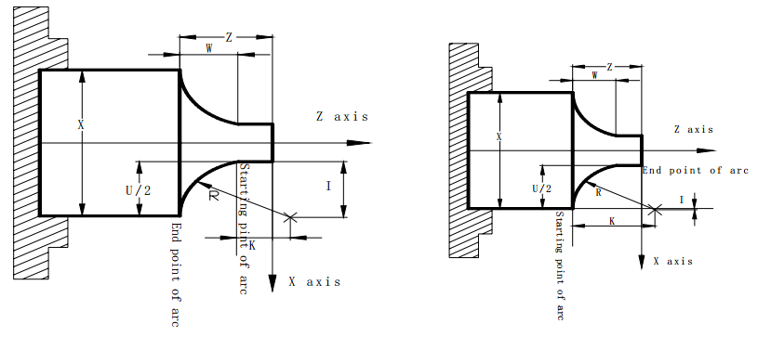
Command the path
G03 path
G02 path
Notes:
Its rear tool post coordinate system – tool is in rear of origin of coo system

Slide 25
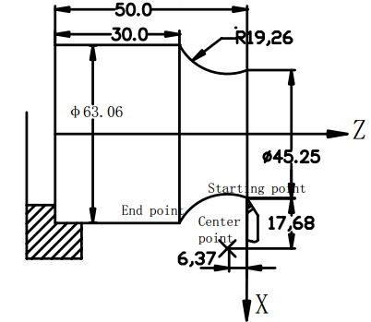
Example 1:
Absolute programming
G03 X63.06 Z-20.0 R19.26 F0.2；
Incremental programming
G03 U17.81 W-20.0 R19.26 F0.2；
Absolute programming
G03 X63.06 Z-20.0 I17.68 K-6.37 F0.2;
Incremental programming
G03 U17.81 W-20.0 I17.68 K-6.37 F0.2;

Slide 26
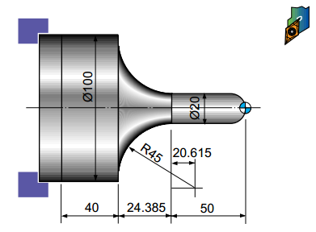
Example 2: Write a manual part program to generate the ff profile.
O0001
G21 M03 S200 ;
G00 X0 Z3.0 M08 ;
G01 Z0 F0.2;
G03 X20.0 Z-10.0 R10.0;
G01 Z-50.0;
G02 X100.0 Z-74.385 R45.0;
G01 Z-114.385;
G00 X200.0 Z200.0 M05 M09;
M30;

Slide 27
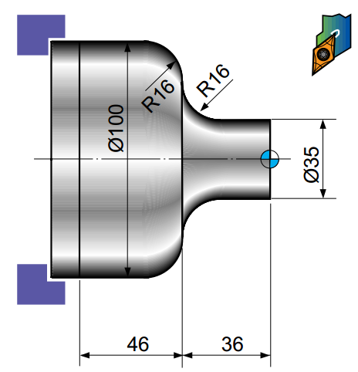
Example 3:
Process: Facing process, turning process
Dimension: ø105 x 86L
Material: mild steel
DOC for stock removal
2-3 mm
DOC for finishing
1mm
Condition of using tool
 | tool | Process type
facing | T01 | Stock removal
 | T02 | finishing
turning | T03 | Stock removal
 | T04 | finishing

Slide 28
M06→ Tool change
The tool change command typically has the tool number and a tool change command.
When the command is executed, the tool changer causes the commanded tool to come to the spindle.
Format:
M06Taa
aa is the tool number
M06 is the tool change command.

Slide 29
  G04 (Dwell)
    Command format: G04 P__ ; or
    G04 X__ ; or
    G04 U__ ;
    Command function:
    each axis stops the motion, the modal of G commands and the reserved data, state are not changed, and execute the next block after dwelling the defined time.
    G04 is non-modal.
    the dwell value is programmed using the address letters X/U (time in seconds) or P (time in 1/1000 seconds)
    Ex. G04 X1.5; This command is read perform a dwell of 1.5 seconds.
    G04 P2500; This command is ready to perform a dwell of 2.5 seconds.

Slide 30
  G20/G21 (imperial/metric data input)
    The machine controller can be programmed in either Imperial (inch) unit input (G20) or Metric (millimeter) unit input (G21).
  G28 (Reference automatic return)
    Command format: G28 X(u) Z(w)
    By command, commanded axis automatically returns to the reference.
  G32 (Thread cycle)
    Command format: G32 Z(w) F ; or
    X(u) Z(w) F ;
    G32 is applied to only single block and its modal.
    Values of over travel δ1 and δ2 can be calculated as:
where
L = Lead of thread
n = rev/min of spindle

Slide 31
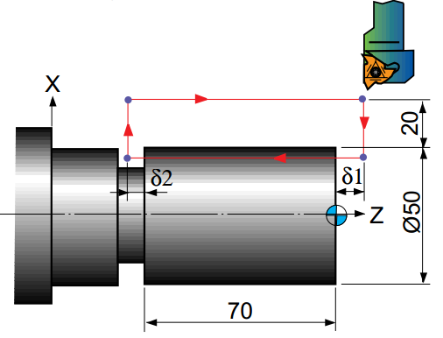
Example 1: Straight lead
Lead of screw : 3mm
δ1 : 5mm
δ2 : 1.5mm
Depth of cut : 1mm(2cut two times)
(ABSOLUTE)
N0005 G90 G21 S900 M03 ;
N0010 G00 X90.0 Z5.0 M08 ;
N0015 X48.0 ;
N0020 G32 Z-71.5 F0.3 ;
N0025 G00 X90.0
N0030 Z5.0 ;
N0035 X46.0 ;
N0040 G32 Z-71.5 ;
N0045 G00 X90.0 ;
N0050 Z5.0;
N0055 X150.0 Z150.0 T0100 ;
N0060 M30 ;

Slide 32
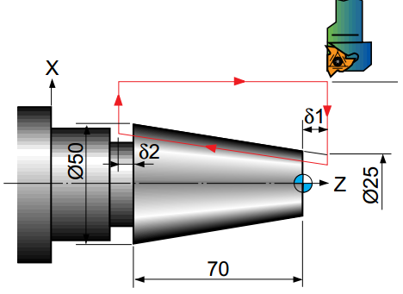
Example 2
ABSOLUTE
N0005 G90 G21 S900 M03 ;
N0010 G00 X90.0 Z5.0 ;
N0015 X23.0;
N0020 G32 X48.0 Z-71.5 F3.0 ;
N0025 G00 X90.0 ;
N0030 Z5.0 ;
N0035 X21.0 ;
N0040 G32 X46.0 Z-71.5 ;
N0045 G00 X90.0 ;
N0050 Z5.0 ;
N0055 X150.0 Z150.0 Mo5Mo9T0100 ;
N0060 M30 ;
Lead of screw: 3mm
δ1: 5mm
δ2: 1.5mm
Depth of cut: 1mm(2cut two times)

Slide 33
INCREMENTAL
N0005 G90 G21 S800 M03 ;
N0010 G00 X90.0 Z5.0 ;
N0015 U-67.974 ;
N0020 G32 U27.321 W-76.5 F3.0 ;
N0025 G00 U40.438 ;
N0030 W76.5 ;
N0035 U-68.948 ;
N0040 G32 U27.321 W-76.5 ;
N0045 G00 X90.0 ;
N0050 W76.5 ;
N0055 X150.0 Z150.0 T0100 ;
N0060 M30 ;

Slide 34
2.2.1.1: Fixed cycle command
To simplify programming, the system defines G command of single machining cycle with one block to complete the rapid traverse to position, linear/thread cutting and rapid traverse to return to the starting point:
G90 (Axial cutting cycle)
  Command format: G90 X(U) __ Z(W) __ F__; (cylinder cutting)
  G90 X(U) __ Z(W) __ R__ F__; (taper cutting)
  Command function: From starting point, the cutting cycle of cylindrical surface or taper surface is completed by radial feeding(X) and axial (Z or X and Z) cutting. where X(U): X coordinate at the end point of Z.
  Z(W) : End point
  R- : When cutting from the start point to X+ direction
  R+ : When cutting from the start point to X- direction
  R : Inclination(Designate the radius value)

Slide 35
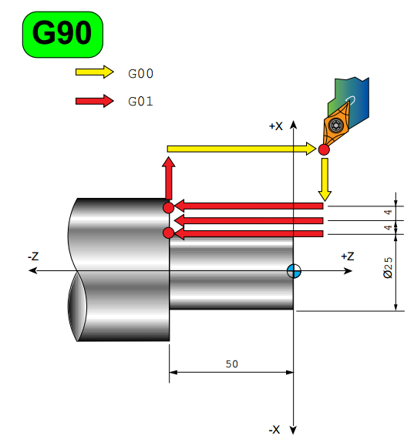

Slide 36
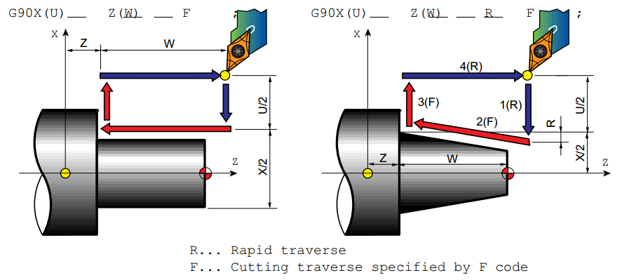

Slide 37
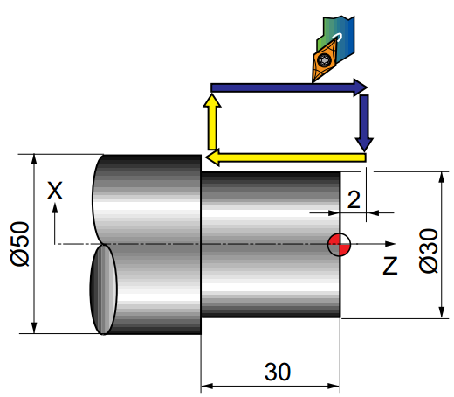
Example 1: Cylindrical cycle
O0013
N010 G21 G90;
N015 MO3 S300 T0101 ;
N020 G00 X56.0 Z2.0 M08 ;
N025 G90 X51.0 W-32.0 F0.25 ;
X46.0 ;
X41.0 ;
X36.0 ;
X31.0 ;
X30.0 ;
N030 G28 U0 W0 ;
N035 M30 ;

Slide 38
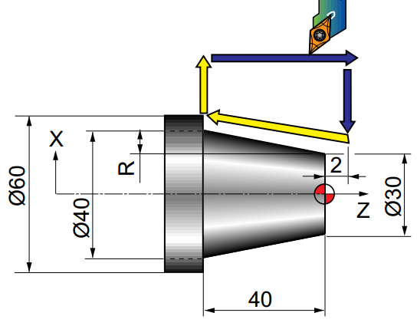
Example 2:
O0012
N010 G21 G90;
N015 MO3 S300 T0101 ;
N020 G00 X61.0 Z2.0 M08 ;
N025 G90 X55.0 W–42.0 F0.25 ;
X50.0 ;
X45.0 ;
X40.0 ;
Z-12.0 R-1.5 ;
Z-26.0 R-3.25 ;
Z-40 R-5 ;
N030 G28 U0 W0 ;
N035 M30 ;

Slide 39
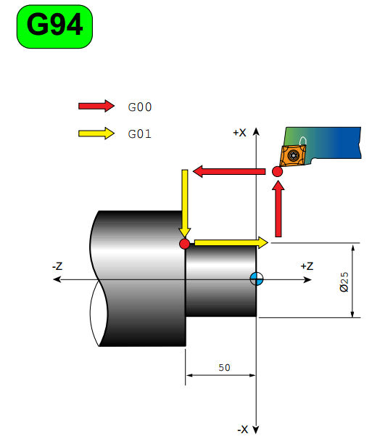
(G94) Radial cutting cycle
  Command format: G94 X(U) __ Z(W) __ F__; (face cutting)
  G94 X(U) __ Z(W) __ R__ F__; (taper face cutting)
  Command function: From starting point, the cutting cycle of cylindrical surface or taper surface is completed by radial feeding (X) and axial (Z or X and Z) cutting.

Slide 40
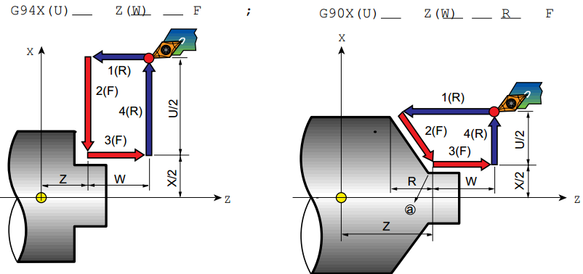
  Cycle process:
  ① Z rapidly traverses from starting point to cutting starting point;
  ② Cutting feed (linear interpolation) from the cutting starting point to cutting end point;
  ③ Z executes the tool retraction at the cutting feed rate (opposite direction to the above-mentioned ①
  ④ The tool rapidly traverses to return to the starting point and the cycle is completed.

Slide 41
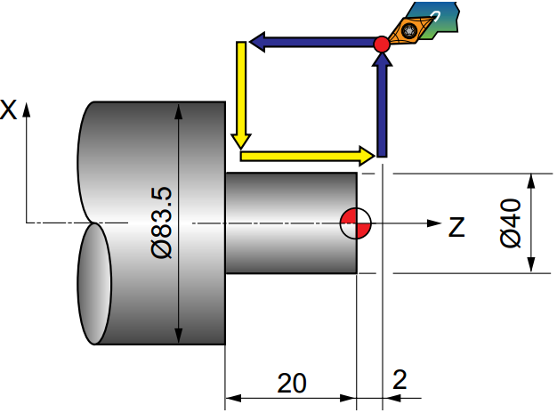
Example 1:
O0014
N010 G21 G90 ;
N015 MO3 S300 T0101 ;
N020 G00 X85.0 Z2.0 M08 ;
N025 G94 X40.0 Z–2.0 F0.2 ;
Z–4.0 ;
Z–6.0 ;
Z–8.0 ;
Z–10.0 ;
Z–12.0 ;
Z–14.0 ;
Z–16.0 ;
Z–18.0 ;
Z-19.7 ;
Z–20.0 ;
N030 G28 U0 W0 ;
N035 M30 ;

Slide 42
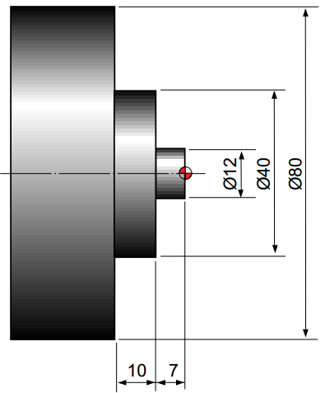
Example 2: G94 Stock removal cycle in facing
O0015
N010 G21 G90 M08 ;
N015 MO3 S300 T0303 ;
N020 G00 X85.0 Z2.0 ;
N025 G94 X12.0 Z-2.0 F0.2 ;
Z-4.0 ;
Z-6.0 ;
Z-7.0 ;
X 40.0 Z-9.0 ;
Z-11.0 ;
Z-13.0 ;
Z-15.0 ;
Z-17.0 ;
N030 G0 X200.0 Z200.0 T0300 ;
N035 M30 ;

Slide 43
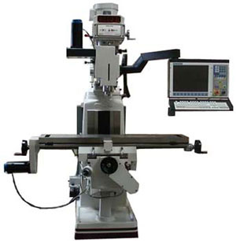
CNC Drilling

Slide 44
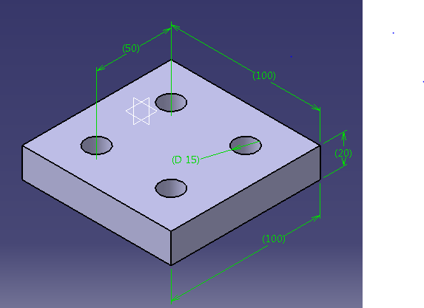
Ex. 1 CNC Drilling
Four holes of 15mm in diameter
A drill of 15mm dia available
All part dimensions are given in mm.

Slide 45
CNC Drilling:
Tool At Start
Algorithm
Move To Hole Position
Move Just Above Hole
Top
View
Turn On Spindle
Turn On Coolant
Plunge Hole
Move Out Of Hole
REPEAT THE ABOVE INSTRNS FOR THE REMAINING 3 HOLES
Front
View
Move Away
Turn Off Spindle
Turn Off Coolant

Slide 46
Tool At Start
Move To Hole Position
Move Just Above Hole
Top
View
Turn On Spindle
Turn On Coolant
Plunge Hole
Move Out Of Hole
REPEAT THE ABOVE INSTRNS FOR THE REMAINING 3 HOLES
Front
View
Move Away
Turn Off Spindle
Turn Off Coolant

Slide 47
Move To Hole Position
Move Just Above Hole
Top
View
Turn On Spindle
Turn On Coolant
Plunge Hole
Move Out Of Hole
REPEAT THE ABOVE INSTRNS FOR THE REMAINING 3 HOLES
Front
View
Move Away
Turn Off Spindle
Turn Off Coolant

Slide 48
Move To Hole Position
Move Just Above Hole
Top
View
Turn On Spindle
Turn On Coolant
Plunge Hole
Move Out Of Hole
REPEAT THE ABOVE INSTRNS FOR THE REMAINING 3 HOLES
Front
View
Move Away
Turn Off Spindle
Turn Off Coolant

Slide 49
Algorithm
Move To Hole Position
Move Just Above Hole
Top
View
Turn On Spindle
Turn On Coolant
Plunge Hole
Move Out Of Hole
REPEAT THE ABOVE INSTRNS FOR THE REMAINING 3 HOLES
Front
View
Move Away
Turn Off Spindle
Turn Off Coolant

Slide 50
Move To Hole Position
Move Just Above Hole
Top
View
Turn On Spindle
Turn On Coolant
Plunge Hole
Move Out Of Hole
REPEAT THE ABOVE INSTRNS FOR THE REMAINING 3 HOLES
Front
View
Move Away
Turn Off Spindle
Turn Off Coolant

Slide 51
Move To Hole Position
Move Just Above Hole
Top
View
Turn On Spindle
Turn On Coolant
Plunge Hole
Move Out Of Hole
REPEAT THE ABOVE INSTRNS FOR THE REMAINING 3 HOLES
Front
View
Move Away
Turn Off Spindle
Turn Off Coolant

Slide 52
Move To Hole Position
Move Just Above Hole
Top
View
Turn On Spindle
Turn On Coolant
Plunge Hole
Move Out Of Hole
REPEAT THE ABOVE INSTRNS FOR THE REMAINING 3 HOLES
Front
View
Move Away
Turn Off Spindle
Turn Off Coolant

Slide 53
Move To Hole Position
Move Just Above Hole
Top
View
Turn On Spindle
Turn On Coolant
Plunge Hole
Move Out Of Hole
REPEAT THE ABOVE INSTRNS FOR THE REMAINING 3 HOLES
Front
View
Move Away
Turn Off Spindle
Turn Off Coolant

Slide 54
Move To Hole Position
Move Just Above Hole
Top
View
Turn On Spindle
Turn On Coolant
Plunge Hole
Move Out Of Hole
REPEAT THE ABOVE INSTRNS FOR THE REMAINING 3 HOLES
Front
View
Move Away
Turn Off Spindle
Turn Off Coolant

Slide 55
Move To Hole Position
Move Just Above Hole
Top
View
Turn On Spindle
Turn On Coolant
Plunge Hole
Move Out Of Hole
REPEAT THE ABOVE INSTRNS FOR THE REMAINING 3 HOLES
Front
View
Move Away
Turn Off Spindle
Turn Off Coolant

Slide 56
CNC Program for Drilling
Tool At Start
Top
View
Front
View
Notes:
More importantly, we are stressing the importance of visualization. This also makes a good point to stress the importance of understanding basic machining practice. A machinist, having experience performing the machining operations commonly done on a machining center will already know what it is they want the machine to do. It will be a relatively simple matter to learn how to tell the machine what it is they wish it to do. On the other hand, a person with little or no machining practice experience may find it very difficult (if not impossible) to visualize, since they have never actually seen machining operations being performed.

Slide 57
Tool At Start
y
Top
View
x
z
Front
View

Slide 58
Tool At Start
N01 G90 G71 G95
N02G00 X25.0 Y25.0
N03 G00 Z0.1 M08
N04 M03 S600
N05 G01 Z-20.0 F0.5
N06 G00 Z0.1
N07 G00 X75.0
No8 G01 -20.0
N09 G00 Z0.1
N10 G00 X75.0Y75.0
N11 G01Z-20.0
N12 G00 Z0.1
N13 G00X25.0
N14 G01 Z-20.0
N15 G00 Z0.1
N16 G00 X250.0 Y250.0
N17 M05 M09
N18 M02
y
Top
View
x
z
Front
View

Slide 59
Tool At Start
N01 G90 G21 G95
N02G00 X25.0 Y25.0
N03 G00 Z0.1 M07
N04 M03 S600
N05 G01 Z-20.0 F0.5
N06 G00 Z0.1
N07 G00 X75.0
No8 G01 -20.0
N09 G00 Z0.1
N10 G00 X75.0Y75.0
N11 G01Z-20.0
N12 G00 Z0.1
N13 G00X25.0
N14 G01 Z-20.0
N15 G00 Z0.1
N16 G00 X250.0 Y250.0
N17 M05 M09
N18 M02
Top
View
Front
View

Slide 60
Tool At Start
N01 G90 G21 G95
N02G00 X25.0 Y25.0
N03 G00 Z0.1 M08
N04 M03 S600
N05 G01 Z-20.0 F0.5
N06 G00 Z0.1
N07 G00 X75.0
No8 G01 -20.0
N09 G00 Z0.1
N10 G00 X75.0Y75.0
N11 G01Z-20.0
N12 G00 Z0.1
N13 G00X25.0
N14 G01 Z-20.0
N15 G00 Z0.1
N16 G00 X250.0 Y250.0
N17 M05 M09
N18 M02
Top
View
Front
View

Slide 61
Tool At Start
N01 G90 G21 G95
N02G00 X25.0 Y25.0
N03 G00 Z0.1 M08
N04 M03 S600
N05 G01 Z-20.0 F0.5
N06 G00 Z0.1
N07 G00 X75.0
No8 G01 -20.0
N09 G00 Z0.1
N10 G00 X75.0Y75.0
N11 G01Z-20.0
N12 G00 Z0.1
N13 G00X25.0
N14 G01 Z-20.0
N15 G00 Z0.1
N16 G00 X250.0 Y250.0
N17 M05 M09
N18 M02
Top
View
Front
View

Slide 62
Tool At Start
N01 G90 G21 G95
N02G00 X25.0 Y25.0
N03 G00 Z0.1 M08
N04 M03 S600
N05 G01 Z-20.0 F0.5
N06 G00 Z0.1
N07 G00 X75.0
No8 G01 -20.0
N09 G00 Z0.1
N10 G00 X75.0Y75.0
N11 G01Z-20.0
N12 G00 Z0.1
N13 G00X25.0
N14 G01 Z-20.0
N15 G00 Z0.1
N16 G00 X250.0 Y250.0
N17 M05 M09
N18 M02
Top
View
Front
View

Slide 63
Tool At Start
N01 G90 G21 G95
N02G00 X25.0 Y25.0
N03 G00 Z0.1 M08
N04 M03 S600
N05 G01 Z-20.0 F0.5
N06 G00 Z0.1
N07 G00 X75.0
No8 G01 -20.0
N09 G00 Z0.1
N10 G00 X75.0Y75.0
N11 G01Z-20.0
N12 G00 Z0.1
N13 G00X25.0
N14 G01 Z-20.0
N15 G00 Z0.1
N16 G00 X250.0 Y250.0
N17 M05 M09
N18 M02
Top
View
Front
View

Slide 64
Tool At Start
N01 G90 G21 G95
N02G00 X25.0 Y25.0
N03 G00 Z0.1 M08
N04 M03 S600
N05 G01 Z-20.0 F0.5
N06 G00 Z0.1
N07 G00 X75.0
No8 G01 -20.0
N09 G00 Z0.1
N10 G00 X75.0Y75.0
N11 G01Z-20.0
N12 G00 Z0.1
N13 G00X25.0
N14 G01 Z-20.0
N15 G00 Z0.1
N16 G00 X250.0 Y250.0
N17 M05 M09
N18 M02
Top
View
Front
View

Slide 65
N01 G90 G21 G95
N02G00 X25.0 Y25.0
N03 G00 Z0.1 M08
N04 M03 S600
N05 G01 Z-20.0 F0.5
N06 G00 Z0.1
N07 G00 X75.0
No8 G01 -20.0
N09 G00 Z0.1
N10 G00 X75.0Y75.0
N11 G01Z-20.0
N12 G00 Z0.1
N13 G00X25.0
N14 G01 Z-20.0
N15 G00 Z0.1
N16 G00 X250.0 Y250.0
N17 M05 M09
N18 M02
Top
View
Front
View

Slide 66
N01 G90 G21 G95
N02G00 X25.0 Y25.0
N03 G00 Z0.1 M08
N04 M03 S600
N05 G01 Z-20.0 F0.5
N06 G00 Z0.1
N07 G00 X75.0
No8 G01 -20.0
N09 G00 Z0.1
N10 G00 X75.0Y75.0
N11 G01Z-20.0
N12 G00 Z0.1
N13 G00X25.0
N14 G01 Z-20.0
N15 G00 Z0.1
N16 G00 X250.0 Y250.0
N17 M05 M09
N18 M02
Top
View
Front
View

Slide 67
N01 G90 G21 G95
N02G00 X25.0 Y25.0
N03 G00 Z0.1 M08
N04 M03 S600
N05 G01 Z-20.0 F0.5
N06 G00 Z0.1
N07 G00 X75.0
No8 G01 -20.0
N09 G00 Z0.1
N10 G00 X75.0Y75.0
N11 G01Z-20.0
N12 G00 Z0.1
N13 G00X25.0
N14 G01 Z-20.0
N15 G00 Z0.1
N16 G00 X250.0 Y250.0
N17 M05 M09
N18 M02
Top
View
Front
View

Slide 68
N01 G90 G21 G95
N02G00 X25.0 Y25.0
N03 G00 Z0.1 M08
N04 M03 S600
N05 G01 Z-20.0 F0.5
N06 G00 Z0.1
N07 G00 X75.0
No8 G01 -20.0
N09 G00 Z0.1
N10 G00 X75.0Y75.0
N11 G01Z-20.0
N12 G00 Z0.1
N13 G00X25.0
N14 G01 Z-20.0
N15 G00 Z0.1
N16 G00 X250.0 Y250.0
N17 M05 M09
N18 M02
Top
View
Front
View

Slide 69
N01 G90 G21 G95
N02G00 X25.0 Y25.0
N03 G00 Z0.1 M08
N04 M03 S600
N05 G01 Z-20.0 F0.5
N06 G00 Z0.1
N07 G00 X75.0
No8 G01 -20.0
N09 G00 Z0.1
N10 G00 X75.0Y75.0
N11 G01Z-20.0
N12 G00 Z0.1
N13 G00X25.0
N14 G01 Z-20.0
N15 G00 Z0.1
N16 G00 X250.0 Y250.0
N17 M05 M09
N18 M02
Top
View
Front
View

Slide 70
N01 G90 G21 G95
N02G00 X25.0 Y25.0
N03 G00 Z0.1 M08
N04 M03 S600
N05 G01 Z-20.0 F0.5
N06 G00 Z0.1
N07 G00 X75.0
No8 G01 -20.0
N09 G00 Z0.1
N10 G00 X75.0Y75.0
N11 G01Z-20.0
N12 G00 Z0.1
N13 G00X25.0
N14 G01 Z-20.0
N15 G00 Z0.1
N16 G00 X250.0 Y250.0
N17 M05 M09
N18 M02
Top
View
Front
View

Slide 71
N01 G90 G21 G95
N02G00 X25.0 Y25.0
N03 G00 Z0.1 M08
N04 M03 S600
N05 G01 Z-20.0 F0.5
N06 G00 Z0.1
N07 G00 X75.0
No8 G01 -20.0
N09 G00 Z0.1
N10 G00 X75.0Y75.0
N11 G01Z-20.0
N12 G00 Z0.1
N13 G00X25.0
N14 G01 Z-20.0
N15 G00 Z0.1
N16 G00 X250.0 Y250.0
N17 M05 M09
N18 M02
Top
View
Front
View

Slide 72
N01 G90 G21 G95
N02G00 X25.0 Y25.0
N03 G00 Z0.1 M08
N04 M03 S600
N05 G01 Z-20.0 F0.5
N06 G00 Z0.1
N07 G00 X75.0
No8 G01 -20.0
N09 G00 Z0.1
N10 G00 X75.0Y75.0
N11 G01Z-20.0
N12 G00 Z0.1
N13 G00X25.0
N14 G01 Z-20.0
N15 G00 Z0.1
N16 G00 X250.0 Y250.0
N17 M05 M09
N18 M02
Top
View
Front
View

Slide 73
N01 G90 G21 G95
N02G00 X25.0 Y25.0
N03 G00 Z0.1 M08
N04 M03 S600
N05 G01 Z-20.0 F0.5
N06 G00 Z0.1
N07 G00 X75.0
No8 G01 -20.0
N09 G00 Z0.1
N10 G00 X75.0Y75.0
N11 G01Z-20.0
N12 G00 Z0.1
N13 G00X25.0
N14 G01 Z-20.0
N15 G00 Z0.1
N16 G00 X250.0 Y250.0
N17 M05 M09
N18 M02
Top
View
Front
View

Slide 74
N01 G90 G21 G95
N02G00 X25.0 Y25.0
N03 G00 Z0.1 M08
N04 M03 S600
N05 G01 Z-20.0 F0.5
N06 G00 Z0.1
N07 G00 X75.0
No8 G01 -20.0
N09 G00 Z0.1
N10 G00 X75.0Y75.0
N11 G01Z-20.0
N12 G00 Z0.1
N13 G00X25.0
N14 G01 Z-20.0
N15 G00 Z0.1
N16 G00 X250.0 Y250.0
N17 M05 M09
N18 M02
Top
View
Front
View

Slide 75
N01 G90 G21 G95
N02G00 X25.0 Y25.0
N03 G00 Z0.1 M08
N04 M03 S600
N05 G01 Z-20.0 F0.5
N06 G00 Z0.1
N07 G00 X75.0
No8 G01 -20.0
N09 G00 Z0.1
N10 G00 X75.0Y75.0
N11 G01Z-20.0
N12 G00 Z0.1
N13 G00X25.0
N14 G01 Z-20.0
N15 G00 Z0.1
N16 G00 X250.0 Y250.0
N17 M05 M09
N18 M02
Top
View
Front
View

Slide 76
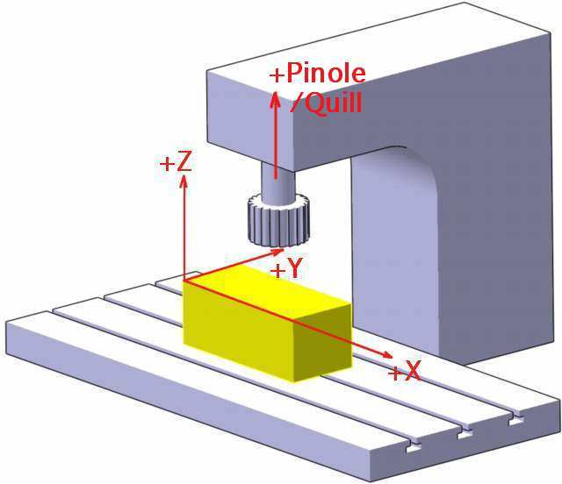
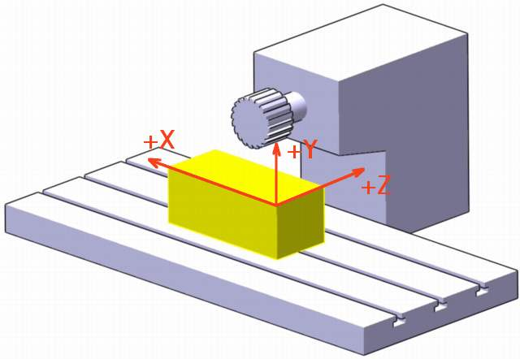
2.3: Manual Part Programming For NC Milling
Vertical milling machine
Horizontal milling machine

Slide 77
2.3.1: G codes(preparatory functions)
Basic Preparatory NC Codes
G00 Linear Movement (rapid) G95 Feed in mm/rev
G01 Linear Movement (feed) G96 Speed m/min
G02 Circular Movement (cw) G97 Speed in RPM
G03 Circular Movement (ccw)
G20 Inch units
G21 Metric units
G90 Absolute dimensions
G91 incremental dimensions
G94 Feed in mm/min

Slide 78
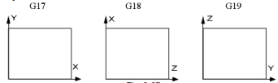
Plane selection G17～G19
  Command format： G17……XY plane
G18……ZX plane
G19……YZ plane
  Command function: use G commands to select the plane of the arc interpolation.
  Command explanation: G17, G18, G19 are modal, and the plane does not change in the block without the command.

Slide 79
CNC Milling
2D - Surface Machining

Slide 80
CNC Programming

Slide 81
CNC Programming
N00 G90 G21 G17 G94 ;
N01 G00 X0 Y-4;
N02 G01 X54 Y-4 F0.2;
N03 G01 X54 Y24;
N04 G01 X50 Y24;
N05 G02 X29 Y45 I0 J21;
N06 G03 X-29 Y45 I-29 J0;
N07 G02 X-50 Y24 I-21 J0;
N08 G01 X-54 Y-24;
N09 G01 X-54 Y-4;
N10 G01 X0 Y-4;
N11 G00 X100 Y100;
N11 M30;
Tool radius = 4 mm (tool at X = 0, Y = -4)
Tool starts from origin and returns to origin
Only motion statements
All motions are feed motions

Slide 82
CNC Programming
N04 G02 X29 Y45 I0 J21
N05 G03 X-29 Y45 I-29 J0
N06 G02 X-50 Y24 I-21 J0
Options
N04 G02 X29 Y45 R21
N05 G03 X-29 Y45 R29
N06 G02 X-50 Y24 R21
Tool radius = 4 mm (tool at X = 0, Y = -4)
Tool starts from origin and returns to origin
Only motion statements
All motions are feed motions

Slide 83
Options
N00 G42
N01 G00 X0Y0
N02 G01 X50 Y0
N03 G01 X50 Y20
N04 G02 X25 Y45 I0 J25
N05 G03 X-25 Y45 I-25 J0
N06 G02 X-50 Y20 I-25 J0
N07 G01 X-50 Y0
N08 G01 X0 Y0
N09 G00X100 Y100 G40
N10 M30;
N01 G00 X0 Y-4
N02 G01 X54 Y-4
N03 G01 X54 Y24
N04 G01 X50 Y24
N05 G02 X29 Y45 I0 J21
N06 G03 X-29 Y45 I-29 J0
N07 G02 X-50 Y24 I-21 J0
N08 G01 X-54 Y-24
N09 G01 X-54 Y-4
N10 G01 X0 Y-4

Slide 84
Tool Radius Compensation
G41 Radius Compensation (left)
G42 radius Compensation (right)
G40 Cancel Compensation
Use G42
Use G41
Use G41
Use G42

Slide 85
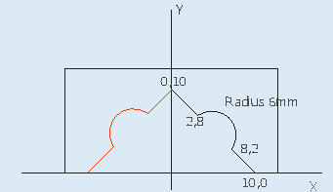
Mirroring (G10-G13)
  Command format: G10 ; (Cancellation of mirroring image)
  G11 ; (Mirror image on X axis)
  G12 ; (Mirror image on Y axis)
  G13 ; (Mirror image on Z axis)
  Command function: It is used when features of components shares symmetry about one or more axes and are also dimensionally identical.
Example:
Profile depth = 2mm

Slide 86
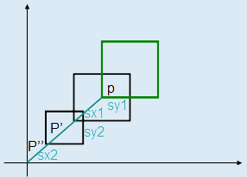
O0002
N005 G21 G17 M08 G90;
N010 M03 S500;
N015 G00 X0 Y0;
N020 G00 X10;
N025 G00 Z2;
N030 G01 Z-2;
N035 G01 X8 Y2;
N040 G03 X2 Y8 R6;
N045 G01 X0 Y10;
N050 G00 Z10;
N055 G00 X0 Y0;
N060 G11;
N065 G25 N020.055;
N070 G00 X100 Y100 G10 M05 M09;
N075 M30;
Shifting origin (G92)
  Command format:
  G92 X__ Y__ ; Where: X and Y values are positions after shifting.
  Command function: It is used to temporarily shift the origin to the reference point specified.

Slide 87
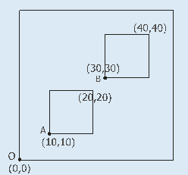
Example:
O0004 N055 Y0 ;
N005 G21 G17 M08 G90 ; N060 G00 Z10 ;
N010 M03 S500 ; N065 G92 X30 Y30 ;
N015 G00 X0 Y0 ; N070 G00 X0 Y0 ;
N020 G00 Z2 ; N075 G00 Z2 ;
N025 G92 X10 Y10 ; N080 G25 N035.055 ;
N030 G00 X0 Z0 ; N085 G00 Z10 ;
N035 G01 Z-2 ; N090 M30 ;
N040 X10 ;
N045 Y10 ;
N050 X0 ;

Slide 88
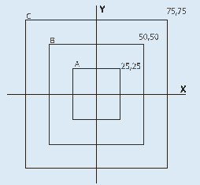
Scaling (G72)
  Command format: G72 K__ ;
  Where: K: the scaling factor.
  Command function: It is used to program geometrically similar components with varying sizes. The scaling command can be cancelled by using the statement G72 K1.0.
Example:

Slide 89
Cont’d…
O0007
N005 G21 G17 M08 G90;
N010 M03 S500;
N015 G00 X0 Y0;
N020 G00 Y25;
N025 G01 Z-2;
N030 X-25;
N035 Y-25;
N040 X25;
N045 Y25;
N050 X0;
N055 G00 Z10;
N060 G00 X0 Y0;
N065 G72 K2.0;
N070 G25 N020.050;
N075 G00 Z10;
N080 G00 X0 Y0;
N085 G72 K3.0;
N090 G25 N020.050;
N095 G00 Z10;
N100 G00 X0 Y0;
N095 G72 K1.0;
N105 M30;

Slide 90
Summary of G Codes
G00 Rapid linear movement
G01 Linear feed movement
G02 Circular movement (CW)
G03 Circular movement (CCW)
G70 Inch units
G71 Metric units
G90 absolute dimension
G91 incremental dimension
G94 Feed per minute
G95 Feed per revolution
G96 Constant surface speed
G97 Speed in RPM
G40 Cancel cutter compensation
G41 Cutter compensation (left)
G42 Cutter compensation (right)

Slide 91
Summary of M Codes
M02 End of program
M03 Spindle on CW
M04 Spindle on CCW
M05 Spindle Off
M06 Tool Change
M08 Coolant On
M09 Coolant Off
M10 Clamp Workpiece
M11 Unclamp Workpiece

Slide 92
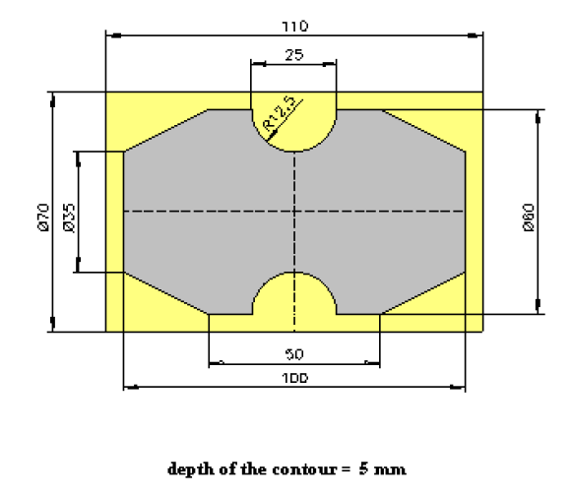
Quiz 1 – (15 mins)
Write a full manual part program for manufacturing the following part using CNC machine.

Slide 93
QNS???

