Slide 1
Chapter Three Part II System Safety Analysis and Link to Reliability
Topics
Root Cause of Failure
Fault Tree Analysis
Hazard analysis
Failure Modes and Effects Analysis (FMEA)

Slide 2
Root Cause of Failure
For a reliability problem,
when an analysis of the true root cause of failure is done, the source of the defects that created the failure will be known.
An analysis of root causes of reliability problems in various industries yields the following causes:
Procurement: 12% of the failures were caused by wrong parts, late delivery, vendor selection and other factors
Plant Engineering: 22% of failures were caused by improper design, modification or other changes

Slide 3
Management: 11% of the failures were caused by management philosophy that drove a reactive mindset (don’t waste time doing a quality repair; get it running quickly!)
Sales: 15% of the failures were caused by improper product mix (resulting in numerous process changes), delivery commitments, order size and other factors

Slide 4
Production: 23% of the failures were caused by improper planning, poor procedures and operator errors
Maintenance: 17% of the failures were caused by improper maintenance, poor planning and errors Another way of illustrating this point is the Reliability Model, shown below, introduced by Ron Moore in his book, “Making Common Sense Common Practice.”

Slide 5
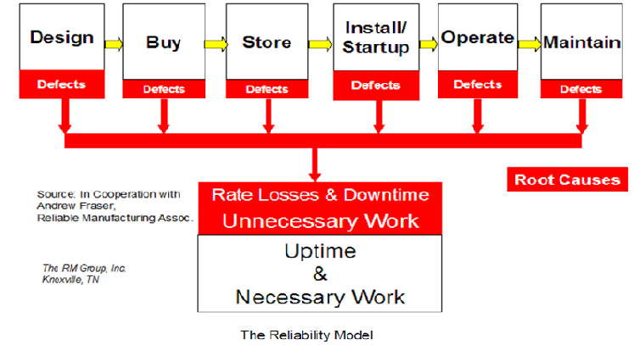

Slide 6
This model illustrates that defects can be produced at any point in the life cycle of a physical asset.

Slide 7
A potential defect is produced if:
the engineer designing the system selects equipment that is minimally adequate,
the purchasing agent selects a poor quality component because it’s cheaper,
the storeroom attendant does not store the component in a way that protects its physical integrity,
the person installing the asset does not use precision methods for alignment or balancing

Slide 8
the operator starting up and running the equipment does not use the proper procedures,
the craftsman performing routine maintenance does not do so with the appropriate degree of precision and care,
All of these defects have the opportunity to result in throughput losses, quality losses or downtime.
The end result is that we pay a penalty in manufacturing performance and spend labor and material resources unnecessarily.

Slide 9
Fault Tree Analysis
Fault Tree Analysis (FTA) is one of the most important logic and probabilistic techniques used in system reliability assessment.
A fault tree (FT) is a top-down logical diagram that displays the interrelationships between a critical system event and its causes.

Slide 10
The main elements of a fault tree are:
TOP event, which is the description of the critical system event
Basic events, they are the lowest level of identified causes
Logic gates, such as OR or AND gates, which gives the logical relationship between the TOP event and the basic events
Fault tree analysis is the qualitative and quantitative analyses that can be carried out on the basis of a fault tree.

Slide 11
FTA is a System Analysis Tool
Evaluates complex systems (small to large)
Identifies causal factors that can result in an Undesired Event
Visual Model - displays complex cause-consequence combinations
Combines failures, errors, normal events, time, HW, SW, HE
Deductive (general to the specific)
Provides risk assessment (Quantitative / Qualitative)
Defined, structured and rigorous
Easy to learn, perform and follow
Utilizes Boolean Algebra, probability theory, reliability theory, logic
Proven over time

Slide 12
Fault Tree Analysis
Work from the overall system backwards towards the component level (top down or deductive approach)
Identify system fault modes and possible causes
Assign probabilities to each fault mode
Build a ‘tree’ and use it to evaluate overall reliability, availability, etc.

Slide 13
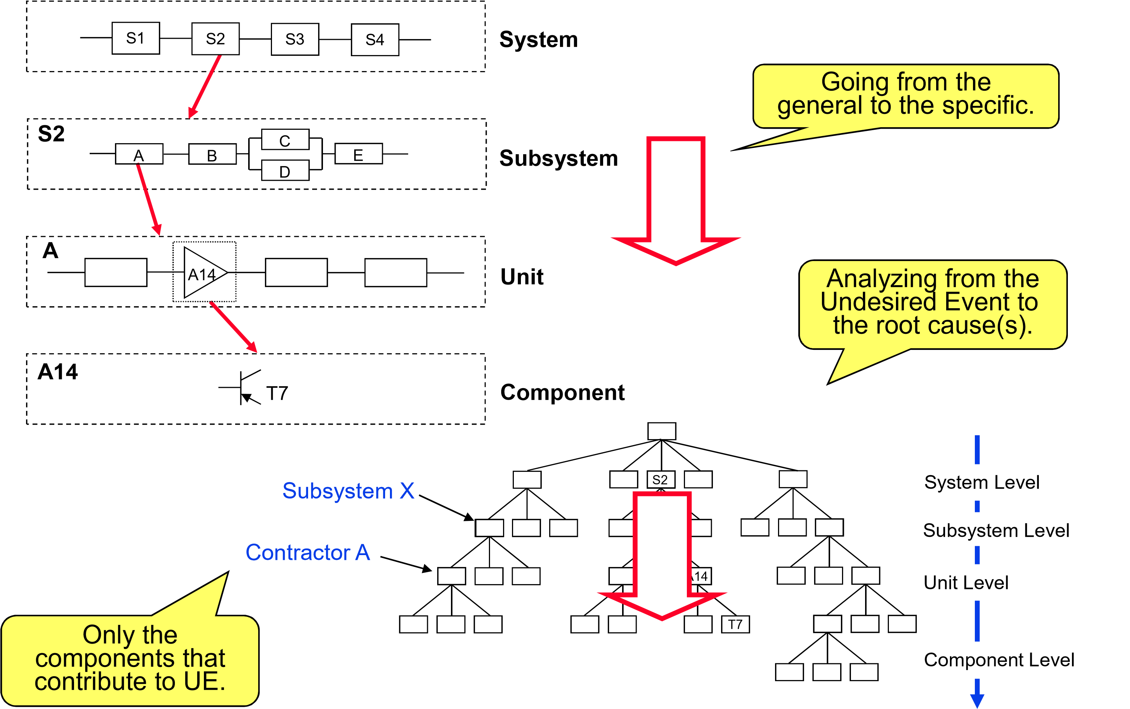
FTA – Deductive Approach

Slide 14
Why Do A FTA?
Root Cause Analysis
Identify all relevant events and conditions leading to Undesired Event
Determine parallel and sequential event combinations
Model diverse/complex event interrelationships involved
●

Slide 15
Risk Assessment
Calculate the probability of an Undesired Event (level of risk)
Identify safety critical components/functions/phases
Measure effect of design changes

Slide 16
Design Safety Assessment
Demonstrate compliance with requirements
Shows where safety requirements are needed
Identify and evaluate potential design defects/weak links
Determine Common Mode failures

Slide 17
Fault tree analysis is often carried out in five steps:
Definition of the problem, system, and boundary conditions of the analysis
Construction of the fault tree
Identification of minimal cut sets
Qualitative analysis of the fault tree
Quantitative analysis of the fault tree

Slide 18
Fault Tree vs Reliability Block Diagram

Slide 19
Minimal Cut Sets
Identification of minimal cut sets is one of the most important qualitative analysis of a fault tree.
A cut set in a fault tree is a set of basic events whose (simultaneous) occurrence ensures that the TOP event occurs.
Minimal cut set is a cut set that cannot be reduced without losing its status as a cut set. The TOP event occurs if one or more of the minimal cut sets occur.

Slide 21
Fault tree modeling (Example)

Slide 24
Consider a SIF that comprises three pressure transmiers (voted 2oo3), one logic solver, and two shutdown valves (voted 1oo2).
The critical event is that the pressure becomes to high, due to a failure of the SIF.
The corresponding fault tree can be as shown below

Slide 25
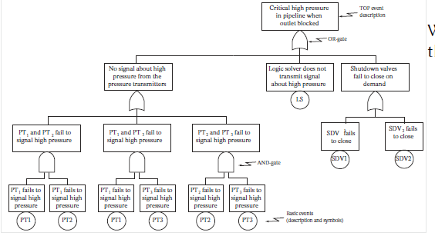
With larger and more complex fault trees we need to use special tools (implementing algorithms for extraction) of minimal cut sets.

Slide 26
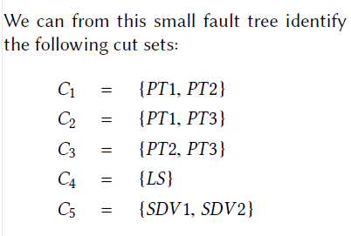

Slide 27
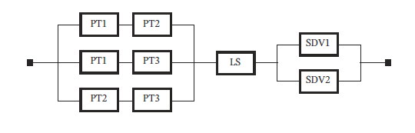
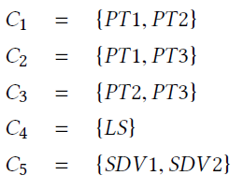
Comparison with Reliability Block Diagram
The system on the previous slide may also be represented by reliability block diagram, as seen below.
With this simple structure, we identify easily the same minimal cut sets (denoted Ci ):

Slide 28
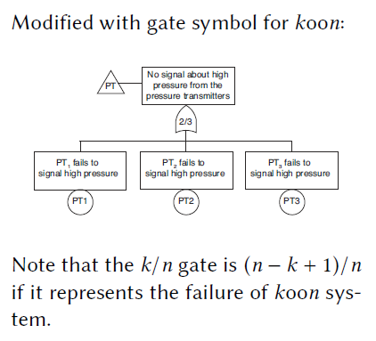
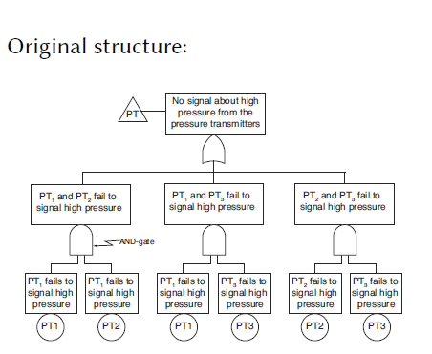
Fault Tree Symbols for koon Systems
The fault tree structure below indicates that the subsystem of pressure transmiers are voted 2oo3.

Slide 29
Qualitative Analysis
Qualitative analysis of the fault tree may include:
Analysis of minimal cut sets, including:
To identify and verify any single points of failure?
To identify that other main contributors (e.g. for minimal cutsets up to order 3) seem correct I
Common cause and dependency analysis:
This may include to check if logical events connected by local AND-gates are independent
Review minimal cut sets up to e.g order 3 to check if there are dependencies and if they must be modelled

Slide 30
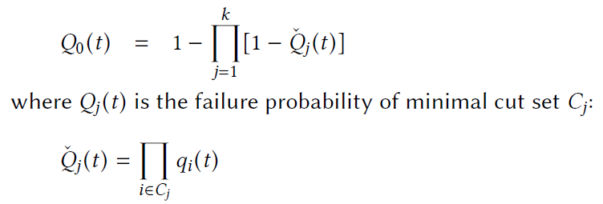
Quantitative Analysis
The TOP event occurs if one of the minimal cut sets occurs
The main challenge is therefore to identify the minimal cut sets
If all minimal cut sets were independent, we could calculate the the probability of the top event by:

Slide 31
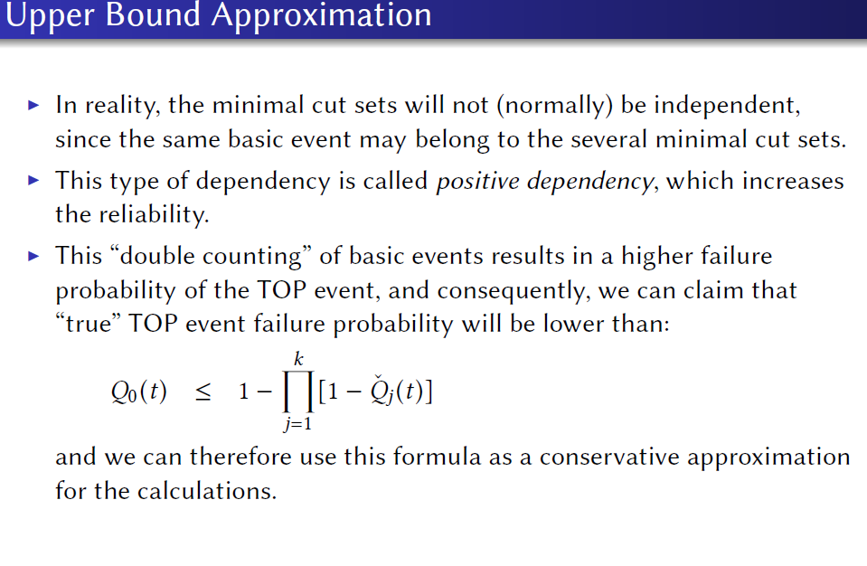

Slide 32
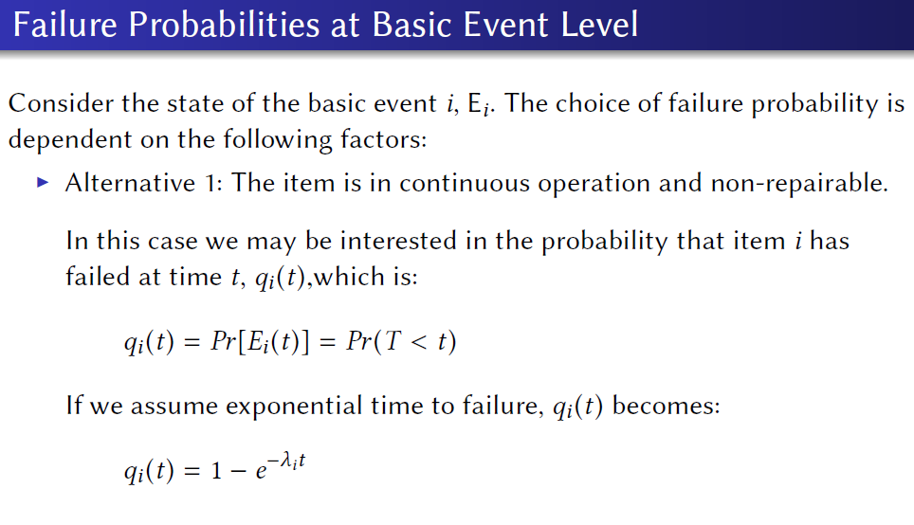

Slide 33
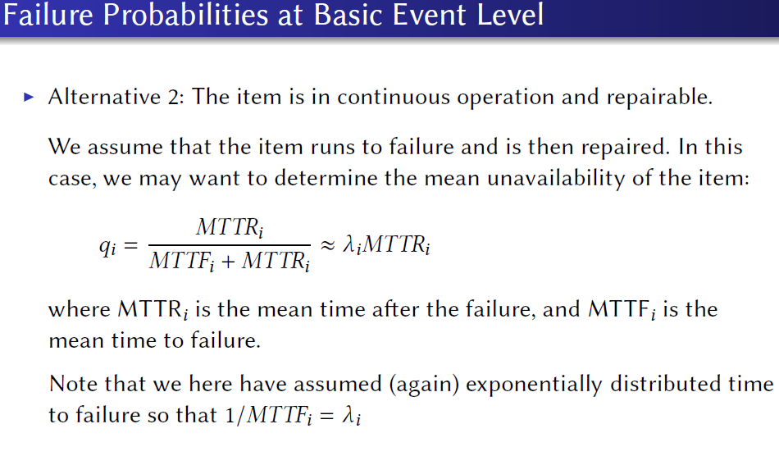

Slide 34
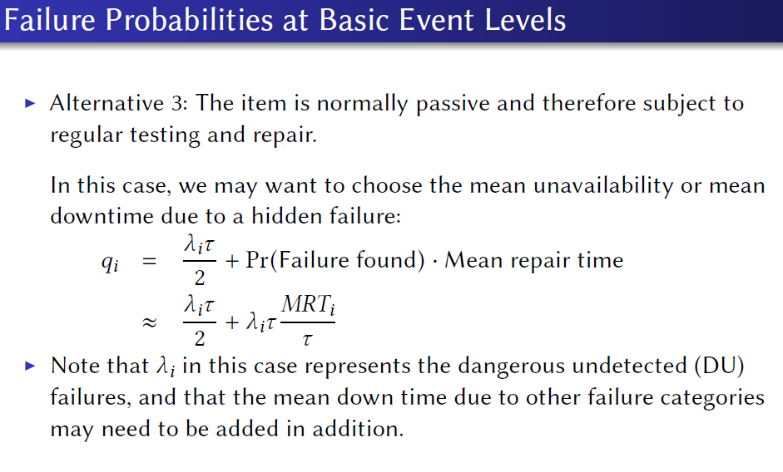

Slide 35
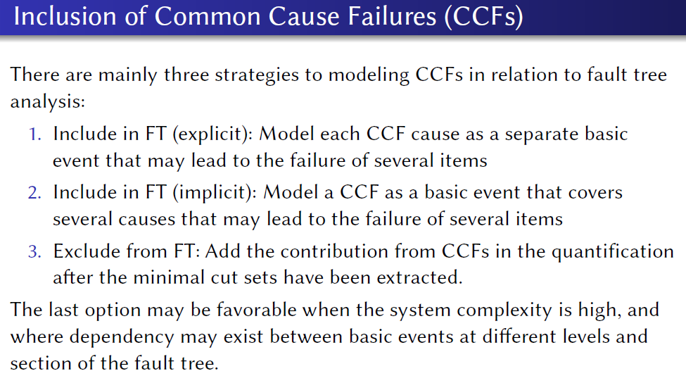

Slide 36
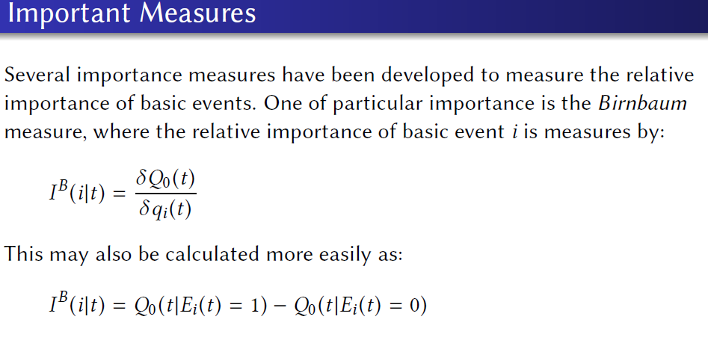

Slide 37
Hazard Function
Hazard is the potential to cause harm. Harm including ill health and injury, damage to property, plant, products or the environment, production losses or increased liabilities.

Slide 38
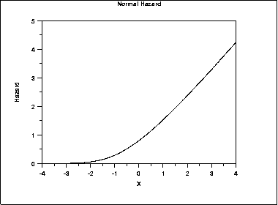
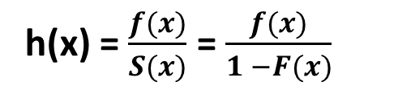
The hazard function is the ratio of the probability density function to the survival function, S(x).
Hazard plots are most commonly used in reliability applications.
The following is the plot of the normal distribution hazard function
h(x) = $\frac{f(x)}{S(x)}$ = $\frac{f(x)}{1 −F(x)}$

Slide 39
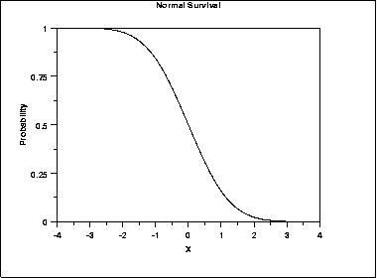
Survival functions are most often used in reliability and related fields.
The survival function is the probability that the variate takes a value greater than x. S(x) = p(X>x) = 1 – F(x)
The plot of the normal distribution survival function.
For a survival function, the y value on the graph starts at 1 and monotonically decreases to zero. The survival function should be compared to the cumulative distribution function

Slide 40
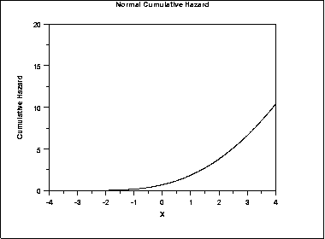
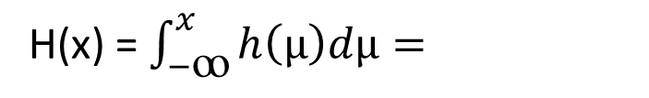
Cumulative Hazard Function
The cumulative hazard function is the integral of the hazard function.
Which can be alternatively expressed as H(x) = -ln(1-F(x))
H(x) = $\int_{−ꝏ}^{x}{h\left(μ\right)dμ= }$
The plot of the normal cumulative hazard function

Slide 41
FMEA and FMECA
Failure Modes and Effects Criticality Analysis
Work from the component level and identify all possible fault modes at the component level (a team effort and bottom-up approach)
Assess criticality of each component fault and its effects on overall system performance

Slide 42
Build a ‘table’ with all fault modes, assign probabilities, severity, determine interactions, possible actions, etc.
Three factors for failure analysis: The severity of a failure (Sev), The probability of occurrence of the failure (Occ), The likelihood of detecting the failure (Det)
RPN (risk priority number)=(Sev)(Occ)(Det): quantify overall risk for a specific failure
Use the table to asses overall reliability (see an example)

Slide 43
Performance Indexes
reliability,
operational availability,
failure rate, and
Expected time between failure (MTBF).

