Slide 1
Chapter Two
Reliability Function
Topics:
Unreliability Function
Reliability Function
Reliability Function Derivation Process
  Exponential Distribution
  Weibull Distribution
  Normal Distribution

Slide 2

Unreliability Function
The reliability function can be derived using the definition of the cumulative density function.
Note that the probability of an event happening by time t based on a continuous distribution given by f(x), (or f(t) since our random variable of interest in life data analysis is time) is given by:
One could also equate this event to the probability of a unit failing by time t, since the event of interest in life data analysis is the failure of an item.

Slide 3
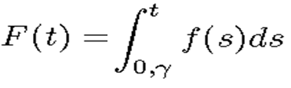
This defines the unreliability function, Q(t), which is the probability of failure, or the probability that the time-to-failure is in the region of 0 (or γ) and t.
So, from the previous equation, we have:

Slide 4
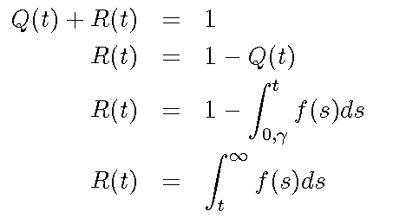
Reliability Function
In this situation, there are only two mutually exclusive situations that can occur: success or failure.
Since reliability and unreliability are the probabilities of two mutually exclusive states, the sum of these probabilities is always equal to unity. So then:
Where R(t) is the reliability function

Slide 5

Conversely, the pdf can be defined in terms of the reliability function as:

Slide 6
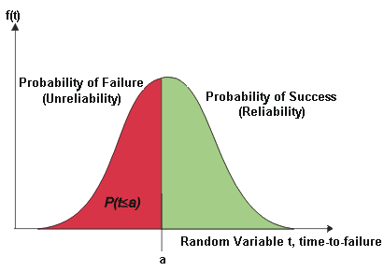
Relationship between the Reliability Function & CDF
The following figure illustrates the relationship between the reliability function and the cdf, or the unreliability function.

Slide 7
Reliability Function Derivation Process
We will illustrate the reliability function derivation process with the exponential distribution.
The exponential distribution, the most basic and widely used reliability prediction formula, models machines with the constant failure rate, or the flat section of the bathtub curve.
Most industrial machines spend most of their lives in the constant failure rate, so it is widely applicable.

Slide 8

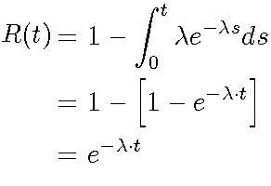
The pdf of the exponential distribution is given by:
λ = Failure rate (1/MTBF, or 1/MTTF)
t = operating time, life, or age, in hours, cycles, miles, actuations, etc.
e = base of the natural logarithms (2.718281828)
The exponential PDF represents a random occurrence over time
Hence, the reliability function for the exponential distribution is:

Slide 9
As λ is decreased, the distribution is stretched out to the right,
As λ is increased, the distribution is pushed toward the origin.
This distribution has no shape parameter as it has only one shape, (i.e., the exponential, and the only parameter it has is the failure rate, λ ).
The location parameter, ϒ, is zero.

Slide 10
The distribution starts at t = 0 at the level of f(t = 0) = λ and decreases thereafter exponentially and monotonically as t increases, and is convex.
As , t approaches infinity, f(t) approaches zero.
The pdf can be thought of as a special case of the Weibull pdf withϒ = 0 and β = 1 and .

Slide 11
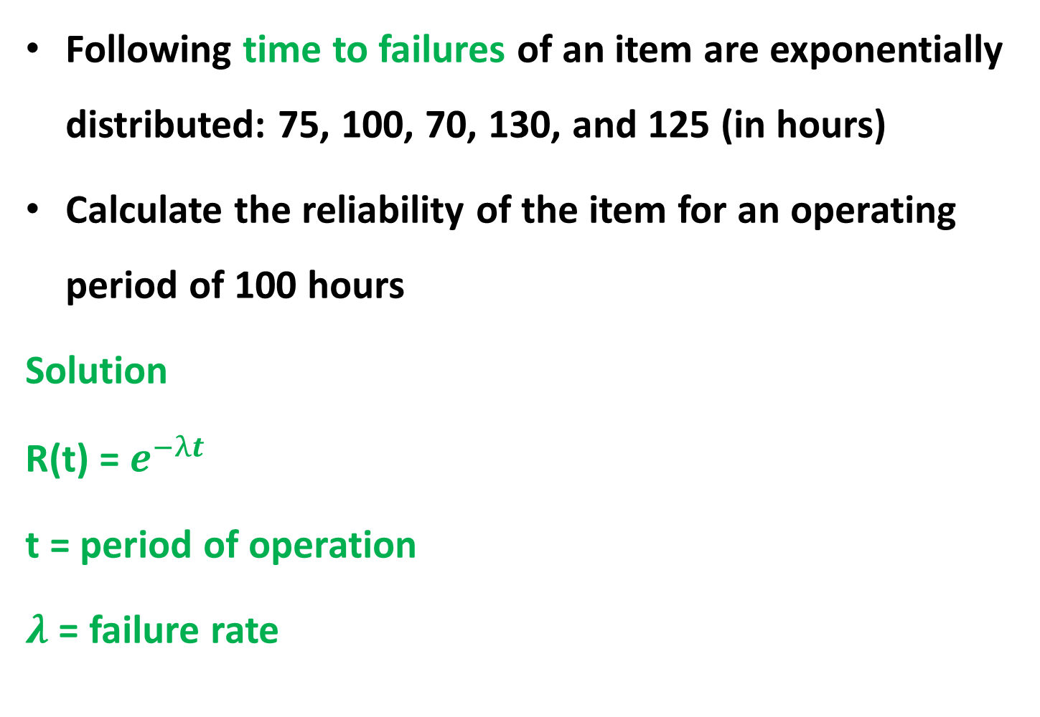
Example
Following time to failures of an item are exponentially distributed: 75, 100, 70, 130, and 125 (in hours)
Calculate the reliability of the item for an operating period of 100 hours
Solution
R(t) = $e^{−λt}$
t = period of operation
$λ$ = failure rate

Slide 12
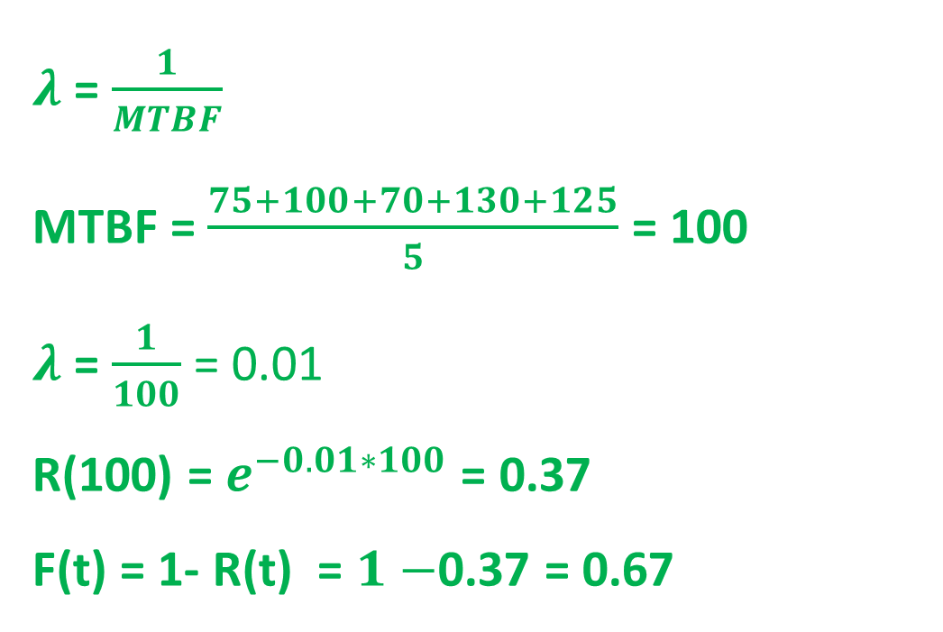
$λ$ = $\frac{1}{MTBF}$
MTBF = $\frac{75+100+70+130+125}{5}$ = 100
$λ$ = $\frac{1}{100}$ = 0.01
R(100) = $e^{−0.01∗100}$ = 0.37
F(t) = 1- R(t) = $1−$0.37 = 0.67

Slide 13

Operating optimum time when reliability target is 50%
R(t) = $e^{−λt}$
0.5 = $e^{−0.01t}$
ln0.5 = ${lne}^{−0.01t}$
ln0.5 $= −0.01t$
t =-$\frac{\ln{0.5}}{0.01}$ = $\frac{0.693}{0.01}$ = 69.3 hours

Slide 14
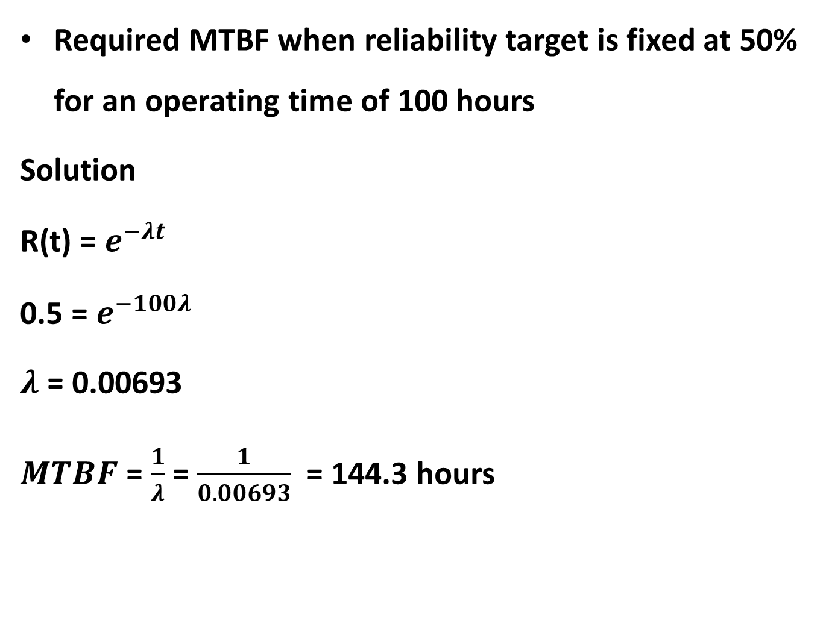
Required MTBF when reliability target is fixed at 50% for an operating time of 100 hours
Solution
R(t) = $e^{−λt}$
0.5 = $e^{−100λ}$
$λ$ = 0.00693
$MTBF$ = $\frac{1}{λ}$ = $\frac{1}{0.00693}$ = 144.3 hours

Slide 15
The 2-Parameter Exponential Distribution
The 2-parameter exponential pdf is given by:
Where ϒ is the location parameter.
The location parameter, ϒ , if positive, shifts the beginning of the distribution by a distance of to the right of the origin, signifying that the chance failures start to occur only after hours of operation, and cannot occur before
The scale parameter is
The exponential pdf has no shape parameter, as it has only one shape.
The distribution starts at t=ϒ at the level of f(t=ϒ ) = λ and decreases thereafter exponentially and monotonically as t increases beyond ϒ and is convex.
As , t approaches infinity, f(t) approaches zero.

Slide 16
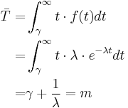
The Mean or MTTF
The mean, or mean time to failure (MTTF) is given by:
Note that when ϒ = 0, the MTTF is the inverse of the exponential distribution's constant failure rate.
This is only true for the exponential distribution.
Most other distributions do not have a constant failure rate.
Consequently, the inverse relationship between failure rate and MTTF does not hold for these other distributions

Slide 17
Different other distributions exist, such as the Weibull, normal, etc., and each one of them has a predefined f(t).
These distributions were formulated by statisticians, mathematicians and/or engineers to mathematically model or represent certain behavior.
For example, the Weibull distribution was formulated by Walloddi Weibull and thus it bears his name.
Some distributions tend to better represent life data and are most commonly referred to as lifetime distributions.

Slide 18
However, the exponential distribution and the Weibull distribution are the two most widely applied distributions to reliability engineering.

Slide 19
For the derivation of the reliability functions for other distributions, including the Weibull, normal and lognormal, see ReliaSoft's Life Data Analysis Online at http://reliawiki.org/index.php/Life_Data_Analysis_Reference_Book.

