Slide 1
Chapter 2
Production Economics

Slide 2
Production economics
Production economics is concerned with issues and problems in engineering economy and investment analysis that are specifically relevant to the production function. The subject includes methods of evaluating investment proposals for manufacturing, production costs and break-even analysis.

Slide 3
Methods of evaluation investment proposals
  Payback period method
  Present worth (PW) method
  Uniform annual cost (UAC) method
  Rate-of-return method
  Note : It is discussed in the Industrial Project Management

Slide 4
Costs in manufacturing
A fixed cost is one that is constant for any level of production output like cost of the factory building insurance, property taxes, and the cost of production equipment.
A variable cost is one that increases as the level of production increases like direct labor cost raw materials, and electrical power to operate the invention machines.
Overhead costs are all the other costs associated with running a manufacturing firm.

Slide 5
Cont’d
Factory overhead includes the costs of operating the factory other than direct labor and materials. Corporate overhead cost is the cost of running the company other than its manufacturing activities.

Slide 6
Cost
Variable Cost
Fixed Cost
Output Annual
Plot of Fixed and Variable Cost as a function of Production Output

Slide 7
Direct
Materials
Direct
Labor
Manufacturing
Overhead
The Product
Notes:
Manufacturing costs are usually grouped into three main categories: direct materials, direct labor, and manufacturing overhead. These costs are incurred to make a product.

Slide 8
Direct Materials
Raw materials that become an integral part of the product and that can be conveniently traced directly to it.
Example: A radio installed in an automobile
Notes:
Direct materials are raw materials that become an integral part of the finished product and whose costs can be conveniently traced to it. Examples include the aircraft engines on a Boeing 777, the Intel processing chip in a personal computer, the blank video cassette in a pre-recorded video, and a radio in an automobile.

Slide 9
Direct Labor
Those labor costs that can be easily traced to individual units of product.
Example: Wages paid to automobile assembly workers
Notes:
Direct labor consists of that portion of labor cost that can be easily traced to a product. Direct labor is sometimes referred to as “touch labor,” since it consists of the costs of workers who “touch” the product as it is being made.

Slide 10
Direct Costs
Raw Materials
Waste Treatment
Utilities
Operating Labor
Supervisory and Clerical Labor
Maintenance and Repairs
Operating Supplies
Laboratory Charges
Patents and Royalties

Slide 11
Manufacturing Overhead
Manufacturing costs that cannot be traced directly to specific units produced.
Examples: Indirect materials and indirect labor
Materials used to support the production process.
Examples: lubricants and cleaning supplies used in the automobile assembly plant.
Wages paid to employees who are not directly involved in production work.
Examples: maintenance workers, janitors and security guards.
Notes:
Manufacturing overhead includes all manufacturing costs except direct materials and direct labor. These costs cannot be easily traced to specific units produced (also called indirect manufacturing cost, factory overhead, and factory burden).
Manufacturing overhead includes indirect materials that are part of the finished product, but that cannot be easily traced to it. It includes indirect labor costs that cannot be conveniently traced to the creation of products.
Other examples of manufacturing overhead include: maintenance and repairs on production equipment, heat and light, property taxes, depreciation and insurance on manufacturing facilities, etc.

Slide 12
Nonmanufacturing Costs
Selling
Costs
Administrative Costs
Costs necessary to secure the order and deliver the product.
All executive, organizational, and clerical costs.
Notes:
A manufacturing company incurs many other costs in addition to manufacturing costs. For financial reporting purposes, most of these other costs are typically classified as selling costs and administrative costs. These costs are also called selling, general and administrative costs, or SG&A. Selling and administrative costs are incurred in both manufacturing and merchandising firms.
Selling costs include all costs necessary to secure customer orders and get the finished product into the hands of the customer. These costs are also referred to as order-getting and order-filling costs. Examples of selling costs include advertising, shipping, sales travel, sales commissions, sales salaries, and costs of finished goods warehouses.
Administrative costs include all executive, organizational, and clerical costs associated with the general management of an organization. Examples of administrative costs include executive compensation, general accounting, secretarial, public relations, and similar costs involved in the overall general administration of the organization as a whole.

Slide 13
The many types of cost: A summary
Term | Definition | Mathematical Description
Explicit costs Implicit costs Fixed costs Variable costs Total cost Average fixed cost Average variable cost Average total cost Marginal cost | Costs that require an outlay of money by the firm Costs that do not require an outlay of money by the firm Costs that do not vary with the quantity of output produced Costs that vary with the quantity of output produced The market value of all the inputs that a firm uses in production Fixed cost divided by the quantity of output Variable cost divided by the quantity of output Total cost divided by the quantity of output The increase in total cost that arises from an extra unit of production | FC VC TC = FC + VC AFC = FC / Q AVC = VC / Q ATC = TC / Q MC = ΔTC / ΔQ

Slide 14
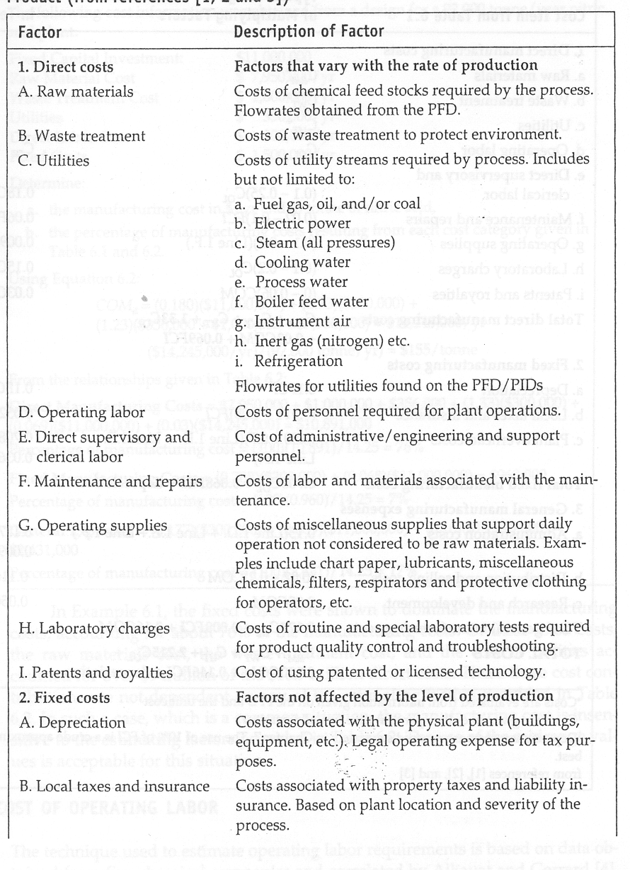

Slide 15
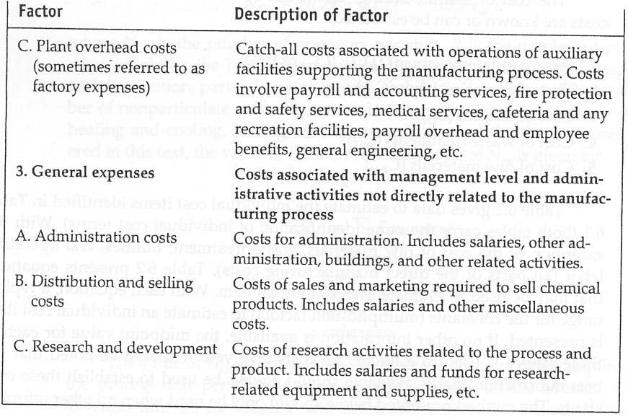

Slide 16
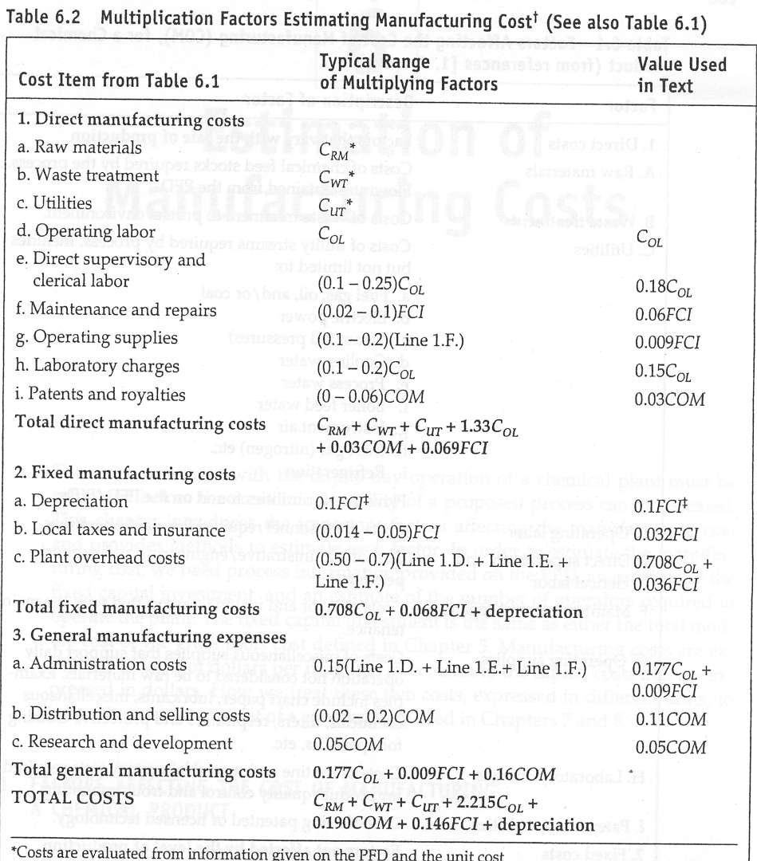

Slide 17
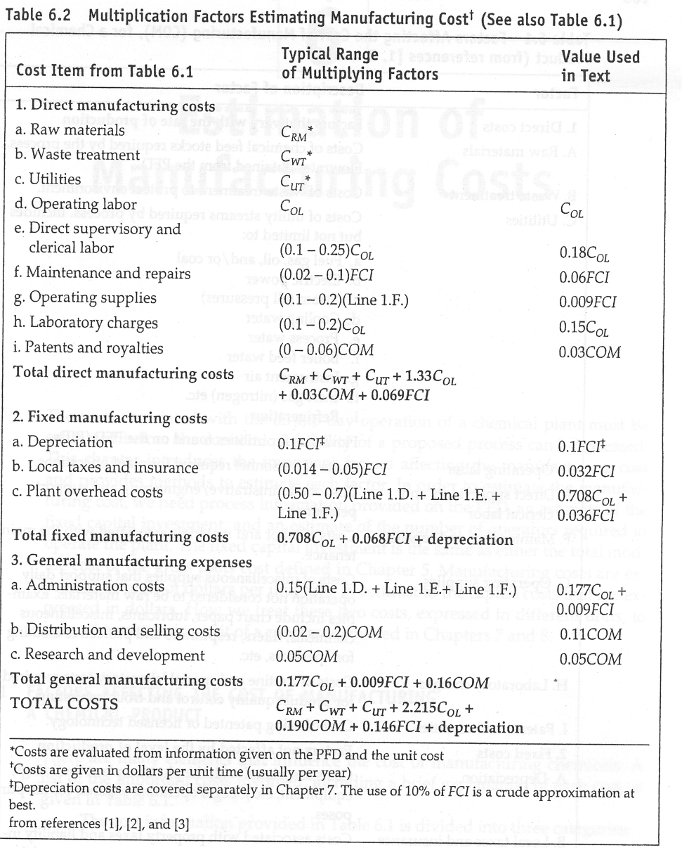

Slide 18
Break-even analysis is a method of assessing the effect of changes in production output on costs, revenues and profits. It is most commonly conceptualized in the form of a break-even chart. To construct the break-even chart, the manufacturing cost is plotted as a function of production output. Revenues can also be plotted on a break-even chart as a function of production output.

Slide 19
Breakeven analysis (cost-volume-profit analysis): approach to profit planning that requires derivation of various relationships among revenue, fixed costs, and variable costs in order to determine units of production or volume of sales dollars at which firm “breaks even” (where total revenues equal total of fixed and variable costs)

Slide 20
Cont’d
Profit Analysis. The break-even chart shows the effect of changes in output on costs and revenues. This gives a picture of how profits (or losses) will vary for different output levels.
2. Production method cost comparison. The break-even chart shows the effect of changes in output level on the costs of two (or more) different methods of production.

Slide 21
Breakeven Applications
Four major applications:
  New product decisions
  Pricing decisions
  Modernization or automation decisions.
  Expansion decisions.

Slide 22
Breakeven Applications
New product decisions
  Determine sales volume required for firm (or individual product) to break even, given expected sales and expected costs
Pricing decisions
  Study the effect of changing price and volume relationships on total profits

Slide 23
Modernization or automation decisions
  Analyze profit implications of a modernization or automation program
  In this case, firm substitutes fixed costs (i.e. capital equipment costs) for variable costs (i.e. direct labor)
Expansion decisions
  Study aggregate effect of general expansion in production and sales
  In this case, relationships between total dollar dales for all products and total dollar costs for all products are examined in order to indentify potential changes in these relationships

Slide 24
Example: A manually operated production machine costs $66,063. It will have a service life of 7 years with an anticipated salvage value of $5000 at the end or its life. The machine will be used to produce one type of part at a rate of 20 units/h the annual cost to maintain the machine is $2000. A machine overhead rate of 15% is applicable overhead rate is 30%. Determine the profit break-even point if the value added is $1.00/unit and the rate of-of-return criterion is 20%. Cost of labour is $10/hr. The machine operates 8 hrs a day 40 hrs a week and 250 days a year.

Slide 25
Cont’d
Let Q be the annual level. Variable cost is labor cost($10.00/hr), including applicable overhead, divided by production rate.

Slide 26
The variable cost as a function of Q is 0.65Q.
The annual fixed cost is figured on the machine investment plus the maintenance. First, ignoring overhead, we have
UAC = 66,063(A/P, 20%, 7) + 2000 – 5000 (A/F, 20%,7)
= $19,939
Adding the 15% overhead, the fixed cost = $22.930.
The sum of the fixed and variable costs provides the total cost equation as a function of Q:
Total cost = $22,930 + 0.65Q

Slide 27
Cont’d
Revenues as a function of Q are the product of value added per unit multiplied by Q. Revenues = $1.00Q. The break-even point occurs where the revenue line intersects the total cost line. To calculate the break-even point:
Profit = 1.00Q –22,930 – 0.65Q = 0
Q = 65,514 units/year

Slide 28
Cont’d
Suppose that an alterative to the manually operated production machine of the example is available. The alternative is an automated machine, costing $125,000, but capable of a production rate of 50 units/h. Its service life is 5 years with no salvage value at the end of that time. Annual maintenance will cost $5000. One-third of one operator costing $12.00/h will be required to run the machine. The overhead rates and rate of return used in the example are applicable. Determine the break-even point for the automated and manual methods of production.

Slide 29
Cont’d
Solution Variable cost for the automated machine is
Fixed cost is the capital cost plus maintenance, with machine overhead added.
Total cost is variable cost plus fixed cost:

Slide 30
Cont’d
The intersection point for the two methods represents the break-even point. Setting the two total cost equations equal yields
53,820 + 0.104Q = 22,930 + 0.65Q
Q = 56,575 units/yr
For the manual method, this corresponds to 2829 h of production per year, and for the automated method this quantity would require 1131.5 h of operation per year.

Slide 31
Cont’d
The profit break-even point given that the value added $1.00/unit.
This would require 1201.3 h of operation per year.

Slide 32
Cost per
Revenue
80,000
Profit line
60,000
60,000
Profit break
even Point
50,000
Total Cost
Function
40,000
30,000
Revenue line
20,000
Loss
10,000
20,000
40,000
60,000
80,000
Annual Output
Profit Break-even Chart

Slide 33
Unit Cost
4.00
3.00
Unit Cost Function
For Automated Method
2.00
1.00
Unit Cost Function
for Manual method
20,000
40,000
60,000
80,000
Annual Output
Cost

Slide 34
Cost
80,000
60,000
Cost Function for
Automated Method
60,000
Profit break
even Point
50,000
40,000
Cost Function for
Manual methods
30,000
20,000
10,000
20,000
40,000
60,000
80,000
Annual Output
Production Method Cost Break-even Chart

Slide 35
Unit Cost of Production
The unit cost equation Cpc (cost per piece) is obtained by dividing the total cost equation by the quantity Q.
Cpc for the manual machine is
Similarly, Cpc for the automated is

Slide 36
Cont’d
Will the extra hours be achieved by using two machines? the capital cost (fixed cost) is doubled; or by using two shifts on one machine? the worker on the second shift will probably be paid at a higher rate, or by working overtime by one production worker? The overtime rate is higher than the regular shift rate. In each instance, there are additional costs, which are not included in the total cost equation.

