Slide 1
Industrial Technology selection

Slide 2
Technology is the body of scientific knowledge used in the production of goods or services.
Industrial technology is the use of engineering and manufacturing technology to make production faster, simpler and more efficient.
The industrial technology help a company to achieve efficiency, productivity and profitablity

Slide 3
Selection criteria of technology
Appropriate to setting
Machine /Equipment should be:
suitable for the level of facility and service provided
acceptable to staff and patients
suitable for operator skills available
suitable for the local maintenance support capabilities
compatible with existing equipment and consumable supplies
compatible with existing utilities and energy supplies
suited to the local climate, geography and conditions
able to be run economically with local resources.

Slide 4
2. Affordable and cost-effective
Machine /Equipment should be:
available at a price that is cost-effective
affordable in terms of costs for freight, insurance, import tax,..
affordable in terms of installation, commissioning, and training of staff to use and maintain them
affordable to run (for example, cover the costs of consumables, accessories, spare parts and fuel over its life-time)
affordable to maintain and service
affordable in terms of the procurement process (for example the cost of a procurement agent or foreign exchange)
affordable in terms of staffing costs (for example, costs of any additional staff or specialization training required).

Slide 5
3.Ease of use and maintenance
You should choose Machine / equipment:
for which you have the necessary skills in terms of operating, cleaning, and maintenance
for which instructions and manuals are available to you in a suitable language
for which staff training is offered by the supplier
for which local after-sales support is available with real technical skills
which offers the possibility of additional technical assistance through service contracts
which comes with a warranty/guarantee, covering a reasonable length of time, for which you understand the terms.
which offers a supply route for equipment-related supplies (for example, consumables, accessories, spare parts)
which offers assured availability of these supplies for a reasonable period (up to 10 years).

Slide 6
4. Conforms to existing policies, plans and guidelines
You should choose Machine / equipment:
according to your purchasing and donations policy
according to your standardization policy
according to the technology level described in the Model
which is deemed to be suitable, having studied available literature and compared products
which is deemed to be suitable, having received feedback regarding previous purchases .

Slide 7
Preparing specification of equipment
Equipment purchased without a detail specification relies on the vendor to supply their standard equipment or to fabricate according to their own procedures.
A properly prepared equipment specification will define the performance requirements of the equipment, materials of construction, fabrication methods and procedures, test and inspection requirements, etc.

Slide 8
Component of specification
Scope
Standards, Codes and Specifications
Materials of Construction
Design Basis
Guarantees
Testing and Inspection
Documentation

Slide 9
1.Scope
The scope defines the requirements of the specification and gives a brief description of the project.
The scope may also include a general description of the application or service in which the equipment will be placed
2. Standards, Codes and Specifications
This section of the specification defines the codes and standards to be used for the design, fabrication,
erection, etc. of the equipment. The applicable codes and standards to be used will depend on the location
of the plant which will define the laws, rules and regulations to be used.

Slide 10
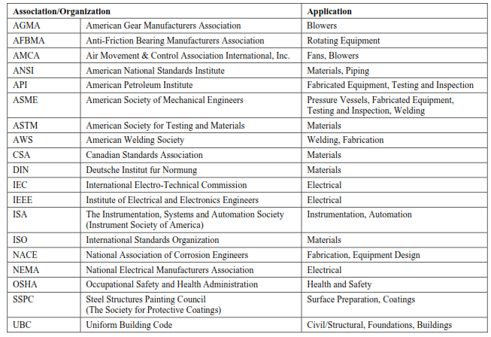

Slide 11
3. Materials of Construction
The materials that will be used for the fabrication of the equipment need to be specified clearly so that the equipment performs properly from a mechanical and corrosion point of view

Slide 12
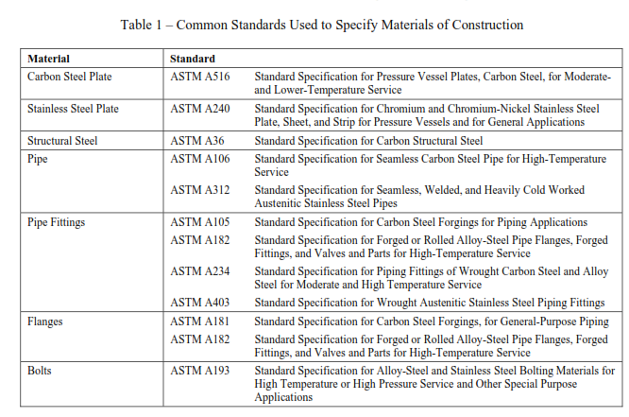

Slide 13
4. Design Basis
The design basis for a piece of equipment needs to be specified in detail so the vendor has sufficient information to design or size the equipment.
Process conditions (i.e. flows, temperature, concentrations, pressures, etc.)
Site conditions (i.e. ambient temperatures, barometric pressure, seismic zone, precipitation, etc.)
Noise limitations
Utilities (i.e. steam, compressed air, water, cooling water, fuel, etc.)
Dimensions

Slide 14
5. Guarantees
The specification and purchase of equipment generally includes for some form of guarantee of quality or performance.
Any mechanical equipment should be guaranteed against defective design, material, workmanship, etc. for the period of time specified in the purchase order agreement.

Slide 15
6. Testing and Inspection
Testing and inspection of the equipment is required to ensure that the equipment will meet its design intent.
FAT and SAT
  Radiography is generally used to examine the quality of the welds used to fabricate the equipment.
  A hydrostatic test is required for all pressure vessels in accordance with the applicable codes (i.e. ASME).
  The test requirements for rotating equipment like pumps, fans and blowers will be different than fabricated equipment
    Mechanical running test
    Overspeed test
    Noise level test
    Performance test

Slide 16
7. Documentation
Process and Instrument Drawing (P&ID)
General Arrangement Drawings
Electrical Drawings
High-pressure pump curves
Operation and maintenance manuals
Equipment drawings
Material certificates

Slide 17
Plant Erection and commissioning

Slide 18
Plant erection
Signing the contract with potential supplier
Opening of L/C
Perform Factory Acceptance Testing (FAT)
Perform Logistics related booking document
  Packing list
  Bill of lading
  Certificate of origin
  China Inspection Quarantine (CIQ)
  Commercial invoice

Slide 19
  Supplier Name and detail Address
  Buyer company name and detail address
  Commercial Invoice Number
  LC number ( ZBLC02108/2012)
  Exchange control permit number ( ZEB/ZBH/01-03218/2012)
  TIN Number (0026439437)

Slide 20
Prepare foundation of the machinery as per the foundation drawing and specification
  Foundation requirement
  Foundation ancourage procedures
Perform Site Acceptance Testing (SAT)
Install the machinery
  Follow the installation drawing and manuals
  P&ID diagram

Slide 21
Commissioning
Commissioning is a systematic process of ensuring that all the systems perform interactively according to the contract documents, the design intent and the owner’s operational needs.
This is achieved ideally by beginning in the pre-design phase with design intent development and documentation, and continuing through design, construction and the warranty period with actual verification through review, testing and documentation of performance.

Slide 22
Pre-Commissioning (or “Unit test”): the checking and testing of equipment prior to their cold commissioning with power and air.
Such works shall consist of testing the alignment and direction of rotating parts, the verification of the wiring and cabling, the verification of the PLC system, verification of correct mounting of piping, verification of correct mounting of valves and actuators, cold pressure testing of piping and vessels, etc.
Pre-commissioning checks, when completed, will release individual items of equipment to be powered up and made available for inclusion in the cold commissioning phase.

Slide 23
Cold-Commissioning: the no-load, dynamic testing (including the starting-up of motors and other electrical equipment, flushing and cleaning of tanks and piping
if applicable, adjustment and regulation of protective devices, functional tests, leakage and pressure tests, inspection of bearings, etc.) and operation of equipment for a period of time.
This will be mainly as individual items, but may involve running some of the equipment in sequence.

Slide 24
Hot Commissioning: this will include the introduction of fuel (waste), process gas and reagent (including the boiling out of pressure parts, curing of the refractory, blowing of steam pipe to turbine, etc).
The whole plant will be tested, operating in sequence under full load conditions.

