Slide 1
Part - #2
Geometric
Transformation (2D & 3D)
March, 2019

Slide 2
1. Geometric Transformations
What is transformation?
  It is the backbone of computer graphics, enabling us to manipulate the shape, size, and location of the object.
  Changing something to something else via rules.
Why are they important to graphics?
  It can be used to effect the following changes in a geometric object:
1. Change the location
2. Change the shape
3. Change the size
4. Rotate
5. Copy

Slide 3
2. Types of Transformations
i. Geometric/Object Transformation
  This transformation alters the coordinate values of the object. Basic operations are scaling, translation, rotation and combination of one or more of these basic transformations.
  Object transformation = Move (transform) an object in the 2D/3D space.
ii. Visual/ Coordinate System Transformation
  In this transformation there is no change in either the geometry or the coordinates of the object. A copy of the object is placed at the desired sight, without changing the coordinate values of the object.
  Coordinate system transformation = Move (transform) the coordinate system. View the objects from the new coordinate system.

Slide 4
3. Types of Geometric Transformations
Translation
Rotation
Scaling
Reflection/Mirroring.

Slide 5
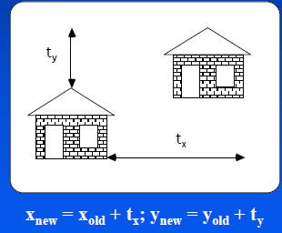
i. Translation - 2D
Moving an object is called a translation.
We translate a point by adding to the x and y coordinates, respectively, the amount the point should be shifted in the x and y directions.
We translate an object by translating each vertex in the object.
Notes:
Rotation and translation
Angles and distances are preserved.
Unit cube is always unit cube.
Translation is independent of any coordinate system
Translation is definrd as the addition of columns
Polygons are translated by translation its vertexes and redrawing it

Slide 6
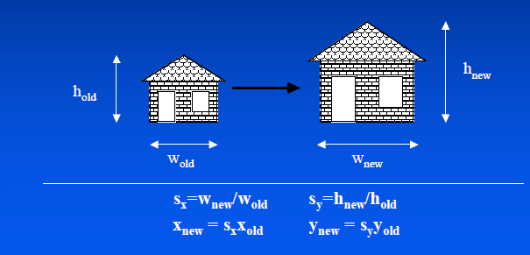
ii. Scaling
Changing the size of an object is called a scale. We scale an object by scaling the x and y coordinates of each vertex in the object.
Notes:
It does not preserve angles and size.
Uniform scaling preserve only angles

Slide 7
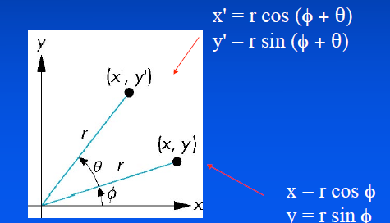

iii. Rotation about the origin
Consider rotation about the origin by Θ degrees
Radius stays the same, angle increases by Θ.
Notes:
Rotation changes the orientation of an object by an angle teta about fixed line perpendicular to xy plane
Rotation preserves length and angles
Translation and rotation are rigid body transformation b/c no combination of these transformation can alter the shape and volume of the object

Slide 8
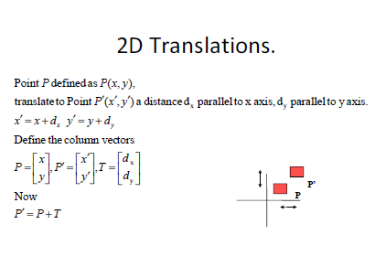
3. Transformations as Matrices

Slide 9
Cont’d…
Example:
Translate the rectangle (2, 2), (2, 8), (10, 8), (10, 2)
2 units along x-axis and 3 units along y-axis.

Slide 10
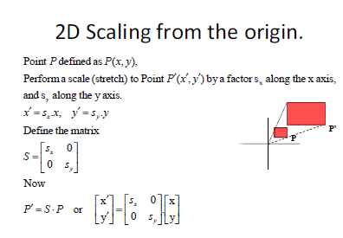
Cont’d…

Slide 11
Example:
If the triangle A(1, 1), B(2, 1), C(1, 3) is scaled by a factor 2, find the new coordinates of the triangle.

Slide 12
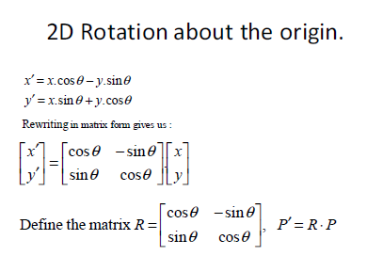
Cont’d…

Slide 13
Cont’d…
Example:
Rotate the rectangle (0, 0), (2, 0), (2, 2), (0, 2) by 30o ccw about its centroid and find the new coordinates of the rectangle.

Slide 14
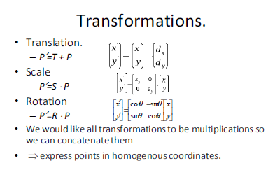
Summary

Slide 15
4. Homogeneous Coordinates
In order to represent a translation as a matrix multiplication operation we use 3 x 3 matrices and pad the points to become 3 x 1 matrices.
This coordinate system (using three values to represent a 2D point) is called homogeneous coordinates.
Let the added extra coordinate be W, to a point: P (x, y, W).
Two sets of homogeneous coordinates represent the same point if they are a multiple of each other.
If W ≠ 0 , divide by it to get Cartesian coordinates of point: (x/W, y/W, 1).
If W = 0, point is said to be at infinity.

Slide 16
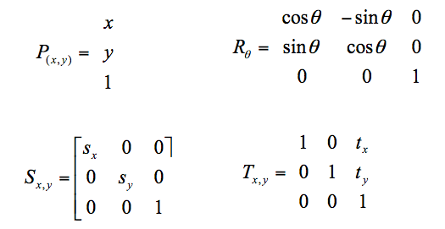
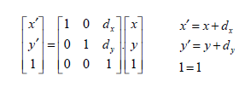
Cont’d…
Transformation matrices for 2D translation are now 3x3.

Slide 17
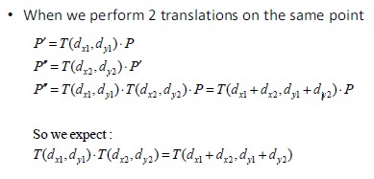
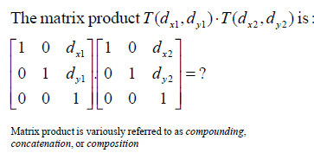
5. Concatenation of transformation

Slide 18
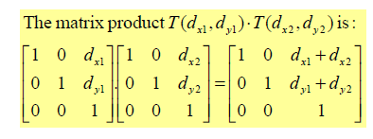
Cont’d…

Slide 19
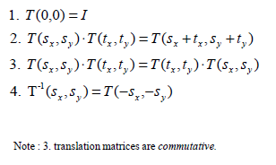
Properties of Translations

Slide 20
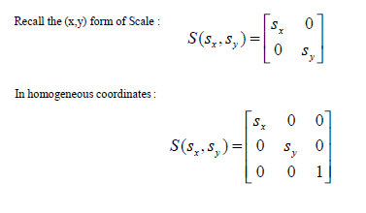
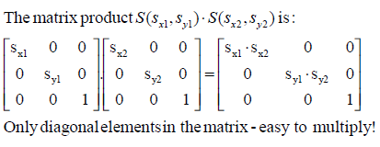
Homogeneous form of scale
Concatenation of scales

Slide 21
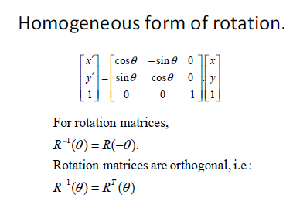

Slide 22
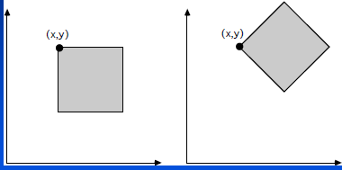
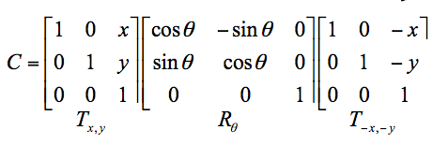
Ex. 1: Rotation of object about arbitrary point P (x, y) by θ
Translate point (x, y) to origin by (-x, -y)
Rotate by θ
Translate the point by (x, y)

Slide 23
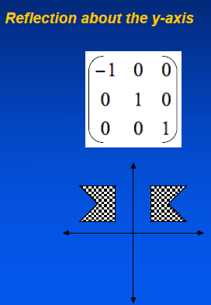
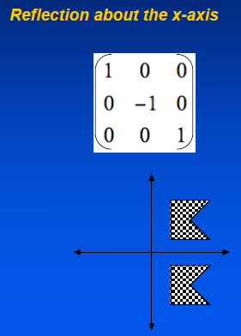
6. Reflections/Mirroring

Slide 24
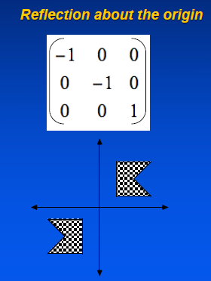
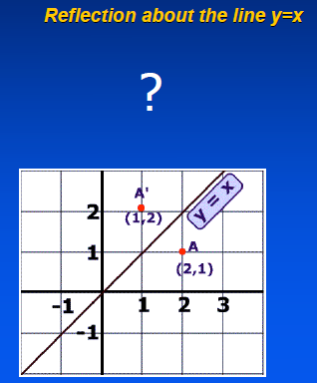
More Reflections
Notes:
0 1 0
1 0 0
0 0 1

Slide 25

3 D - Rigid body transformations
Methods for object modeling transformation in three dimensions are extended from two dimensional methods by including consideration for the z coordinate.
Preserve lines, angles and distances.
Generalize from 2D by including z coordinate
Straight forward for translation and scale
Rotation more difficult
Homogeneous coordinates: 4 components
Transformation matrices: 4×4 éléments.

Slide 26

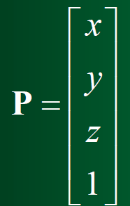
3D Point:
We will consider points as column vectors.
Thus, a typical point with coordinates (x, y, z) is represented as:
3D Point Homogenous Coordinate:
A 3D point P is represented in homogeneous coordinates by a 4-dim, Vector.
We don't lose anything.
The main advantage: it is easier to compose translation and rotation.
Everything is matrix multiplication.

Slide 27
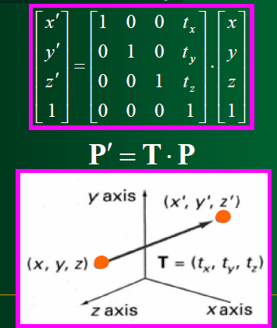
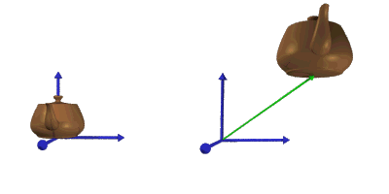
i. 3D Translation
In homogeneous coordinates, 3D transformations are represented by 4×4 matrixes:.
P is translated to P' by:
An object is translated in 3D
dimensional by transforming
each of the defining points of
the objects .

Slide 28
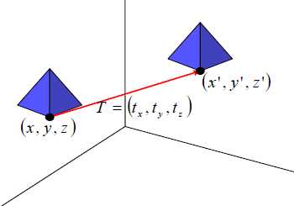
Cont’d…
An object represented as a set of polygon surfaces, is translated by translate each vertex of each surface and redraw the polygon facets in the new position.

Slide 29
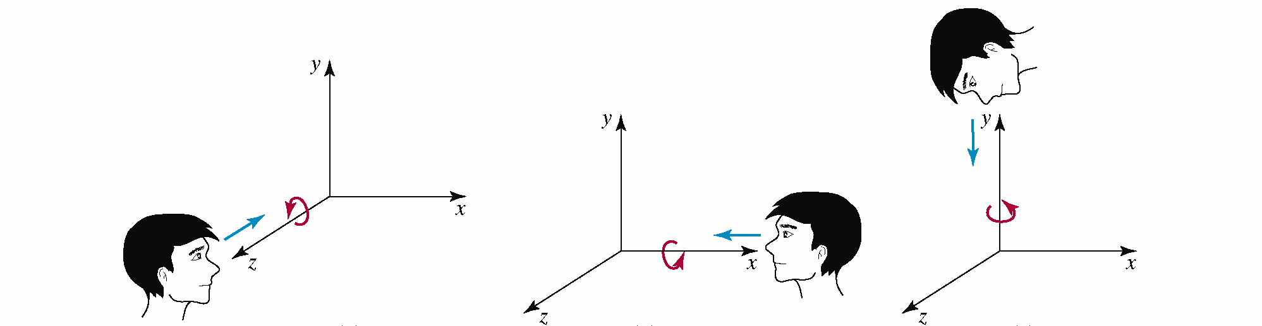
ii. 3D Rotation
In general, rotations are specified by a rotation axis and an angle.
In two-dimensions there is only one choice of a rotation axis that leaves points in the plane.
The easiest rotation axes are those that parallel to the coordinate axis.
Positive rotation angles produce counterclockwise rotations about a coordinate axis, if we are looking along the positive half of the axis toward the coordinate origin.

Slide 30
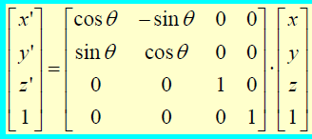
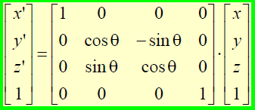
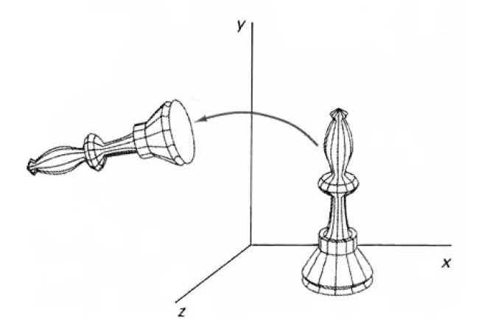
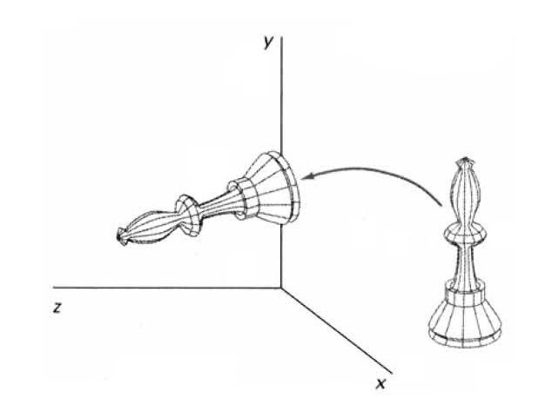
Rotation about Z-axis:
:For z axis same as 2D rotation:
Rotation about X-axis:
P′ = Rz(θ) ⋅P
P′ = Rx(θ) ⋅P

Slide 31
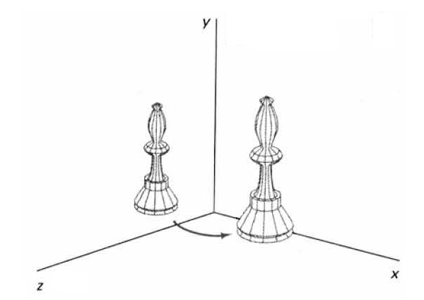
Cont’d…
Y-axis rotation:
X’ cos(θ) 0 -sin(θ) 0
Y’ = 0 1 0 0
Z’ sin(θ) 0 cos(θ) 0
1 0 0 0 1

Slide 32
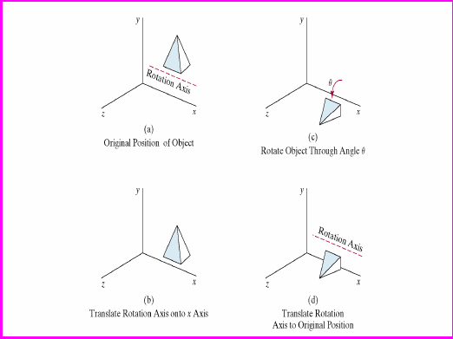

General 3D Rotations about axis // to Coordinate Axis
Rotation axis parallel with coordinate axis (Example x axis):

Slide 33
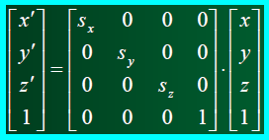
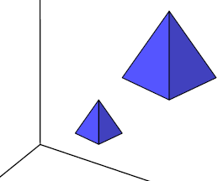
iii. 3D Scaling
About origin: changes the size of the object and repositions the object relative to the coordinate original.
P′ = S ⋅ P

Slide 34
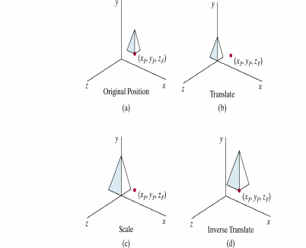
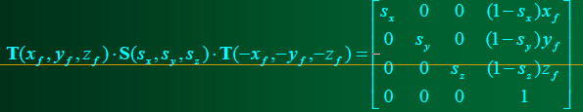
Scale about any arbitrary point:

Slide 35
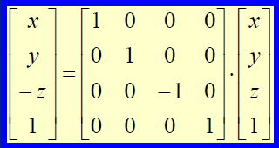
iV. 3D Reflections
About an axis: equivalent to 180°rotation about that axis.
About a plane: A reflection through the xy plane.
A reflections through the xz and the yz planes are defined similarly.

Slide 36
Exercise
You sat in the car, and find the side mirror 40mm on your right and 30mm in your front. You started your car and drove 200mm forward, turned 30 degrees to right, moved 200mm forward again, and turned 45 degrees to the right, and stopped.
What is the position of the side mirror now, relative to where you were sitting in the beginning?

Slide 37
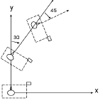

Solution
The side mirror position is locally (40, 30).
The matrix of first driving forward 200mm is:

Slide 38
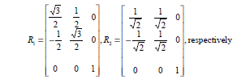
Cont’d…
The matrix to turn to the right 30 deg and 45 degrees (rotating -30 and -45 degrees about the origin) are:
The 3rd transformation is moving by 200mm along an axis oriented 60 degree with the x-axis.

Slide 39
QSns????

