Slide 1
Overview of
Catia
April, 2020

Slide 2
CATIA Overview
CATIA v5 is an integrated Computer Aided Engineering tool:
Incorporates CAD, CAM, CAE, and other applications.
Completely re-written since CATIA v4 and still under development.
CATIA v5 is a native Windows application.
User friendly icon based graphical user interface.
Encourages design flexibility and design reuse.
Supports knowledge based design.

Slide 3
Catia v5:
A Flexible Modelling environment:
  Ability to easily modify models, and implement design changes
  Support for data sharing, and data reuse.
Knowledge enabled
  Capture of design constraints, and design intent as well as final model geometry.
  Management of non-geometric as well as geometric design information.
The 3D Part is the Master Model
  Drawings, assemblies and analyses are associative to the 3D parts

Slide 4
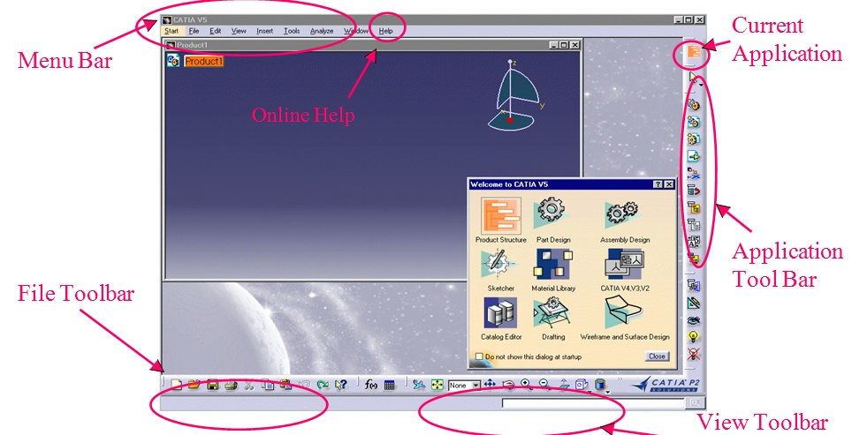
CATIA User Interface

Slide 5
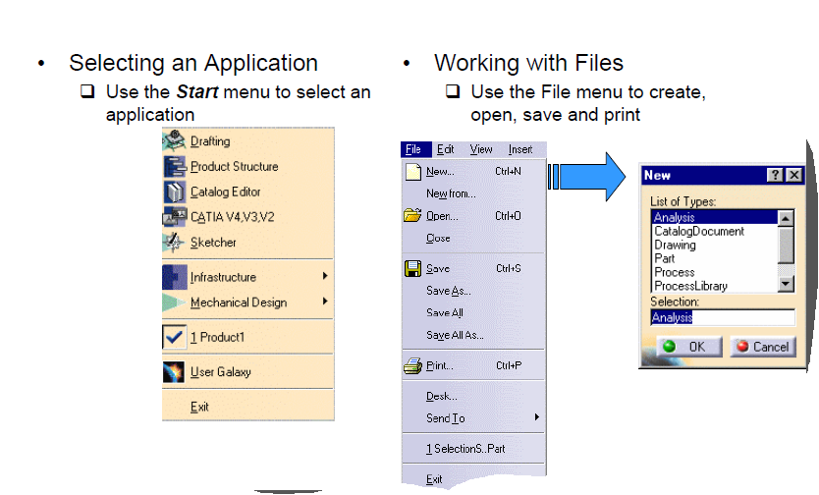
Interacting with CATIA

Slide 6
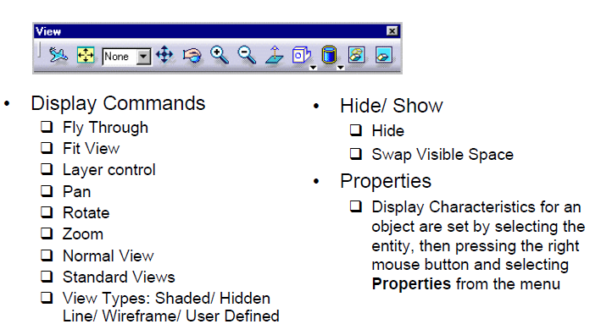
Cont’d..

Slide 7
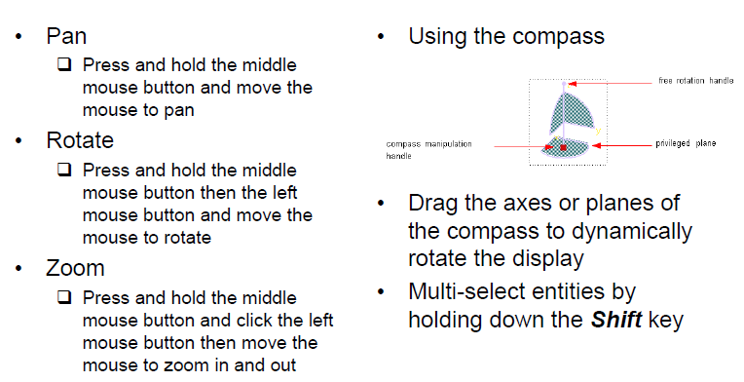
Manipulating the Display using the Mouse

Slide 8
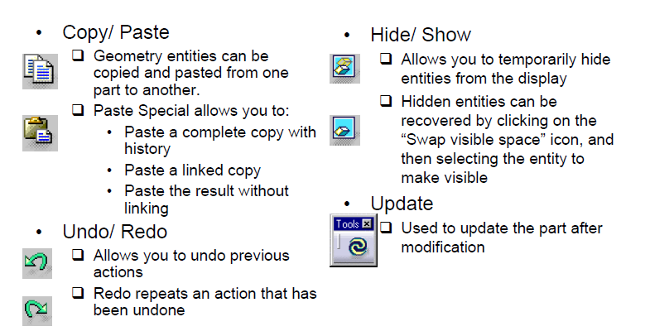
More Common
Commands

Slide 9
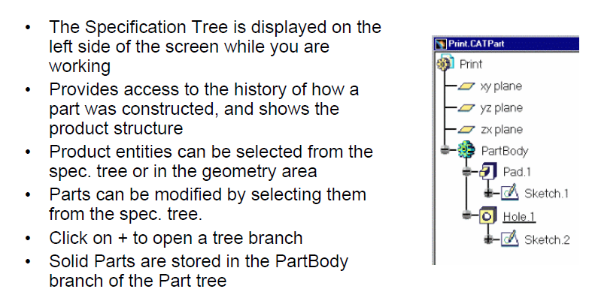
The Specification Tree

Slide 10
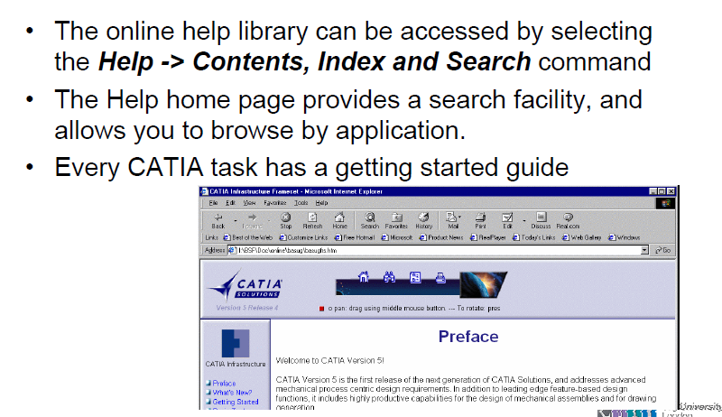
Getting Help

Slide 11
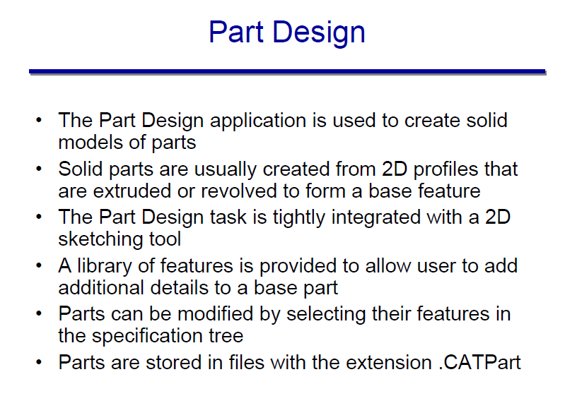

Slide 12
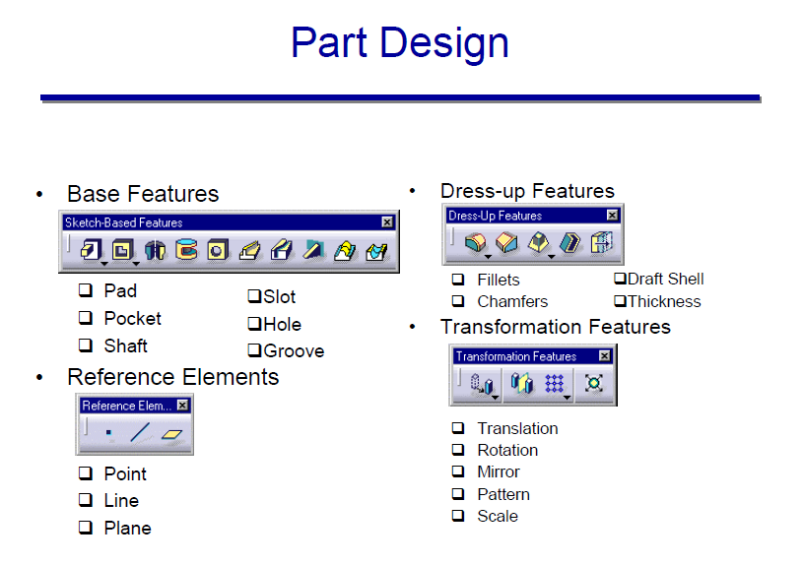

Slide 13
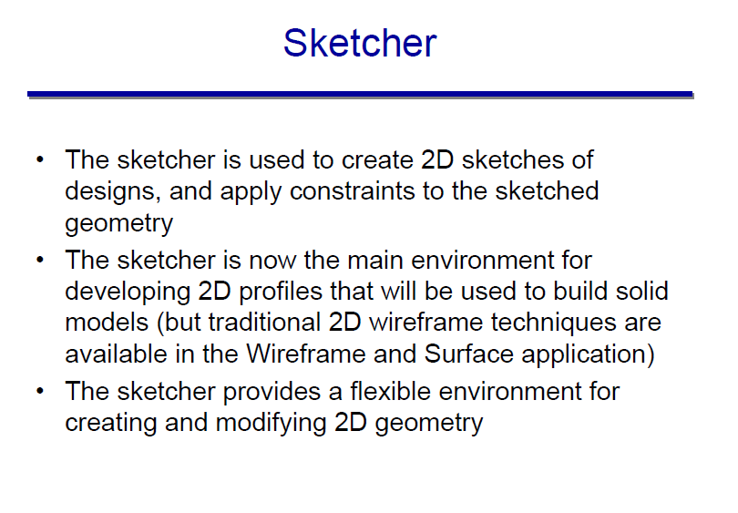

Slide 14
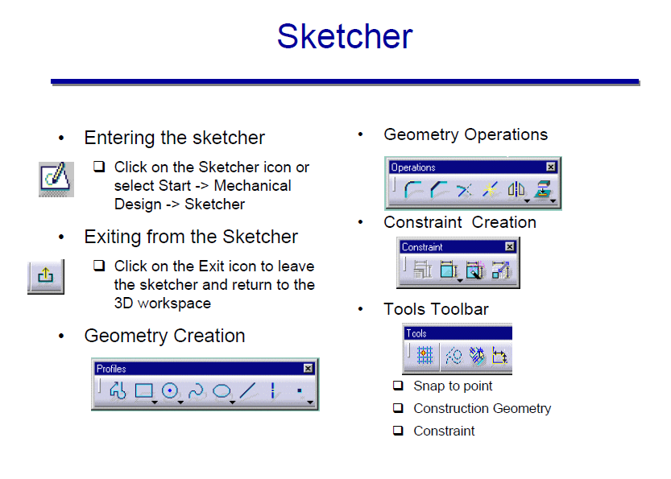

Slide 15
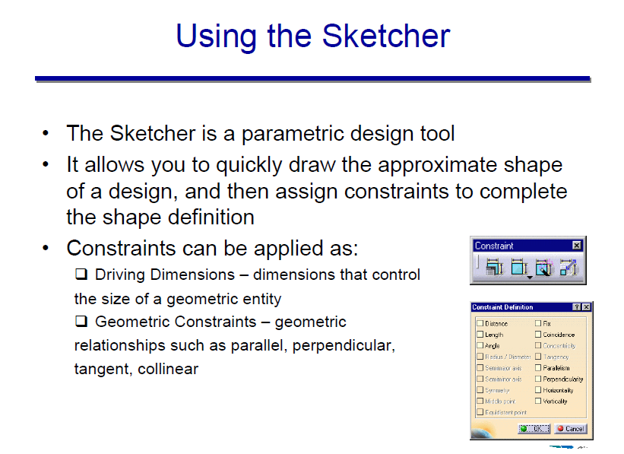

Slide 16
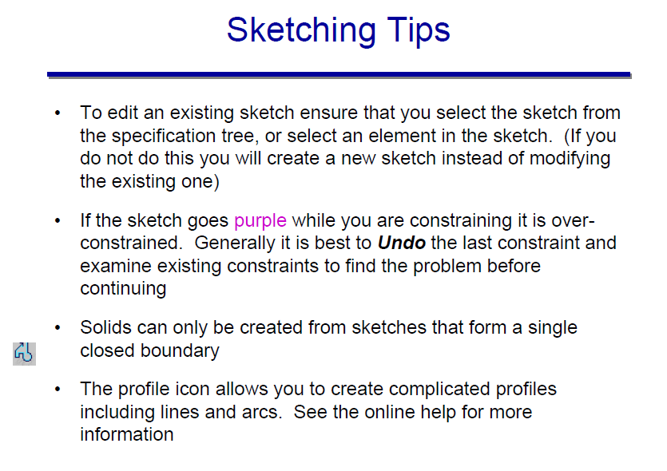

Slide 17
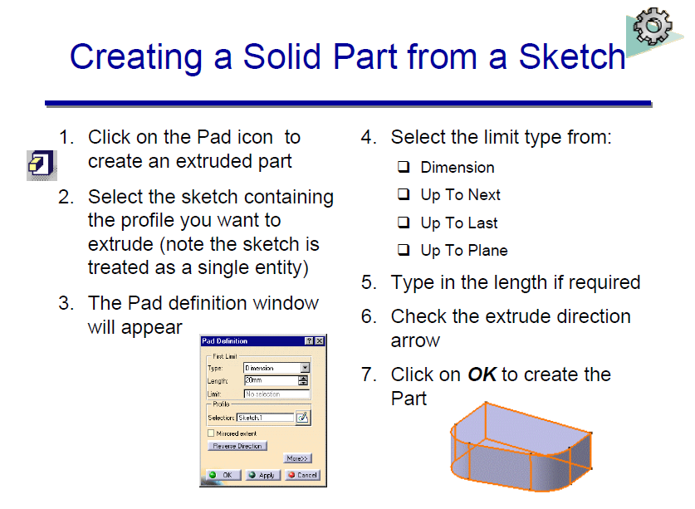

Slide 18
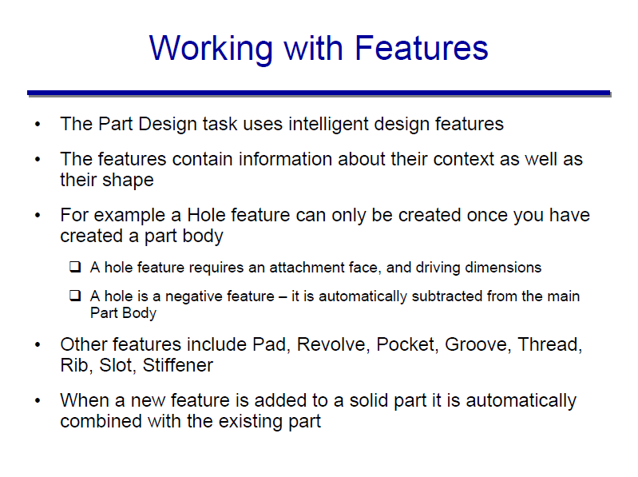

Slide 19
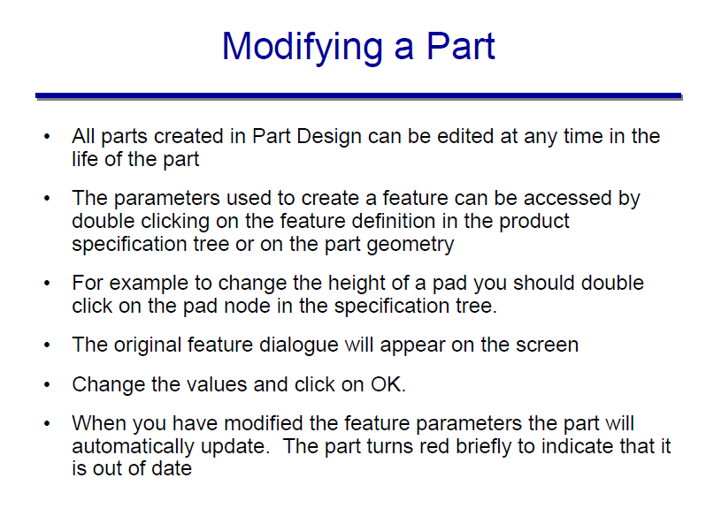

Slide 20
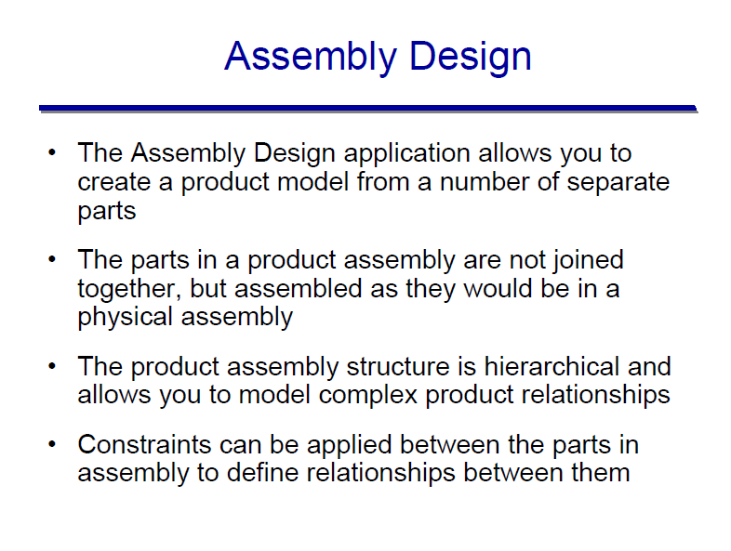

Slide 21
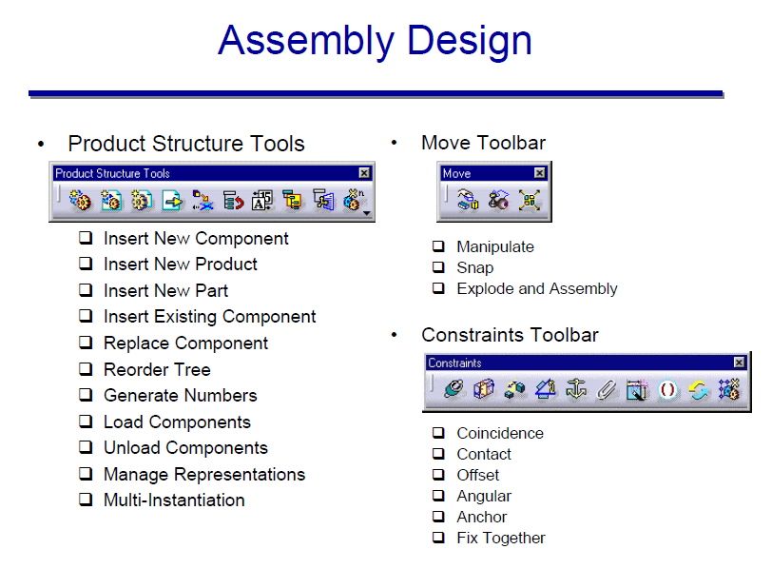

Slide 22
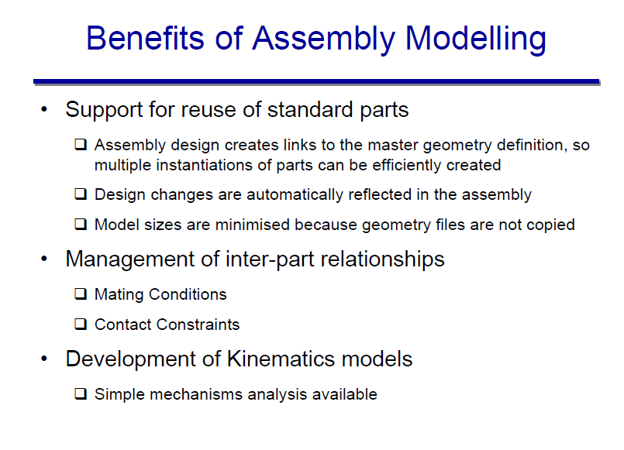

Slide 23
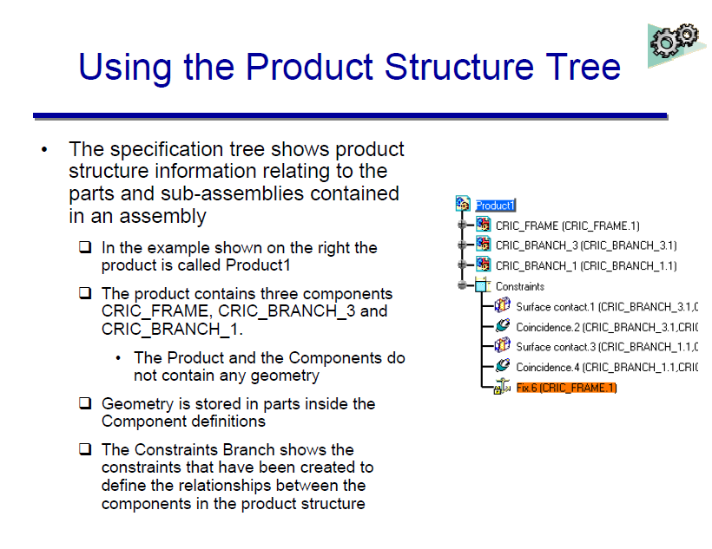

Slide 24
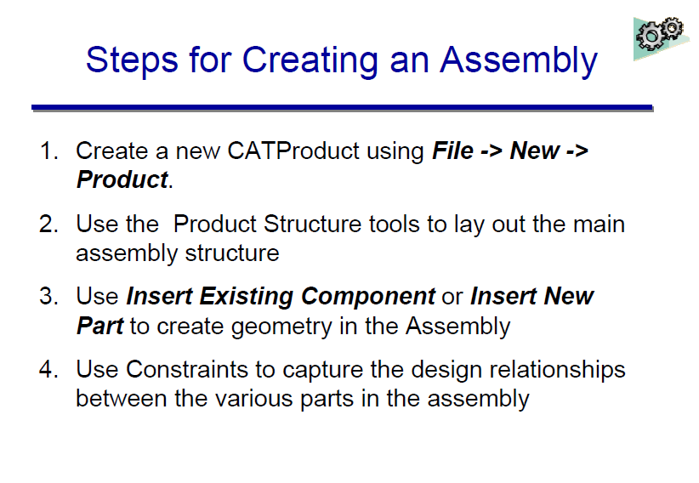

Slide 25
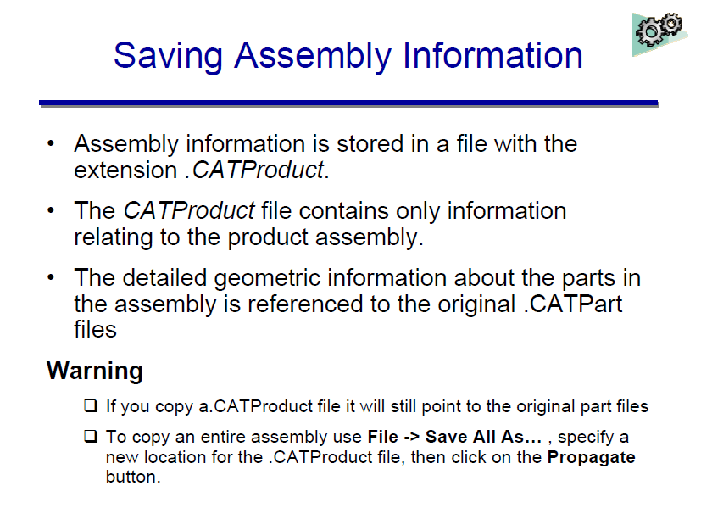

Slide 26
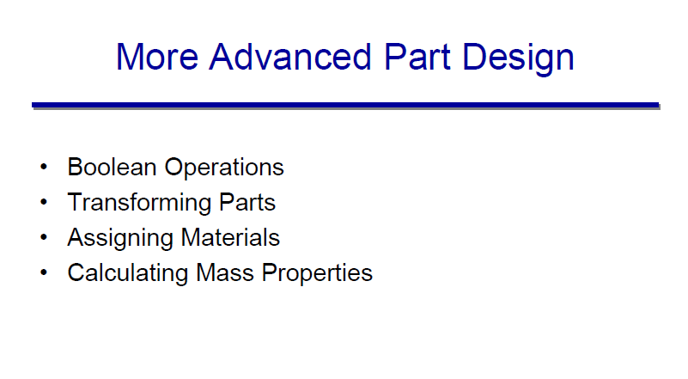

Slide 27
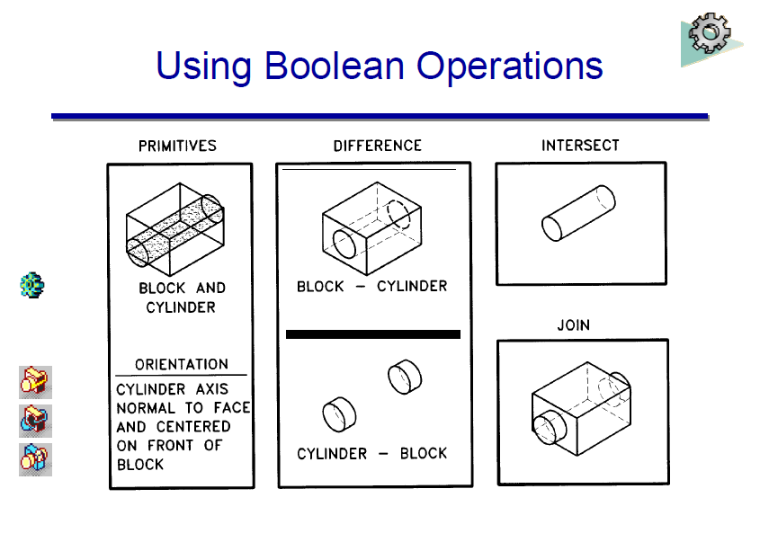

Slide 28
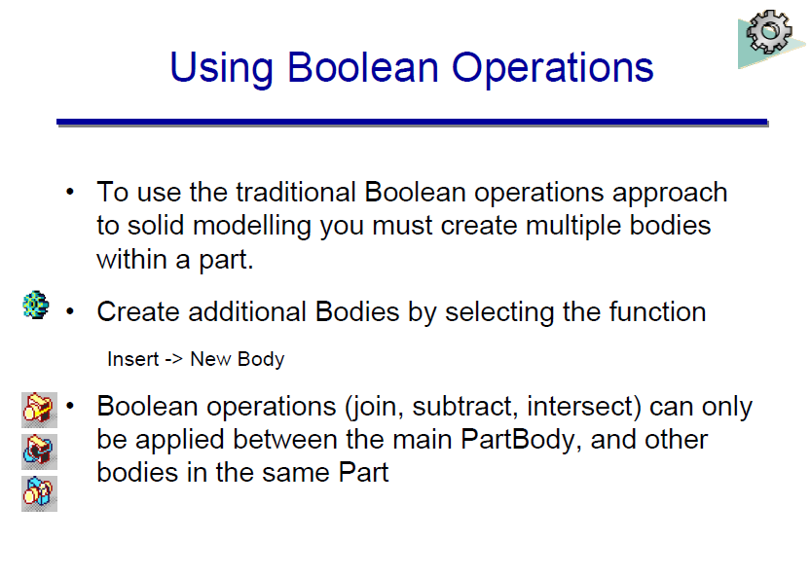

Slide 29
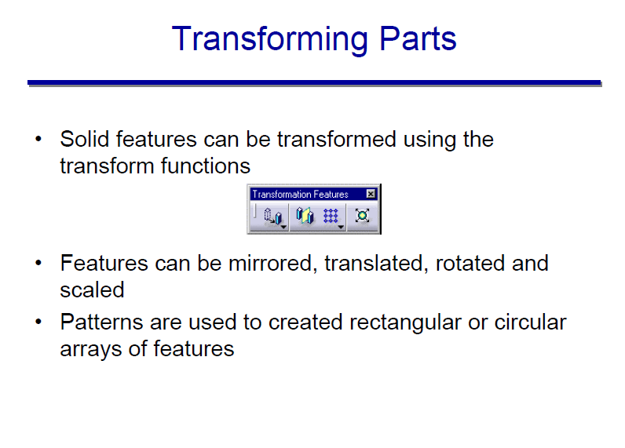

Slide 30
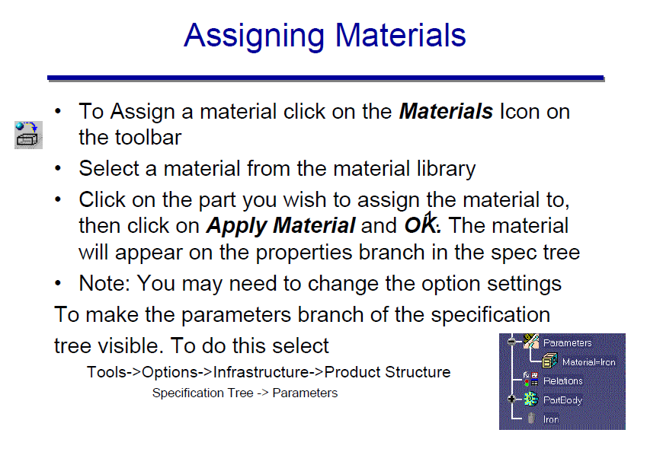

Slide 31
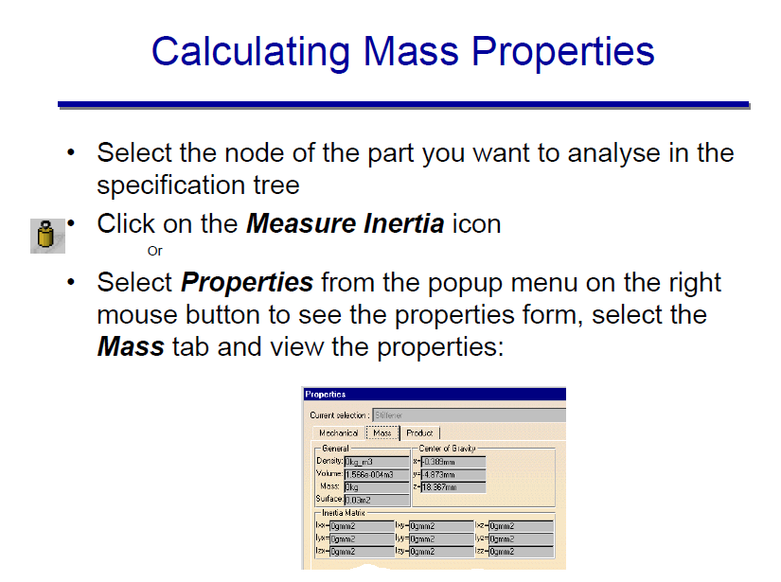

Slide 32
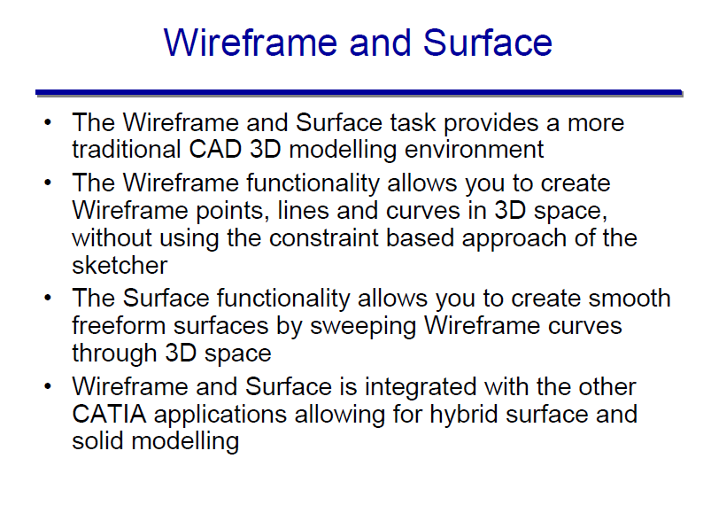

Slide 33
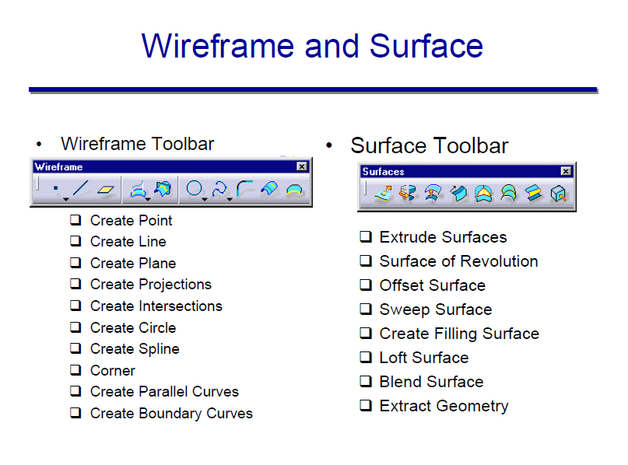

Slide 34
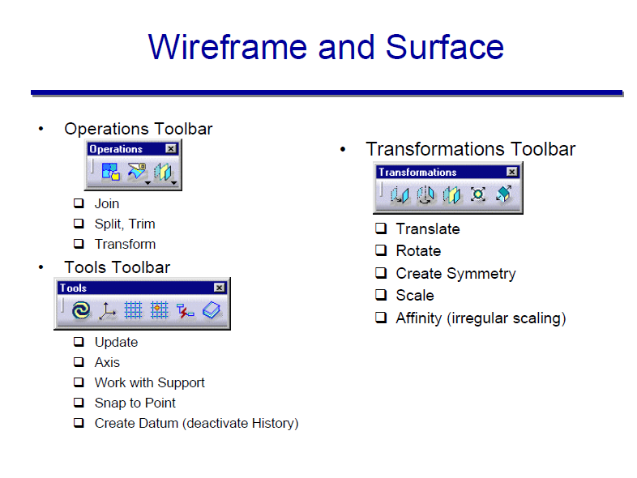

Slide 35
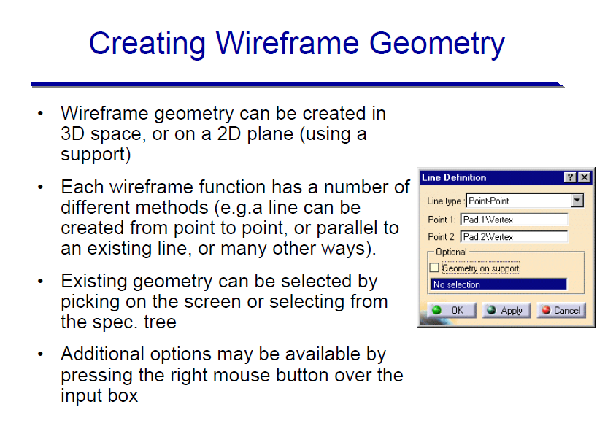

Slide 36
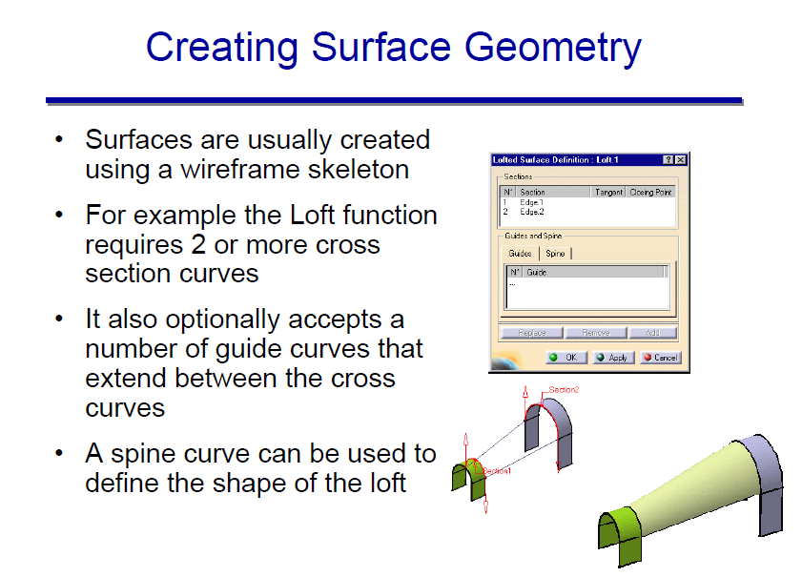

Slide 37
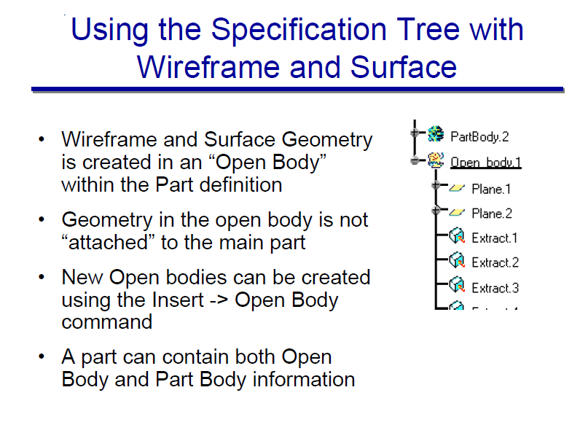

Slide 38
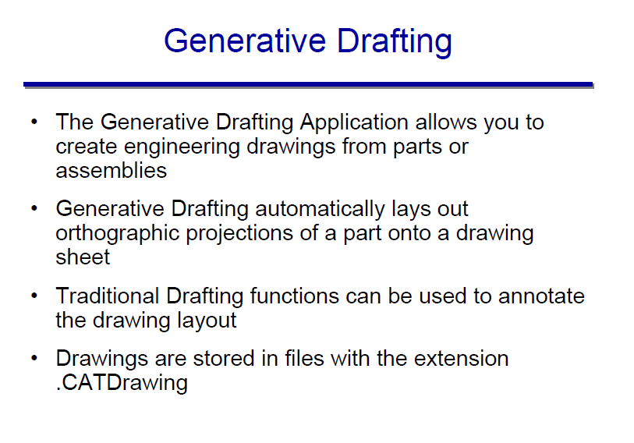

Slide 39
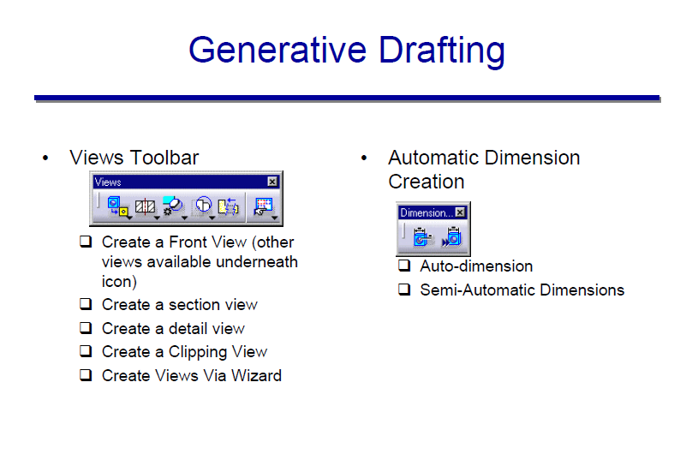

Slide 40
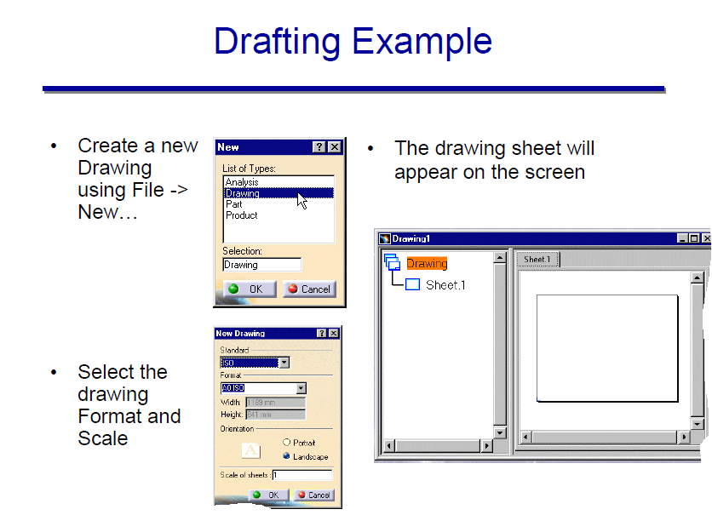

Slide 41
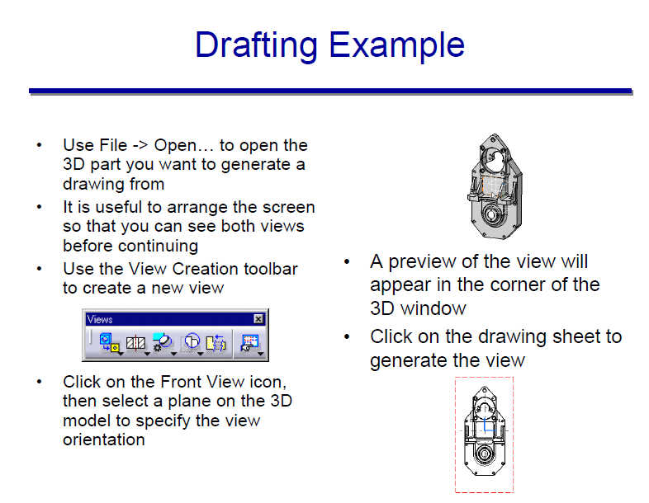

Slide 42
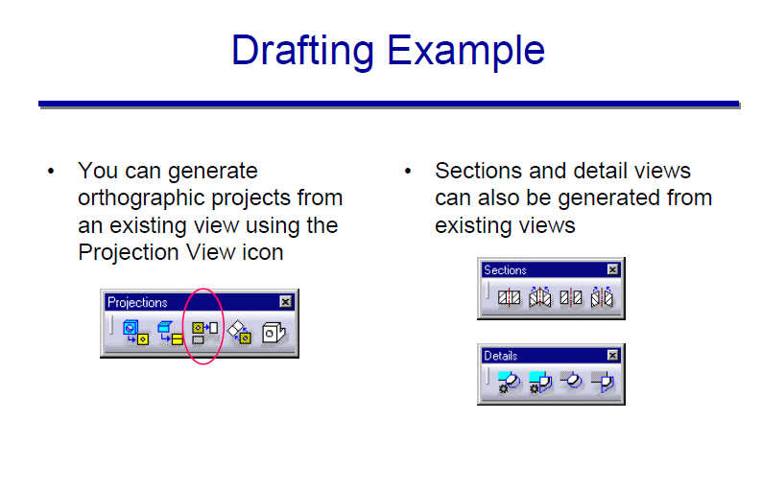

Slide 43
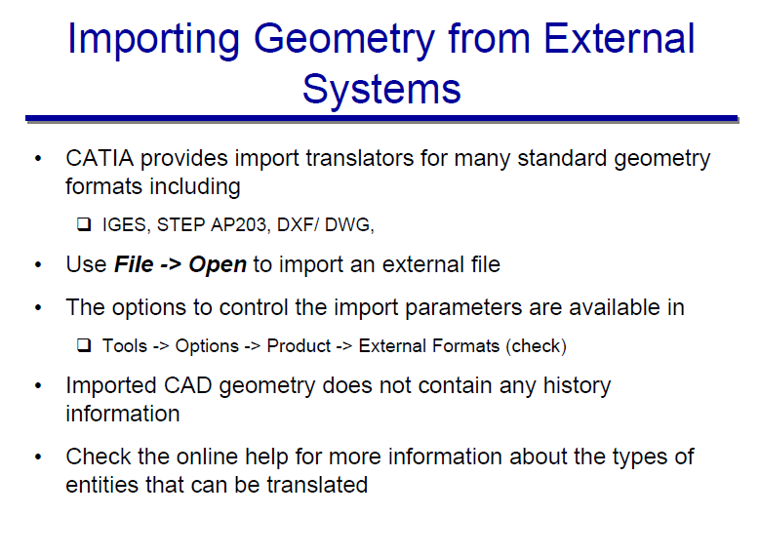

Slide 44
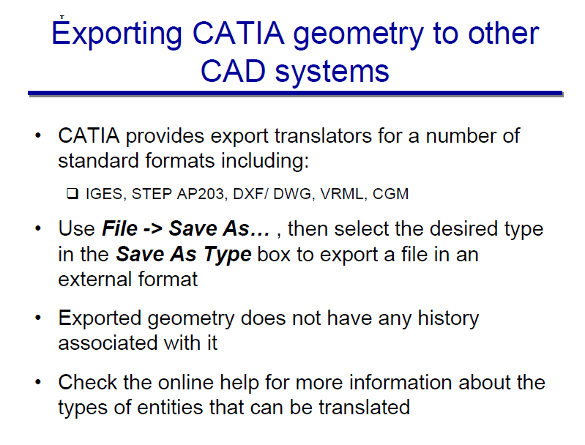

Slide 45
Editing & Engineering Features in Part Modeling
Round: Modify the sharp edge to curved edge
Chamfer: Modify the sharp edge to flat edge
Shell: Removes a surface or surfaces from the solid then hollows out the inside of the solid, leaving a shell of a specified wall thickness.
Rib: Special type of protrusion to create a thin fin or web
Cut: Remove the undesirable portion from the basic part

Slide 46
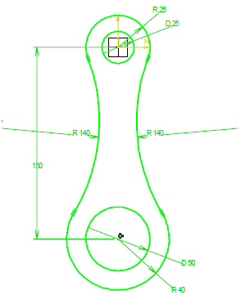
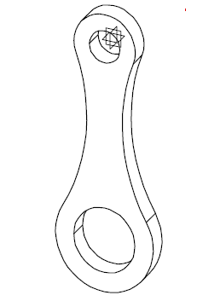
Tutorial 1: Conrod
Notes:
Corner operation

Slide 47
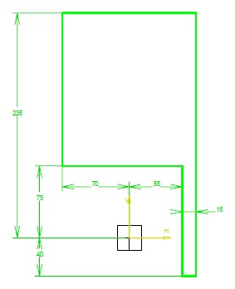
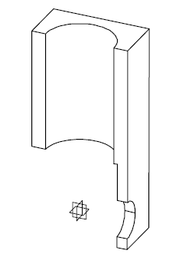
Tut. 2: Block
Depth of the block: 70mm
Cylinder profile on top: 100mm dia.
Shaft profile on the left side: 50mm dia

Slide 48
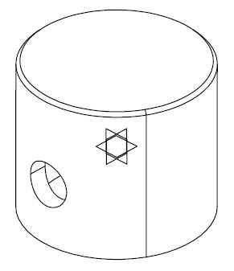
Tut. 3. Piston
A piston with 50mm diameter and with gudgeon pin hole and 2mm champer

Slide 49
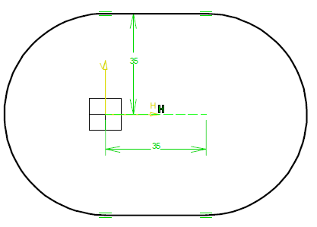
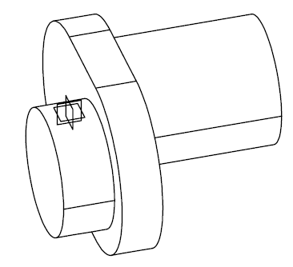
Tut. 4: Crank Shaft
R25mm on both sides with 20mm and 60 mm cylinder and the thickness of the part is 16mm.
Notes:
35 mm oblong profile

Slide 50
Qns???

