Slide 1
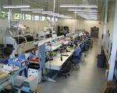
Ch. #1
Introduction to Flexible Manufacturing Systems (FMS)
Feb 2020

Slide 2
Outline:
History of FMS
The Principle objectives of FMS
Fixed vs Flexible Manufacturing System
Basic Components of FMS
Flexibility in Manufacturing
Types of FMS
Types of FMS layouts
Adv. and Disadv. of FMS
Application areas of FMS

Slide 3
1.1. History of Flexible Manufacturing System
In the beginning, there was not much competition and so FM systems were not needed.
After WWII, market focused on consumer (not manufacturer).
The first FM system was patent in 1965 by Theo Williamson who made numerically controlled machines.

Slide 4
Cont’d…
Change in Manufacturing over time:
60’s - Efficiency in manufacturing
70’s - Efficiency and Quality
80’s - Efficiency, Quality and Flexibility.
Thus, companies are forced to adapt itself to:
Increased international competition
The need to reduce manufacturing cycle time
Pressure to cut production costs
React in the case of changes.

Slide 5
Cont’d…
A new strategy was formulated (Customizability). The companies have to adapt to the environment in which they operate, to be more flexible in their operations and to satisfy different market segments.
Thus the innovation of FMS became related to the effort of gaining competitive advantage.

Slide 6
Cont’d…
FMS is considered as a natural evolution of the technology of CAD/CAM which by itself evolved by the integration of CAD and CAM.
MIT - USA is credited with pioneering the development in both CAD and CAM.
The need to meet the design and manufacturing requirements of aerospace industries after the WWII necessitated the development these technologies.
Notes:
The manufacturing technology available during late 40's and early 50's could not meet the design and manufacturing challenges arising out of the need to develop sophisticated aircraft and satellite launch vehicles.

Slide 7
Cont’d…
The first major innovation in machine control is the Numerical Control (NC), demonstrated at MIT in 1952.
Early NC Systems were all basically hardwired systems, since these were built with discrete systems. Every NC machine was fitted with a tape reader to read paper tape and transfer the program to the memory of the machine tool block by block.
Mainframe computers were used to control a group of NC machines by mid 60's. This arrangement was then called Direct Numerical Control (DNC) as the computer bypassed the tape reader to transfer the program data to the machine controller.

Slide 8
Cont’d…
By late 60's mini computers were being commonly used to control NC machines. At this stage NC became truly soft wired with the facilities of mass program storage, offline editing and software logic control and processing. This development is called Computer Numerical Control (CNC).
A further development to this technology is the distributed numerical control (DNC) in which processing of NC program is carried out in different computers operating at different hierarchical levels - typically from mainframe host computers to plant computers to the machine controller.

Slide 9
Cont’d…
Robots were introduced to automate several tasks like machine loading, materials handling, welding, painting and assembly.
All these developments led to the evolution of flexible manufacturing cells and flexible manufacturing systems in late 70's.
A manufacturing cell in its broadest sense implies the logical arrangements of standalone manual or NC equipment into groups or clusters of machines to process parts by part family.

Slide 10
Cont’d…
Processing parts in the manufacturing cell includes completing as much as the work piece processing as possible within the cell before moving it to the next sequential processing stock inspection or assembly station.
Today the term “manufacturing cell is much broader and further implies some level of automated part loading, unloading, delaying or exchange to the clustered machines.
Thus, these advancements in manufacturing led to the development of flexible manufacturing system.

Slide 11
1.2. FMS – Defn.
A FMS is multiple machines that are integrated by an automated material handling system whose operation is managed by a computerized control system.
FMS consists of a group of processing work stations interconnected by means of an automated material handling and storage system and controlled by integrated computer control system.
FMS is called flexible due to the reason that it is capable of processing a variety of different part styles simultaneously at the workstation and quantities of production can be adjusted in response to changing demand patterns.

Slide 12
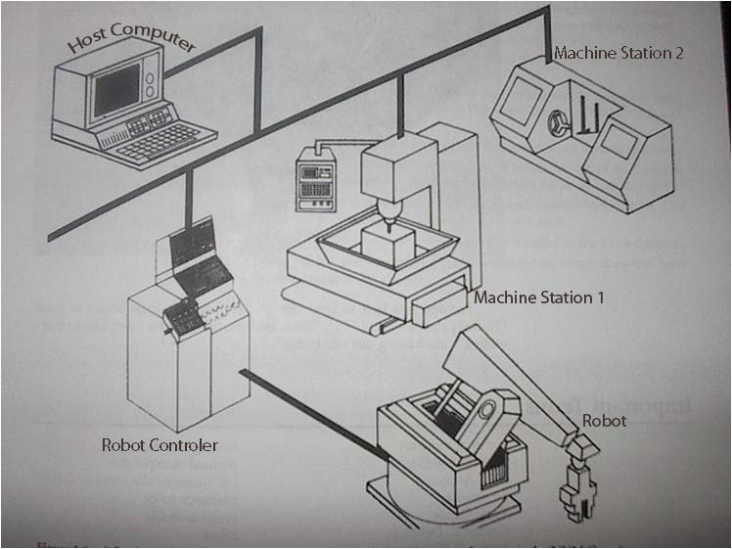
Cont’d…
An Industrial FMS consists of robots, computer-controlled machines, computers, sensors, and other stand-alone systems such as inspection machines as shown in Figure 1.
Fig. 1 Illustrations of FMS

Slide 13
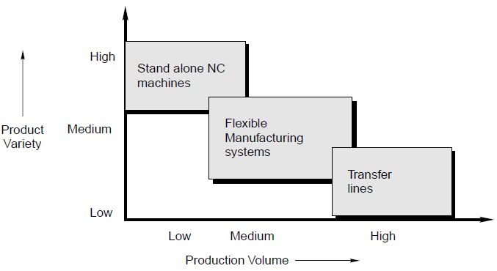
Cont’d…
The FMS is most suited for the mid-variety & mid-volume production.
Fig 3. Application Characteristics of FMS

Slide 14
What are the features of FMS?
An FMS is distinguished from an automated production line by its ability to process more than one product style simultaneously.
At any moment, each machine in the system may be processing a different part type.
FMS can let us make changes in production schedule in order to meet the demands on different products.

Slide 15
Differences between FMS and FMC
FMC
Has two or three machines
Lack central computer for control, rather controlled by cell controller
Higher effect of machines failurity
FMS
Has four or more machines
Larger and more sophisticated computer control system
Minimized effect of machine breakdowns

Slide 16
1.3. Objectives of FMS
The principle objectives of FMS are
1. To improve operational control through:
Reduction in the number of uncontrollable variables
Providing tools to recognize and react quickly to deviations in the manufacturing plan
Reducing the dependence of human communication.
2. To reduce direct labor:
Removing operators from the machining site
Eliminating dependence on highly skilled machines
Providing a catalyst to introduce and support unattended or lightly attended machining operation.

Slide 17
Cont’d…
3. To improve short run responsiveness consisting of:
Engineering changes
Processing changes
Machining downtime
Cutting tool failure
Late material delivery
4. To improve long-run accommodations through quicker and easier assimilation of:
Changing product volumes
New product additions and introductions
Increase machine utilization by:
Eliminating machine setup
Utilizing automated features to replace manual intervention
Providing quick transfer devices to keep machines in the production cycle

Slide 18
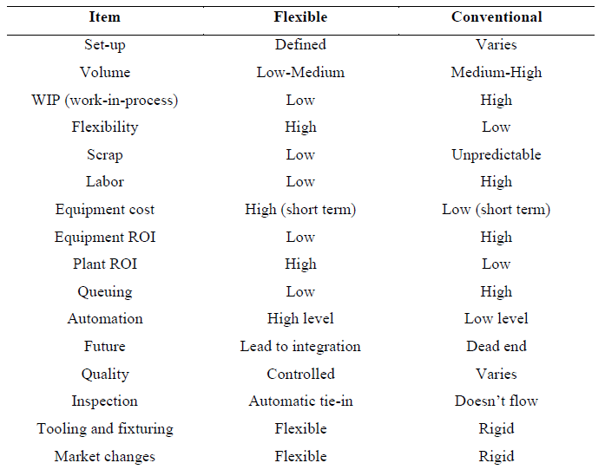
1.4. Rigid (Conventional) vs Flexible Systems

Slide 19
1.5. Basic Components of FMS
The basic components of FMS are:
Workstations
Automated Material Handling and Storage system
Computer Control System.

Slide 20
i. Workstations
In present day application, these workstations are typically computer numerical control (CNC) machine tools that perform machining operation on families of parts.
The various workstations are:
Machining centers
Load and unload stations
Assembly work stations
Inspection stations
Forging stations
Sheet metal processing, etc.

Slide 21
ii. Automated Material Handling and Storage System
The various automated material handling systems are used to transport work parts and subassembly parts between the processing stations.
It consists of power vehicles, robots, conveyers, automated guided vehicles (AGVs), and other systems to carry parts between workstations.
The various functions of automated material handling and storage system are:
Random and independent movement of work parts between workstations
Handling of a variety of work part configurations
Temporary storage
Convenient access for loading and unloading of work parts

Slide 22
iii. Computer Control System (CCS)
It is used to control the activities of the processing stations and the material handling system in the FMS.
The various functions of CCS are:
Control of each machine tools
Production control
Workpiece and tool control
Traffic control
Work handling system and monitoring
System performance monitoring and reporting

Slide 23
1.6. Types of Flexibility in Manufacturing
Flexibility in manufacturing means the ability to deal with slightly or greatly mixed parts, to allow variation in parts assembly and variations in process sequence and change the production volume.
There are three levels of manufacturing flexibility.
Basic flexibilities
System flexibilities
Aggregate flexibilities

Slide 24
(a) Basic flexibilities
Machine flexibility: The ease with which a machine can process various operations.
Material handling flexibility: A measure of the ease with which different part types can be transported and properly positioned at the various machine tools in a system.
Operation flexibility: A measure of the ease with which alternative operation sequences can be used for processing a part type.

Slide 25
(b) System flexibilities
Volume flexibility :A measure of a system’s capability to be operated profitably at different volumes of the existing part types.
Expansion flexibility: The ability to build a system to expand it incrementally.
Routing flexibility: It can define as capacity to produce parts on alternative workstation in case of equipment breakdowns, tool failure, and other interruptions at any particular station.
Process flexibility: A measure of the volume of the set of part types that a system can produce without incurring any setup.
Product flexibility: It refers to ability to change over to a new set of products economically and quickly in response to the changing market requirements.

Slide 26
(c) Aggregate flexibilities
Program flexibility: The ability of a system to run for reasonably long periods without external intervention.
Production flexibility: The volume of the set of part types that a system can produce without major investment in capital equipment.
Market flexibility: The ability of a system to efficiently adapt to changing market conditions.

Slide 27
1.7. Flexibility test
Flexibility has three primary capabilities in the FMS; it must have the capability: to identify and distinguish among the different incoming part or product styles processed by the system; of performing a quick changeover of operating instructions; and of performing a quick changeover of physical set-up.
These capabilities are expressed in various ways in the FMS, which can best be seen from an example such as is provided in Figure next. This figure depicts an automated manufacturing cell with two machine tools and robot.
The question arising from this figure is: is it a flexible cell?
To be considered flexible there are four reasonable tests that can be applied to the system to determine its level of flexibility.

Slide 28
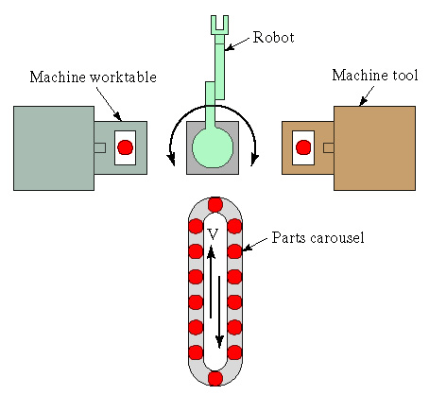
Cont’d…
Flexibility test:
Part variety test— can the system process different part styles?
Schedule change test— can the system readily accept changes in the production schedule, either in the product mix or the expected production volume?
Error recovery test— can the system recover gracefully from equipment malfunctions and breakdowns, so that production is not completely disrupted?
New part test—can new part designs be introduced into the existing product mix with relative ease?

Slide 29
Cont’d…
The system is flexible if we can answer “yes” to all of these questions, with the most important criteria for flexibility being numbers 1 and 2. Numbers 3 and 4 are softer criteria that may be implemented at various levels.
In Figure, the automated manufacturing cell with two machine tools and robot shall be considered flexible if it:
can machine different part mixes taken from the carousel by the robot;
allows for changes in the production schedule, without affecting the operation of the robotic arm and the two machine tools;
is able to carry-on operating even if one machine tool breaks down; and
can accommodate new part designs if the numerical control programme to do so is written off-line and then downloaded by the system for execution.

Slide 30
1.8. Types of FMS
FMS can be distinguished by how they perform, as either processing operations or assembly operations.
FMS are custom-built so that we may expect to find a wide range of types have been implemented to suit differing projects.
Each FMS is customized and unique; however, we can still define a typology for FMS depending on:
the number of machines it contains; or
Level of flexibility (whether it is a dedicated or random-order FMS, in terms of the parts it processes.)

Slide 31
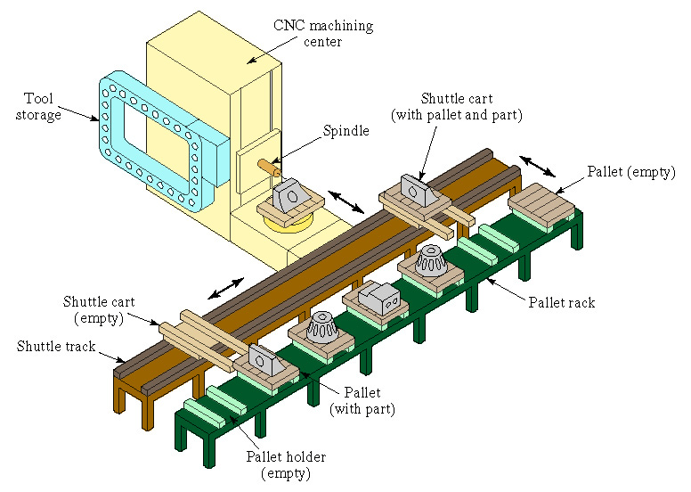
i. Based on the Number of Machines:
Single machine cell:
It contains one machine (often a CNC machining centre) connected to a parts storage system, which can load and unload parts to and from the storage system .
When it operates in flexible mode, the system satisfies three of the four tests for flexibility—the exception being error recovery, since, if the CNC machine centre breaks down, the system stops.

Slide 32
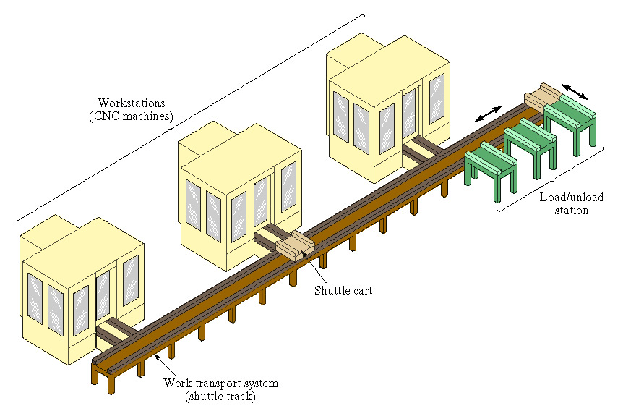
2. Flexible manufacturing cell: contains two or three processing workstations (often CNC machining or turning centers), plus a parts handling system. This set-up can operate in flexible mode and batch mode, as necessary, and can readily adapt to evolving production schedule and increased production volumes. Since there is more than one machine, error recovery is possible by re-routing the failed machine’s intended parts for processing to the other two machines in the system; and new part designs can be introduced with relative ease into the set-up. The flexible manufacturing cell satisfies all four flexibility tests.

Slide 33
3. Flexible manufacturing system (FMS)
consists of four or more processing stations connected mechanically by a common parts handling system and electronically by a distributed computer system (as in Figure ).
FMS is larger than the flexible manufacturing cell, not only in the number of workstations it may contain, but also in the number of supporting stations in the system, such as part/pallet washing stations, co-ordinate measuring machines, storage stations and so on.
Computer control is also more sophisticated; it includes functions not found in the FMCl such as diagnostics and tool monitoring.
The FMS satisfies all four flexibility tests.

Slide 34
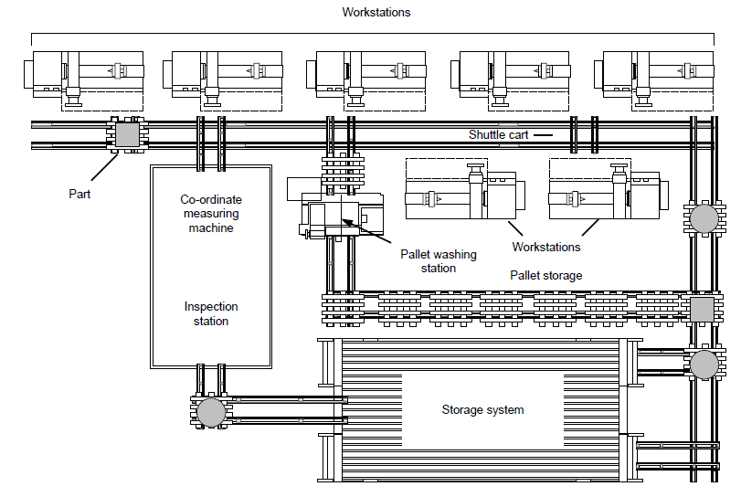
Cont’d…
Fig. Plan view of a seven-station flexible manufacturing system

Slide 35
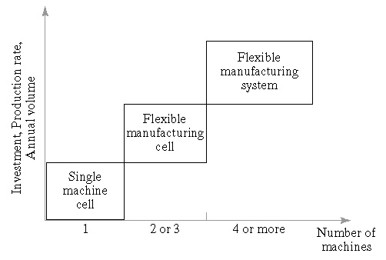
Cont’d…
A comparison of the three FMS types is illustrated in Figure , where the number of machines is plotted against metrics of investment, production rate and annual volume.
Features of the three categories of flexible cells and systems

Slide 36
ii. Types of FMS based on level of flexibility:
Sequential FMS: It manufactures one-piece part batch type and then planning and preparation is carried out for the next piece part batch type to be manufactured. It operates like a small batch flexible transfer line.
Random FMS: It manufactures any random mix of piece part types at any one time.
Dedicated FMS: It continually manufactures, for extended periods, the same but limited mix of piece part batch types.
Engineered FMS: It manufactures the same mix of part types throughout its lifetime.
Modular FMS: A modular FMS, with a sophisticated FMS host, enables FMS user to expand their FMS capabilities in a stepwise fashion into any of the previous four types of FMS.
Notes:
In dedicated FMS types a limited variety of parts is catered for on a custom-built FMS with specialist machines to achieve high production rates. In the random-order FMS type, a large part family with wide possibilities for future design changes, and changing production schedules, is catered for on a general-purpose FMS with random-order sequencing of parts.

Slide 37
1.9. Types of FMS layouts
Progressive or Line Type
Loop Type
Ladder Type
Open field type and
Robot centered type

Slide 38
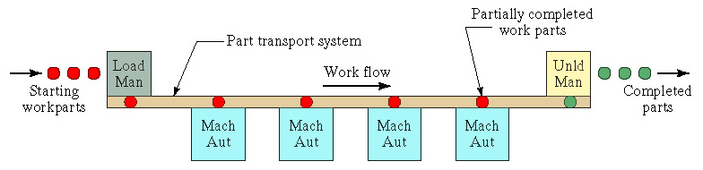
i. Progressive or Line type
The machines and handling system are arranged in a line as shown in the Fig..
It is most appropriate for a system in which the part progress from one workstation to the next in a well defined sequence with no back flow.
The operation of this type of system is very similar to transfer line type. Work always flows in unidirectional path.
Notes:
Similar operation to a transfer line (see unit 13), except the system holds a greater variety of parts
Material handling equipment used: in-line transfer system; conveyor system; or rail-guided vehicle system

Slide 39
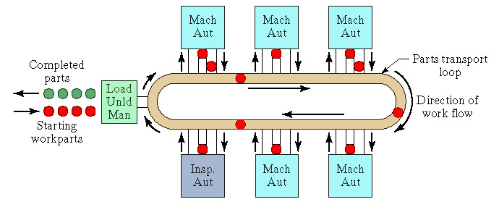
ii. Loop Type
The basic loop configuration is as shown in Fig..
The parts usually move in one direction around the loop, with the capability to stop and be transferred to any station.
The loading and unloading station are typically located at one end of the loop.
Notes:
An alternative form is the rectangular layout shown in Figure 15.7(d). This arrangement allows for the return of pallets to the starting position in a straight line arrangement

Slide 40
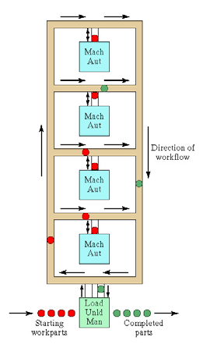
iii. Ladder Type
The configuration is as shown in Fig..
The loading and unloading station is typically located at the same end.
The sequence to the operation/transfer of parts from one machine tool to another is in the form of ladder steps as shown in Fig.
Notes:
This consists of a loop with rungs upon which workstations are located. The rungs increase the number of possible ways of getting from one machine to the next, and obviates the need for a secondary material handling system. It reduces average travel distance and minimizes congestion in the handling system, thereby reducing transport time between stations

Slide 41
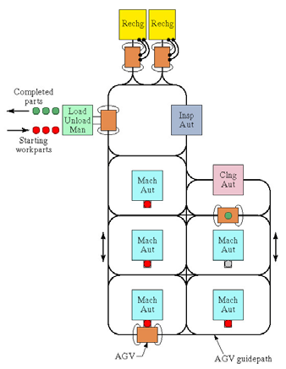
iv. Open Field Type
The configuration of the open field is as shown in Fig. The loading and unloading station is typically located at the same end. The parts will go through all the substations, such as CNC machines, CMMs and wash station by the help of AGV’s from one substation to another.
Notes:
Consists of multiple loops and ladders, and may include sidings also. This layout is generally used to process a large family of parts, although the number of different machine types may be limited, and parts are usually routed to different workstations—depending on which one becomes available first

Slide 42

v. Robot Centered Type
Robot centered type is a relatively new form of flexible system in which one or more robots are used as the material handling systems as shown in Fig.. Industrial robots can be equipped with grippers that make them well suited for handling of rotational parts.
Notes:
This layout uses one or more robots as the material handling system

Slide 43
1.10. Adv. and Disadv. of FMS implementation
Advantages:
Faster and lower-cost changes from one part to another which will improve machine utilization.
Lower direct labor cost due to the reduction in number of workers.
Fewer machines required—because existing machines are highly flexible, and because of higher machine utilization
Reduced inventory due to the planning and programming precision.
Consistent and better quality due to the automated control.
Lower cost/unit of output due to the greater productivity using the same number of workers.
Savings from the indirect labor cost from reduced errors, rework, repairs and rejects.
Notes:
M/c utlzn---owing to 24 hr per day operation, automatic tool changing of machine tools, automatic pallet changing at workstations, queues of parts at stations, and dynamic scheduling of production that compensates for irregularities
Reduced inventory requirements—work-in-process is reduced because different parts are processed together, and not in batches

Slide 44
Cont’d…
Disadvantages:
Limited ability to adapt to changes in product or product mix (ex. machines are of limited capacity and the tooling necessary for products, even of the same family, is not always feasible in a given FMS).
Substantial pre-planning activity
Expensive, costing millions of dollars
Technological problems of exact component positioning and precise timing necessary to process a component
Sophisticated manufacturing systems.

Slide 45
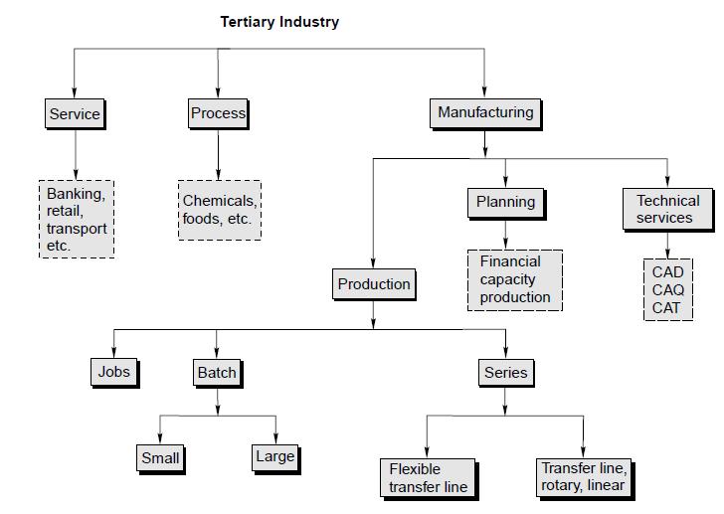
1.11. Application areas of FMS
The ff chart shows various applications areas in an industry.

Slide 46
Summary
Flexibility in manufacturing system is one of the most important issues of present scenario, to fulfill the desired customer’s requirement & getting low cost and high quality of product that enforced to adopting the FMS for various modern manufacturing enterprises.
The basic of FMS is to convert & increases positivity throughout the manufacturing process for achieving higher productivity and best quality of product.
FMS consists of an integrated system of computerized numerically controlled (CNC) machine tool , automated material handling system operating under the controlled computer , workstation, storage etc.
In this lecture session, it is also tried to highlight the types of flexibility, flexibility test, FMS layouts, adv & disadv and application of FMS and also overviewed of other aspect of FMS.

Slide 47
Self-Assessment Questions
What is meant by a flexible manufacturing system?
What is group technology? How does it relate to cellular manufacturing?
What are the three primary capabilities of flexibility in the FMS?
What are the four tests for flexibility in FMS research?
How are different types of FMS specified?
What are the basic components of an FMS?
List the five categories of FMS layout.
What are the benefits of a successful FMS implementation?
Cite the main application areas of FMS.

Slide 48
Qns???

