Slide 1
Part #2
Flexible Manufacturing System Components
April, 2020

Slide 2
Outline
Introduction
Main systems of FMS
Sub-system of FMS: (Technical system, Processing system, Tool management & supply)
Levels of FMS
summary

Slide 3
1. Main Systems/Components of FMA
The main/basic components of an FMS are:
Workstations,
Material handling and storage systems,
Computer control system, and
Personnel that manage and operate the system.

Slide 4
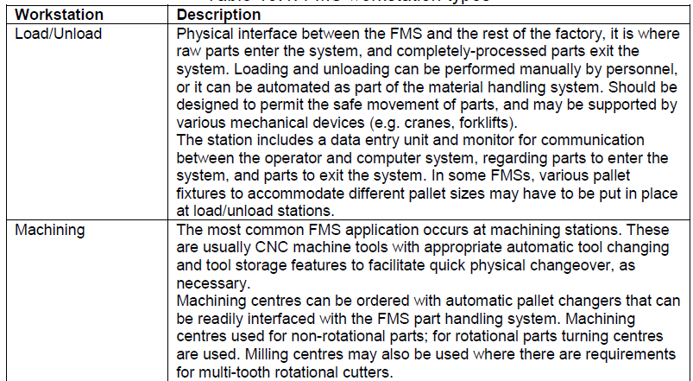
i. Workstations

Slide 5
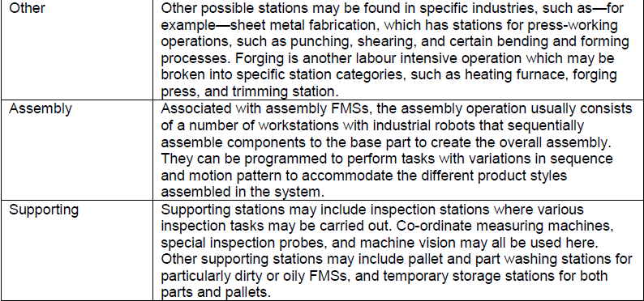
Cont’d…

Slide 6
ii. Material Handling and Storage System
Material handling and storage systems for FMS in three sub-sections:
  functions,
  equipment, and
  lay-out configurations.

Slide 7
a). Functions of the
Handling System
Allows random, independent movement of work parts between stations so as to allow for various routing alternatives for the different parts in the system.
Enables handling of a variety of work part configurations by means of pallet fixtures for prismatic parts, and industrial robots for rotational parts.
Provides temporary storage—small queues of parts awaiting processing may be allowed to build-up in front of each station in the system.
Provides convenient access for loading and unloading work parts at load and unload stations.
Creates compatibility with computer control—the handling system must be under the direct control of the computer system which directs it to the various workstations, load/unload stations, and storage areas.

Slide 8
b). Material Handling
Equipments (MHS)
FMS material handling equipment uses a variety of conventional material transport equipment, in-line transfer mechanisms, and industrial robotics.
There is a primary and secondary MHS used in most FMSs.
The primary MHS establishes the FMS lay-out and is responsible for moving parts between stations in the system.

Slide 9
Cont’d…
The secondary MHS consists of transfer devices, automatic pallet changers, and other mechanisms to transfer parts from the primary MHS to the workhead of the processing station, or to a supporting station.
The secondary MHS is responsible also for the accurate positioning of the part at the workstation, so that the machining process may be performed upon the part in the correct manner.
Other purposes of the secondary MHS include:
    re-orientation of the part if necessary to present the surface that is to be processed; and
    to act as buffer storage as the workstation, should this be needed

Slide 10
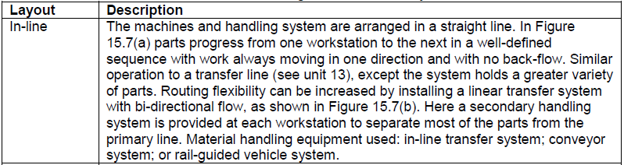
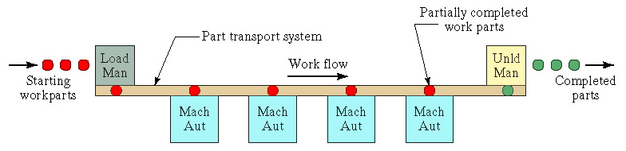
C). Flexible Manufacturing System Layout Configurations

Slide 11
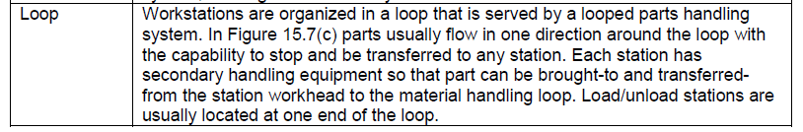
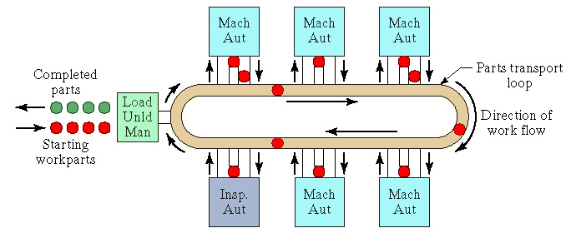
Cont’d…

Slide 12
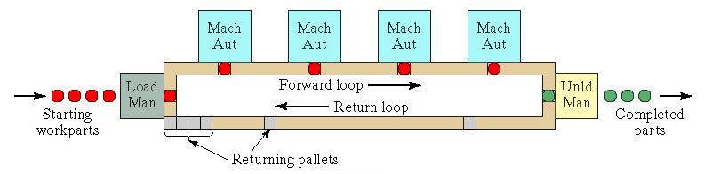
Cont’d…

Slide 13
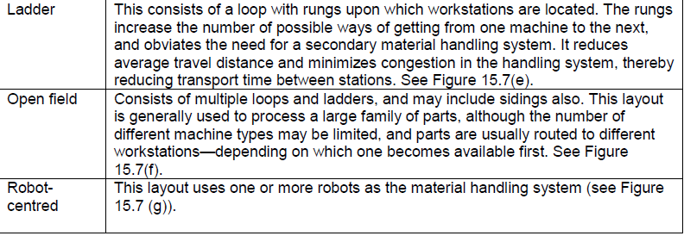
Cont’d…

Slide 14
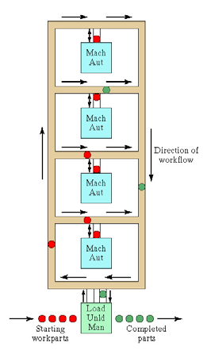
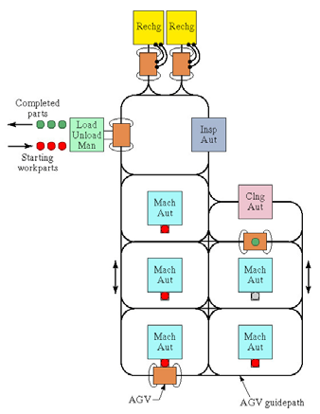
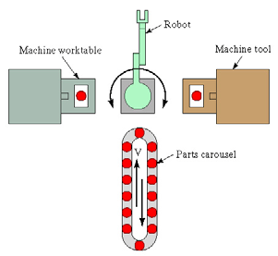
Cont’d…

Slide 15
3. Computer Control
System
To operate, the FMS uses a distributed computer system that is interfaced with all workstations in the system, as well as with the material handling system and other hardware components.
It consists of a central computer and a series of micro-computers that control individual machines in the FMS.
The central computer co-ordinates the activities of the components to achieve smooth operational control of the system.
The following control functions may be noted:

Slide 16
Functions of
Control System
Workstation control: fully automated FMSs use some form of workstation control at each station, often in the form of CNC control.
Distribution of control instructions to workstations: a central computer is required to handle the processing occurring at disparate workstations; this involves the dissemination of part programmes to individual workstations, based upon an overall schedule held by the central computer.
Production control: management of the mix and rate at which various parts are launched into the system is important; alongside data input of a number of essential metrics, such as: daily desired production rates, number of raw workparts available, work-in-progress etc.

Slide 17
Cont’d…
Traffic control— management of the primary handling system is essential so that parts arrive at the right location at the right time and in the right condition.
Shuttle control— management of the secondary handling system is also important, to ensure the correct delivery of the workpart to the station’s workhead.
Workpiece monitoring— the computer must monitor the status of each cart or pallet in the primary and secondary handling systems, to ensure that we know the location of every element in the system.

Slide 18
Cont’d…
Tool control— this is concerned with managing tool location (keeping track of the different tools used at different workstations, which can be a determinant on where a part can be processed), and tool life (keeping track on how much usage the tool has gone through, so as to determine when it should be replaced).
Performance monitoring and reporting— the computer must collect data on the various operations on-going in the FMS and present performance findings.
Diagnostics— the computer must be able to diagnose, to a high degree of accuracy, where a problem may be occurring in the FMS.

Slide 19
4. Human Resources
Human personnel manage the overall operations of the system.
Humans are also required in the FMS to perform a variety of supporting operations in the system; these include:
  loading raw workparts into the system;
  unloading finished parts or assemblies from the system;
  changing and setting tools;
  performing equipment maintenance and repair;
  performing NC part programming;
  programming and operating the computer system; and managing the system.

Slide 20
Subsystem: Processing
System
It performs some activities on a given job.
Such activities convert the job from one shape to another continuous up to the final product.
It enhances significance by altering the geometry, features or appearance of the initial materials.

Slide 21
Subsystem: Tool Management & Supply
Some of the cumbersome and difficult issues to deal with relative to FMS are managing, co-ordination and controlling the wide variety of cutting tools.
This includes not only having and maintaining the required number of cutting tools to process the required parts through the FMS but also managing and coordinating other elements such as:
    Replacement of tools
    Tool Assembly Component requirements
    Tool storage
    Reconditioning and present considerations
    Tool life monitoring and
    Broken tool detection and other factors.

Slide 22
Cont’d…
i. Getting control of cutting tools
Controlling the cutting tools involves good tooling policies, cost-effective part programming strategies on the machine, and sound tool-related practices in tool rooms manufacturing and other off-line operations.

Slide 23
Cont’d…
The following items should be considered as cost-effective optimizing tactics to begin to augment and enhance the full impact of FMS productivity effectiveness:
  Review cutting tool and indexable insert inventory and get control of usage
  Review cutting tool purchasing practices
  Reduce dependency on specialized, nonstandard tooling.
  Guidelines for tool assembly preparation and reconditioning must be established and reinforced.

Slide 24
ii. Tool Management
Regardless of how “flexible” a flexible manufacturing system is, the system is still only capable of processing a finite number of parts.
The overall flexibility or “randomness” of an FMS is typically constrained by two support resources:
  Palletized fixtures that control the rate of workflow coming into and going out of the system
  Tool storage capacity.

Slide 25
Cont’d…
The main problems caused by tool capacity constraints and a lack of tool management are:
Insufficient redundant tool backup at the machine during tool breakage and tool wear conditions.
Insufficient use of present tools and excess tool inventory.
Conflicting priorities with other areas outside the FMS over tool availability and reconditioning.
A limited number of workpieces being available to process due to insufficient tool, matrix capacity.
Under-utilized machines and low production rates caused by too many tools and extensive tool changing.

Slide 26
Cont’d…
Generally, tool management is getting the right tool to the right place at the right time.
Having an acceptable tool management system to fulfill the tooling requirements of an FMS means adequately addressing the following four areas:
    Tool room service
    Tool delivery
    Tool allocation and data flow and,
    Fault sensing.
Notes:
Tool room service: Providing adequate tool room service does not directly affect the machine tools that make up an
FMS, but is essential to system effectiveness. Tool room service is a necessary support function dealing principally with preparing, servicing, organizing and controlling the vast array of perishable tools, inserts, tool holders and tool components.
Tool delivery addresses the tool management function relative to moving the tools between the tool room and the various tool magazines of each machine tool in the FMS. This includes transporting the tools to and from the machine tool requiring those tools, and loading and unloading the tool magazines
once the tool arrive at the machines. If the demand for tools based on the variety of part mix is high enough, complete automation of the tool delivery and distribution function may be necessary.ganizing and controlling the vast array of perishable tools, inserts, tool holders and tool components.
Tool allocation and data flow are two of the most difficult aspects of tool management to manage
and control.
Tool allocation is essentially assigning and controlling the total number of tools required for each machine to process the previously defined FMS part spectrum. It is based on specific part process plans, machine programs and machining methodology along with the varying part mix and
volumes that could be running through the system at any given time. Controlling the tool data flow relative to the allocated tools requires that the MCU (Machine control unit) would assume tool data transfer from the present area as tools are automatically gauged, identified and entered into the FMS tool system data base.
Fault sensing is monitoring and detecting cutting tool problems at each machine. This involves electromechanical and optical sensing and detection of worn and broken tools along with absence of tools or misplacements. Each tool is offset to a contact and non-contact sensor. Each time it is used in order to validate tool presence, correctness and condition. Replacements should be available for the broken tools.

Slide 27
iii. Tool Strategies
Various tool strategies exist within the framework of tool management that requires examination.
Each has its advantages and disadvantages as well as particular application for an FMS.
The tool strategies employed in FMS are:
    Mass Exchange
    Tool sharing
    Tool migration and,
    Assigned tools

Slide 28
a. Mass Exchange
The mass exchange strategy is removing all the tools in each machine tool matrix at the completion of specific production requirements and replacing them with the new part required for tooling.
Mass exchange permits tool exchange control to be minimized at the expense of an increase in tool inventory.
The mass exchange strategy is logical and attractive for FMS applications only where high volume and low part variety workpiece exists.

Slide 29
b. Tool Sharing
The tool-sharing concept permits the logical sharing of tools within the framework of affixed production period and workpiece requirements.
Common tooling among the fixed production requirements is recognized, identified and shared among the various parts to be manufactured in the fixed production period.
After fulfilling part requirements within the fixed production period, a new set of tools for the next production is loaded and common tooling is again identified.
The tool strategy requires computer software to implement due to merging of tool lists and matching requirements to identify the common tooling.

Slide 30
c. Tool Migration
The tool migration strategy is basically an extension of the mass exchange and tool sharing theory. Both consider the workpiece to be manufactured within the fixed production period and tool matrix capacity available to support it.
As parts are completed, many tools used to manufacture those parts become available for removal from the tool matrix. Removing the tools frees tool points in the tool matrix and permits other tools needed for new arriving parts to be loaded.
Tool migration exchanges must be done in an effort to minimize spindle interruption is of primary importance. Consequently, tools completing their manufacture service are removed from the matrix at the tool matrix, while needed new tools are inserted in available tool pockets. Tool delivery is accomplished through various means such as AGV.
The Strategy requires sophisticated computer software and decision logic in order to determine the removal of tools, adding of this tool.

Slide 31
d. Assigned Tools
The above 3 strategies previously discussed assumed that a given set of workpiece be machined at a specific machine tool. The reality of manufacturing operation force consideration of production schedule changes, machine breakdowns, tooling and material unavailability, flexibility among processing equipment becomes high priority. Thus, the assigned tool strategy can address the need for increased flexibility among a set or group machine tools.
This strategy identifies the most used tools for the production requirements and part mix and assigns permanent residence to those tools in each machine tool matrix for the full production run.

Slide 32
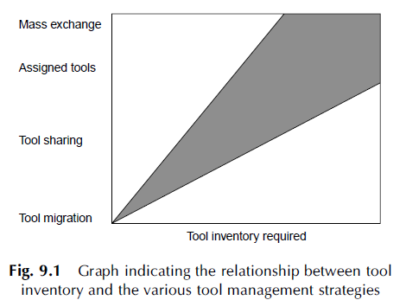
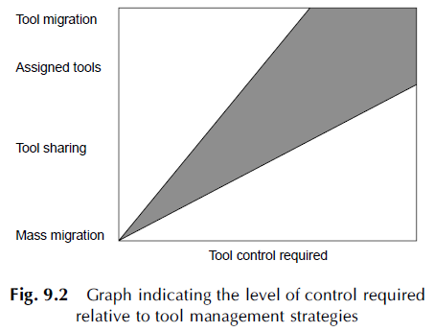
Cont’d…

Slide 33
Part #III
Levels of FMS

Slide 34
Types & levels of FMS
FMS can be distinguished by how they perform, as either processing operations or assembly operations.
FMS are custom-built so that we may expect to find a wide range of types have been implemented to suit differing projects.
Each FMS is customized and unique; however, we can still define a level/typology for FMS depending on:
(1) the number of machines it contains; or
(2) whether it is a dedicated or random-order FMS, in terms of the parts it processes.

Slide 35
Cont’d…
Different levels of flexibilities:
a) On the number of machines
  Flexible Manufacturing Module (FMM): NC Machines;
  Flexible Manufacturing (Assembly) Cell: Four FMMs and an AGV (automated guided vehicle);
  Flexible Manufacturing Group (FMG): Two FMCs, a FMM and two AGVs
  Flexible Manufacturing/production Systems (FMS): A FMG and a FAC, two AGVs, an Automated Tool Storage, and an Automated Part/assembly Storage
  Flexible Manufacturing Line (FML): multiple stations in a line layout and AGVs.

Slide 36
Cont’d…
Flexible Manufacturing Module (FMM): Single machine cell.
It contains one machine (often a CNC machining centre) connected to a parts storage system, which can load and unload parts to and from the storage system (as in Figure next).
It is designed to operate in batch mode, flexible mode, or a combination of the two.
When in batch mode, the system processes parts of a single style in specific lot sizes before physical and programme changeover to the next batch specifications;
In flexible mode the system satisfies three of the four tests for flexibility — the exception being error recovery, since, if the CNC machine centre breaks down, the system stops.

Slide 37
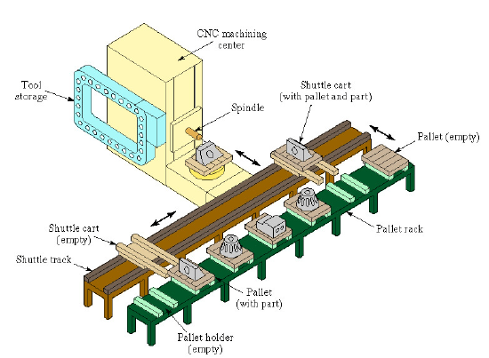
Figure 1: FMM- Single machine cell with one CNC machining centre and parts storage unit

Slide 38
2. Flexible manufacturing cell (FMC)
It contains two or three processing workstations (often CNC machining or turning centres), plus a parts handling system, as in Figure 2.
This set-up can operate in flexible mode and batch mode, as necessary, and can readily adapt to evolving production schedule and increased production volumes.
Since there is more than one machine, error recovery is possible by re-routing the failed machine’s intended parts for processing to the other two machines in the system; and new part designs can be introduced with relative ease into the set-up. The flexible manufacturing cell satisfies all four flexibility tests.

Slide 39
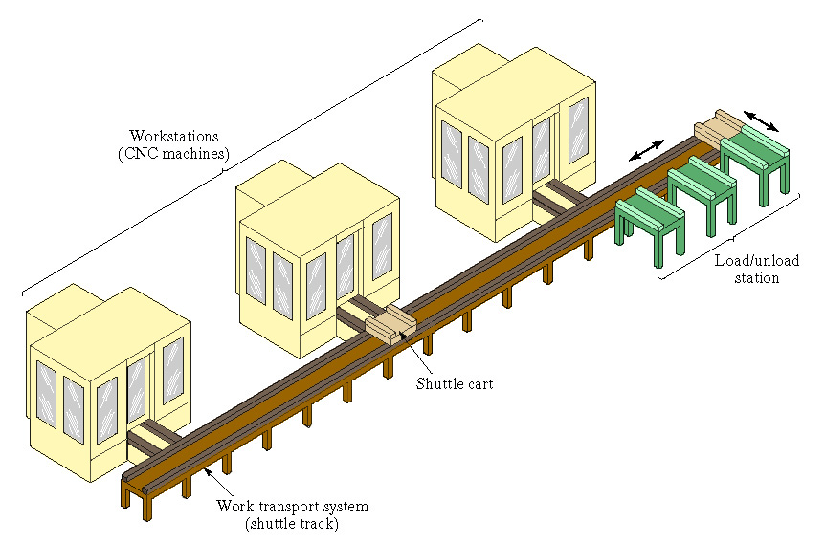
Figure 2: Flexible manufacturing cell with three identical processing stations, a load/unload station, and parts handling system

Slide 40
3. Flexible Manufacturing
System (FMS)
This consists of four or more processing stations connected mechanically by a common parts handling system and electronically by a distributed computer system (as in Figure 3).
FMS is larger than the flexible manufacturing cell, not only in the number of workstations it may contain, but also in the number of supporting stations in the system, such as part/pallet washing stations, co-ordinate measuring machines, storage stations and so on.
Computer control is also more sophisticated; it includes functions not found in the flexible manufacturing cell such as diagnostics and tool monitoring.
The FMS satisfies all four flexibility tests.

Slide 41
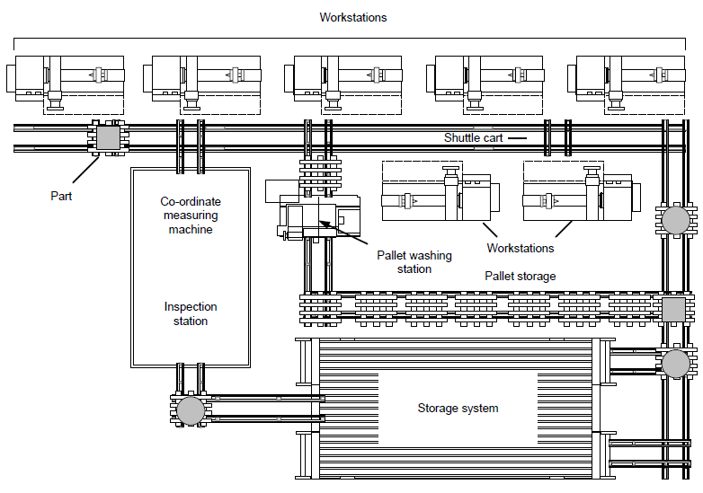
Figure 3: Plan view of a seven-station flexible manufacturing system

Slide 42
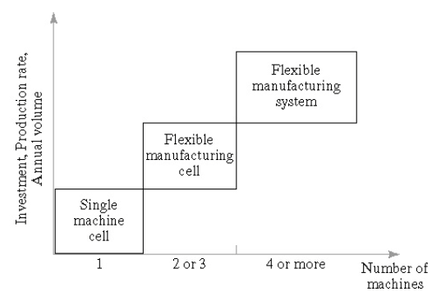
Cont’d…
A comparison of the three FMS types is illustrated in Figure 4, where the number of machines is plotted against metrics of investment, production rate and annual volume.

Slide 43
4. Flexible Manufacturing line (FML)
Flexible manufacturing line is like a production line and flexible manufacturing cell, but it handles more volume and very few products compared to a flexible manufacturing cell.
So, if the volumes are very high or if a cell is required to make only one product then it becomes a flexible manufacturing line, if it makes more than one then it becomes a FMC is a little more variety and a collection of flexible manufacturing cells make a flexible manufacturing system.
Thus FMCs have high flexibility and handle less volume while FML have less flexibility, but can handle very large volumes. So, depending on the volume and variety, we call it an FML or FMC.

Slide 44
Cont’d…
Flexible transfer line has multiple workstations that are automated and linked together by a work handling system that transfers parts from one station to the next, as in Fig. 5.
Starting—un-processed—parts enter the FTL and undergo a system of automated processing at various workstations along the automated production line; the parts are passed from workstation to workstation by means of a mechanized work transport system, until the completely processed parts pass out of the automated production line after the last process occurs to the part at the final workstation in the system.

Slide 45
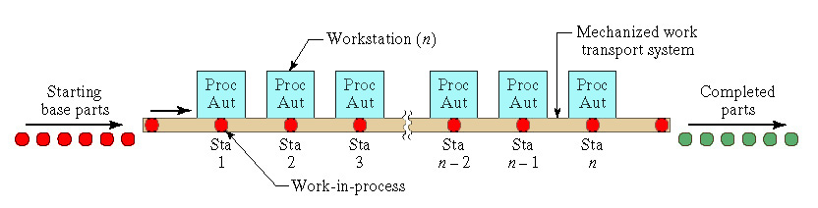
Cont’d…
Figure 5: General configuration of an flexible transfer line

Slide 46
Cont’d…
The line may also include inspection stations to perform intermediate quality checks on parts in the system, as well as a number of manually-operated workstations that accomplish tasks that have not been automated owing to reasons of economy or difficulty.
Each station performs a different operation, so all the operations are required to complete one work unit; this means that the parts’ route through the production line is fixed and cannot be changed.
Multiple parts are processed simultaneously, with one part undergoing processing at each workstation in the system. This means, in the simplest automated production lines, that the number of parts in the system is found to be equal to the number of workstations that the system has; however, in more complicated configurations, provision may have been made for some form of part storage, so this calculation may not be accurate where buffering is manifest.

Slide 47
Cont’d…
The flexible manufacturing line operates in cycles with the slowest workstation processing time setting the pace for the whole line. Each cycle consists of the processing time plus the time taken to transfer parts from one workstation to the next.

Slide 48
Cont’d…
Certain layouts of transfer lines may allow the use of pallet fixtures for part handling. The alternative method of workpart location is simply to index the parts themselves from station to station; this is described as a free transfer line, and is less expensive than the palletized transfer line as pallet fixtures do not have to be custom-designed for the work transport system. However, certain workpart geometries mandate the use of pallets and pallet fixtures, in which case a system of returning them to the front of the line must be devised.

Slide 49
System Configurations of FTL
A number of system configurations for the flexible manufacturing line exist; these are:
    In-line type layout
    Segmented in-line type (L-shaped, U-shaped, rectangular shaped)
    Rotary layout.

Slide 50
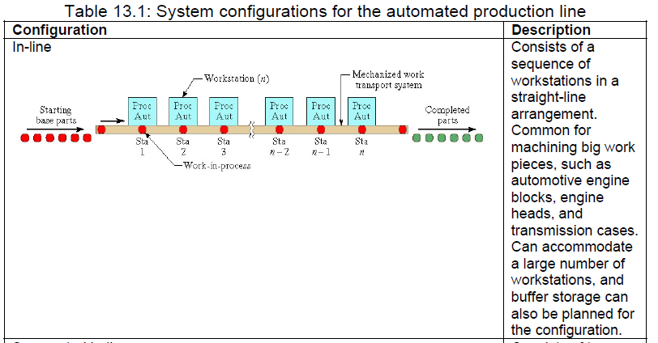
i. In-line type layout

Slide 51
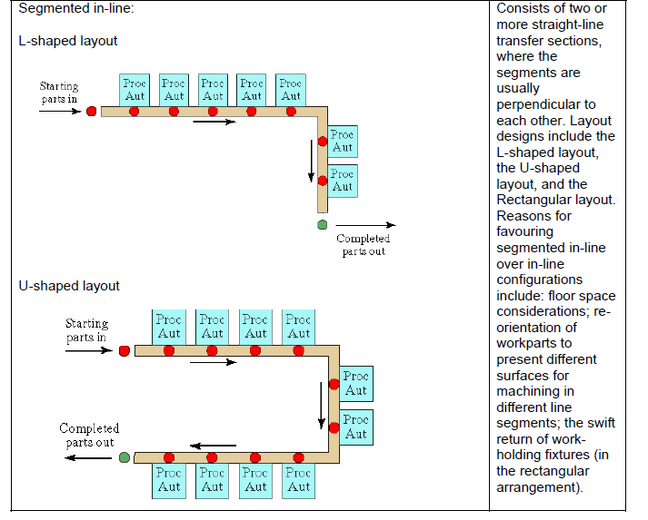
ii. Segmented in-line type

Slide 52
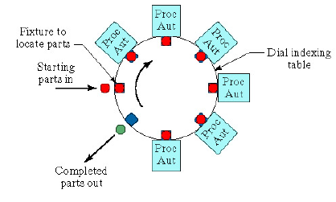
iii. Rotary layout
Consists of a circular worktable around which workparts are fixed to workholders.
The worktable rotates to move each workpart, in turn, into each Automated workstation which is located around the circumference of the worktable.
The worktable is often called a dial, and the equipment is referred to as a dial indexing machine, or simply, indexing machine.
Commonly limited to smaller workparts and relatively few workstations, and they cannot readily accommodate buffer storage capacity. However they require less floor space, and are generally less expensive than other configurations.

Slide 53
Cont’d…
Sometimes a mix of the above configurations may be favored in particular cases. For example in Figure 6; here is illustrated two transfer lines that perform metal machining operations on a rear truck axle.
The first line consists of a segmented in-line configuration, in the rectangular layout; the second line is in the conventional in-line configuration.
There also exists a number of buffer storage locations within the configuration, particularly from one transfer line to the next.

Slide 54
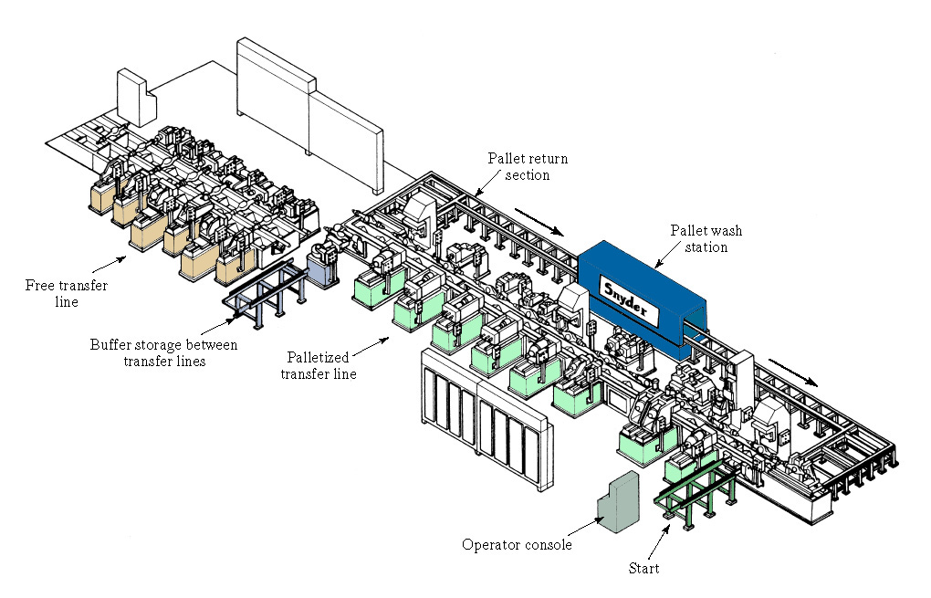
Cont’d…
Figure 6: Two machining transfer lines

Slide 55
Level of flexibility:
The FMS can be examined to determine the level of flexibility it maintains.
There are two levels: dedicated FMS, and random-order FMS.

Slide 56
i. Dedicated FMS
It is designed to produce a limited variety of part styles, and the complete universe of parts to be made on the system is known in advance.
Group technology is likely to be based on product commonality rather than geometric similarity.
Product design is relatively stable, so the system is designed with a certain amount of process specialization in place; machines designed for specific processes can be implemented within the system, which leads to an increased production rate from the system.
In some cases, machine sequence may be virtually identical for all parts processed, so a transfer line may be appropriate as the system lay-out

Slide 57
ii. Random-order FMS
It is designed to produce a large part family, where there are substantial variations in part configurations, and where it is likely that new part designs will be introduced into the system, with engineering changes occurring to existing parts.
The production schedule may also be flexible, changing from day to day.
The random-order FMS must be more flexible than the dedicated FMS to accommodate these requirements.
It is equipped with general purpose machines to deal with product variations, and is capable of processing parts in random order. A more sophisticated computer control system is also required for this FMS type.

Slide 58
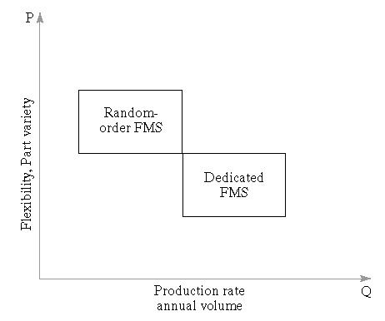
Cont’d…
A comparison of the two FMS types is illustrated in Figure 15.6, where the production rate and annual volume is plotted against metrics of flexibility and part variety.
Figure 15.6: Comparison of dedicated and random-order FMS types

Slide 59
QSns???

