Slide 1
Chapter Five
Equation of state

Slide 2
5.1 INTRODUCTION
State postulate of a simple compressible substance: any intensive property is solely a function of two other independent, intensive properties. The ones that relate P, v, and T are usually known as equations of state whose functional form looks like
f(P,v,T)=0 (algebraic equation, graph or a set of tabular data)
Initially discussions will be on algebraic ones.

Slide 3
An equation of state serves two purposes:
Prediction of PvT behavior of substances; uses PvT cartesian coordinates ; P_{v} plane is a typical case usually represented on reduced pressure (P_{r}), reduced temperature (T_{r}) and reduced specific volume (v_{r}) coordinate systems. Typical P_{v} surface is shown in Fig 5.1
For large values of v_{r} fairly simple mathematical expression can be used to represent an isotherm with reasonable accuracy.

Slide 4
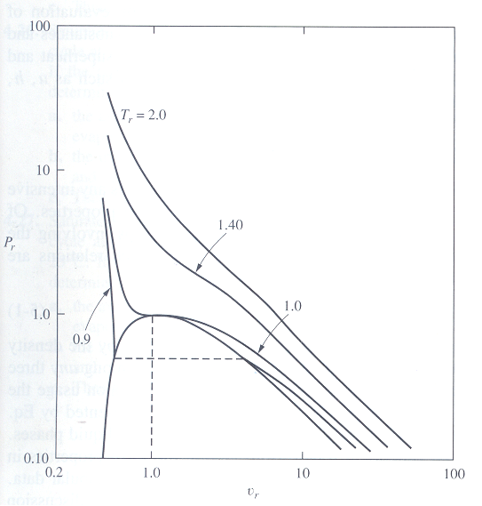
Fig.5.1 Experimental P_{r} - v_{r} relationships for argon along isotherms Tr.

Slide 5
For low values of specific volumes (v_{r}≤1) pressure changes rapidly for small changes in density-will require complex analytical solution.
More complication is in the saturation region a region of discontinuity.
The other major use is in the evaluation of property data that can not be measured directly; u, h, s, c_{p}, c_{v}, g, a, and f.
Usually the mathematical relationships for these properties contain first and second derivatives. Such a function must lend itself to differentiation and integration.
In addition the functions must exhibit some unique PvT characteristics experienced by all substances

Slide 6
Three primary decisions to be made in the development of equation of state: range of values of interest (density);precision or accuracy; amount and kind of input data
5.2 CHARACTERISTIC OF PvT BEHAVIOR
Some criteria which the PvT models should fulfill:
At the critical point, the critical isotherm has an inflection and horizontal slope, requiring
which must be fulfilled by the model function

Slide 7
All isometric lines on the PT diagram are nearly straight (linear). In particular, the slope of the critical isometric is equal to the slope of the vapor pressure curve. So the model must meet this requirement Fig 5.2. Replotting the vapor pressure curve as log₁₀ P_{r} versus 1/T_{r}, experimental data indicate that the lines are nearly straight.
This can be seen to be directly related (dP/dT)_{crit} as follows:

Slide 8
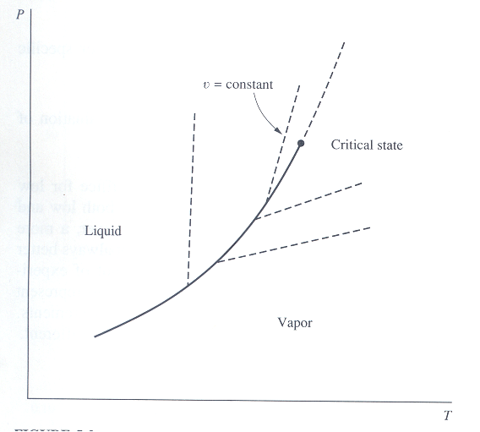
Fig.5.2 PT diagram showing the vapor-pressure curve for a pure substance and constant-volume lines in the single-phase regions

Slide 9
At the critical state T_{r}=1 and P_{r}=1. The above equation will give
where
The value of m determined from vapor pressure data derivative at the critical point must match that obtained from the model equation. The lines in Fig 5.3 represent various values of m.

Slide 10
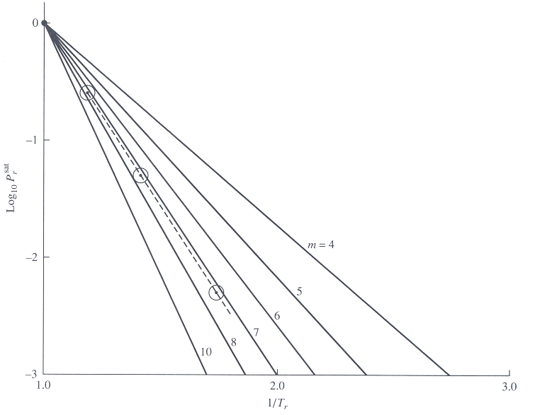
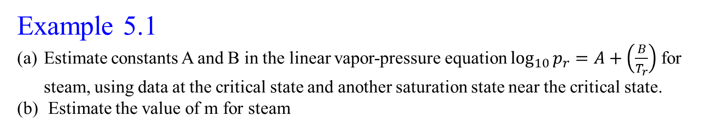
.
Fig.5.3 Generalized vapor-pressure plot
Example 5.1
Estimate constants A and B in the linear vapor-pressure equation $\log_{10}{p_{r}=A+\left(\frac{B}{T_{r}}\right) }$for steam, using data at the critical state and another saturation state near the critical state.
Estimate the value of m for steam

Slide 11
Other general PvT characteristics gases exhibit are
As P approaches zero, gases behave as ideal gases and
Also as P approaches zero v_{ideal}-v_{actual} is a non-zero value known as residual volume α which is solely a function of temperature. The model should predict with a reasonable accuracy (Fig 5.4)
3. Critical isotherm essentially vertical at high pressures, ie. V is constant at the critical temperature and high pressure as given by
Redlich-Kwong equation was devised empirically to satisfy this criterion.

Slide 12
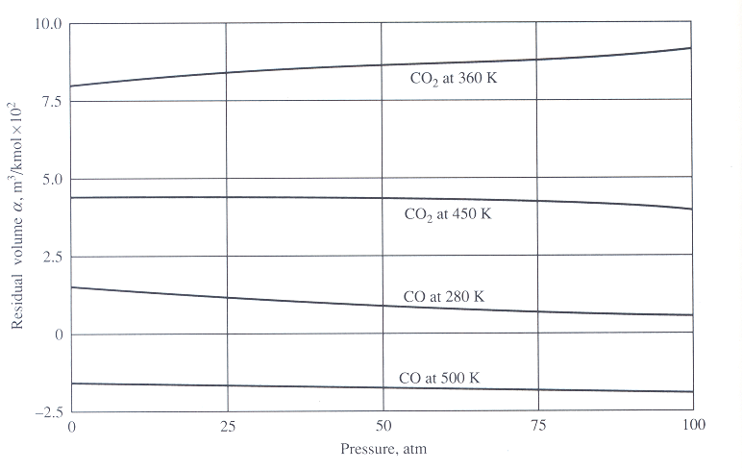
Fig.5.4 Isotherms for the residual volume α versus pressure for CO and CO2.

Slide 13
4. Range of Z_{c} for any substance is between 0.22 and 0.30. Therefore for all gases the model must predict (for all gases)
The critical isometric line (straight line) on a PT diagram must satisfy (in the super heat region)
Although it would be difficult to satisfy all these and other additional criteria it would be hoped that any equation of state would reproduce a number of these characteristics with reasonable accuracy.

Slide 14
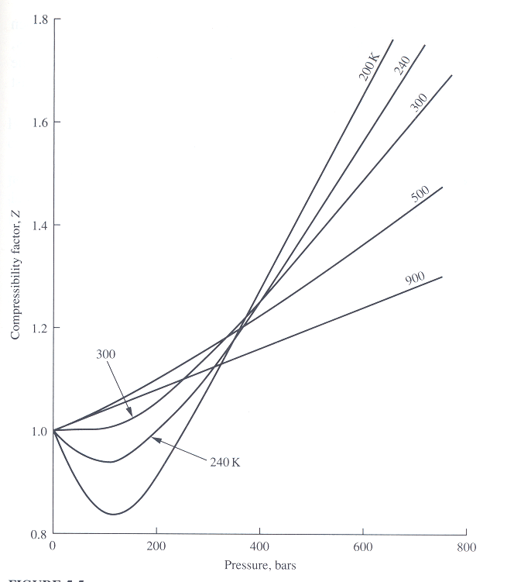
The following is a review of some of the more important equations of state.
5.3 THE COMPRESSIBILITY FACTOR
The equation Pv=ZRT predicts the real gas behavior where Z is known as the compressibility factor, indicator of the degree of deviation from ideal gas behavior. Also Z=(v_{act}/v_{ideal})
Fig.5.5 Compressibility plot for nitrogen gas

Slide 15
5.4 TWO-PARAMETER CUBIC EQUATION OF STATE
This is the simplest for predicting both vapor and liquid behavior. It is cubic in v.
5.4.1 van der Waals Equation
It is the first equation, after J.D. van der Waals in 1873. Basis: Attractive forces reduce the pressure below P_{ideal} (pressure correction is inversely proportional to v²)and particles have finite sizes and this reduces the volume available to the molecules. Thus

Slide 16
For the constants the critical isotherm at the critical state was considered.
Differentiation will give
Two equations and two unknowns give
Insertion into
will give

Slide 17
(which is out of the range 0.22-0.30)
The above equation will enable to express the constants in terms of v_{c} and P_{c} or T_{c} and P_{c}. The latter is preferred.
These values will be different from the previous values as the equation for P_{c} is not valid when actual data are used.High value of Z_{c} leads to another problem. With reference to Fig 5.6 it may be shown that
And applying on, for example, argon, Zc=0.291 will give vc,vdW=1.29vc,act

Slide 18
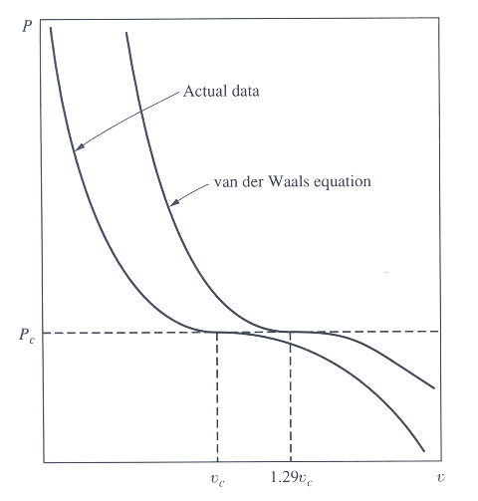
Fig.5.6 Critical isotherms for argon.

Slide 19
vdW equation is good in predicting at low pressures. Fitting experimental PvT data can be used to determine the constants. In the absence of data the inflection points at the critical state are commonly used to evaluate a and b.
Solutions of vdW equations on isotherms
T>T_{c}- two imaginary roots and one real positive root; pressure monotonically decreases with increase in v (Fig 5.7)
T=T_{c}-at critical pressure three real and equal roots
T<T_{c}-below P_{c}, three real and unequal roots

Slide 20
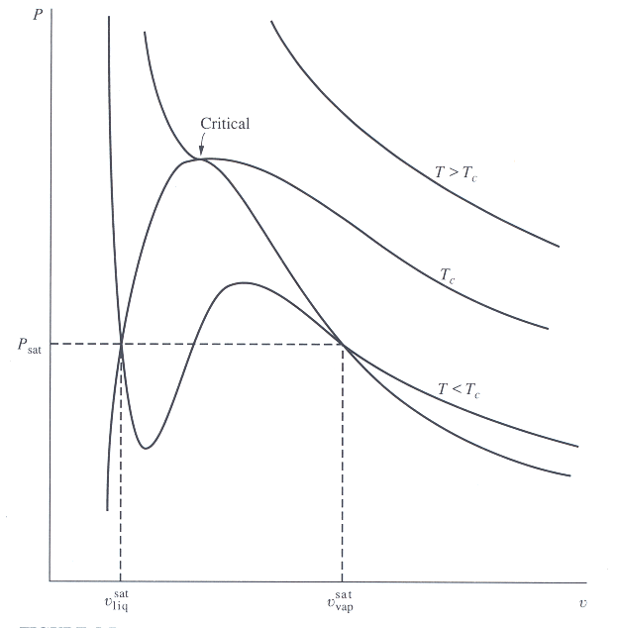
Fig.5.7 Isotherms as given by a cubic equation of state.

Slide 21
The vdW and any other cubic equation can be transformed into the form Z=f(T_{r},P_{r}). In this case
5.4.2 Redlich-Kwong Equation (RK)
Published in 1949, widely accepted cubic equation, considerably more accurate than vdW equation.
Does quite well at small to moderate densities and is much better when T>T_{c}. If PvT data are not available the constants a and b can be determined using the inflection point on T_{c} at the critical point as:

Slide 22
When P and T are known, vdW and RK require solution of cubic equations in v.

Slide 23
5.5 THE CORRESPONDING STATES PRINCIPLE
The functional relationship Z=f(T_{r},P_{r}) is known as the vdW two-parameter theorem of corresponding states. Also known as generalized equation.
It states that any pure gas at the same T_{r} and P_{r} should have the same Z. From vdW and RK equations, it follows that the application extends to both single phases ie. saturated liquid and saturated vapor states.
Fig 5.8 shows this function for 10 common substances (deviation from mean isotherms<1%).
Nelson-Obert chart (avg behavior of 30 substances) predicts Z within 5-6% except near critical states.

Slide 24
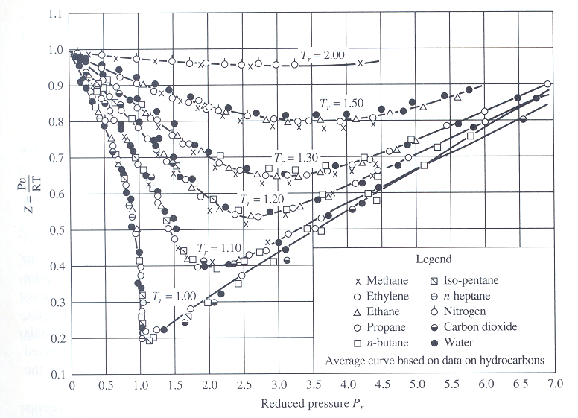
Fig.5.8 Experimental data correlation for a generalized Z chart.

Slide 25
Z for polar substances can deviate by as much as 15-20 %. For H₂, H_{e}, and neon redefine P_{r} and T_{r} as:
For P(atm), T(K) C=8.
To introduce v in the generalized charts (Z_{c}=0.22-0.3)
The above is the pseudo reduced volume used in the Nelson-Obert chart.

Slide 26
5.5.1 Three-Parameter Corresponding States Principle
Failure of the two parameter corresponding states principle to predict Z accurately except for small number of substances indicates one or more additional parameters are required if better accuracy is desired for a larger number of substances.
Experimental data indicate that Z tend to fall into three rough classes depending on the structures of molecules, degree of ‘sphericity’:spherical with respect to geometry and force field , moderately non-spherical and extremely non-spherical.
The two-parameter equation is good for spherical molecules. A third parameter will be required for the other molecules.

Slide 27
5.5.2 The critical compressibilit ( Z_{c}) as a Third Parrameter
Lydersen, Greenkorn, and Hougen presented separate Z-T_{r}-P_{r} charts or tables for particular values of Z_{c}. Such a chart represent the relation Z=f(T_{r},P_{r},Z_{c}). Resulted in a significant improvement of accuracy.
5.5.3 The Acentric Factor as the Third Parameter
Heavier permanent gases argon, krypton, and xenon qualify as having spherical molecules. Gases such as CH₄, CO, N₂, H₂S have structures close to the above gases. These are simple fluids . Moderately non-spherical are classified as normal fluids. The naming is after Pitzer.

Slide 28
The third parameter measures the deviation from simple fluid behavior ie. Nonsphericity or acentricity.
One parameter which fits is the vapor pressure data on a reduced basis. For two parameter fluids there will be a single slope (true for simple fluids).
The position of the reduced vapor pressure curve of a fluid relative to the position of a simple fluid is a sensitive property which could be the basis for the third parameter.
Pitzer used this to define a third parameter, ω, the acentric factor as the difference between the value of log₁₀P_{r}^{sat} for the fluid and that for a simple fluid at a fixed value of T_{r}^{sat}. m=5.4, at T_{r}^{sat}=0.7, log₁₀P_{r}^{sat} =-1for simple fluids.

Slide 29
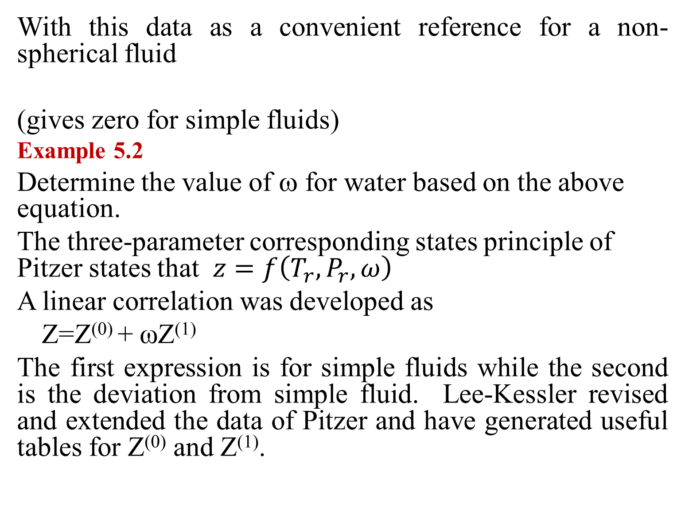
With this data as a convenient reference for a non-spherical fluid
(gives zero for simple fluids)
Example 5.2
Determine the value of ω for water based on the above equation.
The three-parameter corresponding states principle of Pitzer states that $z=f\left(T_{r},P_{r},ω\right)$
A linear correlation was developed as
Z=Z⁽⁰⁾ + ωZ⁽¹⁾
The first expression is for simple fluids while the second is the deviation from simple fluid. Lee-Kessler revised and extended the data of Pitzer and have generated useful tables for Z⁽⁰⁾ and Z⁽¹⁾.

Slide 30
A relatively complicated reference fluid, octane with a compressibility factor Z^{(r)} is used to determine the correction factor Z⁽¹⁾, assumed to be a linear weighted average value such that
tables.docx
Example 5.3 examples.docx

Slide 31
5.6 THREE-PARAMETER CUBIC EQUATIONS OF STATE
5.6.1 Redlich-Kwong-Soave Equation
Soave’s modification of RK equation of states given by:
Used in the prediction of thermodynamic properties of refrigerants.

Slide 32
5.6.2 Peng-Robinson Equation
PR equation has about the same accuracy as the RKS equation in predicting Z and specific volumes.

Slide 33
5.6.3 Generalization of Equation of States
The four cubic equations seen so far and others can be expressed by a general relation of the form
Values of γ, b, c, and d are given in tables.
It can also be converted into a general reduced equation of the form f(Z,Pr,Tr,ω)=0

Slide 34
Equation | c | d | b | γ
Van der Waals Redlich-Kwong Soave Peng-Robinson | 0 b b (1+√2)b | 0 0 0 (1-√2)b

Slide 35
5.7 OTHER EQUATIONS OF STATE
Cubic equations –extremely useful for predicting vapor and liquid PvT data, vapor-pressure data, and vapor-liquid equilibria data. Accuracy limited by the use of only two or three adjustable parameters. For a better overall accuracy, equations of greater complexity are used.
5.7.1 Virial Equations
Statistical mechanics reveals that a theoretical equation relating Z to PvT data should take the form of a series expansion in 1/v as:

Slide 36
B,C…-Second and third virial coefficients… and are only functions of temperature. The given format is Z=f(v,T) and the equation is explicit in P. BWR equation is in the format of this kind of expansion.
For an equation explicit in v (P,T)
The relation between the virial coefficients can be shown to be
Since the virial coefficients are functions of T

Slide 37
then Z=f(P,T). The general trend of B is plotted as shown in fig-chp5\fig5.9.pptx . B=0 gives Boyle temperature as Tr ≈ 2.6 .
Analytical determination of virial coefficients have been successful only when simplified intermolecular force potentials were used. Typically this coefficients are fitted from experimental data.
As a guide line for pressure below 50 bars, the equation truncated to three terms

Slide 38
For modest pressures, the virial coefficients can be truncated to two terms.
On isotherms Z is linear with P. (see compressibility chart at low pressure). For T_{r}<2.5 B is negative →Z is less than unity.
In the absence of experimental data for B three-parameter corresponding states can be used as follows

Slide 39
Proposal of Pitzer and co-workers
Substitution in Z gives
Comparison with Z=Z⁽⁰⁾+ωZ⁽¹⁾ gives
Thus B⁽⁰⁾ and B⁽¹⁾ can be evaluated from Z⁽⁰⁾ and Z⁽¹⁾ . A fit of Z⁽⁰⁾ and Z⁽¹⁾ for nonpolar molecules gives

Slide 40
Also from statistical mechanics, Lennard-Jones had determined an empirical potential function that has two force constants, ε/k and b_{o} (given in tables) to determine B as follows:
Values of B*(T*) are given in tables.
Example 5.4 examples.docx

Slide 41
5.7.2 Benedict-Webb-Rubin Equation
BWR equation- most widely used complex equation; requires eight constants derived from PvT data
BWR equation used in the context of Pitzer’s definition is the Lee-Kessler equation, a highly useful equation.

Slide 42
There are several other equations of state. The text mentions
MBWR equation which requires 32 constants-widely accepted for hydrocarbons and cryogenic fluids;been applied to halocarbon refrigerants.
Martin-Hou equation requires 11 constants, designed to represent all gases
Carnahan-Starling-DeSantis (CSD)equation-model for refrigerants and their mixtures
otherequations.docx

